Slide 1
SCR820 – Real-Time Operator Communication System (RTOC)
Preethi Meher & Christelle Seri
Sep 25th, 2025

Slide 2
SCR820
Agenda
  Quick recap of SCR820 – RTOC
  Project timeline overview
  Tool demo

Slide 3
What is SCR820?
Recap
  A secure, web-based real-time messaging platform for ERCOT and Market Participants
  Enables bi-directional “Send-Review” messaging during emergency events
  Track acknowledgements from recipients
  Reduces reliance on phone calls and improves communication traceability
  One-to-one and one-to-many messaging
  Inspired by Southwest Power Pool’s successful implementation

Slide 4
SCR820 – Project Timelines
Project Timeline
Phase | Milestone | Target Date
Planning | Requirements & Design Finalized | Complete
Development | Development & Internal ERCOT Testing | By Feb 2026
Testing | TOs/QSEs Testing | Feb 2026 – Apr 2026
Parallel Ops | Dual Operation Phase | May 2026
Go Live | Full Launch | June 2026

Slide 5
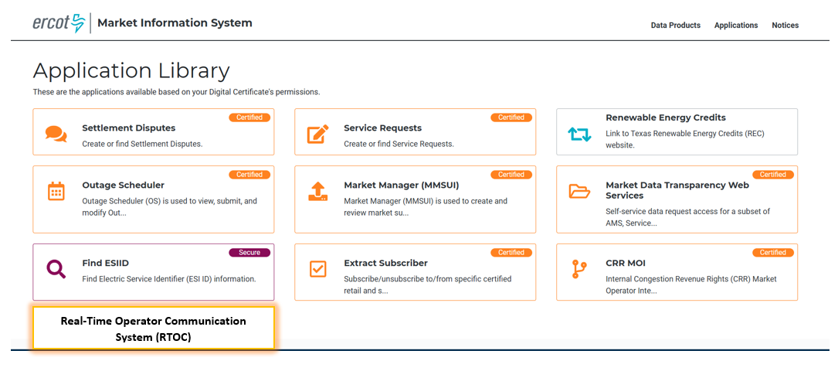
Tool Access
Access control
  Application access will be granted via digital certificates to TSPs/QSEs
  New roles must be added to the certificate for authorization
    Operator (RTOC_M_OPERATOR)
    ReadOnly (RTOC_M_VIEW)
  Link will be available on mis.ercot.com application library

Slide 6
SCR820
Demo

