Slide 1
RTC+B- System Operations Test Environment (SOTE) Readiness
Yugendher Karedla
September 25, 2025

Slide 2
RTC+B SOTE - ERCOT Outage Study Cases in the System Operations Test Environment (SOTE)
The System Operations Test Environment (SOTE) is an environment of the ERCOT Energy Management System (EMS) where the Network Operations Model and the results of the Real-Time State Estimator (SE) are available for review and analysis within five minutes of the Real-Time solution.
This environment is provided as a platform for Transmission Service Providers (TSPs) to perform power flow studies, contingency analyses and validation of SE results.
ERCOT provides Current month’s- 60 day and 90 day outage study cases in SOTE for TSPs on monthly basis.
Providing access to these ERCOT outage cases in SOTE improves the ability of TSPs to evaluate outages prior to submittal to ERCOT, there by increasing the likelihood of outage approvals by ERCOT.

Slide 3
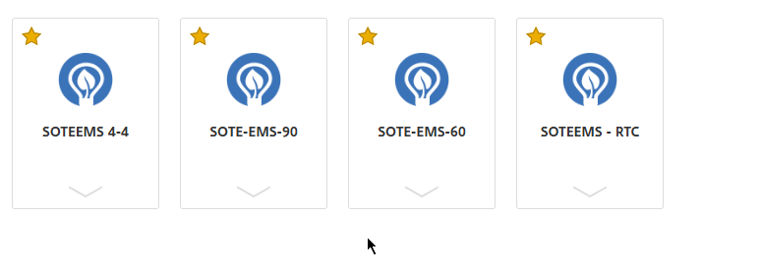
Access to RTC+B SOTE
Login to ERCOT Citrix using https://gateway.ercot.com/
ERCOT will add 2 additional icons to support RTC+B specific one lines corresponding to 60 day ahead and 90 day ahead outage cases from 10/06.

Slide 4
SOTE RTC+B- ESR Outage handling for studies
1. Outages for ESRs will be shown under Unit section, in Outage Scheduler Equipment display in WebFG.
2. Implementing or reverting outages for ESRs can be done using implement / revert Unit outage option from Outage Scheduler Equipment display.

Slide 5
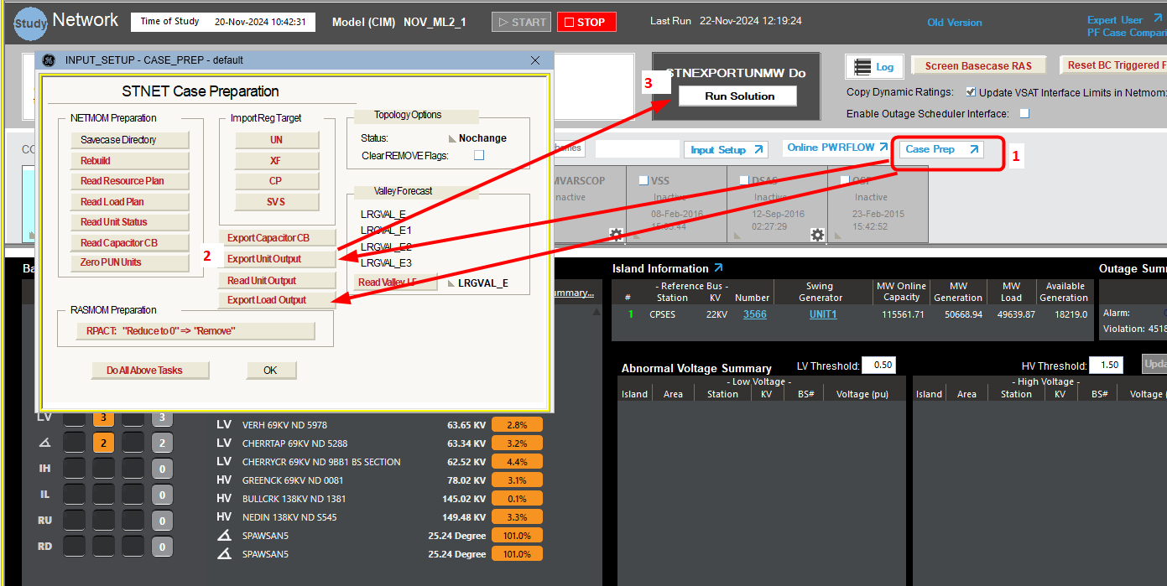
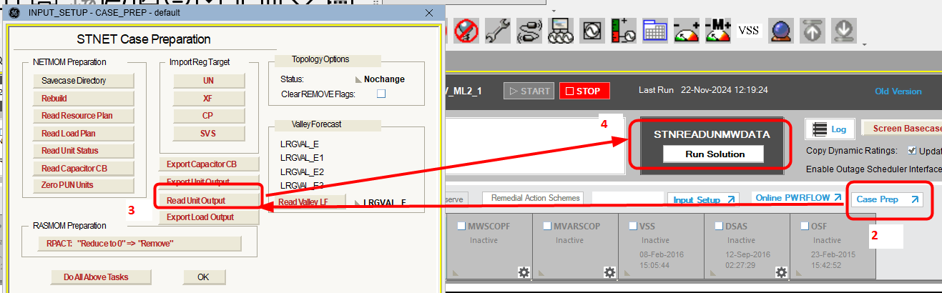
SOTE RTC+B - Resource plan for ESRs
Resource plan export/import - When exporting / importing genoutput file from STNET to update resource plan, ESRs are included along with other units in this same genoutput file. User can update -ve value for ESRs in genoutput file and can import them back into STNET studies, which will set Base MW for those ESRs to be -ve value.

Slide 6
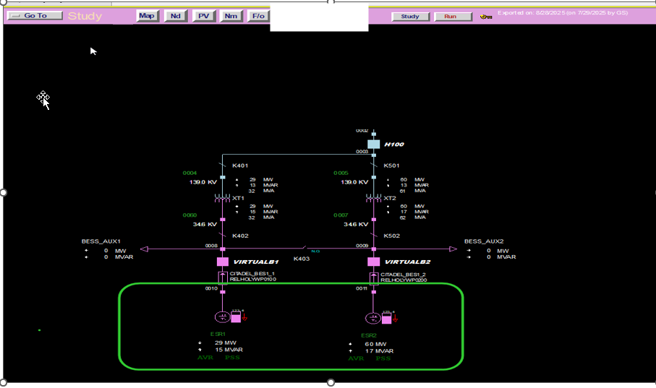
SOTE RTC+B - ESRs on one lines
ESRs are represented in STNET one lines and outages in one lines for ESRs are shown on updated ESR icon in STNET.

Slide 7
Activities and milestones – RTC+B SOTE
Environment Readiness – 10/06
Testing –
10/06 – 11/07
Go Live – 11/07
OE90 case for January ML1 (Single model ) would be available for testing.- Encourage TOs to use it and provide any feedback.
ERCOT continues to approve 90 day ahead outages based on current combo model in October. This cases will continue to be available in current SOTE for TSP studies.
ERCOT will start approving 60 day/90 day ahead outages based single model starting from November. These will be available in RTC SOTE.
Current SOTE will still be available till end of December to support current real time cases for studies.
Set up ready – Verifications in progress
Will be available through existing Citrix gateway like current SOTE
Market Notification with updated SOTE outage study document that provides required details – 10/02
.

