Slide 1
Full and Redacted Representations of RTC+B Model

Slide 2
Key Model Changes to Support RTC+B Effort
Energy Storage Resources will transition from a “combo” to “single” model representation
All ERCOT systems currently represent an ESR as a load/generator pair
Model
EMS/MMS
Key Change: Battery identifiers will change during this transition. (ex: UNIT1 -> ESR1)
Model
EMS/MMS
Post-RTC+B go-live, all core systems will utilize the single-model representation for ESRs

Slide 3
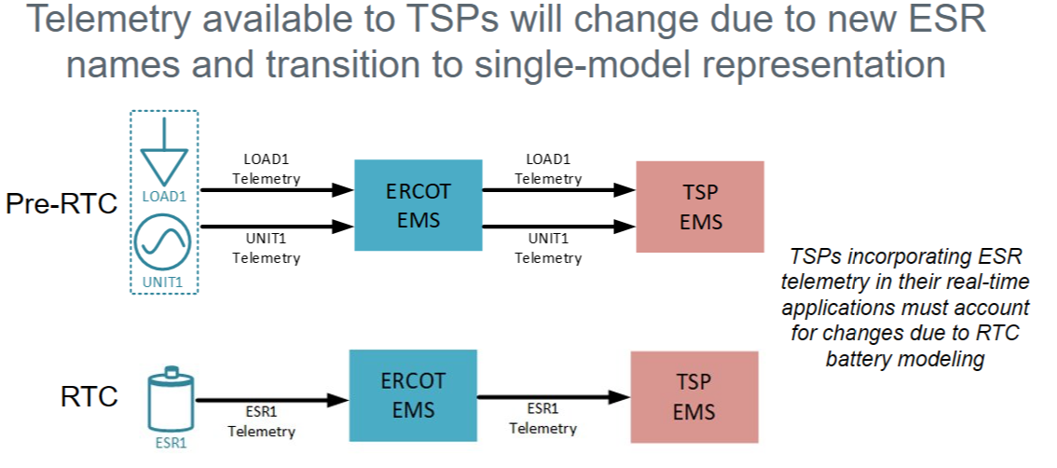
TSPs Must Adjust to New ESR Names in Telemetry “Echo Points”

Slide 4
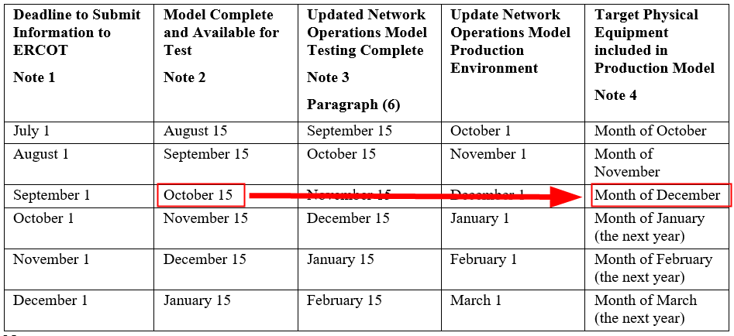
Full and Redacted Representations of RTC+B Model Posted
45-day-ahead models will transition to new battery representation in October
https://www.ercot.com/services/comm/mkt_notices/M-A073025-02

Slide 5
Full and Redacted Representations of RTC+B Model Posted
ERCOT has posted full and redacted RTC+B representations of the September ML1 model
Redacted model is posted to a new MIS location:
  Preview of Modified Redacted CIM Network Model
Full model for TSPs is posted in the NMMS Citrix Postings location:
  Located in the ECEII_NMMS_RTC_Preview folder
Key changes related to Energy Storage Resources
  BatteryGeneratingUnit (BGU) instances have replaced the HydroGeneratingUnit + ControllableLoadResource pairs
  Names of BGU instances have changed (ex: UNIT1 -> ESR1)
https://www.ercot.com/services/comm/mkt_notices/M-A073025-01

Slide 6
ERCOT CIM16 Project

Slide 7
ERCOT’s “CIM16 + SCR813” Project
In 2023, ERCOT initiated the “NMMS IMM Schema Upgrade to CIM16” project
Two main scope items:
  Update of ERCOT’s modeling application to support CIM16-formatted model creation
  Implementation of System Change Request (SCR) 813

Slide 8
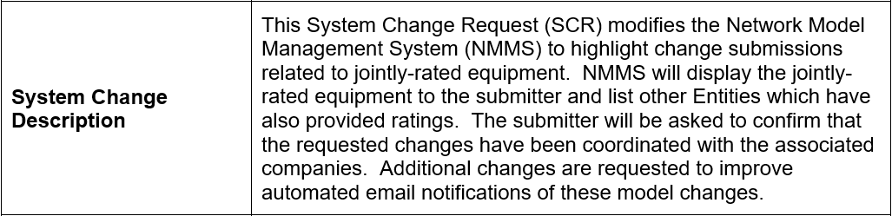
SCR813 - NMMS Jointly-Rated Equipment Coordination Confirmation
SCR813 modifies ERCOT’s modeling application to increase awareness of submissions affecting jointly-rated equipment
  Adds an additional step to TSP model change submission process requiring confirmation of coordination between associated companies
SCR813

Slide 9
Inputs and Outputs of the Modeling Application
ERCOT’s modeling application accepts model change submissions and creates updated models
TSPs submit model changes…
…ERCOT produces models.

Slide 10
Modeling Application Transition to CIM16
The CIM16 project updates ERCOT’s modeling application to create native CIM16-formatted models
Current
Model format is dependent on the database structure/schema
After project completion
To produce CIM16 models, the database of the modeling application must be modified to align with the CIM16 schema

Slide 11
CIM-Related Inputs/Outputs of the Modeling Application
The modeling database schema impacts numerous modeling processes and data artifacts

Slide 12
CIM-Related Inputs/Outputs of the Modeling Application
Changing the database schema requires modification to submission processes and will affect model artifacts

Slide 13
Project Schedule
Q3 2025
  Vendor handoff of repeatable database conversion process
  ERCOT verification of conversion scripts
Q4 2025
  Vendor begins work on SCR813 functionality
  ERCOT verification of modeling application
  ERCOT produces first native CIM16 models and incremental files
Q1 2026
  ERCOT verification of SCR813 changes
  ERCOT updates modeling templates, validation rules, and reports
Q4 2026
  Test modeling application (MOTE) with CIM16 changes made available
  ERCOT to provide TSP training covering:
    Changes to modeling processes due to schema changes
    Changes to submission process due to SCR813
Q1 2027
  Cutover to CIM16 system
  ERCOT only produces CIM16 models; no CIM10 models

Slide 14
Full and Redacted Representations of CIM16 Models
ERCOT has posted full and redacted CIM16 representations of the multiple models
Redacted model is posted to a new MIS location:
  Preview of Modified Redacted CIM Network Model
Full model for TSPs is posted in the NMMS Citrix Postings location:
  Located in the ECEII_NMMS_CIM16_MODELS_PREVIEW folder
Future workshops will be announced via Market Notice, TWG, and NDSWG
https://www.ercot.com/services/comm/mkt_notices/M-A071725-02

