Slide 1
ERCOT Technology Working Group (TWG)
September 25, 2025

Slide 2
ERCOT TWG
WELCOME

Slide 3
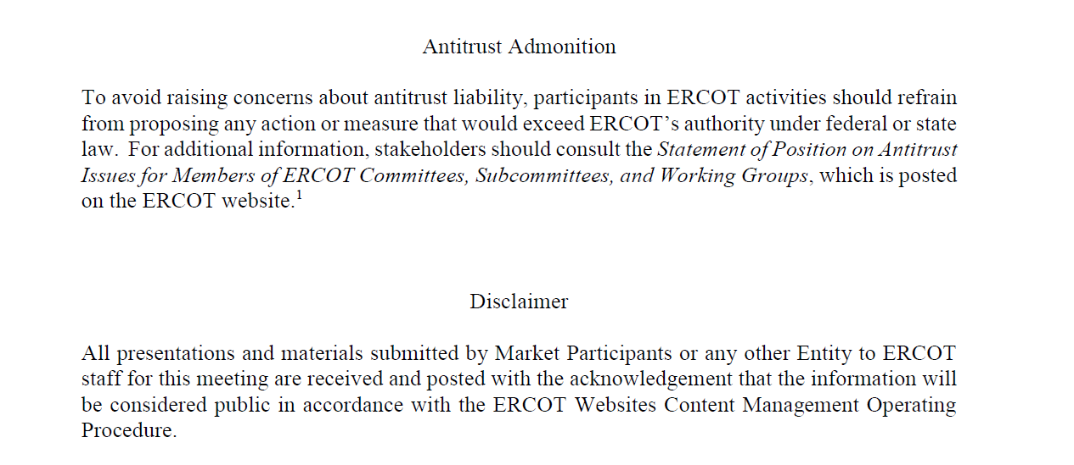
ERCOT TWG

Slide 4
ERCOT TWG Agenda
Item # | Item Description | Presenter | Start Time
1 | Antitrust admonition | Sreenivas Badri | 2:00 PM
2 | NERC EMS WG Updates | Wei Qi | 2:02 PM
3 | Project Updates | Troy Anderson | 2:10 PM
4 | RTC+B Updates RTCBTF and Market Trials updates Closed Loop Testing Lessons Learned Market-Trials-Market-Submissions Testing ICCP Telemetry Modeling update IRRs following UDSP SOTE Readiness for 60- and 90-days cases Weekly Model Loads Schedule update NDCRC MOTE Testing CDR & ISM Reports updates | Matt Mereness/ERCOT Staff | 2:20 PM
5 | RTC+B Market CIM Models Posting update CIM16 Schema Upgrade Project - status update | Joel Koepke | 3:10 PM
6 | ERCOT Distribution Awareness Platform (EDAP) Proof of Concept (POC) Participation | Sreenivas Badri | 3:25 PM
7 | SCR820 – Real-Time Operator Communication System - Demo | Preethi Meher/Christelle Seri | 3:35 PM
8 | Round Table Discussion | Tanner Holder | 3:50 PM
9 | Adjourn | Tanner Holder | 4:00 PM

Slide 5
NERC EMS WG Updates
  NERC EMS WG Updates – Wei Qui

Slide 6
Project Updates
  Project Updates – Troy Anderson

Slide 7
RTC+B Updates
RTCBTF and Market Trials updates – Matt Mereness
Closed Loop Testing Lessons Learned – Sreenivas Badri/ Sruthi Hariharan
Weekly Model Loads Schedule update – Sruthi Hariharan
Market-Trials-Market-Submissions Testing – Sreenivas Badri
      ICCP Telemetry Modeling update – Tejaswi Potluri
      IRRs following UDSP – Abhi Masanna Gari
      SOTE Readiness for 60- and 90-days cases – Yugendher Karedla
      NDCRC MOTE Testing – Sreenivas Badri
      CDR & ISM Reports updates – Jamie Lavas

Slide 8
RTC+B CIM Models and CIM16 Schema Project Updates
RTC+B Market CIM Models Posting update – Joel Koepke
&
CIM16 Schema Upgrade Project - status update - Joel Koepke

Slide 9
ERCOT Distribution Awareness Platform (EDAP) Proof of Concept (POC) Participation
ERCOT Distribution Awareness Platform (EDAP) Proof of Concept (POC) Participation – Sreenivas Badri

Slide 10
SCR820
SCR820 – Real-Time Operator Communication System (RTOC) – Demo Preethi Meher/Christelle Seri

Slide 11
ERCOT TWG – Round Table Discussion
ERCOT TWG – Round Table Discussion
  Future Topics of Interest
  Topics and presentations from TWG members

Slide 12
ERCOT TWG
Thank You
You can reach Sreenivas at
Sreenivas.Badri@ercot.com and Tanner at tholder@tnsk.com

