Slide 1
RTC+B Task Force
Update
Matt Mereness
RTCBTF
September 25, 2025

Slide 2
Outline
Discussion today:
  Update on RTCBTF Issues List
  Scope of RTC+B Program
  Update on NPRRs
  Market Trials Update
  Rest of Today’s Agenda

Slide 3
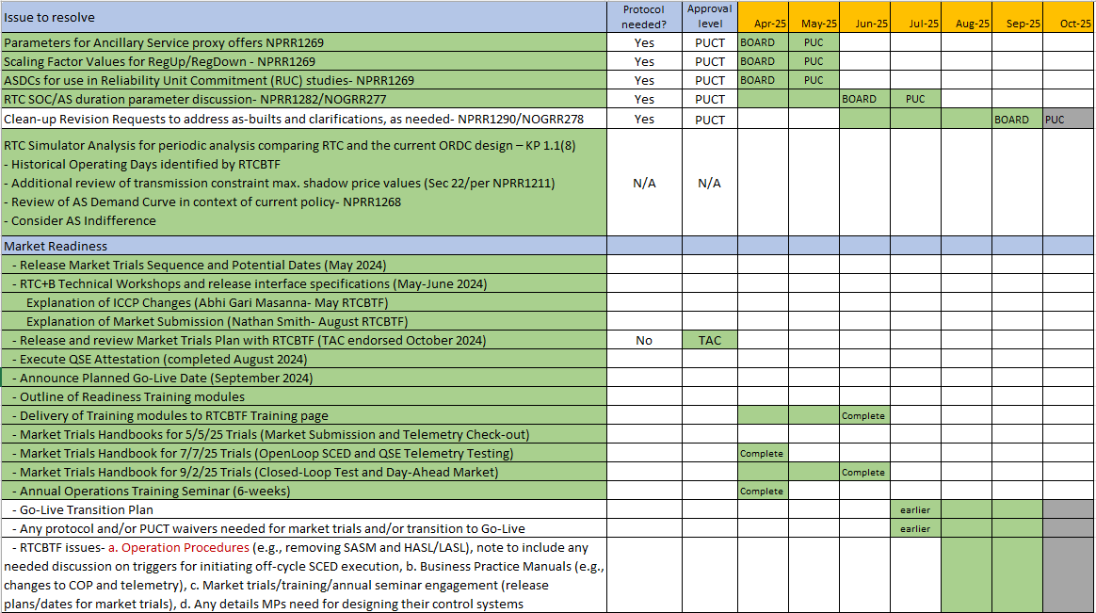
RTCBTF Issues List
Revisions- Final Clean-Up NPRR1290/NOGRR278 (September)
Implementation - Completing handbooks and initiating transition plan details
Market Trials

Slide 4
Summary and Timeline of NPRRs
NPRRs set for PUCT May 15 Open Meeting (PUCT approved)
  NPRR1268 for ASDC Modifications (IMM sponsor)
  NPRR1269 for 3 Parameter/Policy Changes (ERCOT sponsor)
  NPRR1270 for AS Qualification details (ERCOT sponsor)
AS Duration / State of Charge (NPRR1282 / NOGRR277)
  Approved at Board and PUCT
Final Clarifying NPRR1290/NOGRR278
  Approved at PRS
  On to August TAC and Sep Board
Remaining Stakeholder path to Board Meetings before Go-Live:
  PRS Aug 13 > TAC Aug 27 > Board Sep 23

Slide 5
RTC+B Scope
Final 2025 Refinements for Go-Live
Related NPRRs
within Program

Slide 6
Sequence and Dates for Market Trials to Go-Live
30-day Market Notice
11/5/25
March/April
2025
Start
5/5/25
Start
7/7/25
Start
9/2/25
Go-Live
12/5/25*
May 2025
June 2025
July 2025
Aug 2025
Sep 2025
Oct 2025
Nov 2025
Dec 2025
QSE Scorecards & Exit Criteria for each Trial Phase
RTC QSE Submission Testing
(Submit COP, RT AS Offers,
DAM Virtual AS, Outages for ESRs)
Open-loop RTC SCED
(QSE offers, SCED non-binding award/dispatch)
Ongoing Open-Loop
& Periodic Closed-loop SCED/LFC
(QSE RTC offers and telemetry to support closed-loop frequency control test 2-3 tests of 2-4 hour durations)
Transition to Go-Live
Upon completion of testing, confirmation of ERCOT and market readiness for Go-Live.
QSE/Vendor Submission Sandbox and Telemetry Points added Prod EMS model.
RTC QSE Telemetry Check-out (QSEs add/verify new telemetry points for UDSP, New ramp rates, ESR telemetry)
QSE Telemetry Tests
(Individual QSE to follow UDSP and support new ramp rate and ESR telemetry)
Day-Ahead Market
(Non-binding DAM using QSE offers for at least 2 tests)
* Go-Live date reflects 12/5/2025 as first Operating Day
where 12/4/2025 is planned software migration.

Slide 7
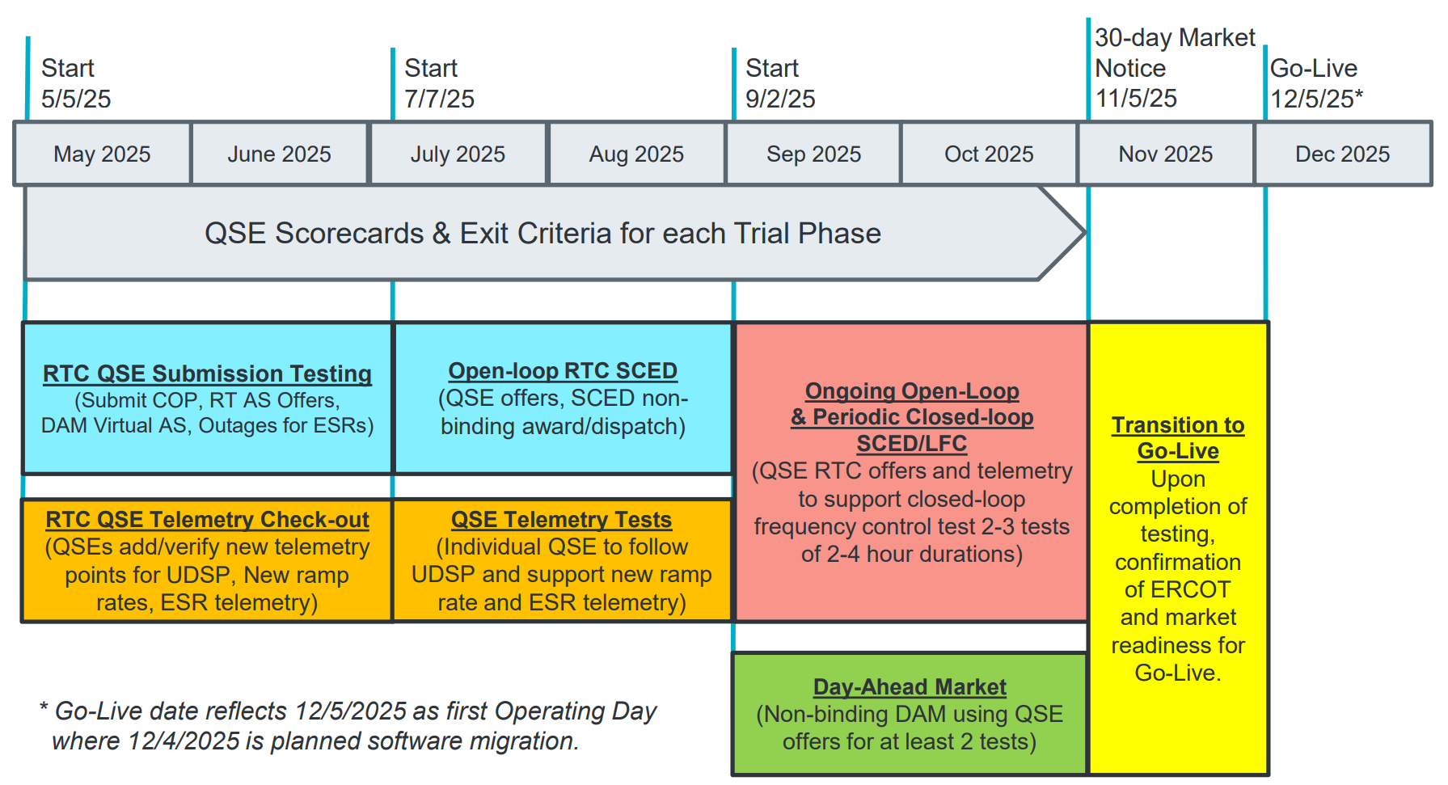
COMPLETED
May & June:
Establishing Connectivity
QSE will test their market submissions for defined subset transactions that are new or modified by RTC+B.
Scorecard goal is for 95% of QSEs to demonstrate successful submissions and have mitigation plans in place for remaining 5% to address in next trial phase.
QSE will add telemetry points for Energy Management System (EMS) system interface with ERCOT (such as Updated Desired Set Points (UDSP), New Ramp Rates, and ESR Telemetry)
Scorecard goal is for 98% of QSEs to demonstrate successful telemetry additions, and mitigation plans in place for remaining 2% to address in next trial phase. (Note 3-week lag in telemetry migrating through network model validation and into trials environment).

Slide 8
COMPLETED
July & August:
Initial Real-Time Market execution and verify QSE ability to follow ERCOT frequency signals
QSE will support “parallel production” 2days/week by entering $bids/offers for non-binding RTC energy and A/S awards and dispatch (Open-loop test)
Scorecard goal for 100% of QSEs to demonstrate successful submissions and telemetry reflective of production, and mitigation plans in place for any outliers.
Coordination of individual QSE tests on subset of resources to ensure resources can follow new UDSP telemetry point from ERCOT.
Scorecard goal is for 98% of QSEs to successfully demonstrate, and mitigation plans in place for remaining 2% to address in next trial phase.

Slide 9
IN FLIGHT
Sep & Oct:
Required live-production test to ensure effective frequency dispatch and control.
Sep & Oct:
Optional Day-Ahead Market
Voluntary Day-Ahead Market for all QSEs will be conducted at least 2 times.
QSE can test their market submissions for Day-Ahead AS Self-Arrangement, AS Only Offers, Trades and normal submissions.
DAM participation is strongly encouraged but not required in Readiness metrics since RTC procures AS in Real-Time.
Participation includes much broader QSE population (marketers and load-only QSEs).
ERCOT and QSEs will conduct live-production tests of RTC-SCED and Load Frequency Control (LFC) prior to go-live.
RTC-SCED and frequency control dispatch during the tests will be binding to manage the reliable operations of the grid for2-4 hours.
ERCOT will coordinate with QSEs on how to submit RTC offers and telemetry for Energy and AS for the two systems (current and RTC system).
ERCOT will provide a summary of the test and use analysis and engineering judgement to assess if the test was successful in controlling frequency.
Market Notice sent regarding DAM for all QSEs

Slide 10
Sep/Oct Market Trials in-flight
Trials meeting every Monday 10-10:30am until December
  Standalone calendar page each week with WebEx
    RTCBTF Home Page houses all market trials documentation
  Averaging 150-175 participants
  Weekly presentation walk-through with Q&A
    Heavy use of RTCB@ercot.com email -> FAQ
  Link to this Monday’s Trials meeting
    First DAM results and Self-Provision activity
Sep 11 LFC Test Results shared at Special RTCBTF last week
  Consolidate into a Whitepaper in next 2 weeks

Slide 11
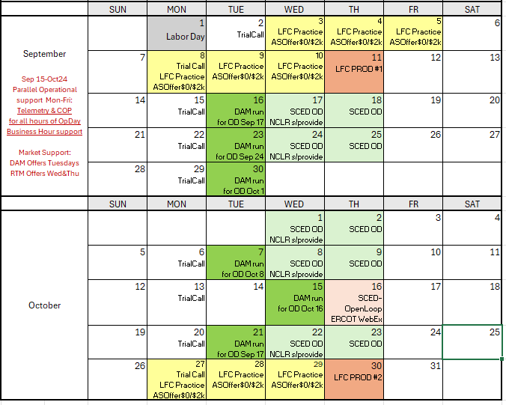
Market Trials Calendar
We are here….
Added focus Open-Loop SCED Test Oct 16
Last planned LFC Test
Oct 30

Slide 12
Upcoming Testing
New activity on October 16 as SCED Open Loop ERCOT WebEx*
  Program considered value of Closed-Loop LFC Test, especially in identifying defects
  On Oct 16, ERCOT will have WebEx call open for real-time questions as QSEs observe both SCED awards and UDSP telemetry
  ERCOT encourages full participation with accurate telemetry and “unscripted market submissions” to help test and shake-out any additional issues
  Focused/support window for Market & ERCOT can provide another round of scrutiny of systems and market outcomes to minimize risk to go-live.
  * Previously referred to on Monday call as LFC Simulation Open Loop Only- replaced with this concept
Confirmed October 30 as second and last planned Closed-Loop LFC Test
  Will essentially be a repeat of September 11 test (similar structure and expectations)
  May be longer (but not to exceed 4 hours) to gain frequency tuning data
  ERCOT will observe Frequency tuning changes in production
  Both ERCOT and QSE opportunity to test any fixes
  Repeat the critical cutover process that will be used 35 days later for go-live
Lack of engagement from other QSEs in DAM
  Considering Market Notice requiring “QSE Acknowledgement of DAM changes and Cutover activities that are forthcoming” to capture QSEs without Resources in engagement.

Slide 13
Other Updates
August 27, 2025 Internal Operating Day Test Completed
September 11, 2025 Closed-Loop LFC Test Completed
  ERCOT working on defect fixes and tuning frequency control parameters
Based on internal and external testing, currently tracking defects:
  Severity 1 (0 defects) and Severity 2 (5 defects)
  Evaluating other must-have fixes for Go-Live from inventory of all defects
Internal work continues on Transition/Cutover Plan Handbook
  Considering if Protocol good cause exceptions for Cutover needed (similar to LFC)
Weekly Market Trials in flight
Next TWG meeting is later today

Slide 14
Focus for remainder of RTCBTF today:
3. AS Deployment Factors Discussion
4. Market Readiness
  Draft Revisions to Operating Procedures (no changes from July)
    Real-Time Desk / Reliability Risk Desk
    DC Tie Desk / RUC Desk
    Scripts / Shift Supervisor Desk
    Resource Desk / Trabsmission and Security
  Transition/Cutover Handbook: version 2
5. Other Business
  AORDC Update

