Slide 1
Texas
Standard
Electronic
Transactions
Introduction to TX SET
2025 TXSET

Slide 2
Antitrust Admonition
To avoid raising concerns about antitrust liability, participants in ERCOT activities should refrain from proposing any action or measure that would exceed ERCOT’s authority under federal or state law.
For additional information, stakeholders should consult the Statement of Position on Antitrust Issues for Members of ERCOT Committees, Subcommittees, and Working Groups, which is posted on the ERCOT website.

Slide 3
Protocol Disclaimer
This presentation provides a general overview of Retail Transaction Processing and is not intended to be a substitute for the ERCOT Protocols, as amended from time to time. If any conflict exists between this presentation and the ERCOT Protocols, the ERCOT Protocols shall control in all respects.
For more information, please visit:
Protocols - Nodal (ercot.com)

Slide 4

Housekeeping
Please unmute yourself prior to speaking
Place yourself on mute when not speaking
Pen/Pencil and Paper to write
Morning, Lunch and Afternoon breaks

Slide 5
Course Objectives
What is TX SET?
Where do I find Tools/References?
How does TX SET work?
How is TX SET managed?
Notes:
The term Texas SET can refer to two different things.
TX SET (Standard Electronic Transactions) are a set of ANSI EDI transaction guidelines customized by the TX SET Working Group for the ERCOT Retail Market.
These standardized transactions support retail processes as documented in the various ERCOT Market rules.
TX SET is an ERCOT Working group comprised of stakeholders participating in the development and maintenance of TX SET EDI transactions .
The Working Group reports to the Retail Market Subcommittee (RMS) and analyzes the need for new electronic transactions or modifications to existing electronic transactions based upon changes that occur within the retail electric market that affect EDI (electronic data interchange) transaction processing.

Slide 6
Agenda
Introduction
Governing Documents
TXSET Working Group
Transaction Overview
Transaction Process Flow
MIS Portal
TXSET Implementation Guides
Appendix

Slide 7
Introduction

Slide 8
What is TX SET?
Texas Standard Electronic Transactions
Facilitates retail business processes
Maintained by TX SET working group
Set of American National Standards Institute (ANSI) EDI transaction guidelines
Notes:
The term Texas SET can refer to two different things.
TX SET (Standard Electronic Transactions) are a set of ANSI EDI transaction guidelines customized by the TX SET Working Group for the ERCOT Retail Market.
These standardized transactions support retail processes as documented in the various ERCOT Market rules.
TX SET is an ERCOT Working group comprised of stakeholders participating in the development and maintenance of TX SET EDI transactions .
The Working Group reports to the Retail Market Subcommittee (RMS) and analyzes the need for new electronic transactions or modifications to existing electronic transactions based upon changes that occur within the retail electric market that affect EDI (electronic data interchange) transaction processing.

Slide 9
Benefits of TX SET
    Standardization of automated processes
    Improves data quality and efficiency
    Greater transparency
    Improved security
    Allows reporting flexibility
    Increased cost savings
Notes:
Why do we have it?
Can you imagine the volumes of transactions per day? (Average daily volume for ERCOT, inbound and outbound, is in excess of 150,000)
Standardization is key!

Slide 10
When are TX SET used?
To execute Retail market processes
  Move In
  Move Out
  Switch
  Disconnects
  Reconnects
  Updates to premise information
  Updates to customer information
Notes:
TX SET transactions should be used when needing to execute a Retail Market
Process supported by TX SET EDI.
In the event a process cannot be supported by TX SET EDI transactions, the
Market standard method should be used. Please consult the ERCOT Retail Market Guide.
Some of these processes include:
The Safety Net Spreadsheet
MarkeTrak

Slide 11
How are TX SET Delivered?
NAESB EDM v1.6
North American Energy Standards Board
Electronic Delivery Mechanism
  Version 1.6 is a National Standard
  Secured computer to computer data protocol
  Modified to fit ERCOT Market
Notes:
TX SET EDI Transactions are securely transmitted through
servers from sender to receiver with the NAESB EDM (Electronic Delivery Mechanism) v1.6 Protocol installed on each server.
This is a protocol with specialized technical enhancements modified to fit the ERCOT retail market.
The NAESB EDM v1.6 is a National Standard maintained by the North American Energy Standards Board.
The ERCOT NAESB EDM v1.6 guideline is managed by the ERCOT Working Group TDTMS (Texas Data Transport and MarkeTrak System).

Slide 12


Transaction Flows
REP’s Customer Information System
TDSP’s Customer Information System
Notes:
TX SET Transactions could potentially follow two paths.
Point to point (REP – TDSP)
Flow through ERCOT

Slide 13
Acronyms
TX SET – Texas Standard Electronic Transactions
PURA – Public Utilities Regulatory Act
PUCT – Public Utility Commission of Texas
ERCOT – Electric Reliability Council of Texas
NAESB – North American Energy Standards Board
MP – Market Participant
ESI ID – Electric Service Identifier

Slide 14
Participants
LSE
Load Serving Entity
REP
Retail Electric Provider
ROR
REP of Record
CR Competitive Retailer
MOU/EC
Municipal/Coop
TDSP Transmission & Distribution Service Provider
TDU Transmission & Distribution Utility

Slide 15
Governing Documents

Slide 16



Hierarchy of Rules
Public Utility Regulatory Act (PURA)
PUCT Substantive Rules
ERCOT Protocols

Slide 17
ERCOT Protocols
Rules/Policies/Standards that govern the ERCOT market
  Created through collaborative efforts
  Define procedures used by ERCOT and Market Participants (MPs)
  MPs, ERCOT and Independent Market Monitor (IMM) bound by Protocols
Notes:
The Electric Reliability Council of Texas (ERCOT) Protocols, created through the collaborative efforts of representatives of all segments of Market Participants, as amended from time to time, that contains the scheduling, operating, planning, reliability, and Settlement (including Customer registration) policies, rules, guidelines, procedures, standards, and criteria of ERCOT.
These Protocols outline the procedures and processes used by ERCOT and Market Participants for the orderly functioning of the ERCOT system and nodal market.
Market Participants, the Independent Market Monitor (IMM), and ERCOT shall abide by these Protocols.

Slide 18
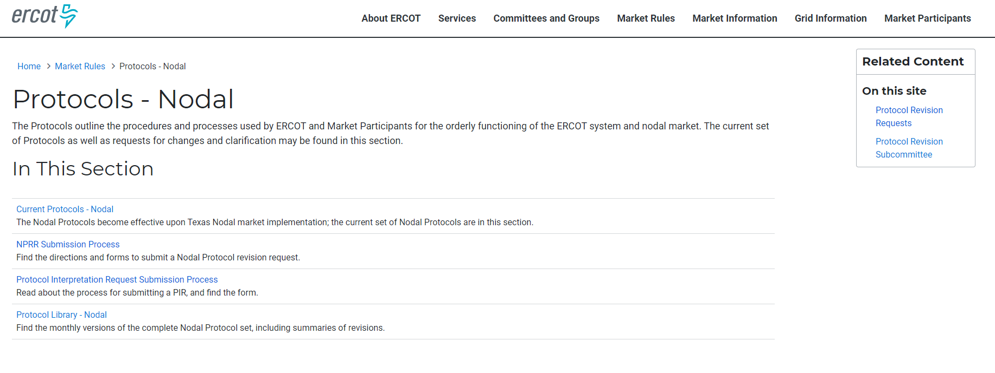

ERCOT Protocols

Slide 19
Relevant ERCOT Protocol Sections
Section 2 – Definitions and Acronyms
Section 9 – Settlements and Billing
Section 10 – Metering
Section 12 – Market Information System
Section 15 – Customer Registration
Section 18 – Load Profiling
Section 19 – Texas Standard Electronic Transaction
Section 21 – Revision Request Process
Section 24 – Retail Point to Point Communications

Slide 20
Section 15 - Customer Registration
ERCOT is the Registration Agent for the Retail Electric Market
ERCOT maintains the Registration Database of all ESI IDs
All Competitive Retailers operating in ERCOT register their customers via TX SET
Notes:
This section provides Market Participants and ERCOT with the market rules and transactional timing when operating in ERCOT’s Retail Electric Market and providing Customer Choice, for example:
ERCOT shall maintain a registration database of all metered and unmetered Electric Service Identifiers (ESI IDs) in Texas for Customer Choice.
All Customer registration processes will be conducted using the appropriate Texas Standard Electronic Transactions (TX SETs). Definitions of all TX SET codes referenced in this Section can be found in Section 19, Texas Standard Electronic Transaction.
All CRs with Customers in Texas, whether operating inside the ERCOT Region or not, shall be required to register their Customers in accordance with this Section.

Slide 21
Section 19 – Texas Standard Electronic Transaction
Transactions between Competitive Retailers (CRs), ERCOT, and Transmission and Distribution Service Providers (TDSPs)
Validation process
TX SET change control process
Retail market testing process
Notes:
Provides the mechanism that enables and facilitates the retail business processes in the deregulated Texas electric market. The Texas SET Implementation Guides shall serve as the standard for the applicable TX SETs among all Market Participants and ERCOT.
This Section shall cover:
Transactions between Transmission and/or Distribution Service Providers (TDSPs) (refers to all TDSPs unless otherwise specified), Competitive Retailers (CRs) and ERCOT;
Technical Advisory Committee (TAC) subcommittee and ERCOT responsibilities; and
Texas SET Change Control process.

Slide 22
Section 24 – Retail Point to Point Communications
Transactions that do not flow through ERCOT
Transactions that flow between CRs and TDSPs
  Disconnect/Reconnect
  Suspension of delivery
  Remittance information
  TDSP Invoice
Notes:
Point to point communications include transactions flowing directly between Competitive Retailers (CRs), and Transmission and/or Distribution Service Providers (TDSPs) and do not flow through ERCOT. These point to point transactions may be Customer requested service orders and CR/TDSP invoicing and remittance advise transactions.

Slide 23
ERCOT Market Guides
ERCOT Protocols
ERCOT
Market Guides
Other Binding Documents (OBDs)

Slide 24
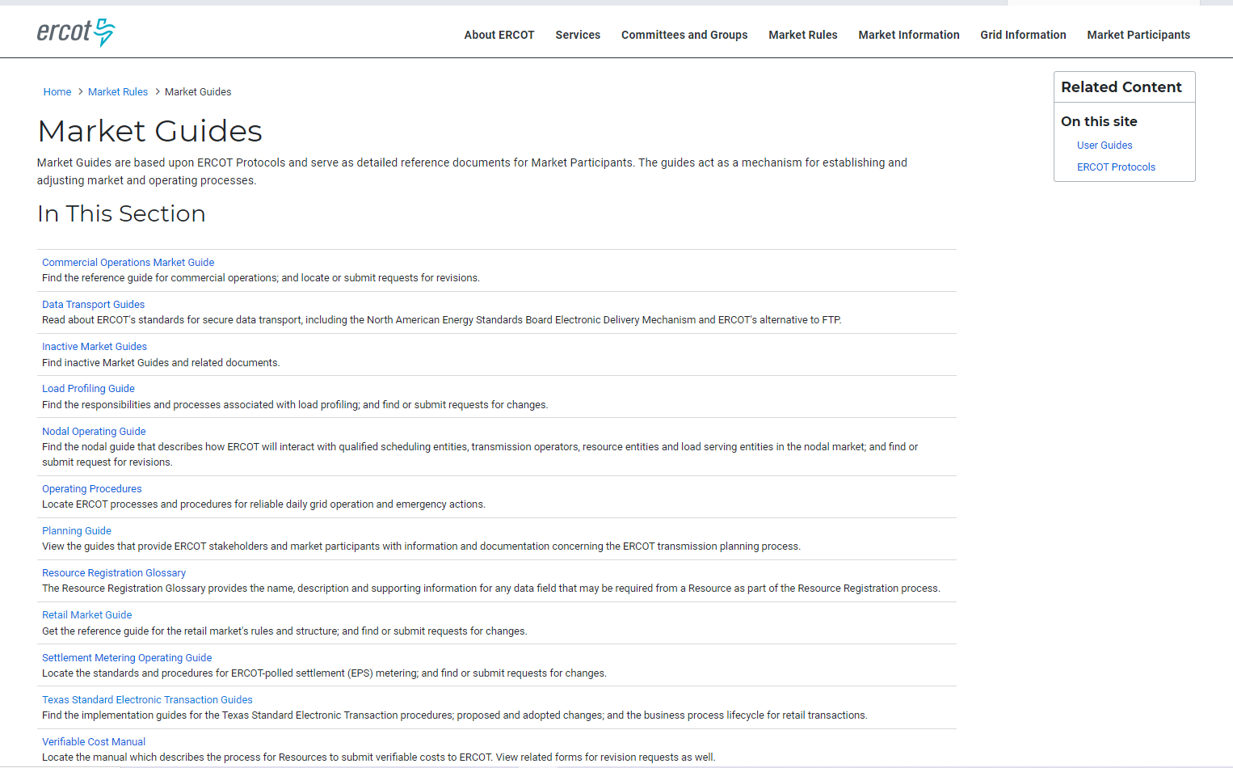




ERCOT Market Guides

Slide 25
ERCOT Retail Market Guide
Section 1 – Purpose
Section 2 – Definitions and Acronyms
Section 3 – Retail Market Guide Revision Process
Section 4 – Public Utility Commission of Texas
Section 5 – Electric Reliability Council of Texas
Section 6 – Retail Market Subcommittee Working Group
Section 7 – Market Processes
Section 8 – Municipally Owned Utilities and Electric Cooperatives
Section 9 – Appendices
Section 10 – Competitive Metering
Section 11 – Solution to Stacking

Slide 26
Section 7 – Market Processes
Section 7.3 – Inadvertent Gain Process
Section 7.4 – Safety Nets
Section 7.5 – Standard Historical Usage Requests
Section 7.6 – Disconnect and Reconnect for Non-Payment Process
Section 7.7 – Transaction Timing Matrix
Section 7.16 – Business Processes and Communications Related to Meter Tampering
Section 7.15 - Advanced Meter Interval Data File Format and Submission
Section 7.17 – Business Processes and Communications for Switch Holds Related to Deferred Payment

Slide 27
Section 9 Appendix D1 – Transaction Timing Matrix
Transaction | Business Process | From | To | Timing/Business Rules | Protocol Reference Section
867_03, Monthly or Final Usage | Final | TDSP | ERCOT | Within three Business days of effectuating meter read | 15.1.1.7, Completion of Switch Request and Effective switch Date
867_03, Monthly or final Usage | Monthly | TDSP | ERCOT | No later than three Retail Business Days after the scheduled meter read cycle or scheduled meter cycle by day of the month for a point of delivery | 15.3, Monthly Meter Reads
867_04, Initial Meter Read | Initial | TDSP | ERCOT | Within three Retail Business Days of the effectuating meter read | 15.1.1.7, Completion of Switch Request and Effective Switch Date

Slide 28
Appendices
Section 9 Appendix D3 – TDSP’s Discretionary Service Timelines Matrix
Section 9 Appendix G – ERCOT Specified File Format for Submission of Interval Data for Advanced Metering Systems
Notes:
Reference protocols section 15

Slide 29
Section 11- Solution to Stacking
  Section 11.1 - Overview of Solution to Stacking
  Section 11.2 - ERCOT Operating Rules
  Section 11.2.2 - Cancellation Rules
  Section 11.2.3 - Concurrent Processing Rules
  Section 11.2.4 - Pending Transaction Rules
  Section 11.3 - Transmission and/or Distribution Service Provider Operating Rules
  Section 11.4 - Retail Electric Provider Operating Rules
Notes:
Section 11.1 - Overview of Solution to Stacking
This Section 11, Solution to Stacking, provides the processes and guidelines for Market Participants operating in the Texas retail market to handle multiple non-sequential Texas Standard Electronic Transactions (TX SETs) on a single Electric Service Identifier (ESI ID).
Section 11.2 - ERCOT Operating Rules
The ERCOT Operating Rules describe the process and guidelines utilized by ERCOT to process multiple, non-sequential transactions concurrently on a single Electric Service Identifier (ESI ID).
Section 11.2.2 - Cancellation Rules
These rules detail the circumstances under which ERCOT will cancel existing orders.
Section 11.2.3 - Concurrent Processing Rules
The concurrent processing rules detail the circumstances in which transactions are allowed to complete after being processed concurrently.
Section 11.2.4 - Pending Transaction Rules
These rules detail the methods used for Pending REP Notification Transactions. These rules were developed to ensure that these transactions are sent only when the appropriate recipient can be positively identified.
Section 11.3 - Transmission and/or Distribution Service Provider
Operating Rules
The business rules Transmission and/or Distribution Service Providers (TDSPs) will follow in order to process multiple, non-sequential transactions concurrently on a single Electric Service Identifier (ESI ID).
Section 11.4 - Retail Electric Provider Operating Rules
Retail Electric Providers (REPs), like the Transmission and/or Distribution Service Providers (TDSPs) and ERCOT, will be required to handle multiple, non-sequential transactions on an Electric Service Identifier (ESI ID).

Slide 30
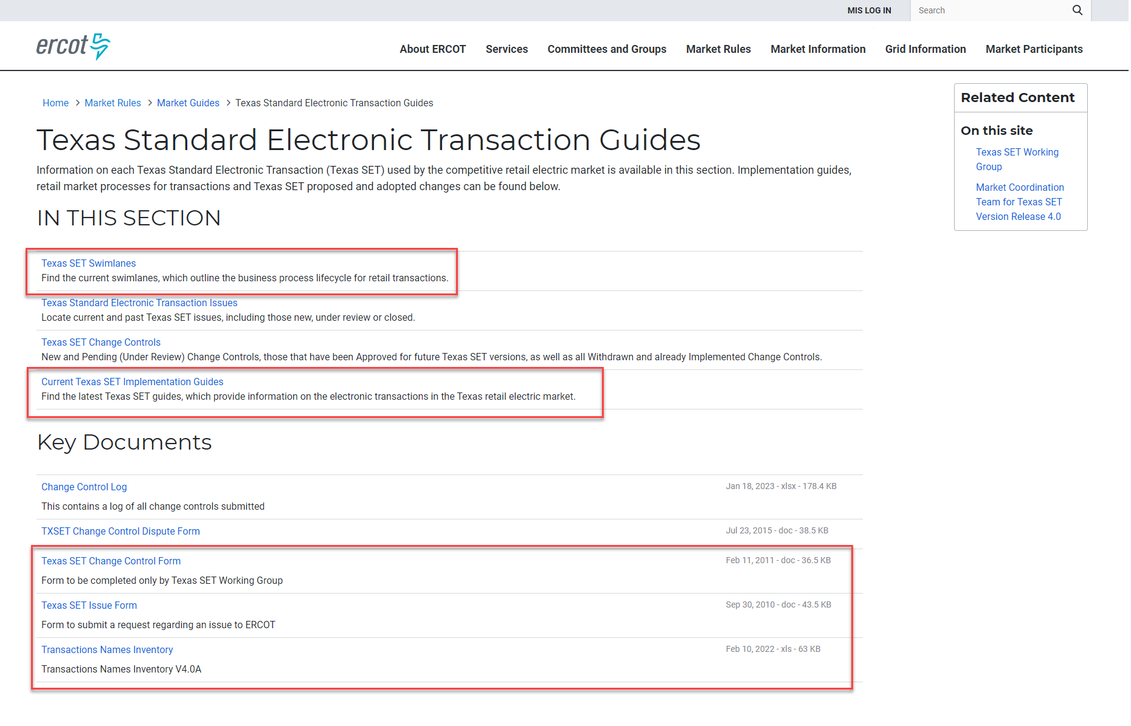
TX SET Guides
Notes:
But for quick reference, there is also a Transaction Name Inventory posted on ERCOT.com, complete with a handy pocket card. We printed and laminated pocket cards to give you here today. We hope that you will find them as useful as we do. We also hope that you will use them in the upcoming class scenarios!

Slide 31

Texas SET Swimlanes
Texas Standard Electronic Transaction (SET) swimlanes are reference documents that outline the business process lifecycle for transactions used in the competitive retail electric market in Texas.
https://www.ercot.com/mktrules/guides/txset/sw

Slide 32
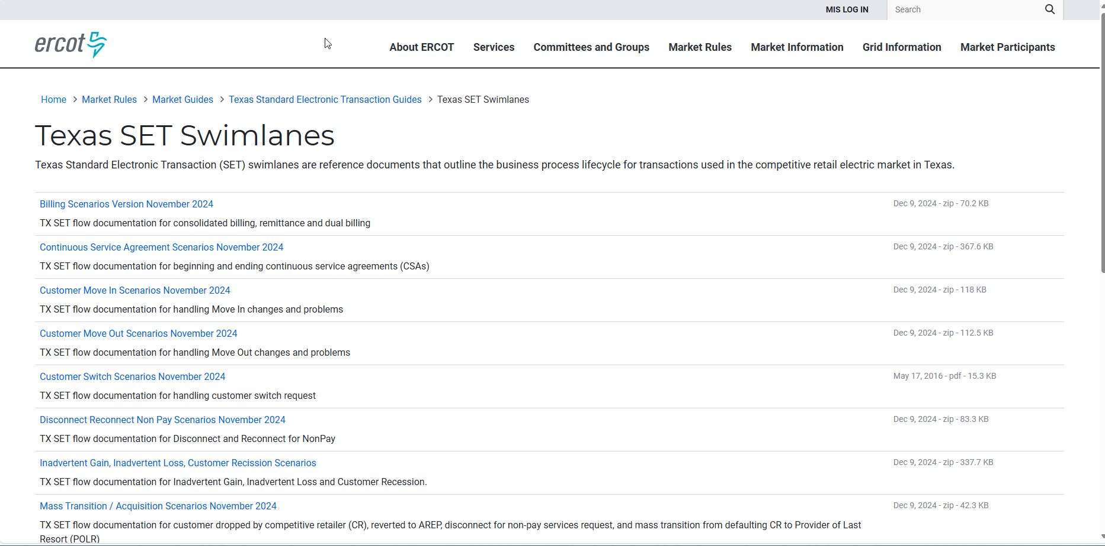
TX SET Swimlanes

Slide 33
Texas SET Implementation Guides (IG)
TX SET Implementation Guides provide technical details contained within the electronic transactions used in the competitive retail electric market in Texas.
Current Version 5.0 supports PUCT Substantive Rules and market process revisions
https://www.ercot.com/mktrules/guides/txset/version

Slide 34
New Functionality of TX SET v5.0 :
Created a new IA (Inadvertent) and CR (Customer Rescission) Move-In Transactional Solution and modified MarkeTrak Processes.
“County” name added as part of the ESI ID Premise Address attributes. NWS for all TX Counties is source for this information.
Created 44 new “Metered Service Type (MSL)” descriptions
Added Continuous Service Agreement “(CSA) Start and End Dates” to minimize incorrect CSA CRs’ financial liability
Created new “CHP” status code for “TDSP Construction Hold”
Replaced “A13 Other” with “(28) Specific Reject Reason” codes
MarkeTrak Enhancements included new Subtypes, Stronger Validations and added “Complete Unexecutable” Drop-down reasons

Slide 35
TX SET Working Group

Slide 36

TX SET Working Group
Texas Standard Electronic Transaction (TX SET) Working Group:
Reports to the Retail Market Subcommittee (RMS)
Analyzes the need for new or modifications to existing electronic transactions
Recommends changes to retail market processes
Works with the ERCOT Flight Administrator to ensure that testing processes and procedures are defined and administered
Maintains the Texas SET Implementation Guides and the Texas Market Test Plan Guide
Collaborates with other Working Groups and Taskforces as directed by RMS
https://www.ercot.com/committees/rms/txset

Slide 37
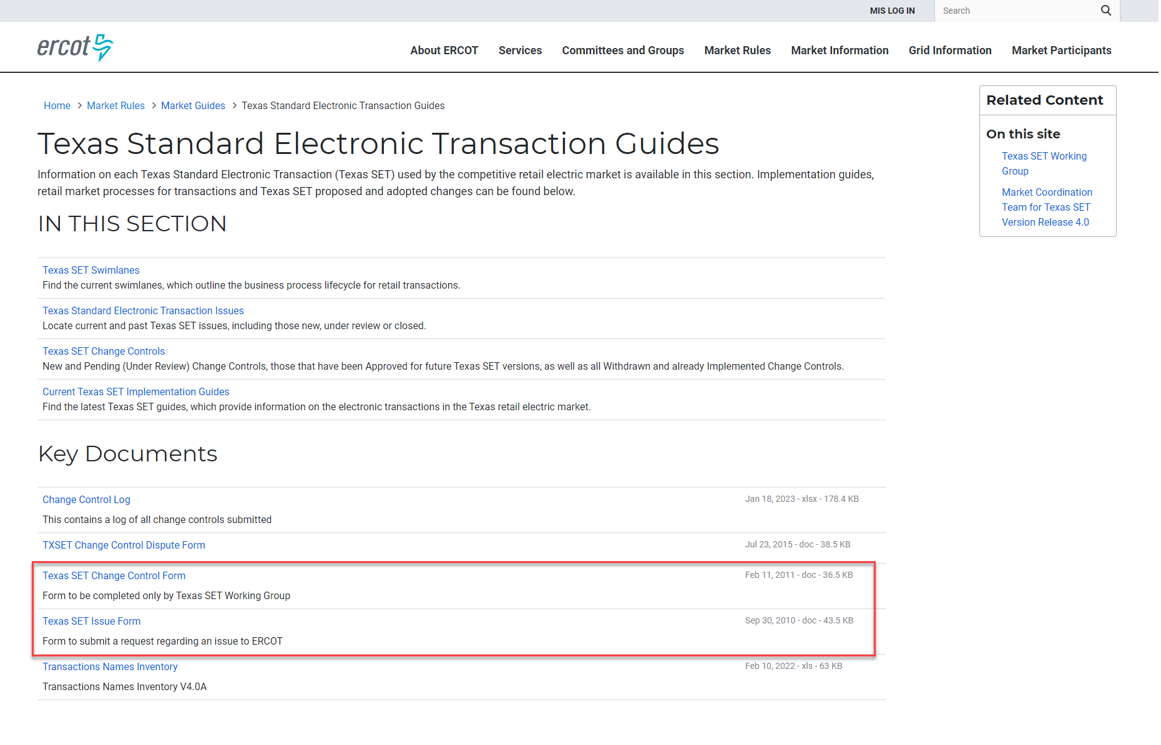
TX SET Issue Submission Process
Formal method to initiate review of issues
Notes:
This process provides Market Participants with a formal way to communicate transactional or market processing issues that should be reviewed and discussed by the Texas SET Working Group for a recommendation and/or resolution.
Issues brought forth through this process may be used by the Texas SET Working Group representatives to develop a Change Control(s) that may be implemented with a future TX SET version.
Market Participants submitting issues to be considered by the Texas SET Working Group should use the Texas SET Issue Form at this link:

Slide 38
Retail Market Testing
Flight Testing:
  All retail Market Participants are required to test for ERCOT certification
  Three Market flights per year
  End to End test scripts (i.e. connectivity, penny test)
Notes:
The Texas Market Test Plan (TMTP) applies to Market Participants doing business in the Texas Electric Choice Market.
The purpose of this document is to define the market plan for testing commercial operations systems and business processes to support the Texas Electric Choice Market.
This document covers all testing requirements and procedures between ERCOT and the Market Participants and Point-to-Point testing between Market Participants.

Slide 39
Retail Market Testing
  Governed by Texas Market Test Plan:
  Maintained by TX SET Working Group
  Outlines testing processes and requirements
All retail Market Participants must participate in and successfully complete testing as described in Protocol Section 19.8, Retail Market Testing, prior to commencing operations with ERCOT.

Slide 40
Transactions

Slide 41



Overview of transaction flow
814 PC/PD only
824
810
TDSP
CR
814
814
824
824
867
867
650
820
650 – Service Orders
814 – ESIID info and relationships
824 – Rejects
810 – Invoice
820 – Remittance advice
867 – Usage
Notes:
Moved up two slides

Slide 42
Texas Standard Electronic Transactions (TX SET)
Many transactions involve ERCOT
Transaction Type | Use
814 –ESI ID info and Relationships (Many flavors) | Enrollments; Switch requests; Move-Ins; Move-Outs; ESI ID Maintenance
867 – Premise Usage | Initial Meter Read; Historical/Monthly Usage; Final Usage
824 – Reject Notification | Invoice or Usage Reject Notification

Slide 43
Texas Standard Electronic Transactions (TX SET)
Some transactions may not involve ERCOT
Transaction Type | Use
810 – Invoice | Bills for Charges between Market Participants
820 – Payments | Payments between Market Participants
650 –Service Order Requests | Disconnects for Non-Pay; Reconnects; Switch Hold and Switch Hold Removal; Planned Outage Notification
824 – Reject Notification | Invoice or Usage Reject Notification
These are called Point-to-Point transactions and flow between TDSPs and REPs

Slide 44
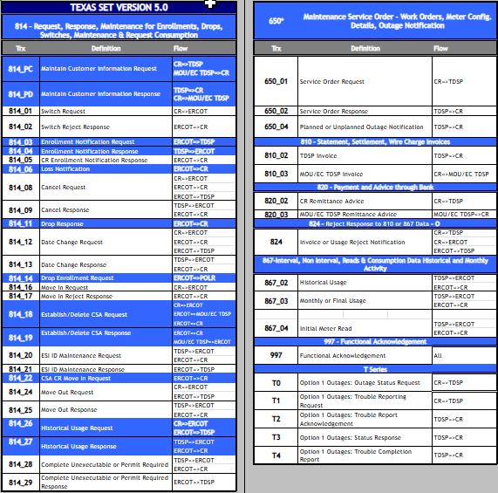
Transaction Names
TX SET Version 5.0 – Transaction Names Inventory
Refer to handout
Defines the transaction name for each transaction
Describes how the transaction flows
Found on the ERCOT website at http://www.ercot.com/mktrules/guides/txset

Slide 45
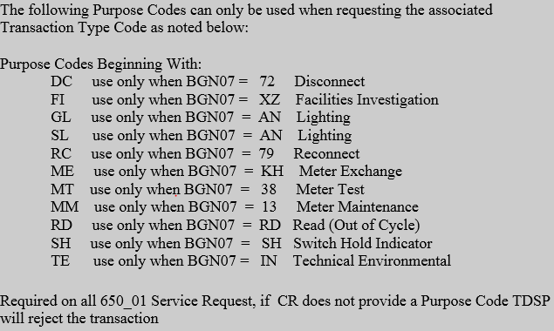
Transaction Names – 650_01 Service Orders
From 650_01 Implementation guide.
There are 80 REF segments to identify the purpose of the 650 Service Order based on the above 11 codes

Slide 46
Option 1 vs Option 3 REP
REPs will designate Option 1, 2, or 3 on their Delivery Service Agreement with each TDSP on the following:
OPTION | REPORTING OF OUTAGES OR SERVICE REQUESTS
1 | REP directs customers to contact REP, REP contacts TDSP via transaction
2 | REP directs customers to contact REP, REP forwards calls to TDSP
3 | REP directs customers to contact TDSP, REP provides TDSP phone number to customers

Slide 47
Move-In vs Switch - Differences
 | Move In – 814_16 | Switch – 814_01
Definition | Customer requesting service connected in their name at either a new or an existing premise. | The process by which the current Customer makes a request to change their REP of Record for their ESI ID(s).
Timing & Costs | Move In fees and potential delays could be encountered | No fees on Standard Switch Self-selected Switches fees may apply.
Rescission | Not applicable | Customer has the right to rescind their decision within 3 Federal business days
Occupant Permit | Required for some municipalities/cities | Not required
Critical Care and Chronic Condition | Designation will be terminated due to New Customer MVI Critical Care and Chronic Condition status’ are associated to the Customer and not the Premise | No change to status
Billing Demand Reset | Demand Ratchet resets | No impact to Billing Demand
4CP (Coincident Peak) | 4CP demand resets | No change to 4CP demand
Non-standard Metering Premise | Meter is replaced with Standard meter and additional charge(s) to Customer if requested to re-install non-standard meter | No change
Smart Meter Texas (SMT) and TDSP Outage Alerts | Customer’s Enrollment associated to Service Address and ESI ID is disabled. Customer will be required to reapply. | No change to SMT Enrollment or TDSP outage alert status

Slide 48
Transactions Initiating Business Process Instance
Initiating Business Process Instance (BPI)
    Move In 814_16
    Switch 814_01
    Move Out 814_24
The business processes listed above will start or end a REP’s relationship with their customer.

Slide 49
Transactions Initiating Business Process Instance
Business process instances may be closed as Completed or Cancelled.
Cancelled transactions may be a result of:
    Cancel Request 814_08
    Complete Unexecutable 814_28 CU

Slide 50
814_28 Complete Unexecutable or Permit Required
Permit Required (PR) | Complete Unexecutable (CU)
TDSP notifies CR via ERCOT Permit is required in order to complete enrollment TDSP typically will not send an 814_04 scheduling response until permit is received ERCOT holds enrollment for up to 20 Retail Business Days | TDSP unexecutes the initiating transaction with the appropriate code construction miscellaneous/unsafe transactional process NOTE: To be more response prescriptive, TX SET v5.0 implemented (5) new unexecutable codes

Slide 51
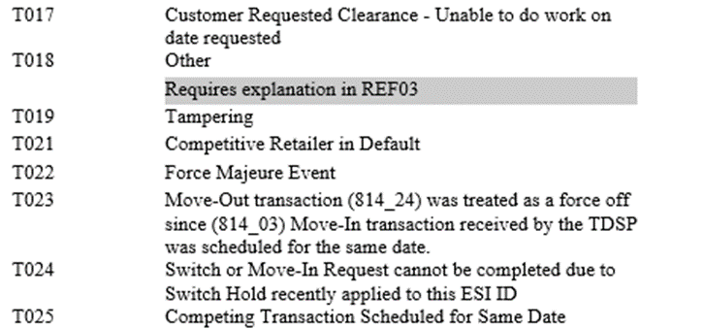
Sample 814_28 CU codes

Slide 52
Monthly or Final Usage and TDSP Invoice
867_03 Monthly or Final Usage | 810_02 TDSP Invoice
TDSP to ERCOT to CR Monthly or Final usage Only the 867_03F will appear in MIS Meter consumption data for invoicing Start / End dates Starting / Ending Register Reads Summary KWh for NIDR meters (AMS meters) Interval KWh for IDR meters kW / kVAR values, if applicable Actual or estimated Distributed generation loop | Point to point transaction Invoice from TDSP to CR Start / End dates Rate Classification Code Line item delivery charges SAC04 code Billing determinant (rate) Explanation of charge Non-discretionary charges - TCRF, Customer charge, etc. Discretionary service charges - MVI, DNP fees, etc.
867_03 and 810_02 are usually paired to trigger CR customer billing

Slide 53
Checkpoint Questions
True or False: Response transactions can only be Rejects.
FALSE
True or False: A point-to-point transaction is sent only to ERCOT.
FALSE

Slide 54

Checkpoint Questions
What transaction is used to determine the actual start date for a customer?
814_04
814_16
867_04
814_01

Slide 55
Checkpoint Question
Which transaction changes the meter and/or meter information?
814_09
814_18
814_26
814_20

Slide 56
Transaction Process Flow

Slide 57
Move In (MVI) – Reject
814_16 (MVI)
New CR
1
ERCOT
814_17 (only a reject)
2

Slide 58
Move In – Accept
814_16
814_03
New CR
1
ERCOT
2
TDSP
814_05
814_04
4
3
867_02
867_02
6
5
867_04
867_04
8
7

Slide 59
Move-In Swimlane
Scenario: Customer Move-In with ESI ID De-Energized
Customer
Contacts New Cr for
Move In
(1)
New CR
Sends 814_16 Move
In Request with/ without Request for Usage History. May Receive 814_17
Move In Reject Response
Receives 814_05 CR Enrollment Notification Response 867_02 Historical Usage
Receives 867_04
Initial Meter Read
ERCOT
(2: 814_16)
(2A: 814_17 Reject Only)
(6:814_05)
(7: 867_02)
(9: 867_04)
Receives 814_16 Move In Request
from New CR with request for Historical Usage and Validates; Responds with
814_17 Move in Reject Response
only if rejected
Sends 814_03 Enrollment
Notification Request to TDSP; Forwards 814_05 CR Enrollment Notification Response and 867_02 Historical Usage to New CR, if requested
Receives
867_04 Initial Meter Read and forwards to CRs; Updates registration database
TDSP
(3:814_03)
(4: 864_02)
(5: 814_04)
(8: 867_04)
Receives 814_03 Enrollment Notification Request and sends 814_04 Enrollment Notification Response and 867_02 Historical Usage (if requested and available)
Performs Meter Read and sends
867_04 Initial Meter Read is sent to
ERCOT
Move In Date Completed

Slide 60
Move In w/ Permit Required – New Installation
814_16
814_03
New CR
1
ERCOT
2
TDSP
814_28
814_28
4
3
City sends permit to TDSP
814_05
814_04
6
5
867_04
867_04
8
7

Slide 61
Move In w/ Permit Not Received
814_16
814_03
New CR
1
ERCOT
2
TDSP
814_28
814_28
4
3
Permit is not received by TDSP within 20 Retail Business days
814_08
5
814_08
814_09
7
6

Slide 62
Move In w/ Cancel
814_16
814_03
New CR
1
ERCOT
2
TDSP
814_05
814_04
4
3
867_02
867_02
6
5
Customer cancels MVI
814_08
814_08
7
8
814_09
814_09
10
9

Slide 63
Move In w/ Date Change
814_16
814_03
New CR
1
ERCOT
2
TDSP
814_05
814_04
4
3
867_02
11
15
867_02
16
6
5
Customer changes MVI date
814_12
814_12
7
8
814_13
814_13
10
9
867_04
867_04
13
12
867_03F
14
814_06
Current CR
867_03F
810_02

Slide 64
Checkpoint Questions
Yes or No: If a MVI order is submitted and an 814_28 PR is received, does it cancel the original MVI order if the permit is received within 20 Retail Business days?
NO
Yes or No: If a MVI order is submitted and an 814_28 PR is received and then later an 814_08 is received, should the CR receive an 867_04?
NO
Yes or No: Based on the scenario in the previous question, should the CR expect this customer to be with the submitting CR?
NO

Slide 65
Switch – Rejected
814_01
New CR
1
ERCOT
TDSP
814_02
2
Current CR

Slide 66
Switch – Accept
814_01
814_03
New CR
1
ERCOT
2
TDSP
814_05
814_04
4
3
867_02
5
11
867_02
12
7
6
867_04
867_04
9
8
867_03F
10
814_06
Current CR
867_03F
810_02

Slide 67
Switch Hold – Add – Deferred Payment Plan (DPP)
650_01 (add)
650_02 (acknowledgement)
1
814_20
814_20
2
Current CR
4
ERCOT
3
TDSP
814_21
5

Slide 68
Switch Hold – Add - Tampering
814_20
814_20
Current CR
2
ERCOT
1
TDSP
814_21
3

Slide 69
Switch Hold – Remove – DPP / Tampering
650_01 (remove)
650_02 (acknowledgement)
1
814_20
814_20
2
Current CR
4
ERCOT
3
TDSP
814_21
5

Slide 70
Switch w/ Switch Hold
814_01
814_03
New CR
1
ERCOT
2
TDSP
814_05R
814_04R
4
3
Same result for MVI

Slide 71
Checkpoint Questions
What transaction does the TDSP receive when an 814_01 or 814_16 is initiated?
867_04
814_03
867_03
814_04

Slide 72
Checkpoint Questions
A Customer Loss (814_06) transaction is sent to which entity?
Current REP of Record
TDSP
ERCOT
New CR
True or False: The 814_04 / 814_05 provides premise attributes and scheduling.
TRUE

Slide 73
Move Out (MVO) – Reject
814_24
Current CR
1
ERCOT
TDSP
814_25R
2

Slide 74
Move Out – Accept
810_02
814_24
814_24
7
Current CR
1
ERCOT
2
TDSP
814_25
814_25
4
3
867_03F
867_03F
6
5

Slide 75
Checkpoint Questions
True or False: If a Switch Hold exists on an ESIID, a MVO transaction (814_24) will automatically reject.
FALSE

Slide 76
Checkpoint Questions
A date change transaction (814_12) is sent to change the date for which transactions? Select all that apply.
814_01
814_05
814_08
814_16
814_18
814_24

Slide 77
Solution to Stacking – RMG Section 11.1
Solution to Stacking, provides the processes and guidelines for Market Participants operating in the Texas retail market to handle multiple non-sequential Texas Standard Electronic Transactions (TX SETs) on a single Electric Service Identifier (ESI ID)
These include:
  ERCOT Operating Rules
  TDSP Operating Rules
  REP Operating Rules

Slide 78
ERCOT Operating Rule Examples
Cancellation Rules –
  MVI / MVO trumps SWI (Rule 7)
  MVI trumps MVO w/ same date (Rule 8)
Concurrent Processing Rules –
  Multiple MVIs w/ different dates (Rule 12)
  Multiple SWI w/ different dates (Rule 13)
Pending Transactions –
  814_06 Loss Notification (Rule 15)
  814_22 CSA – upon receipt of MVO, enrollment will be sent to CSA holder (Rule 17)

Slide 79
TDSP and REP Operating Rule Examples
TDSP Operating Rule 8 –
The TDSP will reject Backdated Transactions with an 814_04, Enrollment Notification Response, or 814_25, Move Out Response, if it is not associated with a back-office clean up, including safety-net move in.
REP Operating Rule 13 –
CSA Bypass Code – ‘2W’ only to be used by CSA holder on a MVO request
(New 5.0 validation)

Slide 80
ERCOT Rejection Operating Rules
Scheduled | New Transaction | Rejected? | Reason
Move in | Move in | Yes | NFI
Move in | Self-selected Switch | Yes | NFI
Move in | Move out | No | -
Move in | Standard Switch | Yes | NFI
Move out | Move in | No | -
Move out | Self-selected Switch | Yes | SBD
Move out | Move out | Yes | DUP
Move out | Standard Switch | Yes | SBD
Switch | Move in | No | -
Switch | Self-selected Switch | Yes | NFI
Switch | Move out | No | -
Switch | Standard Switch | Yes | NFI

Slide 81
ERCOT Operating Rule 4
MVO trumps SWI
ERCOT will reject a Switch Request if the ESI ID is scheduled to be De-energized at ERCOT on the Requested Date.
12/1 MVO
OILERS ENERGY
12/2
12/4 SWI COWBOYS ENERGY
12/3
COWBOYS ENERGY will need to submit a MVI (814_16) in order to enroll their customer.

Slide 82
ERCOT Rejection Operating Rules
Scheduled | New Transaction | Rejected?
Mass Transition Drop | Move in | No
Mass Transition Drop | Self-selected Switch | No
Mass Transition Drop | Move out | No
Mass Transition Drop | Standard Switch | No
Acquisition Transfer | Move in | No
Acquisition Transfer | Self-selected Switch | No
Acquisition Transfer | Move out | No
Acquisition Transfer | Standard Switch | No
In the event of a Mass Transition or Acquisition Transfer, ERCOT will not reject transactions that are a result of customer choice based on timeline.

Slide 83
ERCOT Operating Rules Scenarios
Scenario 1: Customer is shopping. They sign up with multiple retailers. Which transaction will prevail?
First in is determined by the time-stamp applied when the transaction is received by ERCOT.
Scenario 2: Tenant has scheduled a Move out with their retailer for next week. The LL has called to schedule a Move in for make ready the same day. Which transaction will prevail?
Scenario 3: Customer with a critical designation has been shopping and has scheduled a switch from retailer A to retailer B. Retailer C sends a Move in, instead of a switch. What will happen and what are the possible consequences?

Slide 84
REP Operating Rules
RMG 11.4.1 REP Operating Rule 1: Cancel Move Out
Transactions are validated for ROR not customer. Therefore, REPs who have a pending move out and that REP submits a move in with an earlier Requested Date are responsible for canceling the Pending move out if that is what the Customer requires (REP manages Customer expectations). If the REP does not cancel the move out, the move out will be allowed to effectuate.
10/5 MVI
New Customer
10/9 MVO Existing Customer
10/8
10/7
10/6
MVO transaction from existing customer has left new customer in the dark.
If a REP enrolls a new customer at the same premise and an existing customer has a future dated MVO, if the REP fails to cancel the future dated MVO, the MVO will be executed leaving the new customer in the dark

Slide 85
REP Operating Rule 1: Scenarios
10/5 MVI
New Customer
10/9 MVO Existing Customer
10/8
10/7
10/6
MVO transaction from existing customer has left new customer in the dark.
Scenario 4: A landlord is completing a make ready/clean & show. They move-in on 10/5 and are moving out on 10/9. Their retailer has sent both a move-in and a move-out.
Scenario 5: The tenant is with Oilers and scheduled their move out for 10/9. The Landlord calls Oilers to start services and schedules a move in for 10/5 is completing a make ready. If Oilers does not cancel the tenant MVOT out 10/9, what happens?

Slide 86
Checkpoint Question
A MVI is submitted and scheduled by OILERS ENERGY and then another MVI is submitted later by COWBOYS ENERGY requesting the same day. Which entity would receive an 814_17 Not First In (NFI) reject?
TDSP
ERCOT
OILERS ENERGY
COWBOYS ENERGY

Slide 87
Checkpoint Question
Which entity is responsible for sending an 814_08 cancel when there is a MVO for Customer A pending for 5/5 and a MVI for Customer B pending for 5/1, both with the current REP?
TDSP
ERCOT
Current REP
Another REP

Slide 88
Checkpoint Question
Which entity is responsible for sending an 814_08 cancel when there is a MVO for Customer A pending for 5/5 and a MVI for Customer B pending for 5/5 both with different REPs?
TDSP
ERCOT
REP for Customer A
REP for Customer B

Slide 89
Checkpoint Question
What transaction is used to determine the actual end date of a customer?
814_24
814_01
867_03F
814_22

Slide 90
Move Out to Continuous Service Agreement (CSA)
814_22
814_03
CSA CR
5
ERCOT
2
TDSP
814_04
3
10
4
7
867_03F
6
867_04
867_04
9
8
814_24
Current CR
1
814_25
867_03F
810_02
NOTE: With TX SET v5.0, ERCOT will use the dates for the CSA (Start and End Date) to determine if there will be a CSA CR for the requested date of a Move Out in order for ERCOT to convert the MVO to a MVO to Continuous Service Agreement (CSA) CR.

Slide 91
Checkpoint Question
What does CSA mean?
Continuous Service Arrangement
Continued Service Arrangement
Continuous Service Agreement
Country Served Agreement

Slide 92
Checkpoint Question
If there is a Continuous Service Agreement and the customer moves out what transaction places the service back with the CSA?
867_04
814_18
814_01
814_22

Slide 93
Disconnect for Non-Pay (DNP)*
650_01
650_02
1
2
Current CR
ERCOT
TDSP
* Does not apply to MOU/EC

Slide 94
Reconnect after DNP*
650_01
650_02
1
2
Current CR
ERCOT
TDSP
* Does not apply to MOU/EC

Slide 95
Checkpoint Question
What transaction is necessary in order to re-connect a customer after a disconnect for non-payment or cancel a pending disconnect for non-payment?
650_02
814_08
650_01
814_16

Slide 96
New Indicator Codes in 814_16 Move-In Transaction for Inadvertent Gain or Customer Rescission
These are the transactions that include the new indicator code when an Inadvertent Switch occurs and is returned to the original losing REP.
This is after a MarkeTrak has been submitted and both REPs have agreed to have the ESID returned to the losing REP.
814_16 – Move In (CR to ERCOT)
814_03 – Enrollment Notification Request (ERCOT to TDSP)
814_04 – Enrollment Notification Response (TDSP to ERCOT)
814_05 – Competitive Retailer Enrollment Notification Response (ERCOT to CR)
Indicator Codes:
‘IA’ – Inadvertent Gain MVI
‘CR’ – Customer Rescission MVI

Slide 97
Returning an Inadvertent Gain (IA) or Customer Rescission (CR) to the Losing REP
814_16 (IA/CR)
814_03 (IA/CR)
Losing CR
1
ERCOT
2
TDSP
814_05 (IA/CR)
814_04 (IA/CR)
4
3
867_02
5
11
867_02
12
7
6
867_04
867_04
9
8
867_03F
10
814_06
Gaining CR
867_03F
810_02

Slide 98
Checkpoint Question
True or False: For resolution of an Inadvertent Gain, every backdated/prospective dated move-in should have a CR or IA code within the transaction.
TRUE

Slide 99
Acquisition Transfer vs. Mass Transition Process
What is Acquisition Transfer (“AQ”)?
Is the transfer of ESI IDs from the Current CR to another CR(s) as a result of an acquisition pursuant to P.U.C. SUBST. RULE 25.493.
Example: CR selling some or all ESI IDs to another CR and ERCOT is requested to initiate this process. CR selling may continue to be Certified in the Retail Market.
Note: Not all mergers and acquisitions will utilize this process.
What is a Mass Transition (“TS”)?
Is the expeditious transfer large numbers of ESI IDs from one Market Participant (MP) to another pursuant to P.U.C. SUBST. RULE 25.43.
Examples: Voluntary or Involuntary Decertification, Bankruptcy, or CR Defaulted on their Financial Obligations to ERCOT. CR is Decertified or no longer Active MP!
Both the “AQ” or “TS” processes:
  Utilizes TX SET 814_03 either “AQ“ or “TS” transaction initiated by ERCOT;
  Transfers REP of Records’ responsibilities for affected ESI IDs in a manner that protects the continuity of service to Customers;
  Allows for the honoring of Customer’s Choice to Switch (814_01) to their chosen Competitive Retailer.
Notes:
The following example will focus on the transition of ESI IDs from a Defaulting CR to either a VREP (Volunteer REP) or a designation POLR REP (Provider of Last Resort)…

Slide 100
Acquisition Transfer (“AQ”) or Mass Transition (“TS”) Transaction Flow Process
814_14
814_03 AQ or TS
POLR/ VREP/CR
3a
1
867_02
ERCOT
814_04
TDSP
5
2
867_04
3b
9a
867_02
4
9b
7
867_03F
8
867_04
6
“AQ” or “TS” CR
814_11
867_03F
810_02

Slide 101
MIS Portal

Slide 102
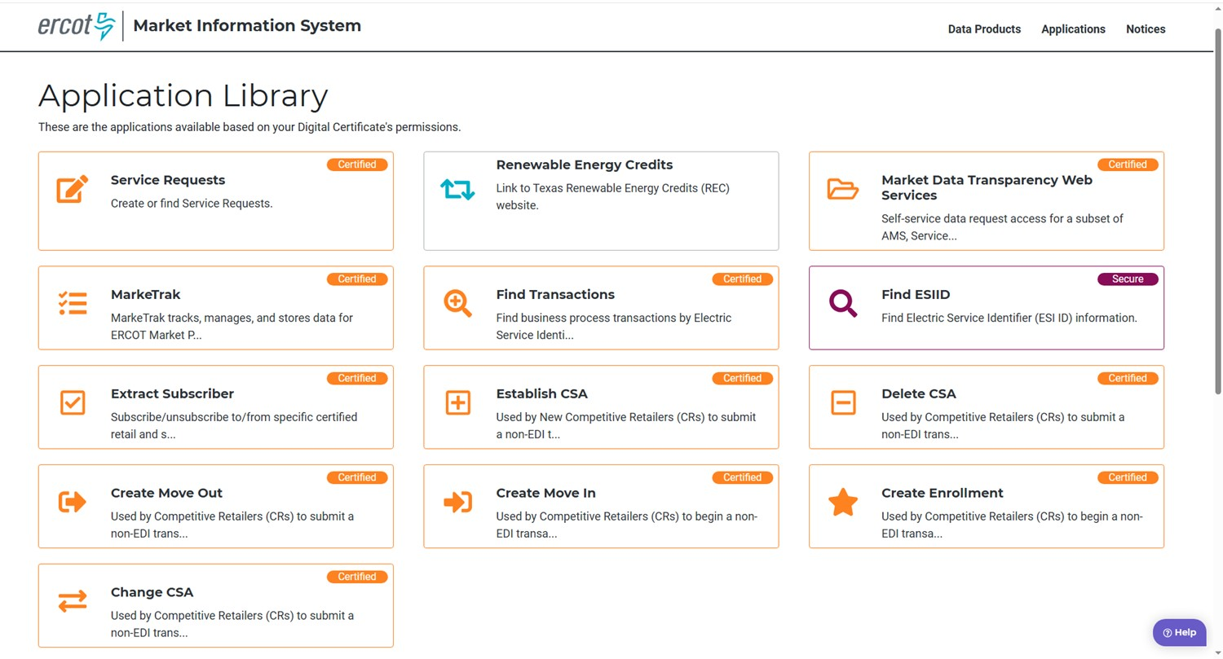
Market Information System

Slide 103
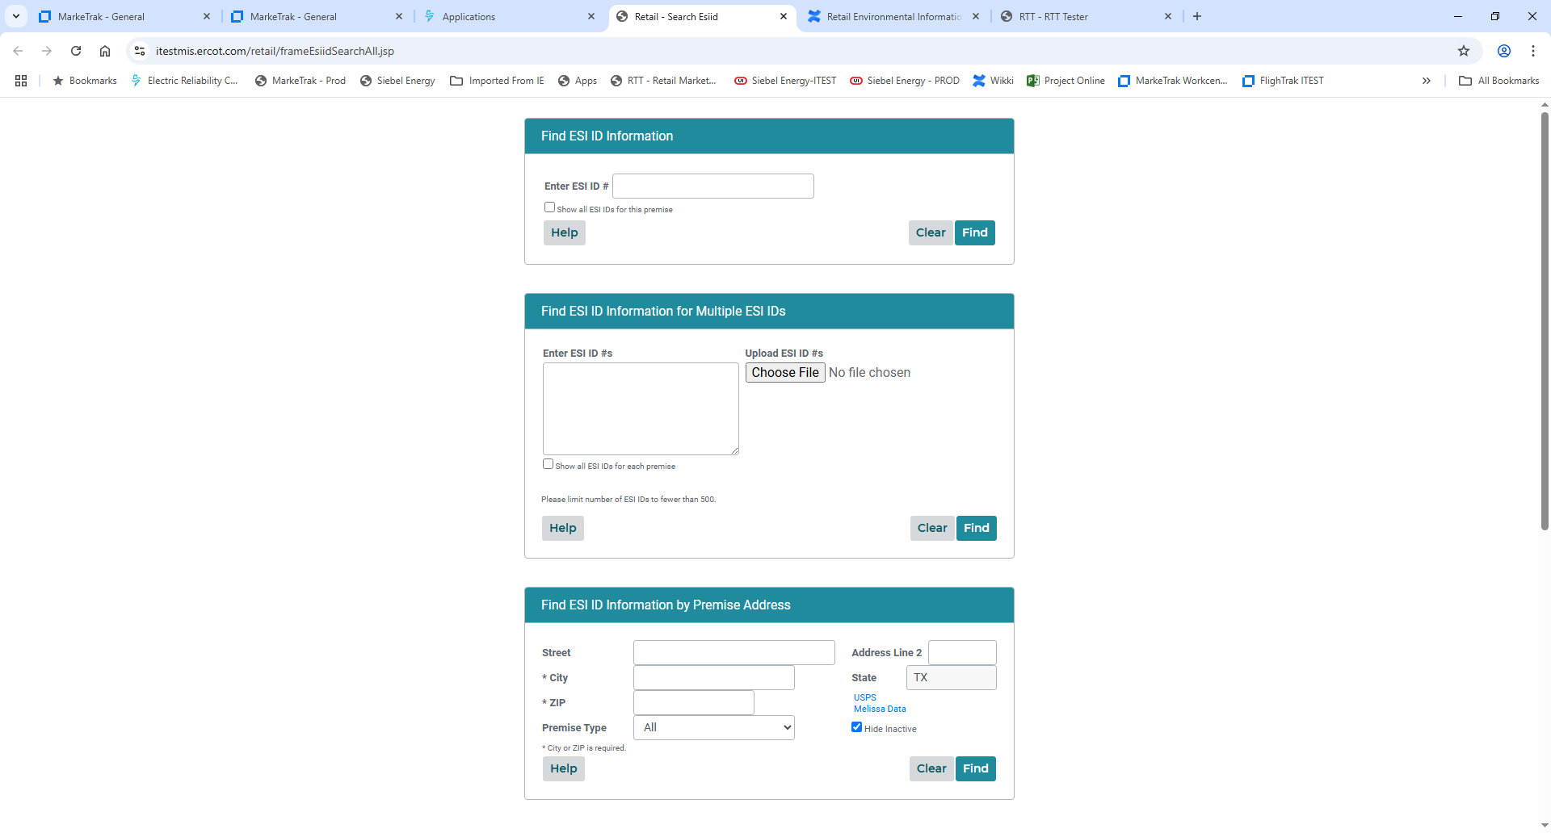
Find ESI ID
Additional information is accessed via an ESI ID #
Or
An address can be used to find the ESI ID number serving that premise
An asterisk (*) serves as a wildcard for address search

Slide 104
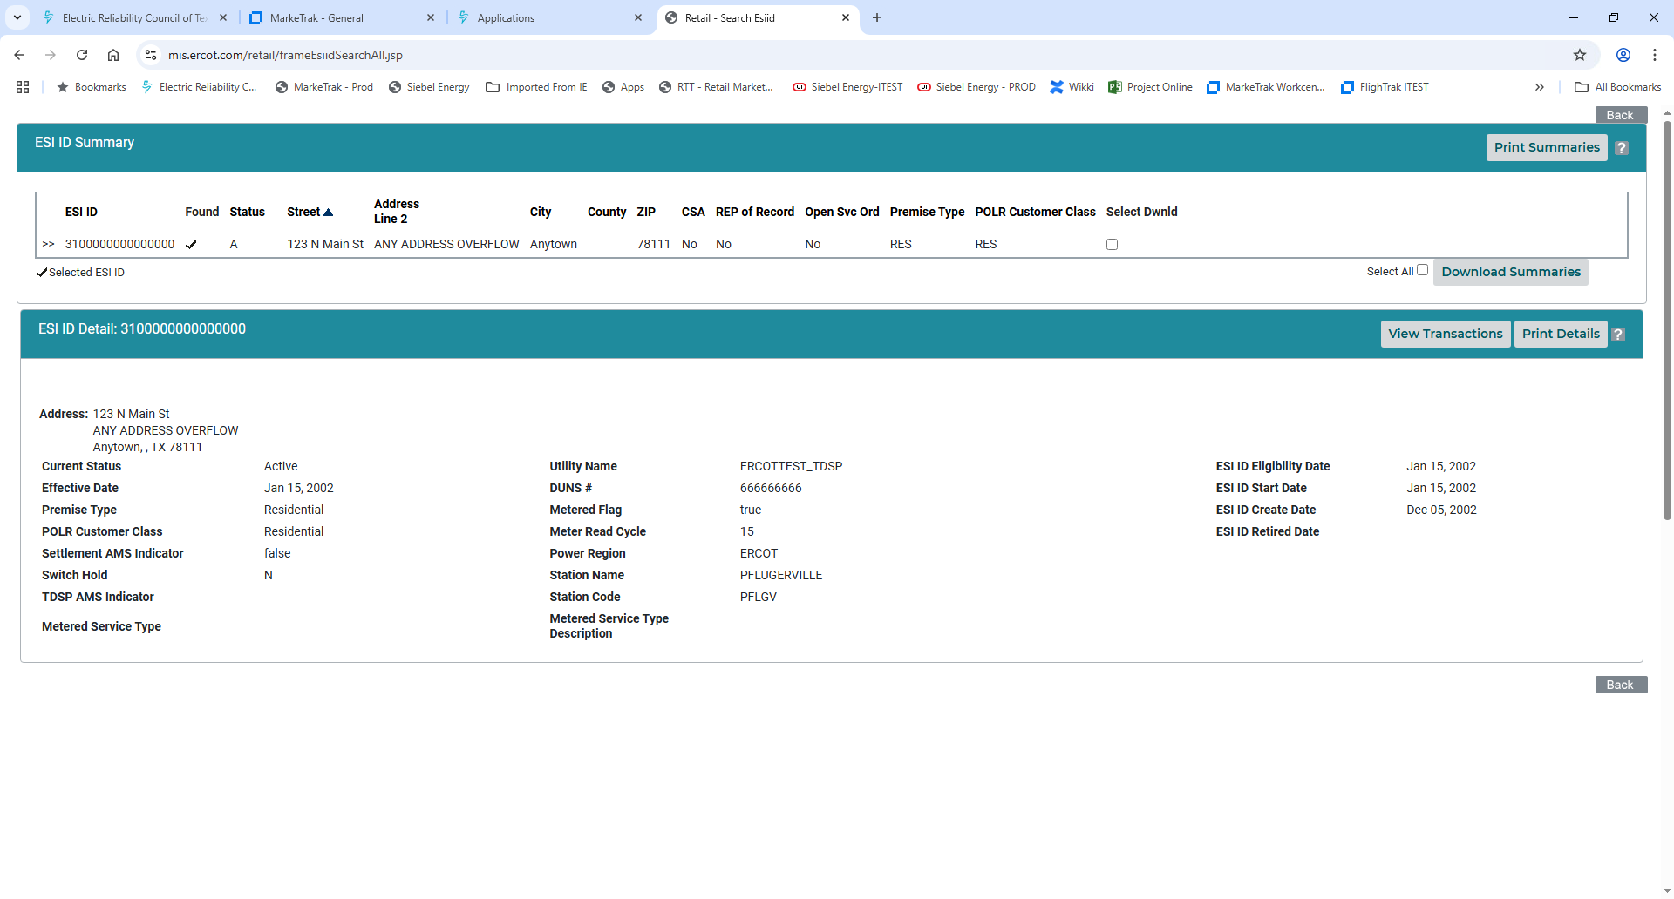
Find ESI ID
STATUS
A – Active
D – Deenergized
I - Inactive
REP of Record
Is the viewer the ROR?
Premise Type
RES – Residential
SMA – Small Non-Res
LAR – Large Non-Res
CSA
Does this ESI ID have a Continuous Service Agreement?
POLR Customer Class
Calculated ERCOT POLR customer classes:
RES – Residential
SMA – Small Non-Res
MED – Medium Non-Res
LAR – Large Non-Res
Open Svc Ord
Are there any current ‘open’ transactions on this ESI ID such as a pending MVO, MVI, etc?

Slide 105
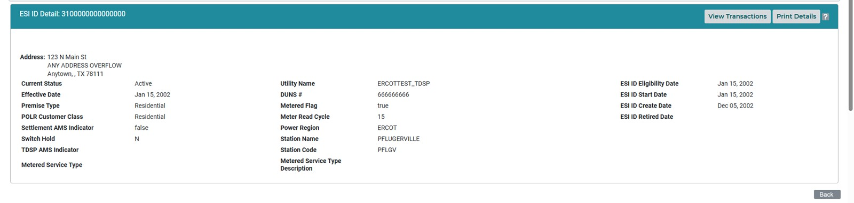

Find ESI ID – Additional information

Slide 106
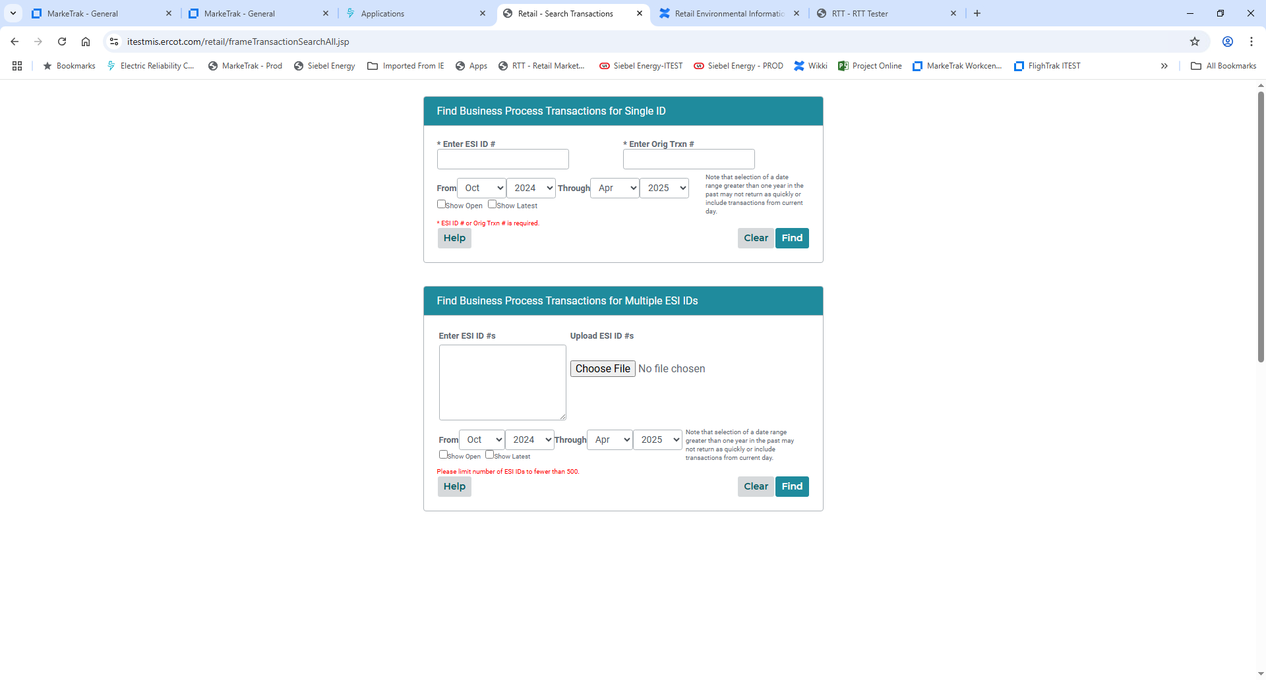
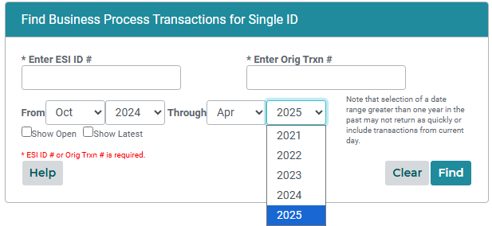
Find Transactions
View Transactions from Find ESI will always only return the most recent and there is not a way other than Find Transactions to view more.
Use drop down arrow features to specify dates for the historical transactions needed.
Default will be only the last seven months of activity and maximum of 5 years.

Slide 107
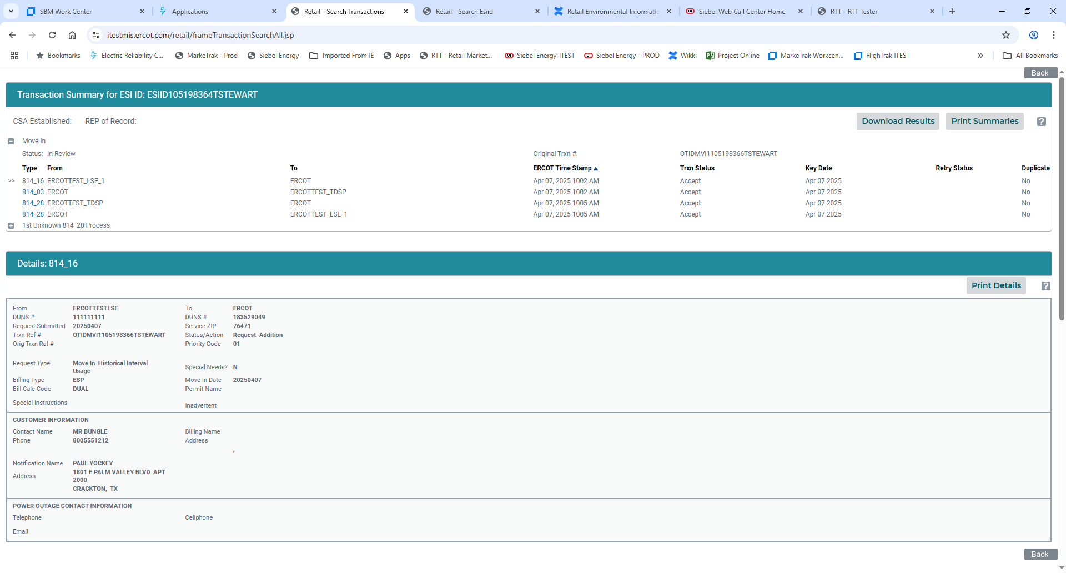
Find Transactions – MVI w/ permit required
Status will remain In Review until TDSP sends 814_04 to ERCOT scheduling the order
Customer information is contact information – not necessarily premise address

Slide 108
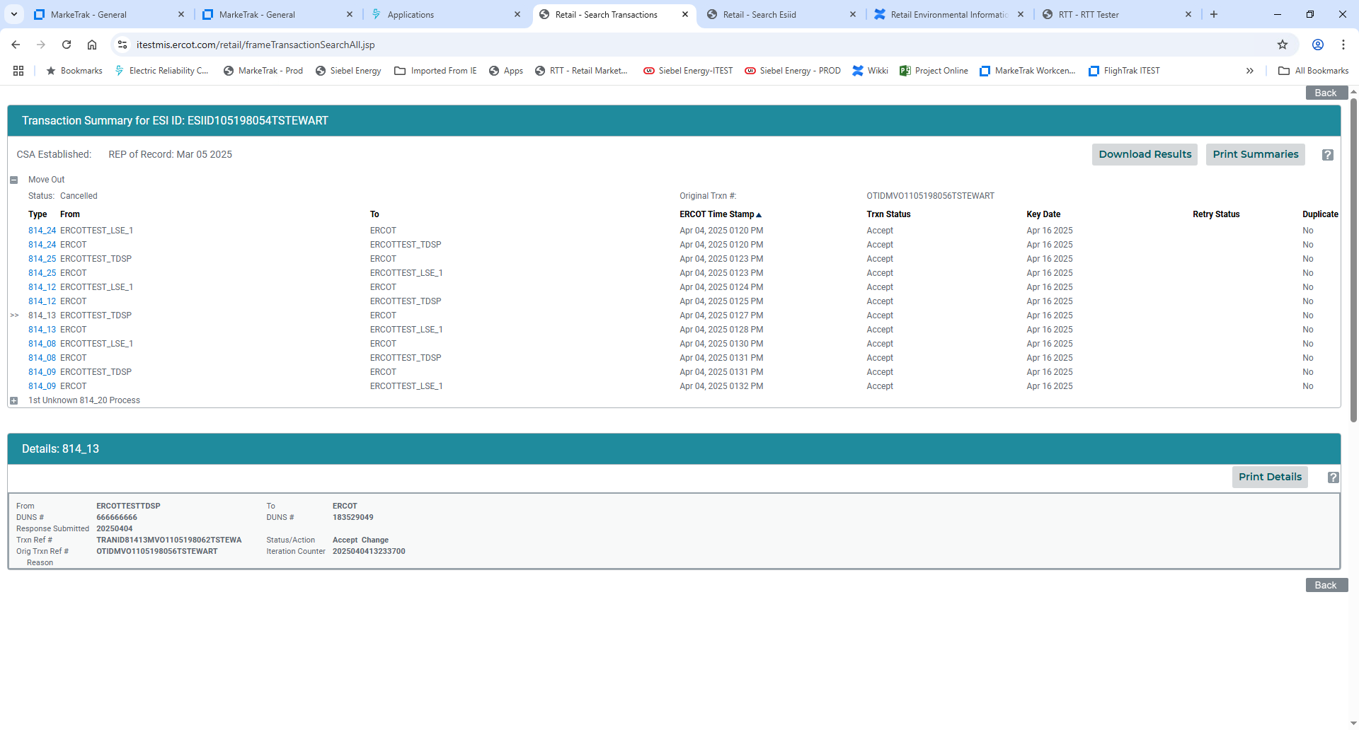
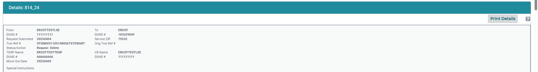
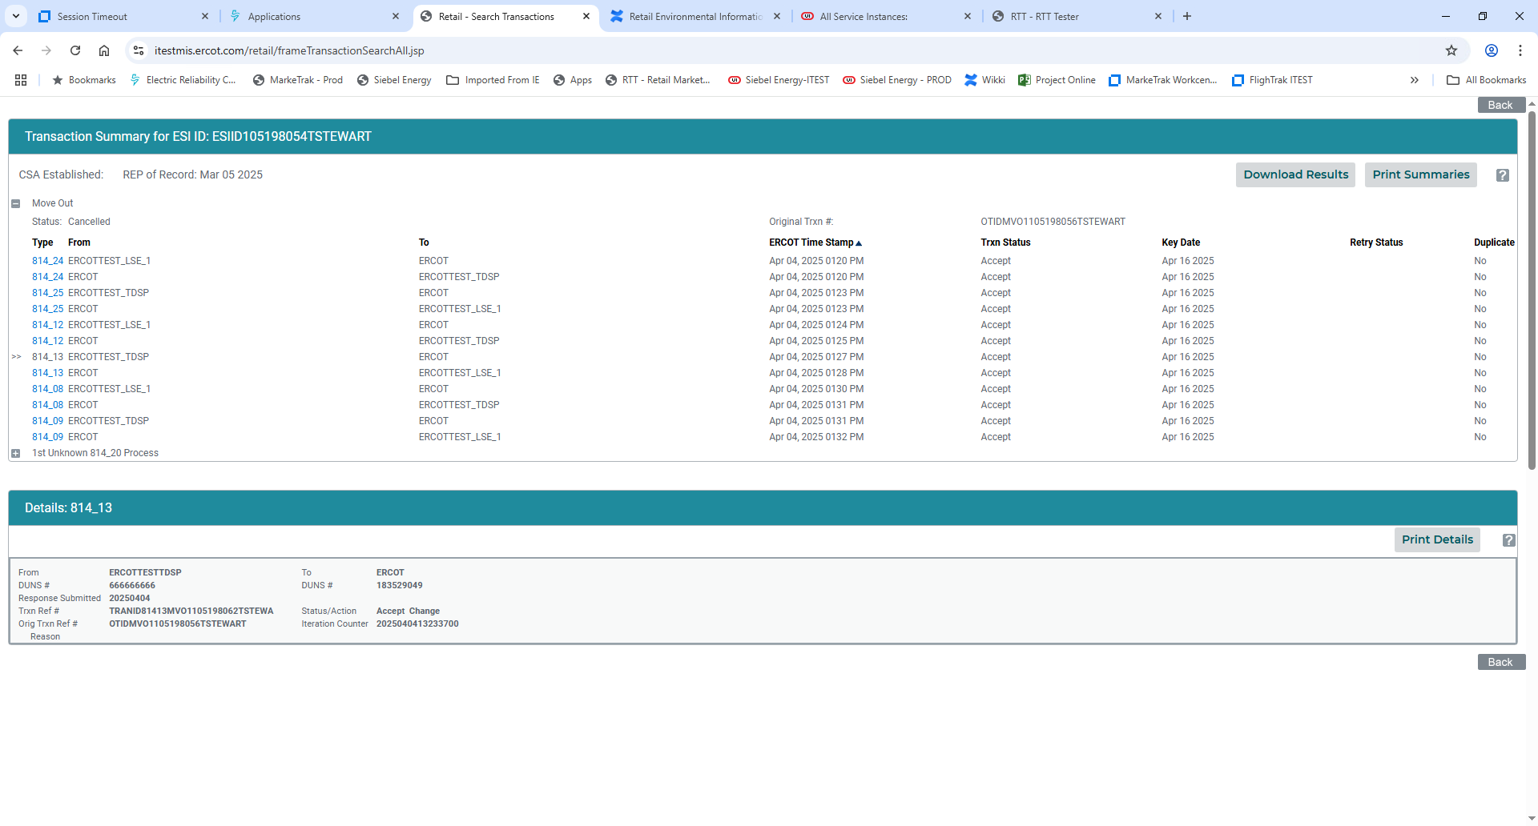
Find Transactions – MVO w/ Date Change & Cancel
Customer requests to change the MVO date from 4/9 to 4/16 on 4/4. Both ERCOT & TDSP accept the change.

Slide 109
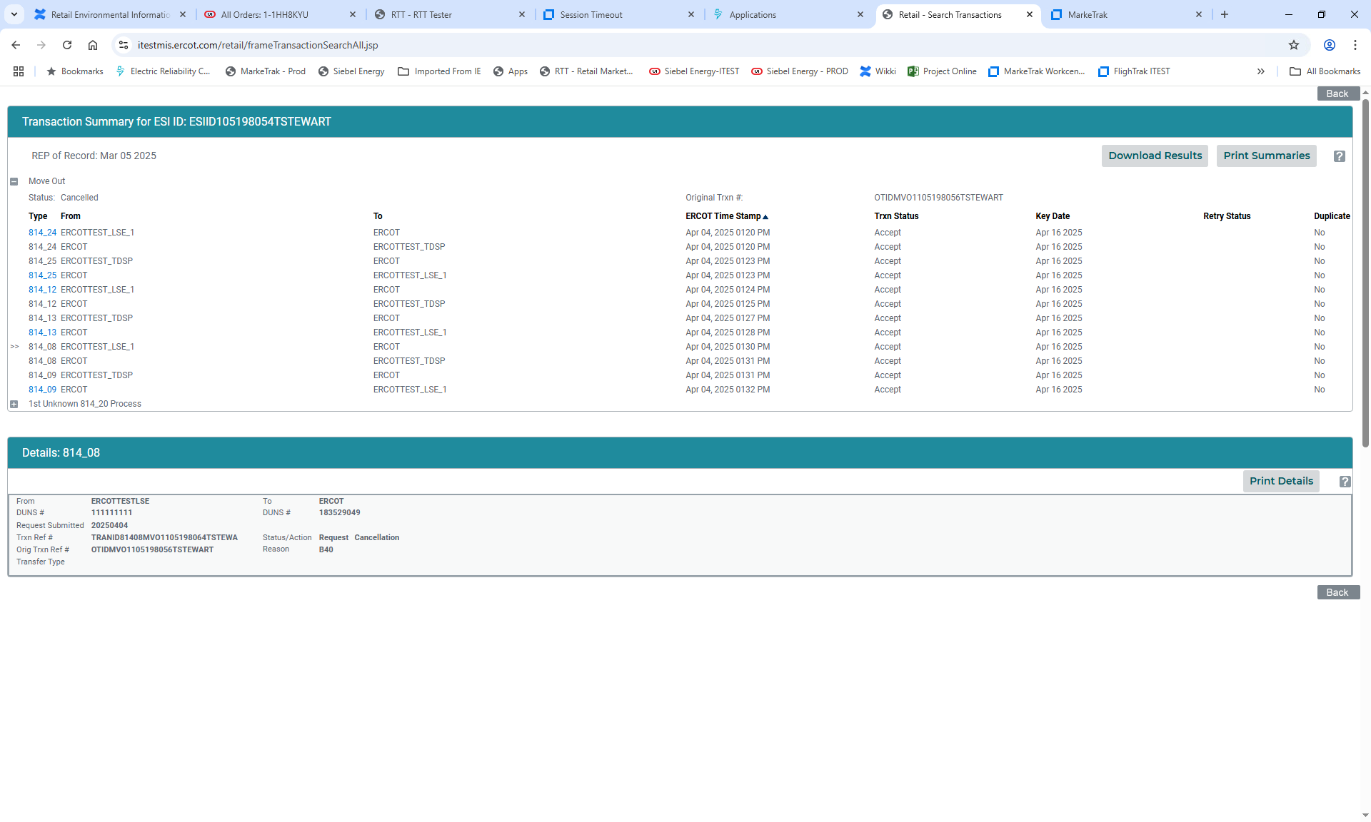
Find Transactions – MVO w/ Date Change & Cancel
Customer now requests to cancel the MVO scheduled for 4/16 on 4/4. Both ERCOT & TDSP accept the cancellation.

Slide 110
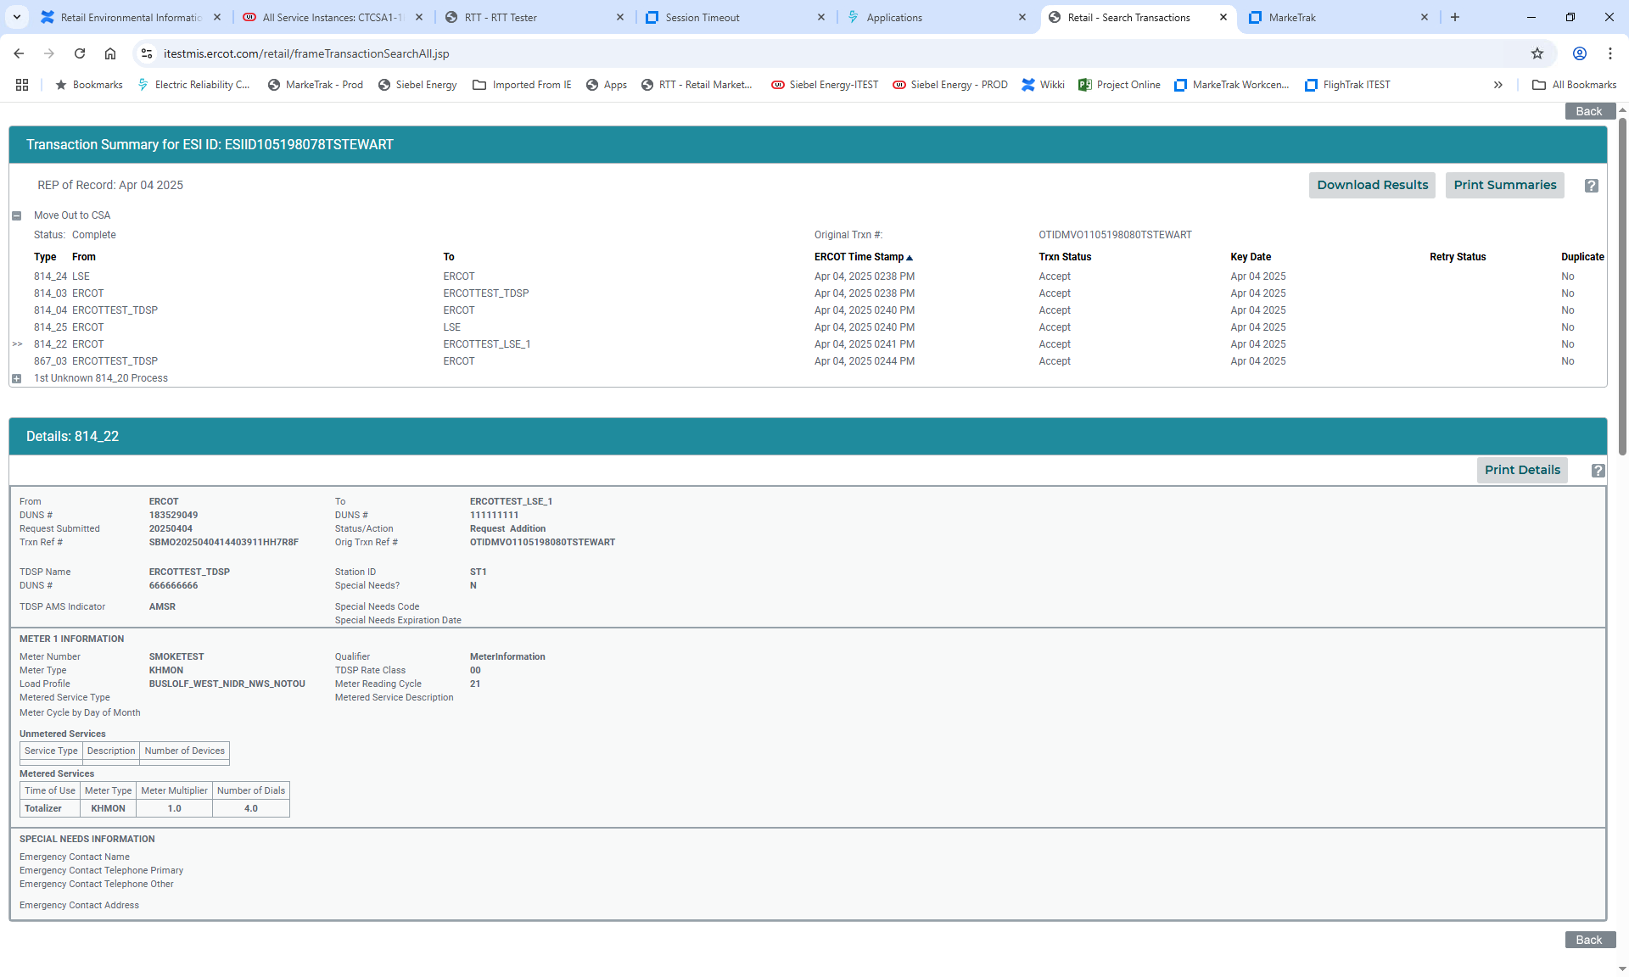
Find Transactions – MVO to CSA
Customer at premise issues a MVO, if there will be a CSA on the requested date of the MVO, ERCOT will treat the MVO as a MVO to CSA. Notification is sent to CSA holder (814_22).
Premise information is provided in the 814_04 and 814_22 including load profile, meter cycle, TDSP Rate Class, and meter information.

Slide 111
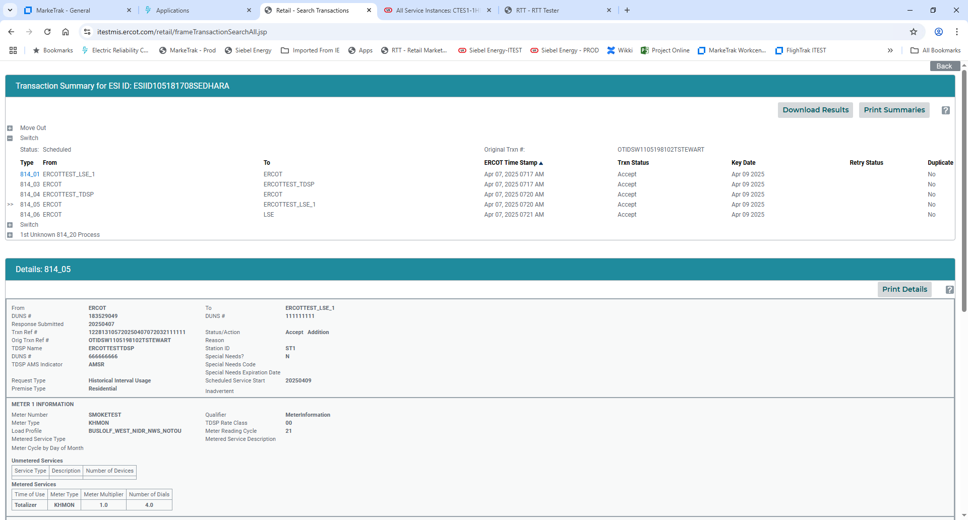
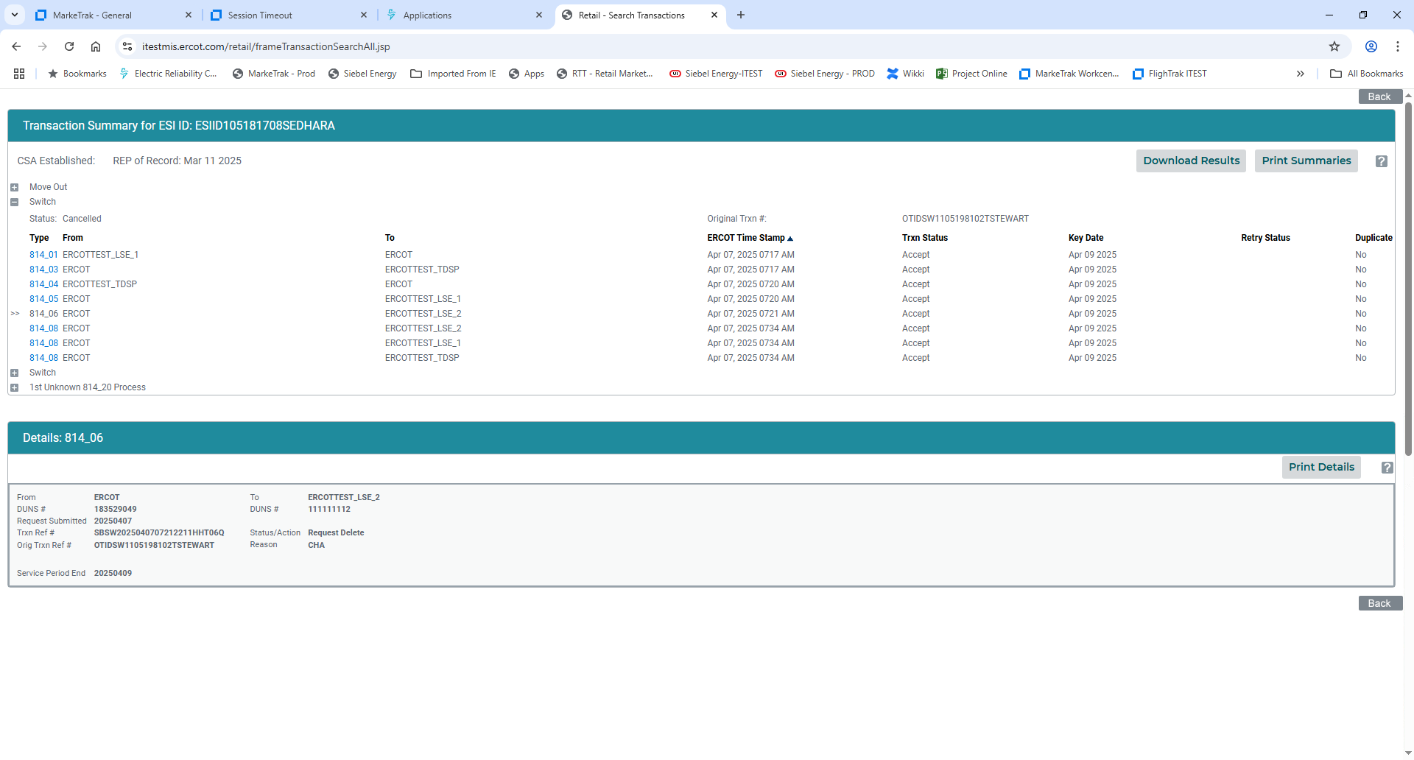
Find Transactions – MVO trumps SWI
Customer issues a SWI on 4/7 for 4/9.
ERCOT will send a loss notification to the Losing REP - an 814_06 with a
CHA indicating ‘customer changed to another CR’

Slide 112
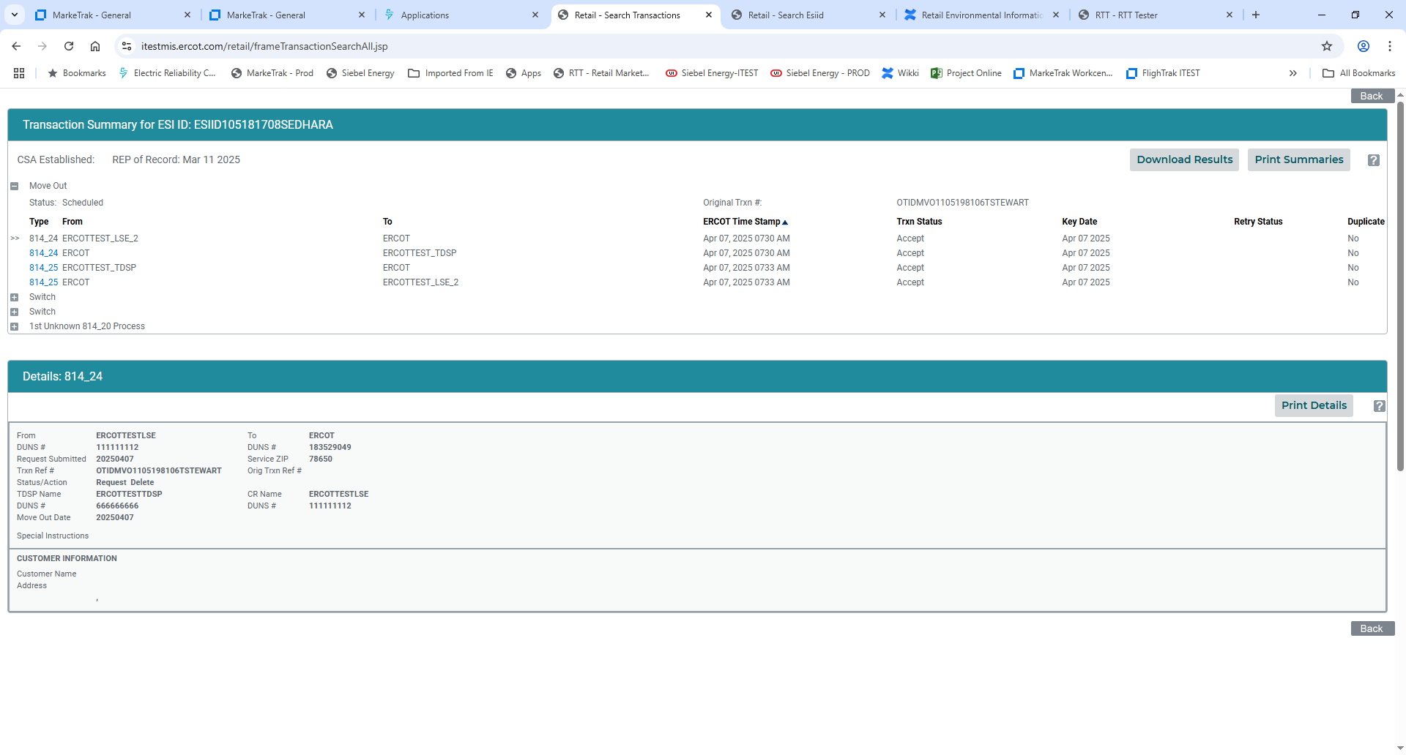
Find Transactions – MVO trumps SWI
Existing REP issues MVO for customer – customer possibly indicated they wanted to “cancel their service” with their current REP.
ERCOT will review any pending transactions two retail business days prior to the effectuating date.

Slide 113
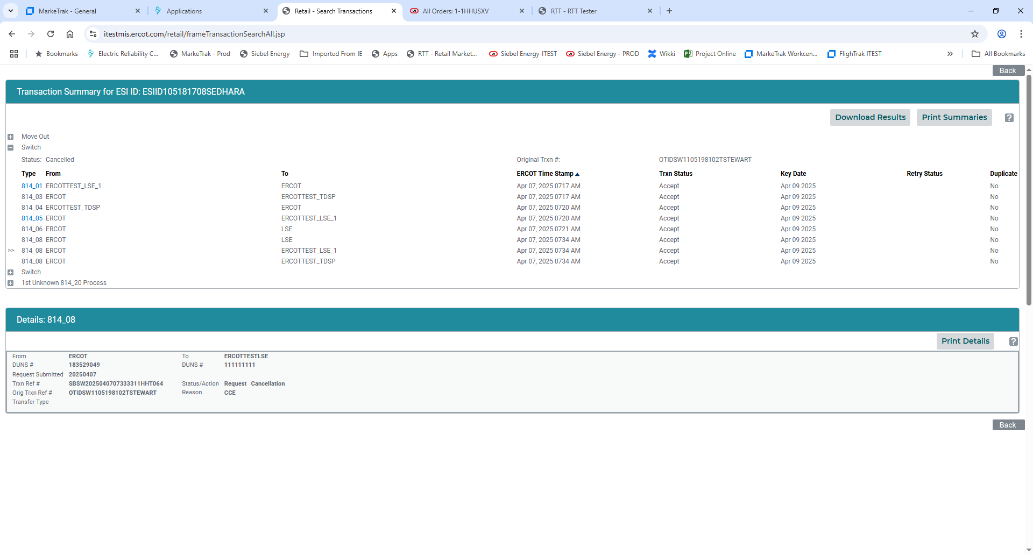
Find Transactions – MVO trumps SWI
With the submittal of the 814_24 MVO, ERCOT proceeds to cancel the 814_01 SWI with an 814_08
814_08 is coded CCE –Cancelled due to Move Out
The REP will now have to submit an 814_16 MVI to energize the premise.

Slide 114
TX SET Implementation Guides

Slide 115
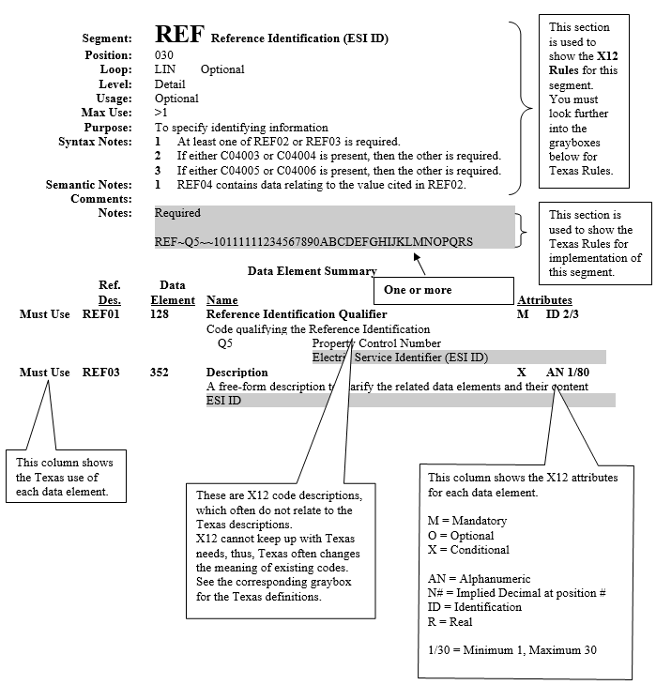
TX SET Implementation Guides w/ Examples
814_20 EDI transaction guide

Slide 116
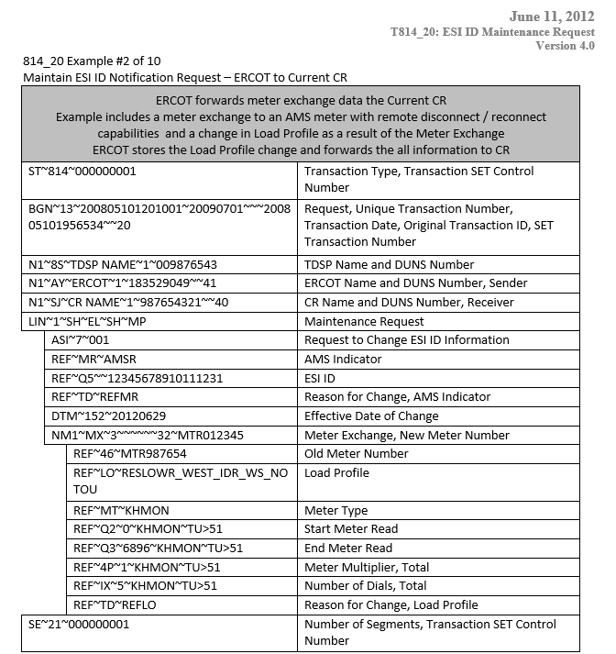
TX SET Implementation Guides w/ Examples
814_20 EDI transaction example – meter exchange

Slide 117
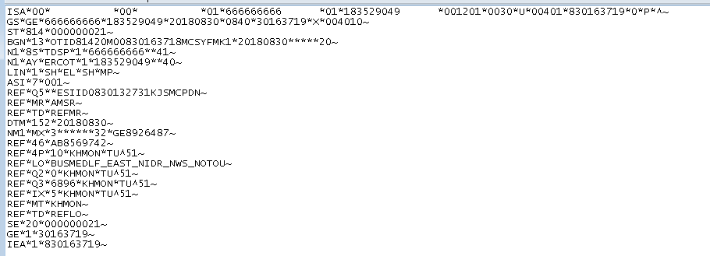
Electronic Data Interface (EDI) Transactions
EDI code is translated by each Market Participant’s system into a readable format.
One does not have to know the code to understand the transaction

Slide 118
TX SET Training
Group Exercise

Slide 119
Group Exercise – Part 1
Provide each transaction number.
Who the transaction is from and who it is going to.
Who is the REP of Record for the scenario listed below?
Customer is moving and calls COWBOYS ENERGY to start service at a new address and OILERS ENERGY is the current REP of Record at that premise …
*Hint – some lines can have up to 4 dots

Slide 120
Group Exercise – Part 1: TX SET Process Flows
From
To
Trans #
OILERS ENERGY
COWBOYS ENERGY
OILERS ENERGY
COWBOYS ENERGY
Transaction Type
ERCOT
TDSP
ERCOT
TDSP
Move In
814_16
Enrollment
Notification Request
814_03
Enrollment
Notification Response
814_04
CR Enrollment
Notification Response
814_05
Historical Usage
(If requested by REP)
2
1
1
2
867_02
Loss Notification
814_06

Slide 121
Continuing from Scenario 1
Group Exercise – Part 2:
Provide each transaction number.
Who the transaction is from and who it is going to.
Who is the REP of Record for the scenario listed below?
Customer calls COWBOYS ENERGY to cancel the Move in the day before the scheduled date…
*Hint – some lines can have up to 4 dots

Slide 122
Group Exercise – Part 2: TX SET Process Flow
Continuing from Scenario 1:
Customer calls COWBOYS ENERGY to cancel the move in the day before the scheduled date…
From
To
Trans #
OILERS ENERGY
COWBOYS ENERGY
OILERS ENERGY
COWBOYS ENERGY
Transaction Type
ERCOT
TDSP
ERCOT
TDSP
Cancel Request – on day before MVI schedule
2
1
1
2
814_08
Cancel Response - Accept
2
1
1
2
814_09
Cancel Request – Response to Cancel Accept
814_08

Slide 123
Group Exercise – Part 3: TX SET Bonus Questions
If the Cancel is Rejected in Exercise – Part 2, who is the REP of Record?
COWBOYS ENERGY
If the Cancel is Rejected in Exercise – Part 2, what PROCESS should be initiated?
Inadvertent Gain

Slide 124
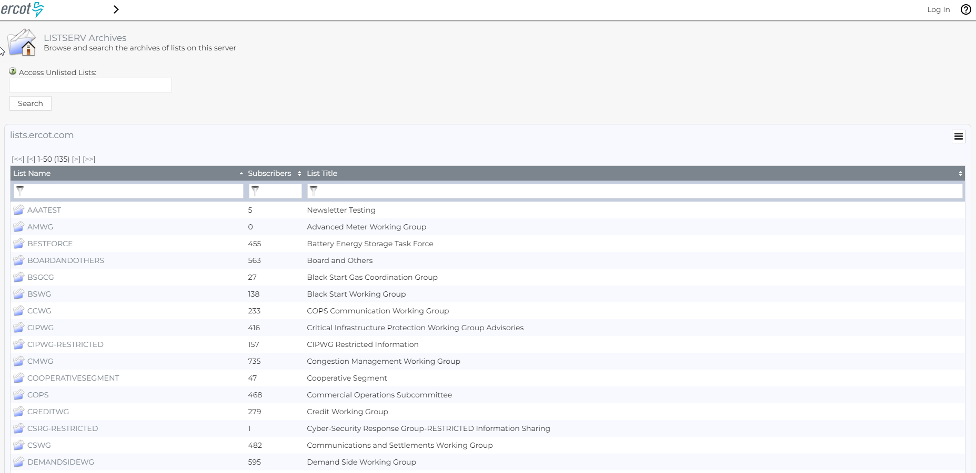
Listserv
http://lists.ercot.com

Slide 125
Additional resources
ERCOT Client Services
Clientservices@ercot.com
ERCOT Mailing Lists
http://lists.ercot.com/
ERCOT Nodal Market Protocols
http://www.ercot.com/mktrules/nprotocols/
ERCOT Training
http://www.ercot.com/services/training/
Market Education Contact
Training@ercot.com

Slide 126
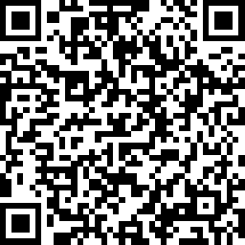
Survey
Scan this QR code to take the course survey!
https://www.surveymonkey.com/r/ERCOTILT

Slide 127
Appendix

Slide 128
Texas SET Swimlanes
Texas SET Swimlanes Scenarios
Description | File Name and Web Link to Documentation
TX SET flow documentation for consolidated billing, remittance and dual billing | Billing Scenarios Version November 2024
TX SET flow documentation for beginning and ending continuous service agreements (CSAs) | Continuous Service Agreement Scenarios November 2024
TX SET flow documentation for handling Move In changes and problems | Customer Move In Scenarios November 2024
TX SET flow documentation for handling Move Out changes and problems | Customer Move Out Scenarios November 2024
TX SET flow documentation for handling customer switch request | Customer Switch Scenarios November 2024

Slide 129
Texas SET Swimlanes
Texas SET Swimlanes Scenarios
Description | File Name and Web Link to Documentation
TX SET flow documentation for Disconnect and Reconnect for Non-Pay | Disconnect Reconnect Non Pay Scenarios November 2024
TX SET flow documentation for customer dropped by Competitive Retailer (CR), disconnect for non-pay services request and Mass Transition from defaulting CR to Provider of Last Resort (POLR) | Mass Transition / Acquisition Scenarios November 2024
TX SET flow documentation for handling Switch Hold add and removal | Switch Hold Scenarios November 2024
TX SET flow documentation of how to report unplanned outages | Unplanned Outages Scenarios November 2024

Slide 130
Texas SET Swimlanes – New with TX SET v5.0
Texas SET Swimlanes Scenarios
Description | File Name and Web Link to Documentation
TX SET flow documentation for Inadvertent Gain, Inadvertent Loss and Customer Recession. | Inadvertent Gain, Inadvertent Loss, Customer Recission Scenarios

Slide 131
TX SET Implementation Guides (IG)
The Texas Standard Electronic Transaction (SET) Implementation Guides provide details of information contained within the electronic transactions used in the competitive retail electric market in Texas.
The current Version 5.0 of the Texas SET Implementation Guides contains updates to retail transactions to support the following:
  NPRR 1095 – Texas SET V5.0 Changes
  RMGRR 169 – Related to NPRR1095, Texas SET V5.0 Changes
  Outstanding Change Controls identified and approved by the Texas Set Working Group
  SCR 823 – ERCOT’s Mass System “County Name” File Updates for Texas SET v5.0 Implementation
  NPRR 1168 – Related to RMGRR172, Texas SET V5.0 Continuous Service Agreements Changes
  RMGRR 172 – Texas SET V5.0 Continuous Service Agreements Changes
  RMGRR 179 – TDSP Temporary Emergency Electric Energy Facility (TEEEF) Deployment Transactional Processing
It was implemented on November 11, 2024.
https://www.ercot.com/mktrules/guides/txset/version

Slide 132
Texas SET Implementation Guides
Service Orders, Invoice and Remittance Transactions
Transaction and Version | Web Link to Documentation
Texas SET V5.0 650 Service Orders Point to Point | Guides Examples
Texas SET V5.0 810 TDSP’s Invoice Point to Point | Guides Examples SAC04 Files
Texas SET 5.0 820 Remittance Advice Point to Point | Guides Examples

Slide 133
Texas SET Implementation Guides
Enrollments, Rejects and Usage Transactions
Transaction and Version | Web Link to Documentation
Texas SET V5.0 814 Enrollments, MVI, MVO, Create/Maintenance/Retire, Maintain Customer Information | Guides Examples
Texas SET V5.0 824 Invoice or Usage Reject Notification | Guides Examples
Texas SET V5.0 867 Monthly and Final Usage, Historical Usage | Guides Examples

Slide 134
Texas SET Implementation Guides
Functional Acknowledgement and CR Option 1 Outage Transactions
Transaction and Version | Web Link to Documentation
Texas SET V5.0 997 Functional Acknowledgement | Guides
Texas SET V5.0 T-Series CR Option 1 Outage Transactions | Guides

Slide 135
Registration and Qualification/Certification
Registration
  The LSE Application for Registration can be found in Section 23 of the Protocols.
  Qualification/Certification
  CRs must be certified by ERCOT. Please read more about Retail Market Test Flight Information
  CRs operating as REPs must also be certified by the Public Utility Commission of Texas (PUCT). Please refer to the Retail Electric Providers Certification and Reporting section of the PUCT website for more information.
  Contact ERCOT Client Services for a full list of requirements

Slide 136
Retail Market Testing
Key Documents
Description | File Name & Web Link to Documentation
The ERCOT Retail Testing Website is used by Market Participants to become certified in conducting retail market processes within the ERCOT market. | Texas Retail Testing
Retail Market Test Scripts and Workbook | Flight Test Scripts Workbook and Testing Requirements Matrix - TX SET 5.0
FlighTrak Users Guide | FlighTrak Users Guide v1.1
Retail Test Environment Users Guide | Retail Market Test Environment User Guide

Slide 137
Retail Market Testing
Key Documents
Description | File Name & Web Link to Documentation
FlighTrak Administrator Form | FlighTrak Administrator Form
Retail Market Testing Frequently Asked Questions | Retail Market Testing Frequently Asked Questions
Testing to Production Checklist | Testing to Production Checklist

