Slide 1
ERCOT Frequency Events
July 2025
ERCOT
Operations Planning
PDCWG | September 24, 2025

Slide 2
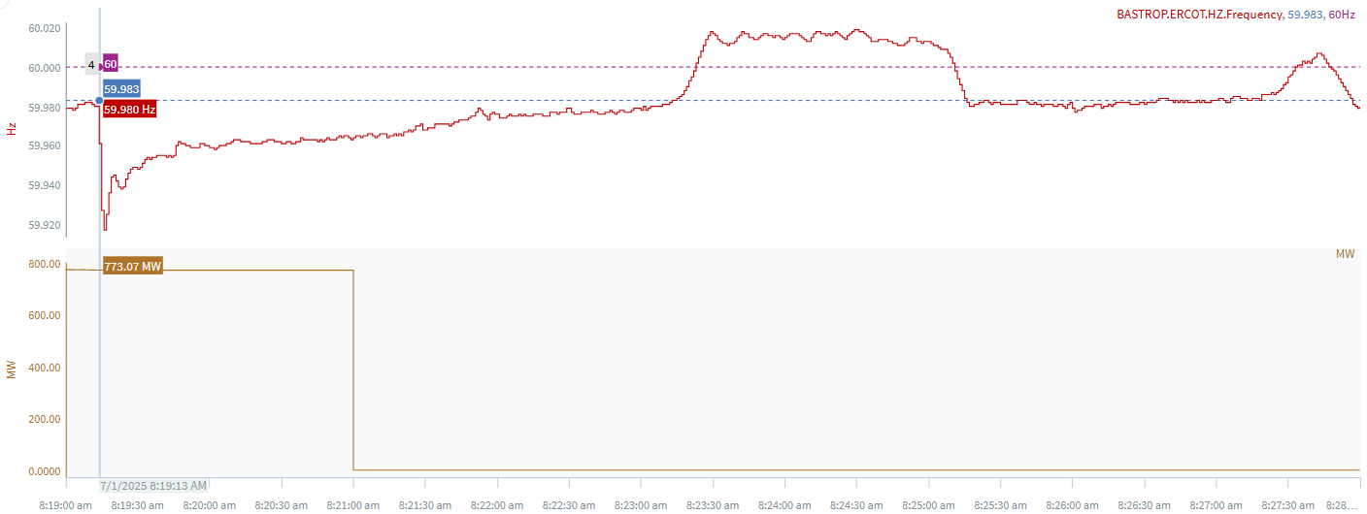
7/1/2025 8:19:13 (Non-FME)
Notes:
The unit tripped offline for~772 MW
Starting Frequency: 59.980 Hz
Minimum Frequency: 59.917 Hz
A-C Time : 3 seconds
Recovery Time(back to deadband): 4 minutes 00 seconds
ECRS Released: 0 MW
Trip Reason: Unknown at this time
Reason for no selection: The event is below the deadband
Contextual Information: A total of 289 MW of regulation Up

Slide 3
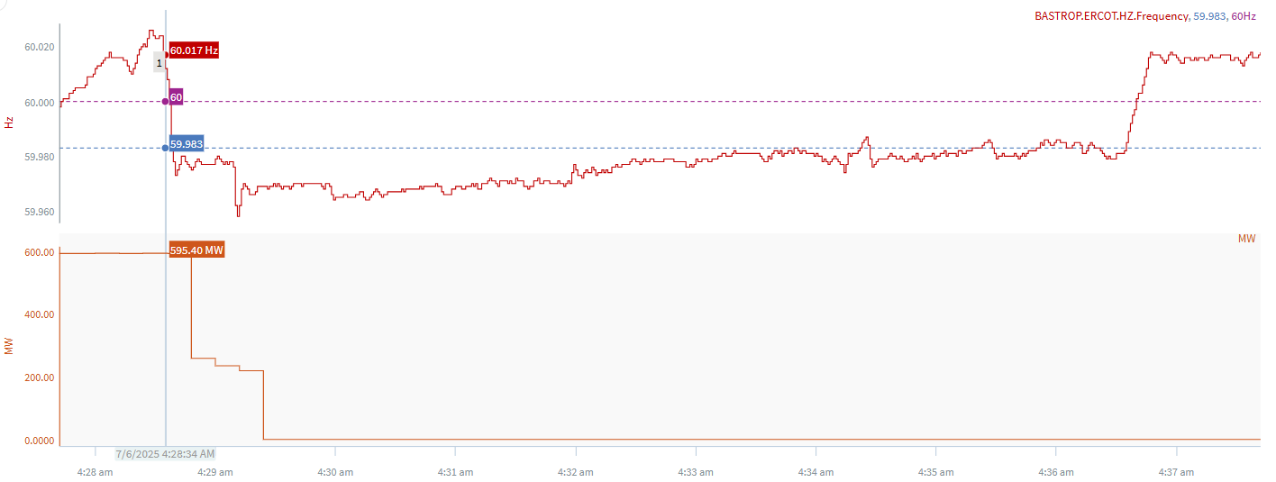
7/6/2025 4:28:34 (Non-FME)
Notes:
The combine cycle tripped in steps for a combine loss of approximately ~595 MW
Starting Frequency: 60.017 Hz
Minimum Frequency: 59.973 Hz
A-C Time : 6 seconds
Recovery Time(back to deadband): 8 minutes 01 seconds
ECRS Released: 0 MW
Trip Reason: Unknown at this time
Reason for no selection: The C point is 59.973
Contextual Information: A total of 244 MW of regulation Up and a manual offset of 300 MW was deployed during the event.

Slide 4
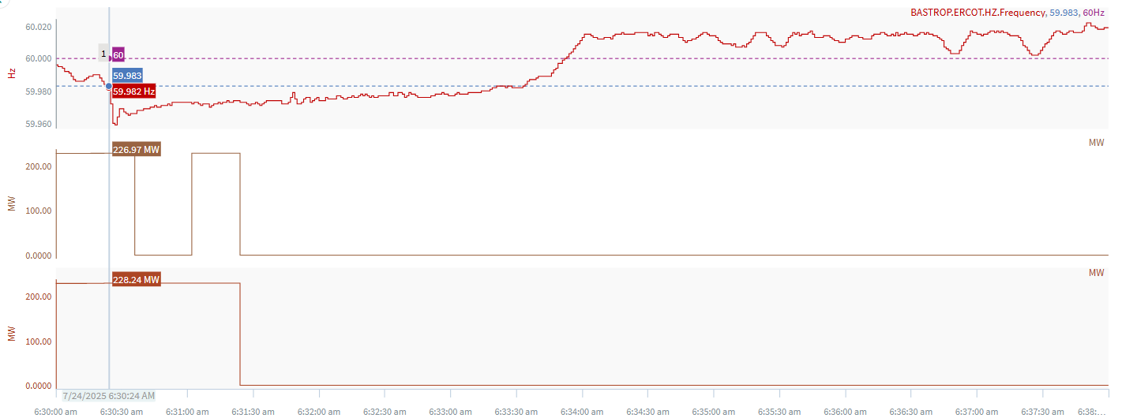
7/24/2025 6:30:24 (Non-FME)
Notes:
The units tripped offline while carrying ~ 455 MW
Starting Frequency: 59.982 Hz
Minimum Frequency: 59.959 Hz
A-C Time : 3 seconds
Recovery Time(back to deadband): 3 minutes 09 seconds
ECRS Released: 0 MW
Trip Reason: A lightning arrestor
Reason for no selection: C point is 59.959
Contextual Information: A total of 358 MW of regulation Up was deployed during the event.

Slide 5
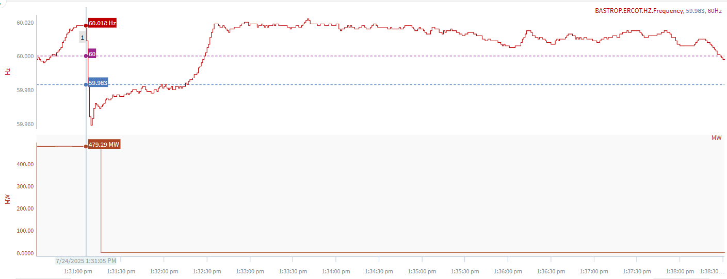
7/24/2025 13:31:05 (Non-FME)
Notes:
A unit tripped for loss of ~479 MW
Starting Frequency: 60.018 Hz
Minimum Frequency: 59.959 Hz
A-C Time : 4 seconds
Recovery Time(back to deadband): 1 minutes 10 seconds
ECRS Released: 0 MW
Trip Reason: A turbine tripped due to low vacuum
Reason for no selection: C point is 59.959
Contextual Information: A total of 358 MW of regulation Up was deployed during the event.

Slide 6
Questions?
Thank you!

