Slide 1
ERCOT Frequency Events
August 2025
ERCOT
Operations Planning
PDCWG | September 24, 2025

Slide 2
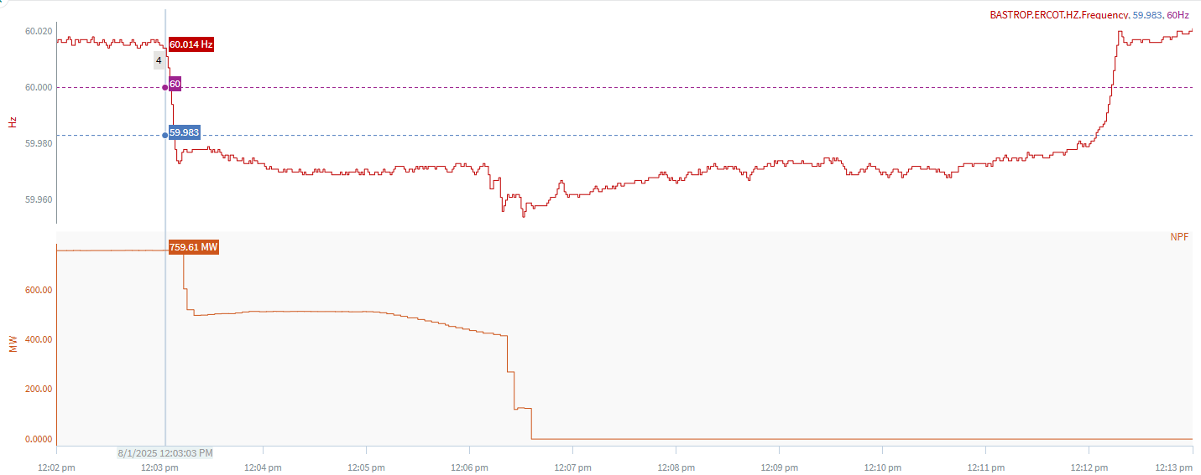
8/1/2025 12:03:03(Non-FME)
Notes:
The combine cycle tripped in steps for a combine loss of approximately ~759 MW
Starting Frequency: 60.014 Hz
Minimum Frequency: 59.973 Hz
A-C Time : 8 seconds
Recovery Time(back to deadband): 9 minutes 01 seconds
ECRS Released: 0 MW
Trip Reason: Faulted hp transmitter
Reason for no selection: C point is 59.973
Contextual Information: A total of 466 MW of regulation Up and a manual offset of 400 MW was deployed during the event.

Slide 3
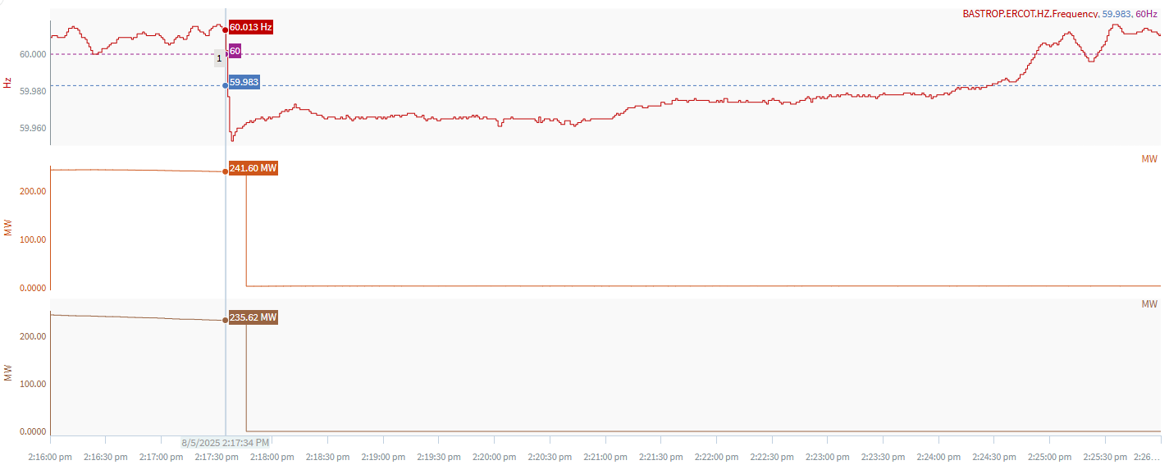
8/5/2025 14:17:34 (Non-FME)
Notes:
The units tripped offline while carrying ~ 471 MW
Starting Frequency: 60.013 Hz
Minimum Frequency: 59.953 Hz
A-C Time : 4 seconds
Recovery Time(back to deadband): 6 minutes 53 seconds
ECRS Released: 0 MW
Trip Reason: Unreported firmware update test
Reason for no selection: C point is 59.953
Contextual Information: A total of 489 MW of regulation Up was deployed during the event.

Slide 4
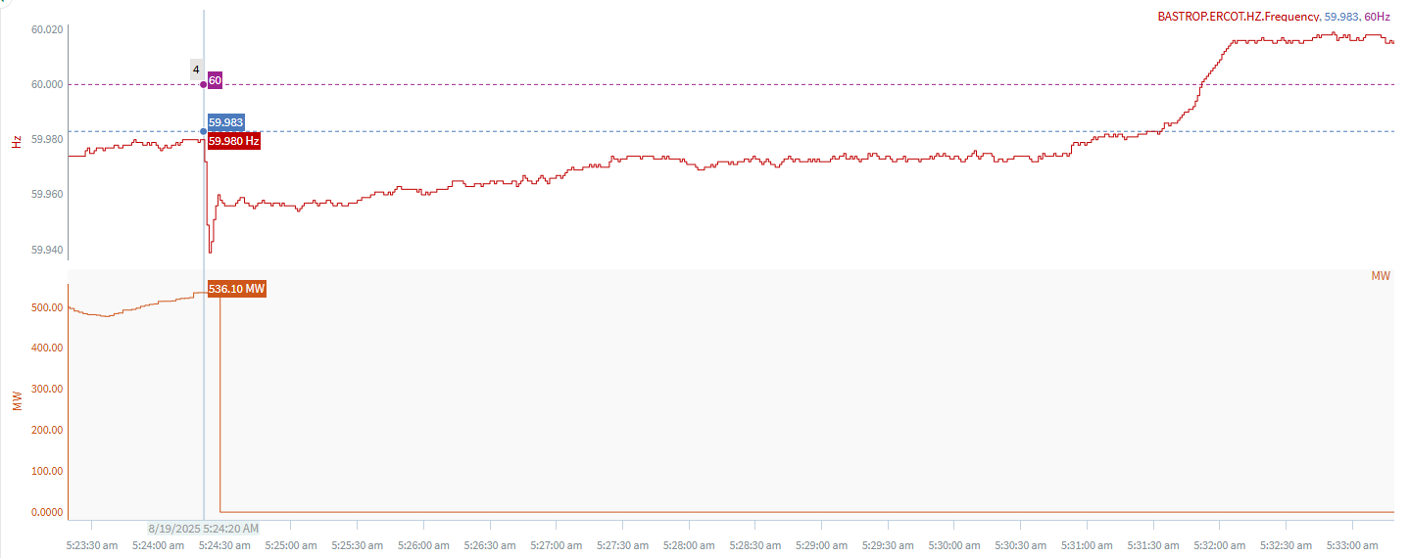
8/19/2025 5:24:20 (Non-FME)
Notes:
A unit tripped offline for ~539 MW and experienced a runback
Starting Frequency: 59.980 Hz
Minimum Frequency: 59.939 Hz
A-C Time : 3 seconds
Recovery Time(back to deadband): 7 minutes 11 seconds
ECRS Released: 0 MW
Trip Reason: Unknown at this time
Reason for no selection: The C point is 59.939 and event is below the deadband
Contextual Information: A total of 229 MW of regulation Up and a manual offset of 300 MW was deployed during the event.

Slide 5
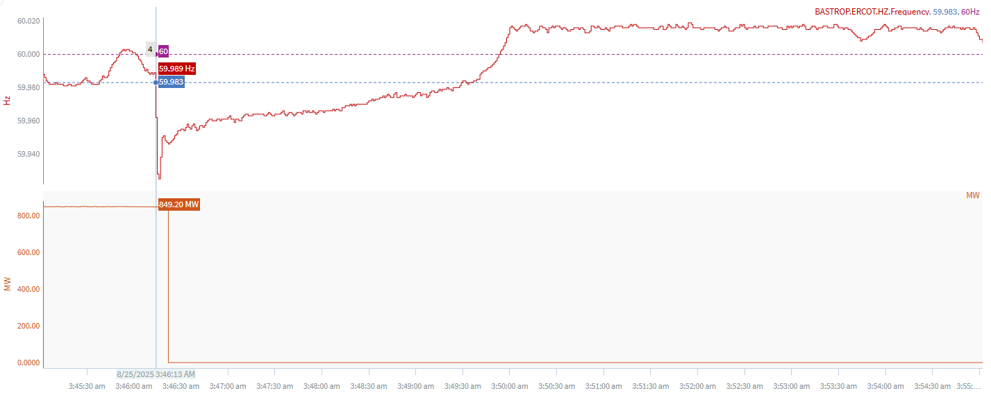
8/25/2025 3:46:13 (FME)
Notes:
Multiple units tripped for loss of ~849 MW
Starting Frequency: 59.989 Hz
Minimum Frequency: 59.925 Hz
A-C Time : 3 seconds
Recovery Time(back to deadband): 3 minutes 16 seconds
ECRS Released: 0 MW
Trip Reason: A main power transformer phase issue
Contextual Information: A total of 194 MW of regulation Up and a manual offset of 400 MW was deployed during the event.

Slide 6
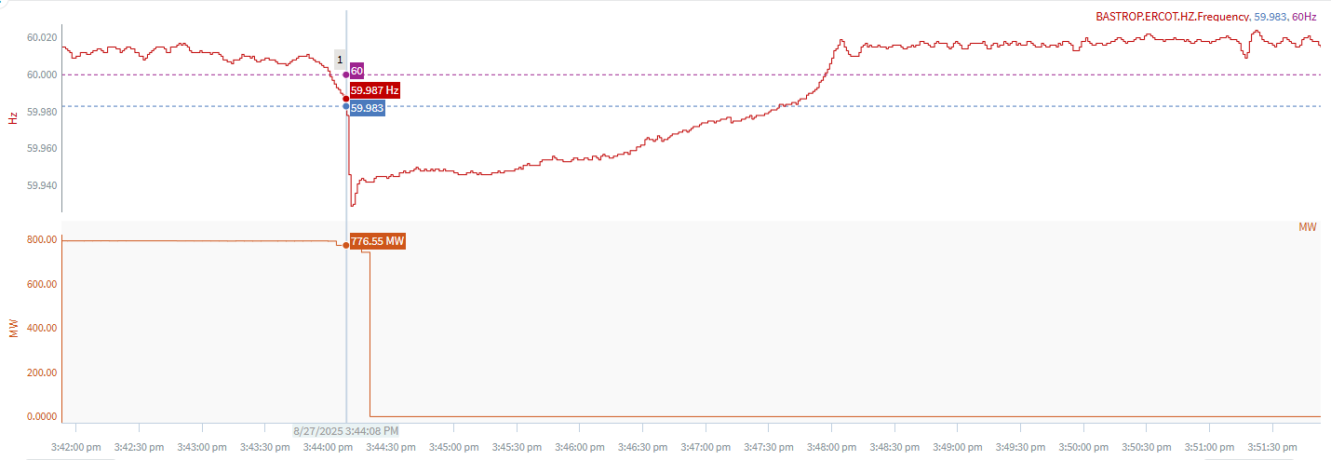
8/27/2025 15:44:08 (Non-FME)
Notes:
A unit tripped for a loss of ~745 MW and experienced runback
Starting Frequency: 59.987 Hz
Minimum Frequency: 59.929 Hz
A-C Time : 3 seconds
Recovery Time(back to deadband): 3 minutes 27 seconds
ECRS Released: 0 MW
Trip Reason: Unknown at this time
Reason for no selection: Unit experienced a runback
Contextual Information: A total of 131 MW of regulation Up and a manual offset of 250 MW was deployed during the event.

Slide 7
Questions?
Thank you!

