Slide 1
CRR Updates
CMWG
September 22, 2025

Slide 2
Agenda
LTAS transactions and solution times
CRR auction limits table – no updates
Counts of CRRAHs and CPs
CRR Performance Timeline

Slide 3
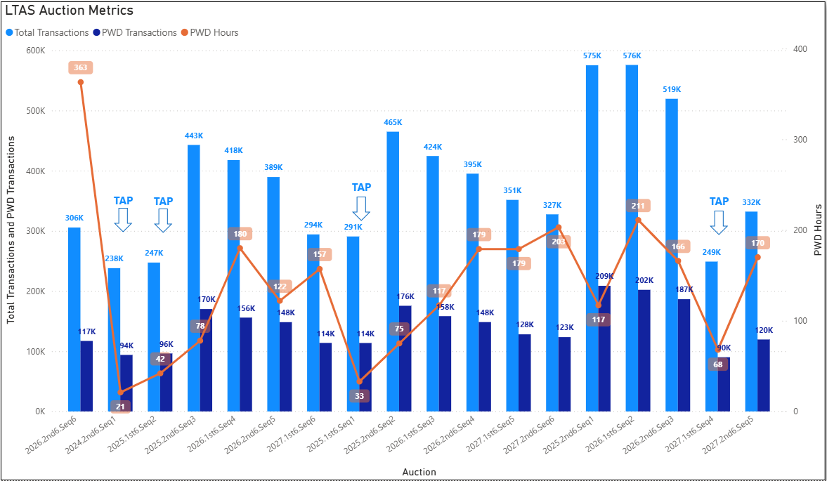
Historical LTAS transactions and solution times

Slide 4
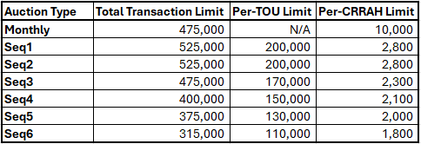
CRR auction transaction limits – no updates
Due to the timing of CMWG meetings, the Seq6 per-CRRAH limit was updated with a market notice on 9/11/2025. The previous Seq6 per-CRRAH limit was 2,000.

Slide 5
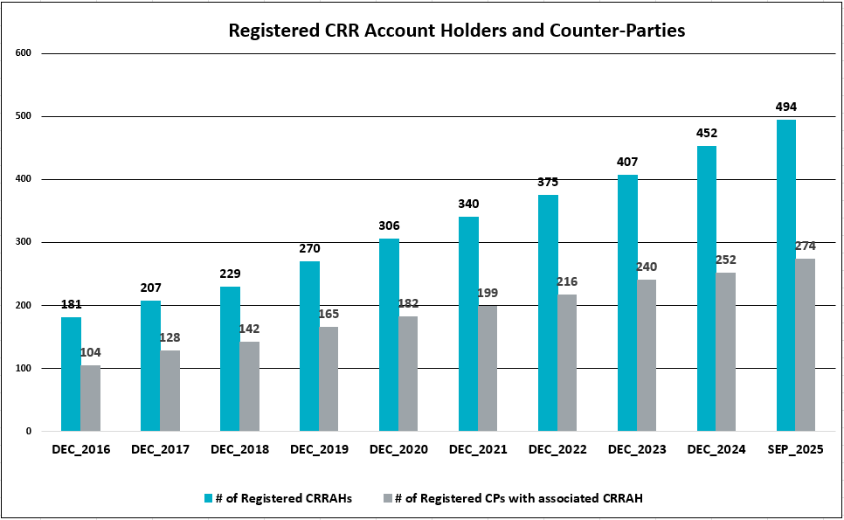
Counts of CRRAHs and CPs

Slide 6
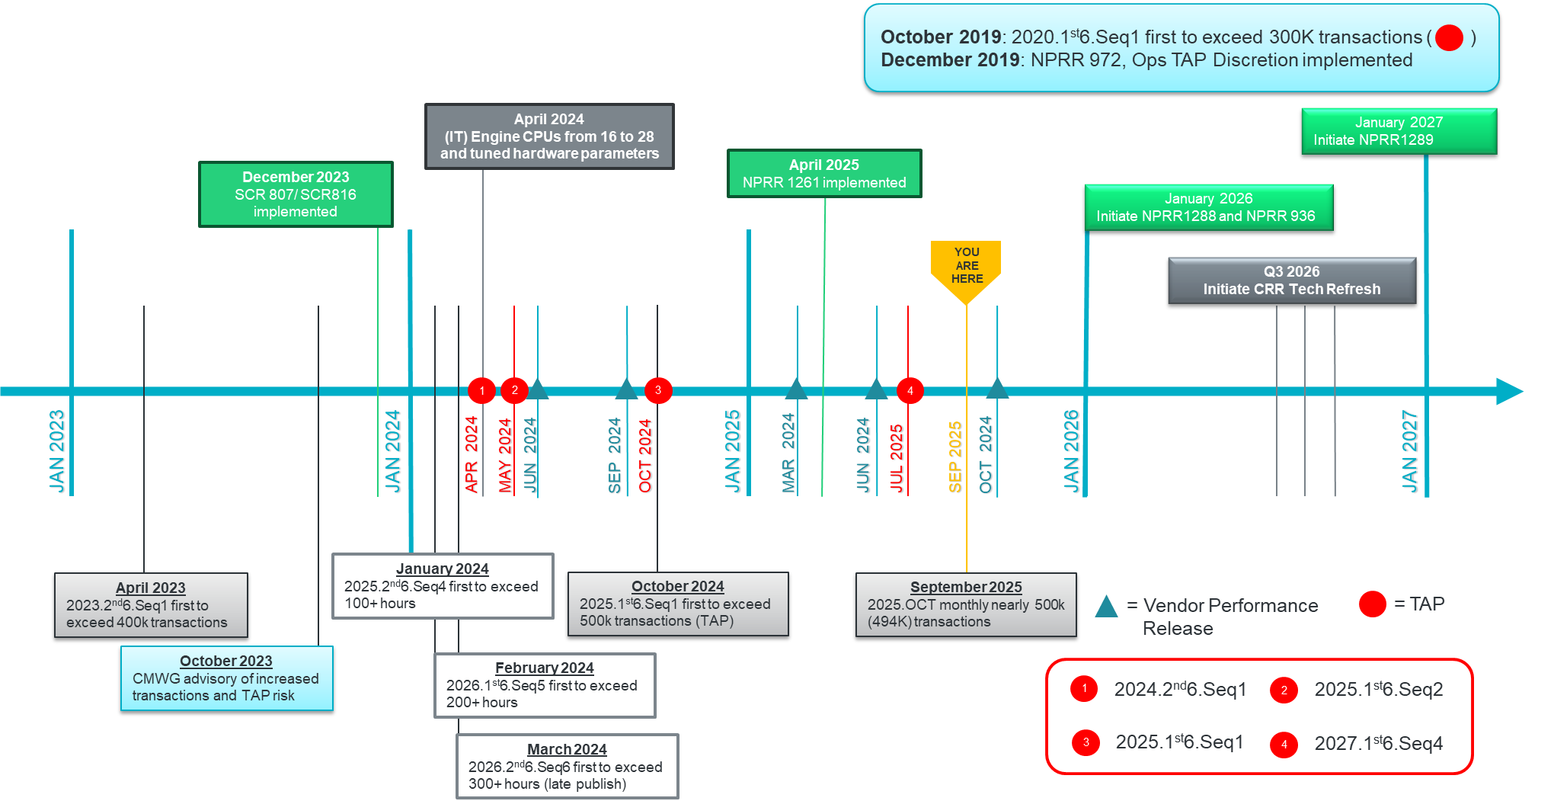
CRR Performance Timeline

