Slide 1

Urgent Business Case
Developers and investors in Texas need more options to energize sites in Texas that will carry large loads for economic growth activities.
ERCOT needs capital to flow to the grid, fund transmission backbone infrastructure, and build power solutions visible to the grid.
Utilities should know which load interconnection requests - and load commissioning plans- come with intention for nodal resource dispatchability. Today, utility studies cannot credit dispatchability in N-1 or N-1-1 solution cases: a path to credible studies is a path for utilities to be business partners and empowered reliability partners in ERCOT.
The market needs to figure out what to build with AI loads, and why – and how to price what gets built. If there is no interconnection study incentive to build for nodal dispatchability in exchange for earlier energization, ERCOT willl not get the nodal dispatchable resources it needs to solve critical load management issues.
For the grid to work for everyone in Texas ERCOT, more loads need to be in SCED: large load developers, site acquisition and tenant customers, cloud providers, generators, batteries, software, need a credible reason to bring their technology solutions and capital to the table.
For the grid to work for all customers, signals to Loads in SCED for economic management of grid problems are superior to out of market actions.
The proposed Planning Guide Revision Request creates business choices, not regulatory mandates.

Slide 2
CLR Planning Benefits PGRR
Prepared for 9/19 LLWG
September 2025

Slide 3
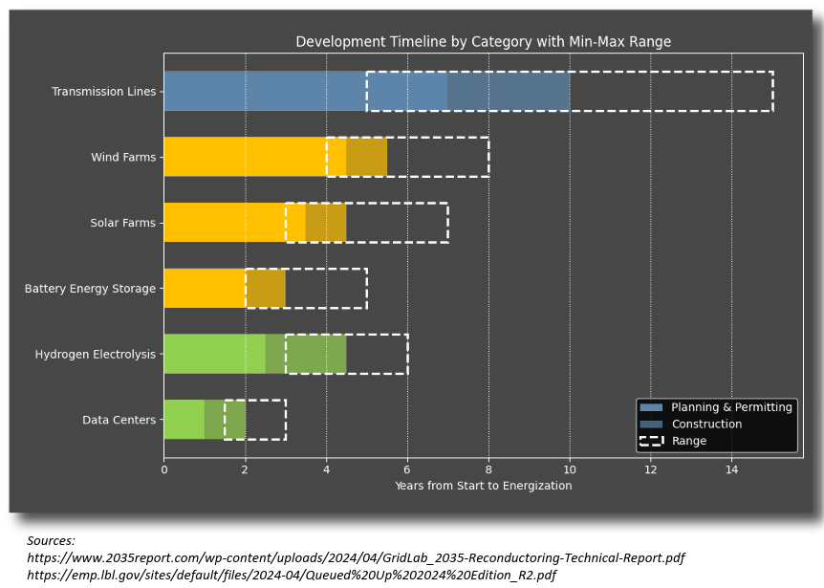
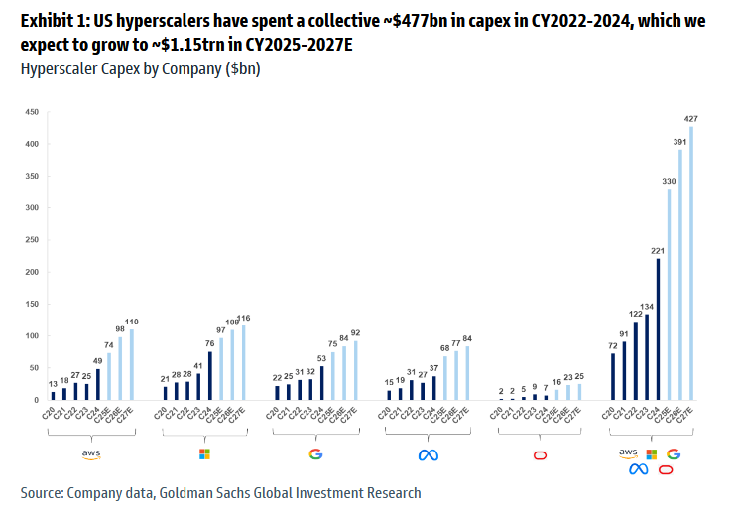
Load Integration Bottleneck: Transmission
Load growth from hyperscale/AI data centers is a $100B+ economic opportunity for the state of Texas…
but capital planning timelines are out-of-phase with the timeline required to plan transmission network upgrades.
Even if developers commit to waiting for transmission network upgrades, hyperscale tenants may go elsewhere in the meantime should a faster opportunity to deploy capital become available.
This presents risks for stranded/inefficient transmission expansion and jeopardizes Texas’ ability to capture this economic opportunity
The solution is to efficiently transfer interim delivery risk to private developers in a manner which ensures capital is committed to load energization today, while also affording the appropriate time to expand the network and deliver firm service to all loads eventually. Controllable Loads unlock this potential.
Time required to build new transmission can be 4-10yrs slower than new load capital planning

Slide 4
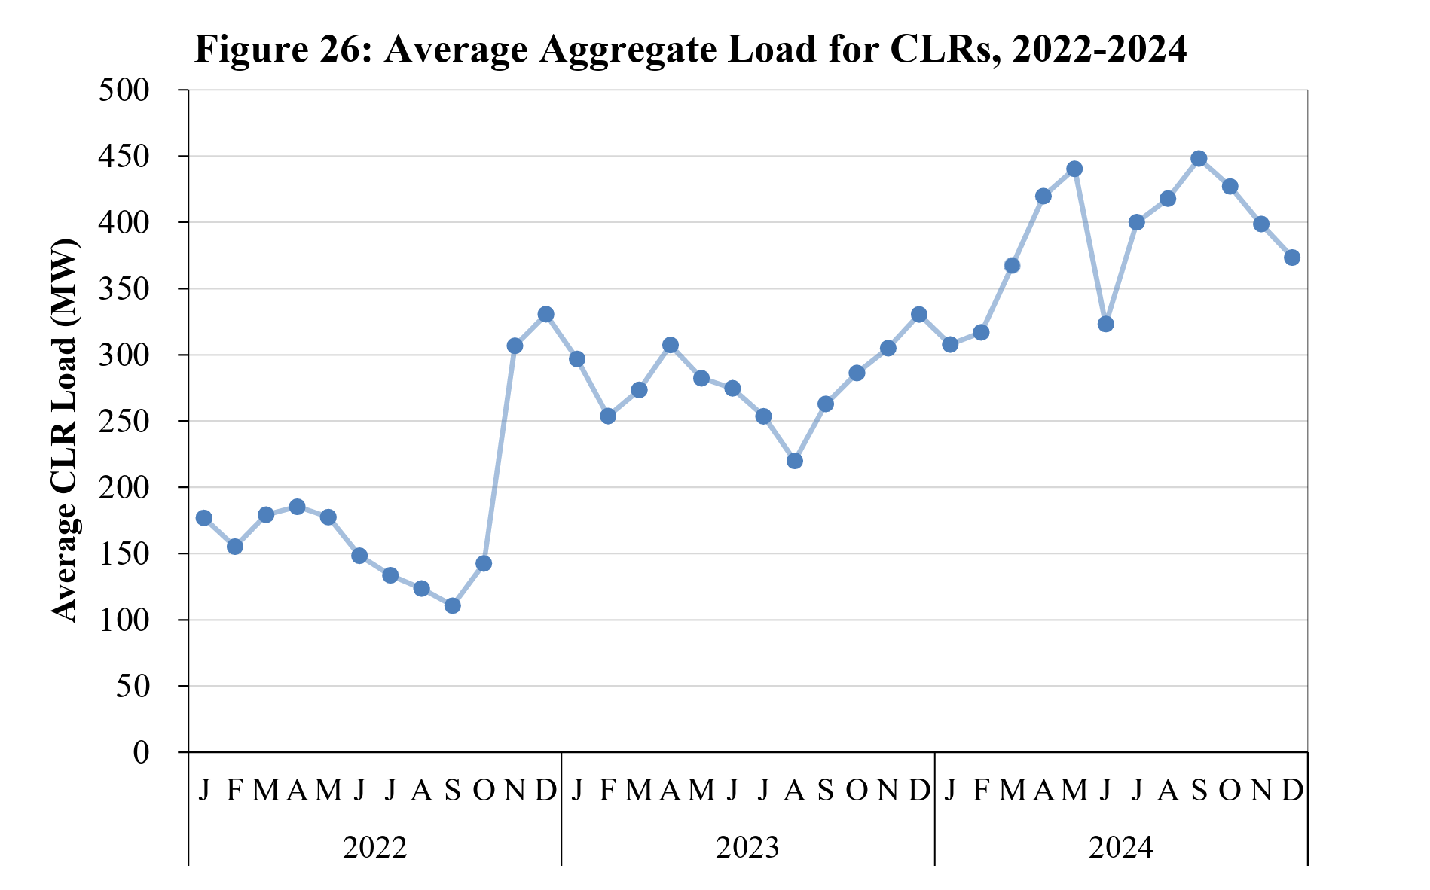
Controllable Load Resources
Controllable Load Resource (CLR)
A Load Resource capable of controllably reducing or increasing consumption under Dispatch control by ERCOT
Usually, dispatchable resources (Generation) benefit in planning studies from the assumption that N-1 transmission constraints will be managed in RT operations via SCED
“Connect and Manage”
This treatment is not given to CLRs today due to zonal dispatch and CLR load ability to telemeter on outage while maintaining consumption
NPRR 1188/OBDRR046: Makes CLRs settled and dispatched at the resource node
A CLR must participate in SCED when consuming energy.
A CLR will be dispatched according to Nodal Shift Factors (same as Generation Resources).
CLR Ancillary Service bids will be co-optimized in the Day Ahead Market.
CLRs will receive Nodal settlement instead of Zonal settlement.
Currently awaiting implementation post Real Time Co-optimization (RTC) estimated Q3 2026
Loads need the option to be planned as a nodal CLR Today
Post-NPRR1188 study of CLRs opens the door for planning treatment similar to generation
Current CLR Load in ERCOT
Potomac ERCOT 2024 State of the Market Report

Slide 5
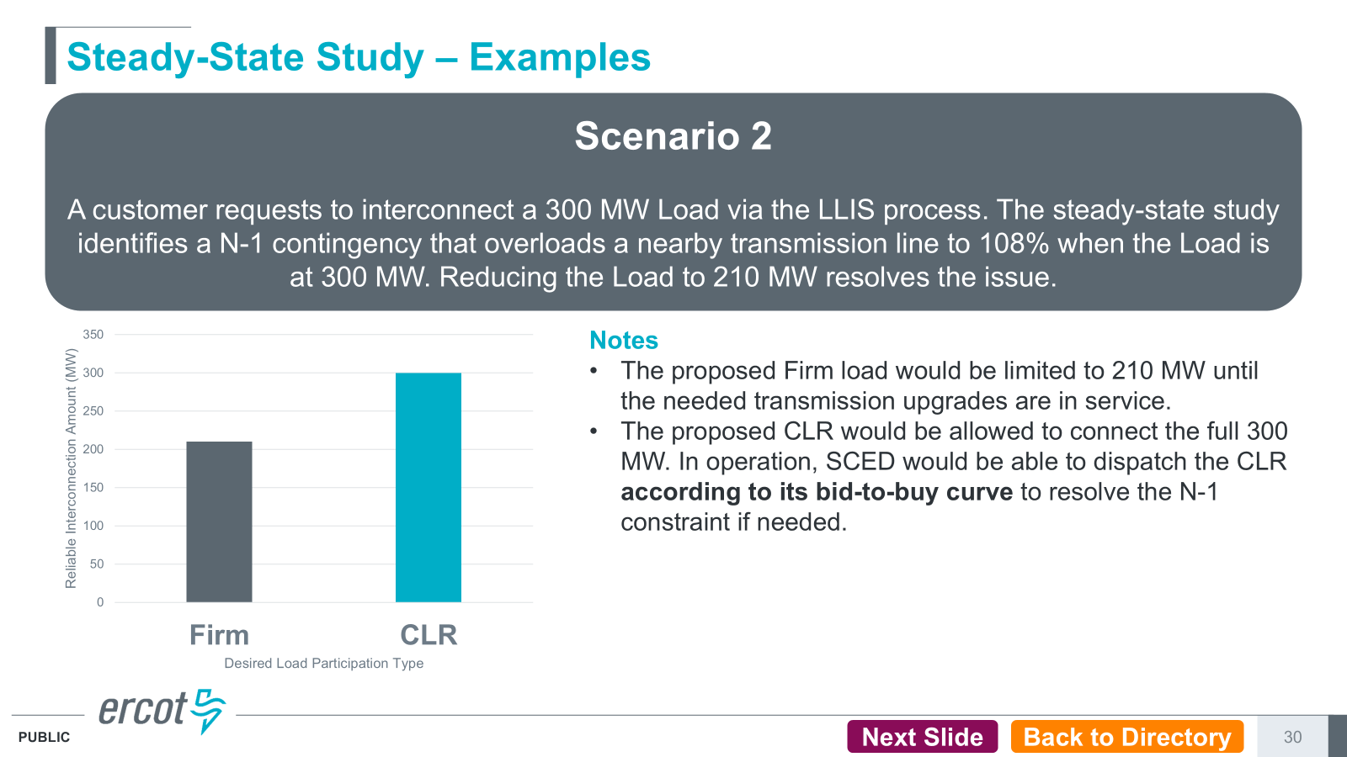
Historical Context
Link: https://www.ercot.com/calendar/08162023-NPRR1191-and-Related-Revision
Concept has been discussed previously by LFLTF
Content to the right is from the August 16th 2023 workshop
Slides also speak to scenarios where CLR status would not resolve constraints
Thermal violations beyond a certain threshold cannot be resolved in SCED due to risk of cascading outages
Voltage violations cannot be resolved with SCED

Slide 6
Historical Context
Maximizing resource participation in SCED is optimal for system operational reliability and load developer optionality
August 16th 2023 Workshop

Slide 7
Example Scenario 1
Scenario
3GW of loads seeking to interconnect for the same COD in the same region
1.5GW of headroom until thermal limit is violated by firm load
All loads want firm service so capacity allocated pro-rata until new upgrades are made

Slide 8
Example Scenario 2
Scenario
3GW of loads seeking to interconnect for the same COD in the same region
1.5GW of headroom until thermal limit is violated by firm load
Firm service allocated pro-rata
Load 3 advances the remaining 500MW of load as a CLR allowing them to energize immediately in exchange for dispatchability when N-1 limit binds
CLR load dispatched down to LPC/LSL to manage n-1 constraints as needed
Key point: CLRs do not take capacity which would otherwise be used to serve firm load, CLRs utilize latent available capacity and will be dispatched to manage system constraints which otherwise make serving firm load infeasible

Slide 9
PGRR Objectives
What this PGRR does:
Provides a path to energize loads ahead of their LCP where N-1 Tx violations limit load adoption and can be resolved via redispatch of CLR down to LSL/LPC
Allows private risk takers to assume delivery risk on an interim basis in exchange for energization ahead of LCP
  All loads still receive firm service eventually
Provides for optional path to compliance with pending SB6 curtailment obligations
Technology Agnostic Approach: Once electing treatment as a CLR, developer/owner determines how they plan to comply with CLR registration requirements
What this PGRR doesn’t do:
Allow CLRs to “take” firm system capacity which would otherwise serve firm load in queue
Not a silver bullet for all load integration challenges
  Ride through, voltage, dynamic/stability issues remain key risks
Does not provide any prespecified parameters regarding the dispatch shape/frequency/duration to managing constraints at the project node
  Very location specific and may change over time as firm load is added
Doesn’t change LLIS process or study treatment of loads for eventual delivery of firm service
  LCP still reflects timeline and queue position for firm service
  Firm service still delivered to all loads over time

Slide 10

SB6 Objectives
Support Business Development
Minimize Stranded Costs
Maintain System Reliability
“The commission by rule shall establish standards for interconnecting large load customers in the ERCOT power region in a manner designed to support business development in this state while minimizing the potential for stranded infrastructure costs and maintaining system reliability.”

Slide 11


Thank You!
Please reach out with your comments, concerns, and questions
Samuel Brandin
(603) 315-2383
Arushi Sharma Frank
(571) 572-9037

