Slide 1
Acquisition of PowerGADS Software to Support Reliability Assessments
Supply Analysis Working Group
Pete Warnken
Resource Adequacy Department
September 19, 2025

Slide 2
Problem Statement
  ERCOT uses data from NERC’s Generating Availability Data System (GADS) to develop forced outage modeling statistics that support probabilistic outage modeling in SERVM (Strategic Energy & Risk Valuation Model); ERCOT’s Outage Scheduler data is not sufficient for this purpose
  ERCOT relies on an annual RFI process to acquire this data directly from Generation Owners since NERC has confidentiality restrictions that prevent ERCOT from accessing its GADS system
  The RFI process is cumbersome and time-consuming; GOs must export and load the GADS data into a custom Excel form and send the form via email; ERCOT staff then compiles the data and addresses nonresponses and reporting errors
  Solution: Replace RFI process with PowerGADS, a commercial web-based, data-reporting application that facilitates GADS data submission and reporting for GOs and ISOs

Slide 3
Problem Statement
  PowerGADS benefits:
    GOs would upload the same data that are used for NERC reporting, thus avoiding the need to prepare and send data customized for ERCOT’s needs
    The software can generates the statistics directly needed for forced outage modeling in SERVM
    NERC requires GADS submission on a quarterly schedule; uploads to PowerGADS would be consistent with that schedule thus avoiding nonresponse/late submission situations
    Data analytics capabilities: canned/ad hoc report design capability
      Useful for reliability modeling enhancements
      Aggregate outage trend reports may be of interest to SAWG participants

Slide 4
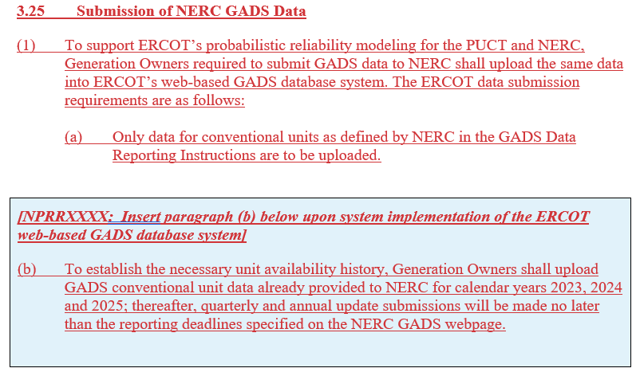
Preliminary Draft NPRR Language
For Discussion Purposes Only

Slide 5
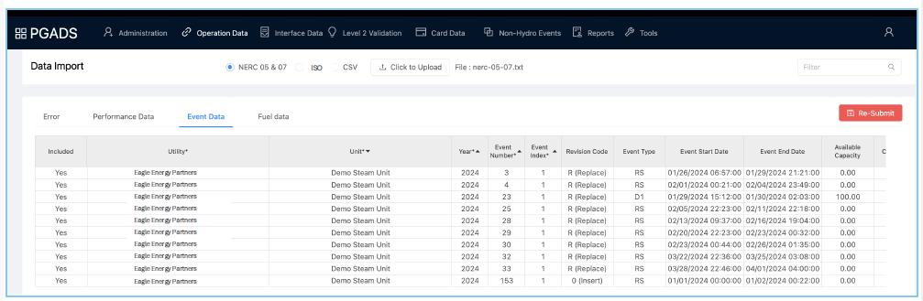
Data Entry Screens

Slide 6
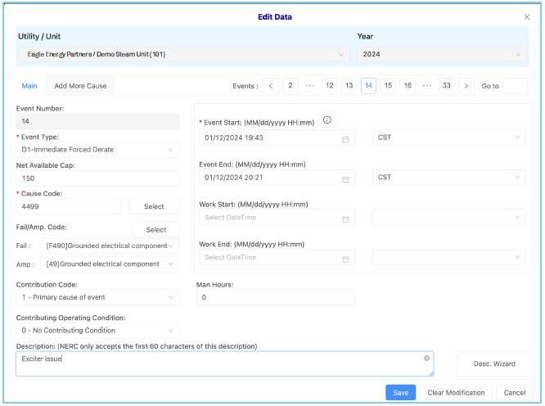
Data Entry Screens

