Slide 1
Credit Exposure Update
Market Credit Work Group
ERCOT Public
September 24, 2025

Slide 2
Monthly Highlights: July 2025 – August 2025
Market-wide average Total Potential Exposure (TPE) decreased from $1.84 billion in July to $1.65 billion in August
  The decrease was largely driven by lower forward adjustment factors
    Discretionary Collateral is defined as Secured Collateral in excess of TPE,CRR Locked ACL and DAM Exposure
  Average Discretionary Collateral increased from $3.91 billion in July compared to $4.36 billion in August
No unusual collateral call activity

Slide 3
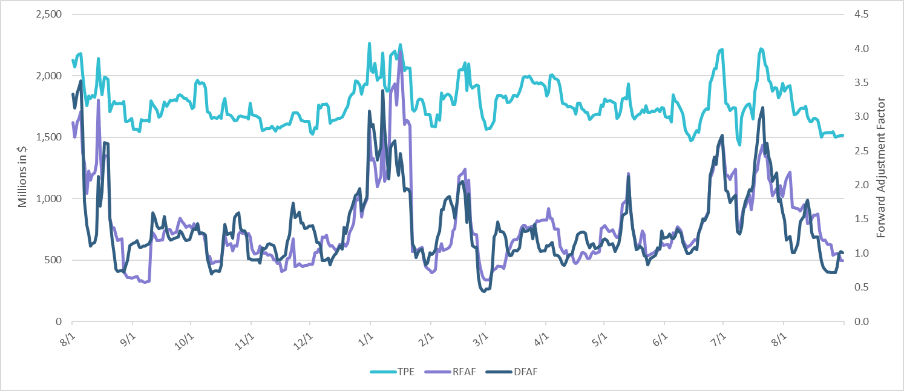
TPE and Forward Adjustment Factors: August 2024 – August 2025

Slide 4
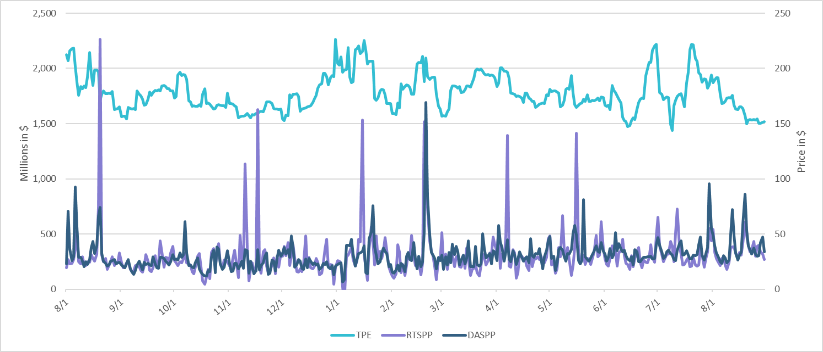
TPE/Real-Time & Day-Ahead Daily Average Settlement Point Prices for HB_NORT:H August 2024 – August 2025

Slide 5
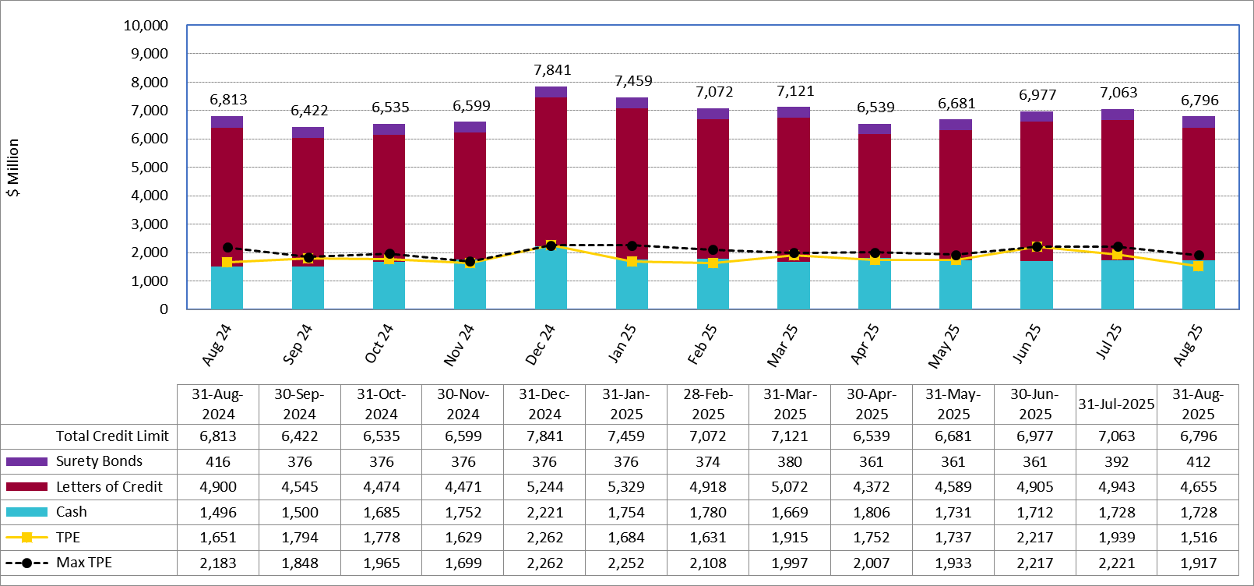
Available Credit by Type Compared to Total Potential Exposure (TPE):
August 2024 – August 2025
Numbers are as of month-end except for Max TPE
Max TPE is the highest TPE for the corresponding month

Slide 6
Issuer Credit Limits vs Total LC Amounts Per Issuer: End-August 2025
As of August 31, 2025
There are a total of 36 banks that have issued LCs.

Slide 7
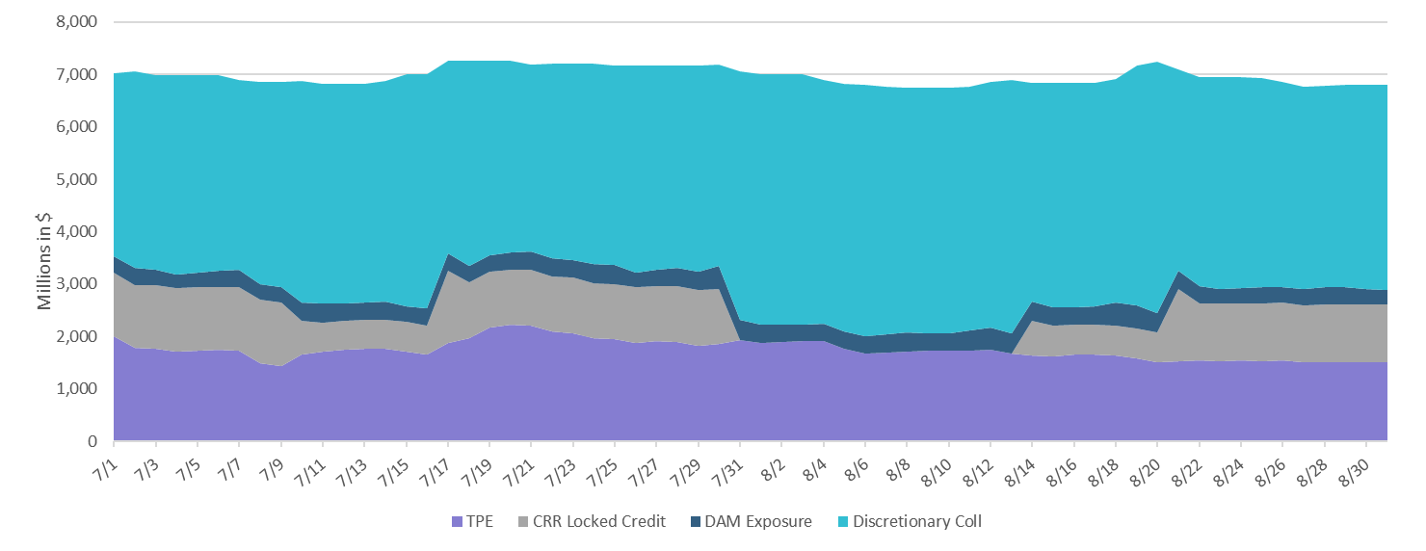
Discretionary Collateral July 2025 – August 2025

Slide 8
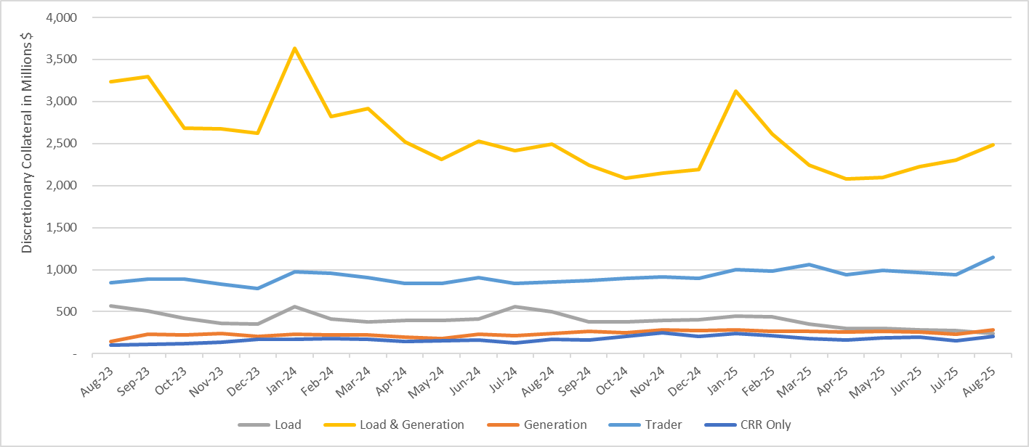
Discretionary Collateral by Market Segment August 2023 - August 2025

Slide 9
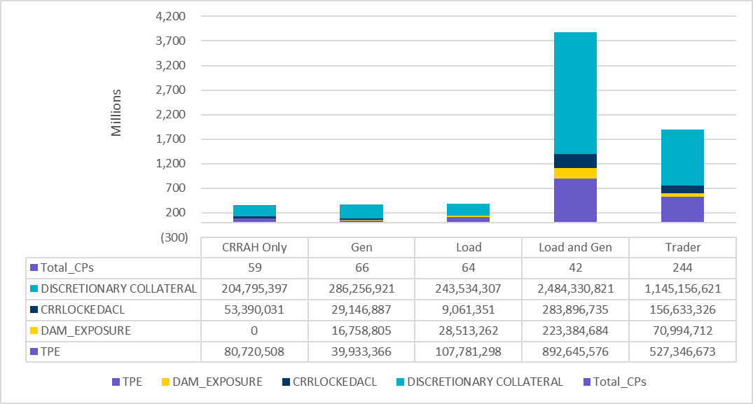
TPE and Discretionary Collateral by Market Segment - August 2025
Load and Generation entities accounted for the largest portion of discretionary collateral

Slide 10
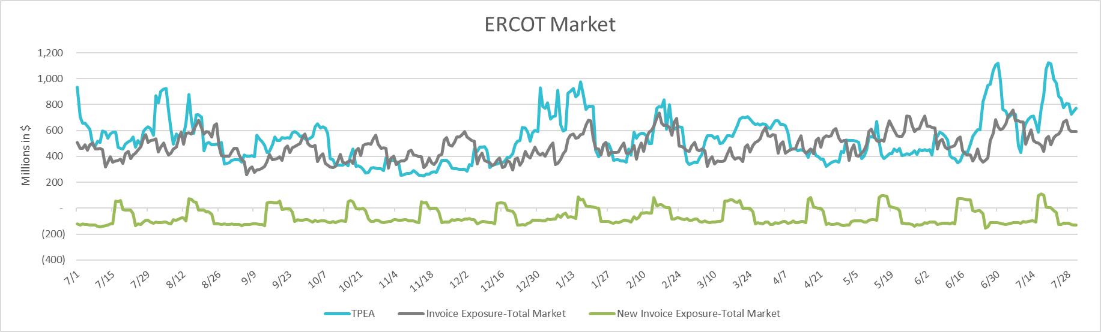
TPEA Coverage of Settlements July 2024 - July 2025
Invoice Exposure | Historical | Future
Existing Invoice Exposure | RTLCNS + UDAA | M1 Days (including current day) Forward Charge Invoice Amounts
New Invoice Exposure | 7 Days Back Net Invoice Amounts (Charges & Credits) | M1 Days (including current day) Forward Net Invoice Amounts (Charges & Credits); Excluding: 1) Securitization Invoices; 2) CRR Auction Invoices; and 3) Subchapter N Funds Distribution Invoice

Slide 11
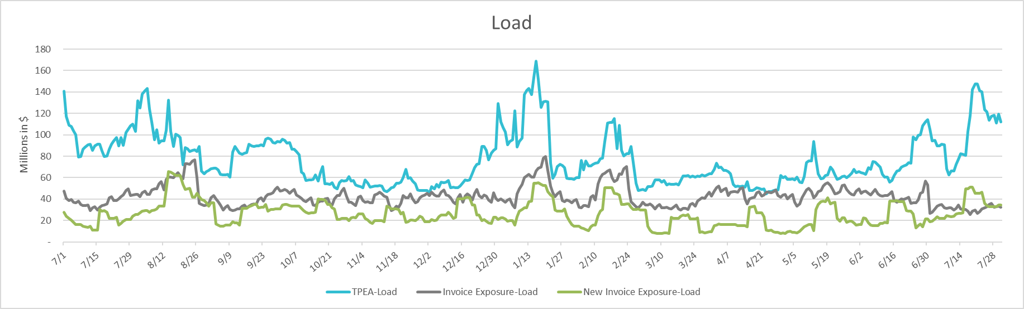
TPEA Coverage of Settlements July 2024 - July 2025
Invoice Exposure | Historical | Future
Existing Invoice Exposure | RTLCNS + UDAA | M1 Days (including current day) Forward Charge Invoice Amounts
New Invoice Exposure | 7 Days Back Net Invoice Amounts (Charges & Credits) | M1 Days (including current day) Forward Net Invoice Amounts (Charges & Credits); Excluding: 1) Securitization Invoices; 2) CRR Auction Invoices; 3) Subchapter N Funds Distribution Invoice

Slide 12
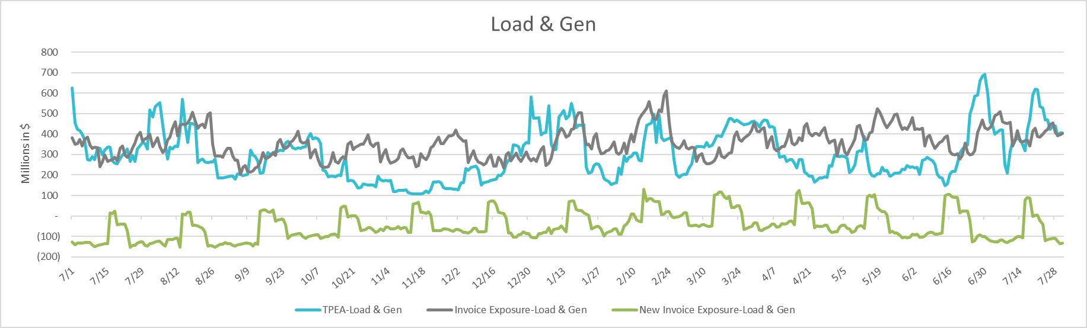
TPEA Coverage of Settlements July 2024 - July 2025
Invoice Exposure | Historical | Future
Existing Invoice Exposure | RTLCNS + UDAA | M1 Days (including current day) Forward Charge Invoice Amounts
New Invoice Exposure | 7 Days Back Net Invoice Amounts (Charges & Credits) | M1 Days (including current day) Forward Net Invoice Amounts (Charges & Credits); Excluding: 1) Securitization Invoices; 2) CRR Auction Invoices; 3) Subchapter N Funds Distribution Invoice

Slide 13
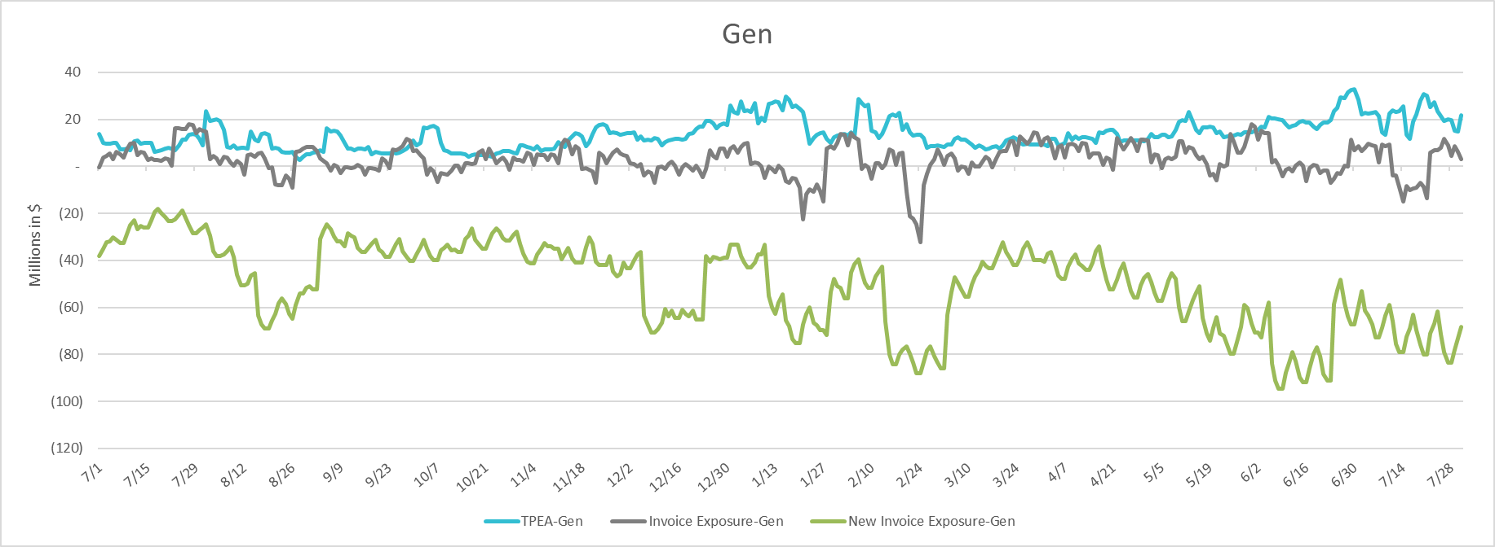
TPEA Coverage of Settlements July 2024 - July 2025
Invoice Exposure | Historical | Future
Existing Invoice Exposure | RTLCNS + UDAA | M1 Days (including current day) Forward Charge Invoice Amounts
New Invoice Exposure | 7 Days Back Net Invoice Amounts (Charges & Credits) | M1 Days (including current day) Forward Net Invoice Amounts (Charges & Credits); Excluding: 1) Securitization Invoices; 2) CRR Auction Invoices; 3) Subchapter N Funds Distribution Invoice

Slide 14
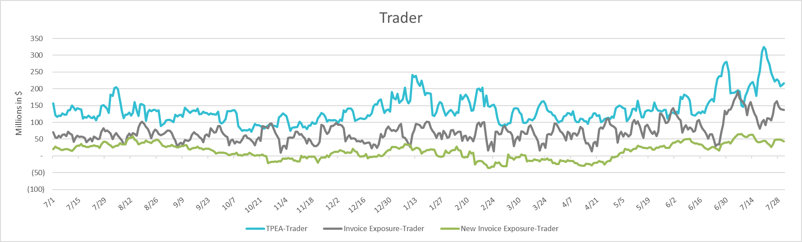
TPEA Coverage of Settlements July 2024 - July 2025
Invoice Exposure | Historical | Future
Existing Invoice Exposure | RTLCNS + UDAA | M1 Days (including current day) Forward Charge Invoice Amounts
New Invoice Exposure | 7 Days Back Net Invoice Amounts (Charges & Credits) | M1 Days (including current day) Forward Net Invoice Amounts (Charges & Credits); Excluding: 1) Securitization Invoices; 2) CRR Auction Invoices; 3) Subchapter N Funds Distribution Invoice

Slide 15
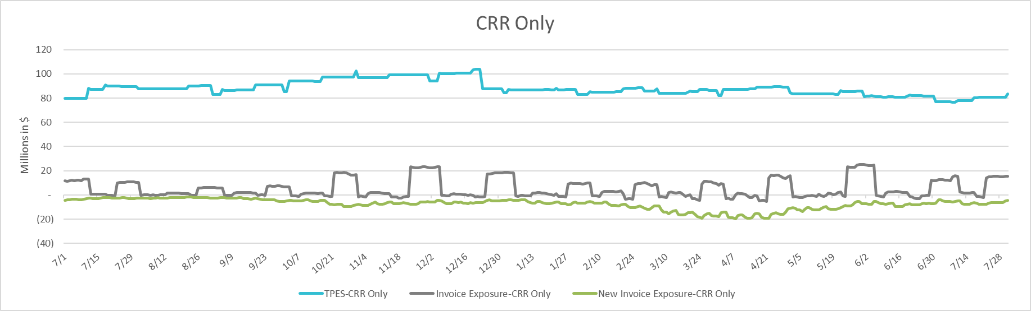
TPEA Coverage of Settlements July 2024 - July 2025
Invoice Exposure | Historical | Future
Existing Invoice Exposure | RTLCNS + UDAA | M1 Days (including current day) Forward Charge Invoice Amounts
New Invoice Exposure | 7 Days Back Net Invoice Amounts (Charges & Credits) | M1 Days (including current day) Forward Net Invoice Amounts (Charges & Credits); Excluding: 1) Securitization Invoices; 2) CRR Auction Invoices; 3) Subchapter N Funds Distribution Invoice

Slide 16
Questions

