Slide 1
LL Frequency Limit Study Update
Luis Hinojosa
ERCOT Operations Planning
LLWG
Sep 19, 2025

Slide 2
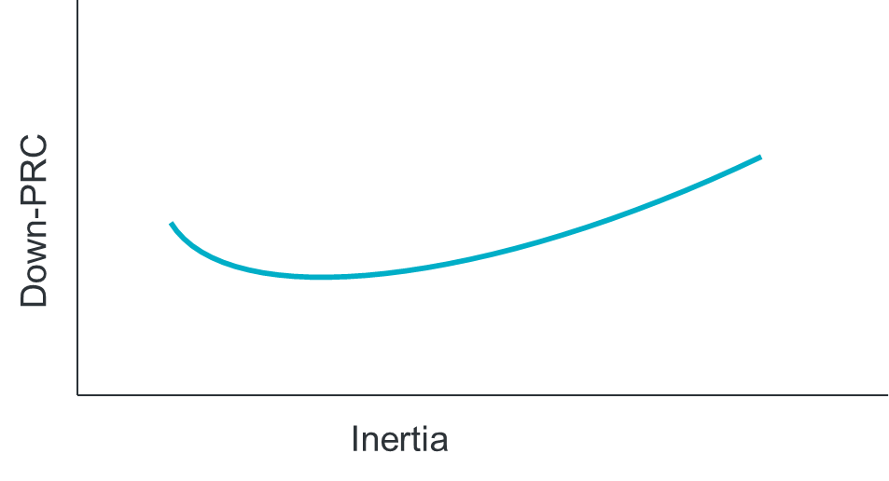
LL Frequency Limit Study
Questions to Answer:
How do different inertia and down-PRC conditions impact the previously-identified¹ 2,600 MW loss of load frequency stability limit?
What would be the benefit of a down-frequency response Ancillary Service?
Scope:
TSAT snapshot cases for various inertia and down-PRC conditions
Identify load loss level that causes steady-state frequency to exceed 60.4 Hz for each case
Outcome (expected Q4 2025):
Table showing load loss limit for various inertia and down-PRC conditions [Public]
  This will serve as input into SOL monitoring criteria (see LL VRT SOL Study)
Identification of amount of down-PRC needed to increase loss of load frequency stability limit at various inertia levels [Public]
1. https://www.ercot.com/files/docs/2025/05/19/Large_Load_Loss_Analysis_051625_LLWG.pptx

Slide 3
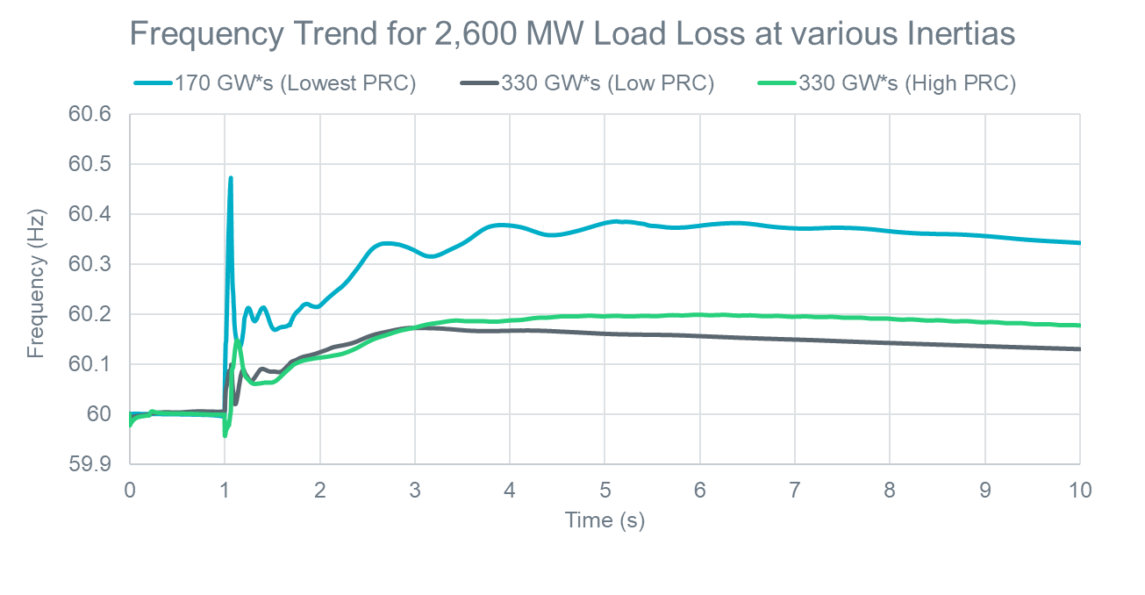
Update on Expanded Load Loss Limit Analysis
ERCOT has identified 18 additional cases with inertia ranging from ~120 GW*s – 335 GW*s and varying levels of down-PRC are being studied to determine how the Large Load loss limit is impacted.
Preliminary analysis shows that at inertia conditions of around ~330 GW*s, the Large Loss level at which frequency stability is impacted is higher than 2,600 MW
ERCOT is in the process of running analysis on these additional cases. ERCOT’s goal is to define a load loss limit curve based on inertia and down-PRC available, and potentially other factors, to better represent system conditions which can be used as input to the System Operating Limit (SOL) monitoring criteria.
ETA: Q4 2025

Slide 4
Impact of downward Fast Frequency Response (FFR) on Frequency stability
Today, ERCOT has an FFR “Up” designed to provide full response within 15cycles or 250ms when frequency drops below 59.85 Hz. This helps reduce Critical Inertia.
Based on feedback received, ERCOT is also testing the impact of faster responding frequency response on grid frequency during load loss type events. Specifically, ERCOT is testing the impact of having a similar FFR-down response that triggers at 60.15 Hz within 250ms on the Large Load loss limit.
  ETA: late Q4 2025 or early Q1 2026

Slide 5
Questions?

Slide 6
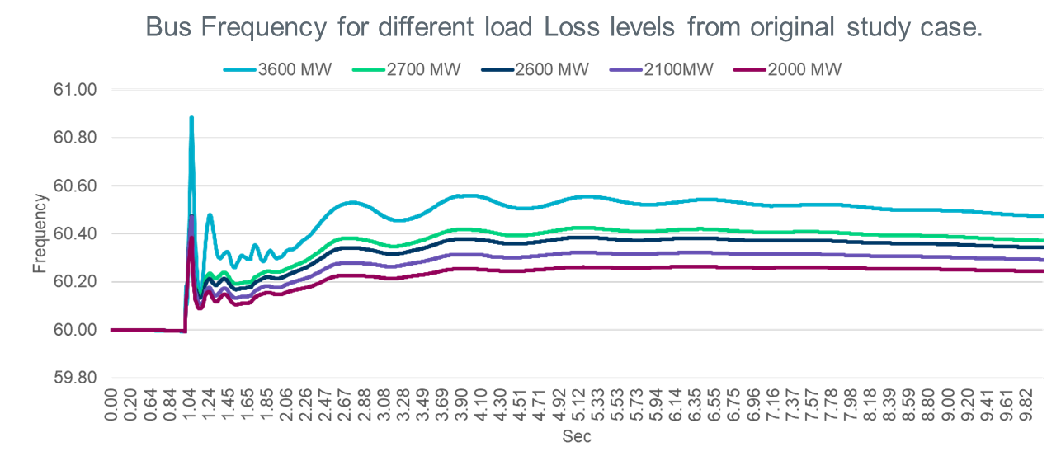
Recap of Initial LL Frequency Limit Study
ERCOT conducted a dynamic TSAT simulation using historical real-time case from 03/12/2024 2:47 AM with lowest down-Physical Responsive Capability (down-PRC*) conditions to identify Large Load loss levels that caused steady-state frequency to exceed 60.4Hz** when a three-phase fault in West Texas (contingency) is applied.
  In this case, ERCOT modeled Large Loads with a trip setting that mimicked the ITIC curve.
ERCOT identified that for Large Load loss greater than 2,600 MW, steady state frequency could exceed 60.4 Hz**, a value that has been adopted as a threshold based on feedback from thermal generation operators in similar past overshoot analysis.
Case: Mar 12, 2024 2:47 ~170 GW.S
MW Load Loss | Steady State Freq
~3,600 | 60.58
~2,700 | 60.42
~2,600 | 60.37
~2,100 | 60.27
~2,000 | 60.25
Key Takeaway: Based on this analysis a Large Load loss limit of around ~2,600 MW would be needed to maintain frequency stability during real time.
* Down-PRC is the capacity available to respond to a high frequency event based on generation output, lower operating limits, and generation droop characteristics.
**DWG has used a 60.4 Hz threshold in the overshoot studies conducted in 2002 and 2009 based on feedback from generator operations (see page 19 of this DWG report***)
***Increasing the over frequency limit above 60.4 Hz should not be done without coordination with plant operators and a detailed study of plant equipment in the ERCOT system.

