Slide 1
Planning Solutions
Load Cluster Studies

Slide 2
Planning Solutions
Load Cluster Studies
Goal - Timely determine projects needed to connect loads reliably to the system.
What are clusters? – groups of electrically similarly situated loads being requested for interconnection
Why clusters?
  Massive volume of interconnection requests
  Massive size of those interconnections
  Allows for more efficient and effective solution than multiple one offs
“It’s like speed dating for interconnections—except everyone shows up with a 500MW load and no transmission.”

Slide 3
Planning Solutions
Load Cluster Studies
Six Month Process Overview
One month prior
One month
Four months
One month
Load Request
Questionnaire
One line
.kmz
Proof of Control
Test Fit
Dynamic data
STUDY FEE
ERCOT
“Load RIOO”
Update models
Contingencies
Cluster Analysis
TSP Assignments
TSP/TSP Groups
Steady State
Dynamic
Project List
ERCOT review
RPG like process
Load Agreement
Actual load ramp
Cost of Connect
Agreement
Funding
Repeated Every Six Months
“It’s 150 GW, six months, and one planning engineer who just updated their LinkedIn.”

Slide 4
Planning Solutions
Load Cluster Studies
One month prior
Load submits all data required for studies
Inaccurate/Incomplete submissions are punted
  Can be re-entered in following cycle
Some of this list has been created by SB6
Much will be reviewed in PUC rulemaking processes
Load Request
Questionnaire
One line
.kmz
Proof of Control
Test Fit
Dynamic data
STUDY FEE
“We asked for a one-line diagram, dynamic data, and proof of site control. We got a napkin sketch, a YouTube link, and a Zillow listing.”

Slide 5
Planning Solutions
Load Cluster Studies
Utilizes ERCOT as a central clearinghouse for studies
System needed similar to Resource Integration Process for generation resources
ERCOT
  Refreshes models with projects from previous study run
  Creates revised contingency list
  Establishes standardized generation assumptions
  Performs a cluster analysis on contingencies to establish clusters
  Makes the cluster assignments to the TSP or TSP Groups in region
Then we’re off to the races.
One month
ERCOT
“Load RIOO”
Update models
Contingencies
Cluster Analysis
TSP Assignments
“ERCOT’s clustering process is like assigning bunk beds at summer camp—except everyone brought 500 MW and nobody wants to share.”

Slide 6
Planning Solutions
Load Cluster Studies
Now the heavy lifting
TSP/TSP Groups
  Perform steady state and dynamic studies on the clusters
  Create transmission solution proposals
  Vet various options to create efficient, holistic proposals
  Coordinate with other clusters to avoid overlap
  Set a complete and final project list
  Coordinate with ERCOT to review in accelerated RPG process
  Create load interconnection packages including:
    Revised load ramps (if needed)
    Project contingencies on load provision with schedule notification
    Financial posting obligations
Take a well deserved 15-minute break.
Four months
TSP/TSP Groups
Steady State
Dynamic
Project List
ERCOT review
RPG like process
“For TSPs, ‘steady state’ doesn’t describe grid studies—it describes their stress level.”

Slide 7
Planning Solutions
Load Cluster Studies
Rubber meet road
Load receives study results for all projects
  List of dependent transmission upgrades related to project;
  Anticipated load ramp provisions;
  Financial posting requirements (Reimbursable and CAIC);
  Notice of 30 day decision or forfeit;
Load sends commitment to proceed;
Posts required financials.
Possible need for initial estimate and final true up
Transmission projects adopted in flight included in subsequent flight
One month
Load Agreement
Actual load ramp
Cost of Connect
Agreement
Funding
“The good news: you cleared the cluster. The bad news: you have 30 days to fund a grid upgrade the size of Delaware.”

Slide 8
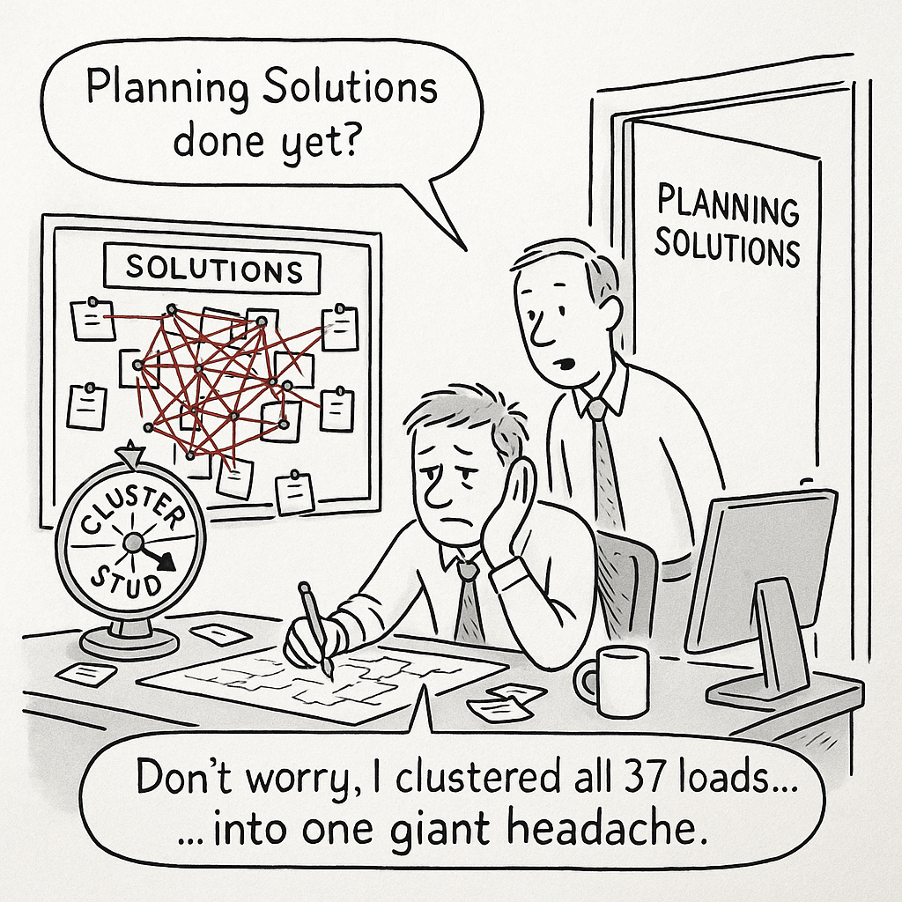
Planning Solutions
Load Cluster Study Considerations
Timing
  Needs to as tightly choreographed as an NFL halftime show
    Minus the wardrobe malfunctions
  Wise to consider NERC filing timelines for efficiency
  Critical to find:
    Opportunities for parallel tasking
    Elimination of redundancy
    Efficiency of tasking
  Possibly need failsafe if “life” happens
“To ensure the process runs smoothly, we’ve implemented strict deadlines, standardized submissions, and just enough panic to keep it interesting.”

Slide 9
Planning Solutions
Load Cluster Study Considerations
Insufficient load agrees to post and move forward
  Can create unneeded projects
  Can create imbalance in financial posting requirements
  Possibly perform quick restudy process:
    Use shift factors of loads that withdraw to determine projects for cancellation/delay
    Revise posting requirements in “True-up” reflecting changes
  Possibly “Fail” the cluster and move loads into subsequent flight
TSP Cluster Groups need to play nice with each other
  Competing desires for projects can create conflict and delay
Need to ensure that pursuit of the “perfect” doesn’t become the enemy of the good
  Errors likely only occur in facilities that are installed slightly early not ones that aren’t needed
“It’s all fun and gigawatts until half the loads ghost the cluster like a bad Tinder date.”

