Slide 1
ERCOT - IBRWG
Power Plant Controller – Fault Ride Through
Sept. 12th, 2025

Slide 2
About Mortenson
An EPC that serves multiple industries:
  Serves the US Market
  Energy Storage: 9 years, 40+ projects, 27 GWh deployment
  Wind: 30 years, 270+ projects, 39+ GW deployment
  Solar: 15 years, 100+ projects, 12+ GW
We’re not your standard EPC
  Actively engaged with developers and OEMs to design solutions and improve project outcomes
  Highly focused on compliance
Notes:
We’re an EPC. But we’re not a standard EPC. We’re supporting the developers and owner/operators from the design phase through COD, (and often afterwards).
We build everything from hospitals to stadiums, but the division that I work with is responsible for Wind, Solar, Storage and electrical infrastructure. Our storage team is a bit unique, as we are highly focused on supporting the customer on compliance topics.

Slide 3
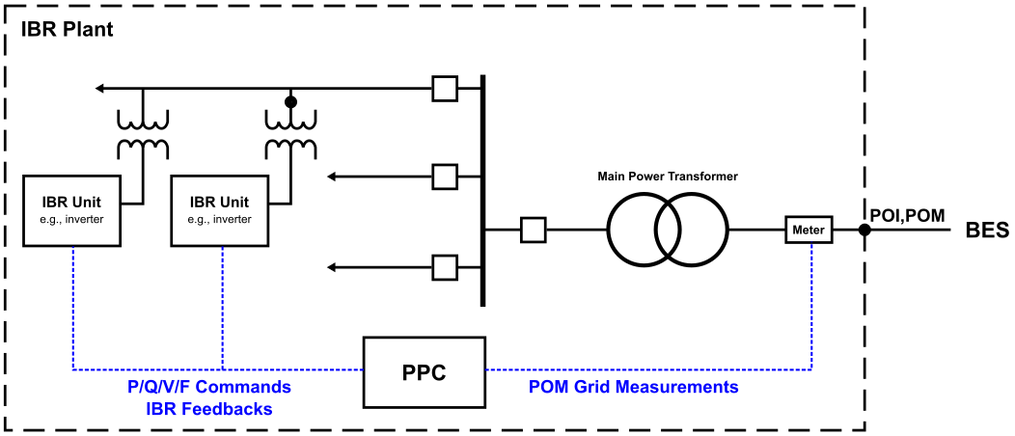
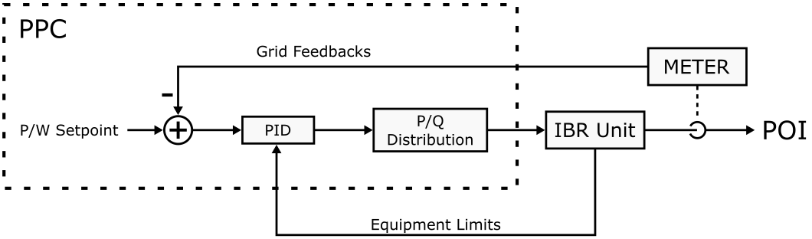
PPCs & Fault Ride Through – The Basics
General Considerations when designing PPC Fault Ride Through (FRT) Responses:
PPCs are too slow to generate a coordinated Fault Ride Through response at the POI
IBRs generally ignore PPC commands during a FRT response (and generates its own)
IBRs generally prioritize reactive power generation, with total current being limited by the power conversion hardware.
  Low voltages yield higher currents to maintain a constant power level. During LVRT, current capability will likely be the limiting factor.
  A prioritization of Q (to maintain terminal voltage) yields a likelihood of reduction in active power production.
There is a disconnect between performance measurements and control during a fault.
  PPC controls are applied and FRT performance is measured at the POM/POI.
  IBR behavior is governed by conditions at its terminals.
  Even with the same observed frequency IBR unit’s hardware introduces tiny offsets in frequency (by the way: 17 mHz = 0.028% of 60Hz)
Not all IBRs enter or exit FRT response at the same time. Local IBR conditions are different across the collector system.
  IBRs at the ends of feeders may see more favorable conditions.
PPCs are generally designed to pause operation and allow IBR units to do their thing.
Notes:
Start with the basics: Most PPCs use some sort of PID loop to generate power commands issued to BR units. Generally, the set point comes from one or more services and gets resolved into a single active or reactive power setpoint. That’s then compared to the point of regulation feedback generally provided by a meter at the POI.
This control design is appropriate when the settling time of your system is approximately 10x your closed loop reaction time (conservative rule of thumb). Anything faster than that risks making the PPC unaware of its impact on the grid and you risk blowing past your phase margins on the control design. When you know what you’re doing, and the equipment is well matched across OEMs, you can move a bit faster than that.
When applying this to PPCs however, the control design breaks down. PPCs and the communication to the equipment that moves power is generally far to slow to provide an appropriate response.
On top of that, IBRs generally ignore what the PPC is asking for anyway during these events.
There are some more considerations that go into building a robust response to LVRT events. Some of the big ones:
First, its important to note that each IBR is a little different. They live in different parts of the collector system and see different conditions at their terminals. While PPCs determine an event using POI/POM data, the individual IBRs determine that an event is occurring and how much of a response to provide using their own terminals. On facilities with larger collector systems, you might see some IBRs with more favorable conditions than others.
That, and due to the fact that each IBR has slightly different hardware I/O characteristics, means that your facility may have some resources in a LVRT response, while others are still listening to the PPC. Its also likely that as the event resolves, individual IBRs might exit their LVRT response at different times.

Slide 4
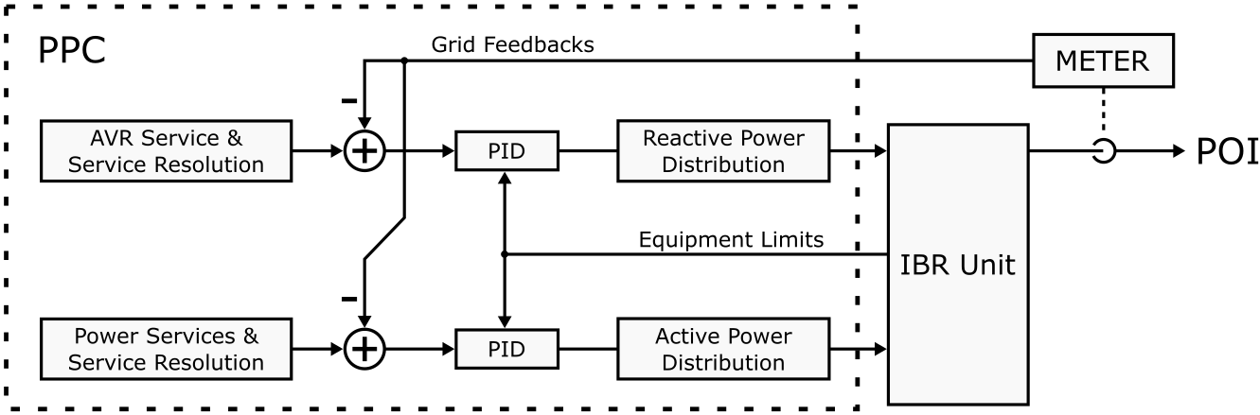
PPCs & Fault Ride Through – Standard Design
Requirements and Typical PPC Response:
Requirement:
Return to pre-fault active power production within 1.0 second of the event resolving.
Typical Design Approach:
Freeze active and reactive power control loops during the event
Enable control again when the POI/POM returns within appropriate limits (0.9<x<1.1 PU)
Active and Reactive Power Service maintain setpoints (i.e. target Voltage SP, Active Power Base Setpoint)
Services (i.e. Primary Frequency Response) may continue to run and apply modifiers to the active and reactive power targets as appropriate. Resolution of a final setpoint is VERY dependent on OEM.
After the FRT event is complete, the active and reactive power control loops will attempt to control the generation to achieve the target setpoints again.
PFR/FFR design considerations:
PPC can not distinguish between a perceived frequency disturbance and a real one. What the meter provides will be taken as truth.
Frequency is typically filtered within the PPC to reduce noise, reject rapid setpoint changes that a facility can not track, and help shape a system overall response. This may mitigate impact of a temporary inaccurate frequency feedback.
Standard approach to measuring frequency is derived from time between voltage zero crossings. Voltage amplitude and phase jumps (among other items) have an impact on the accuracy of the measurements.
Notes:
Standard design practice for PPCs:
The primary requirement that we see from IEEE 2800-2022 and NERC’s PRC-029 is to return active power production at the POI to its pre-fault levels within 1 second of the fault clearing. While in theory there’s a good chance of this happening, theres also a number of reasons why this can also be a challenge.
In general, most PPCs will freeze their controllers if the POM data shows a condition that would warrant LVRT responses from its inverters. This in theory is pretty robust. We assume that the conditions post fault are going to be somewhat similar (in general magnitude) as the conditions observed pre-fault. This gives the PPC a decent starting point when control of the facility resumes.
For this to work correctly, the services that generate power setpoints need to effectively be frozen during the event. If the PID controller is frozen, but comes back with a drastically different setpoint, we’re still going to see disturbances to the power output post fault.
If the event is identified incorrectly, (ie the PPC identifies the event too late and the IBRs are already performing their own responses) then the PPC may wind up. This occurs whenever the PPC is expecting to be in control, and is not seeing a response to its commands. The control design is designed to ask for more of its control action. This is really the nature of PID control, the goal is to remove any observe error between the setpoint and feedback.
If the PPC winds up its control action, its likely going to be at a command limit (max or min P or Q) when the event is over. Even if the event is short, the impact of asking for a 1 second response time at the facility level means that the PPC controller gains must be fast. Fast control gains mean rapid windup on the controller.
how this impacts PFR/FFR handoff: First the PPC can not distinguish between a perceived frequency response and a real one. We rely on the meter to provide accurate feedback. If this is an issue, we need to start looking at how frequency is calculated. Most of the time, this is done via voltage zero crossings. This kind of measurement is very sensitive to the voltage magnitude, so its very likely that this is going to be impacted by an LVRT event.
On the plus side, frequency is generally filtered in the PPC before generating a PFR/FFR response. Depending on the frame rate of the controller, this means that any temporary disturbances to a frequency measurement are reduced.

Slide 5
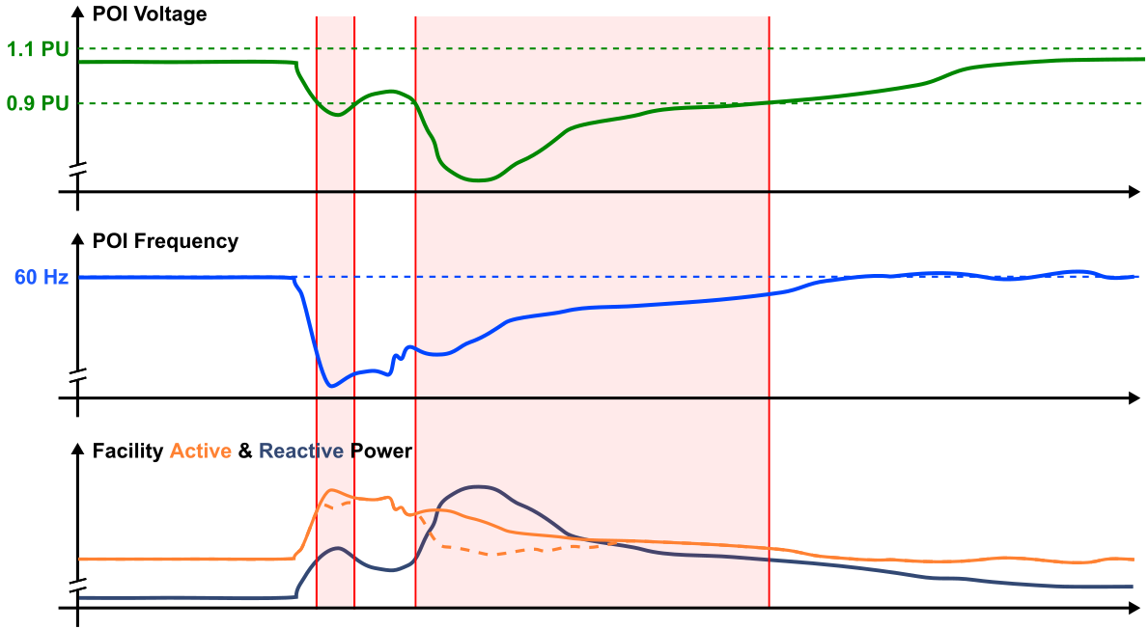
PPCs & Fault Ride Through – Challenges
Why it still wont look right in the field:
Designing a robust solution is harder than it sounds:
What is “pre-fault active power production”?
  To what? Target Setpoint? How close? PPC may have already started a PFR Response. The power prior to the event may no longer be appropriate.
  If your base setpoint is constant or not derived by feedbacks from the meter, the target post fault will likely be near that of pre-fault conditions.
“Within 1.0 second” = FAST
  Indicates a 1 second response time for active power control via PPC. Likely faster than standard operating requirements.
  If control is not frozen correctly during the full event (PPC doesn’t ID the event correctly), fast control means significant possible integrator windup.
At which point has the “event resolved”?
  What happens when multiple events occur? What does your PPC do if not all IBRs are listening?
  Due to the nature of most faults, the PPC will be the first to see a low voltage, and the last to endure it. Ideally, the PPC is aware of which resources are following its commands. Communication delays can make this difficult.
Notes:
Even if we have a perfect design, theres a lot of reasons why what we find in the field, isn’t going to look like we expected:
If we break up that requirement from IEEE 2800 and NERC-PRC-029, we can find issues that are associated with each individual part.
Pre-fault active power for example: depending on the event, the frequency and voltage may already be on the move before an official LVRT event is identified. This meas that a PFR response may already be activated. Its important for a PPC to define the pre-fault active power as the base setpoint, not the base setpoint + a PFR response delta. This mitigates the issues that you might see if there are multiple events within a short window of time. In a good design, this means that the post fault active power resolved setpoint will be the base, plus whatever PFR response is expected when looking at post fault frequency.
1.0 seconds is fast. If we’re moving fast and are relying on the PPC to control post-fault active power to meet that requirement, there are significant risks associated with windup of that pid loop.
Then there’s the time at which the event is resolved. Due to the nature of most LVRT events, the PPC is likely going to be the last one to rise above that voltage threshold. This is a good thing, as it extends the window of frozen control past the window of time that IBRs are doing their own thing. If this doesn’t occur though, the PPC may be trying to control the POI without the IBRs actually listening.
Everything presented here is generalized info from multiple OEMs. In the end, your performance of the facility is a function of half a million configuration settings mixed up with a few thousand potential initial conditions. Most of the time, we’ll likely see an expected result, but its not always a guarantee. More often than not, if the performance wasn’t up to spec, its probably because a configuration setting is wrong somewhere.

