Slide 1
CIM 10 to CIM 16 Transition Workshop
ERCOT Staff
9/18/2025

Slide 2
Antitrust Admonition

Slide 3
Antitrust Admonition
To avoid raising concerns about antitrust liability, participants in ERCOT activities should refrain from proposing any action or measure that would exceed ERCOT’s authority under federal or state law. For additional information, stakeholders should consult the Statement of Position on Antitrust Issues for Members of ERCOT Committees, Subcommittees, and Working Groups, which is posted on the ERCOT website.*
Disclaimer
All presentations and materials submitted by Market Participants or any other Entity to ERCOT staff for this meeting are received and posted with the acknowledgement that the information will be considered public in accordance with the ERCOT Websites Content Management Operating Procedure.
*https://www.ercot.com/about/governance

Slide 4
Agenda
RTC+B Reminder
Introduction
Overview of CIM16 Project
Project Schedule
Review of CIM16 Mapping and Schema Documents
Review of Selected Schema Changes

Slide 5
Key Takeaways
RTC+B schema changes are coming soon
  Redacted Test models to transition in October
  All models to transition with December go-live
ERCOT’s modeling application and model postings will transition to CIM16 at the conclusion of the project
  Project go-live currently scheduled for Q1 2027
  No CIM10-formatted models will be provided after go-live
  TSP testing and training of new system in Q4 2026
Representative CIM16-formatted models have been posted here
  The final CIM16 schema will differ from the representative models
  Schema to be finalized when “native” models are provided EOY2026
Questions can be sent to CIM16@ercot.com

Slide 6
RTC+B Reminder
December 2025

Slide 7
Key Model Changes to Support RTC+B Effort
Energy Storage Resources will transition from a “combo” to “single” model representation
All ERCOT systems currently represent an ESR as a load/generator pair
Model
EMS/MMS
Key Change: Battery identifiers will change during this transition. (ex: UNIT1 -> ESR1)
Model
EMS/MMS
Post-RTC+B go-live, all core systems will utilize the single-model representation for ESRs

Slide 8
Full and Redacted Representations of RTC+B Model Posted
ERCOT has posted full and redacted RTC+B representations of the July ML4 model
Redacted model is posted to a new MIS location:
  Preview of Modified Redacted CIM Network Model
Full model for TSPs is posted in the NMMS Citrix Postings location:
  Located in the ECEII_NMMS_RTC_Preview folder
Key changes related to Energy Storage Resources
  BatteryGeneratingUnit (BGU) instances have replaced the HydroGeneratingUnit + ControllableLoadResource pairs
  Names of BGU instances have changed (ex: UNIT1 -> ESR1)
https://www.ercot.com/services/comm/mkt_notices/M-A073025-01

Slide 9
Introduction

Slide 10
Nodal Market Transition – ERCOT’s CIM Catalyst
In 2004, ERCOT began the transition from a zonal to a nodal market
New rules drafted (Nodal Protocols, Nodal Operating Guides, etc.) to support this transition
New requirement introduced for a high-level of model consistency between all grid applications aiming to resolve:
  Disconnected modeling processes between applications
  Topology, naming, and data inconsistencies
New requirements related to receiving and providing model data via CIM-XML formatted files

Slide 11
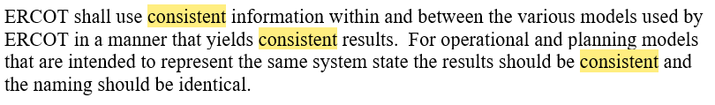
Nodal Protocols - Model Consistency
NP 3.10(5)
…a single modeling system was implemented to manage data needed for downstream grid processes
Instead of multiple disconnected processes to maintain different sets of application data...

Slide 12
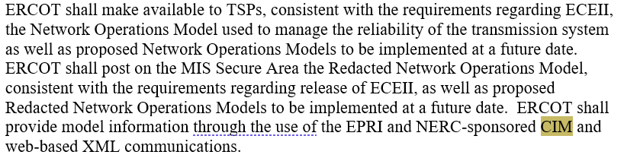
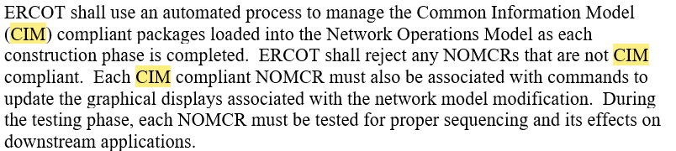
Nodal Protocols – Common Information Model (CIM)
NP 3.10.4(9)
ERCOT must provide models in CIM-XML format
NP 3.10(7)
Model changes provided in CIM-compliant format

Slide 13
What is CIM?
The Common Information Model (CIM) is a framework for describing interconnected systems
Provides guidelines on data naming, attributes, and object relationships
  Enables structured data exchange between different systems
Core schemas can be extended to capture data for custom use cases
ERCOT has used a CIM10 schema to describe the Texas grid since 2010
  Numerous custom extensions (e.g., planning buses, energy storage resources, end caps, etc.)

Slide 14
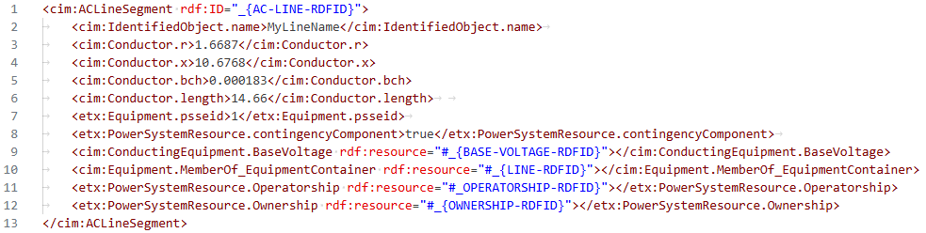
Example of ACLineSegment Instance in CIM10 XML
Namespace
Instance type
Unique ID
Attributes
Unique IDs
Associations to other model instances

Slide 15
Project Overview

Slide 16
ERCOT’s “CIM16 + SCR813” Project
In 2023, ERCOT initiated the “NMMS IMM Schema Upgrade to CIM16” project
Two main scope items:
  Update of ERCOT’s modeling application to support CIM16-formatted model creation
  Implementation of System Change Request (SCR) 813

Slide 17
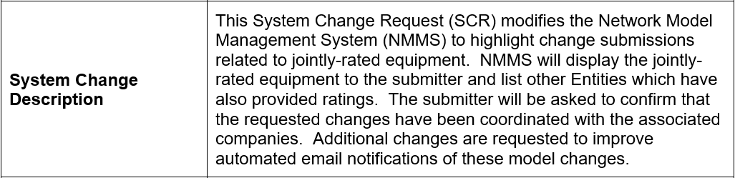
SCR813 - NMMS Jointly-Rated Equipment Coordination Confirmation
SCR813 modifies ERCOT’s modeling application to increase awareness of submissions affecting jointly-rated equipment
  Adds an additional step to TSP model change submission process requiring confirmation of coordination between associated companies
SCR813

Slide 18
Inputs and Outputs of the Modeling Application
ERCOT’s modeling application accepts model change submissions and creates updated models
TSPs submit model changes…
…ERCOT produces models.

Slide 19
Modeling Application Transition to CIM16
The CIM16 project updates ERCOT’s modeling application to create native CIM16-formatted models
Current
Model format is dependent on the database structure/schema
After project completion
To produce CIM16 models, the database of the modeling application must be modified to align with the CIM16 schema

Slide 20
CIM-Related Inputs/Outputs of the Modeling Application
The modeling database schema impacts numerous modeling processes and data artifacts

Slide 21
CIM-Related Inputs/Outputs of the Modeling Application
Changing the database schema requires modification to submission processes and will affect model artifacts

Slide 22
Adjustments to Submission Process
TSP model submissions must account for the CIM16 schema changes
After project conclusion:
The hierarchical “tree view” within the modeling application will change in specific locations
  Example: Transformers
Incremental CIM files must align with the updated schema
  TSP must use CIM16-formatted files
TSP modeling practices are driven by the CIM schema
Prior to go-live, ERCOT will:
Update templates to align with new schema
  Using templates can make CIM16 changes transparent to modelers
Provide a test CIM16 modeling environment
  Modified incremental files can be tested
Provide training for TSPs on CIM16 changes
TSP-developed tools that create incremental files must follow the CIM schema

Slide 23
Changes to Model Files
All model artifacts will utilize the CIM16 schema. ERCOT will no longer produce CIM10 models.
After project conclusion:
All redacted and non-redacted models will be provided in CIM16
Incremental files will be in CIM16
CIM10 models will no longer be created
ERCOT has already:
Provided representative “converted” CIM16 models
ERCOT will soon:
Provide “native” CIM16 models
Provide “native” CIM16 incremental files
All native model artifacts follow the database schema

Slide 24
“Converted” CIM16 Model: CIM10-to-CIM16
ERCOT has developed a process to translate CIM10 models to CIM16 allowing downstream systems to transition early
All downstream systems, such as the EMS and MMS, have transitioned to using CIM16 models

Slide 25
“Converted” CIM16 Model Schema
To expedite delivery of test models, ERCOT has provided representative converted models
Converted Models
Currently, CIM16 models are created by “converting” CIM10 models via script
ERCOT has only posted converted models
ERCOT has not developed a script to convert CIM10 incremental files
Preview of Modified Redacted CIM Network Model

Slide 26
Expected Differences Between “Converted” and “Native” Models
The schema of converted CIM16 models will differ from the upcoming natively-produced models
Modeling application requires key schema concepts to remain
  Natively-produced models will reflect this schema
Differences revolve around “operatorship” and “ownership” of equipment
  Converted models represent this as individual instances of data “underneath” each piece of equipment
  Native models (likely) will use associations to global instances
    Schema expected to mirror CIM10 implementation
Preview of Modified Redacted CIM Network Model

Slide 27
Project Schedule

Slide 28
Project Schedule
Q3 2025
  Vendor handoff of repeatable database conversion process
  ERCOT verification of conversion scripts
Q4 2025
  Vendor begins work on SCR813 functionality
  ERCOT verification of modeling application
  ERCOT produces first native CIM16 models and incremental files
Q1 2026
  ERCOT verification of SCR813 changes
  ERCOT updates modeling templates, validation rules, and reports
Q4 2026
  Test modeling application (MOTE) with CIM16 changes made available
  ERCOT to provide TSP training covering:
    Changes to modeling processes due to schema changes
    Changes to submission process due to SCR813
Q1 2027
  Cutover to CIM16 system
  ERCOT only produces CIM16 models; no CIM10 models

Slide 29
Project Schedule: Go-Live and Stabilization – Q1 2027
TSPs will not be required to “dual model” in CIM10 and CIM16 systems
Tentative cutover to CIM16 modeling application is Q1 2027
Entire cutover process will be done over one weekend
  CIM10 modeling system will be taken down on Friday
  CIM10 to CIM16 conversion will be initiated
  CIM16 system will be made available on Monday

Slide 30
Stakeholder Engagement

Slide 31
Ongoing Stakeholder Engagement
Postings
  Converted CIM16 models posted monthly
    Will stop when native models are available
  Native CIM16 models posted once available
    Recurring cadence to be determined
Communications
  Updates provided during Technical Working Group (TWG) and Network Data Support Working Group (NDSWG) meetings
  Key updates (e.g., release of the native model) announced via Market Notice
Workshops
  To be scheduled after release of native model
  Announced via Market Notice

Slide 32
Key Takeaways
RTC+B schema changes are coming soon
  Redacted Test models to transition in October
  All models to transition with December go-live
ERCOT’s modeling application and model postings will transition to CIM16 at the conclusion of the project
  Project go-live currently scheduled for Q1 2027
  No CIM10-formatted models will be provided after go-live
  TSP testing and training of new system in Q4 2026
Representative CIM16-formatted models have been posted to the MIS
  The final CIM16 schema will differ from the representative models
  Schema to be finalized when “native” models are provided EOY2026
Questions can be sent to CIM16@ercot.com

Slide 33
Review of CIM 16 Mapping Documents and CIM Schema Files

Slide 34
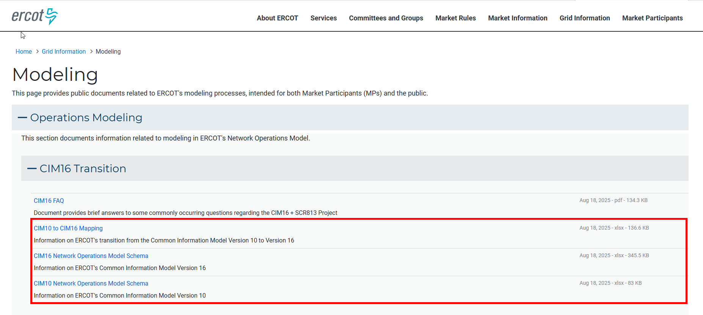
CIM Schema Files
ERCOT has posted two Excel files on https://www.ercot.com/gridinfo/modeling with details on our CIM10 and CIM16 schema. These files cover types, associations, and enumerations.
In the next update we are aiming to provide more information in the Excel files and deliver schema representations that can be used in Enterprise Architect.

Slide 35
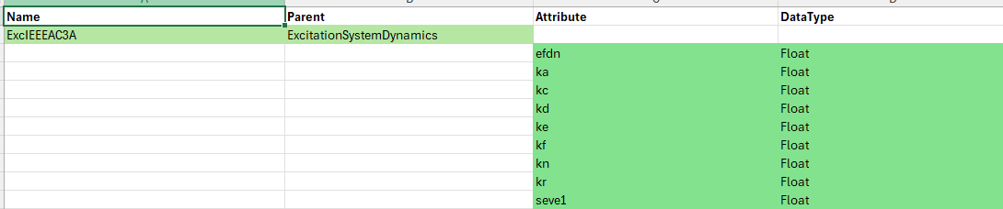
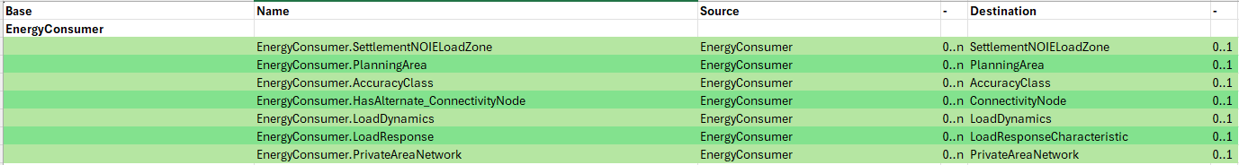
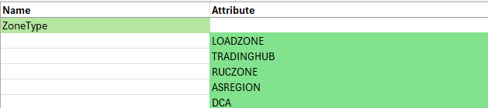
Schema File Details
Types:
  Name
  Parent
  Attribute
  Attribute DataType
Associations:
  Base Class
  Association Name
  Source
  Source Cardinality (Zero to One, Zero to Many, One to One, One to Many, Many to Many)
  Destination
  Destination Cardinality
Enumerations:
  Name
  Attribute

Slide 36
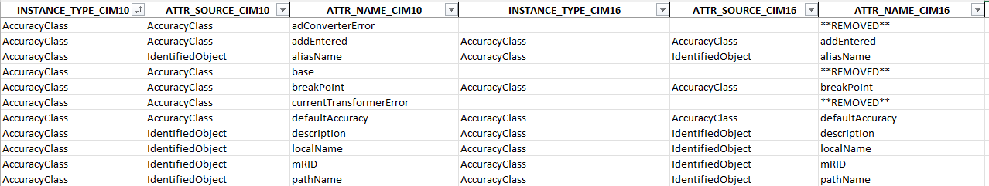
CIM10 to CIM16 Mapping File
To aid in the translation of the CIM10 to CIM16 schemas, ERCOT has also released a CIM10 to CIM16 Attribute Mapping Excel file.
Work is in progress on an Association Mapping file as well.
Notes:
Some attributes can be found in CIM10 and not CIM16, and vice-versa.

Slide 37
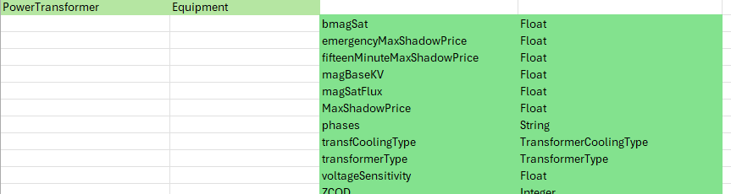
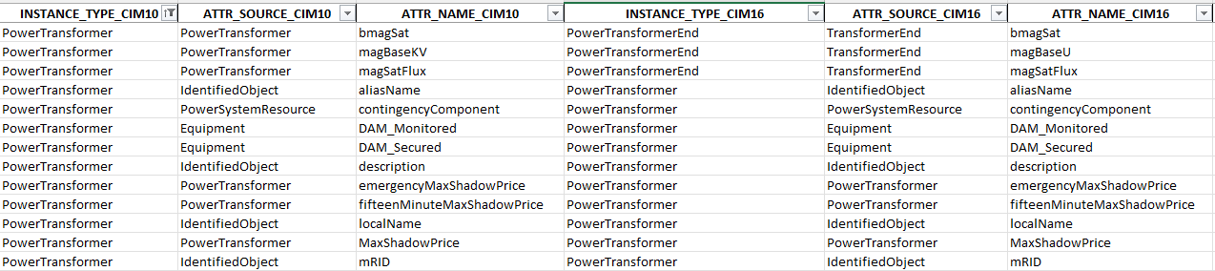
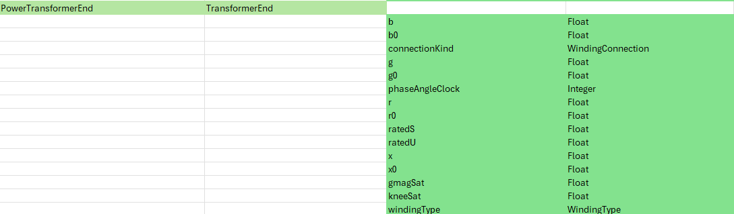
CIM10 to CIM16 Mapping Example – PowerTransformer
CIM 10 Schema File
CIM 10 to CIM 16 Mapping Document
CIM 16 Schema File

Slide 38
Review of Selected Schema Changes

Slide 39
Major Changes with CIM16
There are numerous changes from the CIM10 to CIM16 schema however there are a handful of significant changes that will be highlighted.
  Transformers
  Tap Changer Models
  Measurement and MeasurementValue Class
  Measurement Location Changes
  Calculation Arguments

Slide 40
Power Transformer
In CIM 10, the PowerTransformer is equipment, and the TransformerWinding is ConductingEquipment, and therefore has the Terminal Association. This has led to needing two queries to “trace” connectivity, one to trace the ConductingEquipment – Terminal – ConnectivityNode, and a second query to “hop across” from one TransformerWinding to another via the PowerTransformer association. In the CIM 16 the concept of TransformerWinding is replaced with the TransformerEnd which is not a piece of ConductingEquipment and has a specialized association to Terminal.
The PowerTransformer is now a piece of ConductingEquipment and is associated with all the terminals of the device in the same way that other ConductingEquipment objects (Breakers, Disconnects, SyncronousMachines, etc). This streamlines queries that trace connectivity, as there is no secondary query to “hop across” the PowerTransformer via the TransformerWindings.

Slide 41
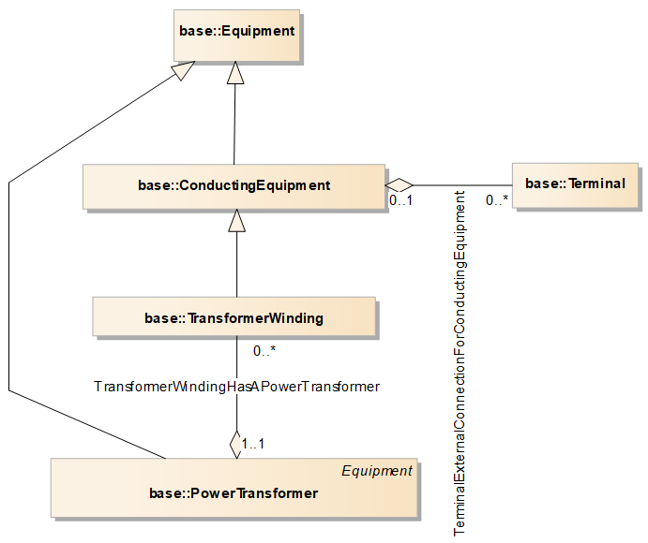
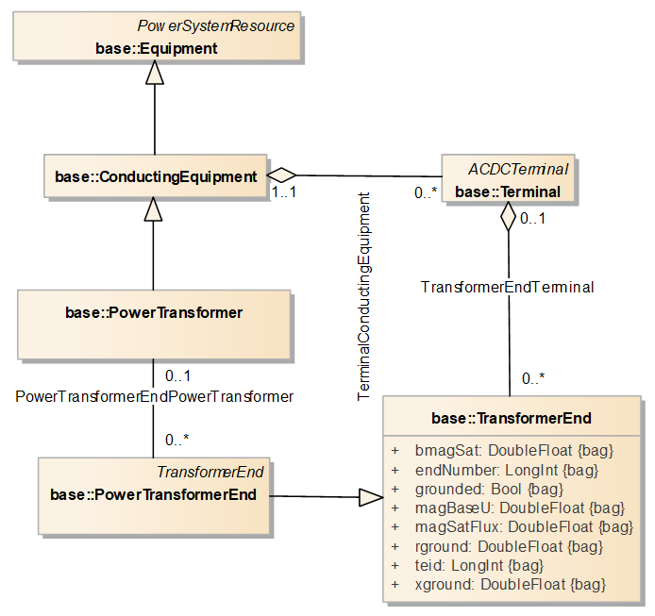
Transformer Changes Illustrated
CIM 10
CIM 16

Slide 42
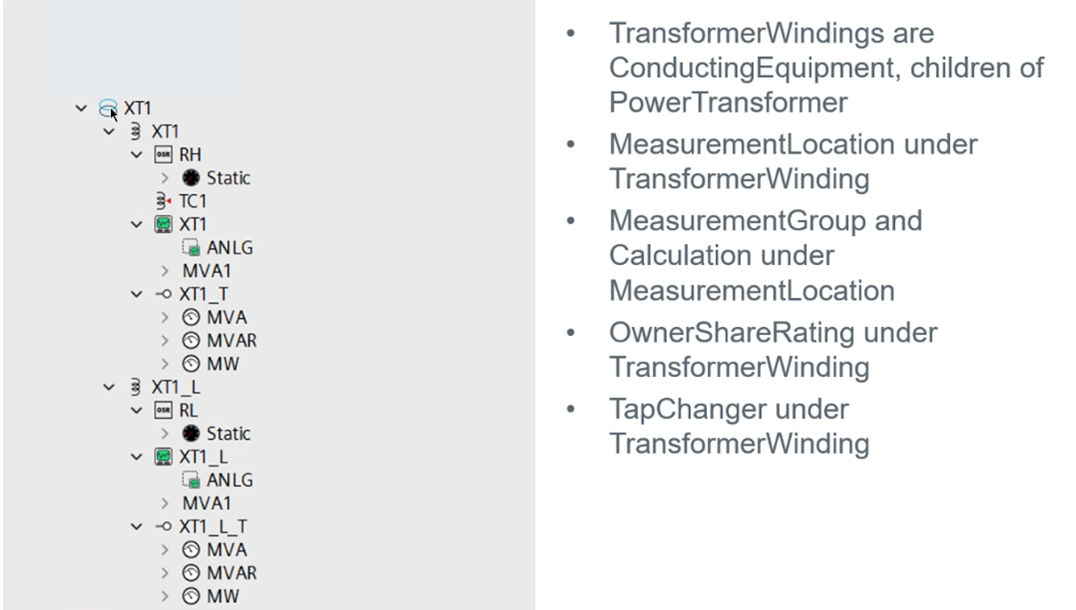
Transformer Model in CIM 10 – MAGE View

Slide 43
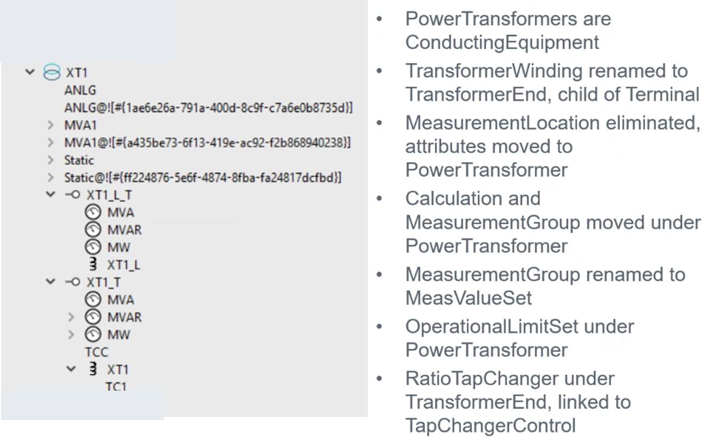
Transformer Model in CIM 16 – MAGE View
Notes:
In CIM10, each TransformerWinding had its own OwnerShareRating and MeasurementLocation.
When converting to CIM16, the Rating under the OSR for each winding is renamed to OperationalLimitSet, and they are both moved under the PowerTransformer, resulting in the duplicated OperationalLimitSet (Static@![...). To the best of James’s understanding, only one OperationalLimitSet is actually needed for a transformer in CIM16.
A similar thing happens with the MeasurementGroup/MeasValueSet (ANLG) and Calculation (MVA1), which were previously under the MeasurementLocation for each winding.

Slide 44
Tap Changers
In CIM 10, there is only a generic type of Transformer TapChanger, in CIM 16 the TapChanger class is expanded to have specialized subclasses. In the CIM 10 model, most of the TapChangers are replaced with RatioTapChangers except for a few that are converted to PhaseTapChangerLinear.
Additionally, TapChangers now have an associated TapChangerControl, and the RegulationSchedules have been replaced by TapSchedules, and if the RegulationSchedule was shared, it is duplicated and one of the RegulationSchedules is converted into a TapSchedule.

Slide 45
Tap Changer Changes Illustrated
CIM 10
CIM 16

Slide 46
Measurement vs MeasurementValues
In CIM 10, All values of operational limits, operational measurements, ICCP, SCADA, LimitSets, alarms, is all tied up in the “Measurements” additionally, MeasurementValue ended up as the primary holder of alarm information, while Measurements themselves have few attributes. As a concept, its important to understand that currently for many Measurements, there are two MeasurementValues, one holding the ICCP tag information, and the other acting a SCADA point tying to a measurement group that in turn tied to the MeasurmentLocation where the rest of SCADA and alarm information was modeled. GE heavily modified this idea. First, there is a deemphasis on the MeasurementValue class and a migration of attributes from the MeasurementValue to the Measurement itself.
And second, MeasurementValue is now solely focused on ICCP related information. This allows for SCADA information, i.e the alarming and monitoring information to be placed at the Measurement level. All MeasurementValues that don’t have an associated MeasurmentValueSource are removed from the model, i.e MeasurmentValues that were part of the tie in to the MeasurmentGroups that connected to the MeasurementLocation.

Slide 47
Measurement vs MeasurementValues Illustrated
CIM 10
CIM 16

Slide 48
Measurement Location
In CIM 10 any PowerSystemResource that has a measurement associated with it, had a Measurement Location object, and the Measurement Location object had a child MeasurementGroup object.
In CIM 16, there is an inheritance where the PowerSystemObject inherits from AlarmableObject, which in turn inherits from ScadaDeviceObject. These two inheritances take the place of the MeasurementLocation class.
The end result is that for all classes inheriting from PowerSystemResource, the MeasurmentLocation was removed and its attributes were transferred to PSR object.
The association etx:MeasurementLocation.DeviceTypeName was renamed to ge:ScadaDeviceObject.EquipmentGroupType. The MeasurementGroup was renamed to MeasValueSet and associated directly with the PSR. If the original Measurement Group was associated to a TransformerWinding the association is moved to the corresponding PowerTransformer, if associated to an OwnerShareLimit, the association is moved to the GeneratingUnit.

Slide 49
Measurement Location Changes Illustrated
CIM 10
CIM 16

Slide 50
Calculation Arguments
In CIM 10, there is a class for CalculationArgument parent class that has a MeasurementArgument class as a child type.
This MeasurementArgument child is deprecated in CIM16 and all MeasurementArgument objects are converted into the parent CalculationArgument type.
Additionally, in CIM 10, the MeasurementArgument are maps to a MeasurementValue which is then mapped to Measurement. In CIM 16 the CalculationArgument maps directly to the Measurement.

Slide 51
Calculation Arguments Changes Illustrated
CIM 10
CIM 16

Slide 52
Model Deliverable Update

Slide 53
Model Deliverables - Production
Each week ERCOT builds a new model for real time operations. Some of these deliverables are posted for MPs on MIS and for TSPs on Citrix. These are the files that will be changing that are produced for the production models.
Posted to MIS
  Redacted Model
  Redacted Model Comparison
Posted for TSPs
  NMMS Model
  NMMS Raw Model
  NMMS Model Comparison
  NMMS Model Reports
    Under Review

Slide 54
Model Deliverables – Market Models
Once a month the following deliverables are produced for the Market Models and will be impacted by the transition to CIM 16.
Posted to MIS
  MP_MarketModel_Redacted_Model_Posting_CIM_XXX_YYYY
    Redacted Model
    Redacted Model Comparison
Posted for TSPs
  TDSP_Market_Val_Posting_CIM_XXX_YYY
    NMMS Model
    NMMS Model Comparison

Slide 55
Additional MAGE and Model Changes

Slide 56
SCR813 - NMMS Jointly-Rated Equipment Coordination Confirmation
As part of the transition to CIM16, ERCOT will also be releasing the functionality requested in SCR813.
This change will modify NMMS to highlight change submissions related to jointly-rated equipment of the type PowerTransformer, ACLineSegment, or SeriesCompensator. A rating change will be a change to an AnalogLimit instance.
The enhancement will traverse the model hierarchy to find additional companies for confirmation and notification. For example, if a TDSP changes a line’s ratings set, the submitter of the change as well as any other companies associated to the ACLineSegment would receive the notification.

Slide 57
Prompt Confirming Coordination
Immediately prior to a change request submission the NMMS application will determine if the requested changes are associated to jointly rated equipment:
  If jointly rated equipment is being modified, the submission form will:
    Display identifying information (Name) of the affected jointly rated equipment.
    Display the path of the of the affected jointly rated equipment.
    Display all companies which provide ratings for the jointly rated equipment.
    Request confirmation, through the use of a checkbox or similar functionality, that coordination has been done by the submitting Entity; and
    Disable final submission until coordination has been confirmed.
  If no jointly rated changes are detected, the submission process will remain unchanged.

Slide 58
Display Confirmation Information
The user identifier for the confirming user and confirmation date will be stored with the Change Request.
Current confirmation date will be shown on the CR Summary Page. This is visible to market participants.
The user identifier for the confirming user and confirmation date over time will be visible to the ISO user in PTC by following the Change Request History link.

Slide 59
Enhanced Automated Email Notification
With this new confirmation, all parties impacted by a change to a jointly rated equipment will receive a notification via a NMMS NOMCR Status emails
This will be a Jointly Rated Equipment Change Confirmation email that is sent to the impacted parties.
The impacted parties will be the owner/operators of the parent object, and the owner/operators of all Ownershare Ratings under the equipment.

Slide 60
FAQ Review

Slide 61
FAQ Content
ERCOT has posted a CIM16 FAQ on https://www.ercot.com/gridinfo/modeling covering common questions about the transition to CIM16.
If you have questions you think should be on the FAQ please email CIM16@ercot.com.
Questions Covered:
  What is CIM
  Project Overview
  Where Can I Find Material on the CIM 16 Transition?
  What Changes are Being Made to the Schema and Model?
  Miscellaneous

Slide 62
Questions?
CIM16@ercot.com

Slide 63
Appendix

Slide 64
Remedial Action Schemes
In CIM 10, there is basically a concept of Analog gates, where values such as thresholdValue, limitPercentage and gate type of gt|ge|lt|le|eq|ne were used to evaluate an analog input value and determine if the gate output went high or low.
In CIM 16, the gates employee purely digital logic and all analog gate types were removed. In the conversion process, the gt|ge|lt|le|eq|ne gates were exchanged for AND gates and new GateInputPins were created of type PinTerminal, where the information from the CIM 10 Gates moved to.

Slide 65
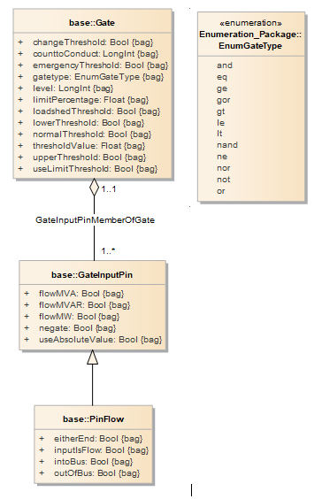
Remedial Action Scheme Changes Illustrated
CIM 10
CIM 16

Slide 66
Ownership and Operatorship Modeling
In MAGE with CIM 16, the central Ownership and Operatorship classes linked to each relevant object will still exist.
While CIM 16 moved to the OperatingShare class, MAGE limitations means that the Ownership and Operatorship classes are retained.

