Slide 1
Reliability Assessment Preparation Update
Supply Analysis Working Group
Pete Warnken
Resource Adequacy Department
September 19, 2025

Slide 2
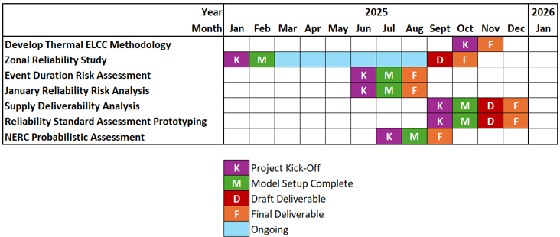
Current SERVM Project Schedule

Slide 3
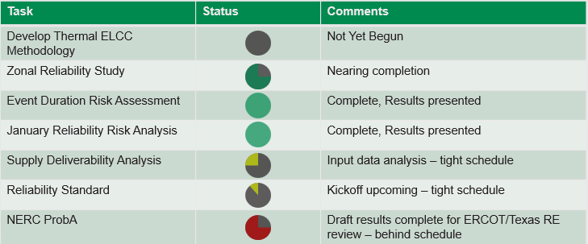
SERVM Project Status

Slide 4
Reliability Assessment Assumption Status
  Table at right is not intended to cover all assumptions that may be documented in ERCOT’s Assumptions filing

