Slide 1
Weatherization & Inspection
Overview of Attachment K and Supplement to Attachment K
Sheri Messer
Weatherization Program Analyst
Raihan Khondker Manager, Weatherization
Date: September 17, 2025

Slide 2

Weatherization & Inspection Program Overview
Background
Mandated in response to extreme weather events and established by Public Utility Commission of Texas (PUCT) Rule 16 Texas Administrative Code (TAC) §25.55.
The program's goal is to ensure generation and transmission assets are prepared for both winter and summer extremes to enhance grid reliability.
Key Program Elements
Mandatory On-Site Inspections: ERCOT inspects all Generation Resources at least once every 3 years and a minimum of 10% of Transmission Service Provider facilities every three years.
Declarations of Preparedness: Asset owners must annually submit notarized declarations attesting that they have completed all weather preparedness requirements.
Deficiency Management: The program includes a formal process for identifying compliance deficiencies, establishing mandatory cure periods, and reporting non-compliance to the PUCT.
Execution
Inspections are conducted by a team of ERCOT Certified Weatherization Inspectors (CWIs) who complete a rigorous, year-long training program involving extensive technical modules and on-the-job field hours.
Key Takeaway: The Weatherization & Inspection program enforces mandatory state standards through expert inspections to verifiably improve the resilience of the Texas grid against extreme weather.
1

Slide 3
Impact & Results
Scale: Over 2,028 winter inspections have been completed across 4 winter seasons since the program began in December 2021.
For the winter 2024-2025 inspection season, we inspected 309 generation resources and 151 transmission substations.
Proven Reliability: The program has had a significant positive impact on reliability, demonstrated by a measurable decrease in forced outages for thermal generators during recent winter storms. Effective winterization is a key factor in maintaining generation availability during extreme weather.
*
2021 – Uri
2022 – Elliot
2024-2025 – Heather, Enzo, Kingston, Cora
Key Takeaway: The program's impact is measurable, with data showing a significant and sustained reduction in forced outages during major winter storms since its implementation.
2

Slide 4
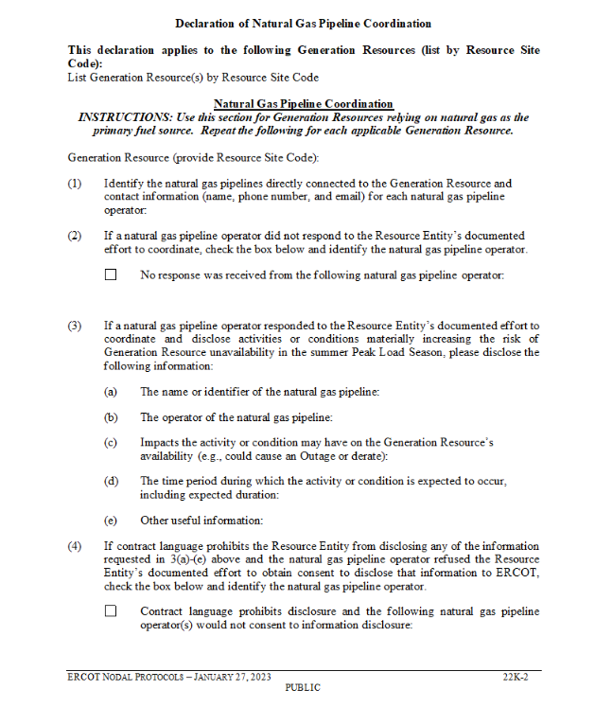
Declaration of Natural Gas Pipeline Coordination
Regulatory Foundation
The requirement for this declaration is established by two key governing documents and is now integrated with the summer Declaration of Weather Preparedness.
ERCOT Nodal Protocol 3.21: Requires Resource Entities with natural gas-fueled generation to submit the "Declaration of Natural Gas Pipeline Coordination." This declaration is specified as Attachment K in Section 22.
PUCT Rule 16 TAC §25.55(c)(3)(B)(iv): Authorizes ERCOT to specify and collect this additional information as part of the weather preparedness process.
Key Takeaway: The requirement for gas-electric coordination is formally established in both PUCT Rules and ERCOT Protocols, integrating fuel supply awareness into grid preparedness.
Notes:
16 TAC 25.55(c)(3)(B)(iv)
Includes any additional information required by the ERCOT protocols in effect as of April 1 of the year in which the declaration is submitted;

Slide 5
The Attachment K Declaration: Purpose & Details
Purpose
To formally document communication efforts between gas-fired generators and their direct-connect pipeline operators.
Proactively identify potential fuel supply risks that could impact generator availability during the peak season.
Required Details
The form requires a Market Participant to provide the following for each applicable generator:
Pipeline Identification: A list of all directly connected pipelines and their operator contact information (name, phone, email).
Coordination Status: An indication of whether a pipeline operator was non-responsive to your coordination attempts.
Risk Disclosure: Details of any potential risks identified by the pipeline operator, including the potential impact (e.g., outage or derate) and the expected timeframe.
Disclosure Limitations: A note if contractual language prohibits sharing risk information and the operator refused to grant consent.
Key Takeaway: Attachment K is the specific tool used to document communication, identify potential fuel supply risks, and report any coordination challenges with pipeline operators.
Notes:
16 TAC 25.55(c)(3)(B)(iv)
Includes any additional information required by the ERCOT protocols in effect as of April 1 of the year in which the declaration is submitted;

Slide 6
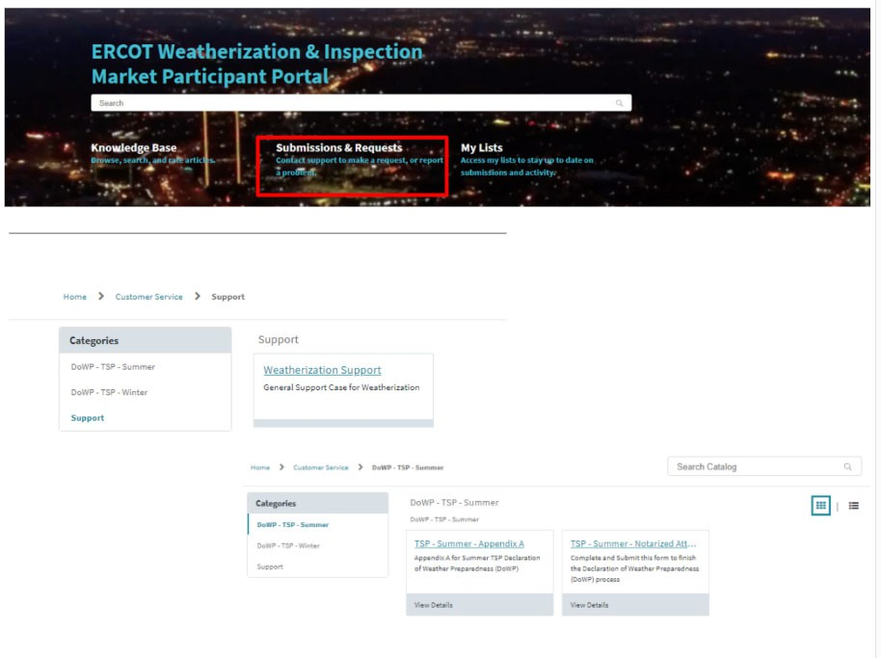
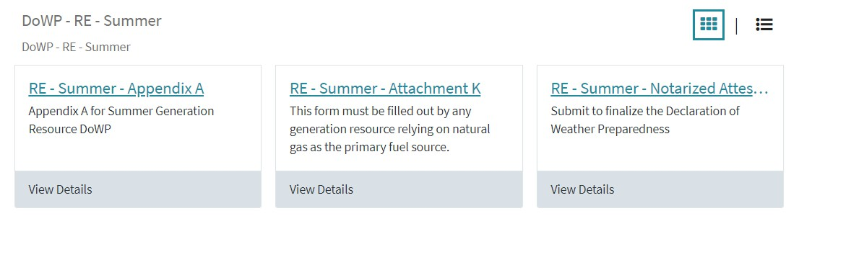
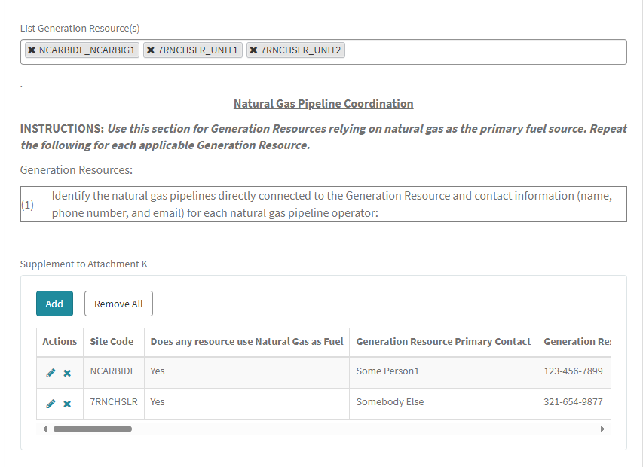
3.21, Submission of Declarations of Natural Gas Pipeline Coordination & 22, Attachment K Nodal Protocol Revision Request (NPRR)
A draft NPRR is in progress to acknowledge that the method of submitting the Declaration of Natural Gas Pipeline Coordination has been modernized to an electronic format.
Information in the Declaration will continue to be submitted with the summer Declaration of Weather Preparedness through the Weatherization & Inspection Market Participant Portal.
The information required in the declaration will not change.

Slide 7
Thank You!
Additional W&I Summer and Winter Readiness details at:
Summer: https://www.ercot.com/gridinfo/resiliency/summerready
Winter: https://www.ercot.com/gridinfo/resiliency/winterready

