Slide 1
Information Technology Report
Mick Hanna
Manager, Market Applications Services Support
ERCOT Public September 2025

Slide 2
Incident Report Highlights – August
Service Availability
  Retail Market IT systems met all SLA targets.
  Market Data Transparency IT systems met all SLA targets.
Retail Incidents & Maintenance
  8/10/2025 Site Failover
  8/24 and 8/27 Retail Release
Non Retail Incidents & Maintenance
  8/7/2025 Site Failover
  8/28/2025 Application Release
ListServ Incidents & Maintenance
  8/10/2025 Site Failover
  SLA Documents and Incident Reporting
  https://www.ercot.com/services/sla/

Slide 3
MarkeTrak Performance
MarkeTrak
August 2025 | Availability (%) | Response Time (seconds) |  | SLO (seconds)
 |  | Monthly Average | 12 Month Average
API QueryDetail | 100.00 | .32 | 0.28 | 2
API QueryList | 100.00 | 2.31 | 1.16 | 10
API Update | 100.00 | .41 | 0.44 | 10
GUI | 99.95 | 1.11 | 1.20 | 10
Average | 99.96

Slide 4
MarkeTrak Volumes
MarkeTrak
August 2025 | Volume
 | Monthly Total | 12 Month Average
API QueryDetail | 102485 | 134647
API QueryList | 70429 | 70514
API Update | 11748 | 22312

Slide 5
August ListServ Stats
3666 Posts
433487 Recipients
RMS List Highlights
  63 Posts
  9 New Subscriptions
  0 Unsubscribes
TDTMS List Highlights
  4 Posts
  0 New Subscriptions
  0 Unsubscribe

Slide 6
Weather Moratorium Removals
DATE | LIST | EMAIL | ACTION
2025-07-01 15:20:22 | weather_moratoriums | dlopez@FREEPOINTSOLUTIONS.COM | SIGNOFF
2025-07-02 13:14:23 | weather_moratoriums | Tsandersparis@YAHOO.COM | SIGNOFF
2025-07-20 00:00:02 | weather_moratoriums | german.tellez@UBIQUITY.COM | AUTODEL
2025-07-23 13:57:08 | weather_moratoriums | retail-ops@GRIDMATIC.COM | SIGNOFF
2025-07-28 08:37:25 | weather_moratoriums | witiinow@HOTMAIL.COM | SIGNOFF
2025-07-28 11:59:26 | weather_moratoriums | ktrabo@AOL.COM | SIGNOFF
2025-08-01 08:56:35 | weather_moratoriums | wedum@ATT.NET | SIGNOFF
2025-08-01 10:58:05 | weather_moratoriums | kmarriott@MILLERBROS.US | SIGNOFF
2025-08-06 12:46:02 | weather_moratoriums | smace@AARP.ORG | SIGNOFF
2025-08-08 10:42:44 | weather_moratoriums | reprelations@ONCOR.COM | SIGNOFF
2025-08-13 06:10:03 | weather_moratoriums | Melenda.Meazle@ONCOR.COM | SIGNOFF
2025-08-15 00:00:05 | weather_moratoriums | ppinilla@AGRGROUPINC.COM | AUTODEL
2025-08-18 12:40:41 | weather_moratoriums | Caroline@REEDERCAP.COM | SIGNOFF
2025-08-18 16:12:56 | weather_moratoriums | UtilityRelations@RSPOWER.COM | SIGNOFF
2025-08-20 00:00:04 | weather_moratoriums | RGahn@FREEPOINTSOLUTIONS.COM | AUTODEL
2025-08-20 08:37:27 | weather_moratoriums | abel.garcia@YARDI.COM | SIGNOFF

Slide 7
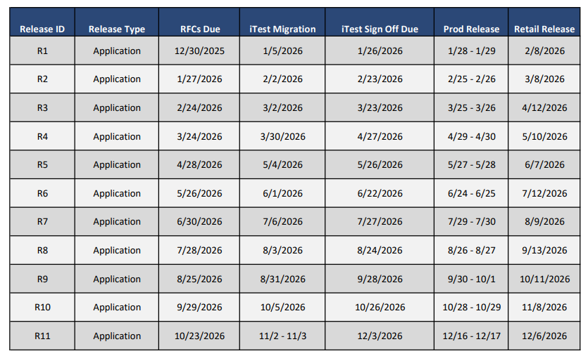
Proposed 2026 Release Calendar Draft

Slide 8
2026 SLA Discussion
Split the Retail and ListServ SLAs into separate documents.
Discuss SLA ownership for ListServ and Market Data Transparency; TWG or others?
IT Services Report – should it be moved to a redirect to Market Notices or retired?

