Slide 1
RTC LFC Closed Loop Market Summary
ERCOT Staff
RTCBTF
September 16, 2025

Slide 2
LFC Closed Loop Test Summary
09-11-2025

Slide 3
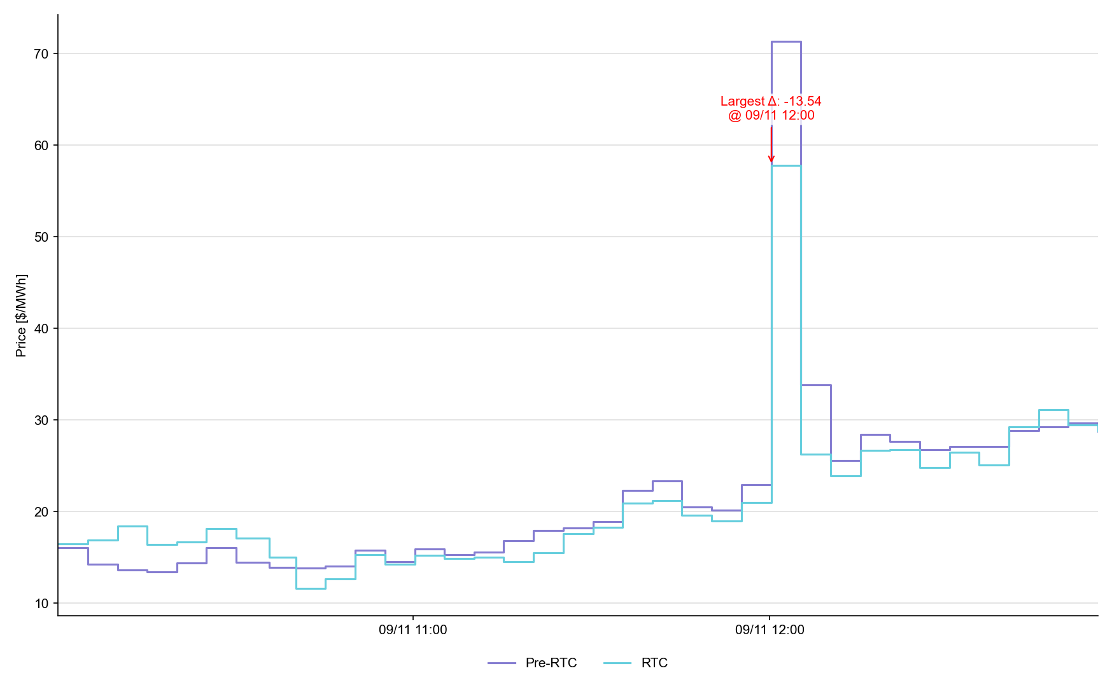
System Lambda (plus Adders)

Slide 4
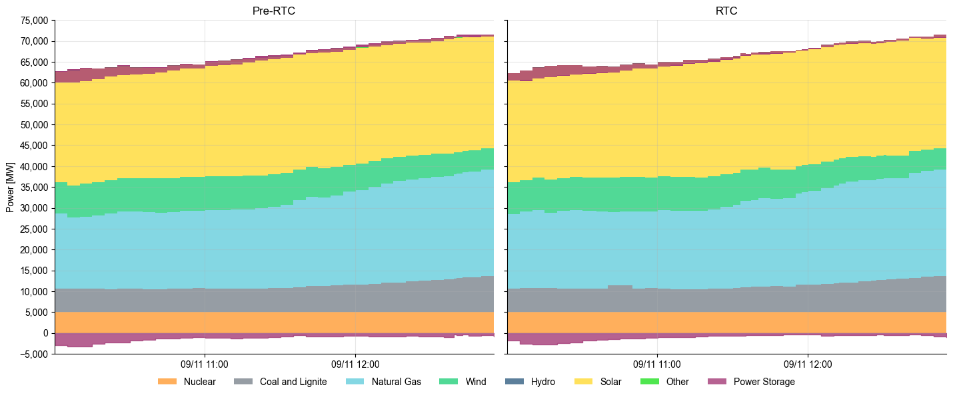
Dispatch Summary by Resource Type

Slide 5
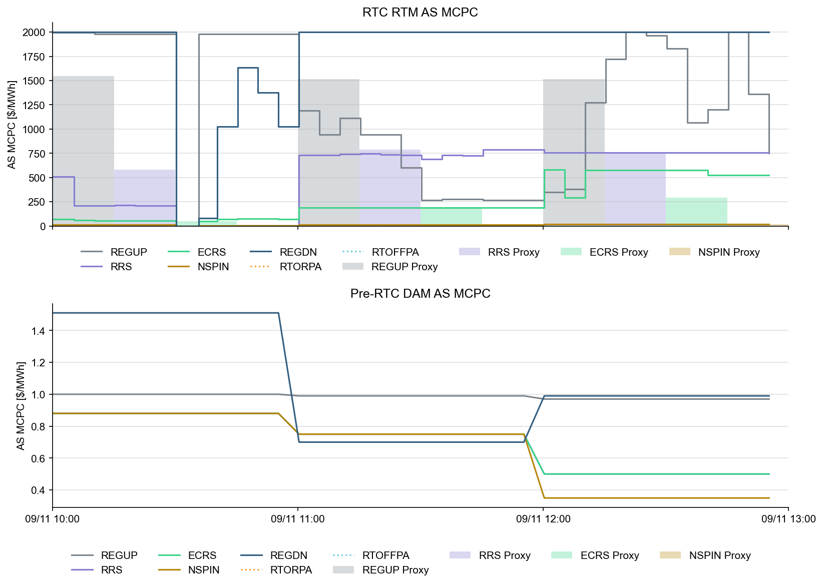
Ancillary Service Prices

Slide 6
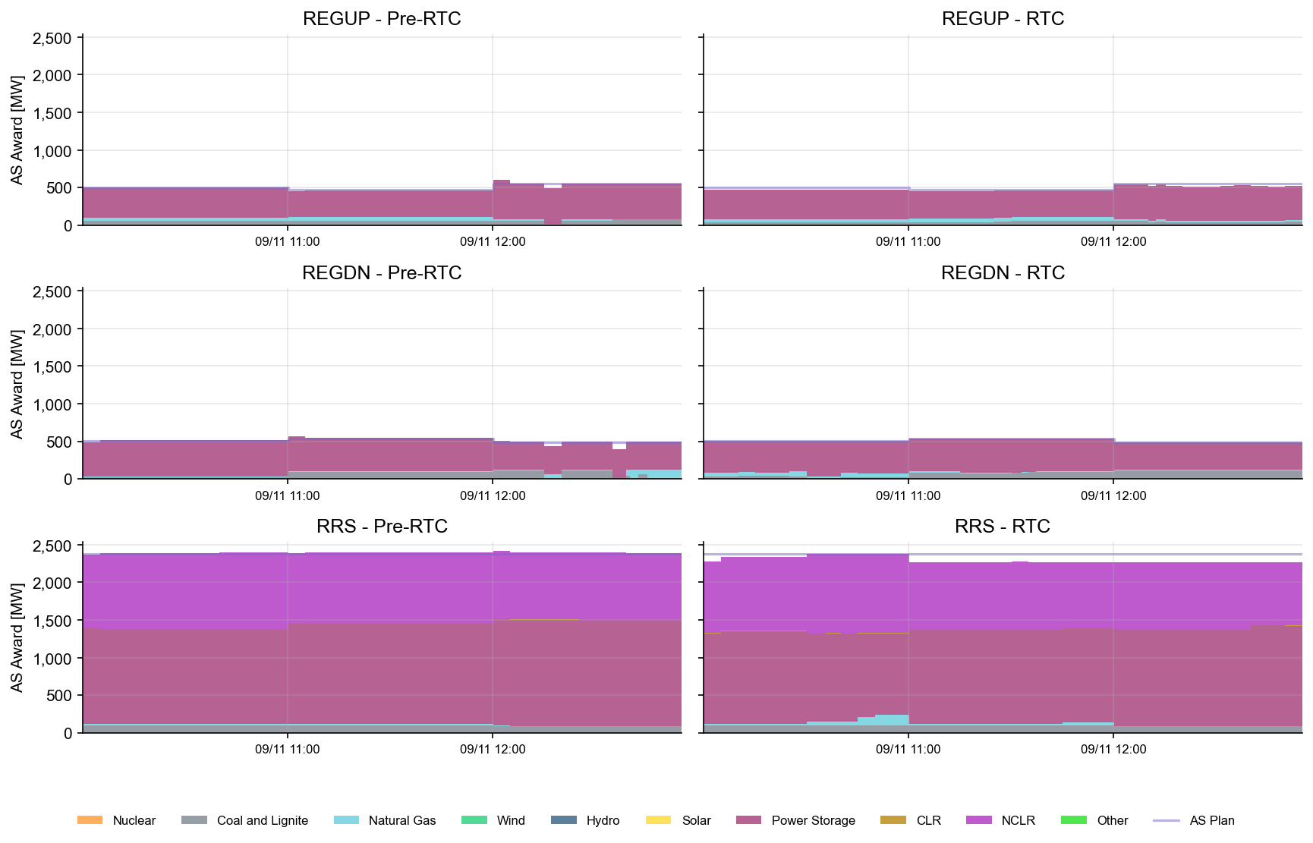
AS Awards* Summary by Resource Type
* Pre-RTC (RTM AS Schedule)
* Pre-RTC (RTM AS Schedule)

Slide 7
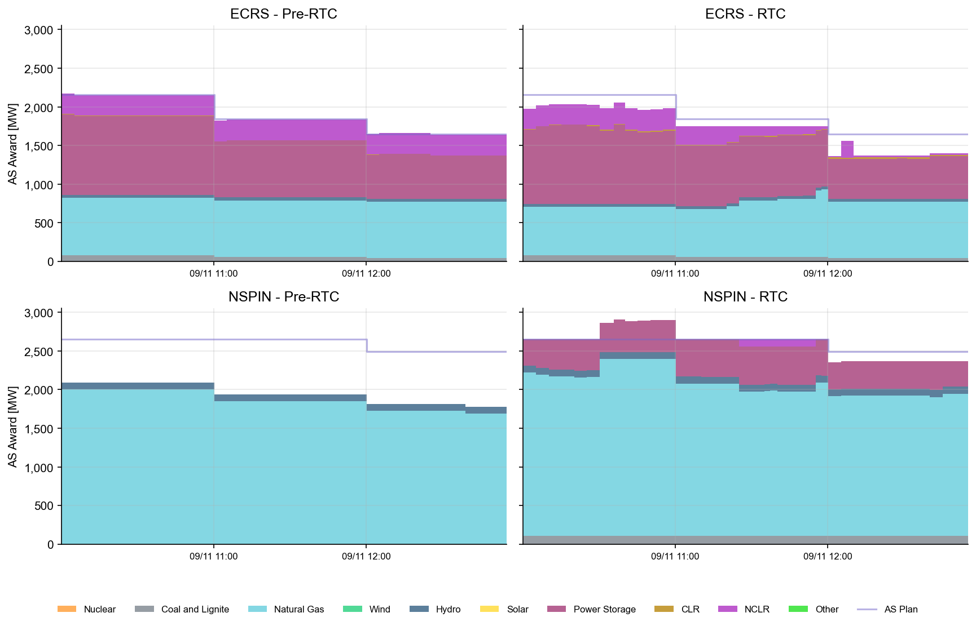
AS Awards* Summary by Resource Type
* Pre-RTC (RTM AS Schedule)

Slide 8
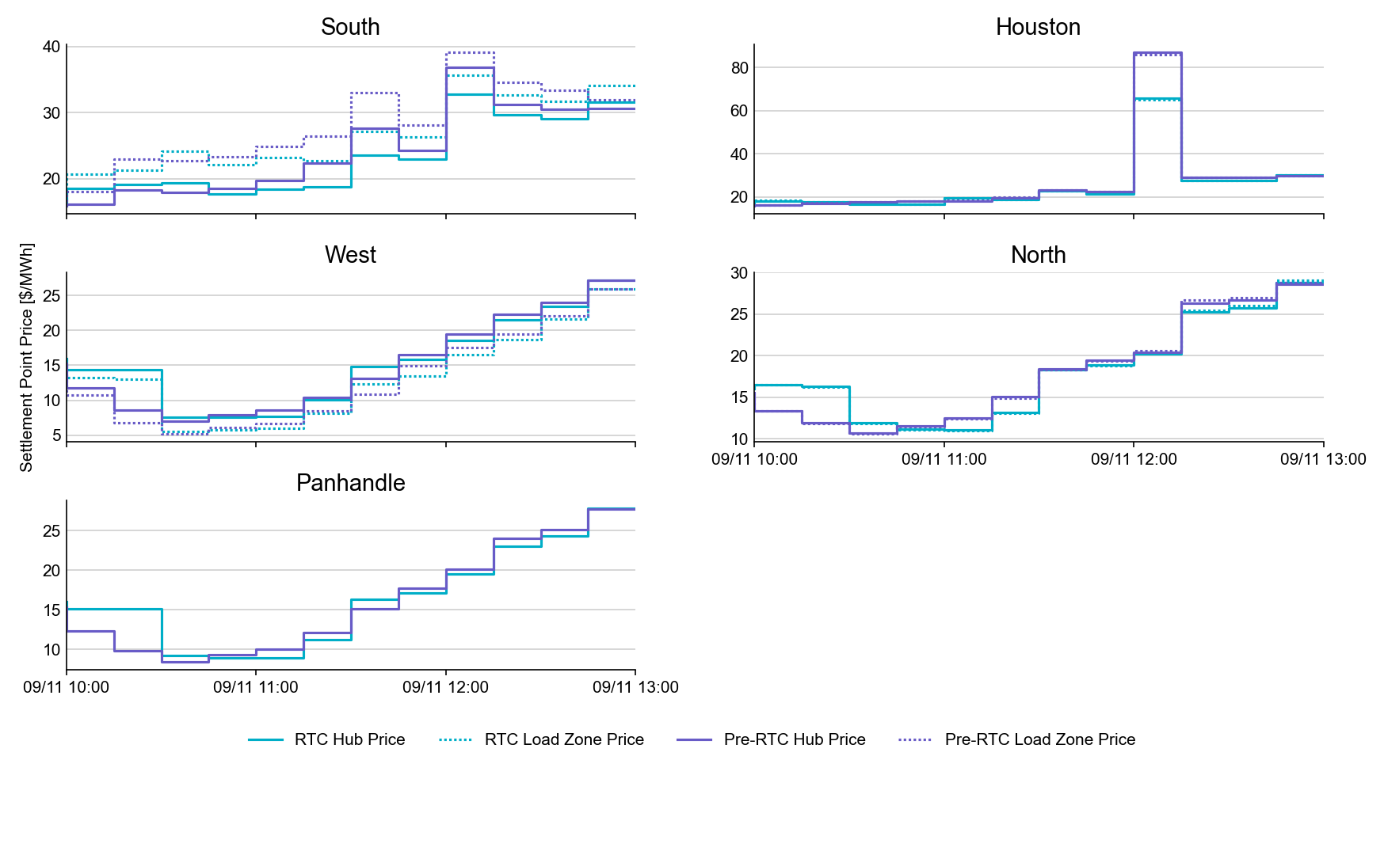
SPP by Hub and Competitive Load Zone

Slide 9
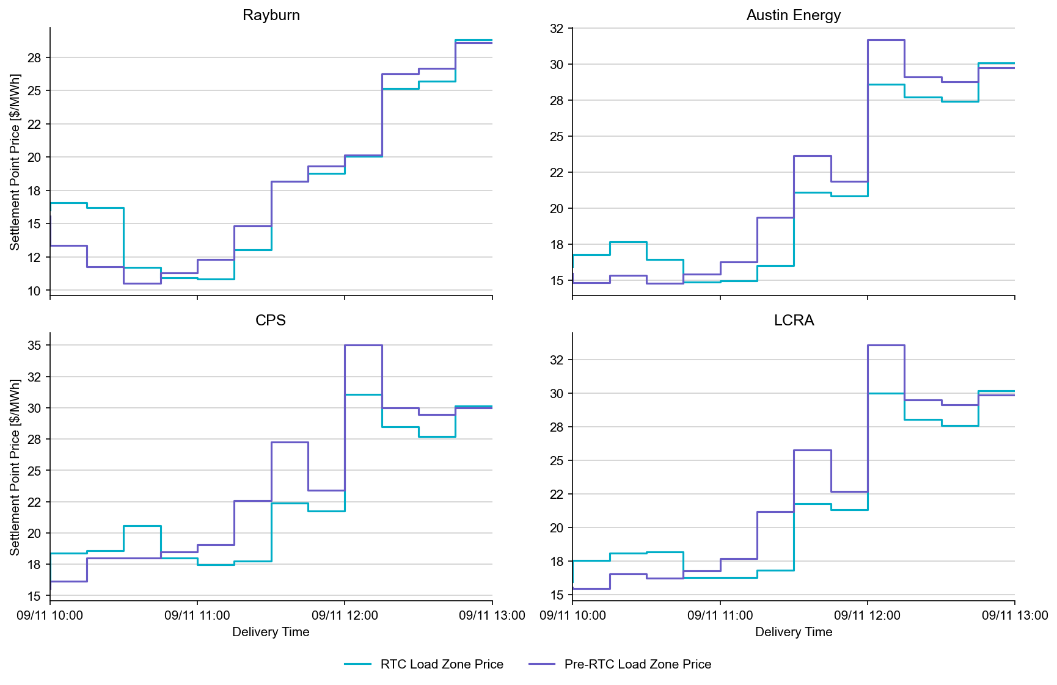
Settlement Point Prices by NOIE Load Zone

Slide 10
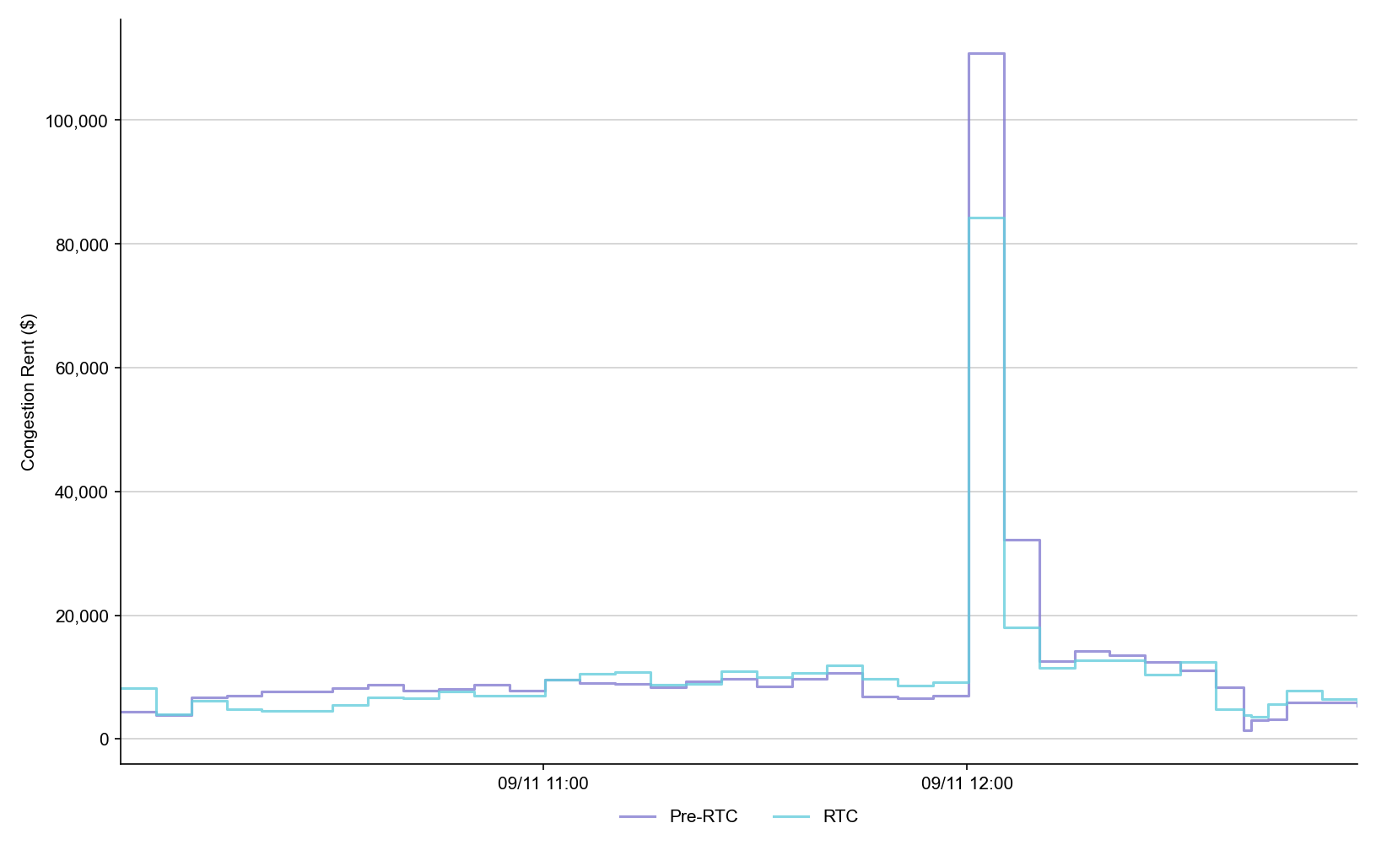
Congestion Rent

Slide 11
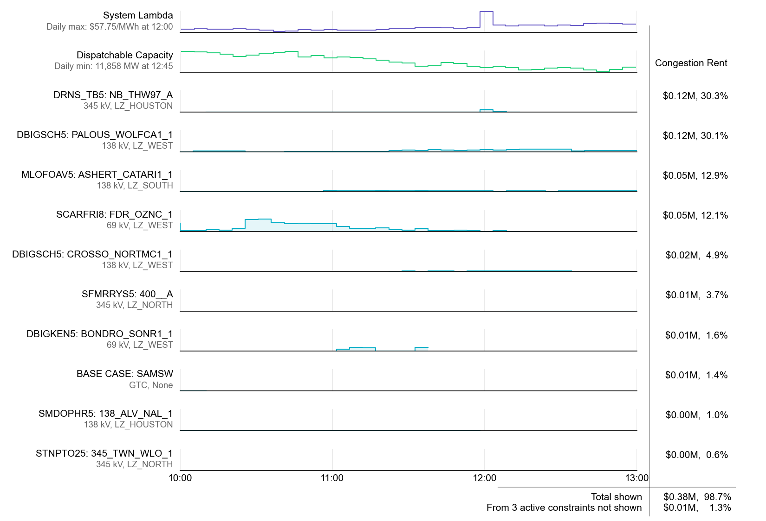
RTC SCED Binding Constraints

Slide 12
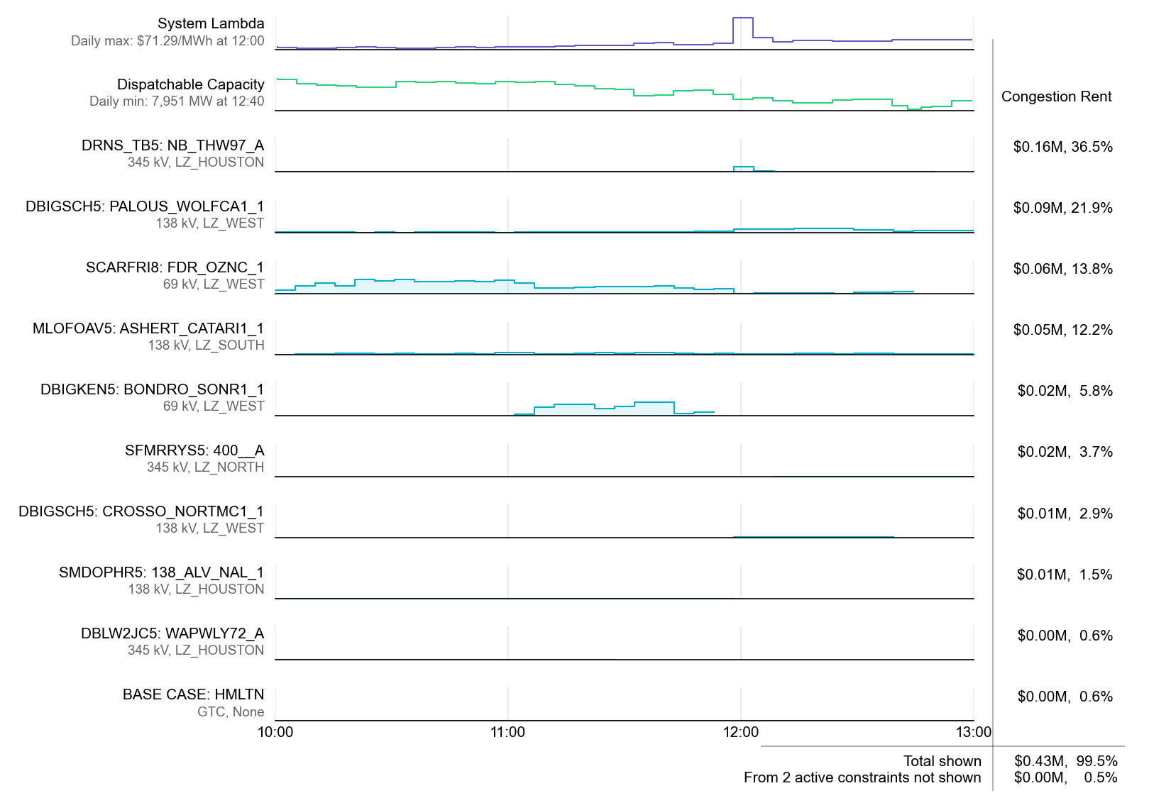
Pre-RTC SCED Binding Constraints

Slide 13
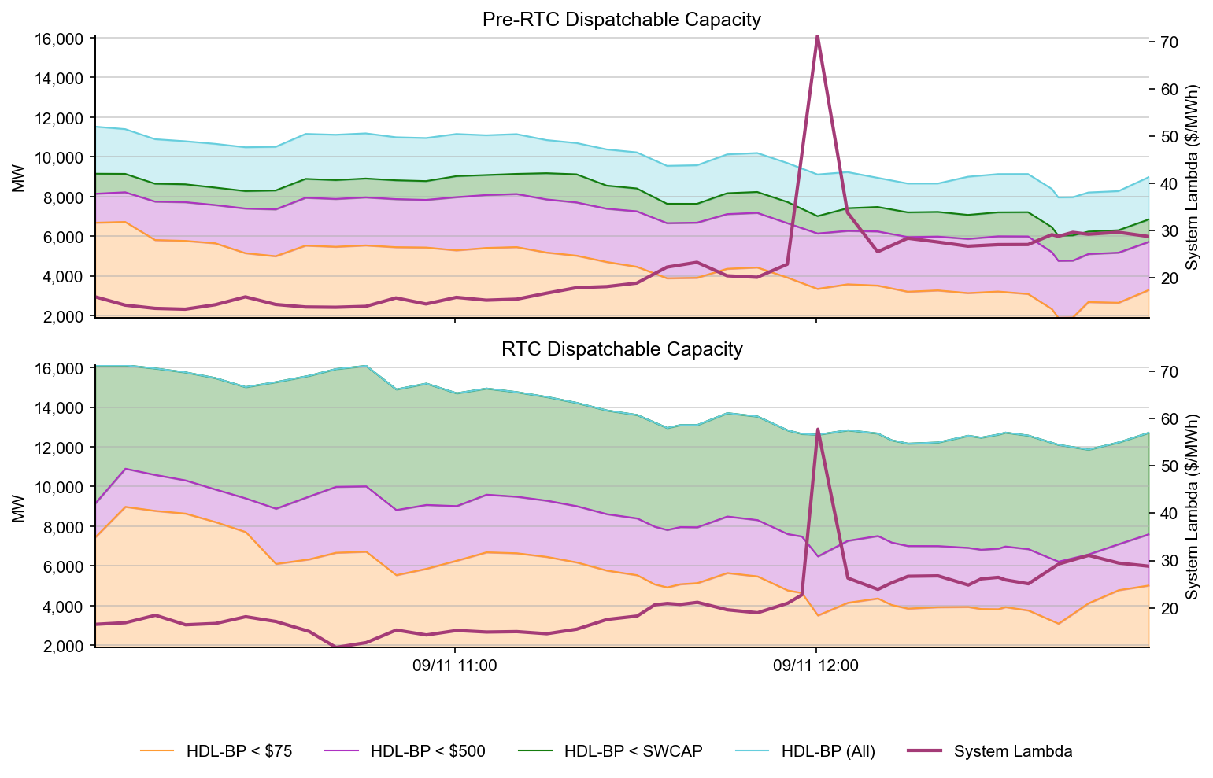
Dispatchable Capacity

Slide 14
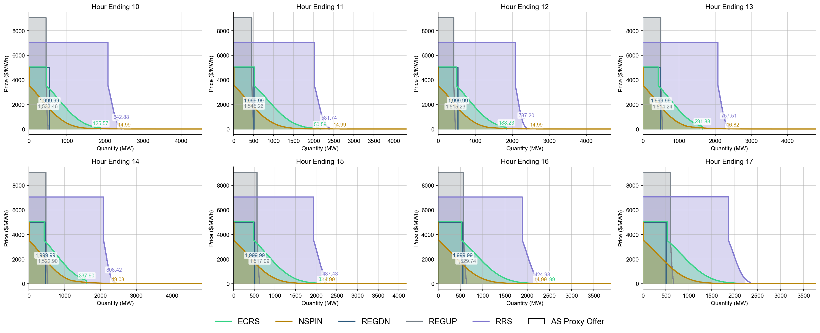
Ancillary Service Demand Curves

