Slide 1
ERCOT Frequency Control During Closed Loop Test on 9/11/25
ERCOT Staff
RTCBTF | 9/16/25

Slide 2
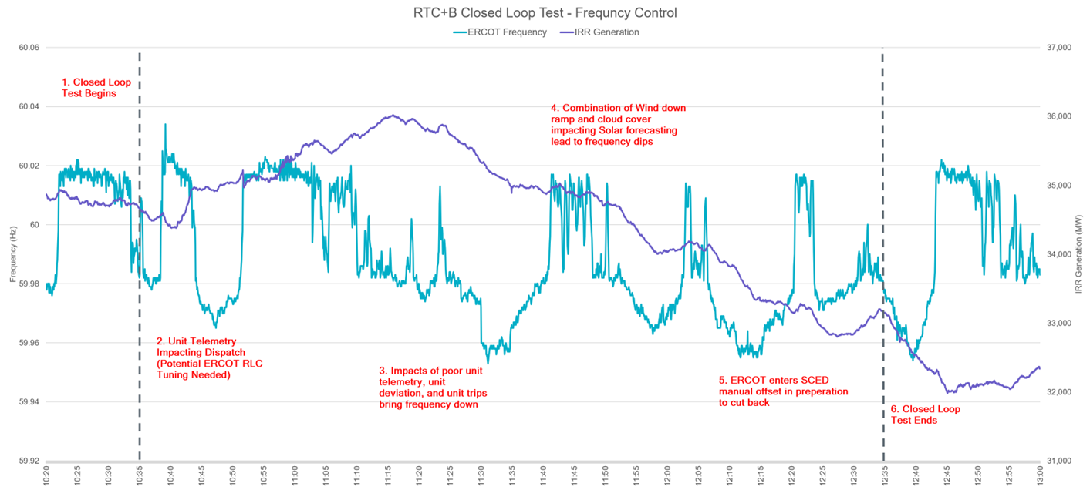
Frequency control Review
Factors that impacted Frequency control:
  Inconsistent telemetry received on handful of units triggered abnormal RLC validation. ERCOT will improve RLC validation to handle this situations going forward.
  An IRR unit was unable to follow the set point when curtailed. ERCOT is working with the QSE to identify the root cause issue.
  There were two small unit trips.
  There was a 3000 MW ramp down in wind generation and further cloud movement impacted Solar generation. There were several 5-min intervals where Wind and Solar down ramp exceeded the forecasted values.
Control room actions:
  6 off cycle SCED runs and two positive offsets of 200 MW were applied.
Notes:
@11:33,11:37,11:57,12:12,12:27 and 12:31.
was applied for 12:15 and 12:20 SCED runs in preparation for cutback.

Slide 3
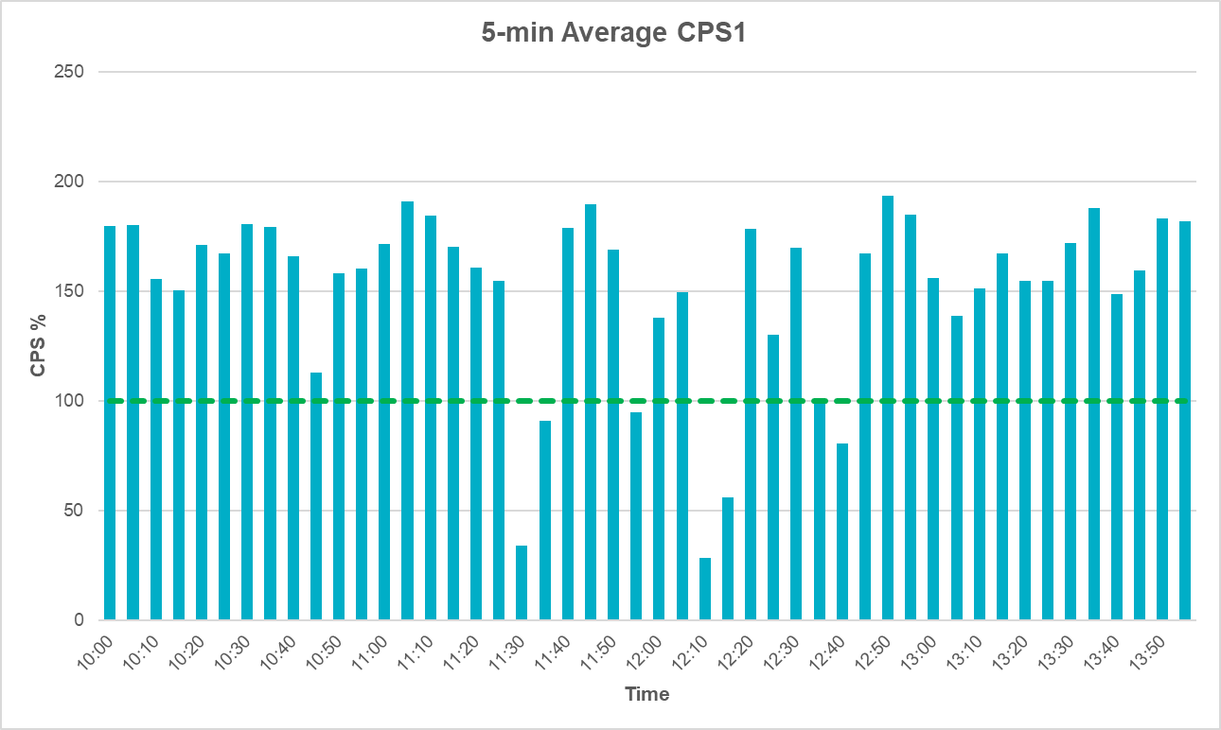
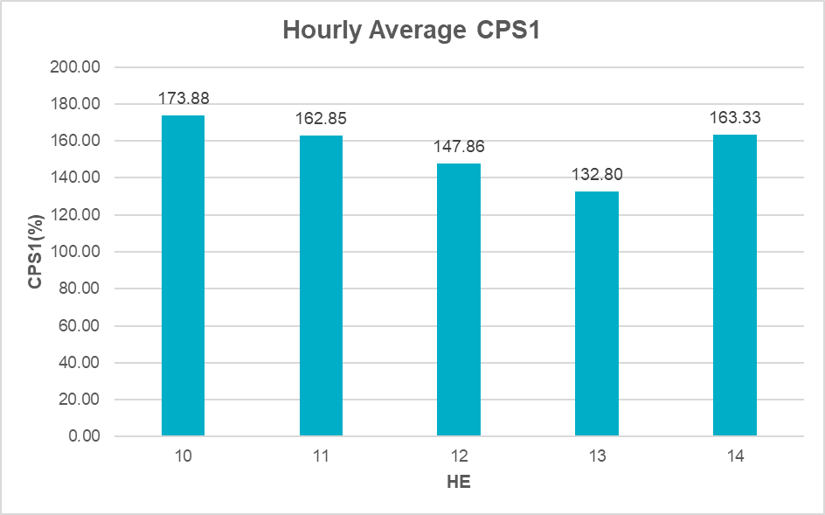
ERCOT CPS1 during the test
Per NERC BAL-001-1,Control Performance Standard1(CPS1) is a measure of a Balancing Authority’s(BA) ability to balance its Load and Generation in real-time to maintain steady-state frequency.
NERC BAL-001-1 requires BA’s to maintain a minimum CPS1 requirement of 100% on a rolling 12-month basis
Key Takeaway: Even though there were few 5-min periods where average CPS1 dropped below 100%, hourly average CPS1 scores from the period were above 100% and ERCOT met its BAL-001 frequency control requirement. ERCOT’s 12-month rolling average CPS1 score is 176.70%.

Slide 4
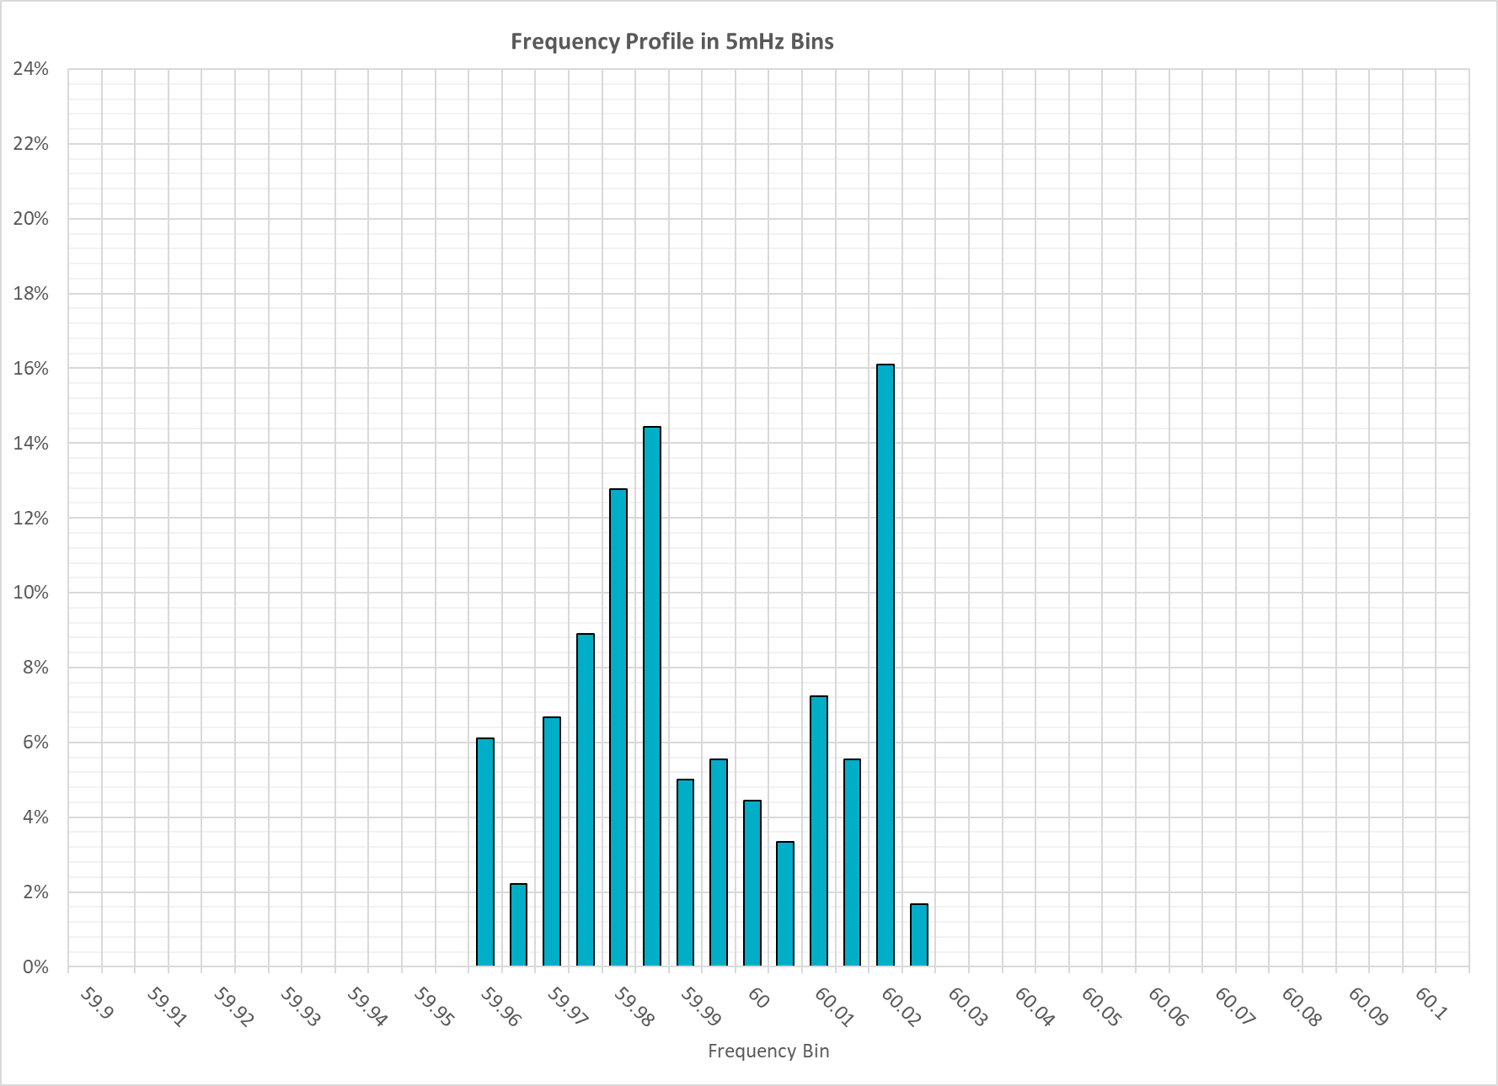
ERCOT Frequency profile during test
Min = 59.953 Hz
Avg = 59.986 Hz
Max = 60.034 Hz
Key Takeaway: During the test Frequency remained with 50mHz from the scheduled Frequency, i.e. 60 Hz.

Slide 5
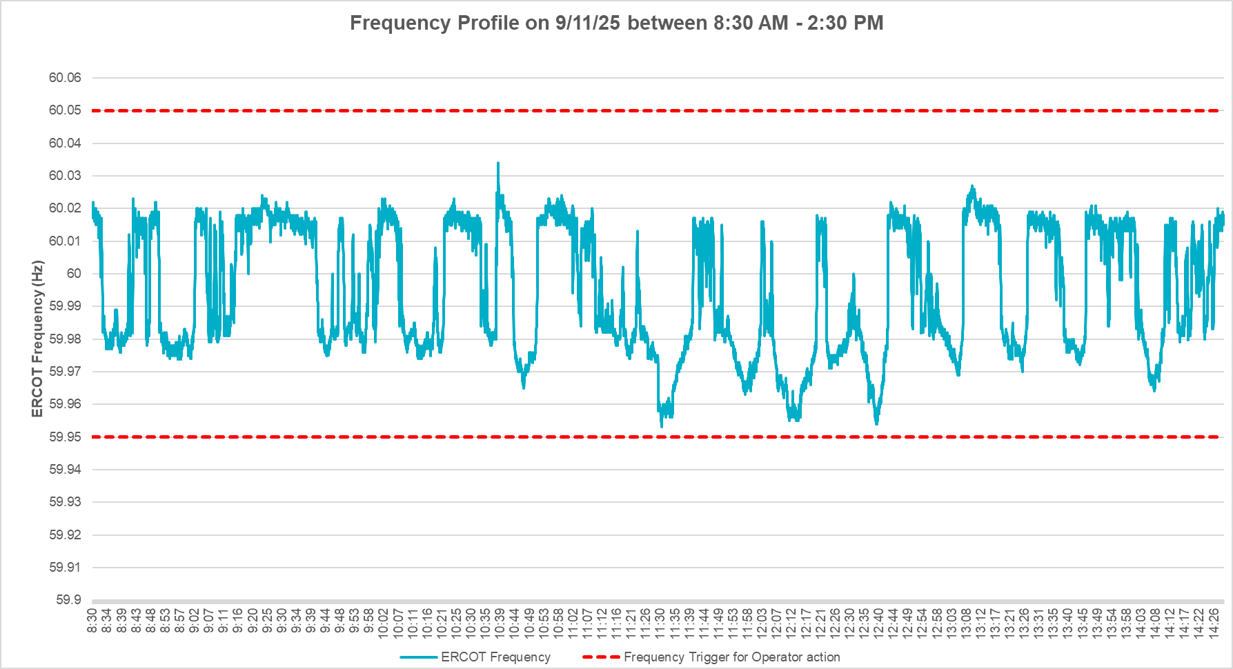
EROCT Frequency profile on 9/11/25 between 8:30 AM – 2:30 PM
Test window

Slide 6
Summary
On 9/11/25 between 10:35 and 12:35, grid frequency was controlled for two hours from the ERCOT control room on RTCB systems. ERCOT met its BAL-001 frequency control requirements.
There were a few 5min periods where the average CPS1 scores dropped below 100% due to
  (1) larger than forecasted down ramp from Wind and Solar generation
  (2) Incorrect handling of inconsistent QSE telemetry
  (3) Curtailed unit not following BP and
  (4) Unit trips.
ERCOT is working on correcting the RLC validations where applicable, working with impacted QSEs to identify root cause for set point deviations and is considering potential tuning of regulation deployment parameters in LFC.

Slide 7
Questions?
Thank you!

