Slide 1
RTCBTF
Special meeting for
RTC+B LFC Test 9/11 Summary
(with TWG invited)
ERCOT Staff
September 16, 2025

Slide 2
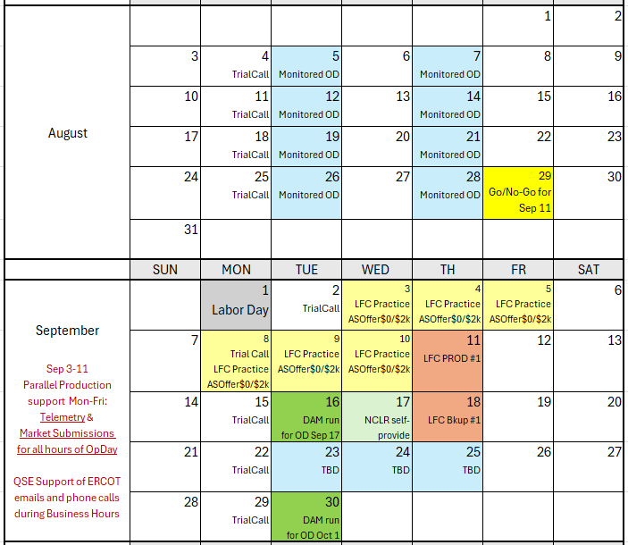
Leading up to LFC Test

Slide 3
Preparing and Supporting QSE inputs prior to test
Week leading up to the test
  First: Thank you for the years of work and months of market trials to get to the 9/11 test! Second: Thank you for the last-minute contact phone numbers!
  Telemetry Outreach
    Outreach began in August (well ahead of LFC test and previously described in market calls) and increased for the week leading into Sep 11.
    Daily emails and phone calls for resolving telemetry discrepancies
  Market Submissions Outreach
    Continued scorecards for submissions by QSE
    Added analysis and daily ERCOT emails to QSEs where:
      Energy offers not same in both systems
      Where RTC AS Offers different from Telemetered AS in real-time (post-SCED check)
      Check for AS Offer of $0/$2000
    Leading into test on September 10
      Energy offers not same in both systems and complying with $0/2000 AS Offers
      After 3pm outreach where RTC AS Offers different from COP AS responsibilities (pre-test check)
      Outreach until 9pm Sep 10, and resumed at 7am Sep 11
      Dozens of emails and calls leading right up to test to educate/reconcile identified gaps

Slide 4
Preparing and Supporting QSE inputs prior to test
Overall QSEs achievements:
  100% on QSE Submissions during the 2-hour window
    Some isolated quality issues, but overall, very successful
  98% on accurate telemetry
    Similarly, some isolated quality issues, but overall, very successful
Exemptions requests totaled 900MW
  Reminder that although all QSEs had proven in prior trial the capability to follow the new RTC-UDSP signal, some QSEs had control issues for certain resources and were allowed to request exemptions from Control Room the test (essentially sidelined with ONTEST status)
  Total of 900MW sidelines, mostly batteries

Slide 5
Proceed with rest of the LFC Test analysis
3 additional presentations:
  Frequency Control during Test
  RTC SCED results during test
  ERCOT Observations, Issues, and Lessons Learned for next test

