Slide 1
Weekly
RTC+B Market Trials Update
ERCOT Staff
September 15, 2025

Slide 2
Outline
Antitrust Admonition
9/11 LFC Summary and Analysis Snapshot
Scorecards (summary only)
Communicate any known Issues within On-going Trial
Expectations of QSEs for the Week
  Pivot to DAM, Adjustment Period, and SCED
Reminder of DAM and NCLR Self-Provision Mechanics
Q&A
Appendix- Supporting Materials:
  Attestation Market Notice
  Telemetry Screening
  New RTC Pricing reports location
  NPRR1290 market submission validation change
  Links to Handbooks
  Prior Scorecards
  FAQ Updated 9/8/2025
  Connectivity and Configuration (digital certs)

Slide 3
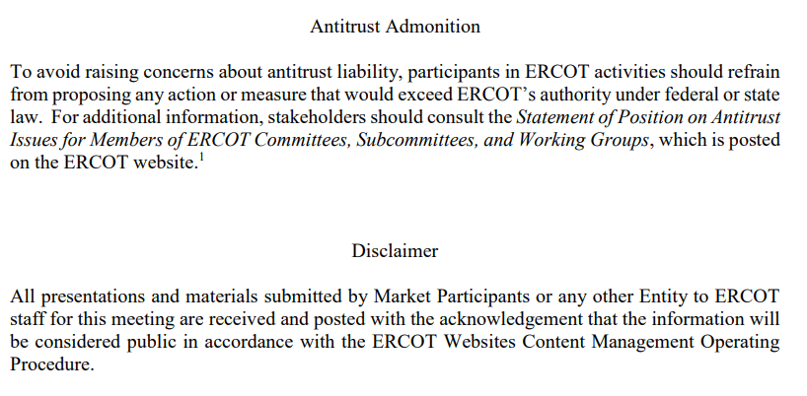
WebEx Meeting reminders (same as other ERCOT forums):
Please keep line muted
If you have a question, please use the chat feature to either:
  Type in your question, or
  Type in “Question” and wait to be recognized to state question

Slide 4
Sequence and Dates for Market Trials to Go-Live
Market trials are a progression of activities to mitigate the risk for Go-Live on new systems and processes for both the Market Participants & ERCOT.
30-day Market Notice
11/5/25
March/April
2025
Start
5/5/25
Start
7/7/25
Start
9/2/25
Go-Live
12/5/25*
May 2025
June 2025
July 2025
Aug 2025
Sep 2025
Oct 2025
Nov 2025
Dec 2025
QSE Scorecards & Exit Criteria for each Trial Phase
#1 RTC QSE Submission Testing
(Submit COP, RT AS Offers,
DAM Virtual AS, Outages for ESRs)
#3 Open-loop RTC SCED
(QSE offers, SCED non-binding award/dispatch)
#5 Ongoing Open-Loop
& Periodic Closed-loop SCED/LFC
(QSE RTC offers and telemetry to support closed-loop frequency control test 2-3 tests of 2-4 hour durations)
Transition to Go-Live
Upon completion of testing, confirmation of ERCOT and market readiness for Go-Live.
QSE/Vendor Submission Sandbox and Telemetry Points added Prod EMS model.
#2 RTC QSE Telemetry Checkout (QSEs add/verify new telemetry points for UDSP, New ramp rates, ESR telemetry)
#4 QSE Telemetry Tests
(Individual QSE to follow UDSP and support new ramp rate and ESR telemetry)
#6 Day-Ahead Market
(Non-binding DAM using QSE offers for at least 2 tests)
* Go-Live date reflects 12/5/2025 as first Operating Day
where 12/4/2025 is planned software migration.

Slide 5
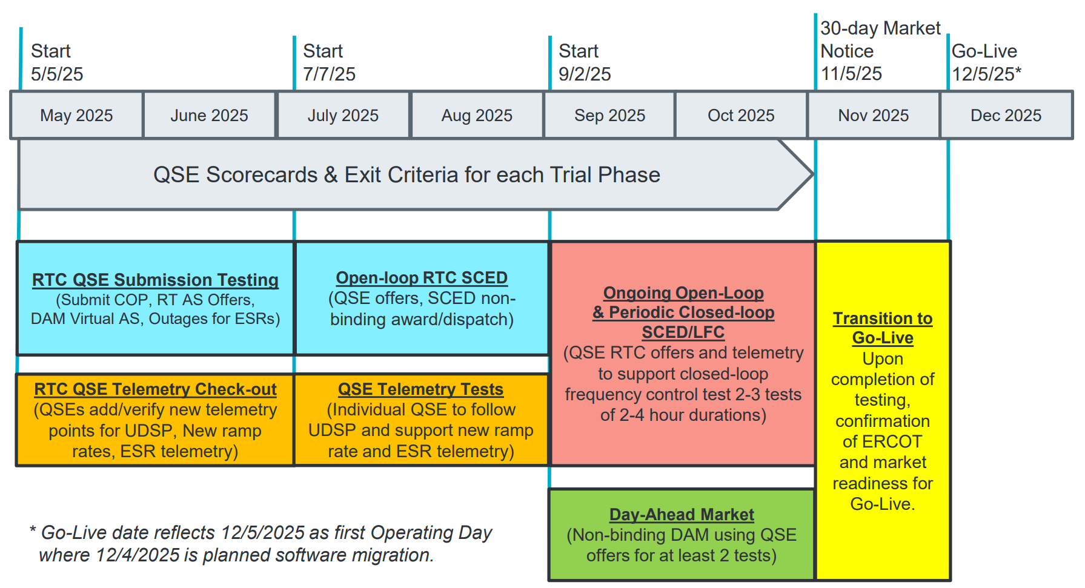
Sep & Oct:
Required live-production test to ensure effective frequency dispatch and control.
Sep & Oct:
Optional Day-Ahead Market
Voluntary Day-Ahead Market for all QSEs will be conducted at least 2 times.
QSE can test their market submissions for Day-Ahead AS Self-Arrangement, AS Only Offers, Trades and normal submissions.
DAM participation is strongly encouraged but not required in Readiness metrics since RTC procures AS in Real-Time.
Participation includes much broader QSE population (marketers and load-only QSEs).
ERCOT and QSEs will conduct live-production tests of RTC-SCED and Load Frequency Control (LFC) prior to go-live.
RTC-SCED and frequency control dispatch during the tests will be binding to manage the reliable operations of the grid for2-4 hours.
ERCOT will coordinate with QSEs on how to submit RTC offers and telemetry for Energy and AS for the two systems (current and RTC system).
ERCOT will provide a summary of the test and use analysis and engineering judgement to assess if the test was successful in controlling frequency.

Slide 6
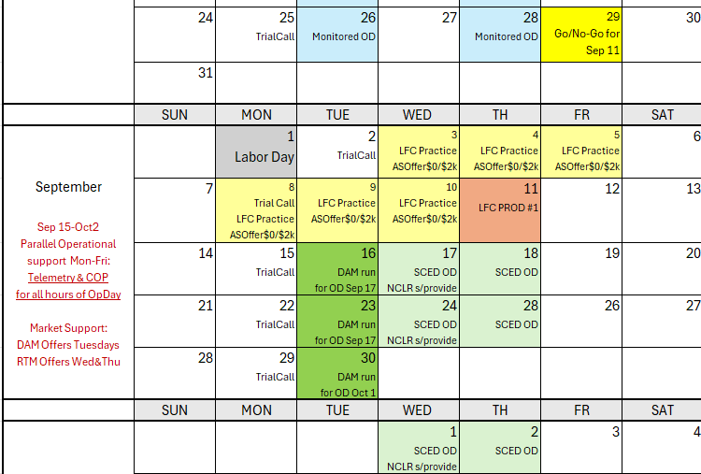
Market Trials Calendar for rest of September
We are here….
Moving second (last planned LFC test) to mid-late-October
NCLR s/provide = NCLR can use self-provision in SCED

Slide 7
Scorecards and Summary for LFC Test
Significant coordination last week- thank you!
Market Submissions- 100%
Telemetry- 98%
Based on ERCOT’s initial analysis, it appears this was a successful test from the following observations:
The frequency was controlled for two hours from the ERCOT control room on RTC+B systems
The real-time market (RTC+B SCED) successfully awarded and dispatched energy and ancillary services in real-time
Market participants were able to submit accurate telemetry/submissions and follow the RTC+B dispatch for 2 hours
Various ERCOT teams are spending time evaluating the details of the production test and will share its initial findings at next week’s RTCBTF, including a roundtable for stakeholder observation and lessons learned.
A reminder that ERCOT is dedicating RTCBTF Sep 16 meeting to the LFC Test analysis and adding another RTCBTF on Sept 25 or 26 as a regular meeting.

Slide 8
LFC Closed Loop Test Summary
09-11-2025

Slide 9
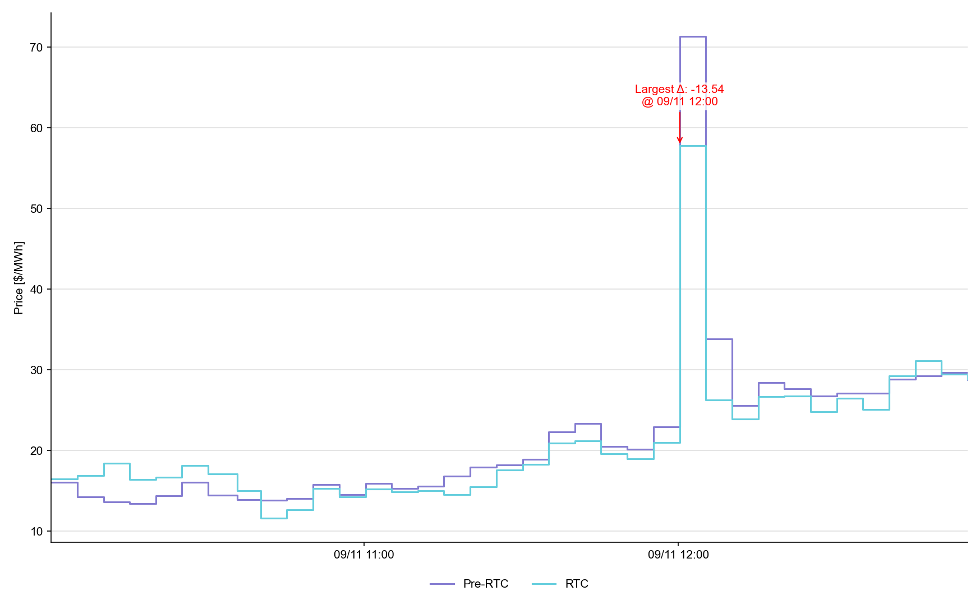
System Lambda (plus Adders)

Slide 10
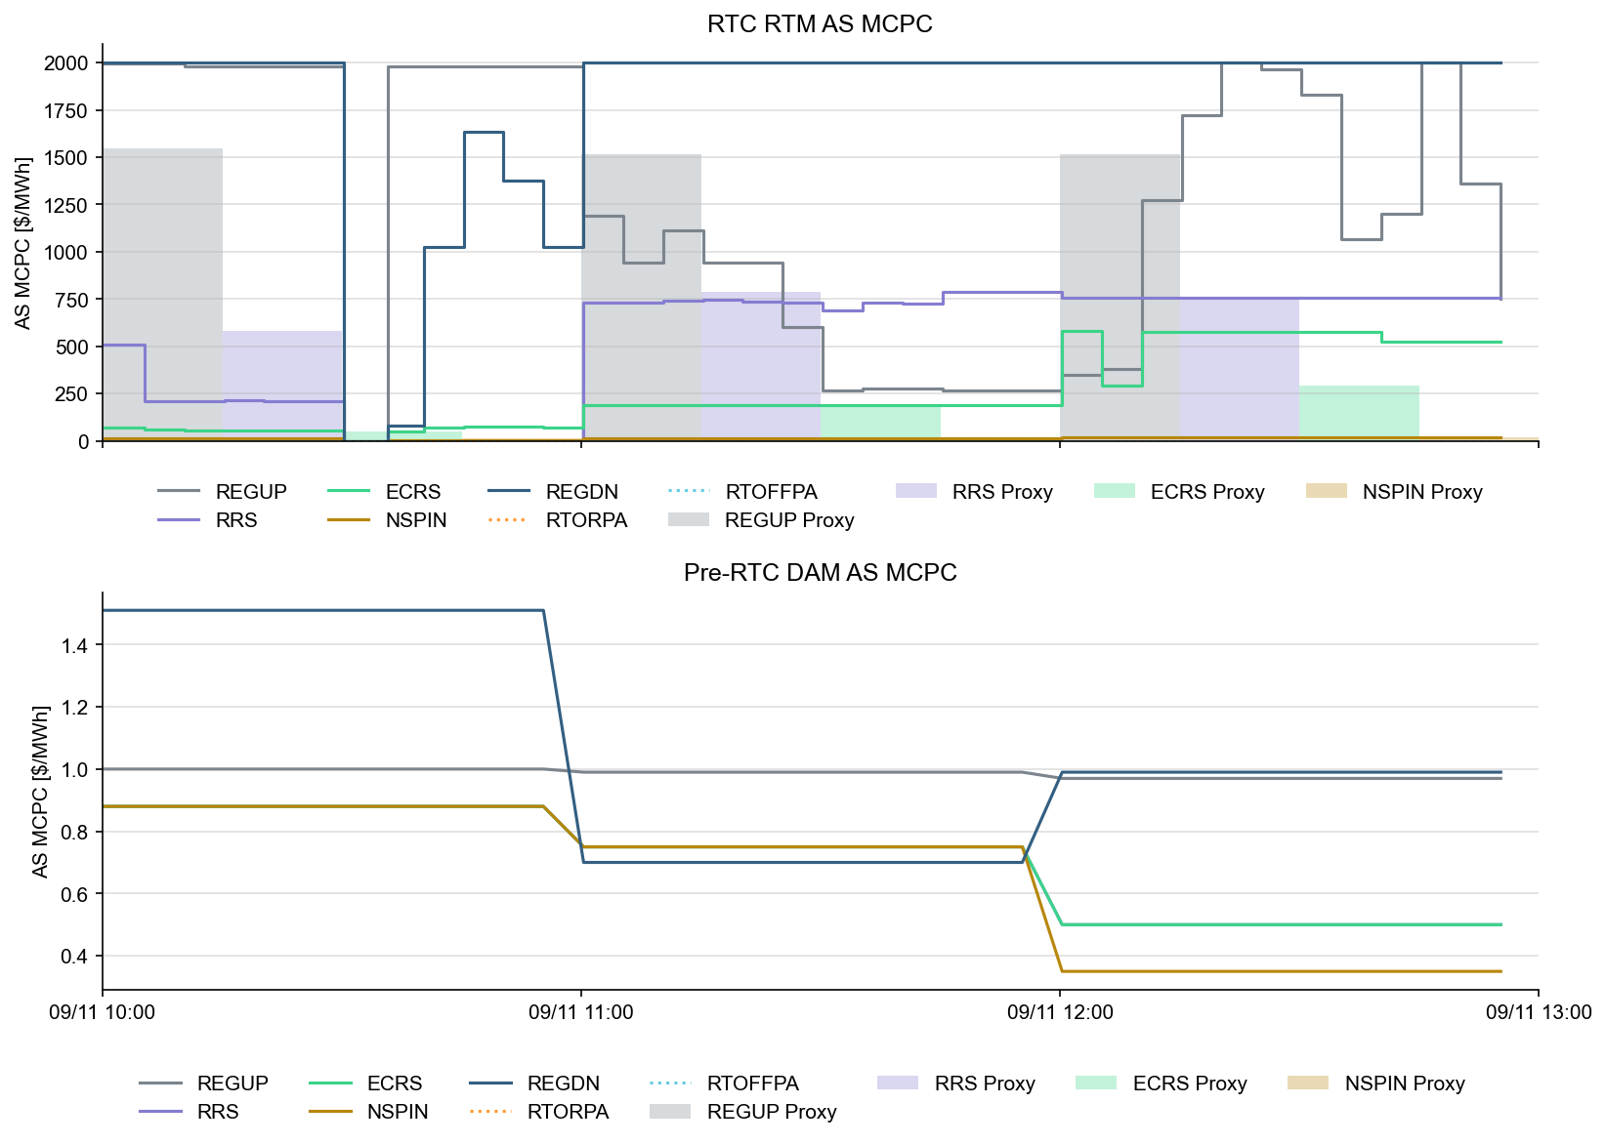
Ancillary Service Prices

Slide 11
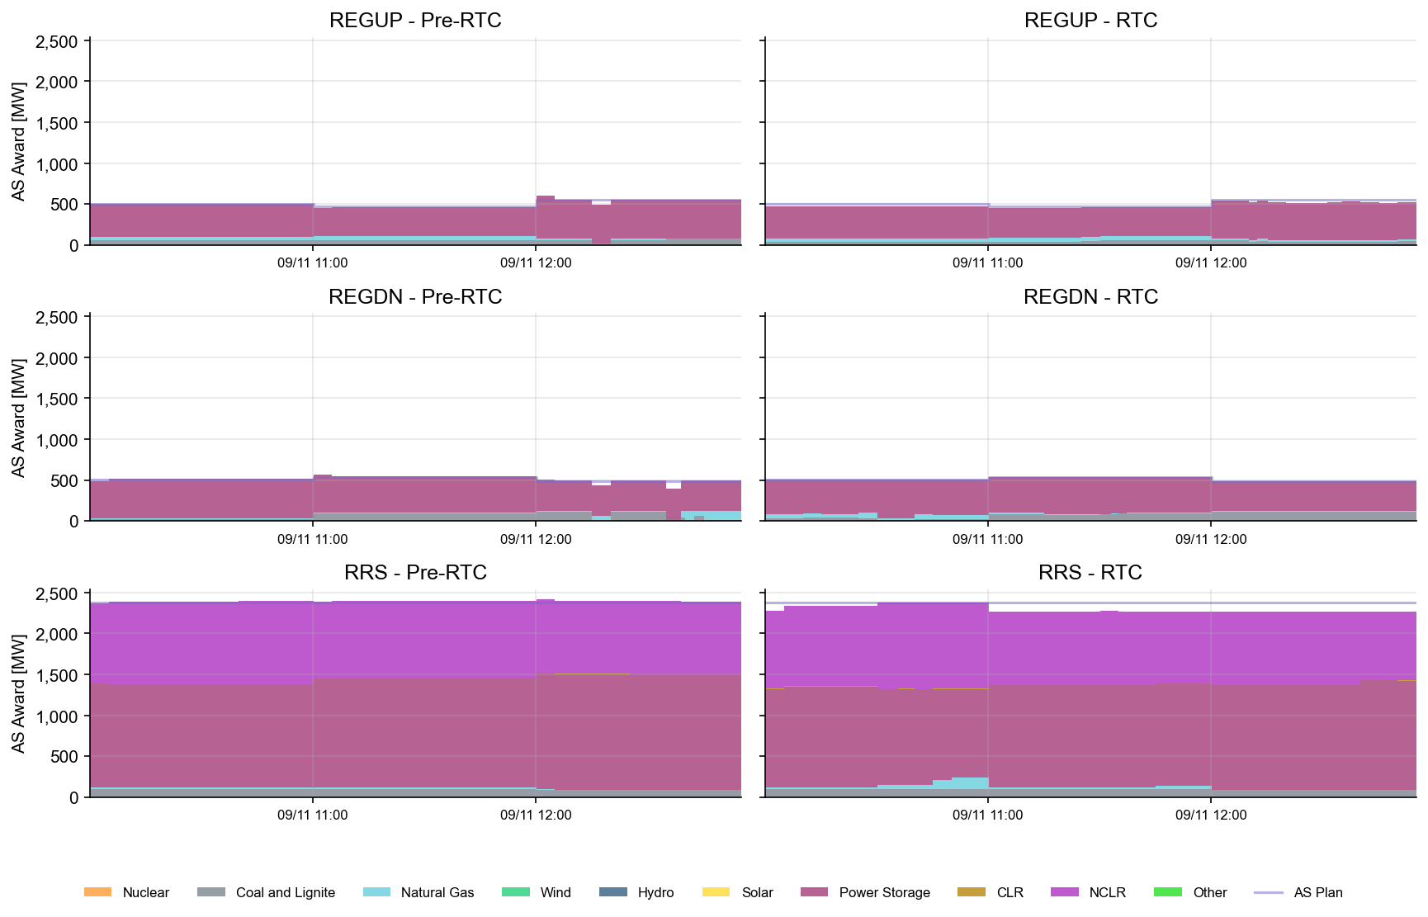
AS Awards* Summary by Resource Type
* Pre-RTC (RTM AS Schedule)
* Pre-RTC (RTM AS Schedule)

Slide 12
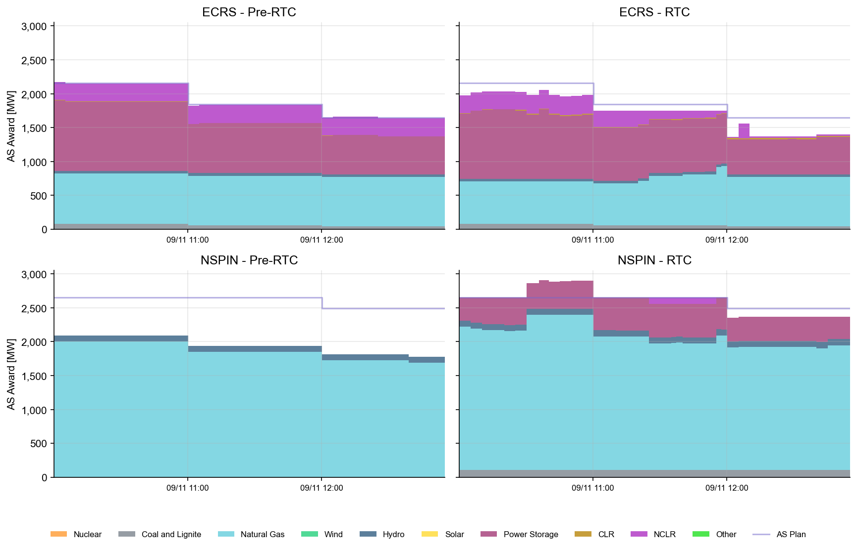
AS Awards* Summary by Resource Type
* Pre-RTC (RTM AS Schedule)

Slide 13
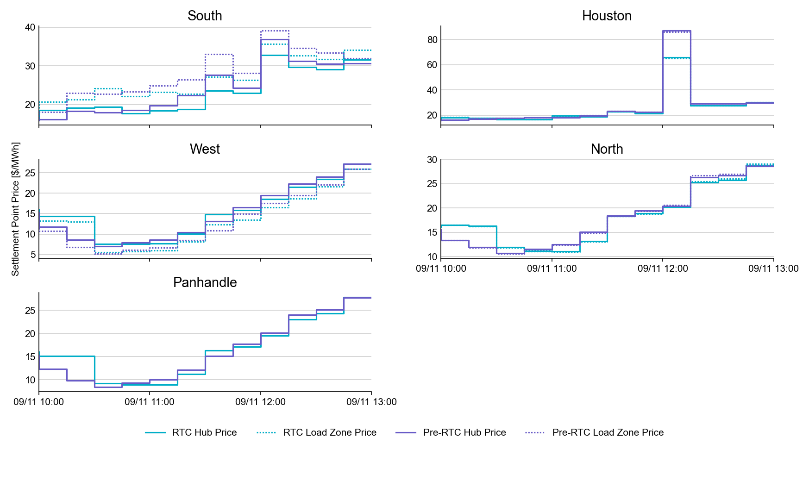
SPP by Hub and Competitive Load Zone

Slide 14
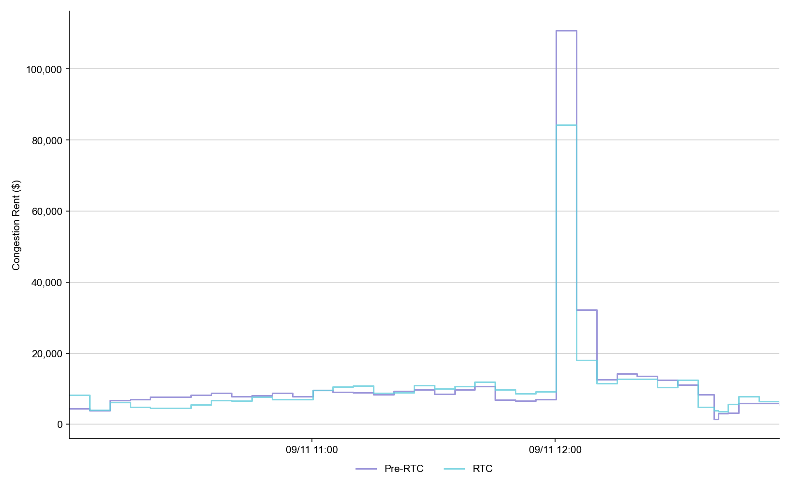
Congestion Rent

Slide 15
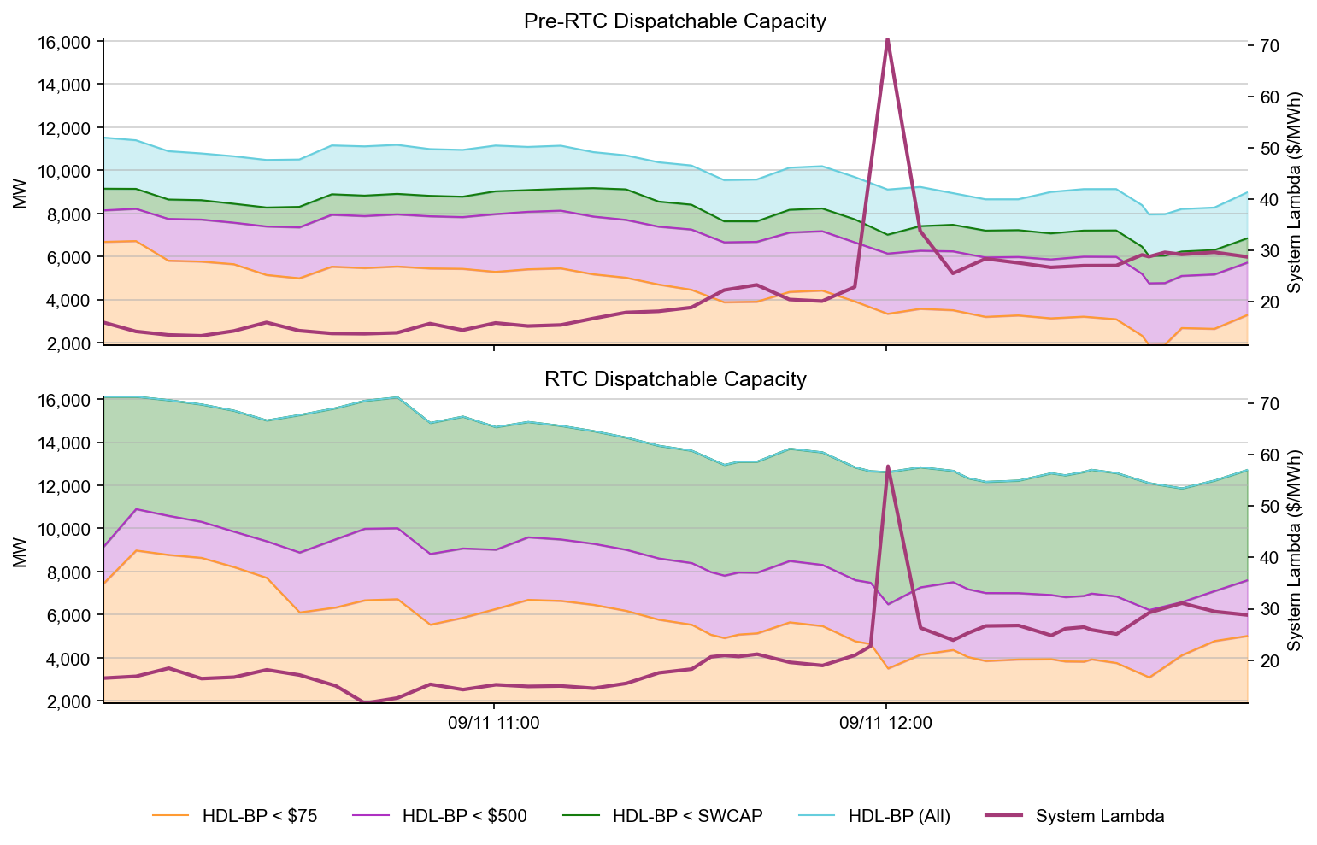
Dispatchable Capacity

Slide 16
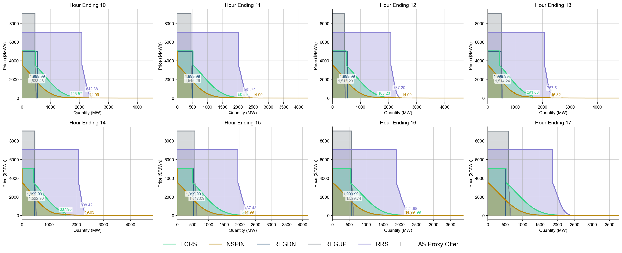
Ancillary Service Demand Curves

Slide 17
Market Trials known issues/updates
Current issues/updates:
  Issues:
    No current software issues
    ERCOT still working to minimize Phase 2 validation impacts
  Update:
    NPRR1282 values were populated Sep 9 (AS Duration Values)
    DAM submissions timeline will be extended to noon each day
      Prevent confusion with production
      Give more time after Prod DAM to populate RTC DAM
    Today DAM submissions timeline extended until 4pm to allow for a “sandbox today” of DAM submissions

Slide 18
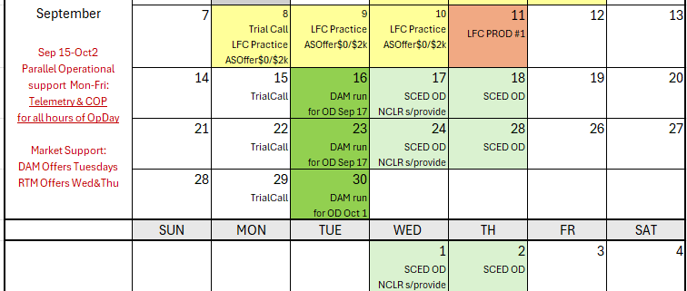
Rest of September
Current plan for next 3 weeks schedule will be same rhythm each week
Continue to maintain Operational alignment of Telemetry and COP in RTC trials systems
Market sequences:
  TUESDAYS: DAM clearing (focus on next day SCED offers and NCLR self-provision)
  WEDNESDAY & THURSDAY: SCED offers for all 24 hours of OD
Offers not scripted:
  QSE allowed/encouraged to make economic offers (non-scripted, but reasonable)
  Energy and AS Offers should cover full capability (ie, goal to minimize proxies from ERCOT)

Slide 19
Day-Ahead Market

Slide 20
DAM Operating Day (OD) Test
Testing strongly encouraged, but not required for all QSEs
  Handbook #6 Day-Ahead Market
  The DAM will run on Tuesday, September 16th for OD 9/17/2025
  First DAM submission window closes at noon on 9/16.
By 0600 QSEs can validate and confirm report posting:
  Advisory AS Obligation: Available on Market Trials MMSUI (5 significant digits after decimal point)
  ASDCs: Available on Production MIS
  Load Ratio Share and PSS/e files will change with RTC cutover, but will not be visible for OD 9/17
For successful DAM completion, and meaningful results, market participants are strongly encouraged to submit various submission types, and not only submission types listed above (E.g., PTPs, EOOs, EBs, AS Self-Arrangement, non-ESR AS and non-ESR TPO submissions).

Slide 21
DAM Operating Day (OD) Test – Pre DAM
Key DAM Submission Changes
  AS Obligation – no self-arrangement will be allowed over QSE’s Advisory AS Obligation.
    Example: RRS Advisory AS Obligation = 2.18368 -> maximum Self-AS submission = 2.1
  COP – can submit negative LSL/HSL for ESR. Can submit values for AS Capability within the existing AS fields.
  TPO (EB/OC) – negative MW quantity reflects ESR EB/OC. ESR startup and minimum energy costs are not allowed and ESRs are considered self-committed.
  Resource-Specific AS Offers – FRRSUP and FRRSDN offers not allowed. Offers must be between $0 and DAM SWCAP. For ESRs, RRSUFR and ECRSM offers not allowed. All AS offers from ESRs are inclusive of EB/OCs.
  AS Only Offers – Offers must be between $0 and DAM SWCAP. REGUP, REGDN, RRSPFR, Online NSPIN, and Online ECRS are allowed. Other AS types are not allowed. Multi-hour and fixed blocks are not allowed.

Slide 22
DAM Operating Day (OD) Test – Post DAM
Post Publish Report Verification
  AS-Only Awards
  ESR Resource-Specific AS awards
  TPO(EB/OC) awards
  QSEs with Advisory AS Obligations and AS awards can download/review their Final AS Obligations and ensure observe/handle values with up to 5 significant digits after the decimal
  DAM LMPs
  DAM MCPCs
  DAM Constraint Shadow Prices
  Other DAM Awards

Slide 23
NCLR Self-Provision
Reminder:
AS Self-Provision is a special design to allow Non-Controllable Load Resources to self-provide their AS Responsibilities into/through SCED/Real-Time Market

Slide 24
NCLR Resource Status Codes
Pre-RTC
  Resource Status Codes (RST)
  OUTL = 260
  ONRL = 259
  ONECL = 264
RTC+B
  Updated Resource Status Codes (RSTR)
  OUTL = 258
  ONL = 257

Slide 25
Ramp Rates and Capabilities
RTC+B
  Ramp Rates & Awards
  UFRC (UFR Capability)
  UFRA (UFR Award)
  ECRR (ECRS RR Capability *10 Min)
  ECRA (ECRS Award)
  NSRR (NSPIN RR Capability *30 Min)
  NSRA (NSPIN Award)
Pre-RTC
  AS Responsibility and Schedule
  RRRS
  RRSC
  ECRS
  ECSC
  NSRS
  NSSC
QSE to ERCOT Telemetry
ERCOT to QSE ICCP

Slide 26
Self-Provision Achieved via Telemetry Points for NCLRs
LEGEND
QSEs will be able to self-provide in real-time via telemetered ICCP points
ICCP Change Request Example RTC+B V1.4 on RTC ERCOT webpage

Slide 27
The Self-Provision Checklist
Scenario: My Load Resource was awarded 15 MW in the DAM, and I purchased 5 MW via a trade.
My total RRS AS Position is 20 MW.
How to correctly self-provide 20 MW:
    Is my resource qualified?
    Telemetry Points
      RSTR set to ONL (257)
      UFR must be Armed
      Can I cover my obligation?
        Qualified MW Amount ≥ Self-provided amount
        NPF - LPC ≥ Self-provided amount
        Capability to Provide AS ≥ Self-provided amount
      Final Step: Telemeter Self-provision
      “your offers explain your extra”

Slide 28
Scenario 1
NCLR_1 has a 20 MW RRS AS Position, 15 MW from DAM award and 5 MW from RRS Trade
Scenario ** Assume AS qualified for All Headroom (NPF-LPC) | Max Power Cons. | Net Power Flow | Low Power Cons. | Resource Status | Under Freq. Relay | Self-provided RRS UFR (MW) | Self-provided ECRS (MW) | Current Capability to provide UFR (MW) | ECRS (10min) Ramp Rate (MW/min) | RRS UFR AS Award | ECRS AS Award | Notes
 | MPC | NPF | LPC | RSTR | UFR | SPUF | SPEC | UFRC | ECRR | UFRA | ECRA
NCLR_1 is qualified to provide 20 MW. DAM awards NCLR_1 with 15MW RRS. QSE also has additional 5MW RRS Position via RRS Trades. | 20 | 20 | 0 | ONL | Arm | 20 | 0 | 20 | 0 | 20 | 0 | NCLR_1 Telemetry needs to show: Status = ONL, MPC >= NPF >= 20 MW, NPF-LPC >= 20 MW, RRS capability >= 20 MW, RRS self-provided telemetry = 20 MW SCED will respect the 20 MW self-provided RRS and award the resource 20 MW RRS UFR.
QSE to ERCOT Telemetry
ERCOT to QSE ICCP

Slide 29
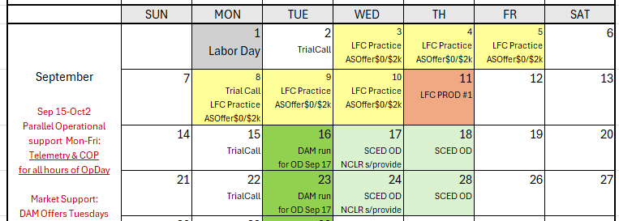
Wrap-Up and Questions
This Market sequences:
  TUESDAYS: DAM clearing (focus on next day SCED offers and NCLR self-provision)
  WEDNESDAY & THURSDAY: SCED offers for all 24 hours of OD
Today DAM submissions timeline extended until 4pm to allow for a “shakeout today” of DAM submissions
ERCOT working to determine date of October LFC Test
Remainder of meeting for Q&A
Can always email the RTC+B Program mailbox: RTCB@ercot.com

Slide 30
APPENDIX- Supporting Materials
Summary of SCE Functionality
Telemetry Screening
New RTC Pricing Reports location
NPRR1290 Validation Changes
Links to Handbooks
FAQ Updated 8/8/2025
Connectivity and Configuration (digital certs)

Slide 31
Summary of SCED functionality
What is RTC SCED using to solve in trials?
  Production Network model from NMMS
  QSE submitted offers (energy and A/S)
  QSE production telemetry
    ERCOT performs some overrides for stale data from QSE sites- improving each week
  Outages in prod telemetry would be outage in RTC SCED
  July 31 improvements implemented:
    NPRR1268/1269 ASDC and Proxies logic implemented
    AS Plan improved and now same as Prod
  Aug 4 improvements implemented:
    IRR Forecast synchronization has been manual, but now automated
  Aug 18 improvements implemented :
    Active constraints flag being manually copied (automation planned for Aug 18)
    Load Forecasts being fed into RTC, but ERCOT manually aligns which forecast is being used based on operator selection in Prod (automation planned for Aug 18)

Slide 32
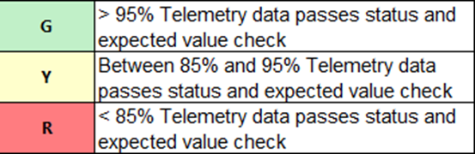
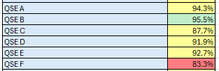
Telemetry Screening for Scorecard 3B for Handbook 3
Acceptable Telemetry Point values received by ERCOT for active resources.
Scoring:
Key points for Telemetry scorecard check
  Device types checked - Units, CLRs, NCLRs, ESRs for each QSE
  RTCB Telemetry status should be “Good” quality
  RTCB Units / CLRs / NCLRs Telemetry values should be within “Expected Range” or an expected value. Details are provided in next few slides.
  Expected values are derived from equivalent analogs in current production, based on defined criteria.
  RTCB ESR telemetry values are checked against corresponding combo model Battery Unit / CLR counterparts in production.

Slide 33
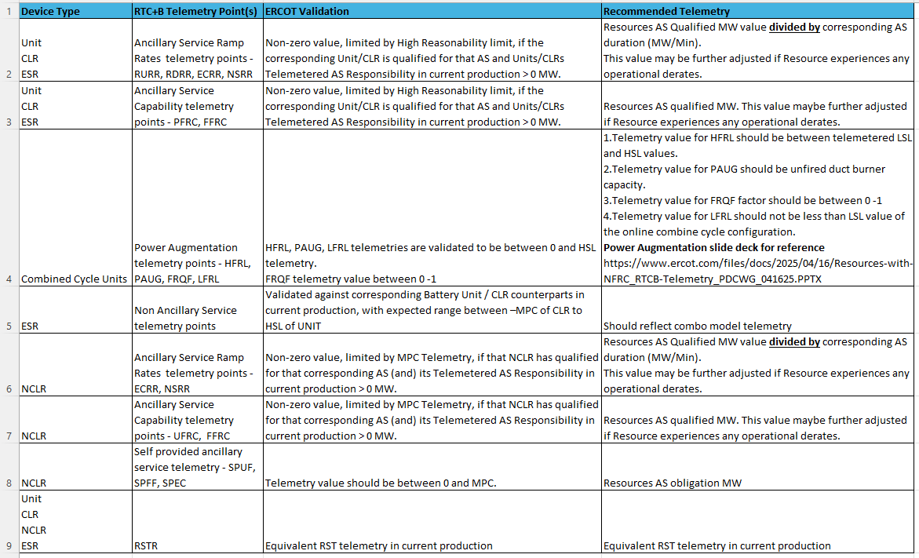
RTC+B Telemetry points screening/validation

Slide 34
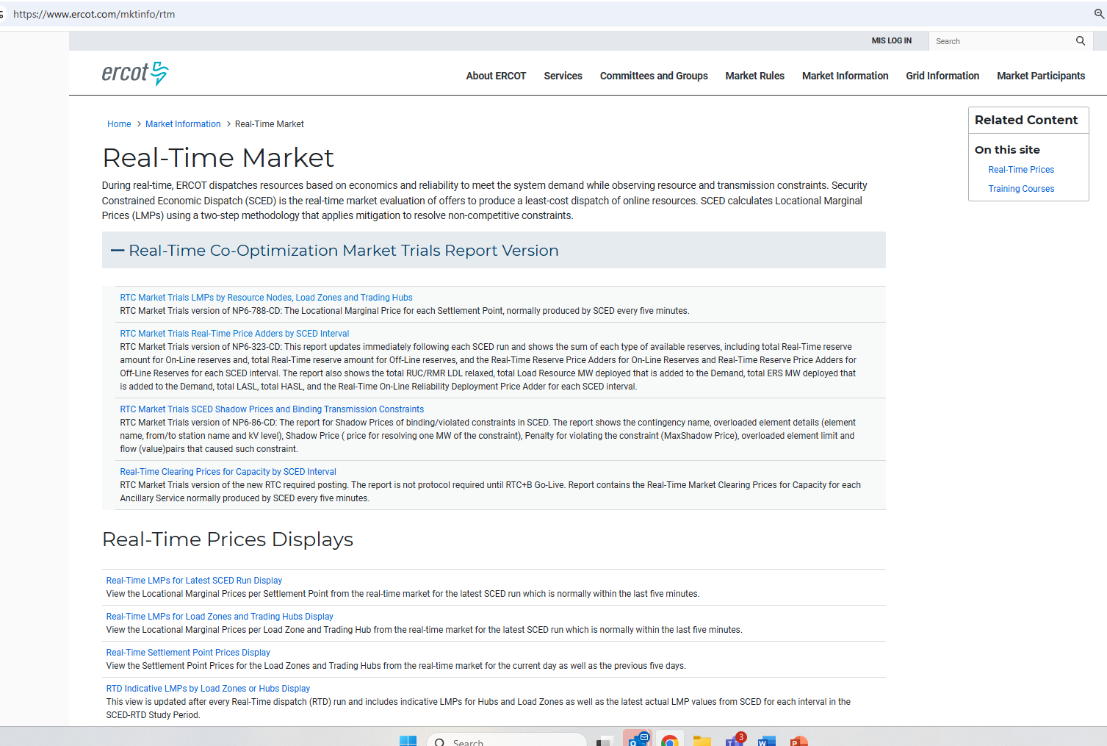
RTC+B New Reports Posted to the ERCOT Website
Links to the available RTC+B versions of Real-Time reports posted on Real-Time Market Information page.

Slide 35
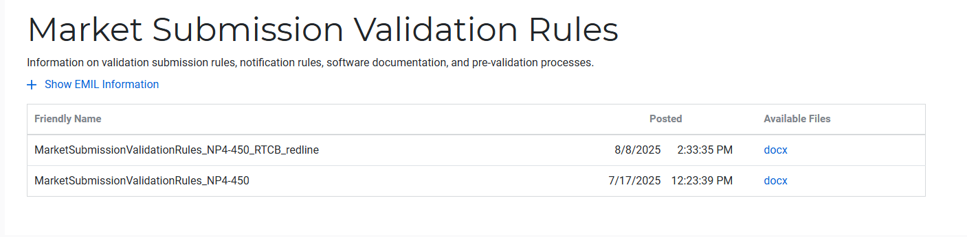
Submission validation update - PROD vs RTC+B
NPRR1290 :
  cleaned up protocol language around submitting offer curves and bid curves
  disallows having more than 2 price/quantity points in a flat/vertical segment of the curve.
Impacts to QSEs during dual-submission – some submissions accepted in Production will be rejected in Market Trials environment:
RTM Energy bids – protocol requiring “increasing quantities” now enforced.
  Reverted this change to validation. Further discussion highlighted protocol should be brought in line to long-standing practice, not validation.
  Example: Bid with Q1=0mw, Q2=10mw, Q3=10mw will be rejected as Q3 does not increase from Q2.
TPO & RTM Bid – more than 2 price/quantity pairs with same price or quantity will be rejected
Market Submission Validation
Rules document updated.

Slide 36
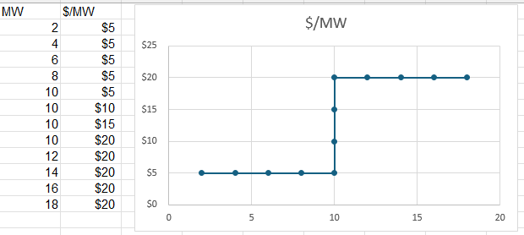
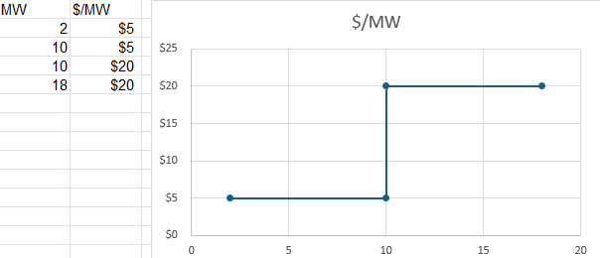
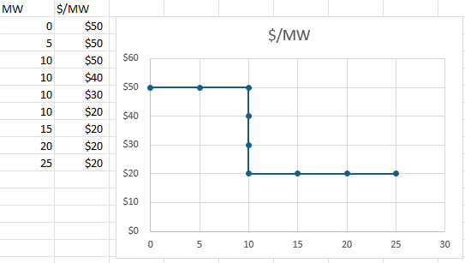
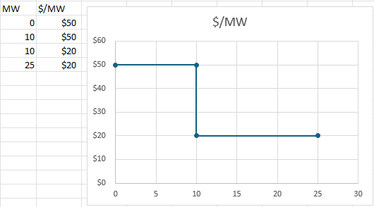
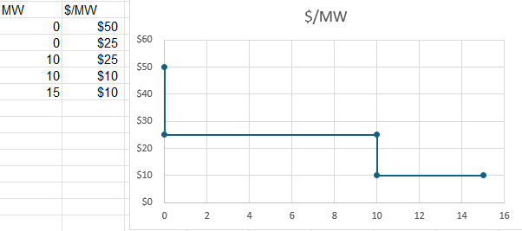
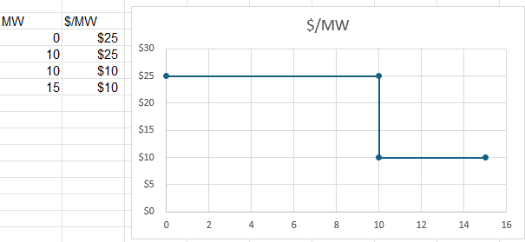
Submission validation update - PROD vs RTC+B
TPO – EB/OC - EOC
RTM EB
RTM EB

Slide 37
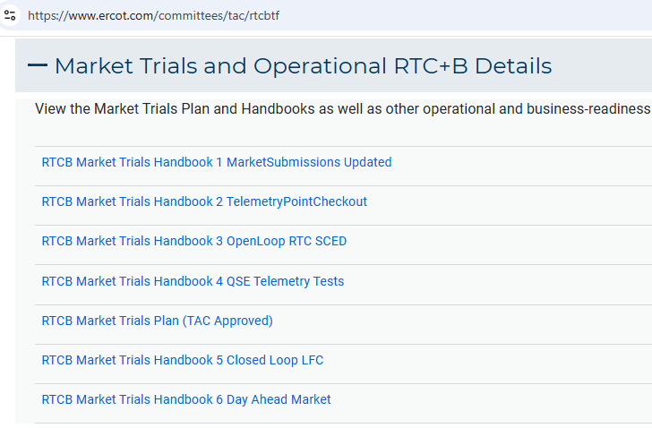
Market Trials Framework:
TAC Approved the Market Trials Plan in October 2024
Discussions with RTC+B Task Force have shaped the Handbooks
Handbook #1- QSE Submission Testing
Handbook #2- QSE Telemetry Tests
Handbook #3- Open Loop SCED
Handbook #4- QSE Telemetry Tests
Handbook #5- Close-Loop LFC Tests
Handbook #6- Day-Ahead Market Tests
All are posted on the
RTCBTF Homepage
under Market Trials banner

Slide 38
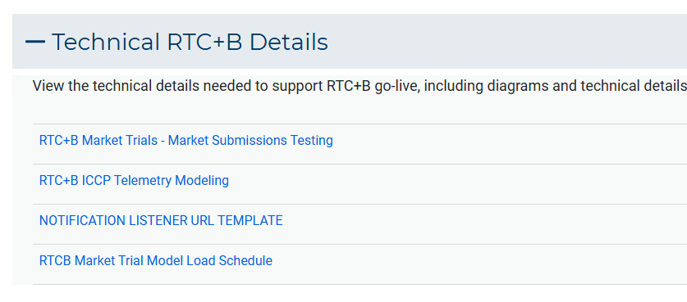
Market Trials Technical Details
Detailed discussions with TWG have provided technical content details
Digital Certificate details
Connectivity/URL details to User Interfaces and APIs
Reminder of how to submit new ICCP requests
RTC and Production Telemetry connectivity
Network Model Load Schedule
All are posted on the
RTCBTF Homepage
under Technical Details banner

Slide 39
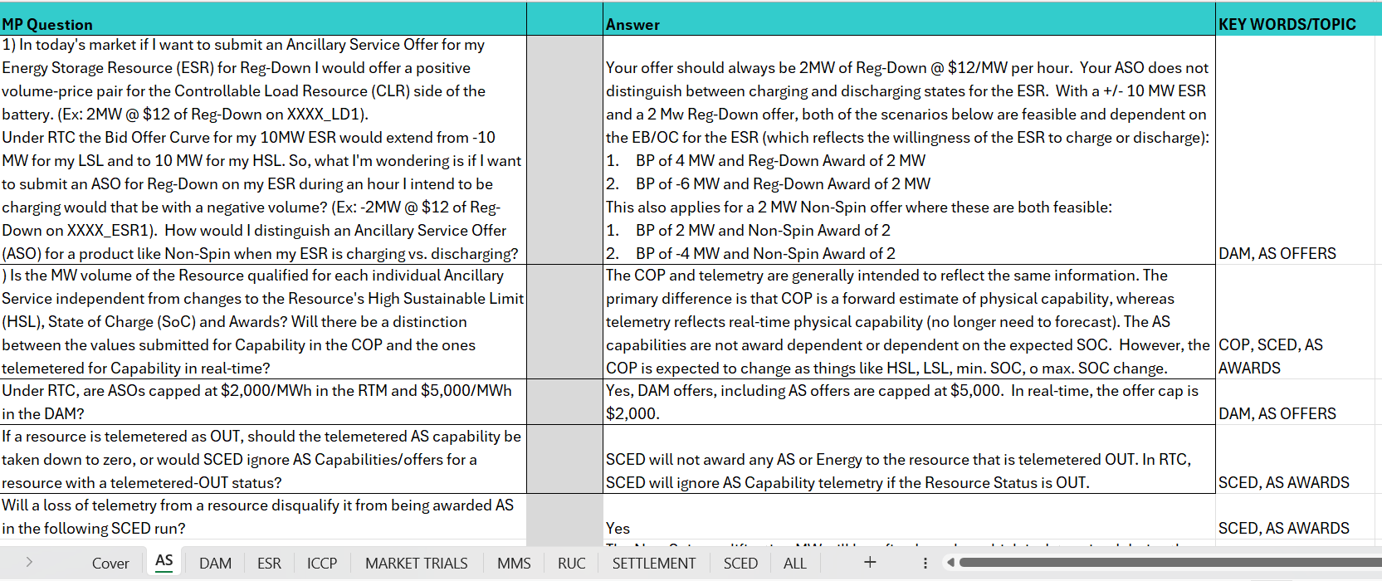
Reminder of RTC+B FAQ
Posted on RTCBTF Home Page under Key Documents
Common questions/responses in Excel Workbook (target weekly updates)
Search workbook for Key Words
Worksheets for categories

Slide 40
RTC+B Market Submissions - Systems configurations
Start
03/2025
Start
05/2025
Start
07/2025
Start
09/2025
Go-Live
12/5/25*
Feb 2025
Mar 2025
Apr 2025
May 2025
June 2025
July 2025
Aug 2025
Sep 2025
Oct 2025
Nov 2025
Dec 2025
Optional: RTC QSE/Vendor Developer
Submission Testing
RTC QSE
Submission Testing
Open-loop
RTC SCED
Ongoing Open-Loop
& Periodic Closed-loop SCED/LFC
Certificate: Current MOTE
Env: ERCOT RTC Market Trial
URL: RTC MIS MOTE URL
Certificate: Current Production
Env: ERCOT RTC Market Trial
URL: RTC MIS Market Trial
Cert: Production
Env: Prod
URL: MIS Prod
QSE/Vendor developer can use MOTE certificates & RTC MIS MOTE API URL to test the submissions until end of submission testing phase (end of June) as needed. At the start of the Open Loop testing, RTC MOTE MIS URLs will be disabled.
URL links: RTC MOTE and Market Trial URL links to be used for MMSUI, OSUI and API submissions. Actual links are provided in next slide.
For notifications/responses to MPs from RTC Market Trials environment, MP will need to provide the listener URL to ERCOT

Slide 41
RTC+B Market Submissions - Systems configurations
(Updated with URLs)
RTC+B Market Trials and Go-live
RTC Phase | Digital Certificate | MMSUI / OSUI URL | API / WAN URL
Vendor/QSE Submissions Testing | Current MOTE | RTC MOTE MIS URLs https://testmarkettrials.ercot.com/mmsui/mmsui/displayTradesLanding.action https://testmarkettrials.ercot.com/osrui/osrui/Summary.action | RTC MOTE API/WAN URL https://testmarkettrialsapi.ercot.com/NodalAPI/EWS/ https://testmarkettrialsapi.wan.ercot.com/NodalAPI/EWS/
Open Loop and Closed Loop Testing | Current Production | RTC Market Trial URL https://markettrials.ercot.com/mmsui/mmsui/displayTradesLanding.action https://markettrials.ercot.com/osrui/osrui/Summary.action | RTC Market Trial API/WAN URL https://markettrialsapi.ercot.com/NodalAPI/EWS/ https://markettrialsapi.wan.ercot.com/NodalAPI/EWS/
From RTC Go-live onwards | Current Production | Current Prod MIS URL mis.ercot.com/mmsui mis.ercot.com/osui | New Production API/WAN URL

Slide 42
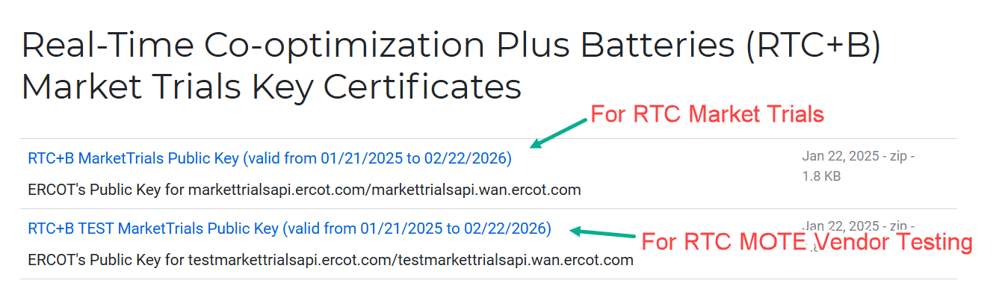
RTC+B Market Submissions - Systems configurations
Public Key Update for WAN/API submissions
For API/WAN submissions into Market Trials environments, need to download public keys and place into the keystore location in system being used for RTC+B submissions.
No change to digital user certificates – continue to use existing MOTE and Production Certificates
Market Trial API Public key location: https://www.ercot.com/services/mdt/webservices

