Slide 1
Far West Texas IROLs
Freddy Garcia
September 11, 2025

Slide 2
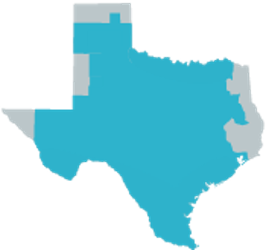
Far West Texas IROLs
Significant new transmission is planned for Far West Texas, but load growth is expected to occur faster than new transmission will be completed
ERCOT has identified that under low wind and solar conditions, there may not be sufficient transmission to import power to serve the increasing load in the area
  The load in the area does not yet exceed this amount but will exceed it when it is all built out to the level that has already been approved to energize
  The resulting overloads would be cascading if these imports are not managed
While SCED will inherently monitor and control the overloads on individual transmission elements, ERCOT has created two new Generic Transmission Constraints(GTCs) to allow monitoring and control of the import level that would result in cascading​
  Effective September 15, 2025​
  I_FW_N: North to Far West Texas Import​
  I_FW_S: South to Far West Texas Import​
  The limits will be calculated in real-time in order to be as accurate as possible​
These interfaces will be treated as Interconnection Reliability Operating Limits (IROLs) and could require localized pre-contingency loadshed to avoid being exceeded
ERCOT has worked with impacted TSPs to incorporate improved dynamic line ratings and is working on other mitigating plans
Generation
Load

