Slide 1
RTC+B – LFC/SCED Closed Loop Testing
Final reminders/Updates
Sreenivas Badri
Matt Mereness
September 10, 2025

Slide 2
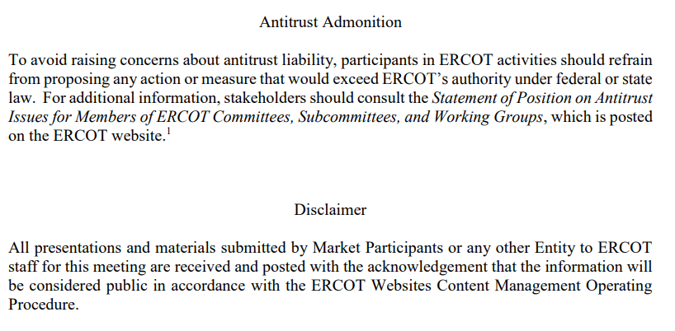
WebEx Meeting reminders (same as other ERCOT forums):
Please keep line muted
If you have a question, please use the chat feature to either:
  Type in your question, or
  Type in “Question” and wait to be recognized to state question

Slide 3
Agenda
Where are we at?
  Scorecard snapshot and outreach summary
Details Communications in Market Notice
  Leading up to and during test
Reminder of Exception Process
  Clarifications
Review Closed Loop LFC/SCED Testing (DeepDive- again)
  Cutover and Cutback plan review
Review of Detailed market submissions/examples (as time allows)

Slide 4
Where are we at?
We are a “Go”
1-day market notice being sent this morning
Market being responsive to outreach (scorecards on next slide)

Slide 5
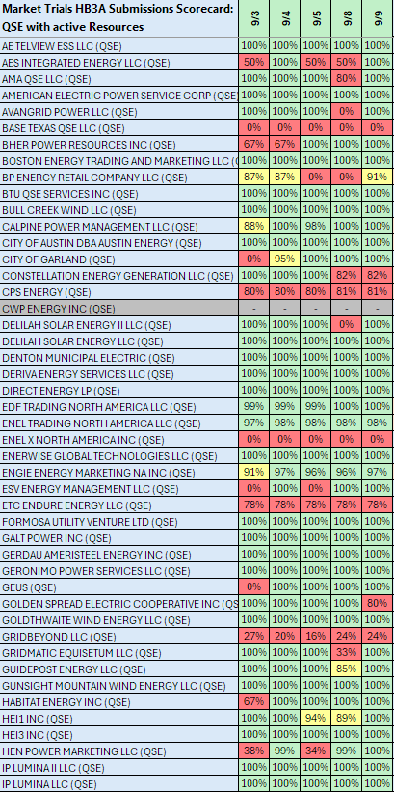
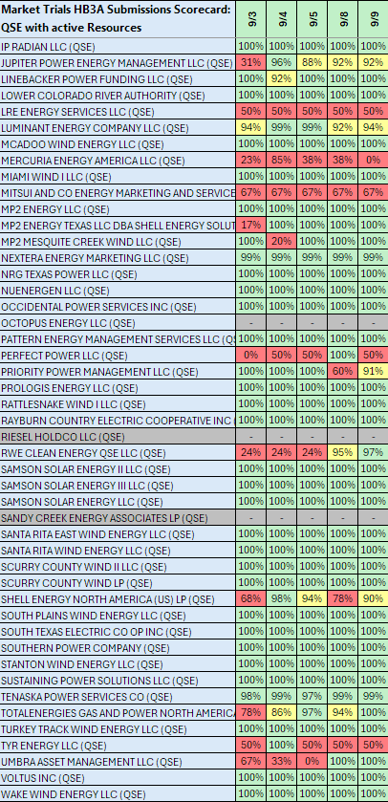
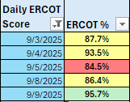
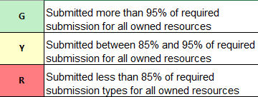
Scorecard 3A for
Handbook 3-
Market submission:
Scores for QSEs with Resources – Appropriate submissions made for each owned resources.
COP – ALL
TPO – Gen, ESR, CLR
ASO – AS Qualified Resources
System Wide Score down last week:
Scoring:

Slide 6
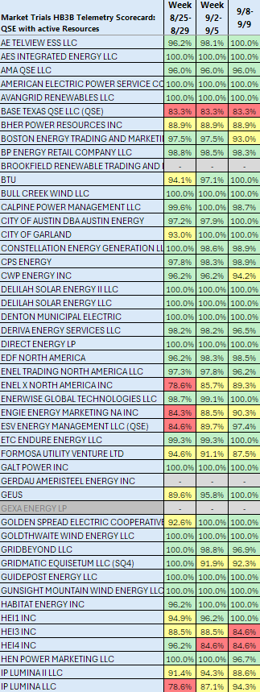
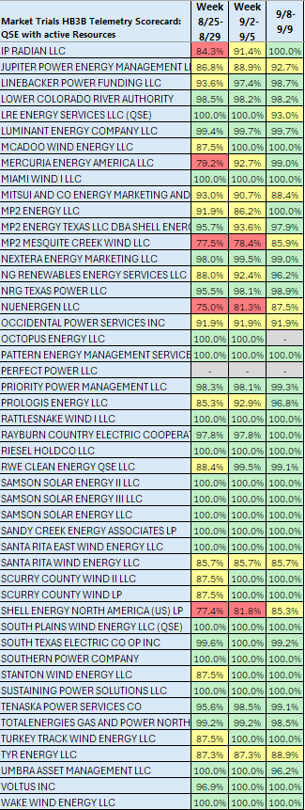
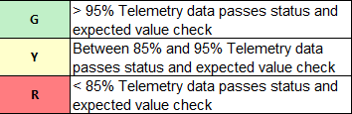
Scorecard 3B for
Handbook 3-
Acceptable Telemetry point values received by
ERCOT for active resources
9/9 Scores for QSE with Resources – Accurate telemetry data sent to ERCOT
System Wide yesterday
hit 97.28%
Scoring:

Slide 7
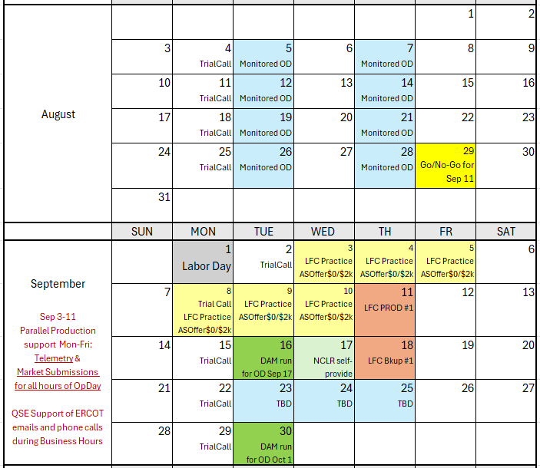
Market Trials Calendar
We are here….

Slide 8
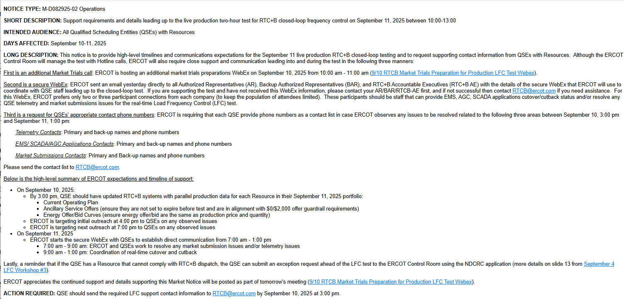
ERCOT communication and contact outreach
Link to full Market Notice

Slide 9
Market Notice support timeline
Today/September 10, 2025:
  By 3:00 pm, QSE should have updated RTC+B systems with parallel production data for each Resource in their September 11, 2025 portfolio:
    Current Operating Plan
    Ancillary Service Offers (ensure they are not set to expire before test and are in alignment with $0/$2,000 offer guardrail requirements)
    Energy Offer/Bid Curves (ensure energy offer/bid same as production $/MW
  ERCOT is targeting initial outreach at 4:00 pm to QSEs on any observed issues
  ERCOT is targeting next outreach at 7:00 pm to QSEs on any observed issues
On September 11, 2025
  ERCOT starts the secure WebEx with QSEs to establish direct communication from 7:00 am - 1:00 pm
    7:00 am - 9:00 am: ERCOT and QSEs work to resolve any market submission issues and/or telemetry issues
    9:00 am - 1:00 pm: Coordination of real-time cutover and cutback

Slide 10
Market Notice communication discussion
Communications next 36 hours (beyond this meeting)
  Email RTCB@ercot.com
    If needed/urgent Matt.Mereness@ercot.com; Sreenivas.Badri@ercot.com
  ERCOT requesting names and phone numbers of key personnel to support issues by 3pm today
    Telemetry Contacts: Primary and back-up names/phone
    EMS/ SCADA/AGC Applications Contacts: Primary and back-up names/phone
    Market Submissions Contacts: Primary and Back-up names/phone
  Confirming Secure WebEx sent to the QSEs (AR/BAR/RTC+B-AE) for use by critical staff for cutover activities and support
    For secure WebEx, ERCOT prefers only two or three participant connections from each company (to keep the population of attendees limited).
    These participants should be staff that can provide EMS, AGC, SCADA applications cutover/cutback status and/or resolve any QSE telemetry and market submissions issues for the real-time Load Frequency Control (LFC) test.
    Contact your leadership if need WebEx info), or email RTCB@ercot.com to assist.

Slide 11
Exemption for RTC+B Resources not ready for 9/11
Some QSEs have indicated not all Resources can follow RTC+B dispatch signals that are “behind in their testing”. To mitigate risk to the test and to preserve full control of the grid for the system-wide test, ERCOT is allowing QSEs to submit an exception request if a subset of Resources cannot follow RTC+B SCED/LFC Dispatch (will be placed in ONTEST status during test)
To be excused from the test, QSEs will need to submit a test request for each Resource using the "QSE Test Request" form available at the ERCOT NDCRC application (https://mis.ercot.com/ndcrc/TestRequestSummaryAction.do).
  Please ensure that the test requests are submitted within a 7-day window from the closed loop test date, preferably before 9/9/25. This will allow the ERCOT control room ample time to review and approve the requests.
  These Resources will need to telemeter RST = ONTEST(8) in the current production system and RSTR = ONTEST(4) in the RTCB system.
  This should be done between 9:00 AM and 2:00 PM on 9/11/25. Additionally, these Resources should refrain from offering any Ancillary Services in the DAM on 9/10/25 for this window and should not carry any Ancillary Services in the current production system throughout this period.
  Addition questions can be directed to RTCB@ercot.com mailbox
Control Room Exception is NOT NEEDED for NCLRs but:
  RTC+B LFC Test dispatch for Resources that follow base-points and/or regulation signals
  If during test there is event require AS deployments beyond, ERCOT will go back to current system
  If carrying AS, NCLRs must submit RTC AS Offers per Handbook requirement

Slide 12
Same Focus- Sep 11 Live LFC Production Test
Objective this week is same
  ERCOT continues outreach on Telemetry
  ERCOT outreach on Market Submissions
What is expected now through LFC test tomorrow?
  RTC+B Telemetry support
  Market Submission scripted offer requirement:
    Adhere to offers per LFC Handbook 5
    Energy offers match production
    AS Offers should be offered at $0 if responsible in current production, remaining AS offer at $2,000

Slide 13
Deeper Dive into Technical Details

Slide 14
RTC+B – Parallel Operations
Currently we are in “Parallel Operations”, will continue to be in this state until Go-Live.
Parallel Operations expectations:
  QSEs should continue to send Production Quality and Consistent Telemetry to ERCOT RTC+B ICCP system in parallel to current production.
  QSEs control room operators should perform the dual entry of telemetry manual overrides etc. based on grid conditions.
  QSEs should continue to make Production quality real-time Market submissions to ERCOT RTC+B market systems in parallel to current production.
  High volume of Telemetry issues were fixed by 08/22/2025, remaining QSE Telemetry issues (identified by ERCOT and communicated to QSEs) should be fixed no later than 09/08/2025
  ERCOT will continue to validate RTC+B telemetry and Market Submissions and communicate issues to QSEs.
  ERCOT will continue to validate RTC+B EMS and SCED applications results based on RTC+B telemetry and market submissions and send UDSP, AS Awards etc. through ICCP and post SCED prices.
If these expectations are not met by QSEs, ERCOT EMS/SCED solution quality can not be validated consistently. This creates a risk for Closed Loop Testing on September 11th and overall program delivery on December 5th.

Slide 15
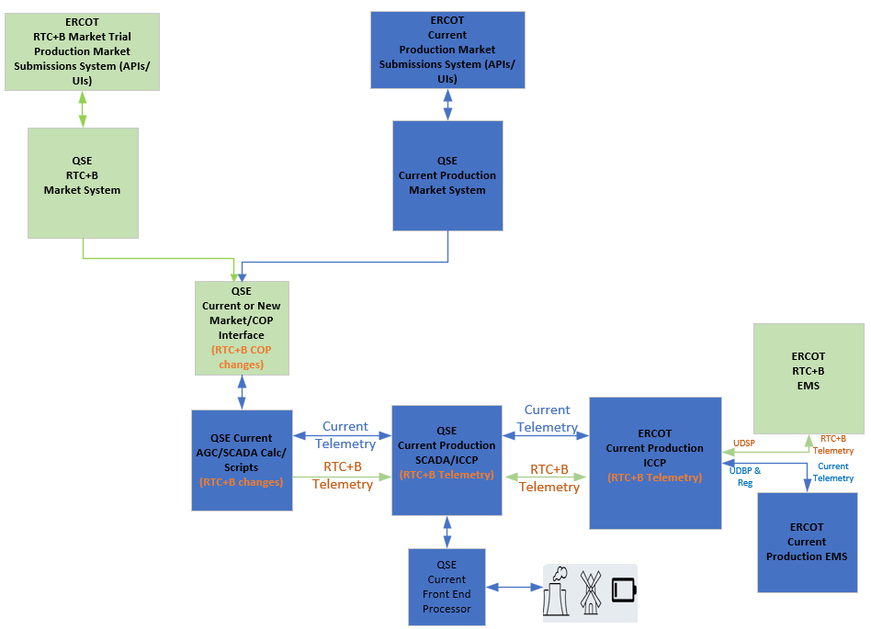
RTC+B – Parallel Operations – Current State of ERCOT and QSE Systems Setup

Slide 16
RTC+B – Parallel Operations – Telemetry Issues
ERCOT identified telemetry issues and met with QSEs that had lower telemetry pass% to discuss the issues.
Based on the discussions with QSEs, telemetry issues can be broadly categorized into two buckets.
  Resource Status Telemetry issues due to not being able to convert correctly from Current Production to RTC+B
  Resource Status and AS Capabilities Telemetry issues
    Due to setup/mapping issue within QSEs RTC+B COP Interface that gets the COP data from RTC+B market system and feed into EMS AGC/SCADA.
  ESR specific telemetry issues directly from plants.
    We are still seeing lot of batteries are not telemetry –ve MW when charging, it is severely impacting state estimator and LFC/SCED solution
ERCOT requests all QSEs to proactively look at the telemetry mismatches between RTC+B and current production and implement fixes in RTC+B no later than 09/08/2025.
  ERCOT can share the list of telemetry issues upon QSE request through RTCB@ercot.com.

Slide 17
Closed Loop LFC/SCED Testing
One of the key goal of the Closed Loop Testing is to ensure that QSEs RTC+B ICCP/SCADA/EMS/Interfaces system changes are designed and setup correctly to respond to RTC+B UDSP signals.
Although it is called “Test”, It is a Live Production Closed Loop Test.
  QSEs must cutover all their resources operating in current production to RTC+B and control the Grid for 2 hours following RTC+B UDSP signal. This means ERCOT and QSEs RTC+B systems will be Live for 2 hours on 09/11/2025.
QSEs are expected to develop their own internal Closed Loop Testing cutover/cutback plan and checklist to ensure smooth transition of QSEs EMS systems/applications to RTC+B and back to current production. This cutover plan and checklist should be updated with any lessons learned from closed loop testing and is expected to be used for Go-Live.

Slide 18
Closed Loop LFC/SCED Testing – Current Production EMS/SCED State
  During Closed Loop Testing, ERCOT Current Production EMS and SCED will continue to run normally without any down time (except UDBP, Regulation Signals and other Non-RTC Outbound telemetry will NOT be sent out to QSEs). It ensures
    smooth transition back to current production at the end of closed loop testing and
    current production SCED can continue to create prices during closed loop testing.
  It is critical for Market participants to
    continue to send production quality telemetry to current production ICCP/EMS (e.g. Current production resource status codes, Regulation participation factors, combo model telemetry for batteries etc.) and
    continue to submit real-time market submissions into current production Market System before and during closed loop testing without any down time.

Slide 19
QSEs RTC+B Systems configurations for Closed Loop Testing
Closed Loop Testing
  EMS/AGC/SCADA Calc/Scripts
    QSEs will utilize System level switch of their EMS/AGC/SCADA Calc/Scripts to switchover their entire system to RTC+B mode. Switchover time must be within 30-60 seconds.
    At the end of the closed loop testing, QSEs must switchback to current production mode by turning off the system level switch. Switchback time must be within 30-60 seconds.
  Market Submissions and Notifications
    QSEs are utilizing parallel RTC+B Market Systems Production system to submit real-time market submissions into ERCOT RTC+B Market Trial Production System in parallel to current production. No systems switchover is required.
    Some QSEs are using current production to support dual real-time market submissions into ERCOT RTC+B Market Trial Production System in parallel to Current Production starting from Open Loop Testing till Go Live. No systems switchover is required.
  For the Closed Loop Testing, QSEs are expected to perform dual real-time market submissions from 3:00PM (or from current production DRUC completion) of the day prior to the closed loop testing day (09/11/2025) until the completion of the test.
    Dual real-time market submissions should be made for all hours of the closed loop testing day (09/11/2025)
  Dual submissions of Outages is not required for Closed Loop Testing.

Slide 20
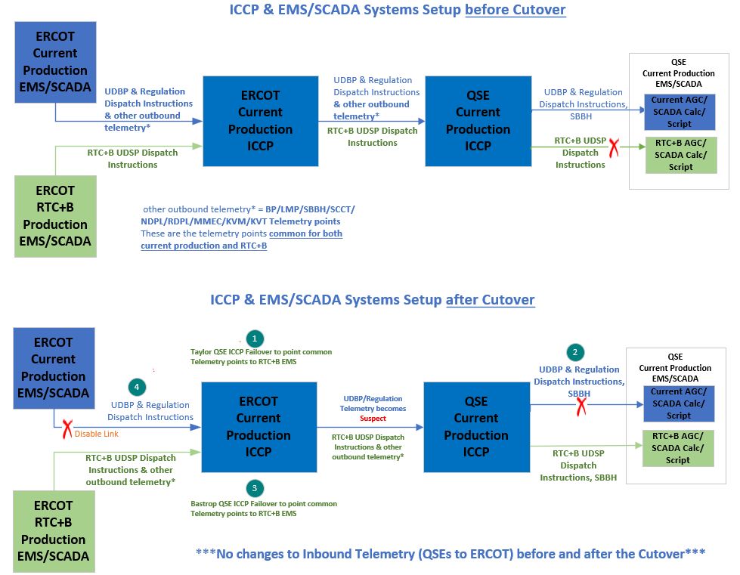
Closed Loop LFC/SCED Testing – EMS/ICCP Cutover Plan

Slide 21
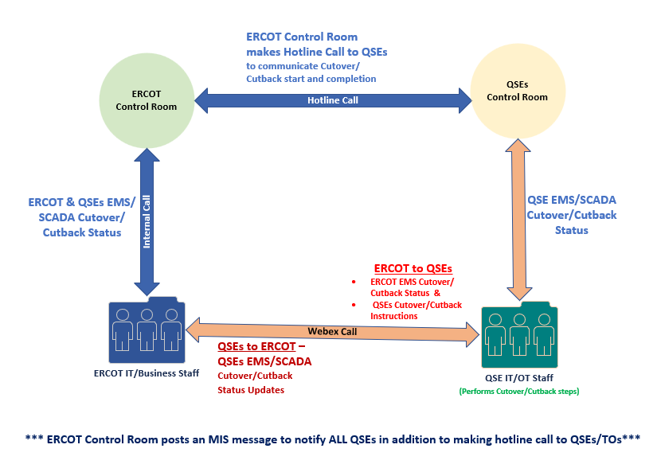
Closed Loop LFC/SCED Testing Cutover/Cutback - Communication

Slide 22
Closed Loop LFC/SCED Testing – Cutover & Cutback Plan Review
Closed Loop LFC/SCED Testing detailed cutover/cutback plan spreadsheet is available on RTCBTF site under Technical RTC+B Details section.
https://www.ercot.com/committees/tac/rtcbtf
QSEs with resources should follow this Cutover and Cutback plan along with their Internal Procedures during Closed Loop LFC/SCED Testing on 09/11/2025.
  It is important for QSEs to line up vendor support as required for closed loop testing to get support immediately on any potential critical issues during cutover/cutback.
ERCOT Control room makes final Go/No-Go decision few minutes before start of the Closed Loop Testing based on Grid Conditions.
  Start & End Times of Closed Loop Testing is subjected to change based on Grid conditions.

Slide 23
Deeper Dive Timeline/Details
  Review posted spreadsheet

Slide 24
Reminder of Submissions Details and Examples on following slides

Slide 25
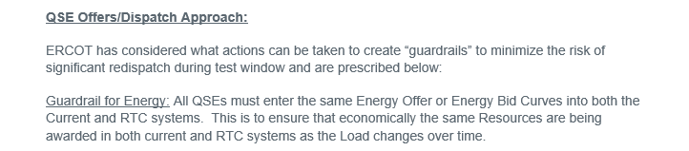
LFC Handbook Reminders
Excerpt from Handbook #5 LFC Closed Loop Test

Slide 26
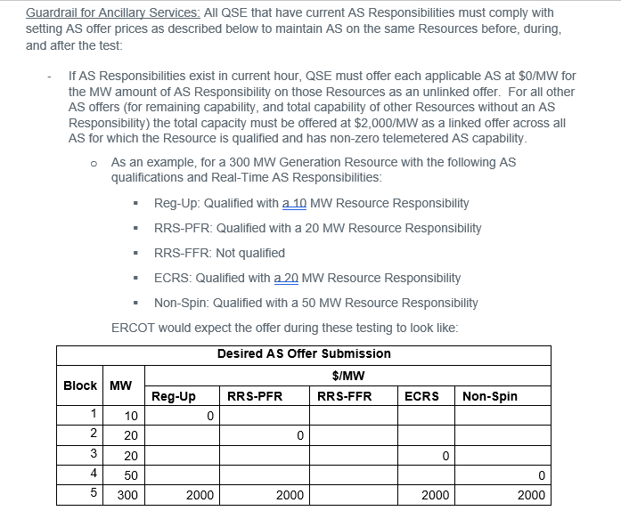
LFC Handbook Reminders

Slide 27
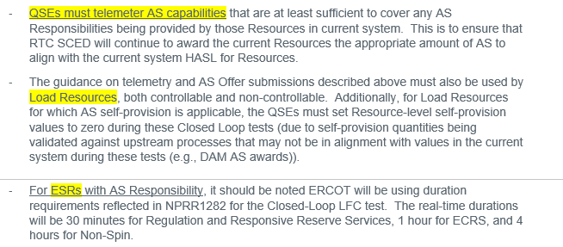
Market Submission (continued)

Slide 28
Market Submission (continued)
Offer cap for Energy:
  All Current/PROD energy offer MWs above $2,000/MWh should be offered at $2,000/MWh in RTCB.
For ESRs:
  The current system has GEN/LD with 10 P/Q pairs each, whereas the RTC system will only allow 10 P/Q pairs for the ESR. How do we handle situations where we may have more than 10 P/Q pairs amongst our GEN/LD battery resource?
    ANSWER: Provide the ESR curve the best you can with the 10 P/Q pairs to match what is reflected with the Combo Model approach currently in PROD

Slide 29
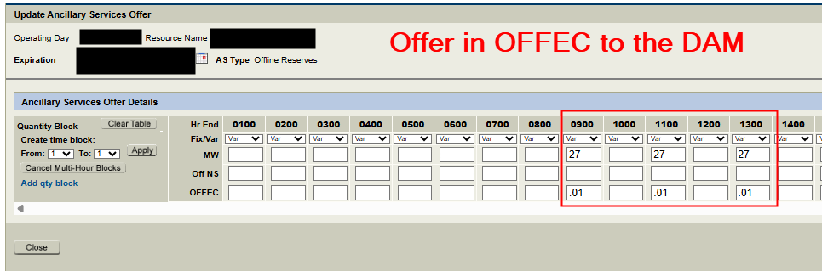
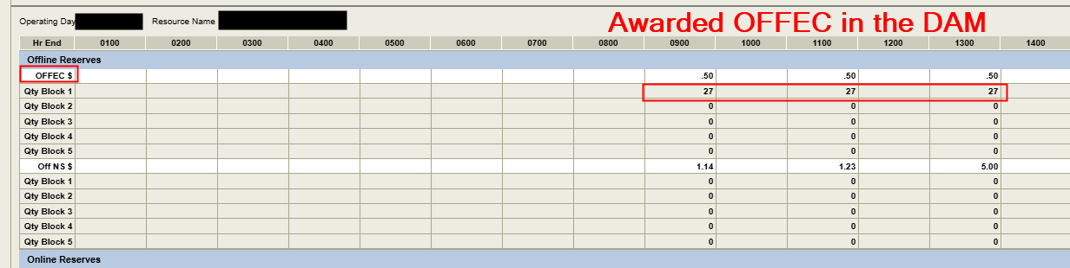
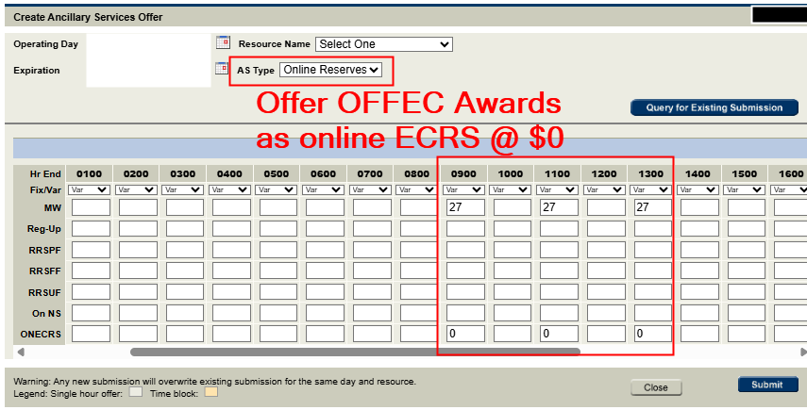
FAQ – Offline ECRS in RTC+B
In RTC+B, Offline ECRS that is offered and awarded in the DAM has to be re-offered as online ECRS if it is to be awarded in RTM.
  Offline ECRS can’t be awarded in RTC+B Real-Time Market. To represent an Offline ECRS Award, resource must:
  Telemeter ‘OFFQS’ status
  Have On-line ECRS AS Offer submitted.

Slide 30
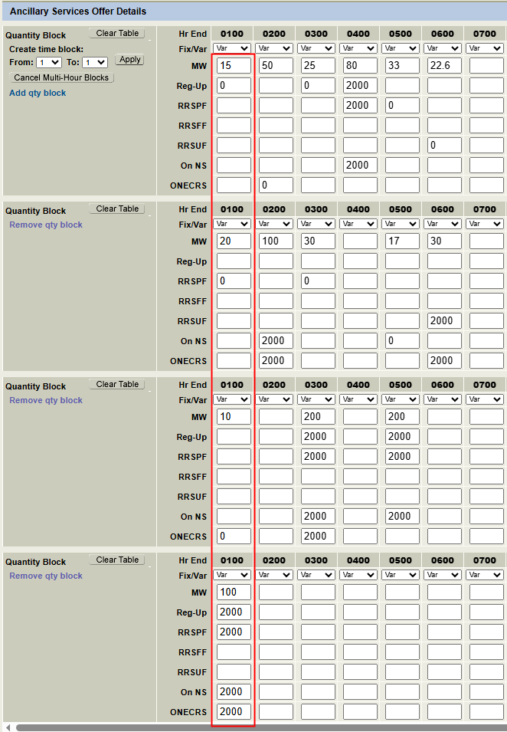
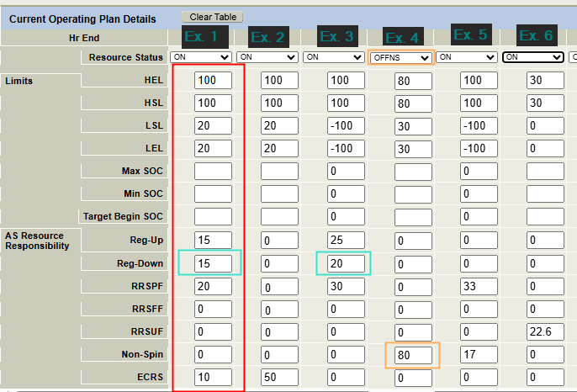
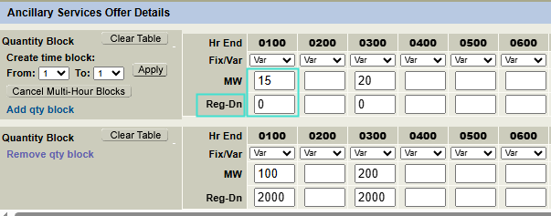
LFC Submissions examples
Ex.1
Carrying: REGUP, REGDN, RRSPF, ECRS
Also Qualified for: NSPIN

Slide 31
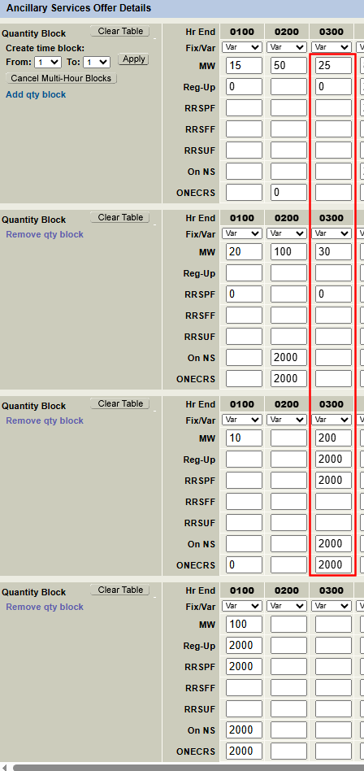
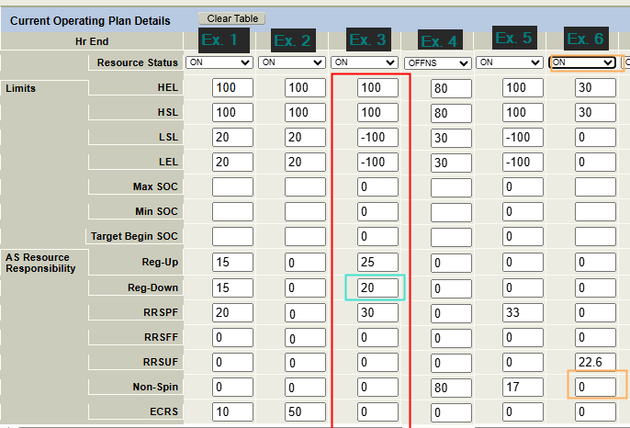
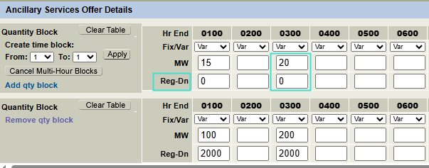
LFC Practice cont’d
Ex.3
Carrying: REGUP, REGDN, RRSPF,
Also Qualified for: ECRS, NSPIN
Battery range is 200 MW

Slide 32
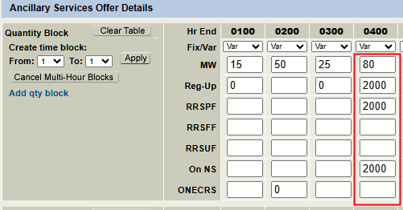
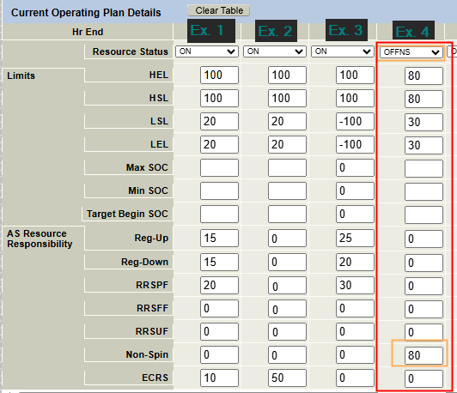
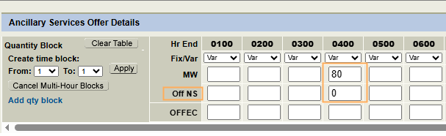
LFC Practice cont’d
Ex.4
Carrying: OFFNS
Also Qualified for: REGUP,RRSPF

Slide 33
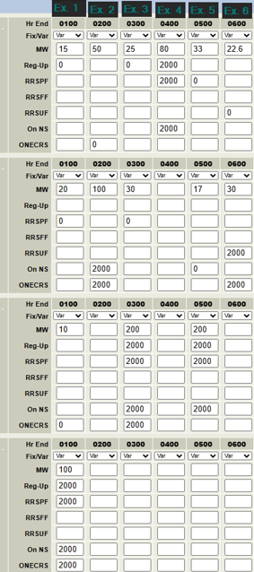
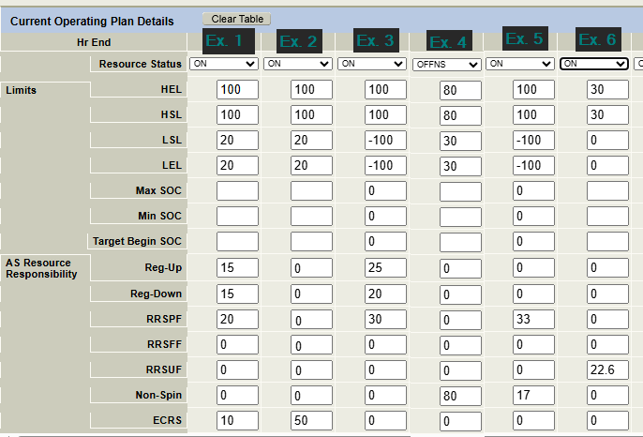
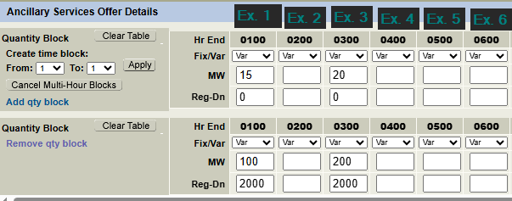
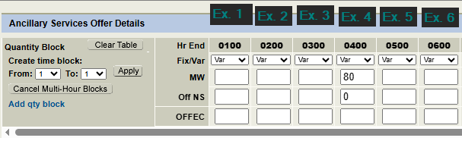
LFC Practice – all examples
Ex.1
Carrying: REGUP, REGDN, RRSPF, ECRS
Also Qualified for: NSPIN
Ex.2
Carrying: ECRS
Also Qualified for: NSPIN
Ex.3
ESR Carrying: REGUP, REGDN, RRSPF
Also Qualified for: ECRS, NSPIN
Ex.4
Carrying: OFFNS
Also Qualified for: REGUP, RRSPF
Ex.5
ESR Carrying: RRSPF, NSPIN
Also Qualified for:REGUP
Ex.6
NCLR Carrying: RRSUF
Also Qualified for: ECRSM

Slide 34
Wrap-Up
Today
  Provide Contact Info by 3pm to RTCB@ercot.com
  Ensure COP/EnergyOffers/Bids/ASOffers entered for 9/11 by 3pm today
  Ensure you have the secure WebEx for tomorrow
  Outreach from ERCOT at targeted at 4pm and 7pm
Tomorrow
  WebEx 7am for subset of technical staff
  Otherwise control room running the cutover
Questions and Answers
Can always email : RTCB@ercot.com

