Slide 1
IRR Reactive Capability at Low or Zero MW Output

Slide 2
ERCOT Operating Guide 2.9.1
(2) An IBR with an SGIA executed on or after August 1, 2024 or that implements a modification, as described in paragraph (1)(c) of Planning Guide Section 5.2.1 for which a GIM was initiated on or after August 1, 2024, shall meet or exceed the capability and performance requirements in the following sections of Institute of Electrical and Electronics Engineers (IEEE) 2800-2022, Standard for Interconnection and Interoperability of Inverter-Based Resources (IBRs) Interconnecting with Associated Transmission Electric Power Systems (“IEEE 2800-2022 standard”), including any intra-standard cross references or definitions, unless otherwise clarified, modified, or exempted in the Protocols, these Operating Guides, or the Planning Guide:
(a) Section 5, Reactive power-voltage control requirements within the continuous operation region;
(b) Section 7, Response to TS abnormal conditions; and
(c) Section 9, Protection.

Slide 3
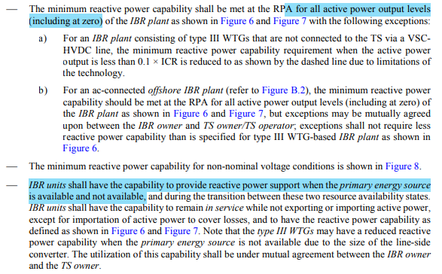
IEEE 2800-2022 Section 5: Reactive power Capability
RPA in NOG is Point
of Interconnection Bus
(POIB)

Slide 4
Protocol 3.15(4)(e)
(4) Each Generation Resource and ESR required to provide VSS shall comply with the following Reactive Power requirements in Real-Time operations when issued a Voltage Set Point by a TSP or ERCOT:
(e) For Generation Resources, the Reactive Power capability shall be available at all MW output levels and may be met through a combination of the Generation Resource’s Corrected Unit Reactive Limit (CURL), which is the generating unit’s dynamic leading and lagging operating capability, and/or dynamic VAr-capable devices. This Reactive Power profile is depicted graphically as a rectangle. For Intermittent Renewable Resources (IRRs), the Reactive Power requirements shall be available at all MW output levels at or above 10% of the IRR’s nameplate capacity. When an IRR is operating below 10% of its nameplate capacity and is unable to support voltage at the POIB, ERCOT, the interconnecting TSP, or that TSP’s agent may require an IRR to disconnect from the ERCOT System for purposes of maintaining reliability. For ESRs, the Reactive Power capability shall be available at all MW levels, when charging or discharging, and may be met through a combination of the ESR’s CURL, and/or dynamic VAr-capable devices. For any ESR that achieved Initial Synchronization before December 16, 2019, the requirement to have Reactive Power capability when charging does not apply if the Resource Entity for the ESR has submitted a notarized attestation to ERCOT stating that, since the date of Initial Synchronization, the ESR has been unable to comply with this requirement without physical or software changes/modifications, and ERCOT has provided written confirmation of the exemption to the Resource Entity. The exemption shall apply only to the extent of the ESR’s inability to comply with the requirement when the ESR is charging;

Slide 5
Protocol 3.15.3 – NPRR1138
(11) The Resource Entity for an IRR synchronized to the ERCOT System that is capable of providing any net Reactive Power when not producing real power shall:
(a) Provide stable Reactive Power output at all MW levels at which the IRR has Reactive Power capability;
(b) When capable of providing real power, set the IRR LSL to 0 MW or the lowest MW level, not to exceed 1 MW, at which the IRR can provide stable Reactive Power after appropriate tuning of settings;
(c) Ensure the lowest MW point on the submitted reactive capability curve accurately reflects the IRR’s MVAr leading and lagging reactive capability when not producing real power;
(d) Ensure the second-lowest MW point on the submitted reactive capability curve accurately reflects the IRR’s leading and lagging reactive capability at its LSL when the LSL is not 0 MW;
(e) Send to ERCOT, via telemetry, an AVR status of “On” when the IRR is synchronized to the ERCOT System, not producing real power, and reactive control is working properly; and
(f) Meet the requirements in paragraphs (2), (4), (5), and (7) above when the IRR is synchronized to the ERCOT System and not producing real power.
(12) The Resource Entity for an IRR that is capable of providing any net Reactive Power when not producing real power may physically desynchronize its inverters from the ERCOT System instead of providing Reactive Power when not producing real power.

Slide 6
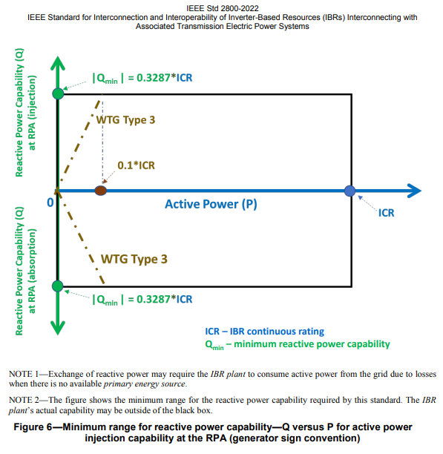
Summary Reactive Capability Requirements
SGIA before 8/1/24: Meet reactive requirements in NP § 3.15(4) for MW >10% and NP § 3.15.3(10)(11) & (12) for <10% (per NPPR1138)
Reactive Power requirements available at all MW output levels at or above 10% (NP § 3.15(4)(e))
Protocols silent for IRR operating at <10%
When < 10% and unable to support voltage, may require IRR to disconnect
Repowers to meet Section 5 of IEEE 2800 (with some exceptions)
SGIA after 8/1/24: Output <10%, Protocols are silent on reactive capability requirements for IRRs therefore NOG 2.9.1 applies and requires meeting Section 5 of IEEE2800. 0MW – 100%.
Protocol 3.15 and IEEE 2800 Section 5 are consistent
At 0 MW, IRR must have reactive capability, but NP § 3.15.3(12) allows IRR to desynchronize at 0 MW (NPRR1138):
RE for an IRR that is capable of providing any net Reactive Power when not producing real power may physically desynchronize its inverters from the ERCOT System instead of providing Reactive Power when not producing real power.

Slide 7
ERCOT – Next Steps
Propose an NPRR and NOGRR to clarify the reactive requirements and move reactive requirements from Operating Guides to NP § 3.15 in the near future

Slide 8
Questions

