Slide 1
Weekly
RTC+B Market Trials Update
ERCOT Staff
September 8, 2025

Slide 2
Outline
Antitrust Admonition
Expectations of QSEs for the Week
  Adding another meeting Wednesday Sep 10 at 10-11am for LFC Prep
Scorecards for in-flight Activities
Communicate any known Issues within On-going Trial
RTC Market Trials outcomes
What is needed this week and next week ahead of Sep 11 LFC Test
Q&A
Appendix- Supporting Materials:
  Attestation Market Notice
  Telemetry Screening
  New RTC Pricing reports location
  NPRR1290 market submission validation change
  Links to Handbooks
  Prior Scorecards
  FAQ Updated 9/8/2025
  Connectivity and Configuration (digital certs)

Slide 3
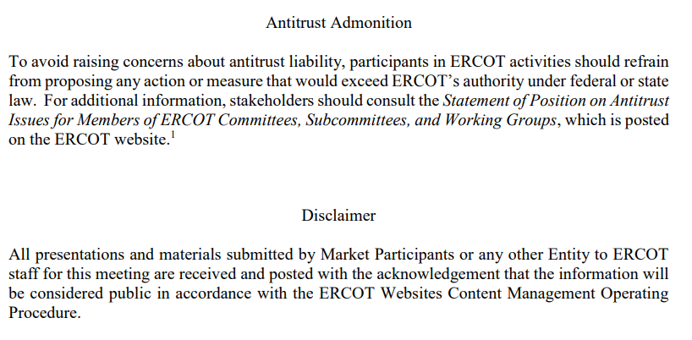
WebEx Meeting reminders (same as other ERCOT forums):
Please keep line muted
If you have a question, please use the chat feature to either:
  Type in your question, or
  Type in “Question” and wait to be recognized to state question

Slide 4
Sequence and Dates for Market Trials to Go-Live
Market trials are a progression of activities to mitigate the risk for Go-Live on new systems and processes for both the Market Participants & ERCOT.
30-day Market Notice
11/5/25
March/April
2025
Start
5/5/25
Start
7/7/25
Start
9/2/25
Go-Live
12/5/25*
May 2025
June 2025
July 2025
Aug 2025
Sep 2025
Oct 2025
Nov 2025
Dec 2025
QSE Scorecards & Exit Criteria for each Trial Phase
#1 RTC QSE Submission Testing
(Submit COP, RT AS Offers,
DAM Virtual AS, Outages for ESRs)
#3 Open-loop RTC SCED
(QSE offers, SCED non-binding award/dispatch)
#5 Ongoing Open-Loop
& Periodic Closed-loop SCED/LFC
(QSE RTC offers and telemetry to support closed-loop frequency control test 2-3 tests of 2-4 hour durations)
Transition to Go-Live
Upon completion of testing, confirmation of ERCOT and market readiness for Go-Live.
QSE/Vendor Submission Sandbox and Telemetry Points added Prod EMS model.
#2 RTC QSE Telemetry Checkout (QSEs add/verify new telemetry points for UDSP, New ramp rates, ESR telemetry)
#4 QSE Telemetry Tests
(Individual QSE to follow UDSP and support new ramp rate and ESR telemetry)
#6 Day-Ahead Market
(Non-binding DAM using QSE offers for at least 2 tests)
* Go-Live date reflects 12/5/2025 as first Operating Day
where 12/4/2025 is planned software migration.

Slide 5
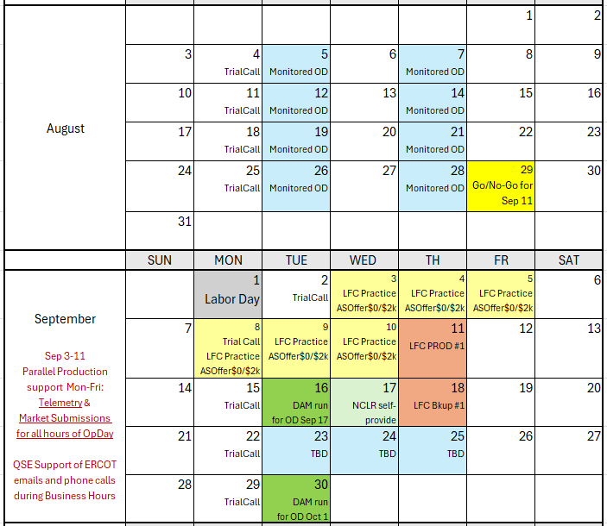
Market Trials Calendar and Transition to September
We are here….

Slide 6
No new Scorecards for Sep/Oct Trials
Preparing for September 11 Test:
ERCOT will continuing existing scorecards for:
  Market Submissions
  Telemetry Scorecard
Reflect completeness of market submissions
Next slides to see your company score
  Please reach out to RTCB@ercot.com if you need support

Slide 7
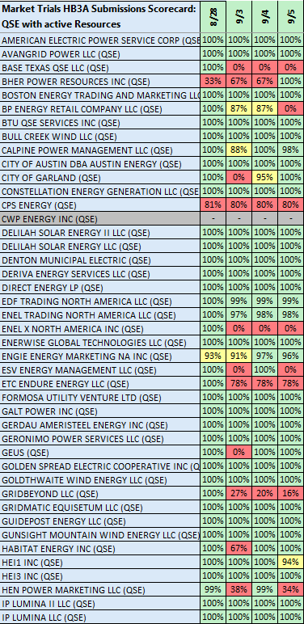
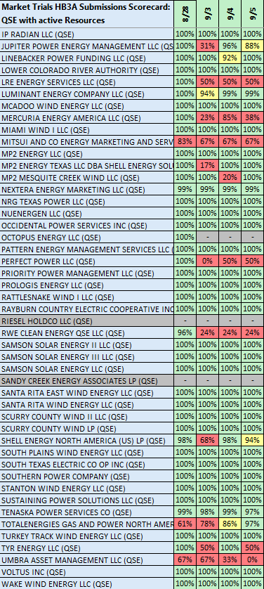
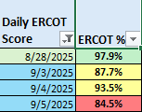
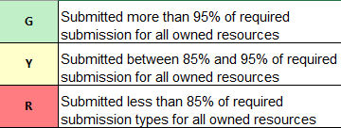
Scorecard 3A for
Handbook 3-
Market submissions:
Scores for QSEs with Resources – Appropriate submissions made for each owned resources.
COP – ALL
TPO – Gen, ESR, CLR
ASO – AS Qualified Resources
System Wide Score down last week:
Scoring:

Slide 8
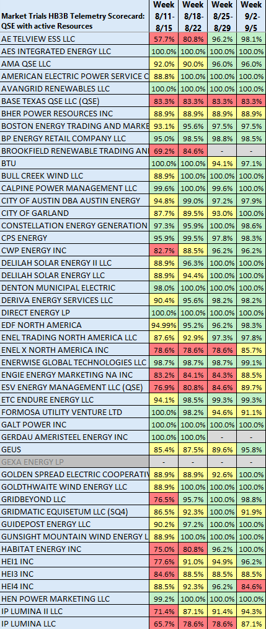
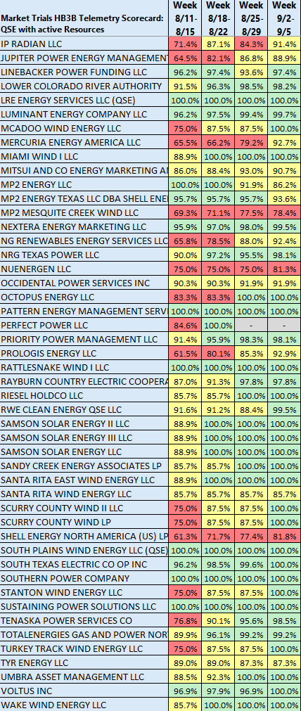
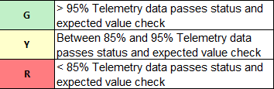
Scorecard 3B for
Handbook 3-
Acceptable Telemetry point values received by
ERCOT for active resources
9/5 Scores for QSE with Resources – Accurate telemetry data sent to ERCOT
System Wide score
hit 97% Friday last week
Scoring:

Slide 9
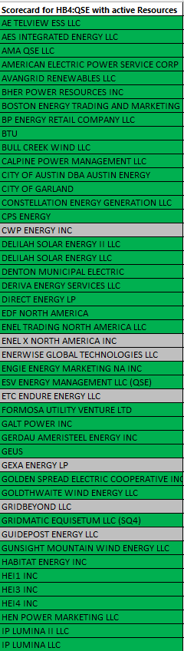
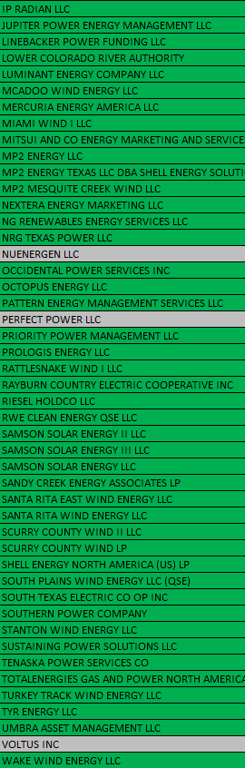
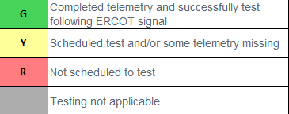
Scorecard 4 for
Handbook 4-
QSEs demonstrate ability to follow UDSP in coordinated test with ERCOT
UDSP following tests
QSEs testing successfully completed!
Scoring:

Slide 10
Market Trials known issues/updates
Current issues/updates:
  Issues:
    Periodic credit issues (phase 2 validation), considering workaround to prevent impacts these 2 weeks.
    No current software issues
  Update:
    NPRR1282 values to be populated Sep 9 (AS Duration Values)

Slide 11
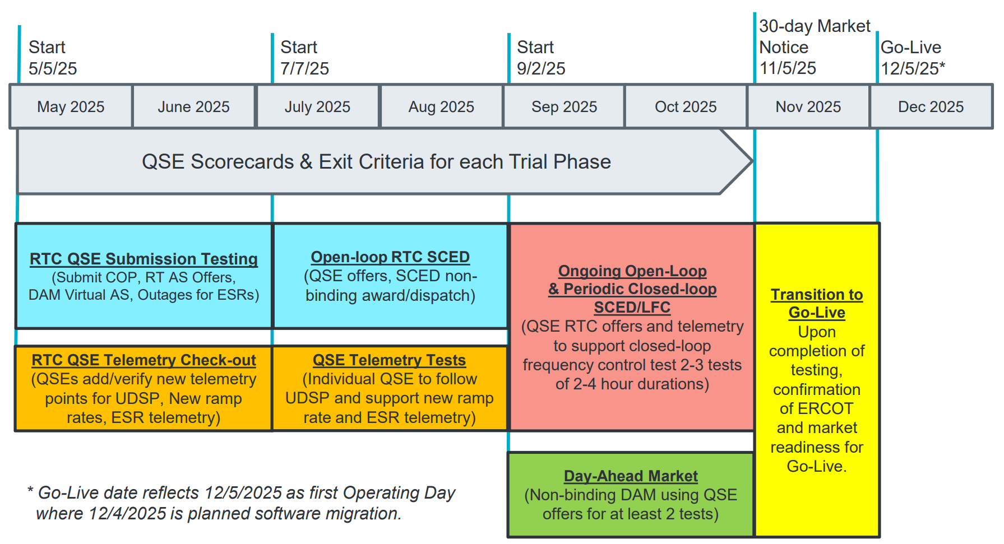
Sep & Oct:
Required live-production test to ensure effective frequency dispatch and control.
Sep & Oct:
Optional Day-Ahead Market
Voluntary Day-Ahead Market for all QSEs will be conducted at least 2 times.
QSE can test their market submissions for Day-Ahead AS Self-Arrangement, AS Only Offers, Trades and normal submissions.
DAM participation is strongly encouraged but not required in Readiness metrics since RTC procures AS in Real-Time.
Participation includes much broader QSE population (marketers and load-only QSEs).
ERCOT and QSEs will conduct live-production tests of RTC-SCED and Load Frequency Control (LFC) prior to go-live.
RTC-SCED and frequency control dispatch during the tests will be binding to manage the reliable operations of the grid for2-4 hours.
ERCOT will coordinate with QSEs on how to submit RTC offers and telemetry for Energy and AS for the two systems (current and RTC system).
ERCOT will provide a summary of the test and use analysis and engineering judgement to assess if the test was successful in controlling frequency.

Slide 12
THIS WEEK-
Objective is to prepare and execute for Closed Loop LFC Test
This week continues
  ERCOT continue coordination on Telemetry
  ERCOT continue coordination on Market Submissions
QSE Expectations?
  QSEs being required for submission for all hours of highlighted Operating Days for September 8-11
  Scripted offer requirement: Adhere to offers per LFC Handbook 5
    Energy offers match production
    AS Offers should be offered at $0 if responsible in current production, remaining AS offer at $2,000
After successful Sept 11 LFC Test, pivot to initial DAM Testing and Self-Provision capabilities

Slide 13
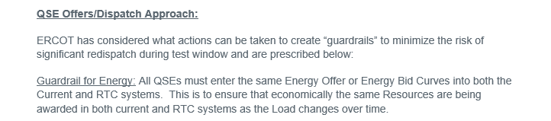
LFC Handbook Reminders

Slide 14
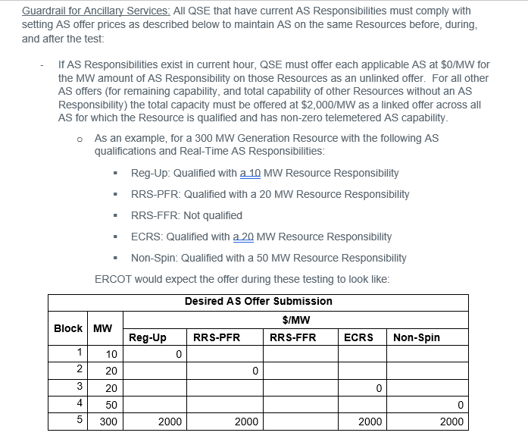
LFC Handbook Reminders

Slide 15
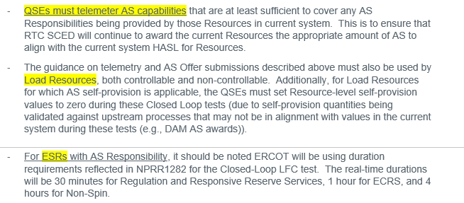
LFC Handbook Reminders

Slide 16
Additional Market Education
Offline ECRS in RTC+B
Additional Examples of LFC Test submissions

Slide 17
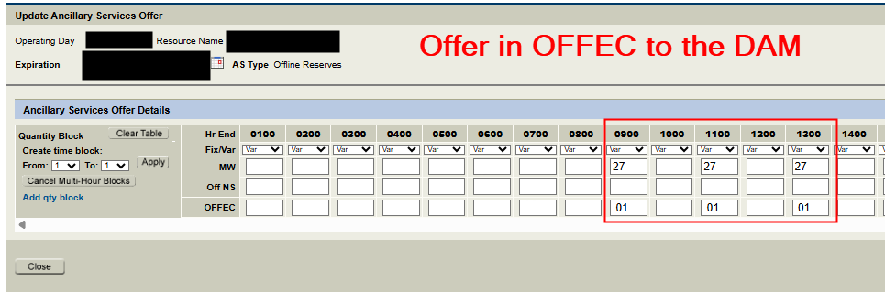
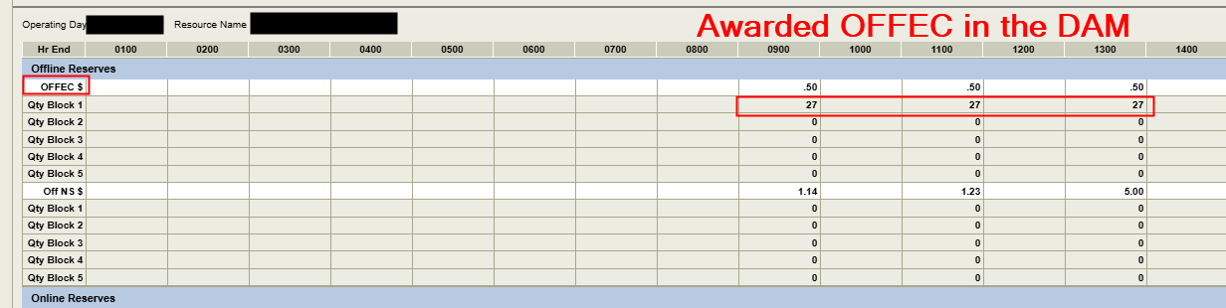
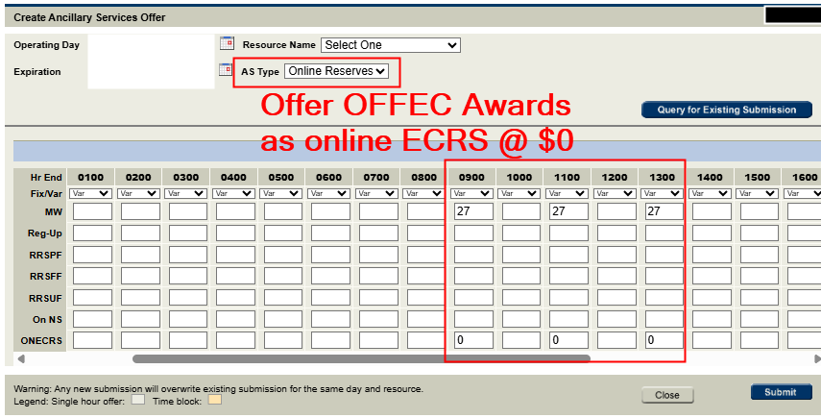
Market Education – Offline ECRS in RTC+B
In RTC+B, Offline ECRS that is offered and awarded in the DAM has to be re-offered as online ECRS if it is to be awarded in RTM.
  Offline ECRS can’t be awarded in RTC+B Real-Time Market. To represent an Offline ECRS Award, resource must:
  Telemeter ‘OFFQS’ status
  Have On-line ECRS AS Offer submitted.

Slide 18
Market Education – Offline ECRS in RTC+B
  For the LFC Practice and LFC cutover on 9/11, to represent your off-line ECRS awards/responsibility from Production in RTC+B, please submit online ECRS offers into the RTC+B system with $0.
  In RTC+B, SCED can not award AS Offers for OFFEC. The correct telemetered status for providing ECRS from an offline resource is ‘OFFQS’, however this status is seen as an online status.
  Since SCED sees ‘OFFQS’ resources as online, an online AS Offer of ECRS is needed to be awarded ECRS in the RTM.

Slide 19
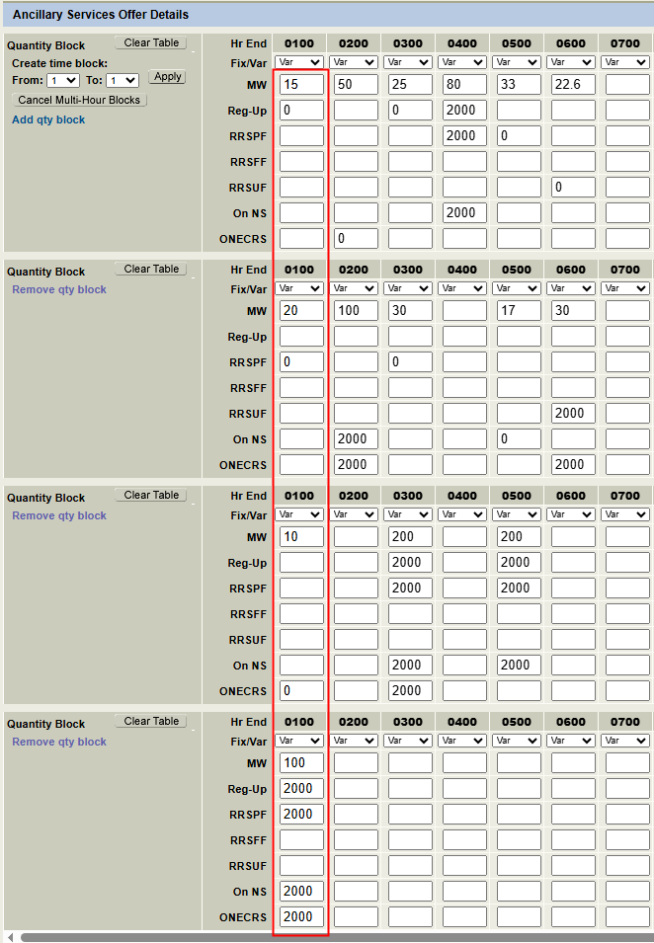
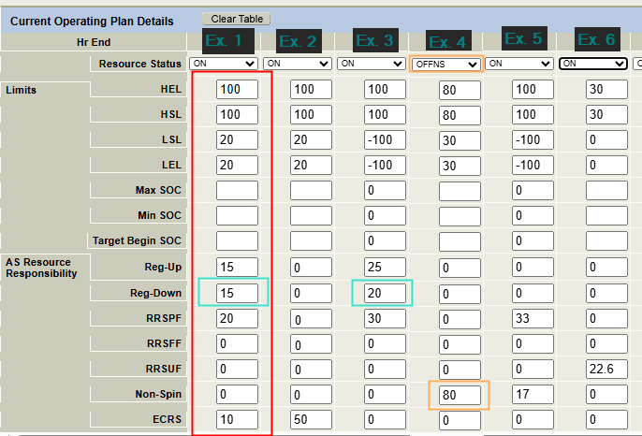
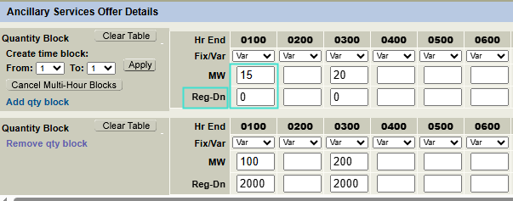
LFC Submissions examples
Ex.1
Carrying: REGUP, REGDN, RRSPF, ECRS
Also Qualified for: NSPIN

Slide 20
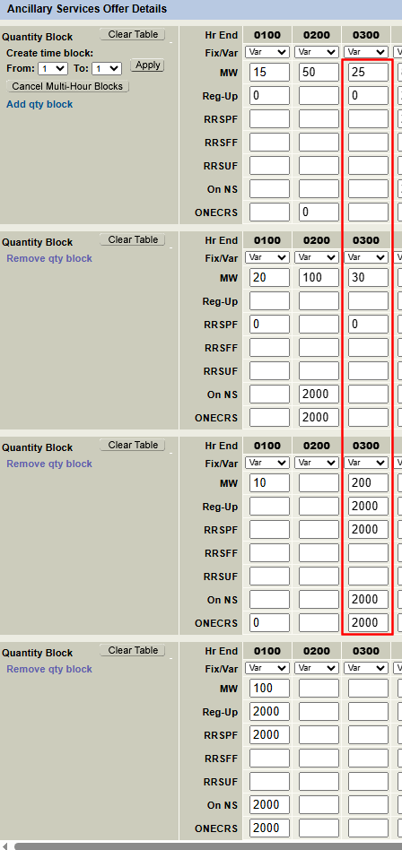
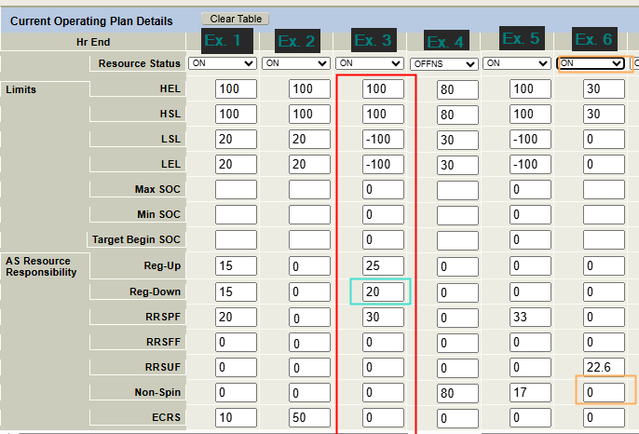
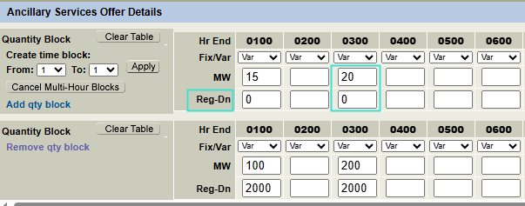
LFC Practice cont’d
Ex.3
Carrying: REGUP, REGDN, RRSPF,
Also Qualified for: ECRS, NSPIN
Battery range is 200 MW

Slide 21
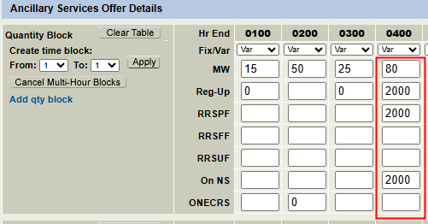
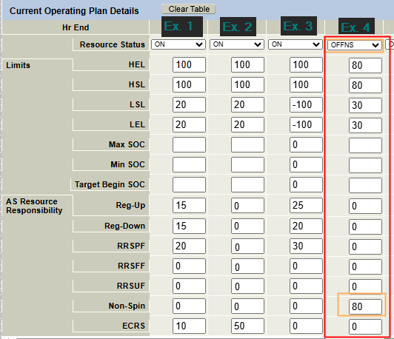
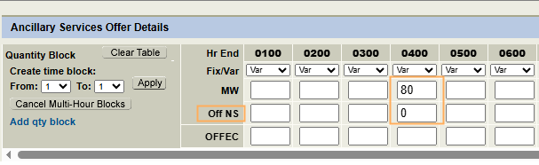
LFC Practice cont’d
Ex.4
Carrying: OFFNS
Also Qualified for: REGUP,RRSPF

Slide 22
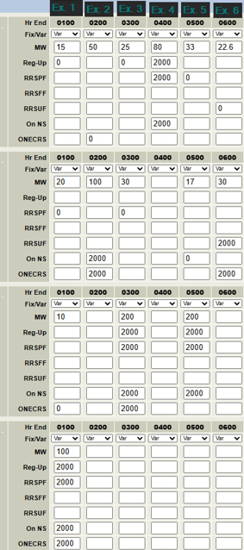
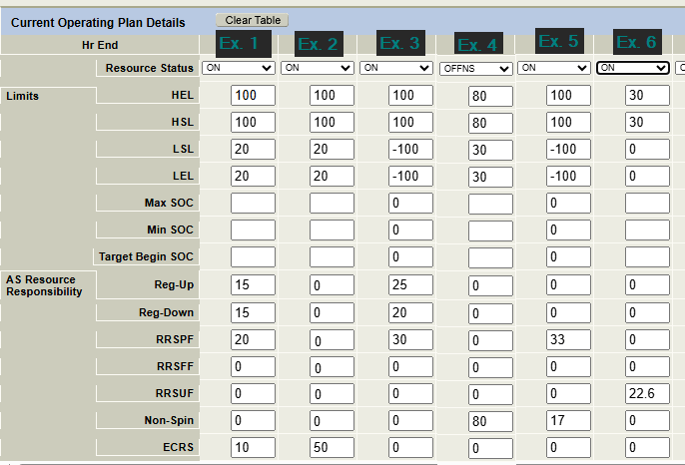
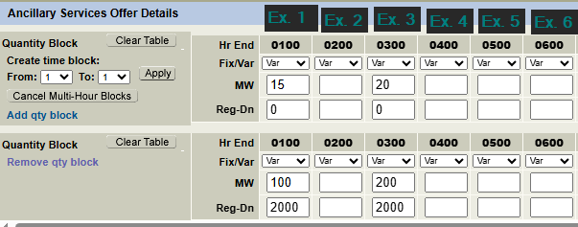
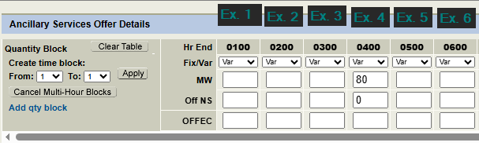
LFC Practice – all examples
Ex.1
Carrying: REGUP, REGDN, RRSPF, ECRS
Also Qualified for: NSPIN
Ex.2
Carrying: ECRS
Also Qualified for: NSPIN
Ex.3
ESR Carrying: REGUP, REGDN, RRSPF
Also Qualified for: ECRS, NSPIN
Ex.4
Carrying: OFFNS
Also Qualified for: REGUP, RRSPF
Ex.5
ESR Carrying: RRSPF, NSPIN
Also Qualified for:REGUP
Ex.6
NCLR Carrying: RRSUF
Also Qualified for: ECRSM

Slide 23
Closed Loop Prep OD Summary
09-03-2025

Slide 24
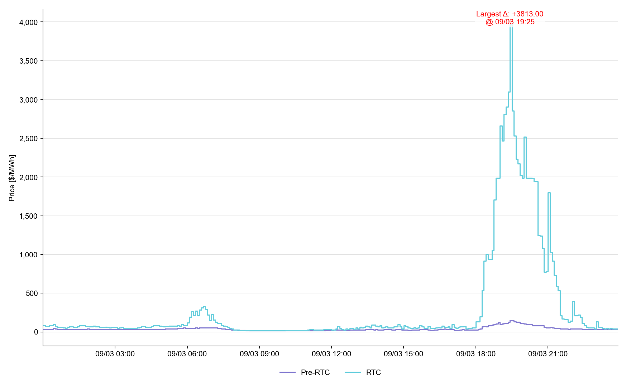
System Lambda (plus Adders)

Slide 25
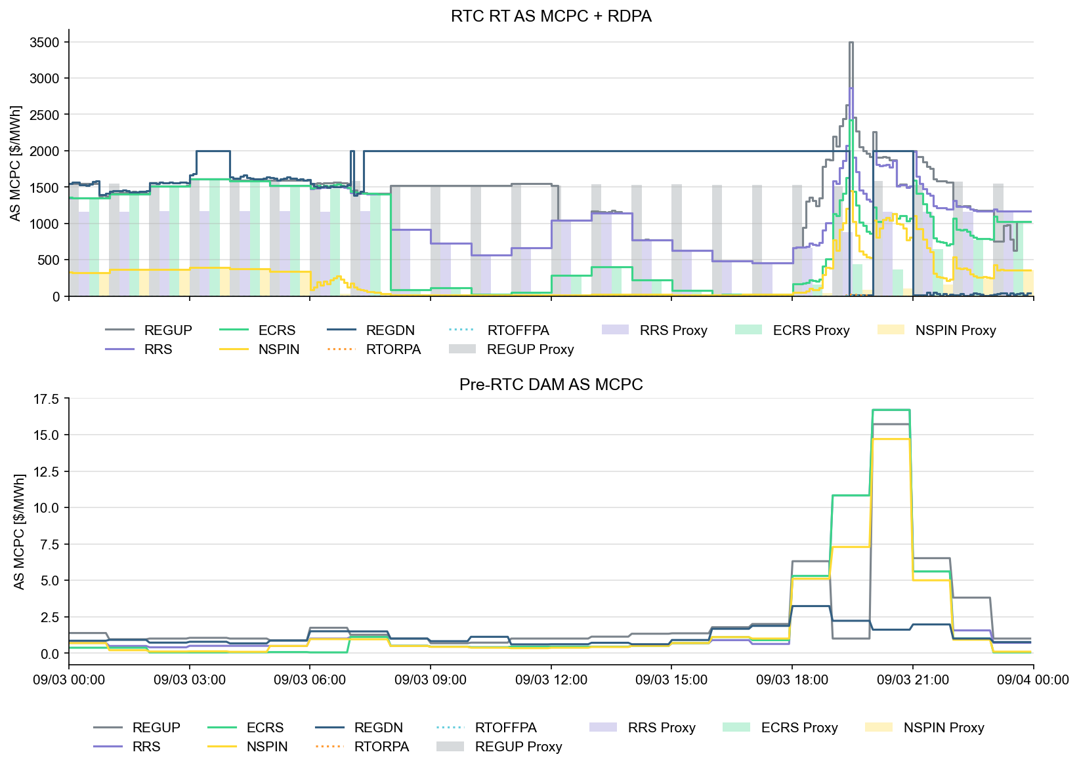
Ancillary Service Prices

Slide 26
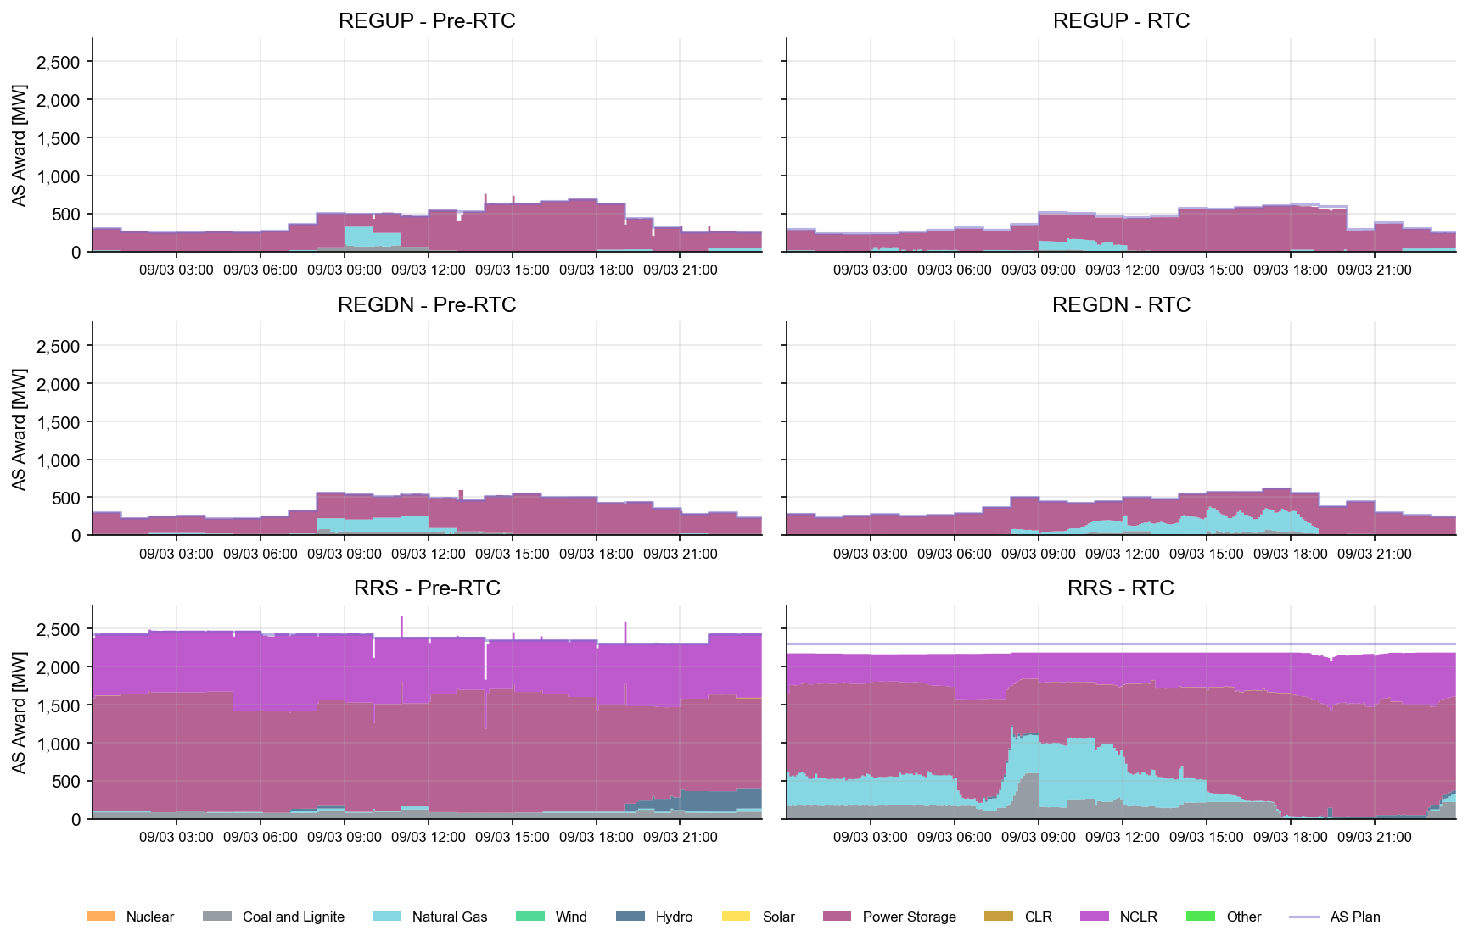
AS Awards* Summary by Resource Type
* Pre-RTC (RTM AS Schedule)
* Pre-RTC (RTM AS Schedule)

Slide 27
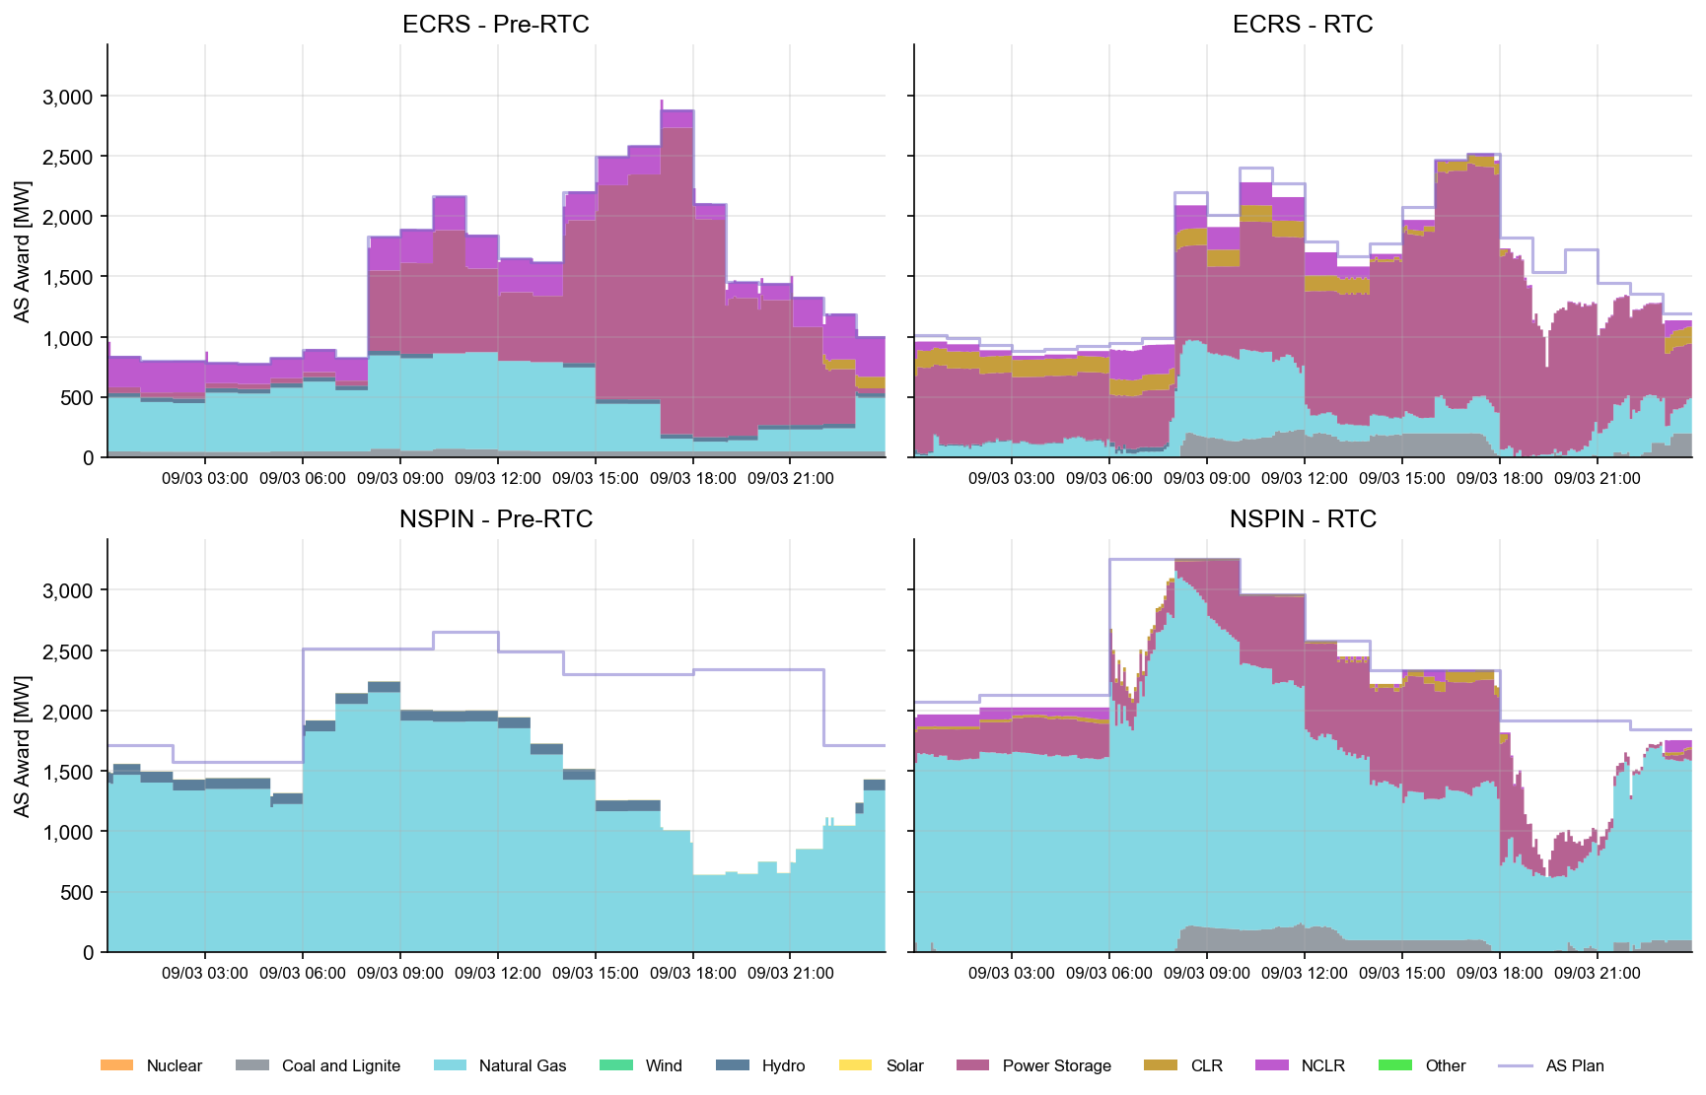
AS Awards* Summary by Resource Type
* Pre-RTC (RTM AS Schedule)

Slide 28
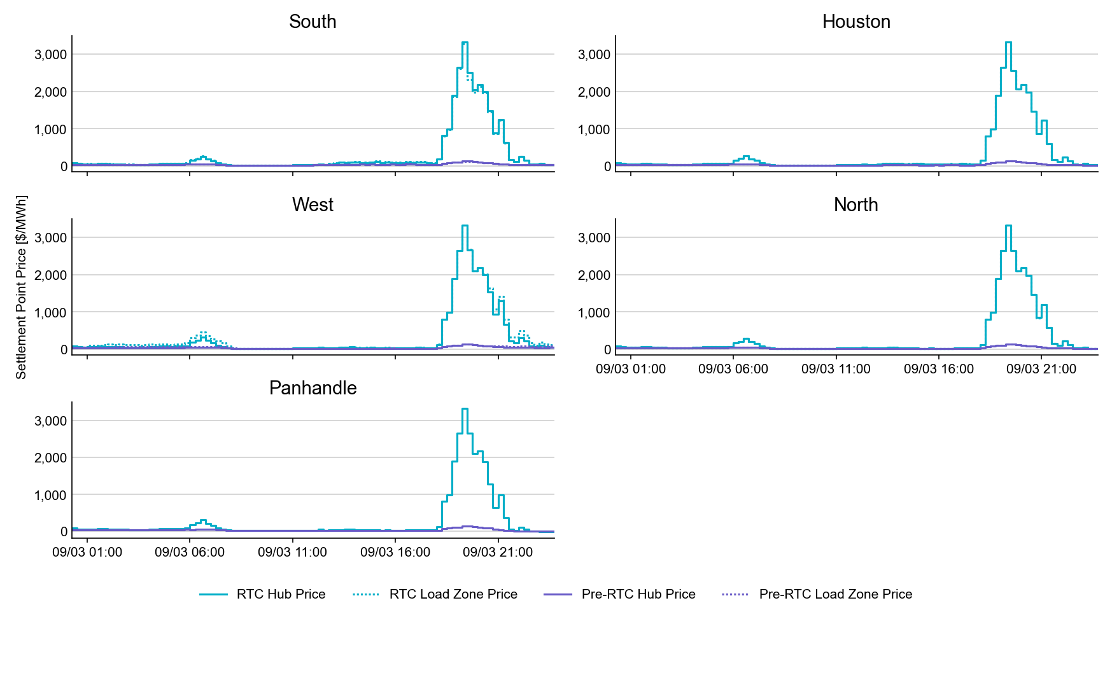
SPP by Hub and Competitive Load Zone

Slide 29
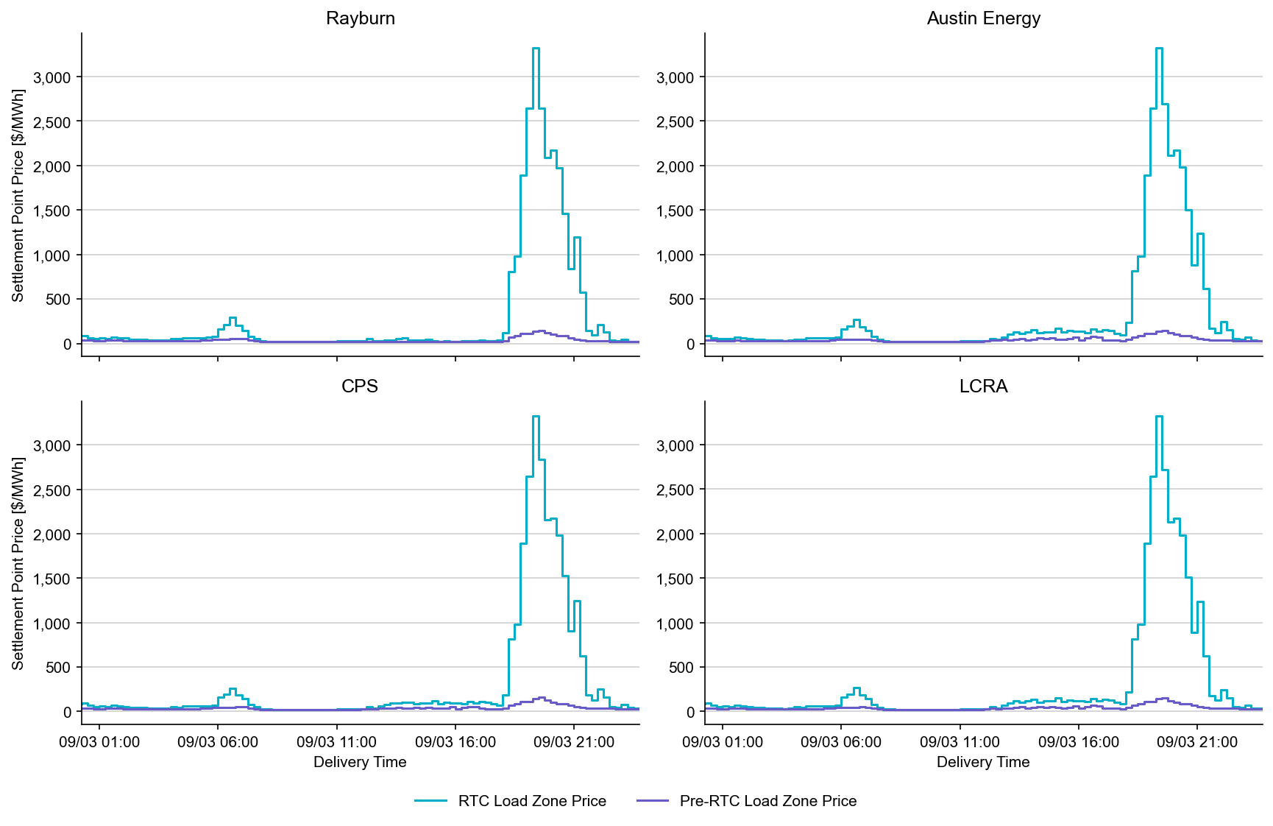
Settlement Point Prices by NOIE Load Zone

Slide 30
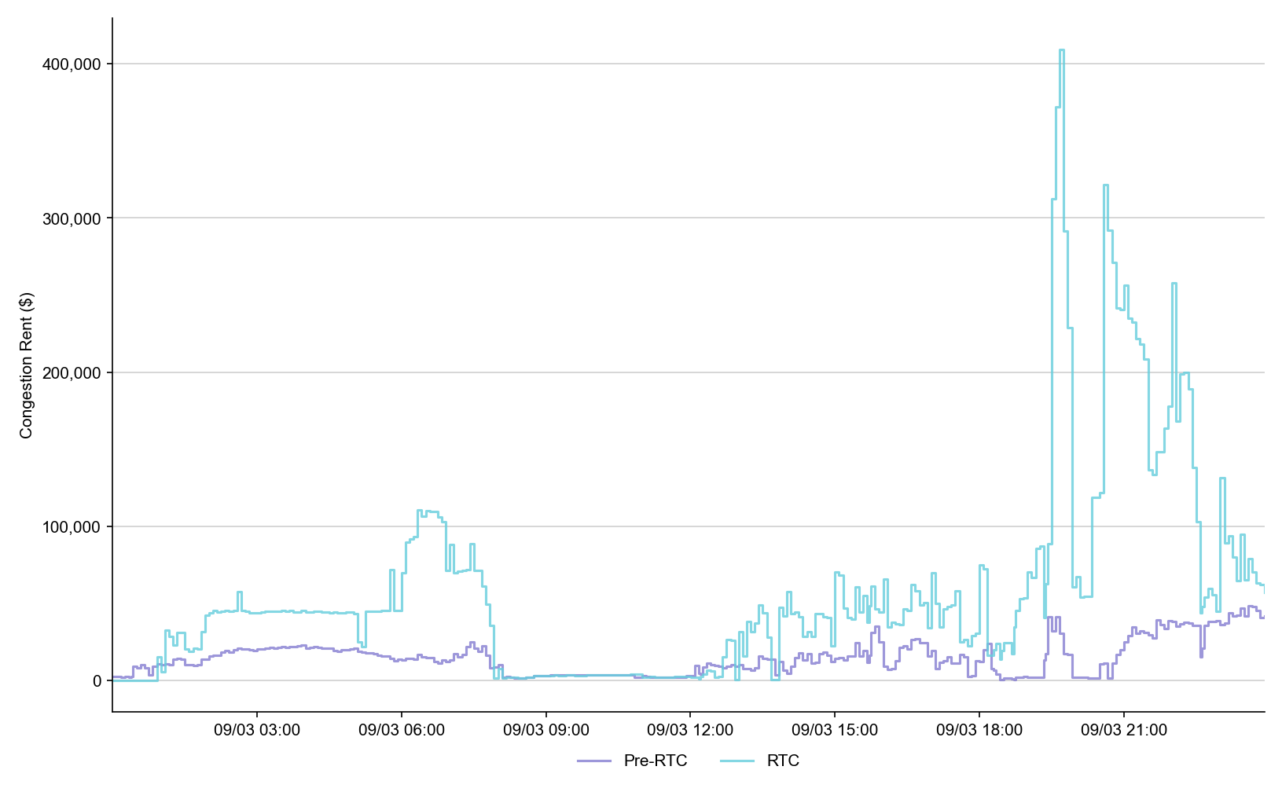
Congestion Rent

Slide 31
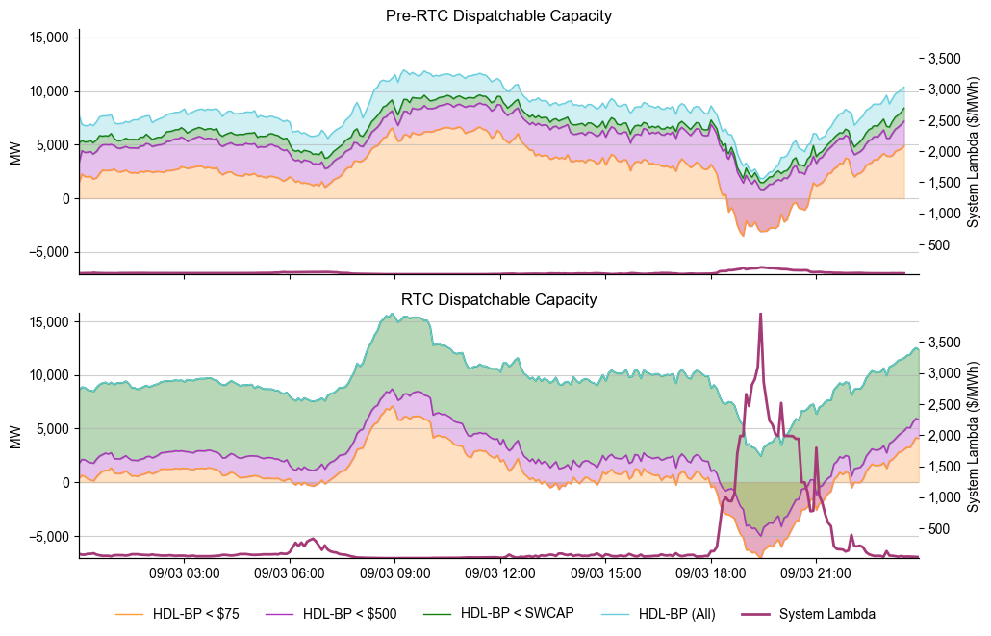
Dispatchable Capacity

Slide 32
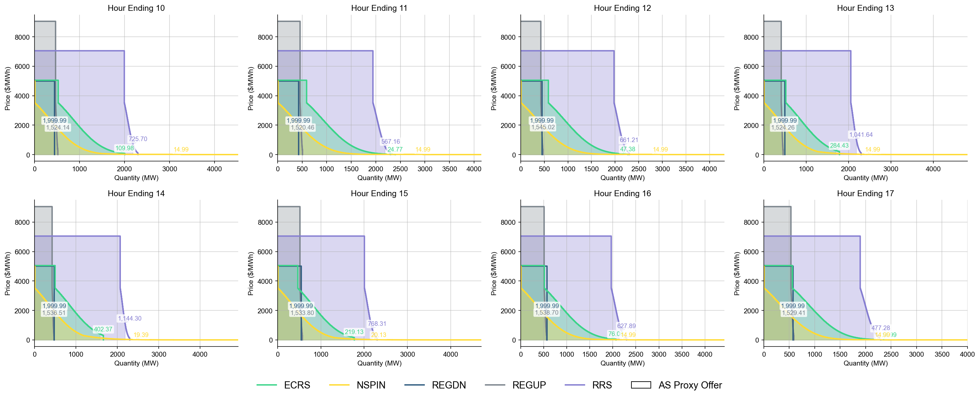
Ancillary Service Demand Curves

Slide 33
Closed Loop Prep OD Summary
09-04-2025

Slide 34
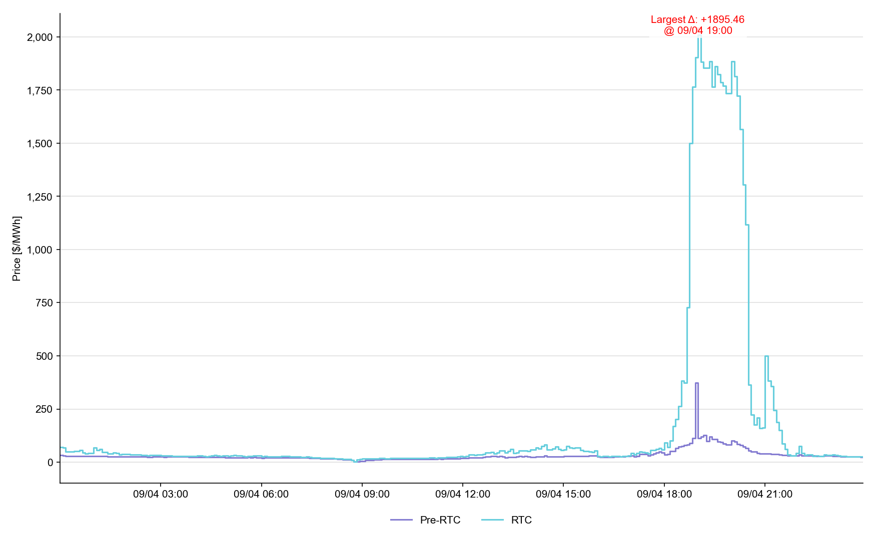
System Lambda (plus Adders)

Slide 35
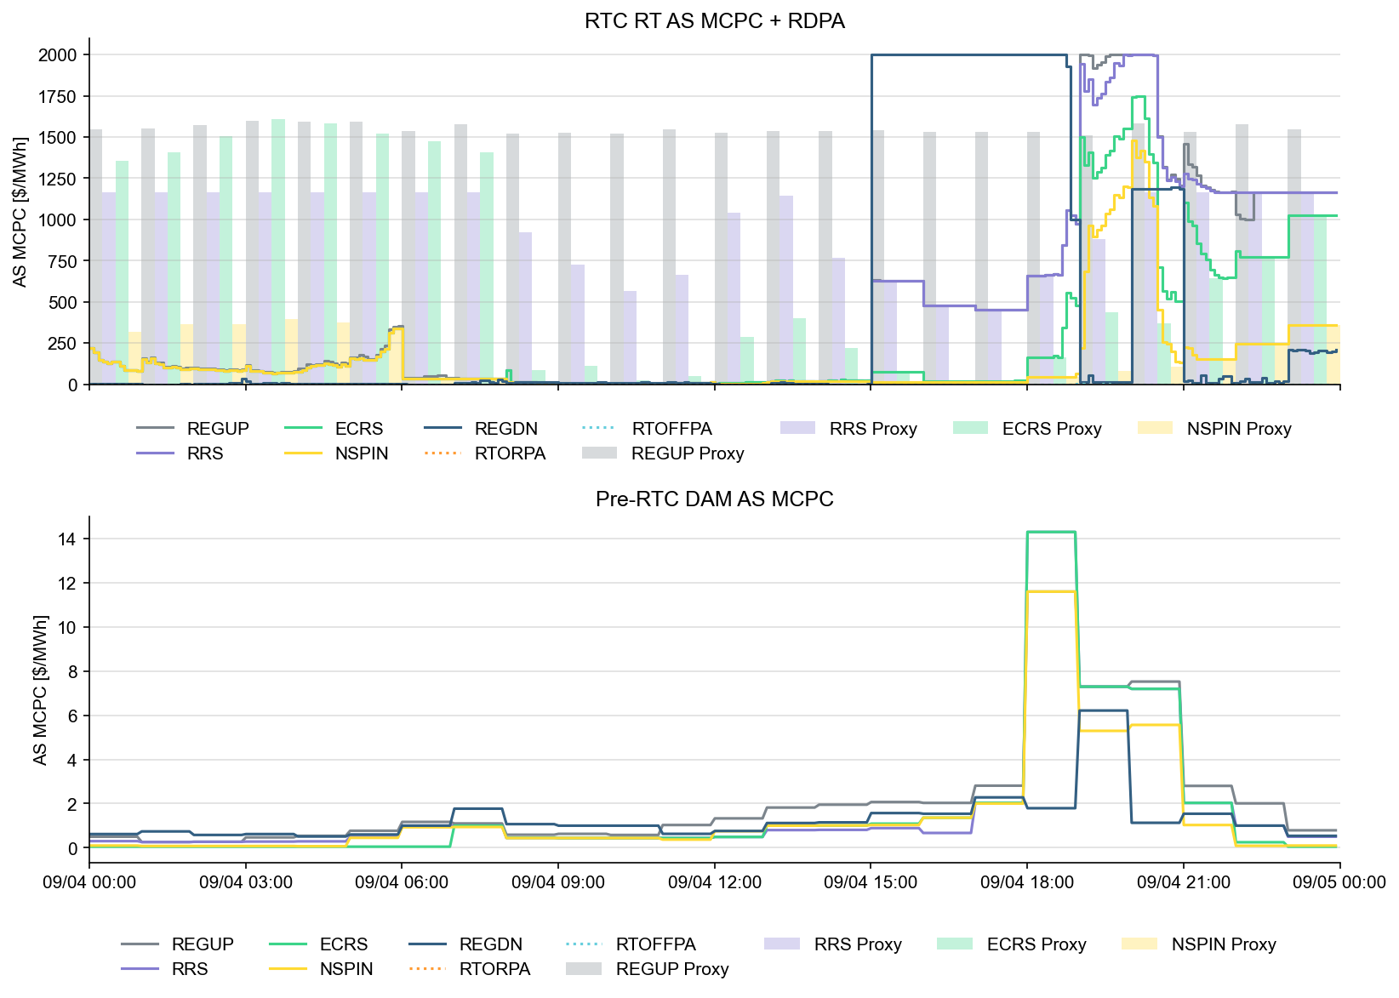
Ancillary Service Prices

Slide 36
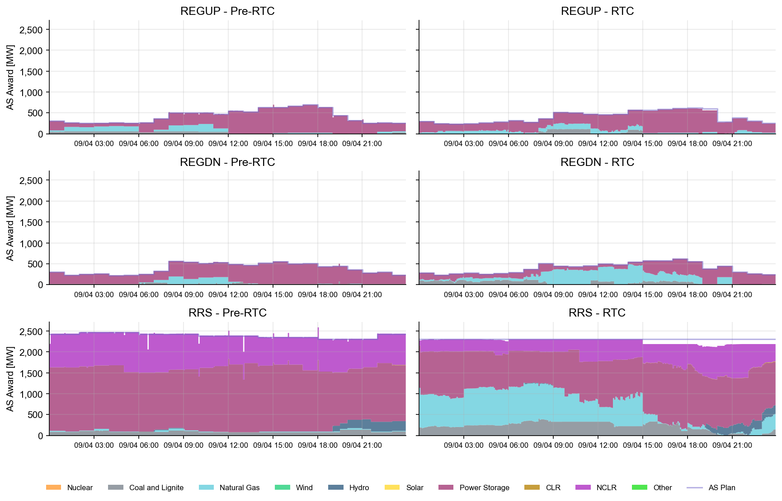
AS Awards* by Resource Type
* Pre-RTC (RTM AS Schedule)

Slide 37
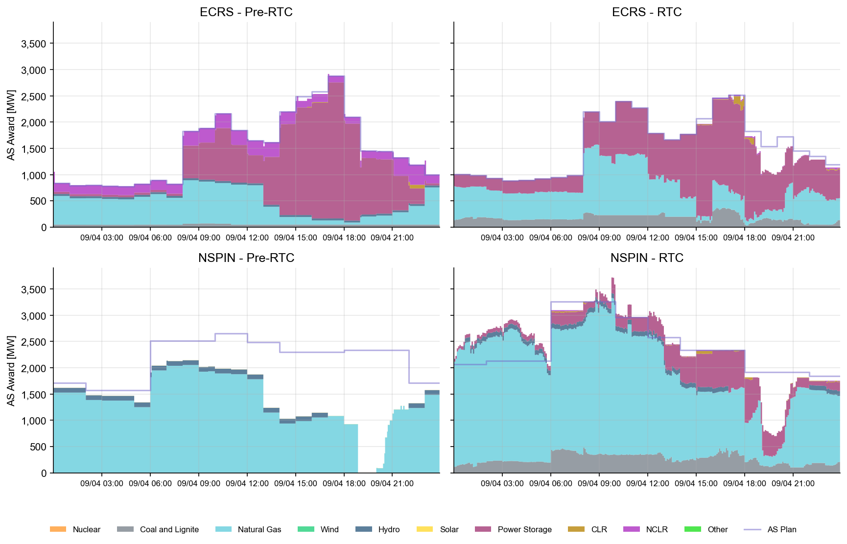
AS Awards* by Resource Type
* Pre-RTC (RTM AS Schedule)

Slide 38
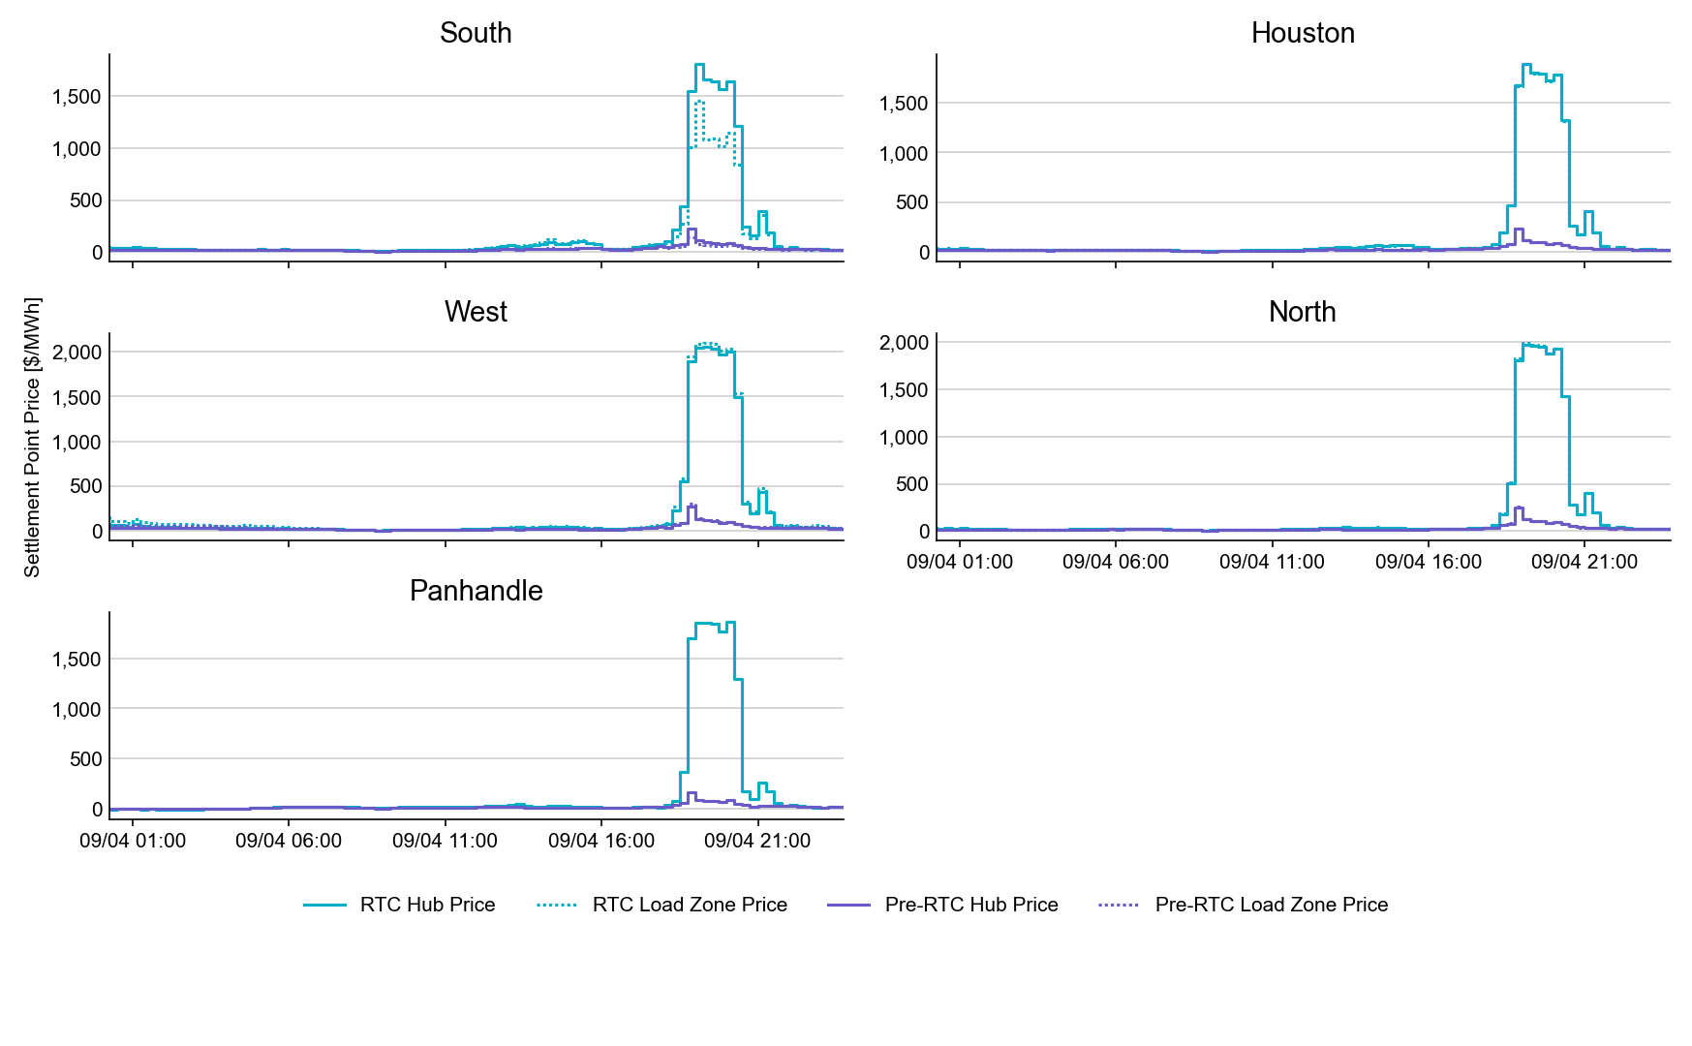
SPP by Hub and Competitive Load Zone

Slide 39
Settlement Point Prices by NOIE Load Zone

Slide 40
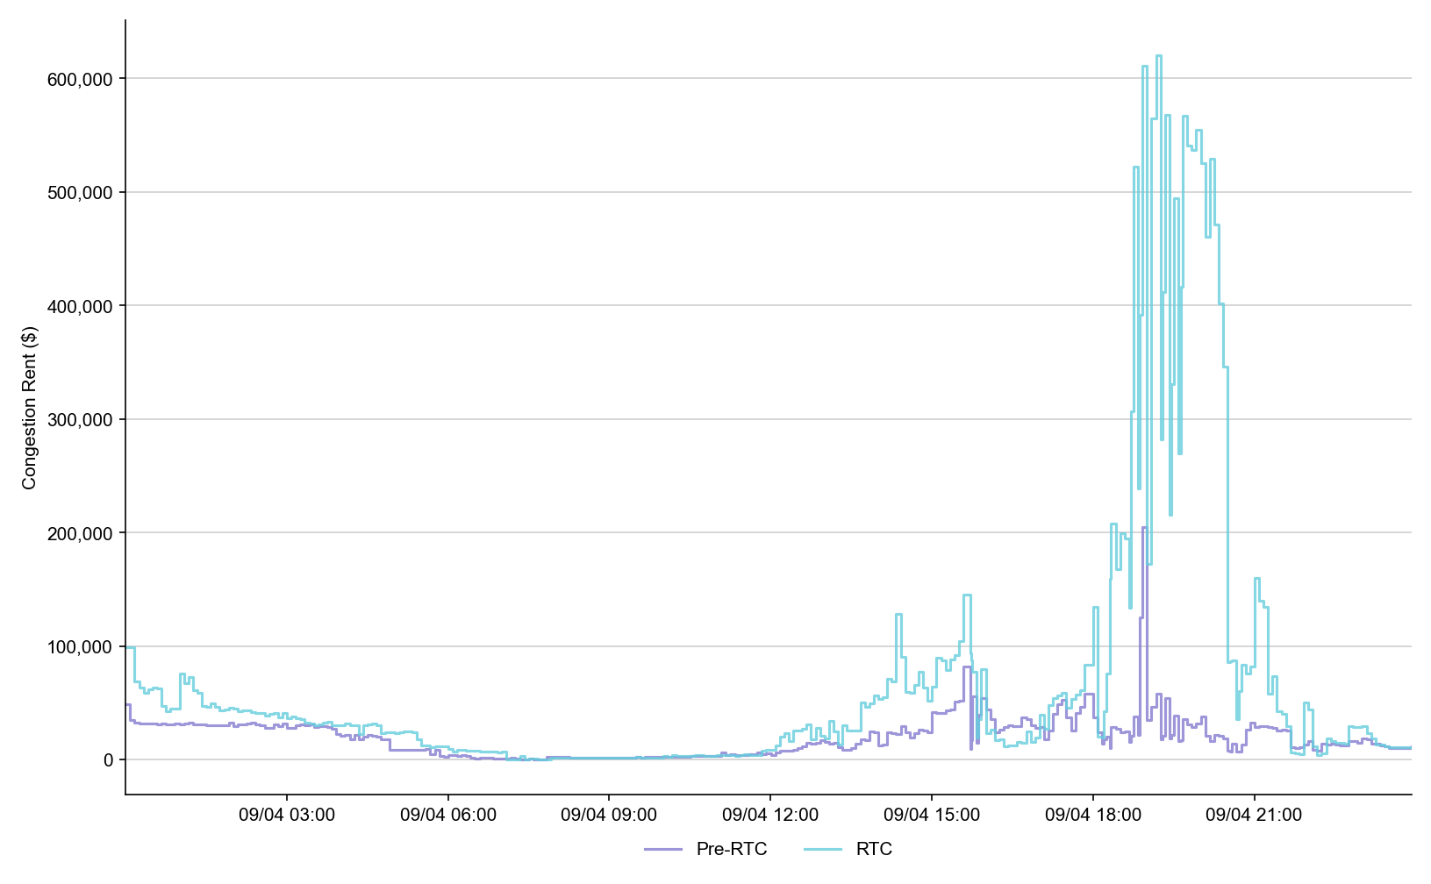
Congestion Rent

Slide 41
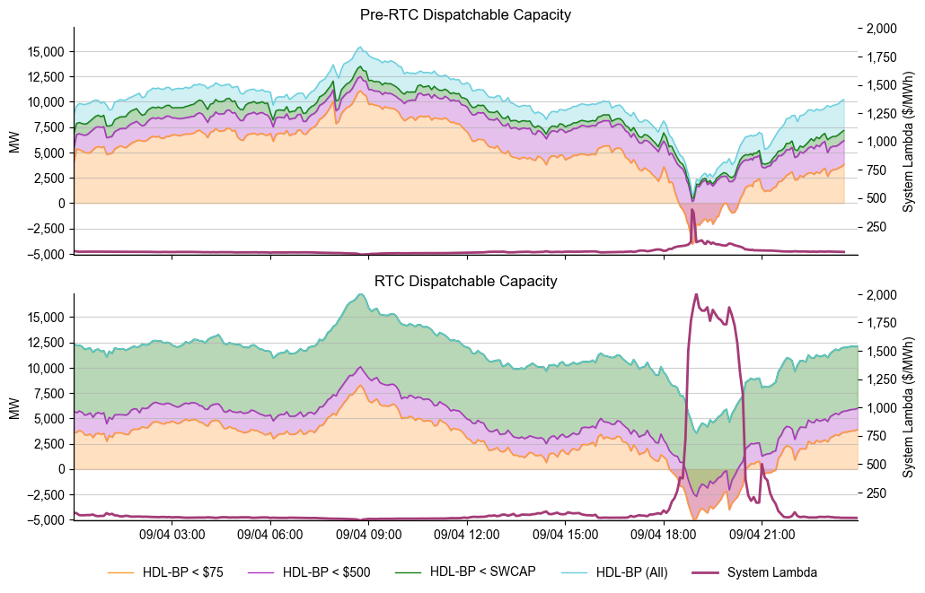
Dispatchable Capacity

Slide 42
Ancillary Service Demand Curves

Slide 43
Closed Loop Prep OD Summary
09-05-2025

Slide 44
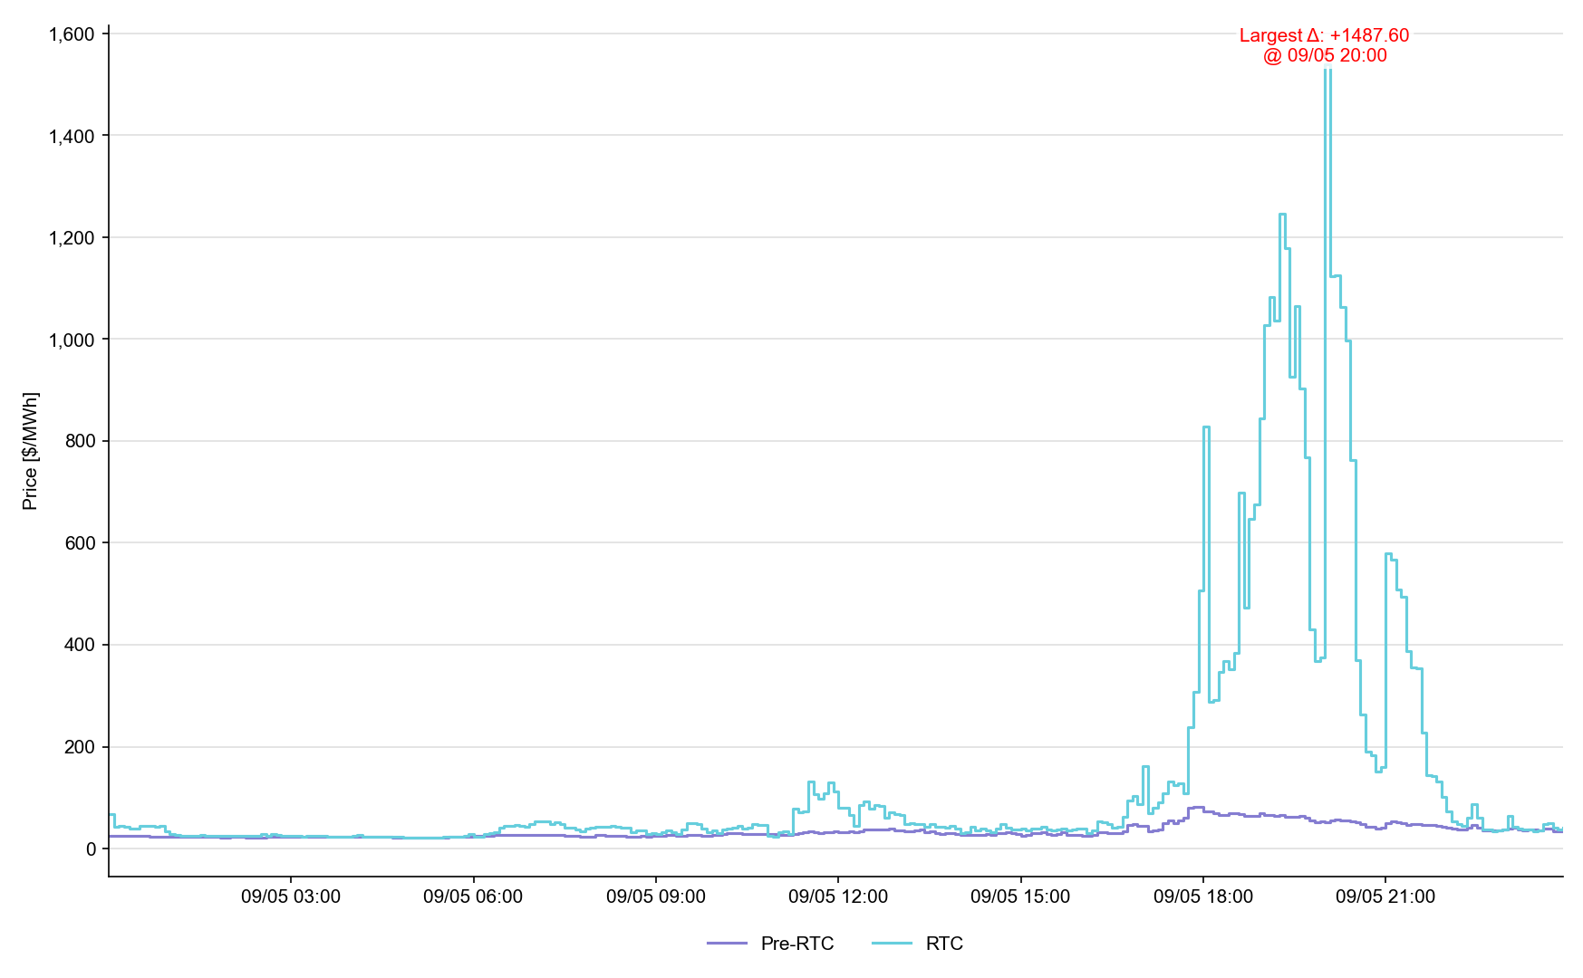
System Lambda (plus Adders)

Slide 45
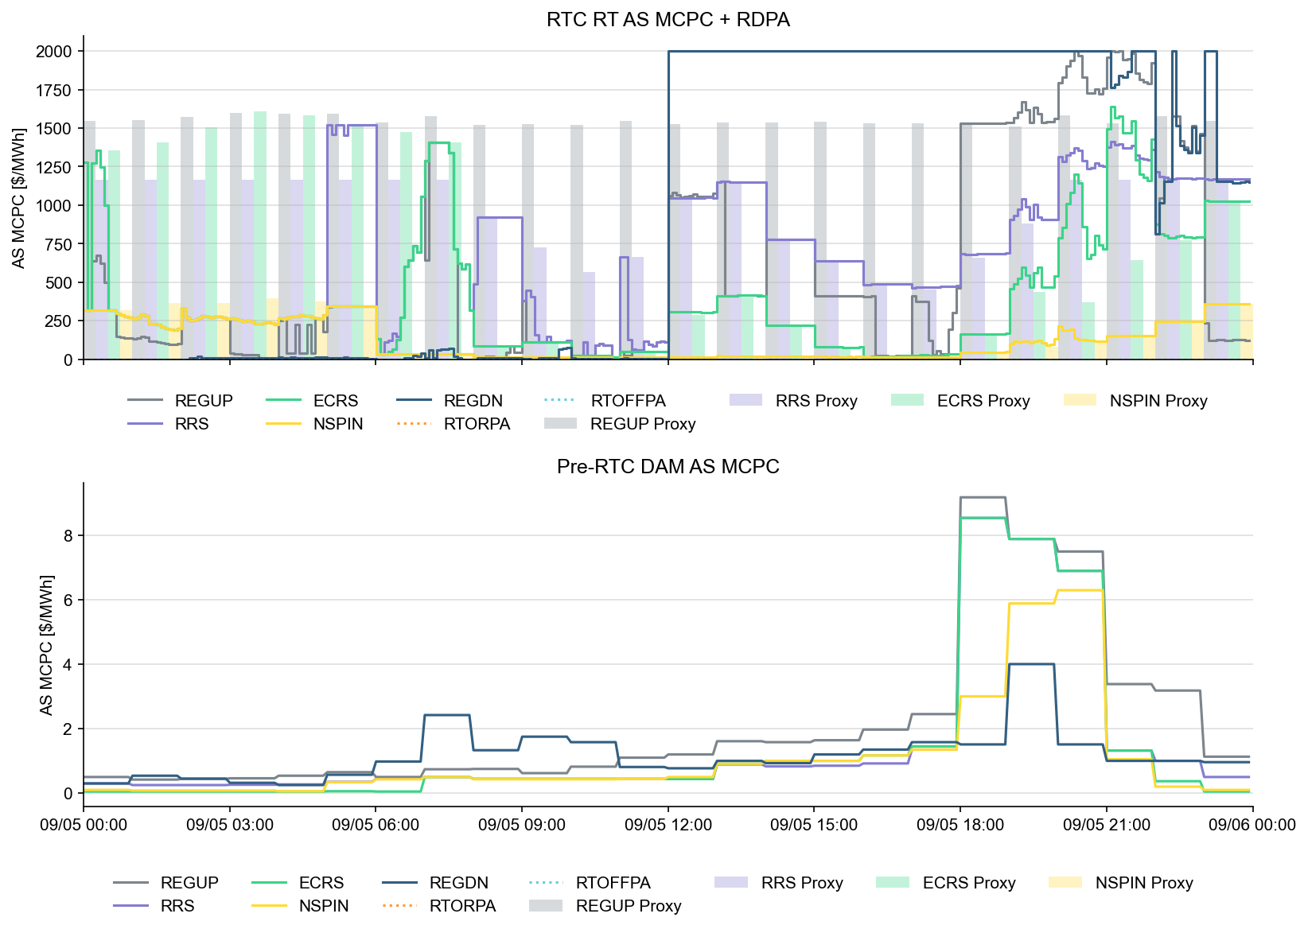
Ancillary Service Prices

Slide 46

AS Awards* by Resource Type
* Pre-RTC (RTM AS Schedule)

Slide 47

AS Awards* by Resource Type
* Pre-RTC (RTM AS Schedule)

Slide 48

SPP by Hub and Competitive Load Zone

Slide 49

Settlement Point Prices by NOIE Load Zone

Slide 50

Congestion Rent

Slide 51

Dispatchable Capacity

Slide 52
Ancillary Service Demand Curves

Slide 53
Additional LFC Information
This week is “parallel production” support Sep 11 LFC Test
Posted with this meeting:
- FAQ
- LFC Workshop Key Files

Slide 54

Wrap-Up and Questions
This week is “parallel production” support Sep 11 LFC Test
We will have additional meeting this Wednesday 10-11am for final LFC Prep
(to be posted)
Remainder of meeting for Q&A
Can always email the RTC+B Program mailbox: RTCB@ercot.com

Slide 55
APPENDIX- Supporting Materials
Summary of SCE Functionality
LFC Sep 11 Market Notice
Telemetry Screening
New RTC Pricing Reports location
NPRR1290 Validation Changes
Links to Handbooks
Prior Scorecards
FAQ Updated 8/8/2025
Connectivity and Configuration (digital certs)

Slide 56
Summary of SCED functionality
What is RTC SCED using to solve in trials?
  Production Network model from NMMS
  QSE submitted offers (energy and A/S)
  QSE production telemetry
    ERCOT performs some overrides for stale data from QSE sites- improving each week
  Outages in prod telemetry would be outage in RTC SCED
  July 31 improvements implemented:
    NPRR1268/1269 ASDC and Proxies logic implemented
    AS Plan improved and now same as Prod
  Aug 4 improvements implemented:
    IRR Forecast synchronization has been manual, but now automated
  Aug 18 improvements implemented :
    Active constraints flag being manually copied (automation planned for Aug 18)
    Load Forecasts being fed into RTC, but ERCOT manually aligns which forecast is being used based on operator selection in Prod (automation planned for Aug 18)

Slide 57

ERCOT confirming Sept 11 Production Test

Slide 58


Telemetry Screening for Scorecard 3B for Handbook 3
Acceptable Telemetry Point values received by ERCOT for active resources.
Scoring:
Key points for Telemetry scorecard check
  Device types checked - Units, CLRs, NCLRs, ESRs for each QSE
  RTCB Telemetry status should be “Good” quality
  RTCB Units / CLRs / NCLRs Telemetry values should be within “Expected Range” or an expected value. Details are provided in next few slides.
  Expected values are derived from equivalent analogs in current production, based on defined criteria.
  RTCB ESR telemetry values are checked against corresponding combo model Battery Unit / CLR counterparts in production.

Slide 59

RTC+B Telemetry points screening/validation

Slide 60

RTC+B New Reports Posted to the ERCOT Website
Links to the available RTC+B versions of Real-Time reports posted on Real-Time Market Information page.

Slide 61

Submission validation update - PROD vs RTC+B
NPRR1290 :
  cleaned up protocol language around submitting offer curves and bid curves
  disallows having more than 2 price/quantity points in a flat/vertical segment of the curve.
Impacts to QSEs during dual-submission – some submissions accepted in Production will be rejected in Market Trials environment:
RTM Energy bids – protocol requiring “increasing quantities” now enforced.
  Reverted this change to validation. Further discussion highlighted protocol should be brought in line to long-standing practice, not validation.
  Example: Bid with Q1=0mw, Q2=10mw, Q3=10mw will be rejected as Q3 does not increase from Q2.
TPO & RTM Bid – more than 2 price/quantity pairs with same price or quantity will be rejected
Market Submission Validation
Rules document updated.

Slide 62






Submission validation update - PROD vs RTC+B
TPO – EB/OC - EOC
RTM EB
RTM EB

Slide 63

Market Trials Framework:
TAC Approved the Market Trials Plan in October 2024
Discussions with RTC+B Task Force have shaped the Handbooks
Handbook #1- QSE Submission Testing
Handbook #2- QSE Telemetry Tests
Handbook #3- Open Loop SCED
Handbook #4- QSE Telemetry Tests
Handbook #5- Close-Loop LFC Tests
Handbook #6- Day-Ahead Market Tests
All are posted on the
RTCBTF Homepage
under Market Trials banner

Slide 64

Market Trials Technical Details
Detailed discussions with TWG have provided technical content details
Digital Certificate details
Connectivity/URL details to User Interfaces and APIs
Reminder of how to submit new ICCP requests
RTC and Production Telemetry connectivity
Network Model Load Schedule
All are posted on the
RTCBTF Homepage
under Technical Details banner

Slide 65



Scorecard 1 for
Handbook 1-
Market submissions:
7/3 Scores for QSEs with Resources – successful submissions for resource types specified in Handbook 1
Scoring: Complete
Complete

Slide 66



Scorecard 2A for
Handbook 2-
100% of ICCP Telemetry points added by QSE:
7/21 Scores for QSE with Resources - ICCP Telemetry points added in current model.
99.5% of 26k points complete
Last points are identified and are being worked on.
Scoring:

Slide 67



Scorecard 2B for
Handbook 2-
Telemetry checkout meetings completed with ERCOT staff for sample of live data transfer capability
Complete
7/3 Scores for QSEs with Resources – Scheduling Check-out and Check-out complete
Scoring: Complete

Slide 68

Reminder of RTC+B FAQ (updated 7/28/2025)
Posted on RTCBTF Home Page under Key Documents
Common questions/responses in Excel Workbook (target weekly updates)
Search workbook for Key Words
Worksheets for categories

Slide 69
RTC+B Market Submissions - Systems configurations
Start
03/2025
Start
05/2025
Start
07/2025
Start
09/2025
Go-Live
12/5/25*
Feb 2025
Mar 2025
Apr 2025
May 2025
June 2025
July 2025
Aug 2025
Sep 2025
Oct 2025
Nov 2025
Dec 2025
Optional: RTC QSE/Vendor Developer
Submission Testing
RTC QSE
Submission Testing
Open-loop
RTC SCED
Ongoing Open-Loop
& Periodic Closed-loop SCED/LFC
Certificate: Current MOTE
Env: ERCOT RTC Market Trial
URL: RTC MIS MOTE URL
Certificate: Current Production
Env: ERCOT RTC Market Trial
URL: RTC MIS Market Trial
Cert: Production
Env: Prod
URL: MIS Prod
QSE/Vendor developer can use MOTE certificates & RTC MIS MOTE API URL to test the submissions until end of submission testing phase (end of June) as needed. At the start of the Open Loop testing, RTC MOTE MIS URLs will be disabled.
URL links: RTC MOTE and Market Trial URL links to be used for MMSUI, OSUI and API submissions. Actual links are provided in next slide.
For notifications/responses to MPs from RTC Market Trials environment, MP will need to provide the listener URL to ERCOT

Slide 70
RTC+B Market Submissions - Systems configurations
(Updated with URLs)
RTC+B Market Trials and Go-live
RTC Phase | Digital Certificate | MMSUI / OSUI URL | API / WAN URL
Vendor/QSE Submissions Testing | Current MOTE | RTC MOTE MIS URLs https://testmarkettrials.ercot.com/mmsui/mmsui/displayTradesLanding.action https://testmarkettrials.ercot.com/osrui/osrui/Summary.action | RTC MOTE API/WAN URL https://testmarkettrialsapi.ercot.com/NodalAPI/EWS/ https://testmarkettrialsapi.wan.ercot.com/NodalAPI/EWS/
Open Loop and Closed Loop Testing | Current Production | RTC Market Trial URL https://markettrials.ercot.com/mmsui/mmsui/displayTradesLanding.action https://markettrials.ercot.com/osrui/osrui/Summary.action | RTC Market Trial API/WAN URL https://markettrialsapi.ercot.com/NodalAPI/EWS/ https://markettrialsapi.wan.ercot.com/NodalAPI/EWS/
From RTC Go-live onwards | Current Production | Current Prod MIS URL mis.ercot.com/mmsui mis.ercot.com/osui | New Production API/WAN URL

Slide 71

RTC+B Market Submissions - Systems configurations
Public Key Update for WAN/API submissions
For API/WAN submissions into Market Trials environments, need to download public keys and place into the keystore location in system being used for RTC+B submissions.
No change to digital user certificates – continue to use existing MOTE and Production Certificates
Market Trial API Public key location: https://www.ercot.com/services/mdt/webservices

