Slide 1
RMTTF
Tomas Fernandez NRG
Debbie McKeever ONCOR
Melinda Earnest AEP Texas

Slide 2
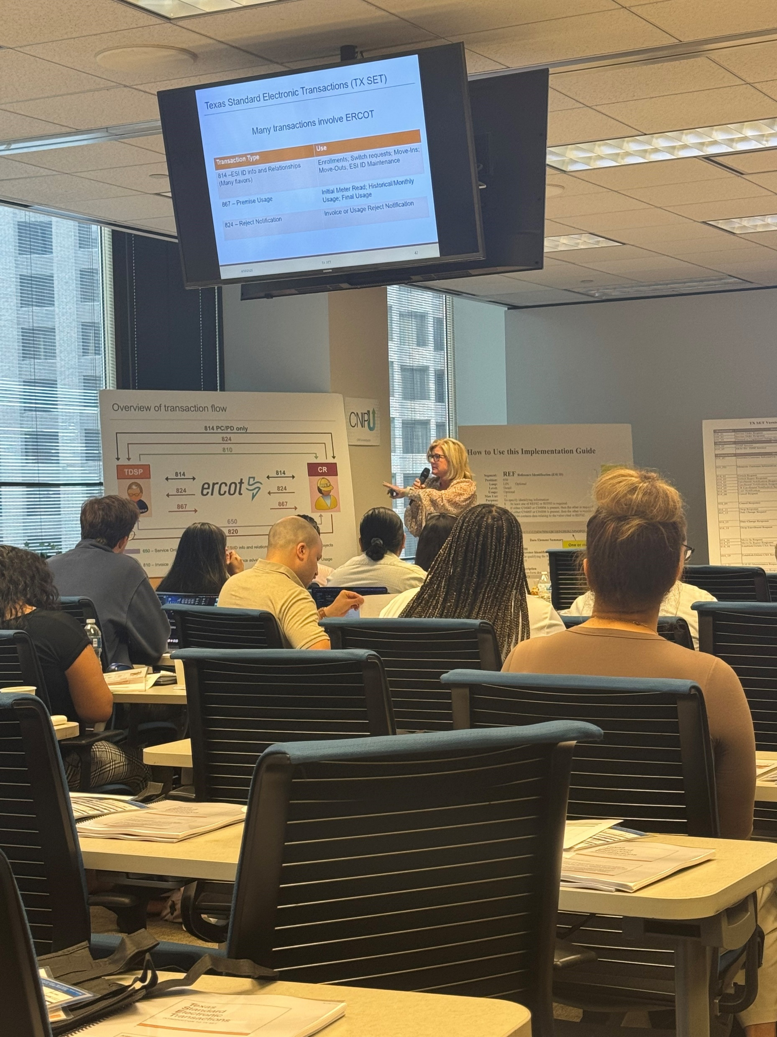
TxSet 5.0 Training via WebEx
TxSet 5.0 training is being re-configured to deliver via WebEx.
Provide an additional opportunity for market participants to engage and learn
Another option for those who cannot or were not able to travel to Houston or Dallas for in-person training
Training scheduled for Wednesday, October 29th
Sign-up available now through LMS on Ercot.com
Will be limited to 50 participants
Survey Responses from the last training held in Dallas:
Provided tons of source material
Broke down the information very well. I felt like I gained a lot of knowledge from this course. Would recommend it to anyone. Glad I was recommended to this course.
Great building from concepts to execution!
Keeping us engaged and great relevant building blocks to understanding the market !! Amazing job

Slide 3

Upcoming Retail Training Opportunities
MarkeTrak Training – 2 Parts
MarkeTrak Part 1-Overview
  Wednesday, September 24th – WebEx only
  8:30 AM to 12:30 PM
  Open for registration on ERCOT.com
    MarkeTrak - Part 1
MarkeTrak Part 2-Switch Holds and IAG
  Thursday, September 25th – WebEx only
  8:30 AM to 12:30 PM
  Open for registration on ERCOT.com
    MarkeTrak/IAG - Part 2
TX SET 5.0 Training
Wednesday, October 29th – WebEx only
  Open for registration on ERCOT.com
    Texas SET Standard Electronic Transactions
Retail 101
Wednesday, December 10th – WebEx only
  Open for registration on ERCOT.com
    Retail 101

Slide 4

On-Demand ERCOT Retail Training Modules Available 24/7
    MarkeTrak Online Training Modules -
      MarkeTraks Overview
      Switch Hold Removal
      Cancel With/Without Approvals
      Inadvertent Gains/Losses & Rescissions
      Usage and Billing
      Other D2D Subtypes
      Bulk Insert
      MarkeTrak Admin Functionality
      Data Extract Variances (DEV) LSE Subtypes
      Data Extract Variances (DEV) Non-LSE Subtypes
      Emails and Notifications
      Reporting – Background & GUI
    Additional Retail Online Training Modules
      Retail 101
      TXSET
      Mass Transition

Slide 5
Upcoming RMTTF Meeting
Wednesday, September 24th 1:30 PM
WebEx and In-person
Oncor
1616 Woodall Rogers Fwy
Dallas, TX 75202
If planning to attend in person, please email Debbie McKeever deborah.mckeever@Oncor.com
If you have questions or suggestions for training, please contact one of the RMTTF co-chairs listed below.
Tomas Fernandez, NRG tomas.fernandez@nrg.com
Melinda Earnest, AEP mdearnest@aep.com
Debbie McKeever, Oncor deborah.mckeever@Oncor.com
Thank you!

