Slide 1

TDTMS Update
Leadership 2025:
Chair - Sheri Wiegand, Vistra
Co-Vice Chairs – Monica Jones, CNP
Sam Pak, Oncor
RMS
September 9th, 2025

Slide 2
TDTMS
ERCOT Report
System Instances – All Retail market SLAs for July met. MarkeTrak performance remains well within SLO. MarkeTrak volumes remain relatively flat.
ERCOT Projects
MIS API – still early stages of development; consolidation of operations - APIs; consistent “look and feel” with ERCOT platforms; retail API and MT API will be impacted; expected development by EOY; SOAP will be retired and replaced with EWS
NAESB upgrade – ERCOT will be contacting service providers and trading partners requesting 1 ‘dummy’ file and 1 large file (IDR) to be sent as a test. Functionality is not in RMTE yet, however, will be new for Flight 1025. To be discussed at Technology Working Group (TWG); communicated through TDTMS by TDTMS leadership.
Enhancement list:
Adding ‘key dates’ back to Find Transactions which may be viewed as a heavier lift an unable to run through agile process
Reject code list in MIS as previously available pre TXSET v5.0
MarkeTrak – addition of ESI within automated subject line of escalation email (low effort per ERCOT and might be able to include in upcoming release)
MarkeTrak – allowing REPs to utilize same Switch Hold removal codes within MTs – today unexecutable reasons were developed for TDSPs

Slide 3
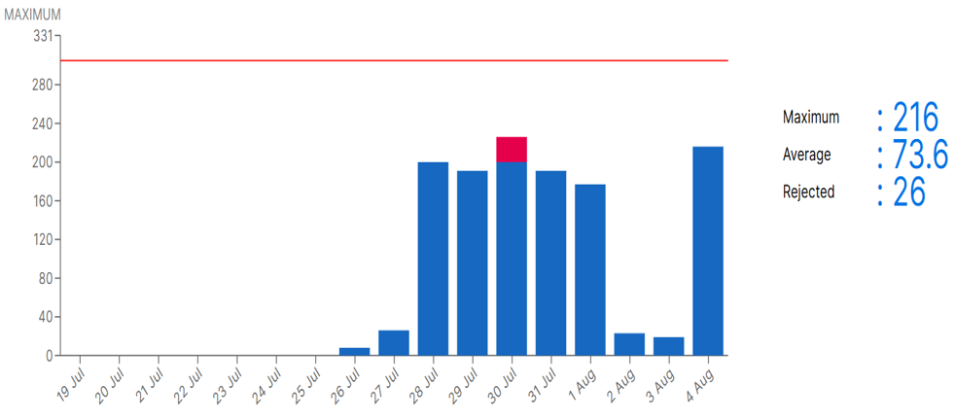
TDTMS
MarkeTrak Licensing Volumes
MarkeTrak concurrent license errors should be submit a Service Now ticket to ERCOT
ERCOT to develop a reference guidance on Service Now ticket submissions to be posted on the TDTMS meeting page

Slide 4
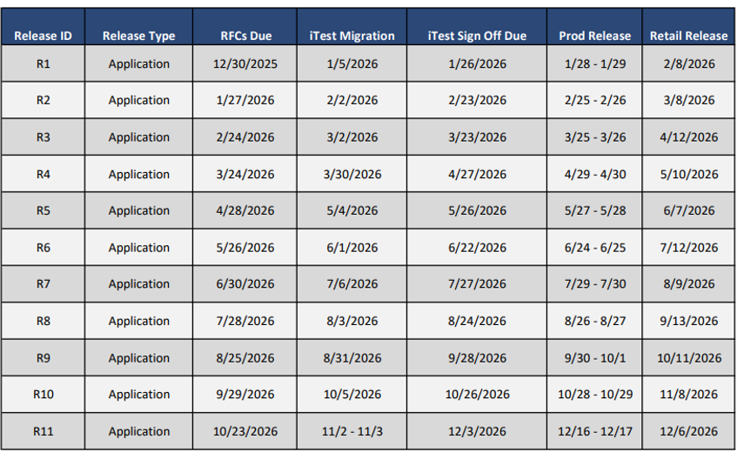
TDTMS
Draft 2026 Release Calendar

Slide 5
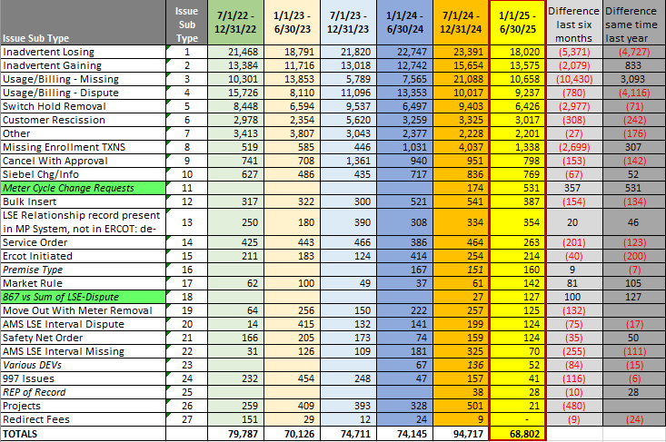
TDTMS
MarkeTrak Subtype Volumes (1st half 2025 update)
Notable Observations
1st half 2025 overall MT volumes have decreased from last year
Events drive spikes in subtype volumes such as new market participant, new system, weather events
Switch Hold volumes remain seasonal – higher second half of the year
Possible additional validations put in place with SCR817 is a likely driver for reduced volumes
Tracking new subtypes (green):
  Meter Cycle Change Request
  867 vs Sum of LSE-Dispute

Slide 6
TDTMS
Next Meeting – September 16, 2025 @ 1:30 PM [WebEx Only]
DRAFT Agenda:
TDTMS Scope & Working Group Procedures
ERCOT Reports
System Instances & MT Performance
Listserv
Service Now ticket tutorial
Projects
MIS – Retail API & UI
NAESB upgrade
MT & Siebel upgrade
Enhancements list
MarkeTrak User’s Guide suggested revisions
MarkeTrak Information Page review
Follow up on Action Items:
Bulk Insert Tips and Tricks - additions
Background Reporting Column Headings – additions
Subytpe Quick Reference Guide – final review
Review of MarkeTrak Tips & Tricks 4.0 – assign review
MarkeTrak Subtype Volumes – further deep dive on Other Subtypes

