Slide 1
RTC+B – LFC/SCED Closed Loop Testing –Cutover and Cutback Plan
Sreenivas Badri
Matt Mereness
September 04, 2025

Slide 2
Agenda
Preparing for the LFC Test
  New FAQ
  Exemption from Production Testing
Expectations for Parallel Operations
QSEs RTC+B System Configurations
Closed Loop LFC/SCED Testing - Cutover and Cutback plan review

Slide 3
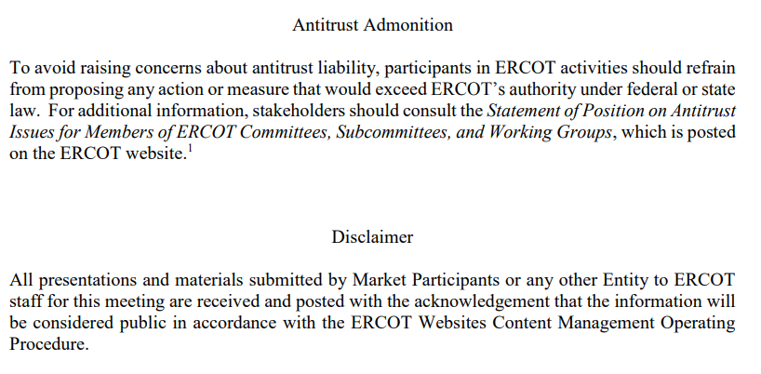
WebEx Meeting reminders (same as other ERCOT forums):
Please keep line muted
If you have a question, please use the chat feature to either:
  Type in your question, or
  Type in “Question” and wait to be recognized to state question

Slide 4
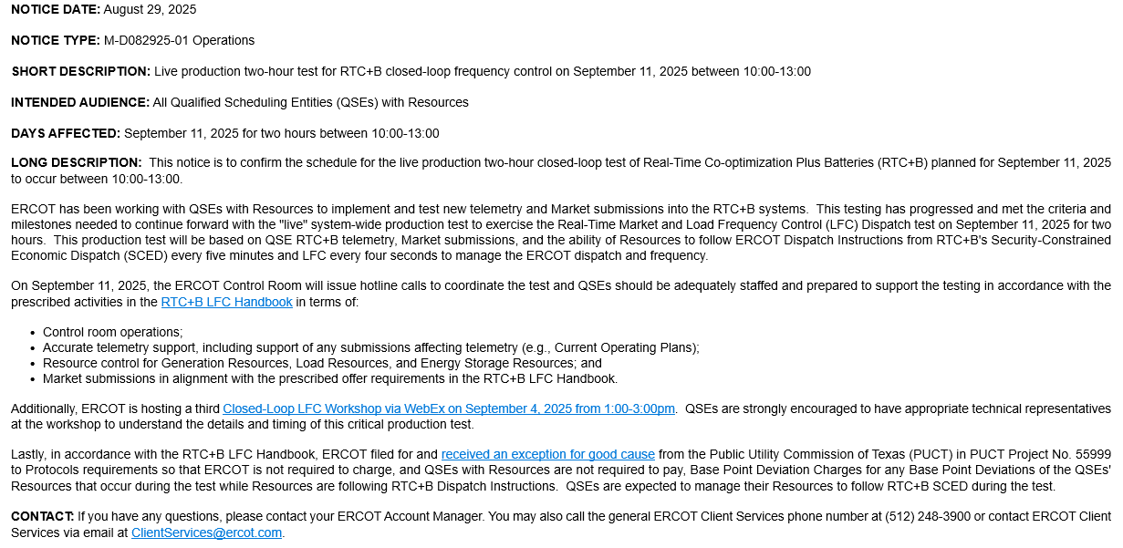
ERCOT confirmed Sept 11 Production Test

Slide 5
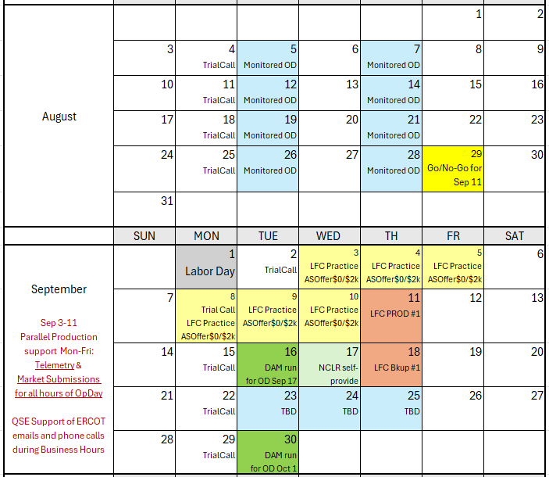
Market Trials Calendar and Transition to September
We are here….

Slide 6
Current Focus- Sep 11 Live LFC Production Test
Objective this week is to prepare for Closed Loop LFC Test next week
  ERCOT continues outreach on Telemetry
  ERCOT outreach on Market Submissions
What is expected?
  Support increase:
    QSEs being required for submission for all hours of highlighted Operating Days for September 3-5, 8-11
  Scripted offer requirement: Adhere to offers per LFC Handbook 5
    Energy offers match production
    AS Offers should be offered at $0 if responsible in current production, remaining AS offer at $2,000

Slide 7
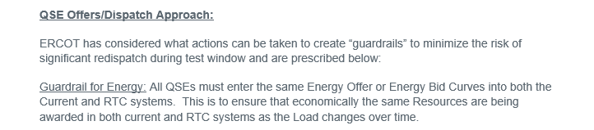
LFC Handbook Reminders
Excerpt from Handbook #5 LFC Closed Loop Test

Slide 8
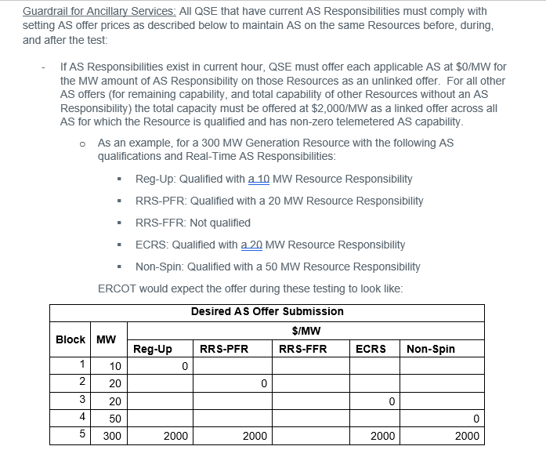
LFC Handbook Reminders

Slide 9
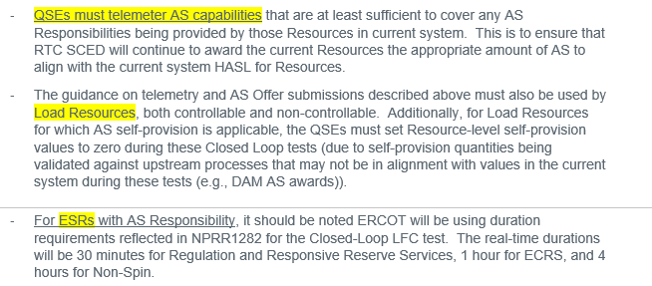
LFC Handbook Reminders

Slide 10
New FAQ
Offer cap for Energy:
  All Current/PROD energy offer MWs above $2,000/MWh should be offered at $2,000/MWh in RTCB.
For ESRs:
  The current system has GEN/LD with 10 P/Q pairs each, whereas the RTC system will only allow 10 P/Q pairs for the ESR. How do we handle situations where we may have more than 10 P/Q pairs amongst our GEN/LD battery resource?
    ANSWER: Provide the ESR curve the best you can with the 10 P/Q pairs to match what is reflected with the Combo Model approach currently in PROD

Slide 11
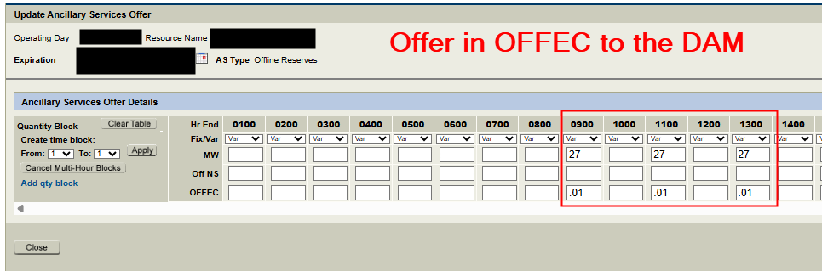
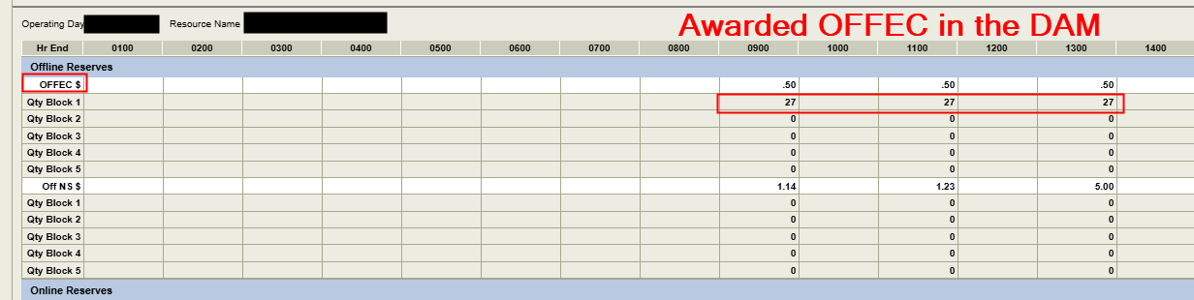
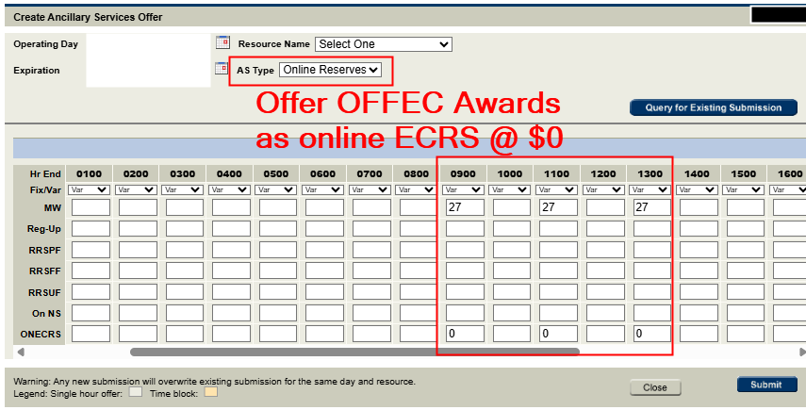
FAQ – Offline ECRS in RTC+B
In RTC+B, Offline ECRS that is offered and awarded in the DAM has to be re-offered as online ECRS if it is to be awarded in RTM.
  Offline ECRS can’t be awarded in RTC+B Real-Time Market. To represent an Offline ECRS Award, resource must:
  Telemeter ‘OFFQS’ status
  Have On-line ECRS AS Offer submitted.

Slide 12
FAQ – Offline ECRS in RTC+B
  For the LFC Practice and LFC cutover on 9/11, to represent your off-line ECRS awards/responsibility from Production in RTC+B, please submit online ECRS offers into the RTC+B system with $0.
  In RTC+B, SCED can not award AS Offers for OFFEC. The correct telemetered status for providing ECRS from an offline resource is ‘OFFQS’, however this status is seen as an online status.
  Since SCED sees ‘OFFQS’ resources as online, an online AS Offer of ECRS is needed to be awarded ECRS in the RTM.

Slide 13
Exemption for RTC+B Resources not ready for September 11
Some QSEs have indicated not all Resources can follow RTC+B dispatch signals
To mitigate risk to the test and to preserve full control of the grid for the system-wide test, ERCOT is allowing QSEs to submit an exception request if a subset of Resources cannot follow RTC+B SCED/LFC Dispatch (will be placed in ONTEST status during test)
To be excused from the test, QSEs will need to submit a test request for each Resource using the "QSE Test Request" form available at the ERCOT NDCRC application (https://mis.ercot.com/ndcrc/TestRequestSummaryAction.do).
  Please ensure that the test requests are submitted within a 7-day window from the closed loop test date, preferably before 9/9/25. This will allow the ERCOT control room ample time to review and approve the requests.
  These Resourcces will need to telemeter RST = ONTEST(8) in the current production system and RSTR = ONTEST(4) in the RTCB system.
  This should be done between 9:00 AM and 2:00 PM on 9/11/25. Additionally, these Resources should refrain from offering any Ancillary Services in the DAM on 9/10/25 for this window and should not carry any Ancillary Services in the current production system throughout this period.
  Addition questions can be directed to RTCB@ercot.com mailbox

Slide 14
Deeper Dive into Technical Details

Slide 15
RTC+B – Parallel Operations
Currently we are in “Parallel Operations”, will continue to be in this state until Go-Live.
Parallel Operations expectations:
  QSEs should continue to send Production Quality and Consistent Telemetry to ERCOT RTC+B ICCP system in parallel to current production.
  QSEs control room operators should perform the dual entry of telemetry manual overrides etc. based on grid conditions.
  QSEs should continue to make Production quality real-time Market submissions to ERCOT RTC+B market systems in parallel to current production.
  High volume of Telemetry issues were fixed by 08/22/2025, remaining QSE Telemetry issues (identified by ERCOT and communicated to QSEs) should be fixed no later than 09/08/2025
  ERCOT will continue to validate RTC+B telemetry and Market Submissions and communicate issues to QSEs.
  ERCOT will continue to validate RTC+B EMS and SCED applications results based on RTC+B telemetry and market submissions and send UDSP, AS Awards etc. through ICCP and post SCED prices.
If these expectations are not met by QSEs, ERCOT EMS/SCED solution quality can not be validated consistently. This creates a risk for Closed Loop Testing on September 11th and overall program delivery on December 5th.

Slide 16
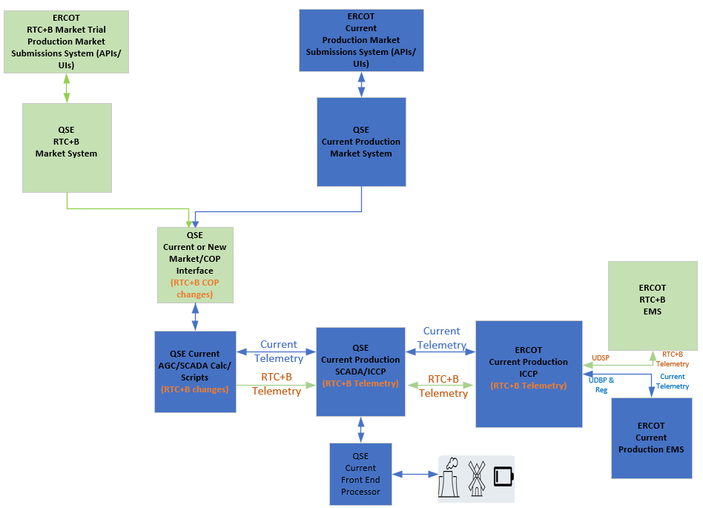
RTC+B – Parallel Operations – Current State of ERCOT and QSE Systems Setup

Slide 17
RTC+B – Parallel Operations – Telemetry Issues
ERCOT identified telemetry issues and met with QSEs that had lower telemetry pass% to discuss the issues.
Based on the discussions with QSEs, telemetry issues can be broadly categorized into two buckets.
  Resource Status Telemetry issues due to not being able to convert correctly from Current Production to RTC+B
  Resource Status and AS Capabilities Telemetry issues
    Due to setup/mapping issue within QSEs RTC+B COP Interface that gets the COP data from RTC+B market system and feed into EMS AGC/SCADA.
  ESR specific telemetry issues directly from plants.
    We are still seeing lot of batteries are not telemetry –ve MW when charging, it is severely impacting state estimator and LFC/SCED solution
ERCOT requests all QSEs to proactively look at the telemetry mismatches between RTC+B and current production and implement fixes in RTC+B no later than 09/08/2025.
  ERCOT can share the list of telemetry issues upon QSE request through RTCB@ercot.com.

Slide 18
Closed Loop LFC/SCED Testing
One of the key goal of the Closed Loop Testing is to ensure that QSEs RTC+B ICCP/SCADA/EMS/Interfaces system changes are designed and setup correctly to respond to RTC+B UDSP signals.
Although it is called “Test”, It is a Live Production Closed Loop Test.
  QSEs must cutover all their resources operating in current production to RTC+B and control the Grid for 2 hours following RTC+B UDSP signal. This means ERCOT and QSEs RTC+B systems will be Live for 2 hours on 09/11/2025.
QSEs are expected to develop their own internal Closed Loop Testing cutover/cutback plan and checklist to ensure smooth transition of QSEs EMS systems/applications to RTC+B and back to current production. This cutover plan and checklist should be updated with any lessons learned from closed loop testing and is expected to be used for Go-Live.

Slide 19
Closed Loop LFC/SCED Testing – Current Production EMS/SCED State
  During Closed Loop Testing, ERCOT Current Production EMS and SCED will continue to run normally without any down time (except UDBP, Regulation Signals and other Non-RTC Outbound telemetry will NOT be sent out to QSEs). It ensures
    smooth transition back to current production at the end of closed loop testing and
    current production SCED can continue to create prices during closed loop testing.
  It is critical for Market participants to
    continue to send production quality telemetry to current production ICCP/EMS (e.g. Current production resource status codes, Regulation participation factors, combo model telemetry for batteries etc.) and
    continue to submit real-time market submissions into current production Market System before and during closed loop testing without any down time.

Slide 20
QSEs RTC+B Systems configurations for Closed Loop Testing
Closed Loop Testing
  EMS/AGC/SCADA Calc/Scripts
    QSEs will utilize System level switch of their EMS/AGC/SCADA Calc/Scripts to switchover their entire system to RTC+B mode. Switchover time must be within 30-60 seconds.
    At the end of the closed loop testing, QSEs must switchback to current production mode by turning off the system level switch. Switchback time must be within 30-60 seconds.
  Market Submissions and Notifications
    QSEs are utilizing parallel RTC+B Market Systems Production system to submit real-time market submissions into ERCOT RTC+B Market Trial Production System in parallel to current production. No systems switchover is required.
    Some QSEs are using current production to support dual real-time market submissions into ERCOT RTC+B Market Trial Production System in parallel to Current Production starting from Open Loop Testing till Go Live. No systems switchover is required.
  For the Closed Loop Testing, QSEs are expected to perform dual real-time market submissions from 5:00PM (or from current production DRUC completion) of the day prior to the closed loop testing day (09/11/2025) until the completion of the test.
    Dual real-time market submissions should be made for all hours of the closed loop testing day (09/11/2025)
  Dual submissions of Outages is not required for Closed Loop Testing.

Slide 21
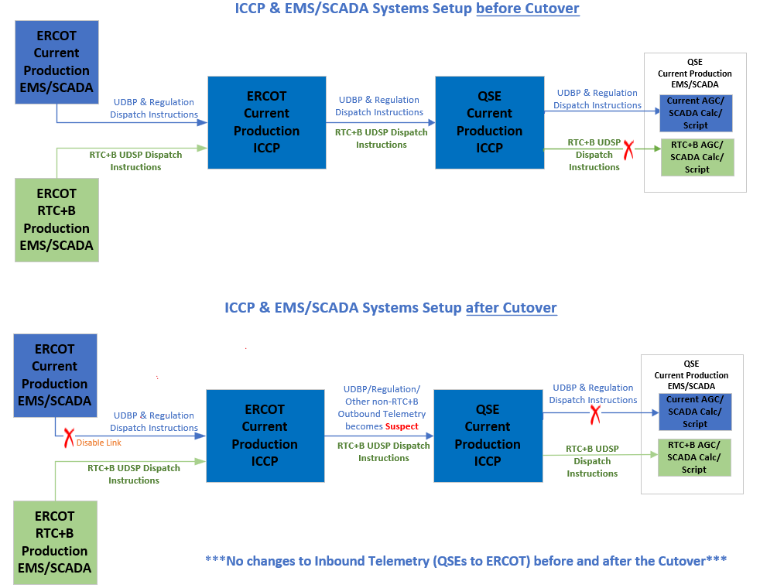
Closed Loop LFC/SCED Testing – EMS/ICCP Cutover Plan

Slide 22
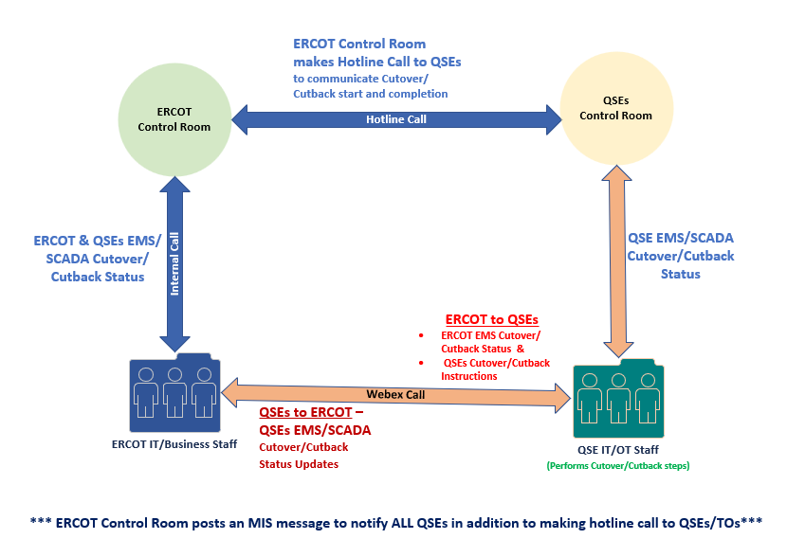
Closed Loop LFC/SCED Testing Cutover/Cutback - Communication

Slide 23
Closed Loop LFC/SCED Testing – Cutover & Cutback Plan Review
Closed Loop LFC/SCED Testing detailed cutover/cutback plan spreadsheet is available on RTCBTF site under Technical RTC+B Details section.
https://www.ercot.com/committees/tac/rtcbtf
QSEs with resources should follow this Cutover and Cutback plan along with their Internal Procedures during Closed Loop LFC/SCED Testing on 09/11/2025.
ERCOT Control room makes final Go/No-Go decision few minutes before start of the Closed Loop Testing based on Grid Conditions.
  Start & End Times of Closed Loop Testing is subjected to change based on Grid conditions.

Slide 24
Deeper Dive Timeline/Details
  Review posted spreadsheet

Slide 25
Wrap-Up
Questions and Answers
Encourage more discussion on Monday Trials Call as needed
Can always email : RTCB@ercot.com

