Slide 1
SSWG Report to ROS
September 11, 2025
Chair: Zach Walker (Zachary.Walker2@oncor.com)
Vice Chair: Chris Ramirez (cramirez@wettllc.com)

Slide 2
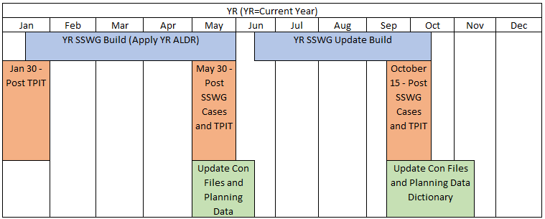
SSWG Report
Key Updates
25SSWG Case Build #2 (update build)
  In Progress: On-Track
  Target Posting: October 17th
PGRR127 - Addition of Proposed Generation to the Planning Models
  Further discussion still needed
SSWG Procedure Manual (PM) Revisions
  Updated PM from ROS consideration
  See summary of changes (next slide)
SSWG Report to ROS External

Slide 3
SSWG Report
Key Updates
SSWG Procedure Manual Update
  Summary of Changes
1. Section 3.2 – SSWG Case Definitions
  Modified seasonal case load assumptions
  Maximum Load expected during season rather than month
2. Section 3.3.4.4 – Entity Responsibilities - ERCOT
  ERCOT BTM / Co-Located Load Modeling Responsibility & Report
    ERCOT to explicitly model loads co-located with generation
    ERCOT to provide deliverable report for modeled load data in SSWG Cases
3. Section 4.6.1.1 – Switched Shunt Devices
  Cleaned up language to match current switched shunt deconsolidation processes
4. Section 5.2 – Contingency Database
  Added new TSP contingency submission requirements related to Large Loads
  Required to comply with revised Planning Guide Section 6.10 (PGRR 115)
5. Multiple Sections – Maintenance Outage Case Addition
  Proposed language to include a maintenance outage case
    FAL (YR+4)
6. Multiple Sections – Net Peak Cases Addition
  Proposed language to include two Net Peak Scenario Cases
    Peak Net Load: PNL1 (YR+2)
    Peak Net Load: PNL1 (YR+4)
SSWG Report to ROS External

