Slide 1
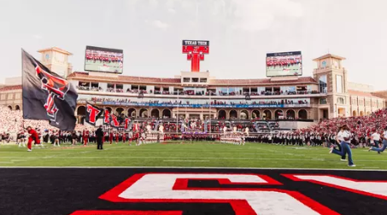
TEXAS SET UPDATE
Retail Market Subcommittee
September 9, 2025

Slide 2
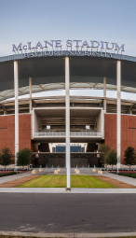
UPDATE
2026 Flight Schedule
  Adjusted dates on schedule to accommodate Juneteenth holiday
Change Control Conference Call
  TXSETCC855: Clarify the 810_02 BIG08 data element by adding language for Original, Cancellation and Replace Invoice due dates(s) that correspond with the TDSP Tariff Section 4.4.5
TMTP Schedule
  Completed review through whole document
  September: Final Draft
  October: Final Review
  Nov/Dec: RMS

Slide 3
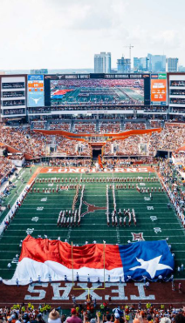
STP
Notified TEXAS SET WG that it would merge with PWG.
  Timeline
    No later than January 2026
  Name/Acronym
    Standard Electronic Transactions
    Testing
    Profiling
  Scope
    Drafted for review of working groups
  Schedule
    TEXAS SET WG and PWG will continue to meet each month and plan to meet Jointly before EOY

Slide 4
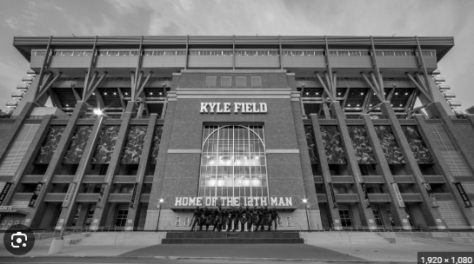
NEXT MEETING
September 16, 2025
Webex Only

