Slide 1
RTC+B Task Force
Update
Matt Mereness
TWG
August 28, 2025

Slide 2
Outline
Update on RTCBTF Issues List
Update on RTC NPRRs
Market Trials Update
  Phase 1 Completed
  Phase 2 Began 7/7/25, almost complete
  Phase 3 Beginning 9/2/2025
Path to Go-Live in 99 days
Next Steps

Slide 3
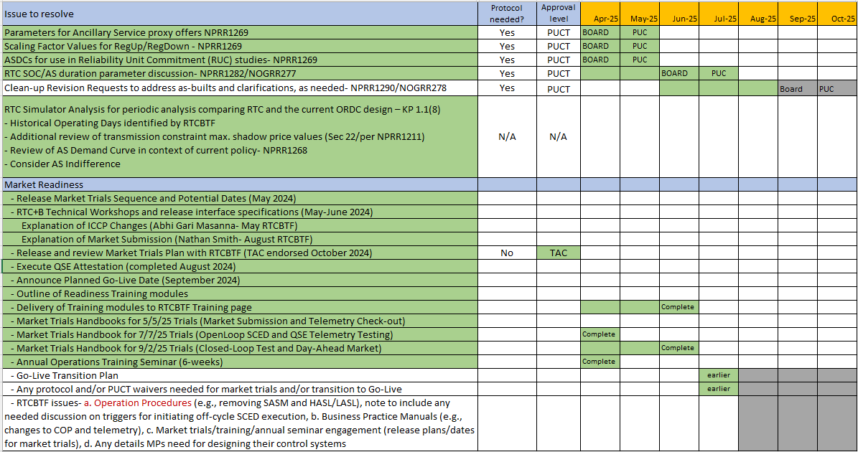
RTCBTF Issues List
Revisions- Final Clean-Up NPRR1290/NOGRR278 (September)
Implementation - Completed handbooks and engaging transition plan details
Market Trials

Slide 4
Summary and Timeline of NPRRs
NPRRs approved at PUCT May 15 Open Meeting
  NPRR1268 for ASDC Modifications (IMM sponsor)
  NPRR1269 for 3 Parameter/Policy Changes (ERCOT sponsor)
  NPRR1270 for AS Qualification details (ERCOT sponsor)
AS Duration / State of Charge (NPRR1282 / NOGRR277)
  Began discussion March 25 June Board approval
  PUCT July 31 consideration
Final Clarifying Revisions – NPRR1290/NOGRR278 (Sept Board)
  NPRR1290 included Hunt Energy revisions for post go-live and approved at PRS (unanimous)
  TAC consideration today and potentially Sept Board consideration
Remaining Stakeholder path to Board Meetings before Go-Live:
  PRS Aug 13 > TAC Aug 27 > Board Sep 23
Note that ERCOT filed Good Cause Exception with PUCT for Closed-Loop LFC Test(s)
  Exception for ERCOT to not charge for Base Point Deviation Charges during RTC+B LFC test

Slide 5
RTC+B Scope
Final 2025 Refinements for Go-Live
Related NPRRs
within Program

Slide 6
Sequence and Dates for Market Trials to Go-Live
Market trials are a progression of activities to mitigate the risk for Go-Live on new systems and processes for both the Market Participants & ERCOT.
30-day Market Notice
11/5/25
March/April
2025
Start
5/5/25
Start
7/7/25
Start
9/2/25
Go-Live
12/5/25*
May 2025
June 2025
July 2025
Aug 2025
Sep 2025
Oct 2025
Nov 2025
Dec 2025
QSE Scorecards & Exit Criteria for each Trial Phase
#1 RTC QSE Submission Testing
(Submit COP, RT AS Offers,
DAM Virtual AS, Outages for ESRs)
#3 Open-loop RTC SCED
(QSE offers, SCED non-binding award/dispatch)
#5 Ongoing Open-Loop
& Periodic Closed-loop SCED/LFC
(QSE RTC offers and telemetry to support closed-loop frequency control test 2-3 tests of 2-4 hour durations)
Transition to Go-Live
Upon completion of testing, confirmation of ERCOT and market readiness for Go-Live.
QSE/Vendor Submission Sandbox and Telemetry Points added Prod EMS model.
#2 RTC QSE Telemetry Checkout (QSEs add/verify new telemetry points for UDSP, New ramp rates, ESR telemetry)
#4 QSE Telemetry Tests
(Individual QSE to follow UDSP and support new ramp rate and ESR telemetry)
#6 Day-Ahead Market
(Non-binding DAM using QSE offers for at least 2 tests)
* Go-Live date reflects 12/5/2025 as first Operating Day
where 12/4/2025 is planned software migration.

Slide 7
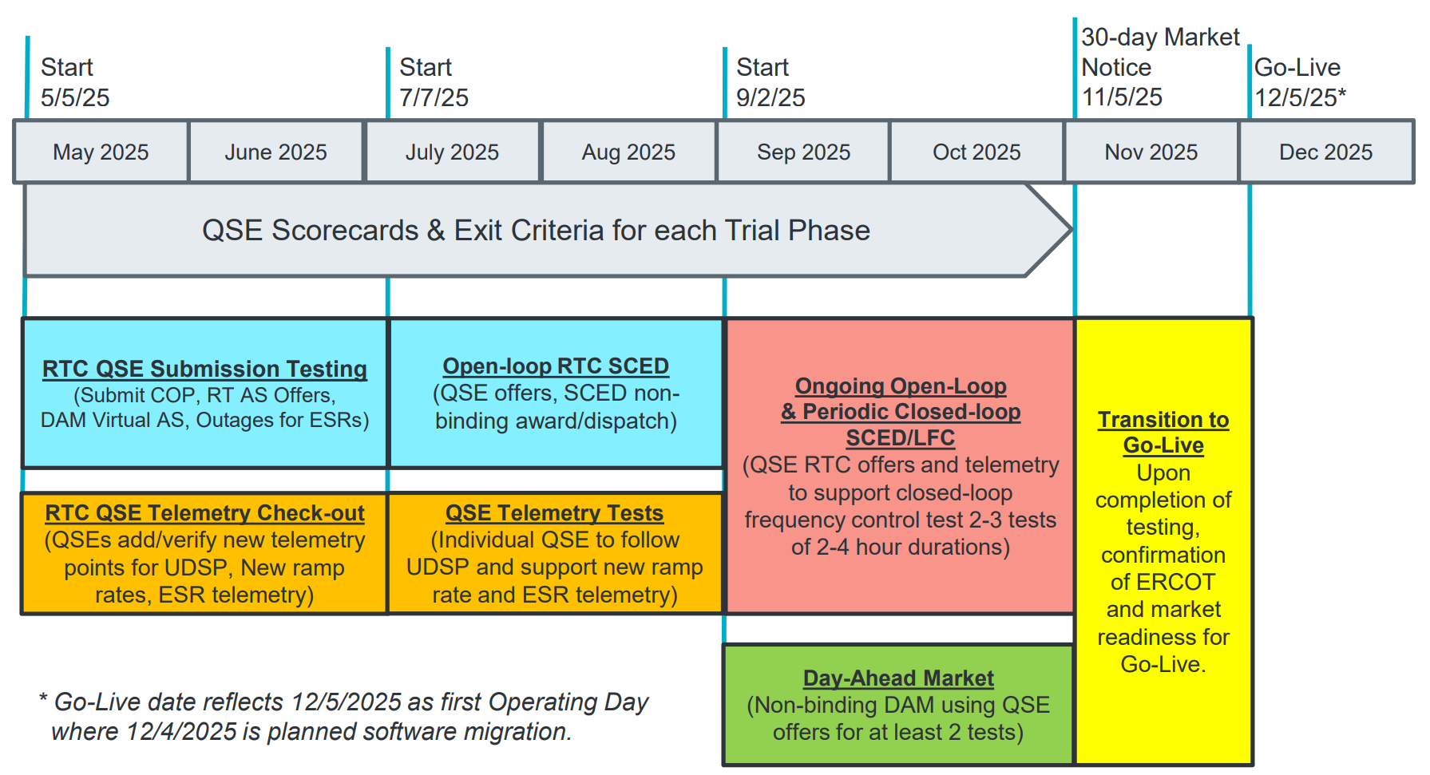
COMPLETED
May & June:
Establishing Connectivity
QSE will test their market submissions for defined subset transactions that are new or modified by RTC+B.
Scorecard goal is for 95% of QSEs to demonstrate successful submissions and have mitigation plans in place for remaining 5% to address in next trial phase.
QSE will add telemetry points for Energy Management System (EMS) system interface with ERCOT (such as Updated Desired Set Points (UDSP), New Ramp Rates, and ESR Telemetry)
Scorecard goal is for 98% of QSEs to demonstrate successful telemetry additions, and mitigation plans in place for remaining 2% to address in next trial phase. (Note 3-week lag in telemetry migrating through network model validation and into trials environment).

Slide 8
IN-FLIGHT
July & August:
Initial Real-Time Market execution and verify QSE ability to follow ERCOT frequency signals
QSE will support “parallel production” 2days/week by entering $bids/offers for non-binding RTC energy and A/S awards and dispatch (Open-loop test)
Scorecard goal for 100% of QSEs to demonstrate successful submissions and telemetry reflective of production, and mitigation plans in place for any outliers.
Coordination of individual QSE tests on subset of resources to ensure resources can follow new UDSP telemetry point from ERCOT.
Scorecard goal is for 98% of QSEs to successfully demonstrate, and mitigation plans in place for remaining 2% to address in next trial phase.

Slide 9
Starts Sep 2
Sep & Oct:
Required live-production test to ensure effective frequency dispatch and control.
Sep & Oct:
Optional Day-Ahead Market
Voluntary Day-Ahead Market for all QSEs will be conducted at least 2 times.
QSE can test their market submissions for Day-Ahead AS Self-Arrangement, AS Only Offers, Trades and normal submissions.
DAM participation is strongly encouraged but not required in Readiness metrics since RTC procures AS in Real-Time.
Participation includes much broader QSE population (marketers and load-only QSEs).
ERCOT and QSEs will conduct live-production tests of RTC-SCED and Load Frequency Control (LFC) prior to go-live.
RTC-SCED and frequency control dispatch during the tests will be binding to manage the reliable operations of the grid for2-4 hours.
ERCOT will coordinate with QSEs on how to submit RTC offers and telemetry for Energy and AS for the two systems (current and RTC system).
ERCOT will provide a summary of the test and use analysis and engineering judgement to assess if the test was successful in controlling frequency.

Slide 10
Market Trials in-flight
Trials meeting every Monday 10-10:30am until December
  Standalone calendar page each week with WebEx
    RTCBTF Home Page houses all market trials documentation
  Averaging 150-200 participants
  Weekly presentation walk-through with Q&A
    Heavy use of RTCB@ercot.com email -> FAQ (160+)
Link to this week’s meeting
  QSE Scorecards (on track) with ongoing outreach
  Summary of OD test RTC+B Prices and AS Awards
  Attestations due from QSEs for readiness for Sep11 Test
  Ramping up for Sept 11 Live Production LFC Test

Slide 11
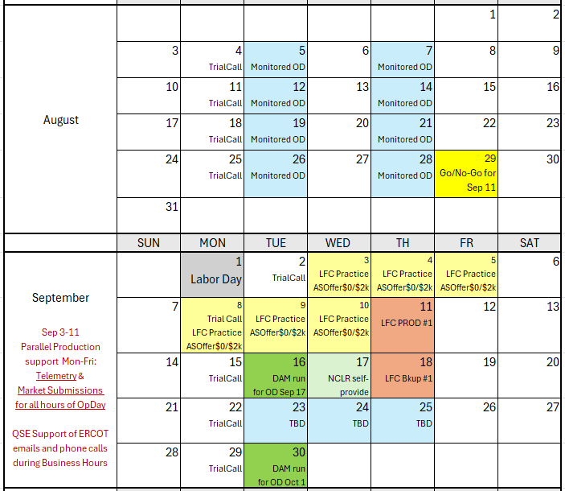
Market Trials Calendar and Transition to September
We are here….

Slide 12
IMPORTANT- Market Trials Transition to September
This week
  ERCOT continues outreach on Telemetry
  ERCOT initiating outreach on Market Submissions
  Although near 90+% on both items, need to improve alignment for SCED
    Example: good market submission may be unawarded due to telemetry (and vice versa)
  Observations:
    QSEs need to offer at least as much AS being carried in production
    In longer-term, QSEs need to offer full/qualified capability (expected in protocols, otherwise Proxy Offers)
    NCLRs need to telemeter Self-Provision = 0 (no DAM AS positions)
Next week and into September 3-11
  Support increase: QSEs being required for submission for all hours of highlighted Operating Days for September 3-5 and 8-11
  Offers Required: QSEs being required to adhere to offers per LFC Handbook 5
    Energy offers match production
    AS Offers should be offered at $0 if responsible in current production, remaining AS offer at $2,000
    If QSE has issues ahead of LFC test, QSE may consider not offering that AS in DAM ahead of LFC day
    Deeper dive next week Market Trials call
  After successful Sept 11 LFC Test, pivot to initial DAM Testing and Self-Provision capabilities

Slide 13
Last week’s RTCBTF:
AS Deployment Factors Discussion
ERCOT performing analysis to assess Operator procedures
Market Readiness
Transition/Cutover Handbook: Initial Draft (no changes since July)
Posted Draft Revisions to Control Room Operating Procedures
  Real-Time Desk / Reliability Risk Desk
  DC Tie Desk / RUC Desk
  Scripts / Shift Supervisor Desk
  Resource Desk / Trabsmission and Security
Reminder of LFC Handbook and Workshop Updates (LFC Workshop #3 Sep 4)
General Readiness- Risks and Mitigation
  Outreach- are companies getting the message? / Initiating more direct communications
  Attestation for Live Production Closed-Loop LFC Test / Confirm QSE are aware and getting prepared
  Telemetry Outreach / Full-on IT press with QSEs to identify and resolve potential telemetry issues
  Adapt to improve market Trials- two key changes/improvements needed
    Load Resources- NCLRs need to submit differently until DAM trials begin
    Increase Telemetry support to 5days/week during Business Hours

Slide 14
Load Resources
NCLR Problem Statement and proposed solution for next few weeks:
  Current Market Trials DO NOT currently include DAM/Trades/Self-Arrangement, which affects how NCLR can participate, specifically self-provision
After RTC+B Go-Live most NCLR providers will likely use the market design allowed by protocols to “self-provide”:
  Ancillary Service Position: Self-provision is limited to the Sum (DAM AS Awards + SelfArrangements + net Trades)
  Self-provision is also validated using telemetry: Armed UFR and AS Capability of Load Resource(s). NOTE: QSE Telemetered self-provision cannot exceed QSE AS position.
  ASOffer= reflects real-time capacity being offered, where self-provided amount is auto-awarded and extra capacity begins at AS Offer price.
  The normal result is “Self-Provision award amount” plus any extra capacity awarded that is in the money (this is the market design).
However, in the absence of DAM, Trades, Self-Arrangement what “needs to occur” for market trials both today and for LFC Test
  For LFC Test, a workaround is prescribed since self-provision cannot be supported:
    QSEs must set Resource-level self-provision values to zero during these Closed Loop tests
    If AS Responsibility exists in current hour, QSE must offer each applicable AS at $0/MW for the MW amount of AS Responsibility on those Resources
    This logic needs to also be followed in current August and Early September Trials to help reflects parallel RTC AS awards
  This is in addition to the NCLR having correct telemetry for things like: Armed UFR status, AS Capability, Resource Status, MPC/LPC/NPC
  NCLRs will be able to test the self-provision functionality beginning with the first Day-Ahead Market run (anticipated September 16) and subsequent DAM days to follow.

Slide 15
Next Steps:
Upcoming 3 weeks are critical:
Aug 27: QSE with Resource Attestations due (yesterday)
Aug 29: Go/No-Go decision to send 10-day Market Notice for Prod LFC Test
Sep 3-11: Support ramp-up for Prod LFC Testing on Sep 11
Sep 4: Planned Workshop#3 for Prod LFC Test (1-3pm WebEx)
Sep 11: Prod LFC Test 10:30am-12:30pm (Control Room Hotline calls)
Sep 16: First RTC+B Day-Ahead Market trial run
Questions on RTCBTF activities?
Question now or later can always be directed to RTCB@ERCOT.com

