Slide 1
NDCRC – RTC+B Changes and Market Testing
Nick Barbas
August 28, 2025

Slide 2
NDCRC – RTC+B
Timeline Update
  NDCRC RTC+B release planned for production in December 2025 to incorporate changes supporting the submission of test data for single model ESRs
  Project is in execution phase with a release candidate currently deployed to test environment at ERCOT
  Update - MOTE environment for market testing NDCRC RTC+B changes is planned for early September
    Scheduled launch date moved from August to early September due to UX changes implemented after internal business testing completed
    Requesting MPs start utilizing NDCRC MOTE for testing RTC+B changes after environment go-live
    USA can request client certificates through MOTE MPIM for RE/QSE roles

Slide 3
NDCRC – RTC+B – MOTE Access
MOTE NDCRC RTC+B URL – https://testmis.ercot.com/ndcrc/Home.do
MOTE MPIM URL – https://testmis.ercot.com/midm
  USA can request certificates here for use with NDCRC’s MOTE environment
  NDCRC_RE role is required for RE level access (all RTC+B changes will be tested using this role)
  QSE_W/QSE_R role is required for QSE level access (needed to access Test Request dashboard)

Slide 4
NDCRC – RTC+B
Unit Changes - Database
  Units with the designation “PWRSTR” (power storage) representing the generation side of a combo model ESR will be removed (units commonly end with _BES/_BESS)
  Units with the designation “CLR” (controllable load resource) representing the load side of a combo model ESR will be removed, but other CLRs outside of combo model ESRs will remain in the database (units commonly end with _LD)
  New units with the designation “ESR” (energy storage resource) will be added to the database to replace the removed “PWRSTR”/”CLR” combo model units
  Naming convention for “ESR” units are “STATION_ESR1”, “STATION_ESR2”…

Slide 5
NDCRC – RTC+B
Unit List Changes Only
  CT Freq. Resp. – exclude single model ESRs from unit list
  ESR Freq. Resp. – only show single model ESRs in unit list
  CLR Freq. Resp. – only show CLRs that aren’t part of a combo model ESR
  Turbine Mech-Hydr. – exclude single model ESRs from unit list
  Turbine Electro-Hydr. – exclude single model ESRs from unit list
  Historical Freq. Resp. – exclude single model ESRs from unit list
  ESR Historical Freq. Resp. – only show single model ESRs in unit list
  Unannounced Seasonal HSL – exclude single model ESRs from unit list
New and Existing Form Changes
  Reactive ESR – A new version of the reactive form specific to ESR units is launching for RTC+B with separate charging/discharging CURL points, modified test labels, and two new VSS validation fields (“Max Net Discharge Power”, “Max Net Charge Power”)
  AVR - New field added to existing form called “AVR Test Category” with values “ESR Charging”, “ESR Discharging”, and “Normal”

Slide 6
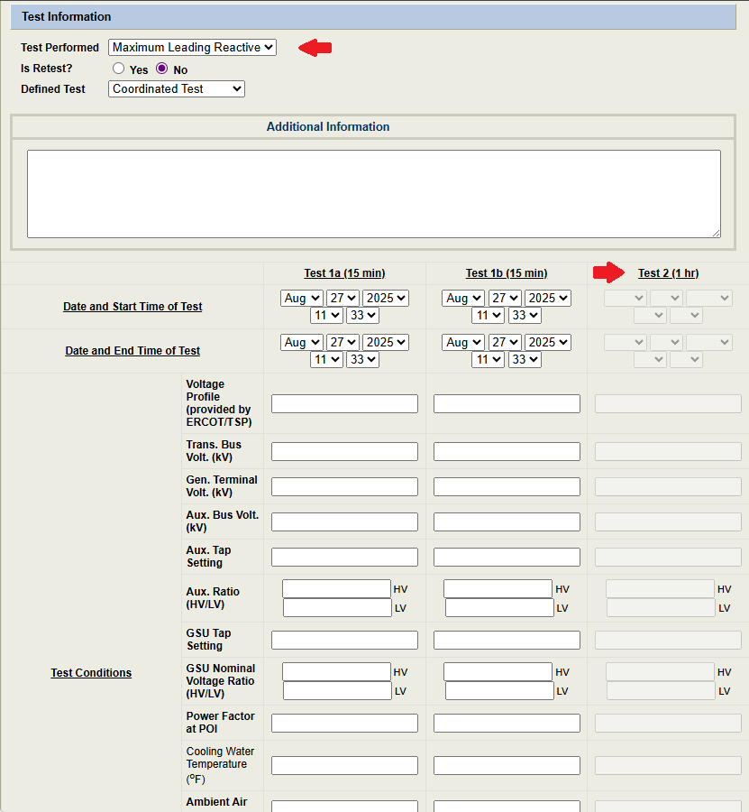
NDCRC – RTC+B

