Slide 1
RTC+B Market Trials - Market Submissions
Sreenivas Badri
Nathan Smith
August 28, 2025

Slide 2
RTC+B Market Trials – Submissions Testing
This presentation covers the plan for ERCOT RTC+B Market Trial system configurations and digital certificates to support the stages of market trials and go-live to achieve the following:
  Isolate initial testing path for QSE/Vendor Sandbox testing from current production
  Minimize risk of RTC+B market submissions impacting current production
30-day Market Notice
11/5/25
Start
03/07/2025
Start
05/05/2025
Start
07/07/2025
Start
09/02/2025
Go-Live
12/5/25*
Feb 2025
Feb 2025
Mar 2025
Apr 2025
May 2025
June 2025
July 2025
Aug 2025
Sep 2025
Oct 2025
Nov 2025
Dec 2025
Optional: RTC QSE/Vendor Developer
Submission Testing
RTC QSE
Submission Testing
Open-loop
RTC SCED
Ongoing Open-Loop
& Periodic Closed-loop SCED/LFC
Transition to Go-Live
RTC Vendor
Submission Testing
RTC QSE
Submission Testing
Day-Ahead Market
Non-Binding DAM using QSE offers for at least 2 tests
* Go-Live date reflects 12/5/2025 as first Operating Day
where 12/4/2025 is planned software migration.

Slide 3
RTC+B Market Submissions - Systems configurations
Start
03/07/2025
Start
05/05/2025
Start
07/07/2025
Start
09/02/2025
Go-Live
12/5/25*
Feb 2025
Mar 2025
Apr 2025
May 2025
June 2025
July 2025
Aug 2025
Sep 2025
Oct 2025
Nov 2025
Dec 2025
Optional: RTC QSE/Vendor Developer
Submission Testing
RTC QSE
Submission Testing
Open-loop
RTC SCED
Ongoing Open-Loop
& Periodic Closed-loop SCED/LFC & Day Ahead Market & Transition to Go-Live
Certificate: Current MOTE
Env: ERCOT RTC Market Trial
URL: RTC MIS MOTE URL
Certificate: Current Production
Env: ERCOT RTC Market Trial
URL: RTC MIS Market Trial
Cert: Production
Env: Prod
URL: MIS Prod
QSE/Vendor developer can use MOTE certificates & RTC MIS MOTE API URL to test the submissions until end of submission testing phase (end of June) as needed. At the start of the Open Loop testing, RTC MOTE MIS URLs will be disabled.
URL links: RTC MOTE and Market Trial URL links to be used for MMSUI, OSUI and API submissions. Actual links are provided in next slide.
For notifications/responses to MPs from RTC Market Trials environment, MP will need to provide the listener URL to ERCOT

Slide 4
RTC+B Market Submissions - Systems configurations
Currently (pre-RTC),
 | Digital Certificate | MMSUI/OSUI | API
Current MOTE | Current MOTE | MOTE MIS URL: testmis.ercot.com/mmsui testmis.ercot.com/osui | MOTE MIS API URL: testmisapi.ercot.com /2007-08/Nodal/eEDS/EWS/ testmisapi.wan.ercot.com:9443/2007-08/Nodal/eEDS/EWS/
Current Prod | Current Production | PROD MIS URL: mis.ercot.com/mmsui mis.ercot.com/osui | PROD MIS API URL: misapi.ercot.com/2007-08/Nodal/eEDS/EWS/ api.wan.ercot.com:8443/2007-08/Nodal/eEDS/EWS/

Slide 5
RTC+B Market Submissions - Systems configurations
RTC+B Market Trials and Go-live
RTC+B Phase | Digital Certificate | MMSUI / OSUI URL | Internet/ WAN API URLs
Vendor/QSE Submissions Testing | Current MOTE | RTC MOTE MIS URLs https://testmarkettrials.ercot.com/mmsui/mmsui/displayTradesLanding.action https://testmarkettrials.ercot.com/osrui/osrui/Summary.action | RTC+B MOTE Internet/WAN URL https://testmarkettrialsapi.ercot.com/NodalAPI/EWS/ https://testmarkettrialsapi.wan.ercot.com/NodalAPI/EWS/
Open Loop and Closed Loop Testing | Current Production | RTC Market Trial URL https://markettrials.ercot.com/mmsui/mmsui/displayTradesLanding.action https://markettrials.ercot.com/osrui/osrui/Summary.action | RTC+B Market Trials Production System Internet/WAN URLs https://markettrialsapi.ercot.com/NodalAPI/EWS/ https://markettrialsapi.wan.ercot.com/NodalAPI/EWS/
From RTC Go-live onwards | Current Production | Current Prod MIS URL mis.ercot.com/mmsui mis.ercot.com/osui | RTC+B Go Live Production System New Internet/WAN URLs: Internet API URL: https://misapi.ercot.com/NodalAPI/EWS/ WAN API URL: https://api.wan.ercot.com/NodalAPI/EWS/

Slide 6
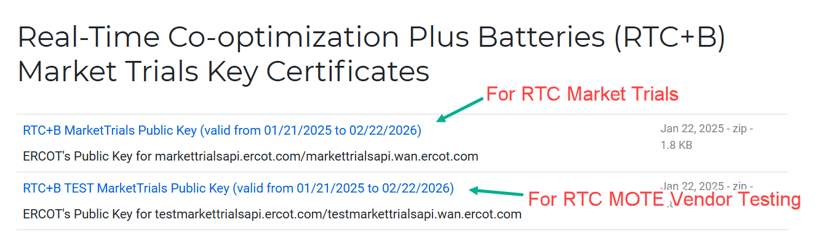
RTC+B Market Submissions - Systems configurations
Public Key Update for Internet/WAN API submissions
For API submissions into Market Trials environments, need to download public keys and place into the keystore location in system being used for RTC+B submissions.
No change to digital user certificates – continue to use existing MOTE and Production Certificates
Market Trail API Public key location: https://www.ercot.com/services/mdt/webservices

Slide 7
RTC+B Market Trial Systems – Site Failover Schedule
No | Site Failover Date | Active Data Center | Notes
1 | 09/05/2025 | Taylor
2 | 10/03/2025 | Bastrop
3 | 11/07/2025 | Taylor
4 | 12/??/2025 | Bastrop | December Site Failover date is not finalized yet
RTC+B Market Trial Systems Site Failover Schedule will be posted to RTCBTF site (https://www.ercot.com/committees/tac/rtcbtf) under Technical Details section once December site failover date is finalized

Slide 8
RTC+B Market Trials Systems Readiness for Market Submissions Testing
RTC+B Market Trials Systems are built and setup for market submissions testing from Market Manager UI and through API.
Market Trials Systems is released for QSE submission testing as well as telemetry verification from 05/05/2025 to 06/30/2025.
Valid current MOTE certificates are required to connect to RTC+B Market Trials Systems for this phase of testing.
Report issues to ERCOT at rtcb@ercot.com
Market Notice was sent on 2/26/2025 with details on QSE/Vendor sandbox testing.
https://www.ercot.com/services/comm/mkt_notices/M-B022625-01
Market Notice was sent on 4/16/2025 with details on QSE/Vendor submission testing and telemetry verification.
  https://www.ercot.com/services/comm/mkt_notices/M-A041625-01

Slide 9
RTC+B Market Trials Systems Readiness for Open Loop and Closed Loop Testing Market Submissions
06/30/2025 5:00 PM - RTC+B Market Trials MOTE URLs (UIs/APIs) will be disabled permanently.
  RTC+B MOTE will be available only from Go Live for normal MOTE testing activities.
  QSEs can use non-monitoring days (Mon/Wed/Fri) to make test submissions into RTC+B Market Trials Production System to test software changes until Go-Live.
    Once testing is completed, cancel the test submission or update test submission with production quality market data.
07/01/2025 – 07/06/2025 – Configure RTC+B Market Trials System with Market Trials Production System URLs, deploy latest RTC+B code and perform site failover testing.
  During this time, Market Trials Market and Outage Submissions systems (APIs/UIs) will be unavailable for market submissions.
07/07/2025 08:00 AM – RTC+B Market Trials Production Systems will be up and running for Open Loop Testing.
Same Market Trials Production System configuration will be used for Day-Ahead Market Submissions (Sept – Oct) and for Closed Loop Testing as well.
QSE Activities
  Update RTC+B Market Trials – Market Submission Systems with ERCOT RTC+B Market Trials Production Systems Internet/Wan API URLs and certs to support Open Loop Testing from 07/07 and Closed Loop Testing.
  Set up the listeners in RTC+B environment to receive notifications from ERCOT during open loop and closed loop testing and provide listener URLs to ERCOT

Slide 10
Dual Market Submissions
Market Submissions to Current Production should not be impacted until Go-Live.
Open Loop Testing (07/07 – 08/29)
  Dual Market Submissions – QSEs are expected to submit following RTC+B real-time Market Submissions into RTC+B Market Trial Production System with Production Quality in parallel to Current Production for the monitoring days (Tuesday/Thursday) 09:00 AM – 5:00 PM as indicated in Handbook#3.
    COPs
    TPOs
    AS Offers
    ESR Energy Bid/Offer Curves
    RTM Bids and Offers
    Output Schedules
  Market Submissions quality will be validated during monitoring days
  RTC+B SCED will be run on these monitoring days (Tuesday/Thursday) with above production quality market submissions and expect to produce production quality SCED results (Energy Base points, AS Awards, congestion management etc.).
Closed Loop Testing (Sept – November)
  1st Closed Loop Testing is planned on September 2nd week, 2nd Closed Loop Testing is planned in October. If needed 3rd Closed Loop Testing will be scheduled in November.
  These are 2 hours tests – RTC LFC/SCED will be controlling the grid.
  Dual Market Submissions – QSEs are expected to submit above RTC+B real-time Market Submissions into RTC+B Market Trial Production System with Production Quality in parallel to Current Production starting from 5:00PM of the day prior to the closed loop testing until the completion of the test.
    Real-time Market Submissions should be submitted for all 24 hours of the closed loop testing day

Slide 11
Dual Market Submissions
Day Ahead Market Executions (Sept – Oct)
  At least 2 RTC+B Day Ahead Markets will be executed
  QSEs RTC+B systems should be setup to test their day-ahead market submissions for defined transactions (Energy Bid/Offer Curves, AS Self-Arrangement, DAM AS Only Offers, and normal DAM submissions).
    During day-market submissions into RTC+B, current production day-ahead market submissions should not be impacted.
  ERCOT will execute and publish at least two Day-Ahead Markets
  DAM participation is strongly encouraged, but will not be required in Readiness metrics
Go-Live
  Dual Market Submissions – QSEs are expected to submit RTC+B real-time Market Submissions into RTC+B Market Trial Production System with Production Quality in parallel to current production starting from few hours or days before Go-Live.
    Exact start time of dual market submissions for Go-Live will be provided during Go-Live Cutover discussions.
At any given time either current production or RTC+B system will be live, NOT both.

Slide 12
Outage Submissions
For the initial phases of market trial testing including Vendor sandbox testing and QSE submission testing (spanning Mar-Jun 2025):
  Request QSEs to send us an email request (to RTCB@ercot.com) with the details of the outage to be approved for ERCOT review/action.
  ERCOT will manually approve the outages.
  This will help QSEs, and their vendors test their Outage Scheduler software.
Open Loop Testing
  Outage Submissions testing is not mandatory during Open Loop Testing but strongly encouraged to continue to test the outage submissions utilizing the RTC+B Market Trials Production Systems URLs until go live.
Closed Loop Testing
  Outage Submissions into ERCOT RTC+B Market Trials Production System is not required during Closed Loop Testing.
Dual Outage Submissions for Go-live
  Dual submission of Outages is not required for Go-Live as well.
Above 2.3.6 and 4.3.8 sections updates modifies XSDs, rest are EIP Specifications Document updates Only.

Slide 13
Outage Submissions
For the initial phases of market trial testing including Vendor sandbox testing and QSE submission testing (spanning Mar-Jun 2025):
  Request QSEs to send us an email request (to RTCB@ercot.com) with the details of the outage to be approved for ERCOT review/action.
  ERCOT will manually approve the outages.
  This will help QSEs, and their vendors test their Outage Scheduler software.
Open Loop Testing
  Outage Submissions testing is not mandatory during Open Loop Testing but strongly encouraged to continue to test the outage submissions utilizing the RTC+B Market Trials Production Systems URLs until go live.
Closed Loop Testing
  Outage Submissions into ERCOT RTC+B Market Trials Production System is not required during Closed Loop Testing.
Dual Outage Submissions for Go-live
  Dual submission of Outages is not required for Go-Live as well.

Slide 14
IRR Forecast to QSEs
ERCOT is not planning to send Wind/Solar forecast to QSEs RTC+B environment through API from ERCOT Market Trials environment.
QSEs are expected to use Wind/Solar forecast from current production for RTC+B COP submissions.

Slide 15
Market Submission Issues
ERCOT is reaching out to a subset of QSEs where ERCOT has observed potential real-time market submission issues on Aug 19 and/or Aug 21.
Summary of issues/observations:
  Off-line ECRS (OFFEC) offers are unable to be awarded in RTM for RTC+B. Please submit these as an online ECRS offer with resource status ‘OFFQS’ during the RTM.
  Resources providing AS in Production did not have respective AS Offers in RTC+B
    Examples:
      Missing online Non-Spin offers for ESRs carrying online Non-Spin in Production.
      Only submitting AS Offers for ECRS instead of all AS types carried in Production (RRSPF, Non-Spin, ECRS)
      ESRs – Only offering in RRSPF, AS Offers not submitted for AS types (REGDN, REGUP, ECRS) that these resources are carrying in Production.
  Submitting AS Offers for just a subset of types the Resource is qualified to provide.
  Submitting “test” MW amounts for all ESRs instead of resource capability for AS.
  Submitting MW amounts much less than resource capability.
ERCOT is requesting QSEs to resolve these issues as soon as possible, these issues are impacting SCED solution quality.
Closed Loop Testing Preparation – Resource RTC+B EOC should match with production EOC. Practice the submission now in preparation for Closed Loop Test on 09/11/2025.

Slide 16
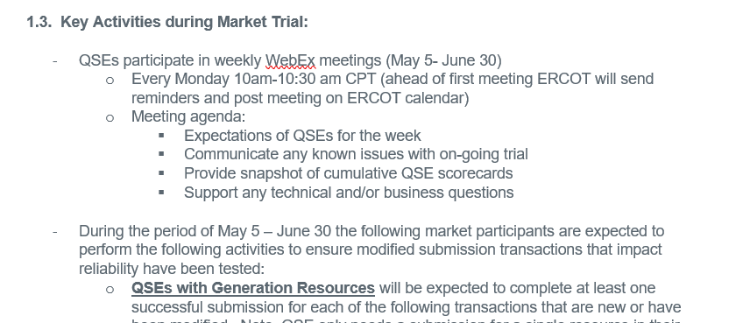
Market Submissions Handbooks Review
For each phase of Market Trials testing, a handbook will be posted to the RTBTF web page - https://www.ercot.com/committees/tac/rtcbtf
Handbook to cover the expectations for each phase of testing, including
  the key activities for that testing phase,
  required submissions and expectations of submissions data entry with regard to current Production submissions. For example, during closed loop testing we would expect RTC submissions to closely align with current Production submissions to ensure smooth transition into and out of closed loop testing,
  QSE performance evaluation criteria,
  and high-level timelines for each phase.
Screenshot from Market Trials Handbook 1 – RTC QSE Submission Testing
https://www.ercot.com/files/docs/2025/04/07/RTCB_Market_Trials_Handbook_1_MarketSubmissions.docx

Slide 17
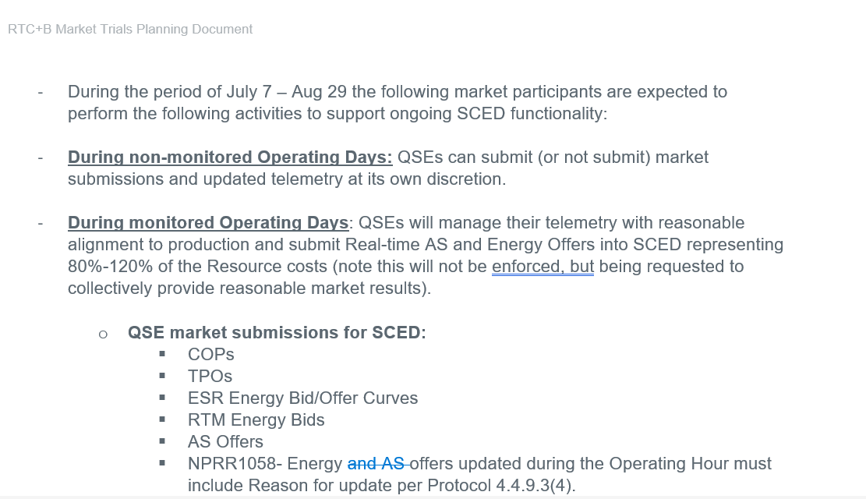
Market Submissions Handbooks Review
Screenshot from RTC Market Trials Handbook 3 - Open Loop Testing
https://www.ercot.com/files/docs/2025/04/07/RTCB_Market_Trials_Handbook_3_OpenLoop_RTC_SCED_04182025_FINAL_Revised_071125.docx

Slide 18
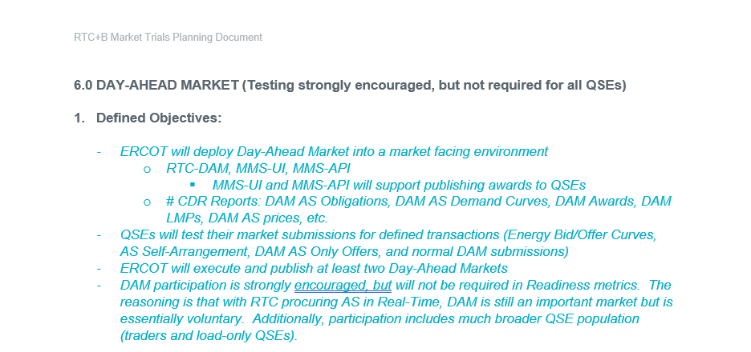
Market Submissions Handbooks Review
Screenshot from RTC Market Trials Handbook 6 – Day Ahead Market
https://www.ercot.com/files/docs/2025/04/28/RTCB_Market_Trials_Handbook_6_DayAheadMarket_06132025_FINAL.docx

Slide 19
FAQ - Market Trials Submission Testing
Q1. The following questions related to Market Trials submissions testing have been addressed in the RTC Market Trial handbooks. Details in the following two slides:
  What are the different submissions that QSE needs to submit for each phase of Market Trials?
  What is the duration for which QSE needs to submit for each phase of Market Trials?
  What actions/applications will ERCOT be running during each phase?
  What are performance evaluation criteria for the QSEs for each phase of Market Trial testing?

Slide 20
FAQ - Market Trials Submission Testing
Q2. Request for IP/DNS information
A2. These are not changed for RTC. For any IP address or DNS names for Ercot API or Ercot Notification Source IP address, please contact the ERCOT client reps/account managers, or send a request email to RTCB mailbox.
Q3. Notifications from ERCOT
A4. To support testing notifications from ERCOT for API submissions, QSEs should submit API Listener URL set up information using the template available from the “Technical RTC+B Details” section of the RTCBTF page. QSEs are expected to complete this template and send it to RTCB@ercot.com.
The specific coded alerts/notifications from ERCOT can be found in the EIP External Specs document Section 5.3.1 - https://www.ercot.com/files/docs/2024/06/24/EIP_External_Interfaces_Specification_RTCB_v1.0.zip
For Market submission validations and corresponding error messages – the only changes are related to the submission changes for RTC. The updated RTC+B submission validation rules can be found here - https://www.ercot.com/mp/data-products/data-product-details?id=NP4-450-M. These messages do not include an error code, and the message text for these vary based on the submission error and are specific to the resource/values submitted.

Slide 21
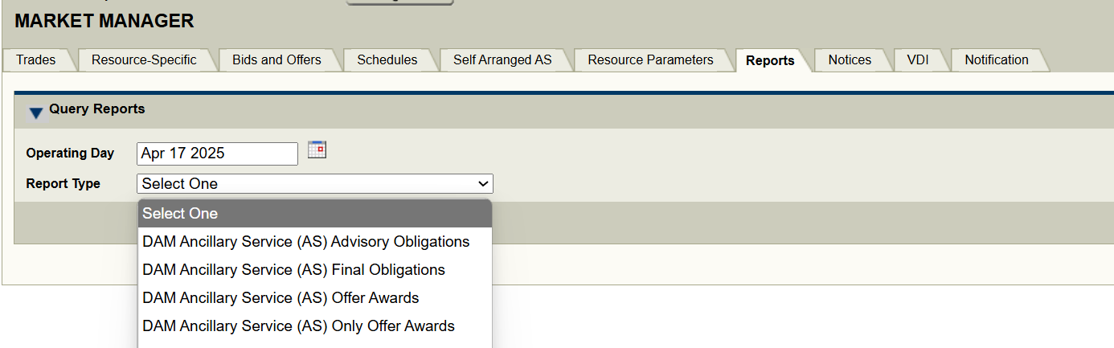
FAQ - Market Trials Submission Testing
Q4. When can MPs start testing DAM and SCED awards data along with reports in Market Trials?
A4. Currently the Market Trial environment is setup with limited functionality. For the first two phases of testing, the functionality is limited to vendor and QSE market submission testing and telemetry validations. Starting with Open Loop testing till go-live, the environment will be updated to allow for DAM/SCED runs.
DAM award reports will be available on MMSUI/via EWS on the days when DAM is run on RTC market trials
During open loop testing, ERCOT will publish the following four reports:
SCED Shadow Prices and Binding Transmission Constraints - NP6-86-CD
LMPs by Resource Nodes, Load Zones and Trading Hubs Market Trials - NP6-788-CD
Modify Real-Time ORDC and Reliability Deployment Price Adders and Reserves by SCED Interval - NP6-323-CD
Real-Time Clearing Prices for Capacity by SCED interval – NP6-332-CD

Slide 22
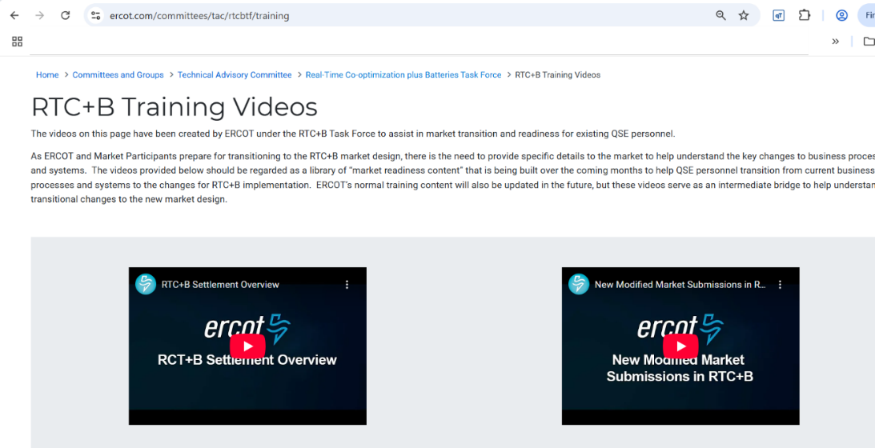
FAQ - Market Trials Submission Testing
Q5. RTC+B Settlements Extracts in Market Trials?
A5. Market Trials are limited for Settlements and Billing:
ERCOT will not be providing QSE specific statement files, however, generalized sample DAM and RTM Statements posted to 5/21 RTCBTF meeting page
  https://www.ercot.com/calendar/05212025-RTCBTF-Meeting
These statements do not structurally change, but will include changes in the billing determinants for RTC
ERCOT has provided training on the RTC billing determinants and posted in a YouTube on this page:
  https://www.ercot.com/committees/tac/rtcbtf/training (Select RTC+B Settlement Overview)

Slide 23
RTC+B Market Trials
Questions?
Provide feedback to ERCOT on any concerns/questions at rtcb@ercot.com

