Slide 1
ERCOT Technology Working Group (TWG)
August 28, 2025

Slide 2
ERCOT TWG
WELCOME

Slide 3
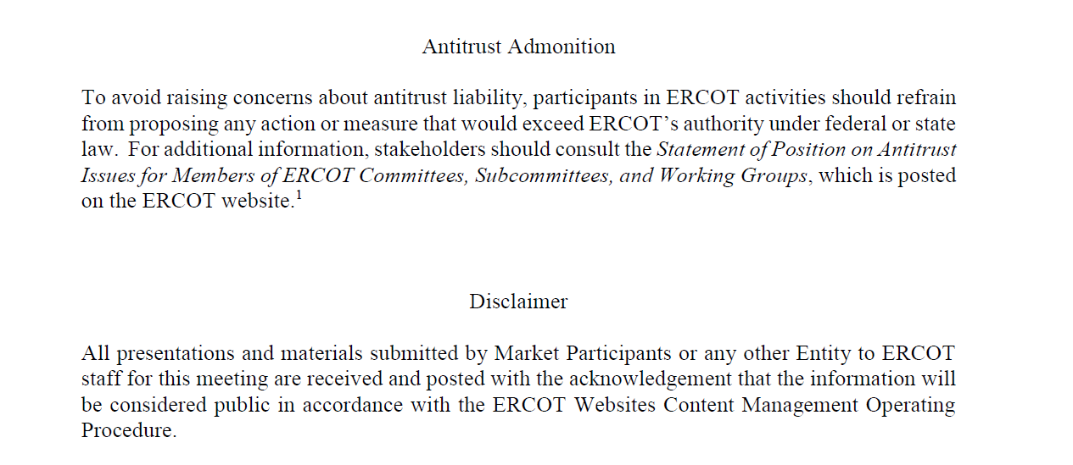
ERCOT TWG

Slide 4
ERCOT TWG Agenda
Item # | Item Description | Presenter | Start Time
1 | Antitrust admonition | Sreenivas Badri | 2:00 PM
2 | Project Updates | Troy Anderson | 2:02 PM
3 | RTC+B Updates Program and RTCBTF Updates Telemetry Validation Refresher on Resource Status Telemetry Guidance on Combined Cycles Telemetry Guidance on NCLR Self Provision AS Telemetry Market Trials - Market Submissions Update CDR Group 1,2 and 3 reports review NDCR MOTE Testing Update Closed Loop Testing – Cutover/Cutback Plan review | Matt Mereness/ERCOT Staff | 2:10 PM
4 | NOGRR245 – RIOO Implementation updates | Ming Shen | 3:10 PM
5 | Proxy Configurations for Secure CIPHERS | Leo Angele | 3:20 PM
6 | Digital Certificates Migration update | Nicholas Jessett | 3:30 PM
7 | Round Table Discussion | Tanner Holder | 3:40 PM
8 | Adjourn | Tanner Holder | 4:00 PM

Slide 5
RTC+B Updates
Program/RTCBTF Updates – Matt Mereness
ICCP Telemetry – Karthik Gopinath/Tejaswi Potluri
Guidance on Combined Cycles Telemetry – Abhi Masanna Gari
Market-Trials-Market-Submissions – Sreenivas Badri/Nathan Smith
CDR changes overview – Jamie Lavas
NDCR MOTE Testing Update – Nick Barbas
Closed Loop Testing – Cutover/Cutback Plan Review – Sreenivas Badri

Slide 6
NOGRR245 – RIOO Implementation updates
NOGRR245 – RIOO Implementation updates
– Ming Shen

Slide 7
Proxy Configurations for Secure CIPHERS
Proxy Configurations for Secure CIPHERS
– Leo Angele

Slide 8
Digital Certificates Migration
Digital Certificates Migration update
– Jessett Nicholas

Slide 9
ERCOT TWG – Round Table Discussion
ERCOT TWG – Round Table Discussion
  Future Topics of Interest
  Topics and presentations from TWG members

Slide 10
ERCOT TWG
Thank You
You can reach Sreenivas at
Sreenivas.Badri@ercot.com and Tanner at tholder@tnsk.com

