Slide 1
Identity and Access Management (IAM): DigiCert ONE
Nicholas Jessett
Head of Identity
Technology Working Group
28 of August 2025

Slide 2
Digital Certificate Migration – Market Notice
LONG DESCRIPTION: On October 1st, 2025, ERCOT will start generating Digital Certificates based on a new Root CA.
Any valid Digital Certificates (based on the present Root CA) will still be accepted by ERCOT MIS and API. As certificates expire, renewed or reissued, the new Root CA.
ERCOT does not anticipate any interruptions or changes to the current process as we migrate to the new Root CA.
In the case of machine-to-machine communication, there should not be any differences from our current setup.
Additional Information: Root CA installation and location information to be provided in a follow-up market notice.
CONTACT: If you have any questions, please contact your ERCOT Account Manager. You may also call the general ERCOT Client Services phone number at (512) 248-3900 or contact ERCOT Client Services via email at ClientServices@ercot.com.

Slide 3
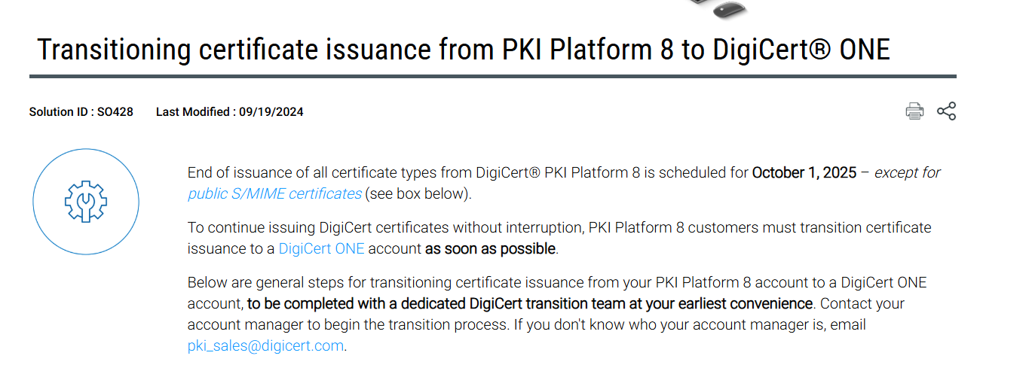
Digital Certificate Migration – Why are we Changing?
DigiCert will end-of-life (EOL) the PKI Platform 8 on October 1, 2025

Slide 4
Digital Certificate Migration – Key Points
October 1st, 2025, thru October 1st, 2026, the ERCOT interfaces will accept client certificates based on two ROOTCAs, PK8 (EOL) and DigiCert One (New) ROOTCA
After October 1st, 2025, any client PK8 certificate that is renewed or revoked followed with a new request will receive a client certificate based on DigiCert One (DC1) ROOTCA
ERCOT does NOT expect any interruptions
ERCOT does NOT expect any changes to the current process

Slide 5
Digital Certificate Migration – Machine to Machine
There should not be any differences from your current setup
Market Participants API software may need to import the DigiCert One (New) ROOTCA
  NOTE: If the software required the old ROOTCA imported, then most likely the new ROOTCA will need to be imported

Slide 6
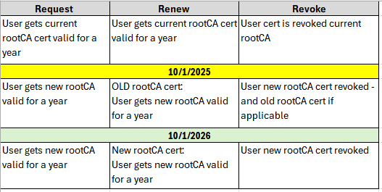
Digital Certificate Migration – Request, Renew, and Revoke
Currently
Oct 2025
Oct 2026

Slide 7

Questions

Slide 8

Questions

