Slide 1
Weekly
RTC+B Market Trials Update
ERCOT Staff
August 25, 2025

Slide 2
Outline
Antitrust Admonition
Expectations of QSEs for the Week
Scorecards for in-flight Activities
Communicate any known Issues within On-going Trial
What is needed this week and next week ahead of Sep 11 LFC Test
RTC Market Trials outcomes
What is needed this week and next week ahead of Sep 11 LFC Test
Q&A
Appendix- Supporting Materials:
  Attestation Market Notice
  Telemetry Screening
  New RTC Pricing reports location
  NPRR1290 market submission validation change
  Links to Handbooks
  Prior Scorecards
  FAQ Updated 8/8/2025
  Connectivity and Configuration (digital certs)

Slide 3
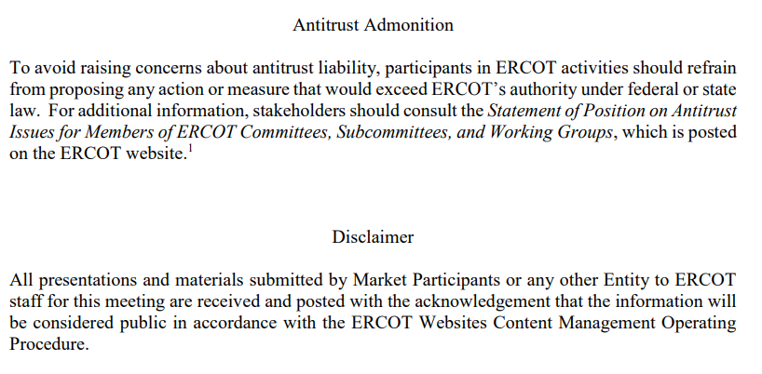
WebEx Meeting reminders (same as other ERCOT forums):
Please keep line muted
If you have a question, please use the chat feature to either:
  Type in your question, or
  Type in “Question” and wait to be recognized to state question

Slide 4
Sequence and Dates for Market Trials to Go-Live
Market trials are a progression of activities to mitigate the risk for Go-Live on new systems and processes for both the Market Participants & ERCOT.
30-day Market Notice
11/5/25
March/April
2025
Start
5/5/25
Start
7/7/25
Start
9/2/25
Go-Live
12/5/25*
May 2025
June 2025
July 2025
Aug 2025
Sep 2025
Oct 2025
Nov 2025
Dec 2025
QSE Scorecards & Exit Criteria for each Trial Phase
#1 RTC QSE Submission Testing
(Submit COP, RT AS Offers,
DAM Virtual AS, Outages for ESRs)
#3 Open-loop RTC SCED
(QSE offers, SCED non-binding award/dispatch)
#5 Ongoing Open-Loop
& Periodic Closed-loop SCED/LFC
(QSE RTC offers and telemetry to support closed-loop frequency control test 2-3 tests of 2-4 hour durations)
Transition to Go-Live
Upon completion of testing, confirmation of ERCOT and market readiness for Go-Live.
QSE/Vendor Submission Sandbox and Telemetry Points added Prod EMS model.
#2 RTC QSE Telemetry Checkout (QSEs add/verify new telemetry points for UDSP, New ramp rates, ESR telemetry)
#4 QSE Telemetry Tests
(Individual QSE to follow UDSP and support new ramp rate and ESR telemetry)
#6 Day-Ahead Market
(Non-binding DAM using QSE offers for at least 2 tests)
* Go-Live date reflects 12/5/2025 as first Operating Day
where 12/4/2025 is planned software migration.

Slide 5
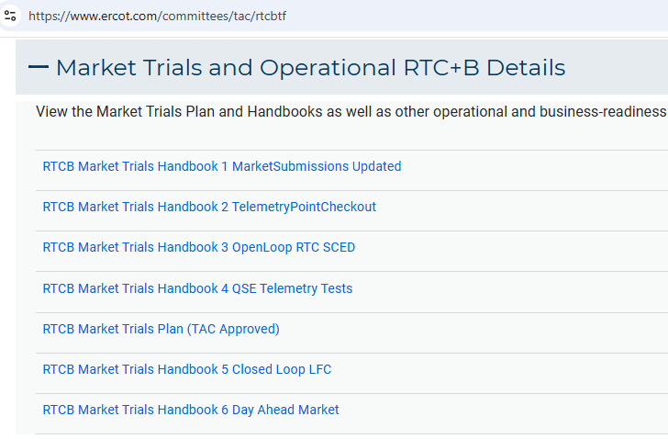
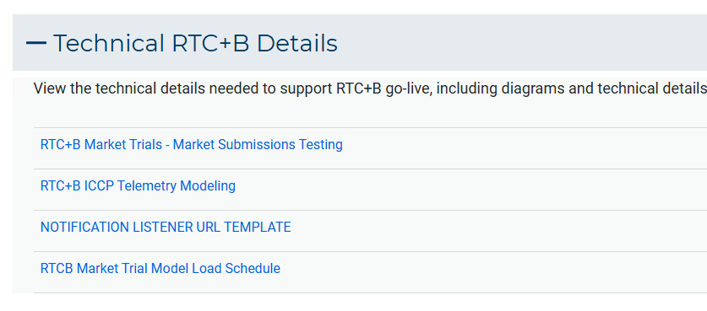
Resources for Sep/Oct Market Trials
Everything needed for current market trials is on RTCBTF home page
Note- TAC Approved the Market Trials Plan in October 2024
May/June complete
July/Aug in flight
Sep/Oct next week

Slide 6
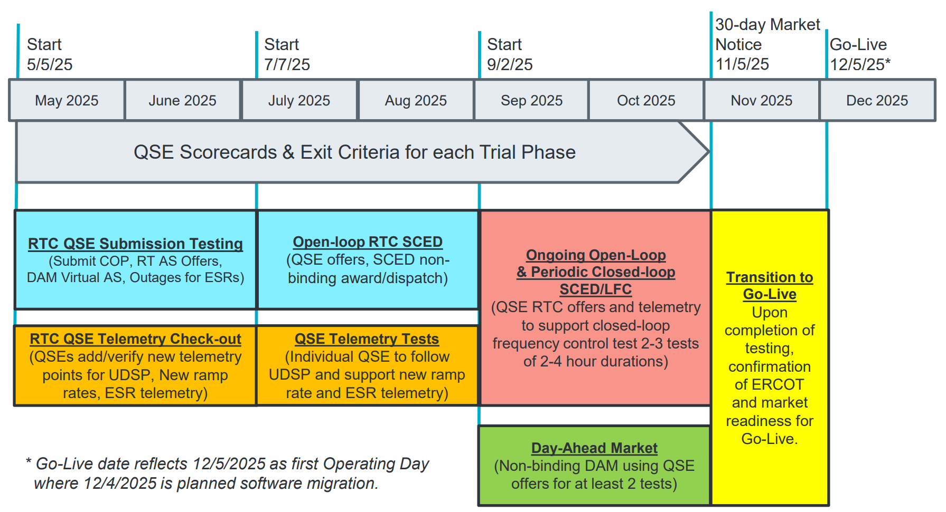
July & August:
Initial Real-Time Market execution and verify QSE ability to follow ERCOT frequency signals during individual QSE test
HB#3: QSE will support “parallel production” 2days/week by entering $bids/offers for non-binding RTC energy and A/S awards and dispatch (Open-loop test)
Scorecard to demonstrate successful submissions and telemetry reflective of production, and mitigation plans in place for any outliers.
HB#4: Coordination of individual QSE tests on subset of resources to ensure resources can follow new UDSP telemetry point from ERCOT.
Scorecard goal for QSEs to successfully demonstrate, and mitigation plans in place to address in next trial phase.

Slide 7
July/August Market Trials Scorecard (Handbook 3)
Handbook #3 - Dual “production-like” data Tue/Thu 9am-5pm
  Market Trials ERCOT/QSE support required for:
    Submissions (TPO/COP/ASOffer etc.) – No outage submissions required
    Telemetry (current and new telemetry points)
    To assist RUC studies, please submit COP, 3PSO, ASOffer through end of OD (midnight)
    Systems will be running 7x24, so submissions encouraged but not required on all days.
Scoring for QSE submissions & telemetry as 2 scorecards for Handbook #3
  All QSEs for all Resources on Monitored Operating Days July 22– Aug 28 every Tue/Thu 9-5
  Green is > 95%
  Yellow is 85% - 95%
  Red is < 85%
  Also an “ERCOT-wide score”
12 OpDays scored in 3a
for market submissions
12 OpDays scored in 3b
for accurate telemetry

Slide 8
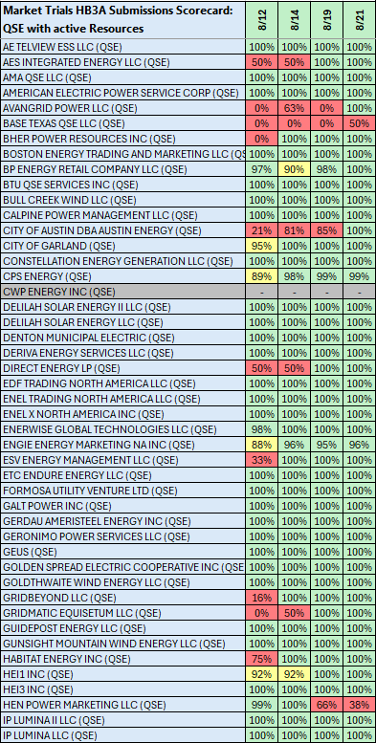
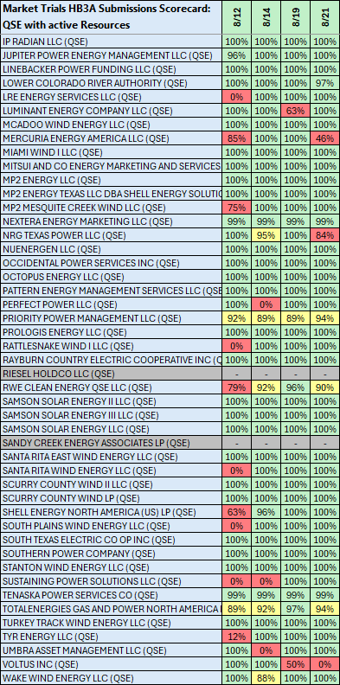
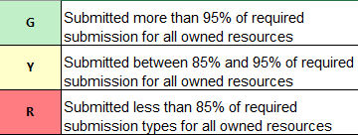
Scorecard 3A for
Handbook 3-
Market submissions:
Scores for QSEs with Resources – Appropriate submissions made for each owned resources.
COP – ALL
TPO – Gen, ESR, CLR
ASO – AS Qualified Resources
Last 3 weeks have progressed
System Wide from
Week 1- 65%
Week 2- 74%
Week 3- 85%
Week 4- 95%
Week 5- 95%
Scoring:

Slide 9
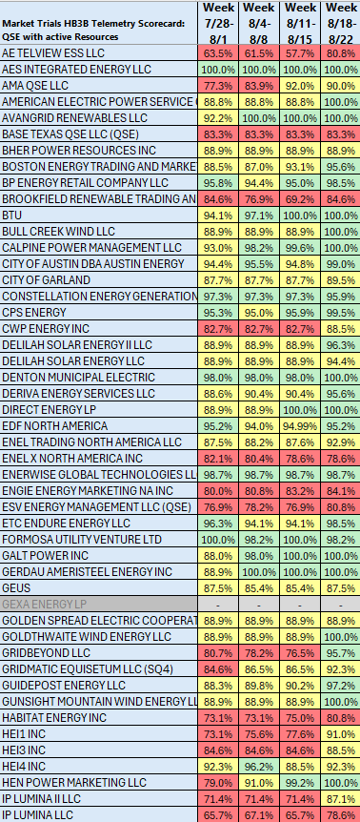
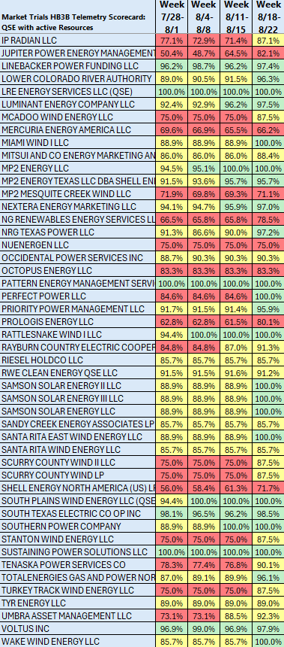
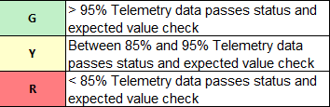
Scorecard 3B for
Handbook 3-
Acceptable Telemetry point values received by ERCOT for active resources.
8/25 Scores for QSE with Resources – Accurate telemetry data sent to ERCOT
System Wide score: 92%
Scoring:

Slide 10
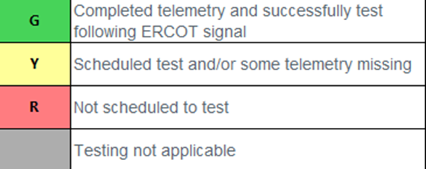
July/August Market Trials Scorecard (Handbook 4)
Handbook #4 - Coordinated Individual QSE Tests to follow UDSP
  ERCOT will schedule meetings with QSEs
    Meeting and test not required for “NCLR-only” QSEs
  Please contact ERCOT if you are ready to test in the trials window
  Single successful test for QSE to complete.
    Green is successfully tested
    Yellow is scheduled but not complete
    Red is not scheduled for test
  Also tracking an “ERCOT-wide score” to achieve 98% testing completed by end of August

Slide 11
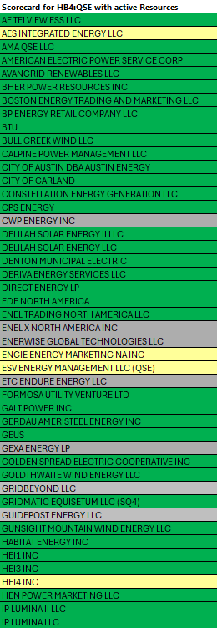
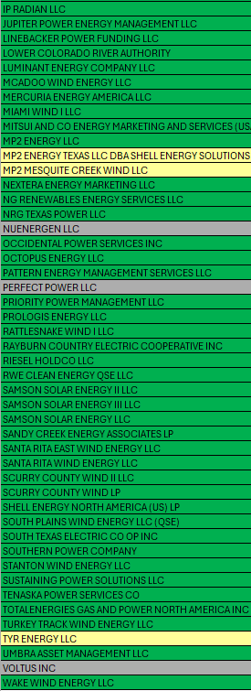

Scorecard 4 for
Handbook 4-
QSEs demonstrate ability to follow UDSP in coordinated test with ERCOT
8/25 UDSP following tests
All QSEs Scheduled to complete testing this week.
Scoring:

Slide 12
Summary of SCED functionality
What is RTC SCED using to solve in trials?
  Production Network model from NMMS
  QSE submitted offers (energy and A/S)
  QSE production telemetry
    ERCOT performs some overrides for stale data from QSE sites- improving each week
  Outages in prod telemetry would be outage in RTC SCED
  July 31 improvements implemented:
    NPRR1268/1269 ASDC and Proxies logic implemented
    AS Plan improved and now same as Prod
  Aug 4 improvements implemented:
    IRR Forecast synchronization has been manual, but now automated
  Aug 18 improvements implemented :
    Active constraints flag being manually copied (automation planned for Aug 18)
    Load Forecasts being fed into RTC, but ERCOT manually aligns which forecast is being used based on operator selection in Prod (automation planned for Aug 18)

Slide 13
Market Trials known issues/updates
Current issues/updates:
  Issues:
    COP submission validation
      Rejects/incorrect validation error when ECRS capability is equal than HSL – LSL (planned fix Aug 27)
      Rejects/incorrect validation error when RRSPF + RRSFF capability exceeds HSL – LSL (planned fix Aug 27)
  September/October Reports are now being posted, but data is not yet accurate:
    Example: RTD Indicative Awards and Price Adders reports postings
Optional- Day-Ahead submission for Monitored Op Day window
  Submissions will be closed from 10AM-11AM on the day prior to OD test windows.
  Day-ahead Submissions window (normally 7AM-10AM) for OD 8/27 will remain open on 8/26 until 6pm for those wanting to test their Day Ahead submissions validation. Not required.

Slide 14
Sep & Oct:
Required live-production test to ensure effective frequency dispatch and control.
Sep & Oct:
Optional Day-Ahead Market
Voluntary Day-Ahead Market for all QSEs will be conducted at least 2 times.
QSE can test their market submissions for Day-Ahead AS Self-Arrangement, AS Only Offers, Trades and normal submissions.
DAM participation is strongly encouraged but not required in Readiness metrics since RTC procures AS in Real-Time.
Participation includes much broader QSE population (marketers and load-only QSEs).
ERCOT and QSEs will conduct live-production tests of RTC-SCED and Load Frequency Control (LFC) prior to go-live.
RTC-SCED and frequency control dispatch during the tests will be binding to manage the reliable operations of the grid for2-4 hours.
ERCOT will coordinate with QSEs on how to submit RTC offers and telemetry for Energy and AS for the two systems (current and RTC system).
ERCOT will provide a summary of the test and use analysis and engineering judgement to assess if the test was successful in controlling frequency.

Slide 15
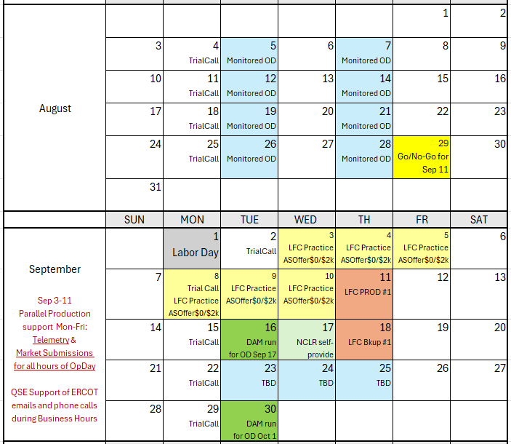
Market Trials Calendar and Transition to September
We are here….

Slide 16
IMPORTANT- Market Trials Transition to September
This week
  ERCOT continues outreach on Telemetry
  ERCOT initiating outreach on Market Submissions
  Although near 90+% on both items, need to improve alignment for SCED
    Example: good market submission may be unawarded due to telemetry (and vice versa)
  Observations:
    QSEs need to at least offer AS being carried in production
    In longer-term, QSEs need to offer full/qualified capability (expected in protocols, otherwise Proxy Offers)
    NCLRs need to telemeter Self-Provision = 0 (no DAM AS positions)
Next week and into September 3-11
  Support increase: QSEs being required for submission for all hours of highlighted Operating Days for September 3-5,8-11
  Offers Required: QSEs being required to adhere to offers per LFC Handbook 5
    Energy offers match production
    AS Offers should be offered at $0 if responsible in current production, remaining AS offer at $2,000
    If QSE has issues ahead of LFC test, QSE may consider not offering that AS in DAM ahead of LFC day
    Deeper dive next week Market Trials call
  After successful Sept 11 LFC Test, pivot to initial DAM Testing and Self-Provision capabilities

Slide 17
Market Trials OD Summary
08-19-2025 (9am – 5pm)

Slide 18
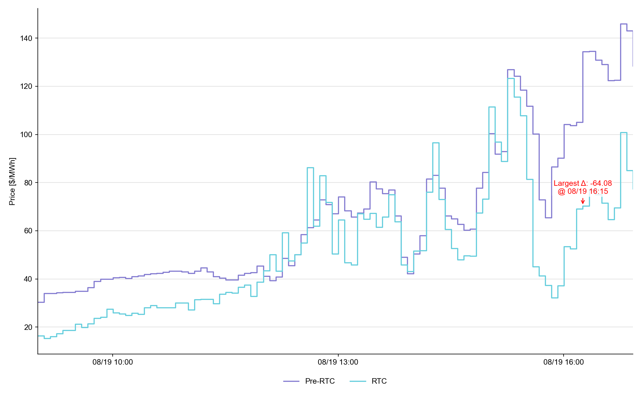
System Lambda (plus Adders)

Slide 19
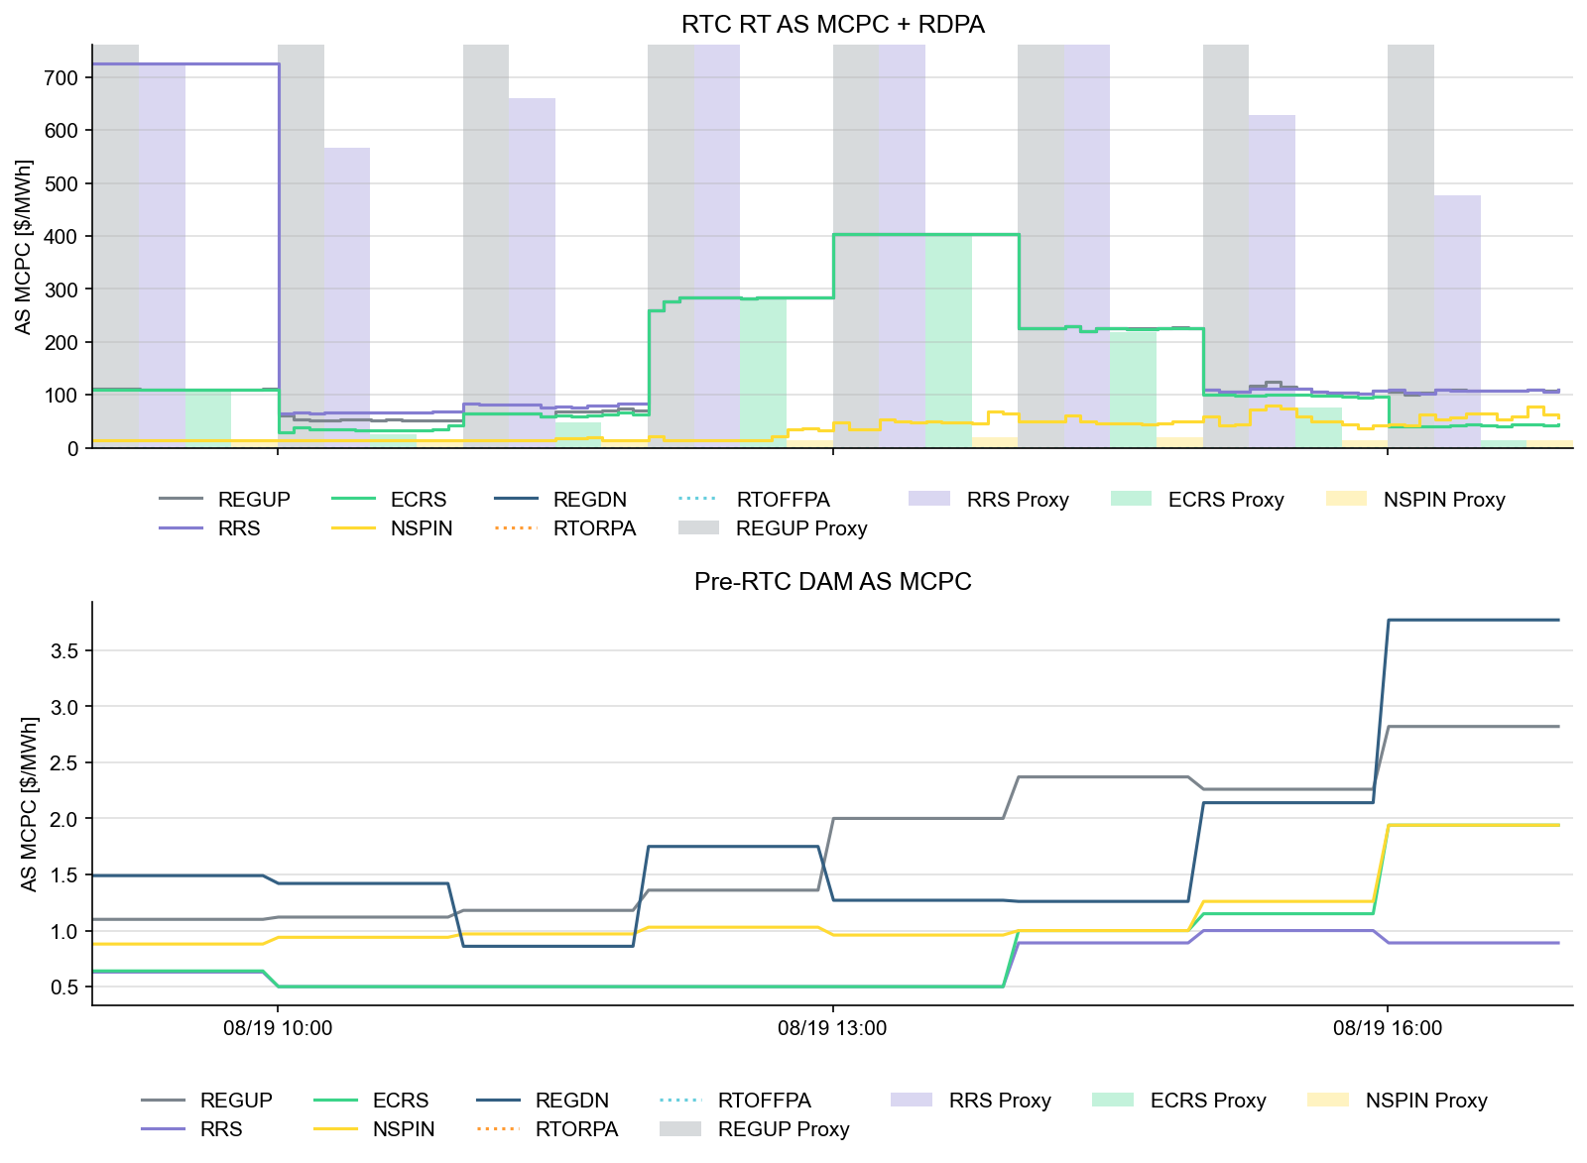
Ancillary Service Prices

Slide 20
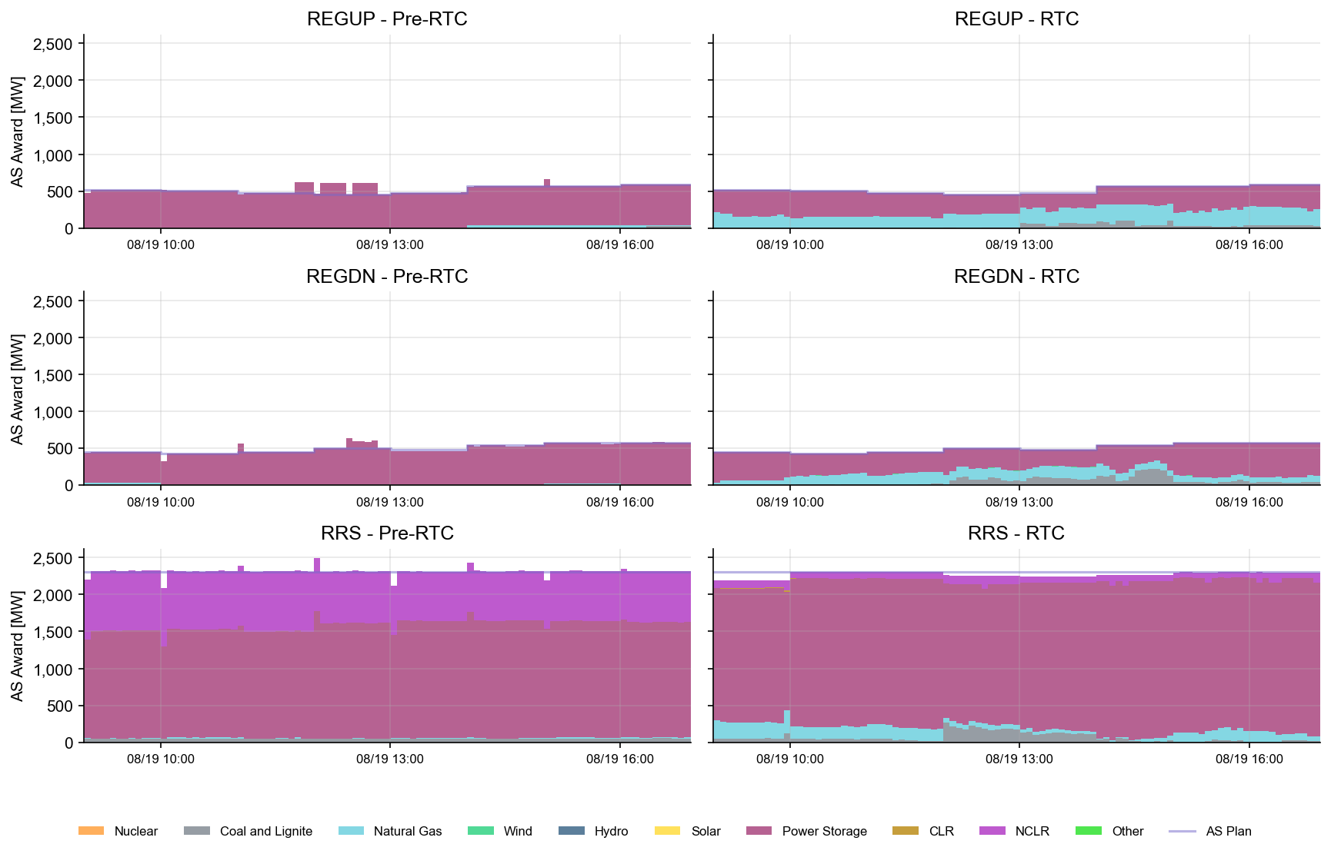
AS Awards* Summary by Resource Type
* Pre-RTC (RTM AS Schedule)

Slide 21
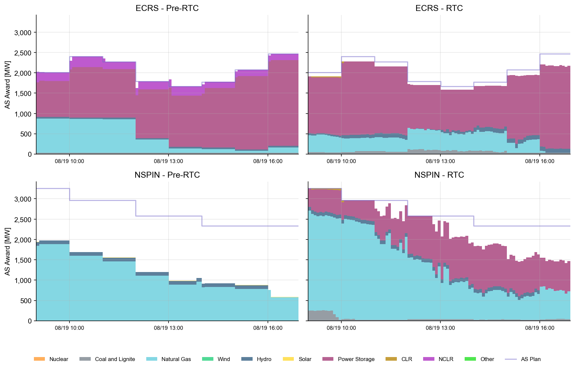
AS Awards* Summary by Resource Type

Slide 22
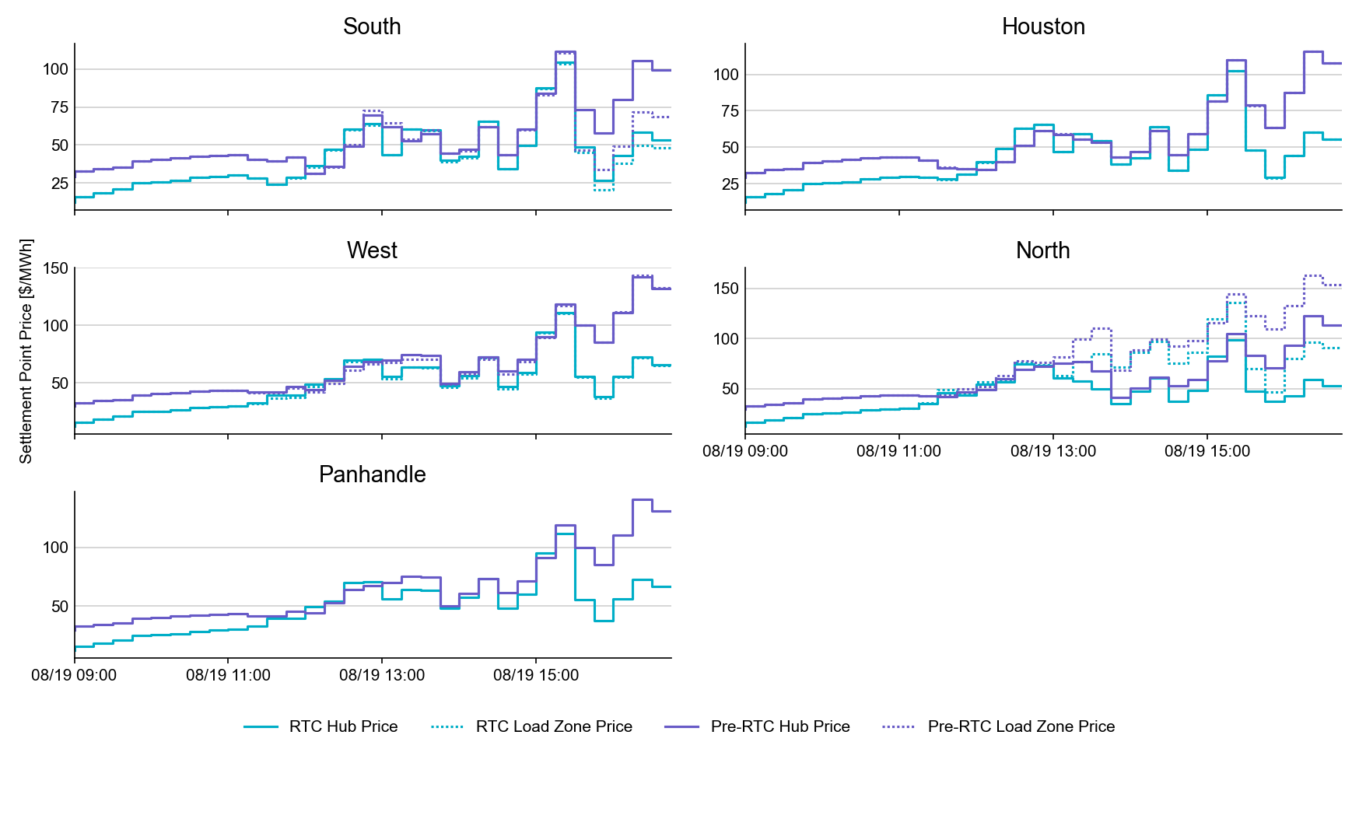
SPP by Hub and Competitive Load Zone

Slide 23
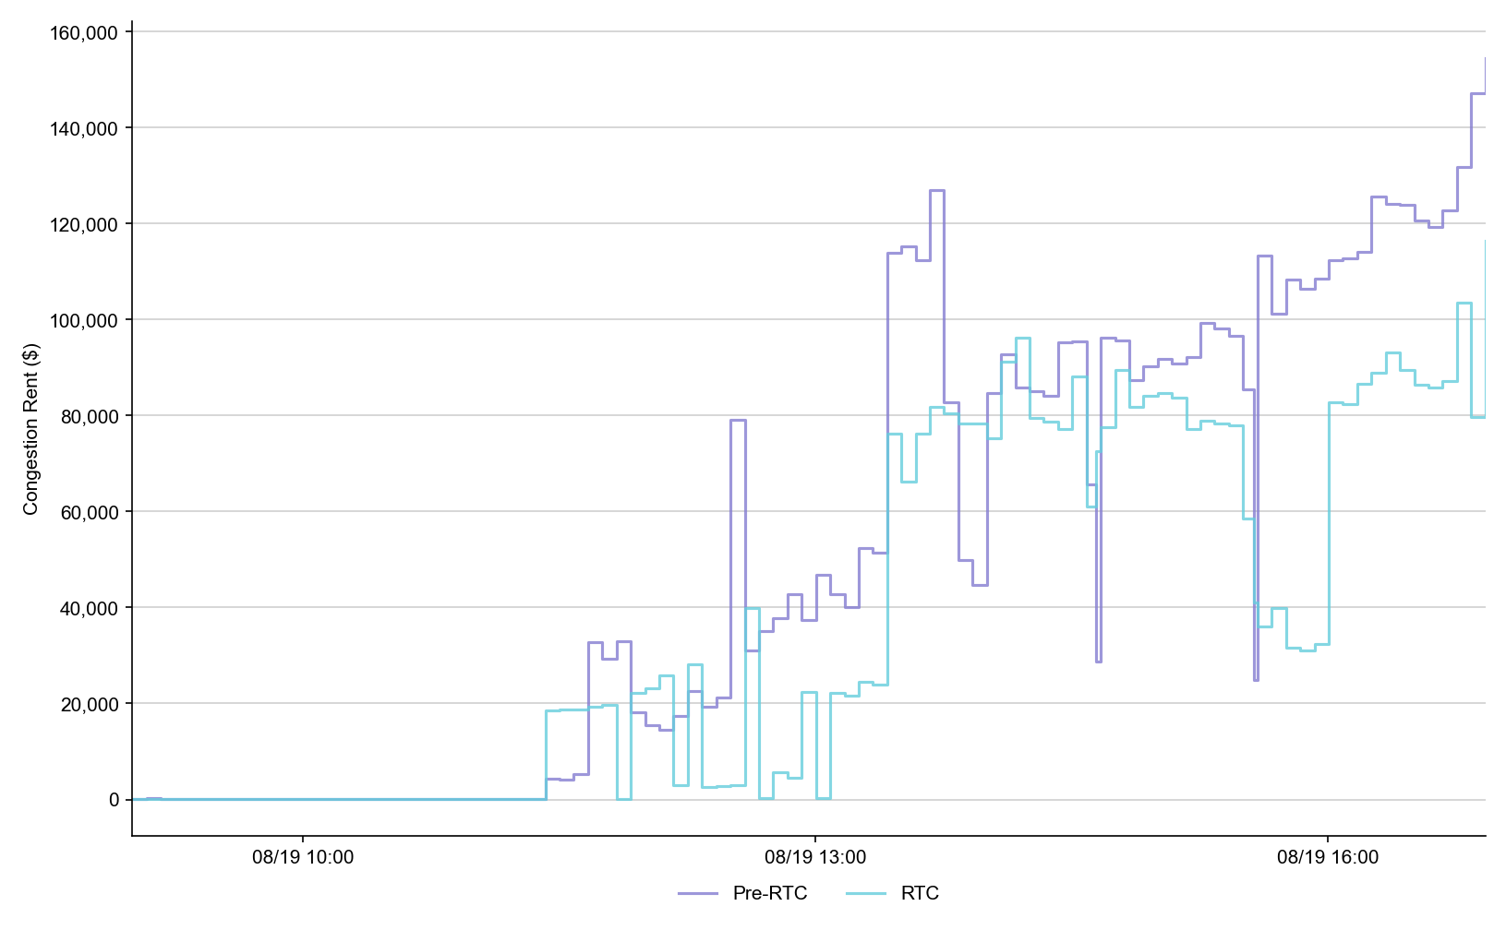
Congestion Rent

Slide 24
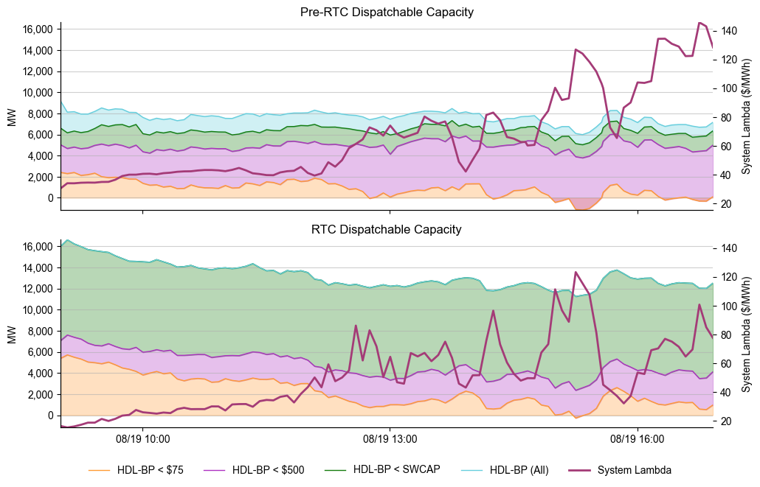
Dispatchable Capacity

Slide 25
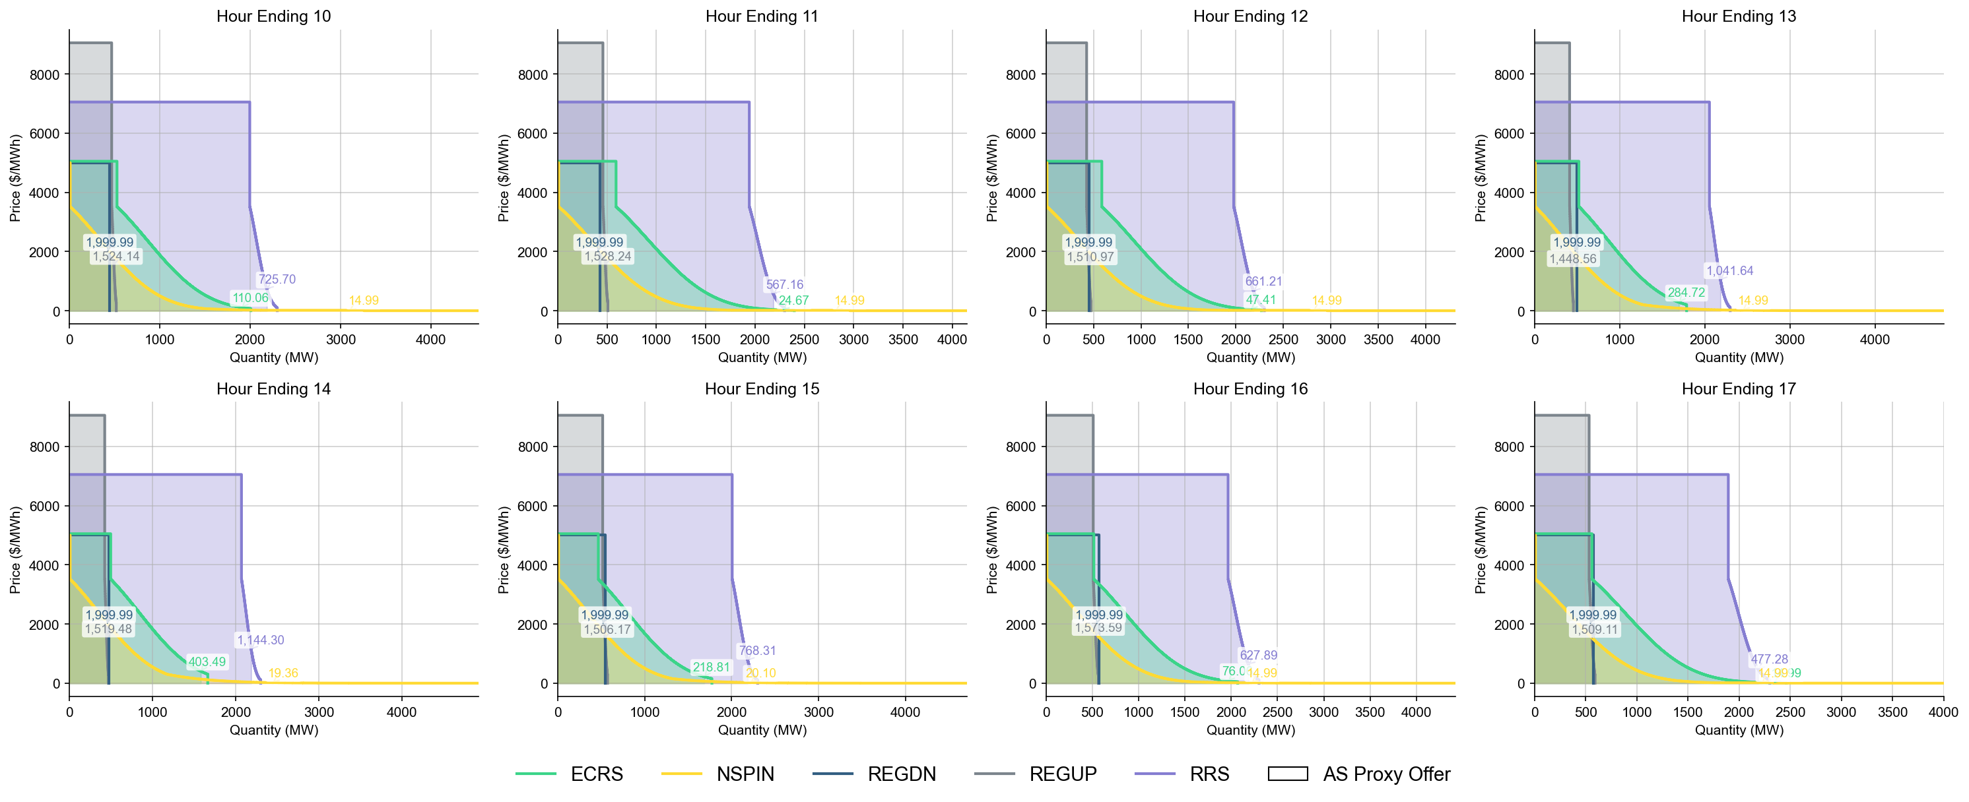
Ancillary Service Demand Curves

Slide 26
Market Trials OD Summary
08-21-2025 (9am – 5pm)

Slide 27
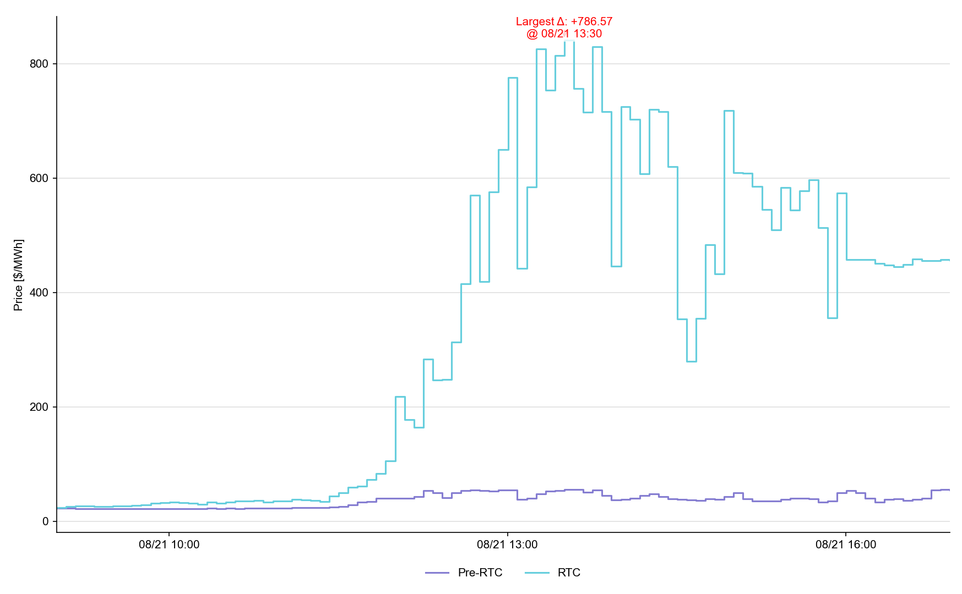
System Lambda (plus Adders)

Slide 28
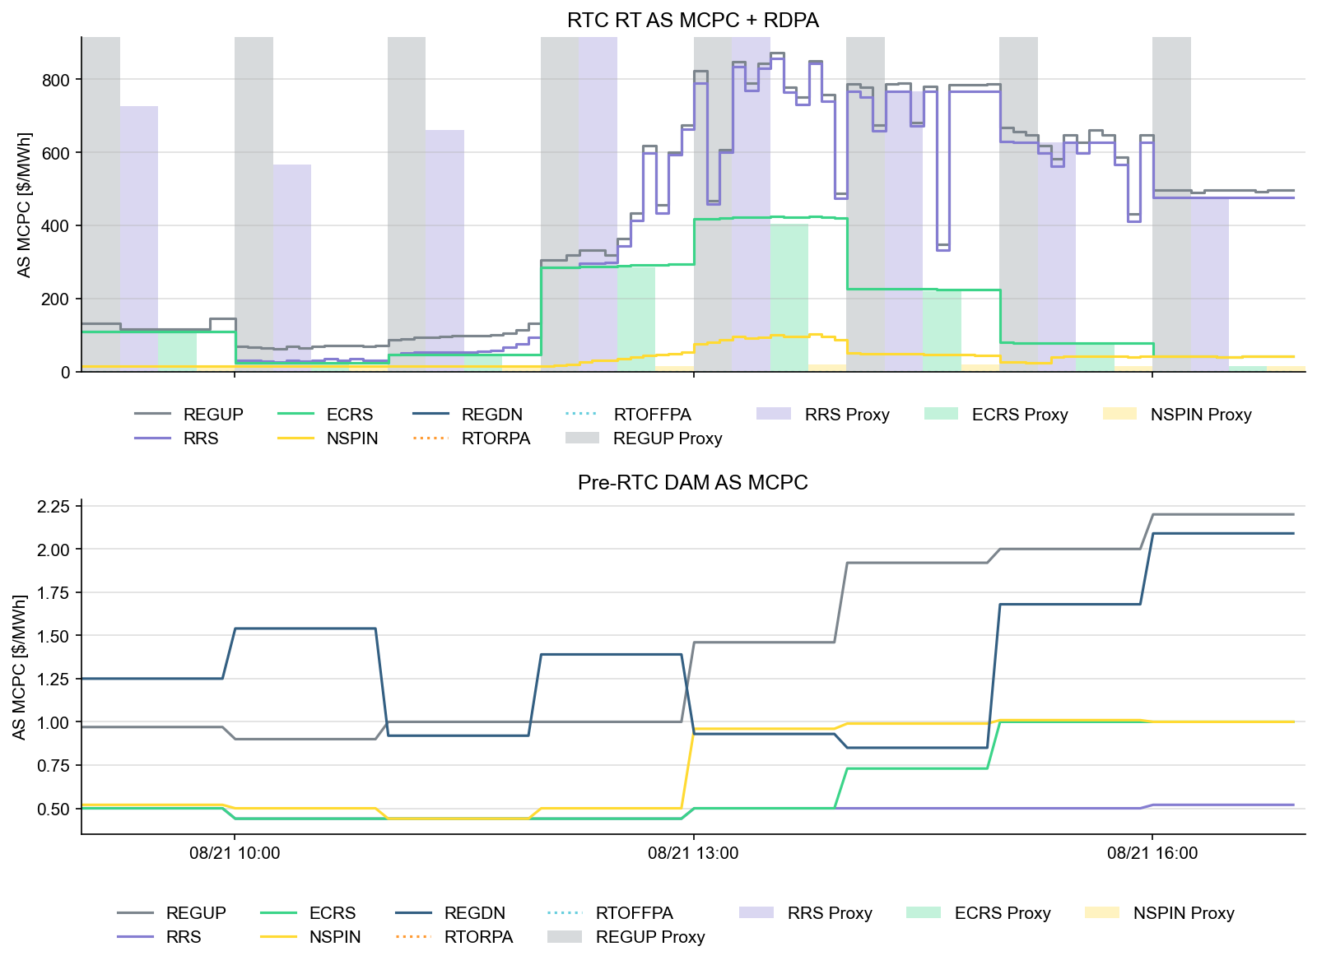
Ancillary Service Prices

Slide 29
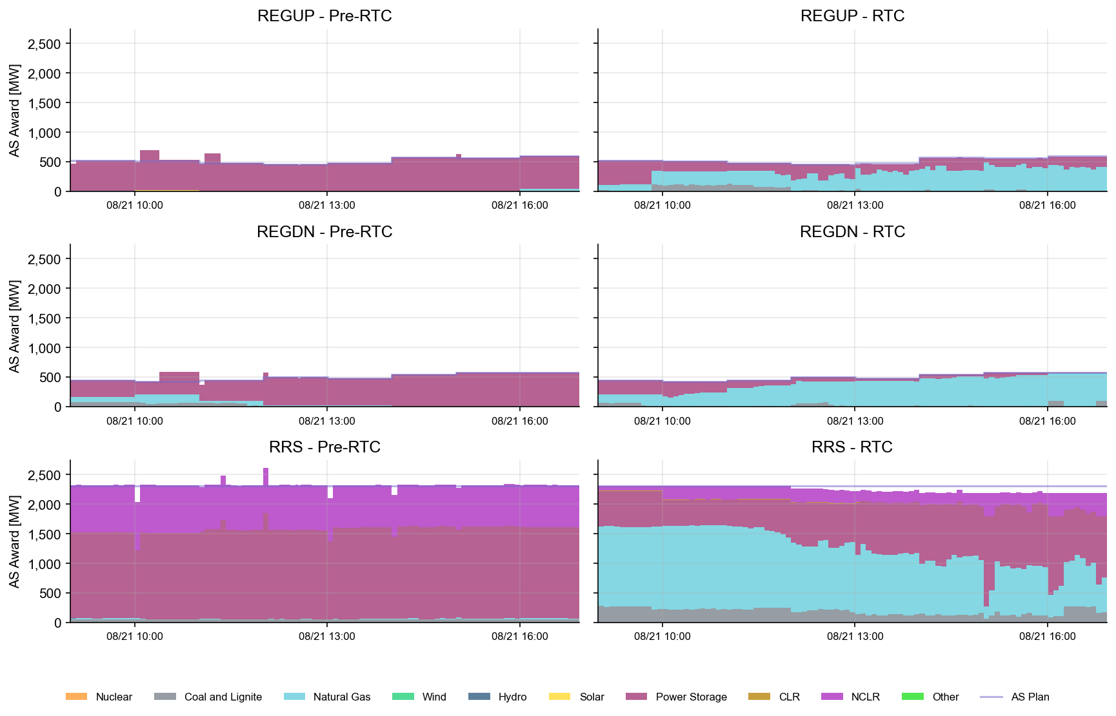
AS Awards* by Resource Type
* Pre-RTC (RTM AS Schedule)

Slide 30
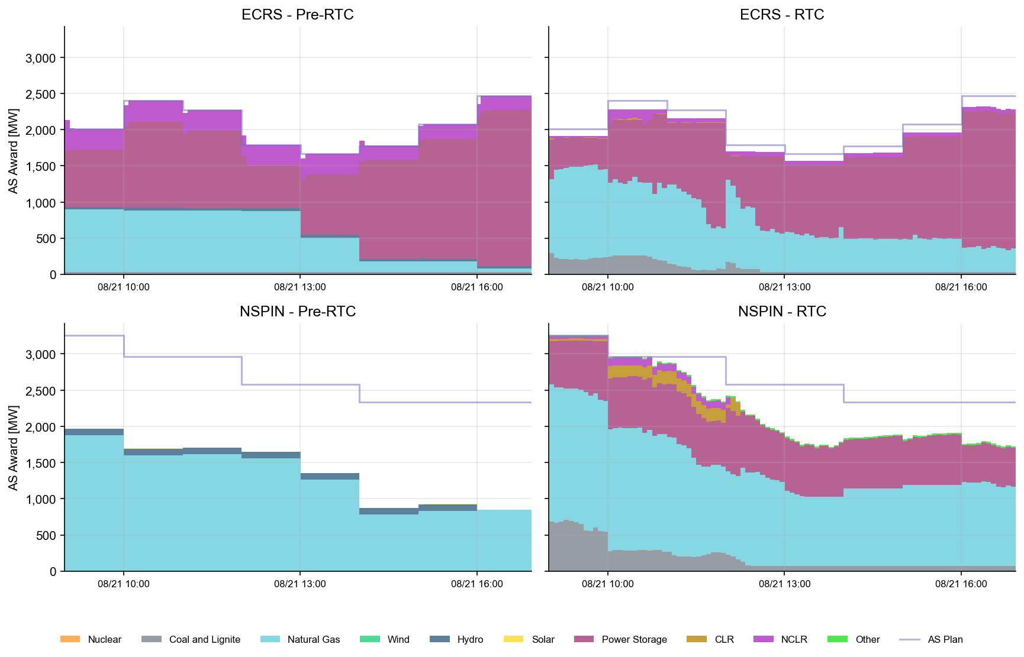
AS Awards* by Resource Type
* Pre-RTC (RTM AS Schedule)

Slide 31
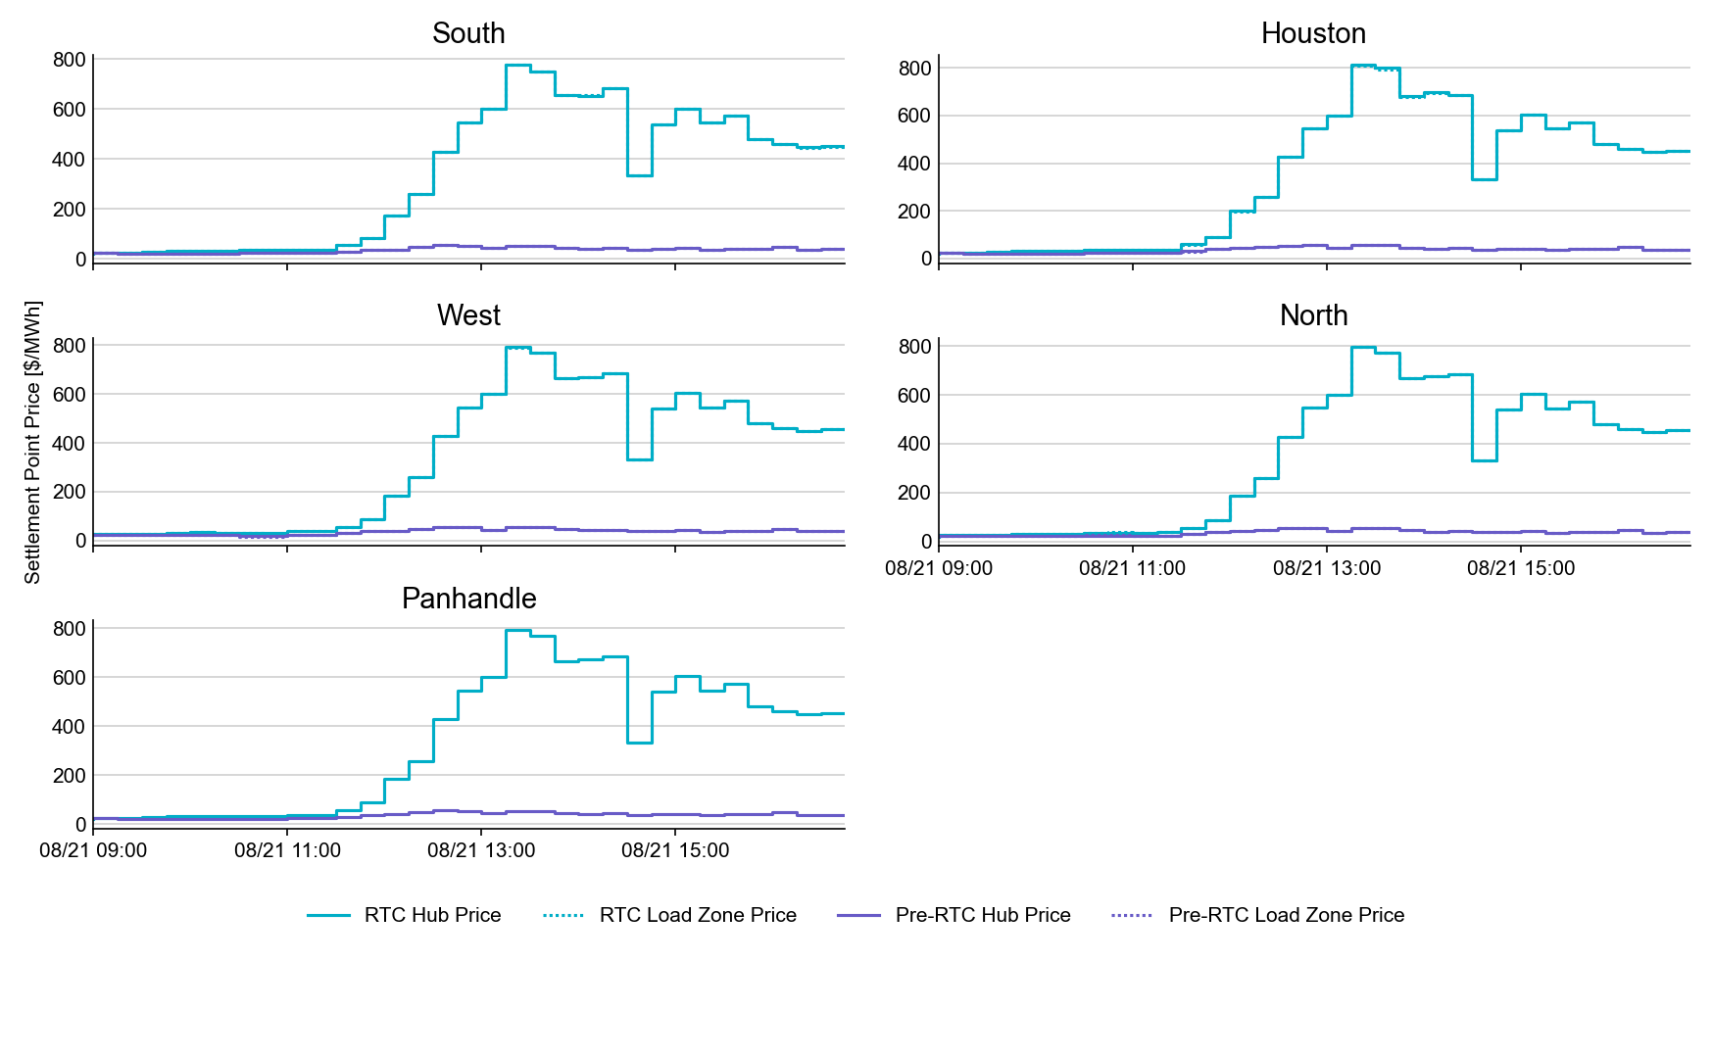
SPP by Hub and Competitive Load Zone

Slide 32
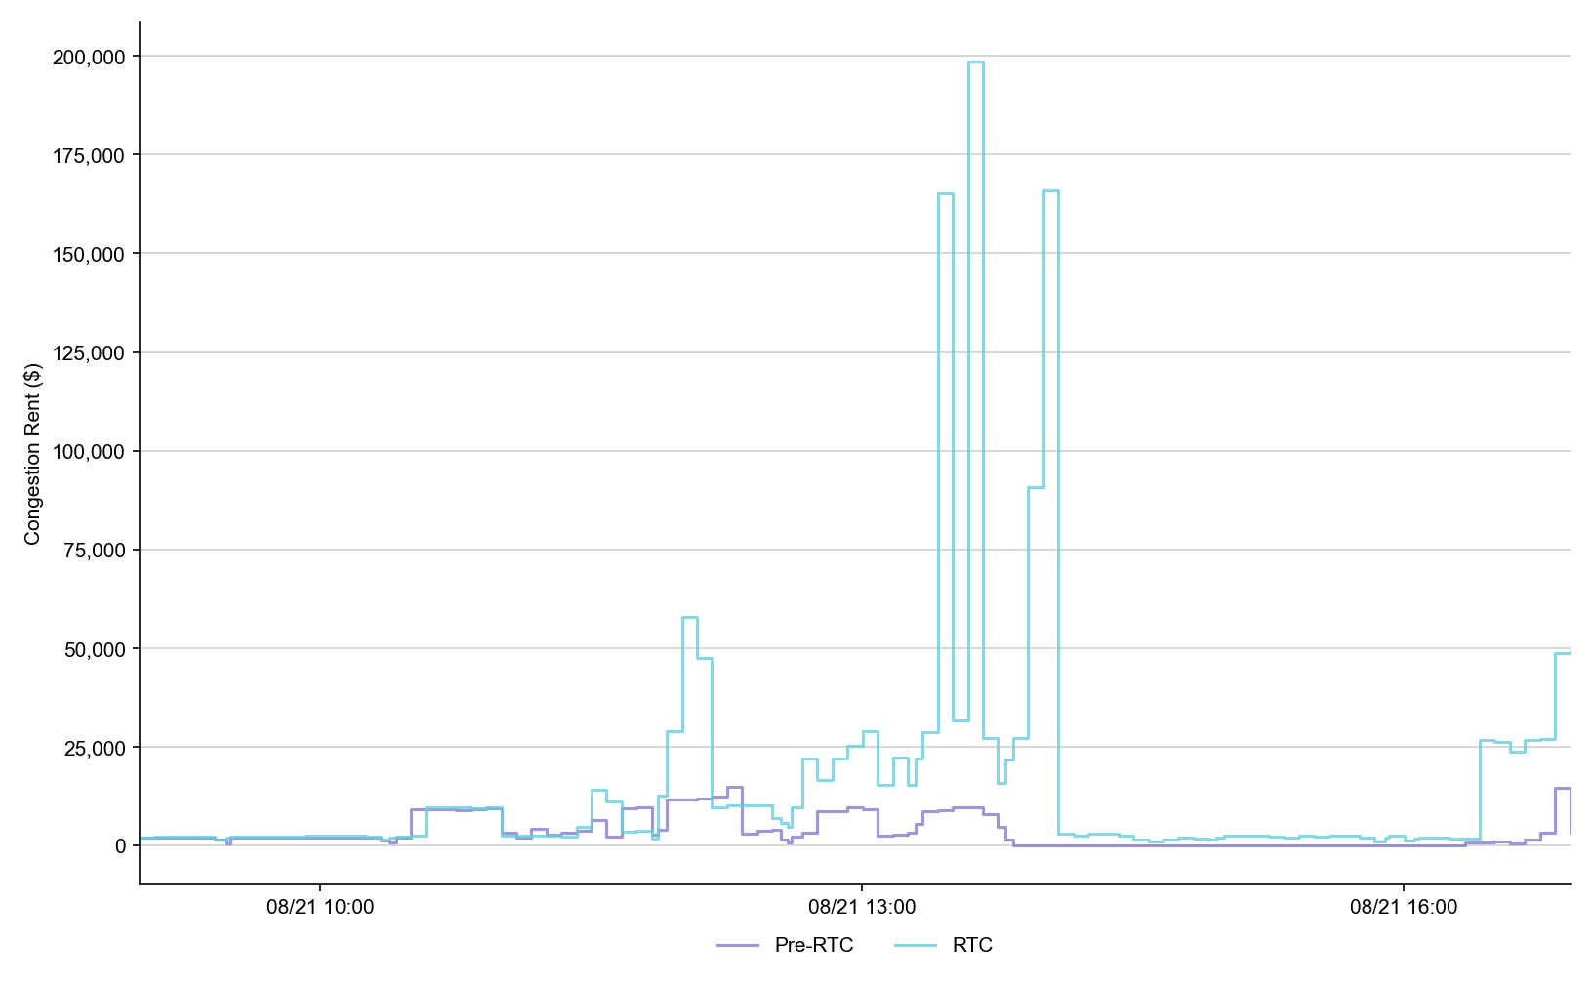
Congestion Rent

Slide 33
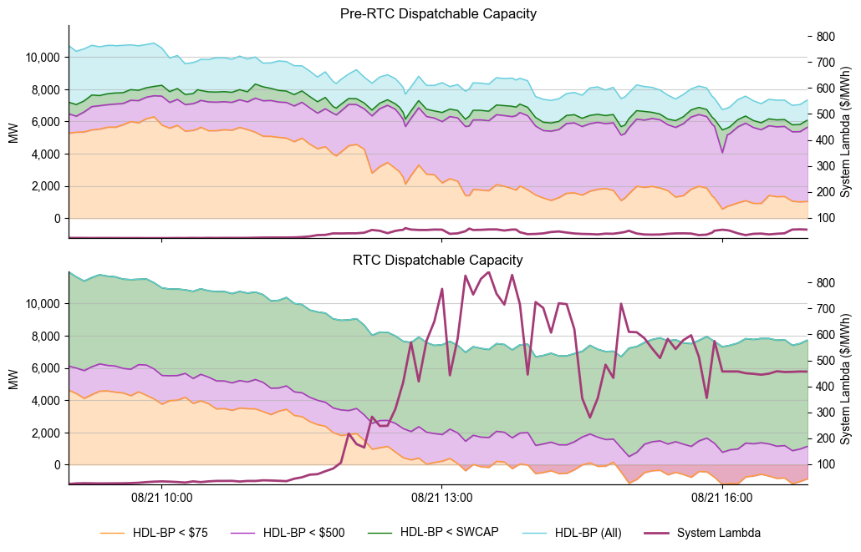
Dispatchable Capacity

Slide 34
Ancillary Service Demand Curves

Slide 35
Market Trials Calendar and Transition to September
We are here….

Slide 36
IMPORTANT- Market Trials Transition to September
This week Aug 25-29
  ERCOT continues outreach on Telemetry
  ERCOT initiating outreach on Market Submissions
  Although near 90+% on both items, need to improve alignment for SCED
    Example: good market submission may be unawarded due to telemetry (and vice versa)
  Observations:
    QSEs need to at least offer AS being carried in production
    In longer-term, QSEs need to offer full/qualified capability (expected in protocols, otherwise Proxy Offers)
    NCLRs need to telemeter Self-Provision = 0 (no DAM AS positions)
Next week and into September 3-11
  Support increase: QSEs being required for submission for all hours of highlighted Operating Days for September 3-5,8-11
  Offers Required: QSEs being required to adhere to offers per LFC Handbook 5
    Energy offers match production
    AS Offers should be offered at $0 if responsible in current production, remaining AS offer at $2,000
    If QSE has issues ahead of LFC test, QSE may consider not offering that AS in DAM ahead of LFC day
    Deeper dive next week Market Trials call
  After successful Sept 11 LFC Test, pivot to initial DAM Testing and Self-Provision capabilities

Slide 37
Wrap-Up and Questions
Reminder of Market Notice Attestations due this Wednesday Aug 27:
See Appendix for more information on readiness for LFC Test
Go/No-Go decision for LFC Test and Market Notice on Friday Aug 29:
Calendar Reminder:
Next Market Call TUESDAY Sept 2 (after Labor Day)
LFC Workshop #3 TBD- likely Thursday Sep 4 (will send market notice)
Remainder of meeting for Q&A
Can always email the RTC+B Program mailbox: RTCB@ercot.com

Slide 38
APPENDIX- Supporting Materials
Attestation Market Notice
Telemetry Screening
New RTC Pricing Reports location
NPRR1290 Validation Changes
Links to Handbooks
Prior Scorecards
FAQ Updated 8/8/2025
Connectivity and Configuration (digital certs)

Slide 39
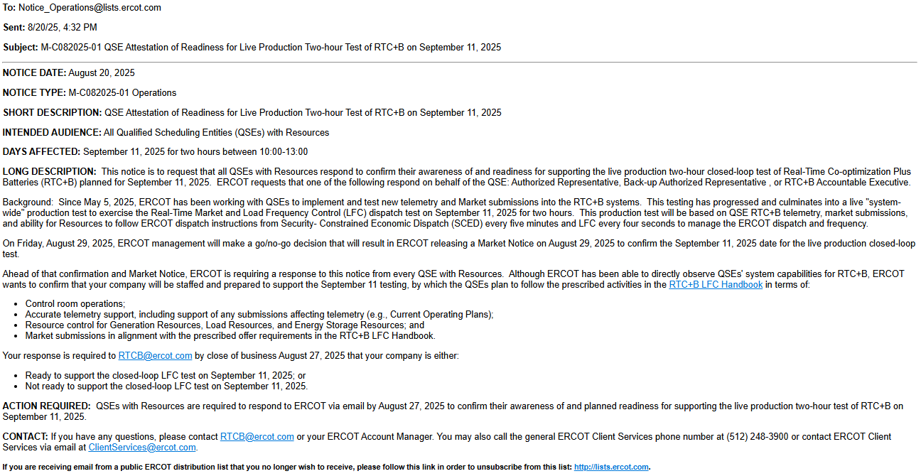
Attestation Market Notice

Slide 40

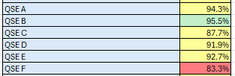
Telemetry Screening for Scorecard 3B for Handbook 3
Acceptable Telemetry Point values received by ERCOT for active resources.
Scoring:
Key points for Telemetry scorecard check
  Device types checked - Units, CLRs, NCLRs, ESRs for each QSE
  RTCB Telemetry status should be “Good” quality
  RTCB Units / CLRs / NCLRs Telemetry values should be within “Expected Range” or an expected value. Details are provided in next few slides.
  Expected values are derived from equivalent analogs in current production, based on defined criteria.
  RTCB ESR telemetry values are checked against corresponding combo model Battery Unit / CLR counterparts in production.

Slide 41
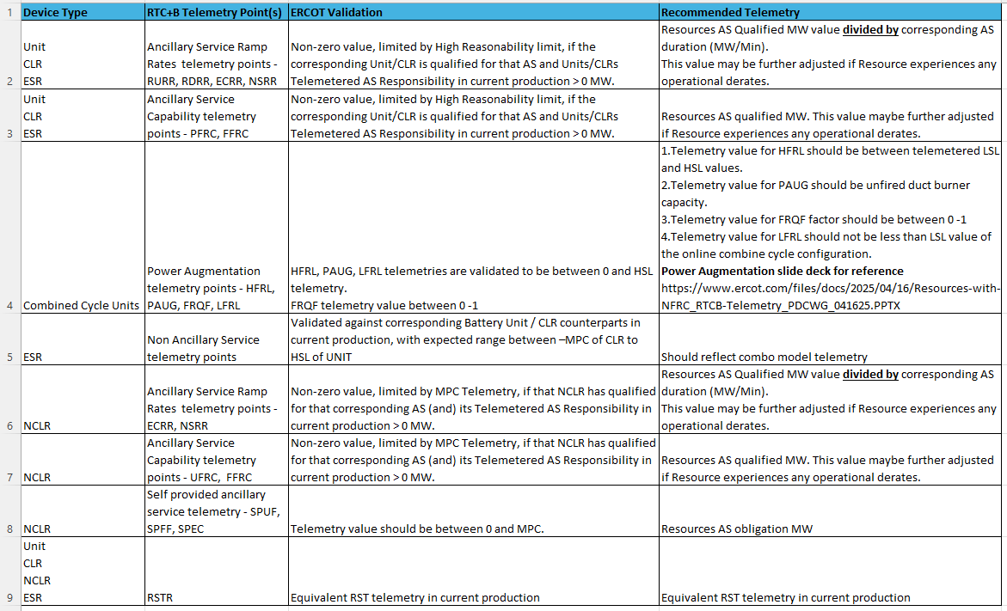
RTC+B Telemetry points screening/validation

Slide 42
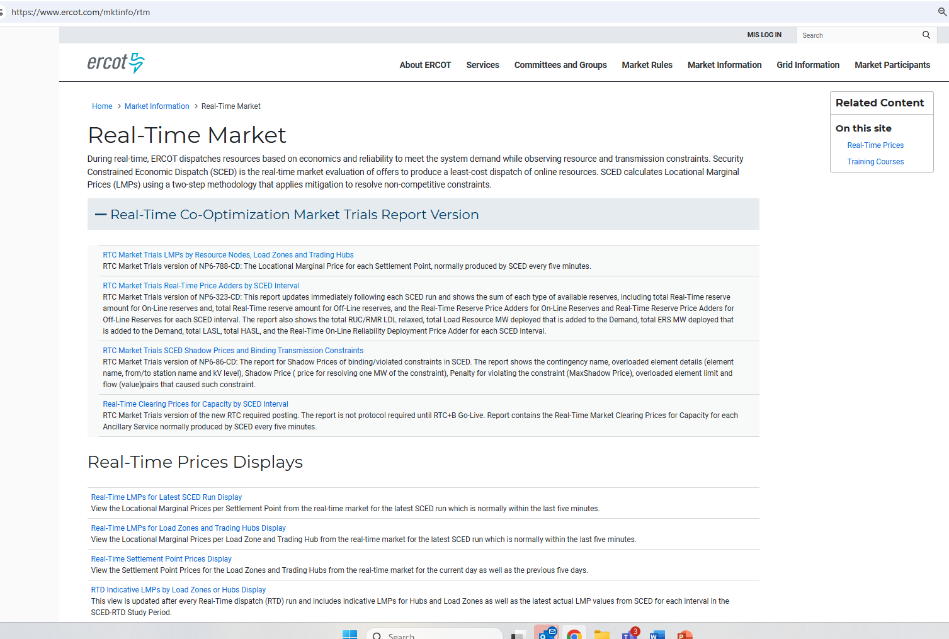
RTC+B New Reports Posted to the ERCOT Website
Links to the available RTC+B versions of Real-Time reports posted on Real-Time Market Information page.

Slide 43
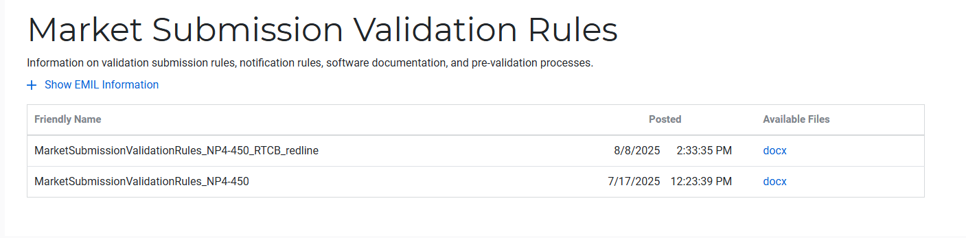
Submission validation update - PROD vs RTC+B
NPRR1290 :
  cleaned up protocol language around submitting offer curves and bid curves
  disallows having more than 2 price/quantity points in a flat/vertical segment of the curve.
Impacts to QSEs during dual-submission – some submissions accepted in Production will be rejected in Market Trials environment:
RTM Energy bids – protocol requiring “increasing quantities” now enforced.
  Reverted this change to validation. Further discussion highlighted protocol should be brought in line to long-standing practice, not validation.
  Example: Bid with Q1=0mw, Q2=10mw, Q3=10mw will be rejected as Q3 does not increase from Q2.
TPO & RTM Bid – more than 2 price/quantity pairs with same price or quantity will be rejected
Market Submission Validation
Rules document updated.

Slide 44
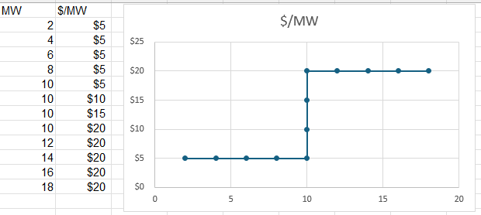
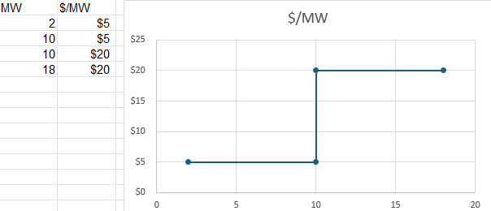
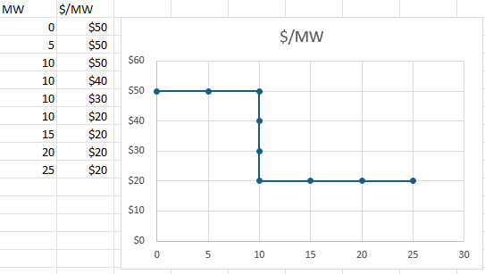
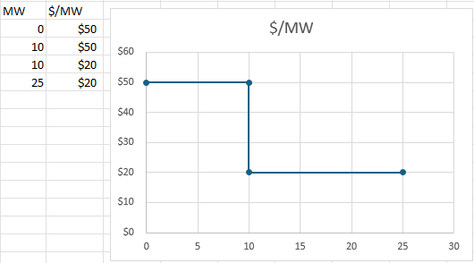
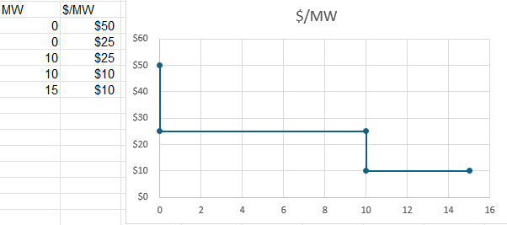
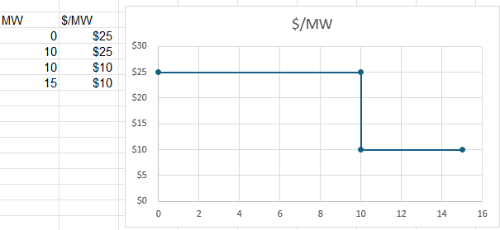
Submission validation update - PROD vs RTC+B
TPO – EB/OC - EOC
RTM EB
RTM EB

Slide 45
Market Trials Framework:
TAC Approved the Market Trials Plan in October 2024
Discussions with RTC+B Task Force have shaped the Handbooks
Handbook #1- QSE Submission Testing
Handbook #2- QSE Telemetry Tests
Handbook #3- Open Loop SCED
Handbook #4- QSE Telemetry Tests
Handbook #5- Close-Loop LFC Tests
Handbook #6- Day-Ahead Market Tests
All are posted on the
RTCBTF Homepage
under Market Trials banner

Slide 46
Market Trials Technical Details
Detailed discussions with TWG have provided technical content details
Digital Certificate details
Connectivity/URL details to User Interfaces and APIs
Reminder of how to submit new ICCP requests
RTC and Production Telemetry connectivity
Network Model Load Schedule
All are posted on the
RTCBTF Homepage
under Technical Details banner

Slide 47
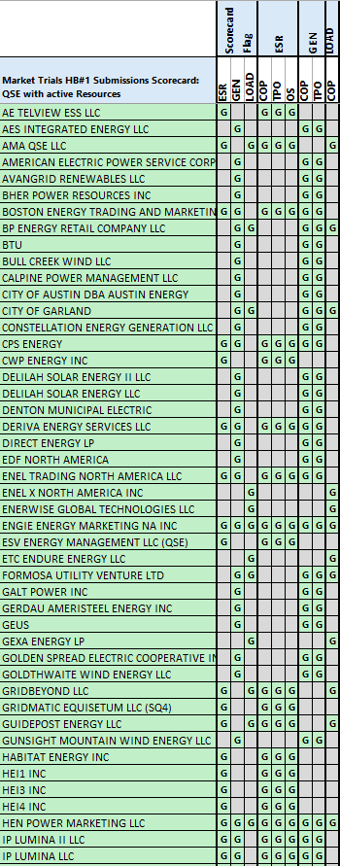
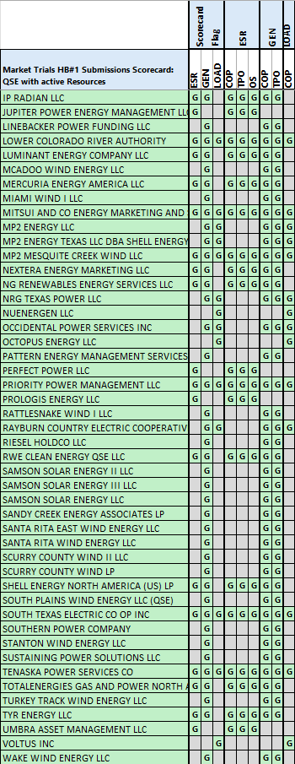
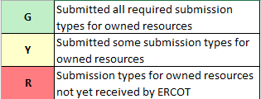
Scorecard 1 for
Handbook 1-
Market submissions:
7/3 Scores for QSEs with Resources – successful submissions for resource types specified in Handbook 1
Scoring: Complete
Complete

Slide 48
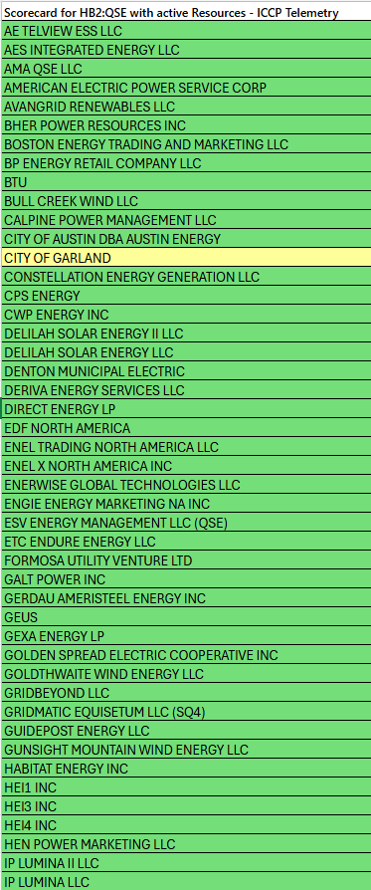
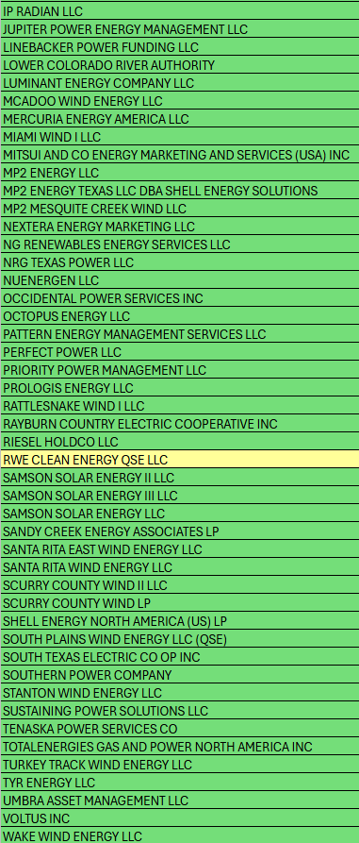
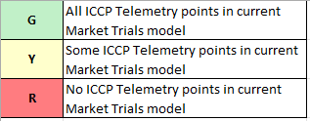
Scorecard 2A for
Handbook 2-
100% of ICCP Telemetry points added by QSE:
7/21 Scores for QSE with Resources - ICCP Telemetry points added in current model.
99.5% of 26k points complete
Last points are identified and are being worked on.
Scoring:

Slide 49
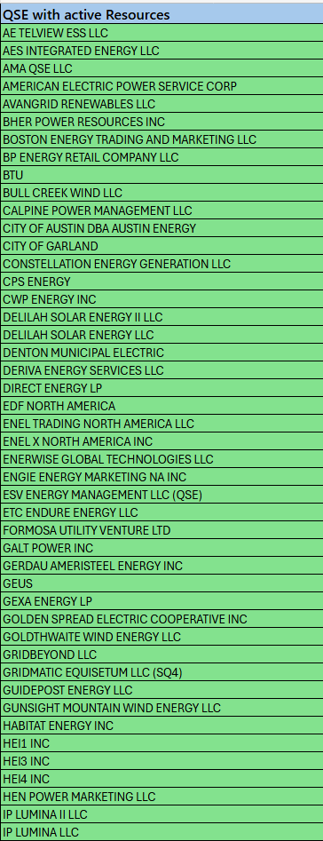
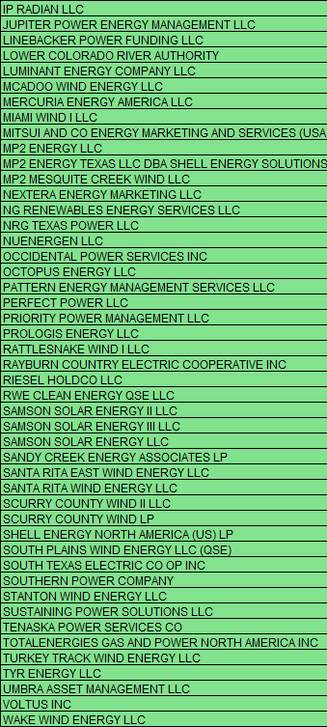
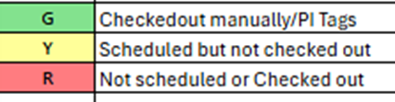
Scorecard 2B for
Handbook 2-
Telemetry checkout meetings completed with ERCOT staff for sample of live data transfer capability
Complete
7/3 Scores for QSEs with Resources – Scheduling Check-out and Check-out complete
Scoring: Complete

Slide 50
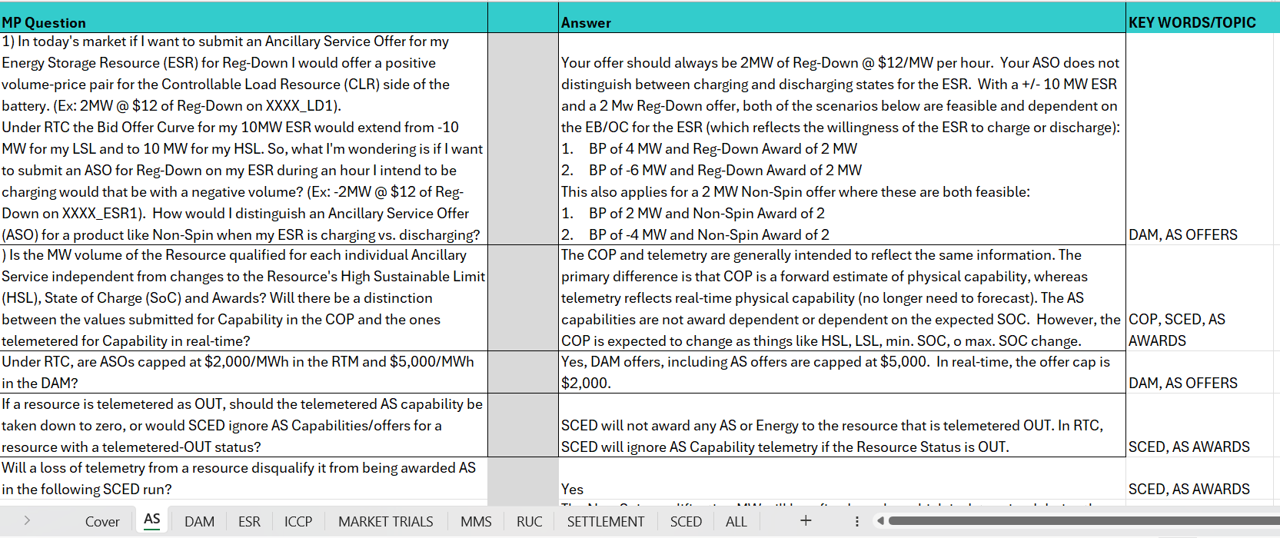
Reminder of RTC+B FAQ (updated 7/28/2025)
Posted on RTCBTF Home Page under Key Documents
Common questions/responses in Excel Workbook (target weekly updates)
Search workbook for Key Words
Worksheets for categories

Slide 51
RTC+B Market Submissions - Systems configurations
Start
03/2025
Start
05/2025
Start
07/2025
Start
09/2025
Go-Live
12/5/25*
Feb 2025
Mar 2025
Apr 2025
May 2025
June 2025
July 2025
Aug 2025
Sep 2025
Oct 2025
Nov 2025
Dec 2025
Optional: RTC QSE/Vendor Developer
Submission Testing
RTC QSE
Submission Testing
Open-loop
RTC SCED
Ongoing Open-Loop
& Periodic Closed-loop SCED/LFC
Certificate: Current MOTE
Env: ERCOT RTC Market Trial
URL: RTC MIS MOTE URL
Certificate: Current Production
Env: ERCOT RTC Market Trial
URL: RTC MIS Market Trial
Cert: Production
Env: Prod
URL: MIS Prod
QSE/Vendor developer can use MOTE certificates & RTC MIS MOTE API URL to test the submissions until end of submission testing phase (end of June) as needed. At the start of the Open Loop testing, RTC MOTE MIS URLs will be disabled.
URL links: RTC MOTE and Market Trial URL links to be used for MMSUI, OSUI and API submissions. Actual links are provided in next slide.
For notifications/responses to MPs from RTC Market Trials environment, MP will need to provide the listener URL to ERCOT

Slide 52
RTC+B Market Submissions - Systems configurations
(Updated with URLs)
RTC+B Market Trials and Go-live
RTC Phase | Digital Certificate | MMSUI / OSUI URL | API / WAN URL
Vendor/QSE Submissions Testing | Current MOTE | RTC MOTE MIS URLs https://testmarkettrials.ercot.com/mmsui/mmsui/displayTradesLanding.action https://testmarkettrials.ercot.com/osrui/osrui/Summary.action | RTC MOTE API/WAN URL https://testmarkettrialsapi.ercot.com/NodalAPI/EWS/ https://testmarkettrialsapi.wan.ercot.com/NodalAPI/EWS/
Open Loop and Closed Loop Testing | Current Production | RTC Market Trial URL https://markettrials.ercot.com/mmsui/mmsui/displayTradesLanding.action https://markettrials.ercot.com/osrui/osrui/Summary.action | RTC Market Trial API/WAN URL https://markettrialsapi.ercot.com/NodalAPI/EWS/ https://markettrialsapi.wan.ercot.com/NodalAPI/EWS/
From RTC Go-live onwards | Current Production | Current Prod MIS URL mis.ercot.com/mmsui mis.ercot.com/osui | New Production API/WAN URL

Slide 53

RTC+B Market Submissions - Systems configurations
Public Key Update for WAN/API submissions
For API/WAN submissions into Market Trials environments, need to download public keys and place into the keystore location in system being used for RTC+B submissions.
No change to digital user certificates – continue to use existing MOTE and Production Certificates
Market Trial API Public key location: https://www.ercot.com/services/mdt/webservices

