Slide 1
Reliability Assessment Preparation Update
Supply Analysis Working Group
Resource Adequacy Department
August 22, 2025

Slide 2
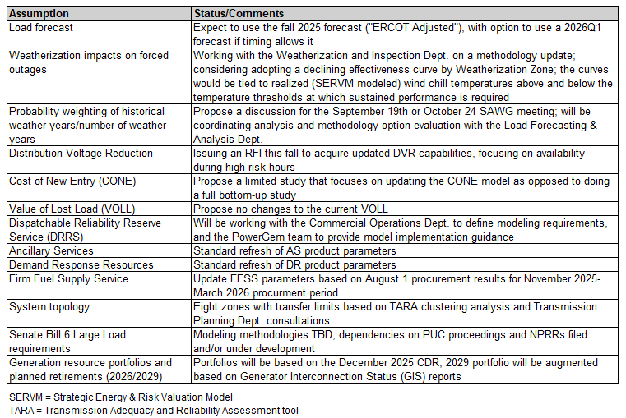
Reliability Assessment Assumption Status
  Table at right is not intended to cover all assumptions that may be documented in ERCOT’s Assumptions filing

