Slide 1
RIOO Updates
Ashwini Patlola
August 20, 2025

Slide 2
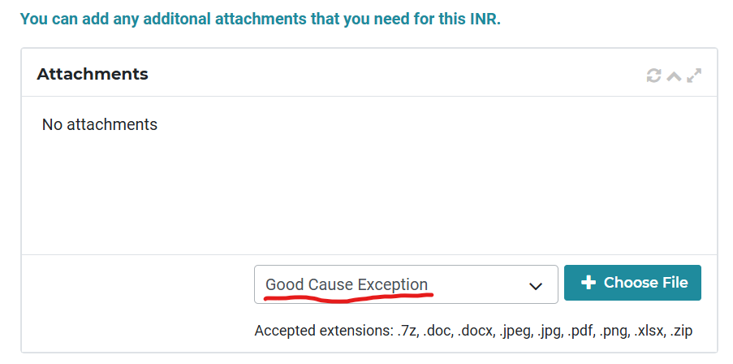
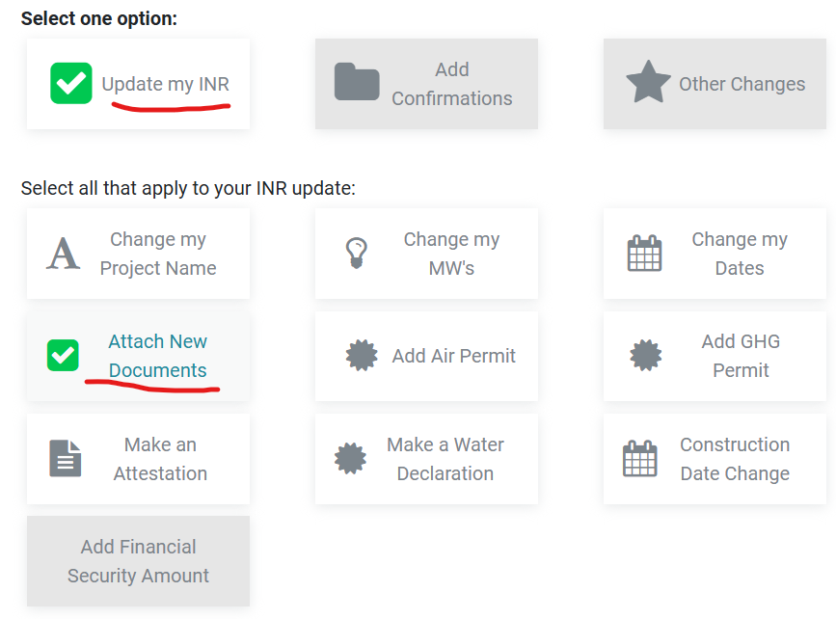
RIOO Updates
  RIOO-IS: A new file type “Good Cause Exception” is added to INR change request workflow where User can attach this file type and submit a change request to ERCOT
  This update in RIOO has been released to PROD environment end of July 2025

Slide 3
RIOO Updates
RIOO-IS: A new Fuel and Tech type combination will be available in RIOO to allow Market to create a Combined Cycle plant that will use Hydrogen as a Fuel Type and Combined-Cycle as Tech Type
Estimated PROD release date for this update in RIOO is end of October 2025

Slide 4
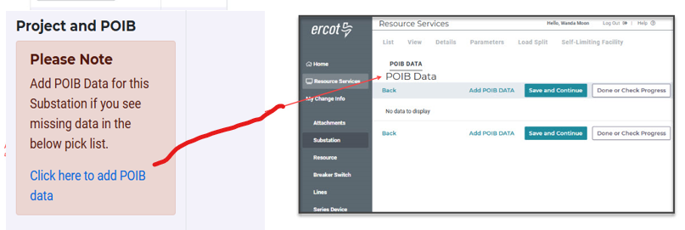
RIOO Updates
RIOO-RS: Link will be available on the Unit details panel for User to easily navigate to POIB panel to add POIB data if/as needed
Estimated PROD release date for this update in RIOO is end of October 2025

