Slide 1
Recent Generation Interconnection Project Trends
Supply Analysis Working Group
Resource Adequacy Department
August 22, 2025

Slide 2
Interconnection Trend: Project Synchronized & Cancellations
Key Takeaway: The capacity ratio of project cancellations to synchronized projects has converged to typical historical levels after anomalous April and May cancellation activity; longer term, cancellation activity has trended upwards.
Notes:
As of October 1, 2023

Slide 3
Interconnection Queue Project Trends by Phase of Study: BESS
*Project Counts above bars
Key Takeaways: Relative to the December 2024 snapshot, the years with the highest expected in-service BESS capacity has shifted from 2026-27 to 2027-28 for projects without IAs; for projects with signed IAs, significantly more in-service capacity is expected for 2027.

Slide 4
Interconnection Queue Project Trends by Phase of Study: Solar
Key Takeaways: Solar continues steady growth with an increase for newer projects relative to year-end 2024 expectations. There is an acceleration of project completions to 2027 for projects with signed IA, which might be influenced by compressed construction/in-service deadlines for tax credit qualification.

Slide 5
Interconnection Queue Project Trends by Phase of Study: Wind
Key Takeaway: Wind continues steady growth with an increase in counts and capacity for projects without signed IAs relative to year-end 2024 expectations; for projects with signed IAs, the number and capacity of expected in-service projects experiences sharp growth during 2027.

Slide 6
Interconnection Queue Project Trends by Phase of Study: Gas
Key Takeaway: Relative to the December 2024 snapshot, projects without signed IAs have increased in numbers and capacity—particularly during 2028; for projects with signed IAs, there is more capacity expected to be in service during 2026 and 2027

Slide 7
Assumptions for Success Rates and Development Cycle Analysis
Analysis based on queue data snapshot from 8/1/25
To account for the development cycle of generation projects, the success rate statistics in this analysis were limited to projects requested between 2002 and 2021 into the ERCOT queue
Successful projects are defined as a planned generation projects that have become operational resources (received Commercial Operations Approval or Synchronization Approval from ERCOT)
Due to Protocol confidentiality provisions, only those projects for which a Full Interconnection Study (FIS) has been requested are included in this dataset
  Consistent with monthly Generator Interconnection Status Report (GIS)
These statistics do not account for delays to expected in-service dates (Projected Commercial Operations Dates)
Wind repowers, thermal upgrade projects were excluded from this dataset due to having different interconnection milestone requirements compared to new Generation Resource (GR) projects

Slide 8
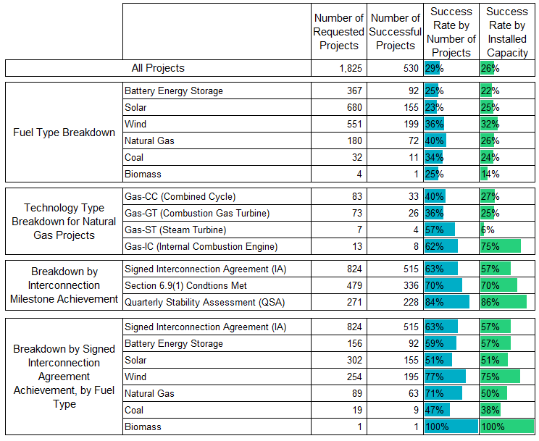
Success Rates of Planned Generation Projects in ERCOT queue
Key Takeaways:
Minimal changes to success rates listed in table after including 328 planned projects requested in 2021.
  179 Battery Energy Storage
  129 Solar
  10 Natural Gas
  9 Wind
  1 Biomass
29% of planned projects requested between 2002 and 2021 have been successful on a project count basis (26% on a capacity basis)
Notes:
Fuel Type Breakdowns for Nuclear, and Compressed Air Energy Storage requests since 2002 were not included in breakdown sections of tables due to lack of successful projects.

Slide 9
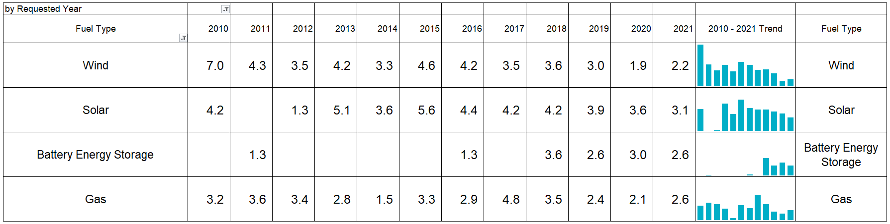
Development Cycle for Planned Projects:
Average Duration in Years for Successful Projects
(from Queue Request to ERCOT Commercial Operations or Synchronization Approval)
Notes:
There were several projects requested prior to 2014 that did not have recorded Commercial Operations or Synchronization Approval dates in queue database. Duration cycles for development for these projects could not be determined.
The Quarterly Stability Assessment (QSA) started in 2018 for planned projects.

Slide 10
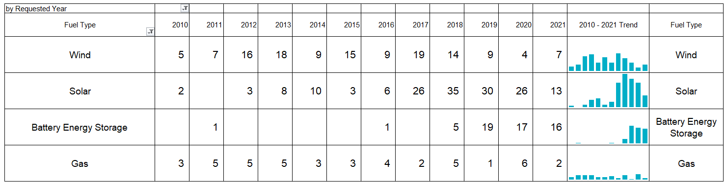
Development Cycle for Planned Projects:
Number of Successful Projects
(from Queue Request to ERCOT Commercial Operations or Synchronization Approval)
Notes:
There were several projects requested prior to 2014 that did not have recorded Commercial Operations or Synchronization Approval dates in queue database. Duration cycles for development for these projects could not be determined.
The Quarterly Stability Assessment (QSA) started in 2018 for planned projects.

Slide 11
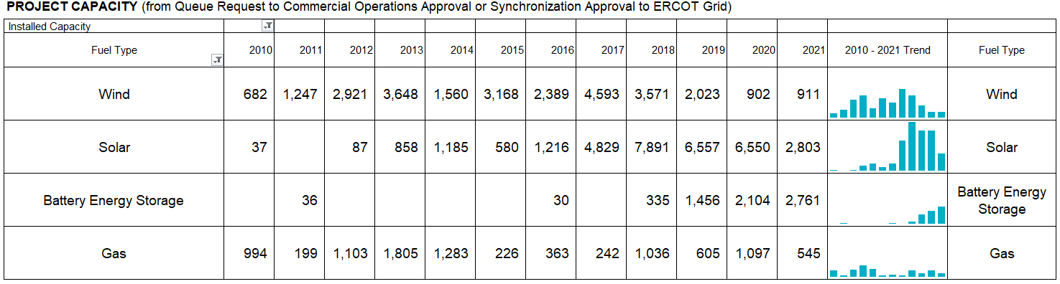
Development Cycle for Planned Projects:
Installed capacity (MW) of successful projects
(from Queue Request to ERCOT Commercial Operations or Synchronization Approval)
Notes:
There were several projects requested prior to 2014 that did not have recorded Commercial Operations or Synchronization Approval dates in queue database. Duration cycles for development for these projects could not be determined.
The Quarterly Stability Assessment (QSA) started in 2018 for planned projects.

Slide 12
Wrap-up
  Are there any other interconnection queue topics that would be useful for SAWG stakeholders?
  If you have any questions on this analysis or requests for additional research, sent them to the following email address with the following subject line item (SAWG analysis request)
    ResourceAdequacy@ercot.com

Slide 13
Appendix

Slide 14
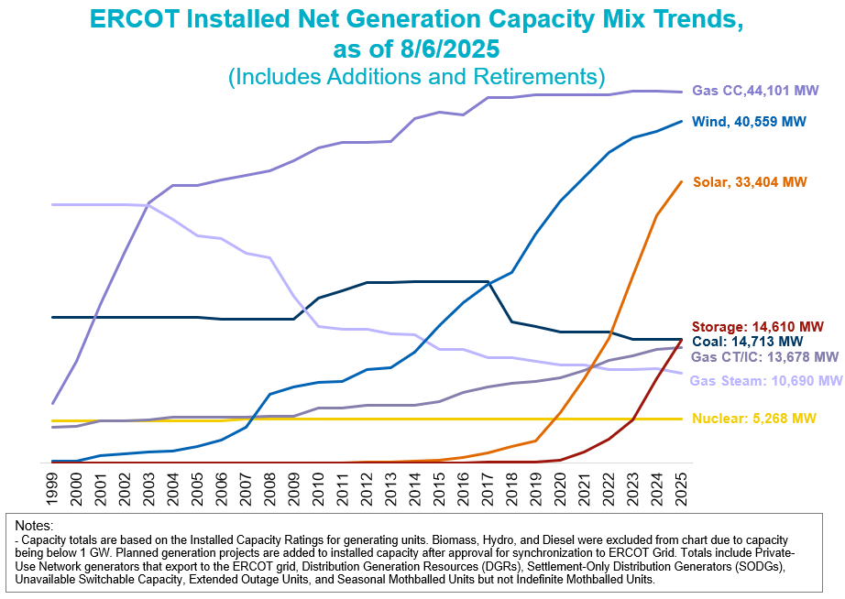

Slide 15
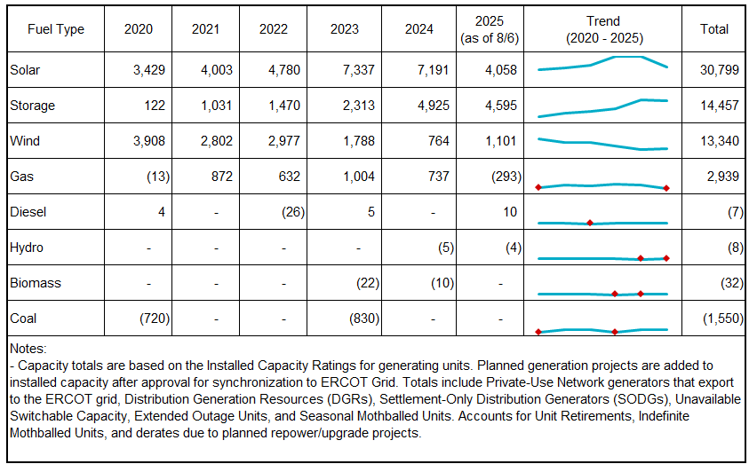
Annual Incremental Generation Capacity Changes by Fuel Type

Slide 16
Retirements in Last Three Years (2023-2025)
Unit Name | Unit Code | County | Fuel | Installed Capacity (MW) | Summer Capacity (MW) | Retirement Effective Year
DOW G37 | DOWGEN_DOW_G37 | BRAZORIA | GAS-GT | 83 | 61 | 7/4/2023
J T DEELY U2 | CALAVERS_JTD2 | BEXAR | COAL | 496 | 420 | 7/7/2023
J T DEELY U1 | CALAVERS_JTD1 | BEXAR | COAL | 507 | 420 | 7/7/2023
TOS BATTERY STORAGE (DGR) | TOSBATT_UNIT1 | HOWARD | STORAGE | 2 | 2 | 11/1/2024
CALENERGY-FALCON SEABOARD STG 3 | FLCNS_UNIT3 | HOWARD | GAS-GT | 62 | 62 | 1/8/2025
HOEFSROAD BESS | HRBESS_BESS | REEVES | STORAGE | 2.0 | 2.0 | 6/13/2025

