Slide 1
Probabilistic Reliability Model (SERVM) Project Status and Study Results
August 22, 2025

Slide 2
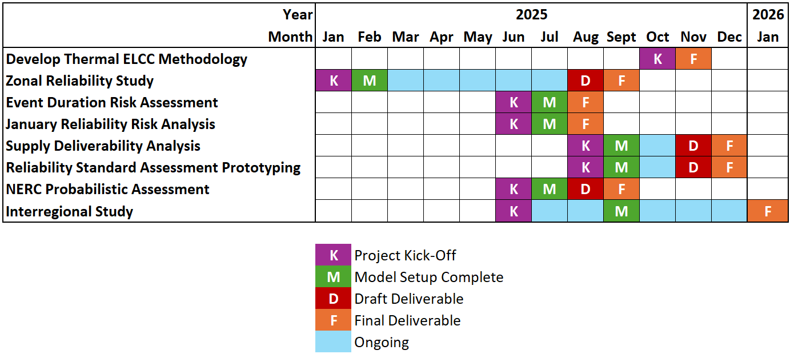
Updated Project Schedule

Slide 3
Event Duration Risk Assessment Project

Slide 4
Event Duration Risk Assessment
To begin an assessment of unit level event duration risk, the GADS data for the URI winter event was reviewed for event duration

Slide 5
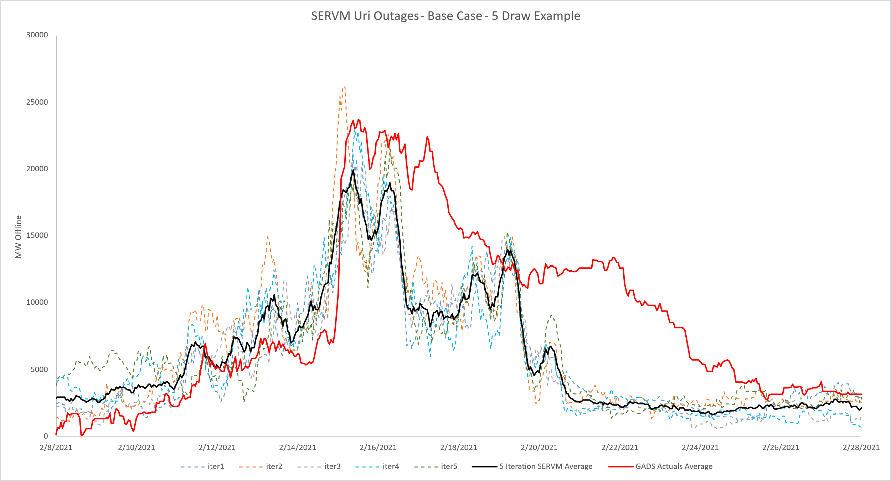
Model – History Alignment
While SERVM simulations are similar to GADS in magnitude the cold weather outages tend to end early, creating a disconnect from the gradual recovery seen in the historic data

Slide 6
Proposed Approach
Consistent with the GADS data, unit level weather outage distributions can sample Uri event data to incorporate tail events, bringing the calibration closer to historic performance.

Slide 7
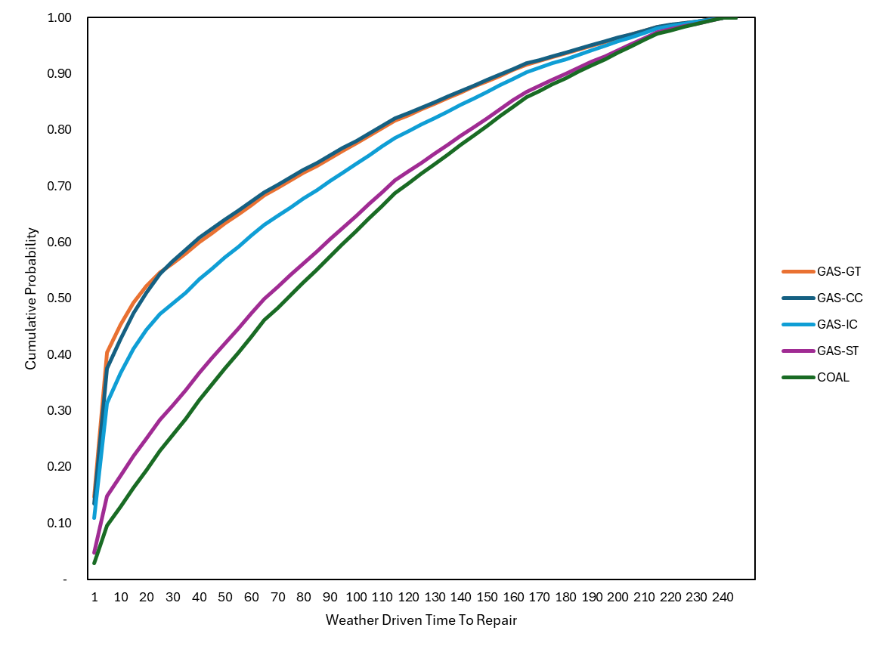
Distributions Assigned to Unit Level
Originally, SERVM assumed weather outages were uniformly 10 hours in duration (single point)
This distribution was broadened to 7 points, unique to each unit, by subsampling technology specific fits of the underlying GADS data

Slide 8
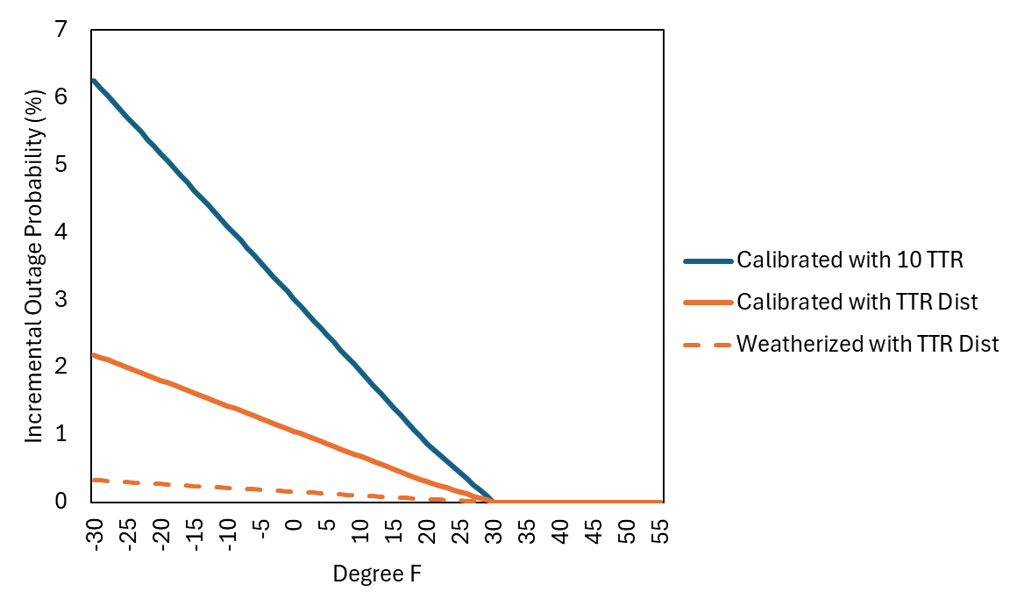
Calibration Steps
Outage Rate by Temp may be adjusted to better calibrate using 7 point distributions for TTR

Slide 9
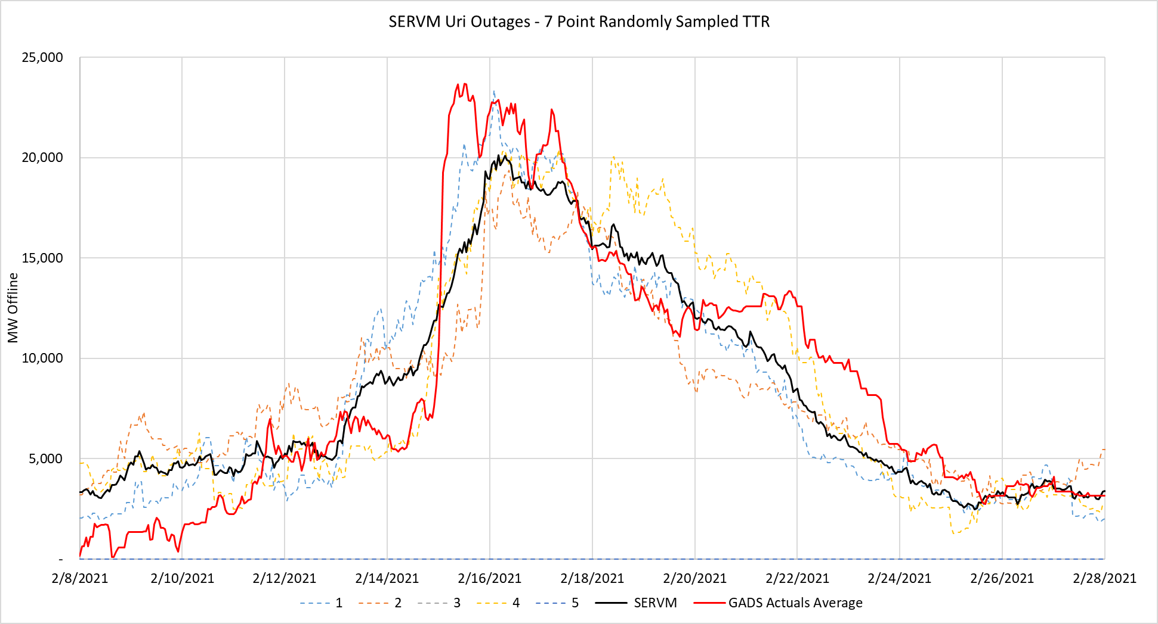
Results, Considerations
URI event falls generally in the range of iteration level outcomes

Slide 10
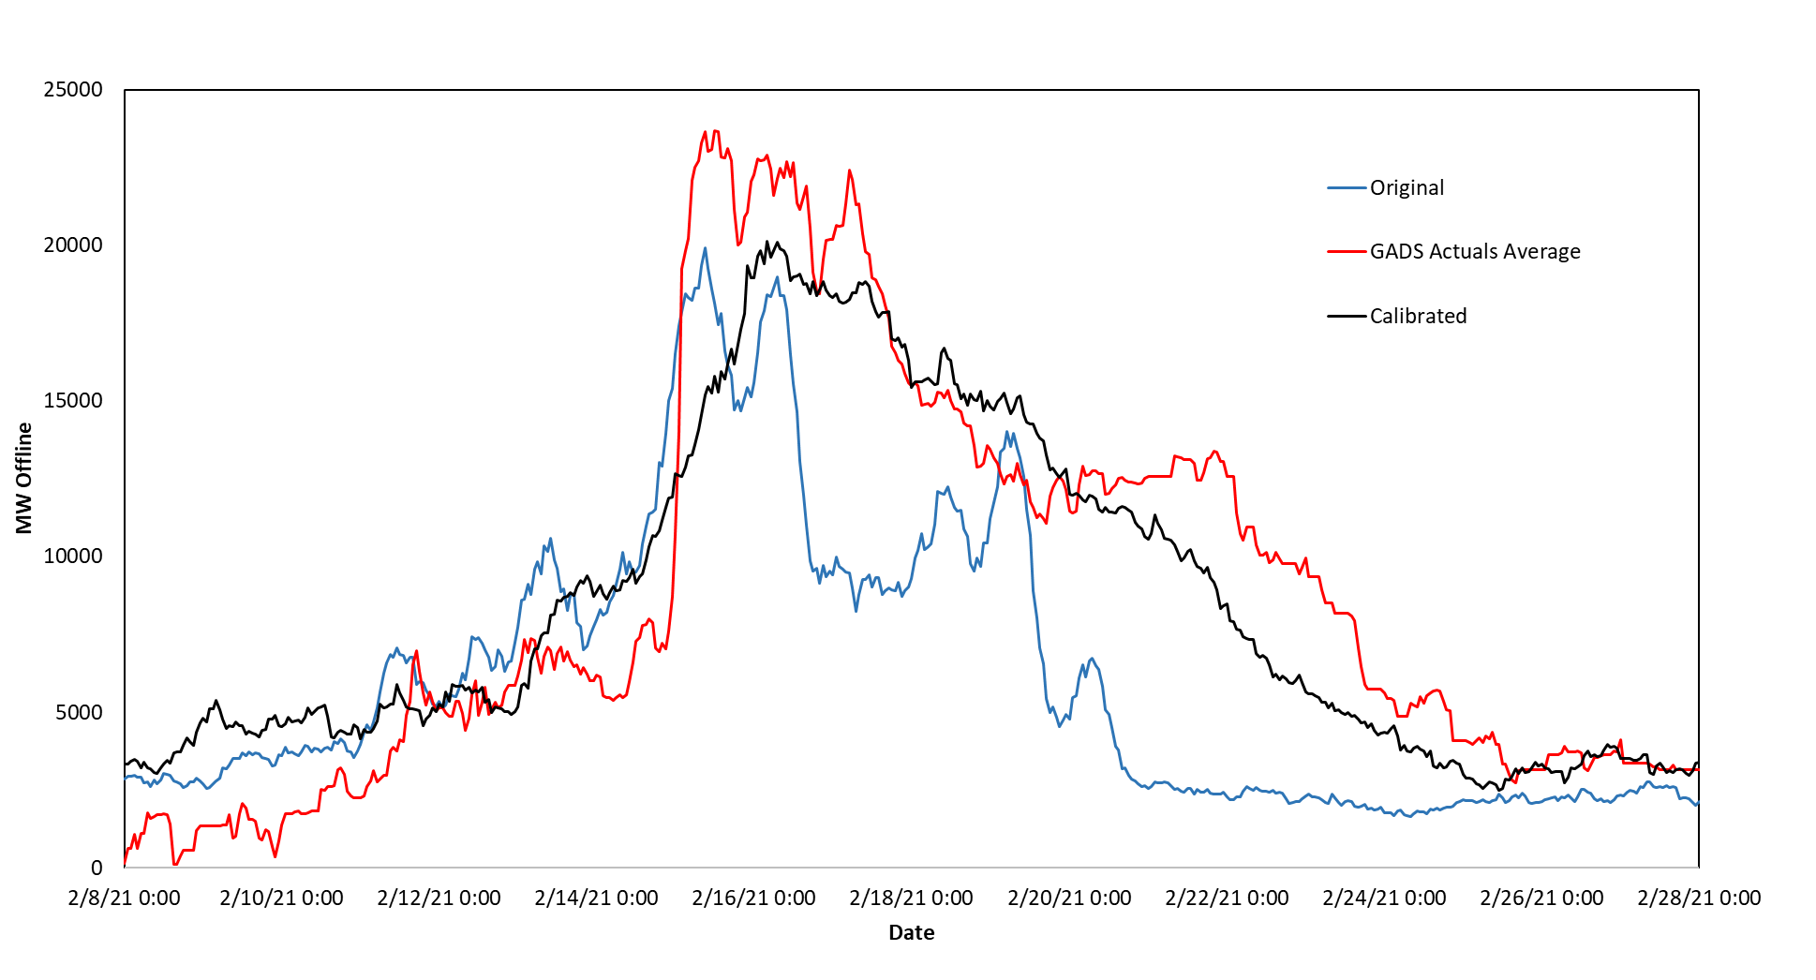
Comparison to Base
Gradual recovery effects are more accurately reflected

Slide 11
Results
TTR distribution modeling appears to have minimal impact on results assuming weatherization
Monthly LOLE
 | Base | Change
1 | - | -
2 | 0.05 | 0.05
3 | - | -
4 | - | -
5 | - | -
6 | 0.00 | 0.00
7 | 0.04 | 0.04
8 | 0.08 | 0.07
9 | 0.00 | 0.00
10 | - | -
11 | - | -
12 | 0.05 | 0.06
Observations
Weather TTRs may also be used as a lever to implement weatherization standards (e.g. cutoff TTR values greater than 100 hours)

Slide 12
January Reliability Risk Assessment

Slide 13
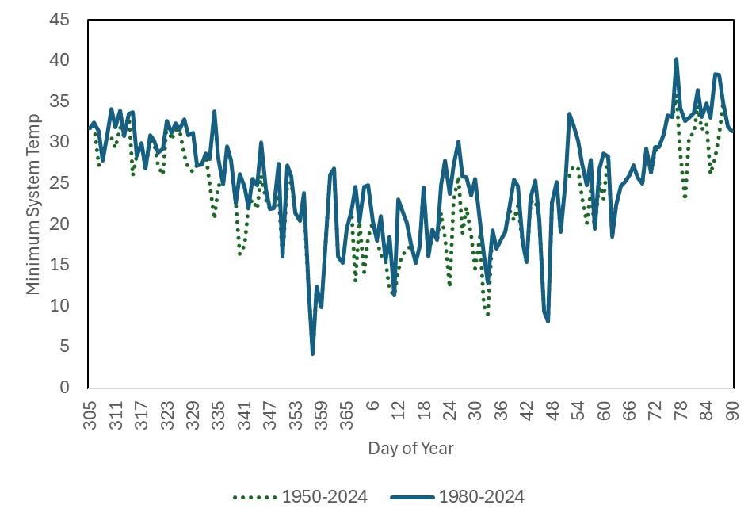
Historic Weather Analysis
SERVM Weather Years
Reviewing the available historic temperature data, there continues to be a slight over-representation of December cold weather events in the longer range record

Slide 14
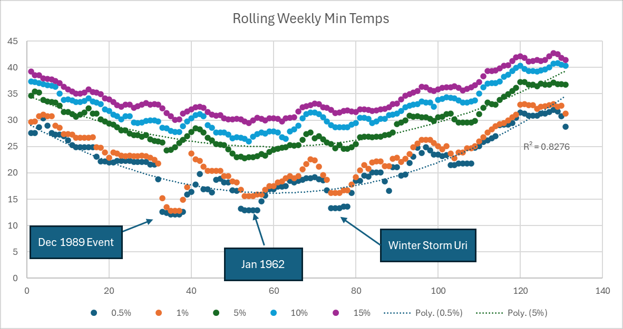
Historic Weather Analysis
Long Range Record

Slide 15
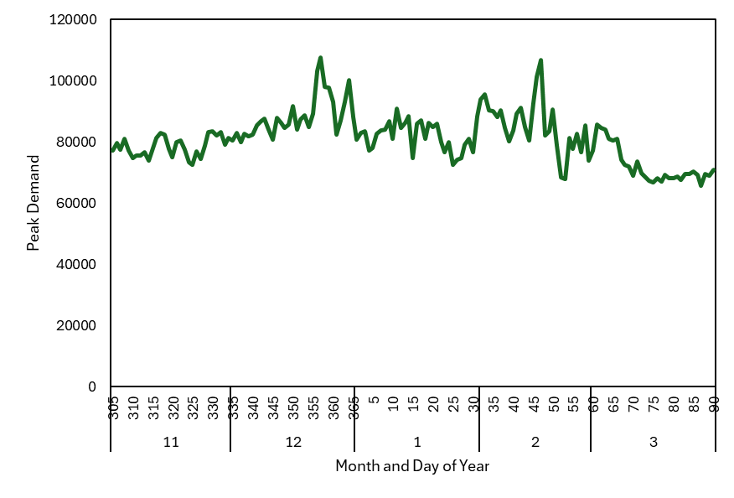
January Reliability Risk Analysis
Within the SERVM modeled weather years, significant weather events are noted in December and February, whereas the long range historical record indicates January is the coldest month
The approach taken to align SERVM results with expected extreme monthly weather conditions
  Shift weather year inclusive of December 1989 weather event 10 days forward in time
  Shift weather year inclusive of Uri weather event 21 days backward in time
  The two new weather years get ½ weighting of a normal weather year
  Original 1989 and 2021 weather years get ½ weight of a normal weather year
Daily Winter Peaks across SERVM Weather Years
1
2
Weather year shift includes adjusting all weather driven inputs (load, solar, wind, temperature) forward or backward in time for winter season for the weather year under investigation
Summer inputs are held static

Slide 16
Monthly LOLE results
Original and +2 Weather Year study results (0.1 LOLE each season) are provided below
+2 Weather Year monthly results are decomposed into driving weather years, right
  Confirms expected change in LOLE by WY
Month | Original | +2 Wys
1 | - | 0.04
2 | 0.05 | 0.03
3 | - | 0.00
4 | - | -
5 | - | -
6 | 0.00 | 0.00
7 | 0.04 | 0.04
8 | 0.08 | 0.07
9 | 0.00 | 0.01
10 | - | -
11 | - | -
12 | 0.05 | 0.04

Slide 17
Zonal Reliability Study

Slide 18
Zonal Reliability Study Objectives
Perform clustering analysis using PowerGEM’s TARA model to identify clusters with similar effects on flow-gates
Perform transfer limit analysis using TARA to identify zone-to-zone constraints and simultaneous import and export constraints
Run SERVM simulations to analyze the change in reliability for 2026 when moving from single zone representation of ERCOT to the clustered representation.

Slide 19
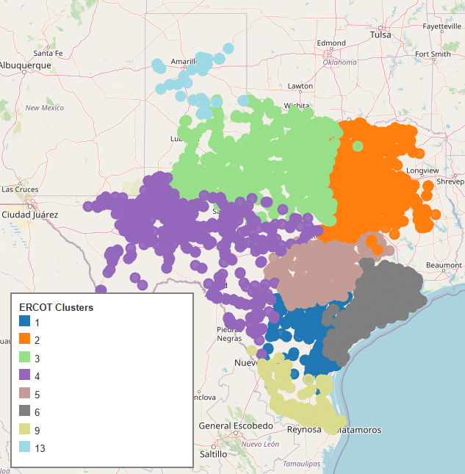
Clustering Results
13 clusters were initially identified by PowerGEM
PowerGEM worked with ERCOT and ultimately consolidated several zones
Final clustering includes 8 zones

Slide 20
Transfer Limit Results
Results based on adjusting generation up in the sending zone and down in the receiving zone until an overload occurs.
Region A | Region B | Capacity Limit In (B->A) | Capacity Limit Out (A->B)
SPP | ENTERGY | 5180 | 5180
ERCOT_Cluster_2 | SPP | 600 | 600
ERCOT_Cluster_2 | ERCOT_Cluster_3 | 8445 | 5102
ERCOT_Cluster_3 | SPP | 220 | 220
ERCOT_Cluster_3 | ERCOT_Cluster_4 | 0 | 2842
ERCOT_Cluster_4 | Mexico | 100 | 100
ERCOT_Cluster_4 | ERCOT_Cluster_1 | 1413 | 1665
ERCOT_Cluster_4 | ERCOT_Cluster_2 | 0 | 7863
ERCOT_Cluster_5 | ERCOT_Cluster_1 | 2831 | 1509
ERCOT_Cluster_5 | ERCOT_Cluster_2 | 5129 | 5282
ERCOT_Cluster_5 | ERCOT_Cluster_4 | 4662 | 556
ERCOT_Cluster_6 | ERCOT_Cluster_1 | 0 | 4736
ERCOT_Cluster_6 | ERCOT_Cluster_2 | 2155 | 884
ERCOT_Cluster_6 | ERCOT_Cluster_5 | 7707 | 194
ERCOT_Cluster_9 | Mexico | 300 | 300
ERCOT_Cluster_9 | ERCOT_Cluster_1 | 2082 | 3031
ERCOT_Cluster_13 | ERCOT_Cluster_3 | 567 | 6595

Slide 21
Simultaneous Transfer Limit Results
For simultaneous imports, generation is decreased in the receiving zone and increased in all other zones. Vice versa for simultaneous exports.
Aggregated Constraint | Import Limit | Export Limit
Cluster_1 | 1,758 | 23
Cluster_2 | - | 3,926
Cluster_3 | 316 | 4,106
Cluster_4 | 2,756 | 2,936
Cluster_5 | 7,069 | -
Cluster_6 | 3,715 | 1,272
Cluster_9 | - | 2,300
Cluster_13 | - | 3,601

Slide 22
Next Steps
Calculate zonal reliability for 2026
Compare to single ERCOT zone reliability for 2026

Slide 23
Supply Deliverability Study

Slide 24
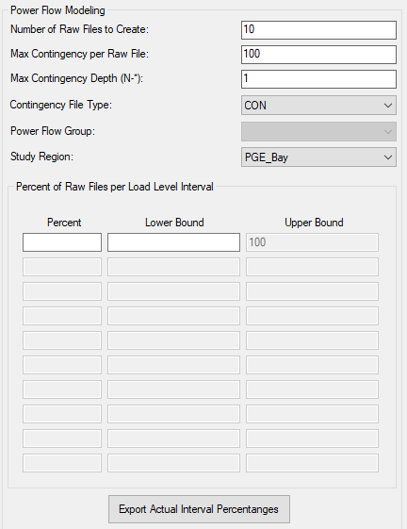
SERVM→TARA
Heuristic to Identify Hourly Snapshots
  Sample based on:
    Load
    Modified Load
    Net Load
    Renewable Output
    Unit Category Output
    State of Charge
    Forced Outages
    Remaining Reserves
    Imports
    EUE

Slide 25
SERVM→TARA
SERVM generates INCH file
  Zonal load
    TARA will adjust bus level loads to match SERVM zonal loads
  Bus-level renewable generation
  Set availability of energy-limited resources according to modeled state of charge in SERVM
SERVM generates CON file
  User determines number of iterations
Contingency 1 / Total Units Out: 2 Total Components Out: 2
DISCONNECT BRANCH FROM BUS 2775 TO BUS 6911 CKT 1
DISCONNECT BRANCH FROM BUS 2944 TO BUS 2945 CKT 1
REMOVE UNIT N4 FROM BUS 150084
REMOVE UNIT C5 FROM BUS 150205
END
Contingency 2 / Total Units Out: 5 Total Components Out: 0
REMOVE UNIT N3 FROM BUS 150083
REMOVE UNIT C4 FROM BUS 150204
REMOVE UNIT N2 FROM BUS 150712
REMOVE UNIT N2 FROM BUS 150722
REMOVE UNIT C1 FROM BUS 150904
END

Slide 26

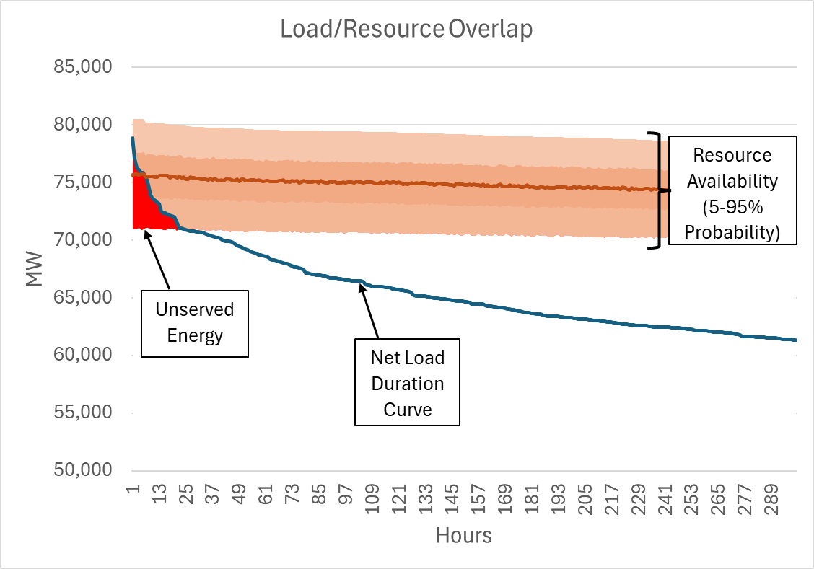
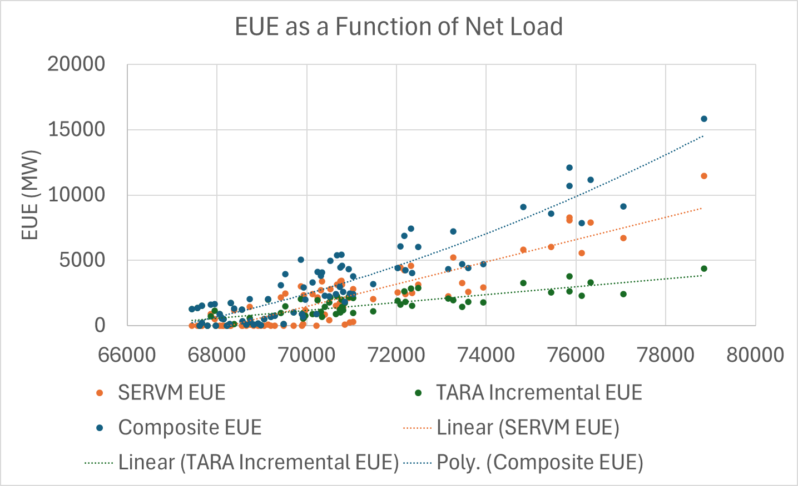
Composite Reliability Metrics
Select adequate number of snapshots to produce convergent composite reliability metrics

Slide 27
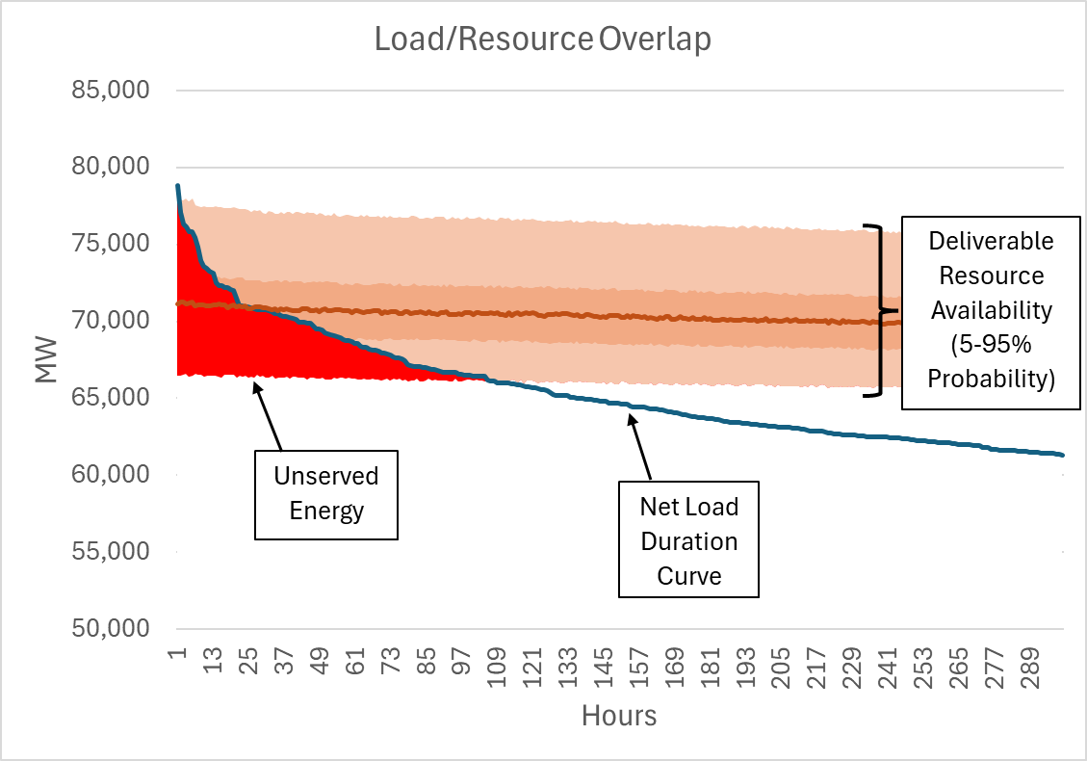
Composite Reliability Metrics
SERVM Standalone
SERVM/TARA Composite

Slide 28
SERVM→TARA
Solve for 0.1 LOLE while respecting all nodal constraints
Convergent reliability metrics generally require 50,000 or more 8760 simulations
  Zonal/Nodal linked models provides the ability to determine convergent reliability models that respect all constraints

Slide 29
NERC Probabilistic Assessment

Slide 30
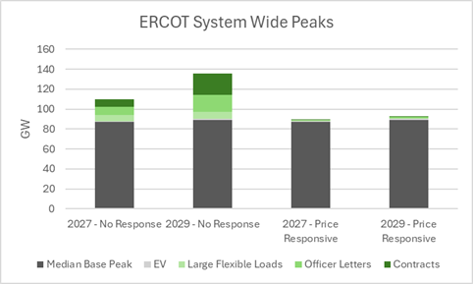
Study Objective
Calculate single zone ERCOT EUE and LOLH metrics for 2027 and 2029
Study Drivers:
  Load Forecast
  Behavior of large loads

Slide 31
Reliability Standard Assessment Prototyping

Slide 32
Study Objectives
The Reliability Standard assessment will use a probability-based model to determine if the ERCOT region is meeting the Reliability Standard and how likely it is to continue meeting it for the next three years.
First study in 2026, but prototyping ongoing in 2025
Criteria
  Frequency of load shed: <1 day in 10 years
  Magnitude: less than can be rotated among consumers during the outage
  Duration: maximum duration less than 12 hours

