Slide 1
Instructions for a Resource Entity Submitting a Declaration of Weather Preparedness for a New Resource
August 2025

Slide 2
Is a Resource Entity required to submit a Declaration of Weather Preparedness (DoWP) for a Resource that is not fully commissioned?
The Public Utility Commission of Texas (PUCT) Weather Emergency Preparedness Rule, 16 Texas Administrative Code (TAC) §25.55 states that a Resource Entity (RE) seeking part 3 commissioning approval for a new resource during the summer or winter season,
  “must submit the appropriate declaration of preparedness prior to the resource commissioning date established in the ERCOT interconnection process for resources” (16 TAC §25.55(c)(3)(C)).
Weatherization and Inspection Recommendation:
Begin developing a plan for meeting the weatherization requirements during part 2 of the ERCOT resource interconnection process.
Resources for submitting a DoWP:
Weatherization and Inspection Summer Weather Readiness Webpage
Weatherization and Inspection Winter Weather Readiness Webpage
Instructions for New Resources Submitting a Declaration of Weather Preparedness for Part 3 of the ERCOT Commissioning Process
Weatherization & Inspection Market Participant Portal User Guide

Slide 3
When does a Resource Entity submit a DoWP for a Resource that is not fully commissioned?
An RE seeking part 3 commissioning for a resource that is not fully commissioned:
Between the winter and summer inspection season
During the months of March, April, and October
DoWPs are not accepted.
The DoWP section of the portal is closed for all Resource Entity submissions.
An RE with at least one fully commissioned resource must submit a DoWP during the submission period that declares the fully commissioned resource but is not required to declare a resource that is not fully commissioned until part 3 of the commissioning process.
During the DoWP submission period
and inspection season
Winter submission period: Nov 1-Dec 1;
Winter inspection season: Dec 2-Feb 28
Summer submission period: May 1-June 1;
Summer inspection season: June 2-September 30
An RE without any fully commissioned resources must submit a DoWP during the submission period or inspection season if the resource is approaching the end of part 3 of the commissioning process provided all weatherization requirements have been met.
An RE may submit a DoWP during the submission period or inspection season for a not-yet-fully-commissioned resource that has not reached part 3 of the commissioning process provided all weatherization requirements have been met.

Slide 4
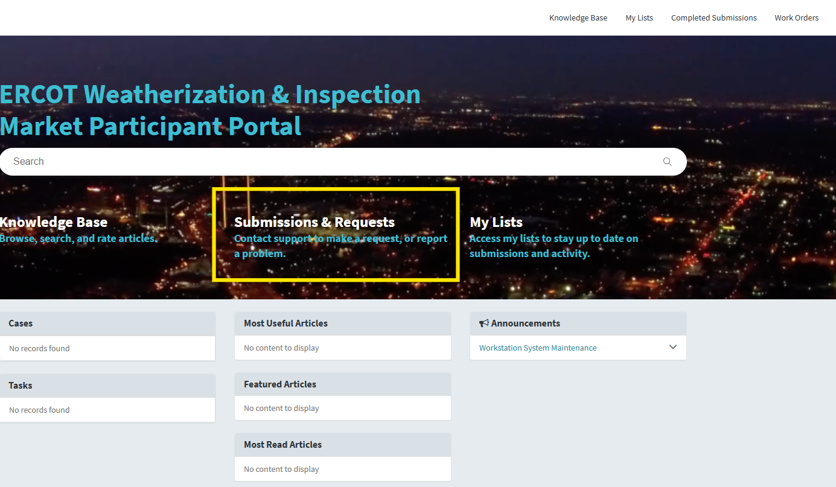
What is the process for submitting a DoWP?
Secure a digital certificate from the Market Participant User Security Administrator (USA) with the appropriate manager role, S N _ M _ W _ M G R _ E C E I I.
Log into the Weatherization & Inspection Market Participant Portal through the ERCOT MIS. https://mis.ercot.com/secure/applications
Navigate to “Submissions and Requests.”

Slide 5
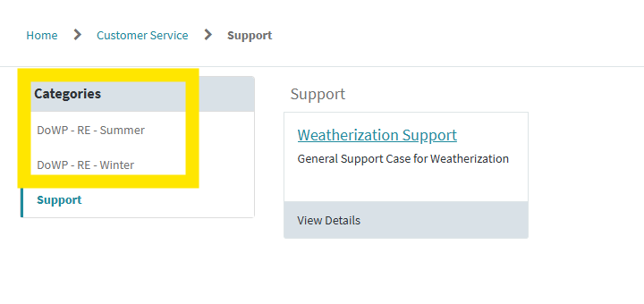
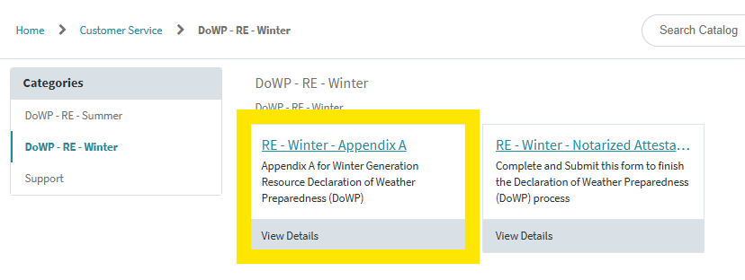
What is the process for submitting a DoWP?
Navigate to ‘Categories’ and select the DoWP for the relevant inspection season.
Select Appendix A.
Step 1: Appendix A

Slide 6
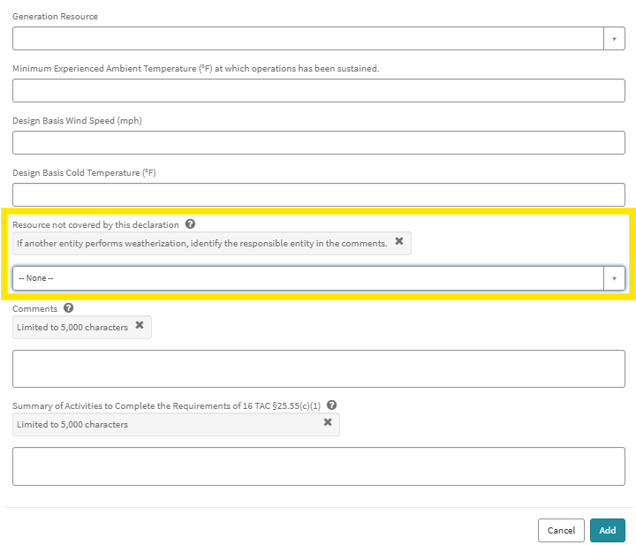
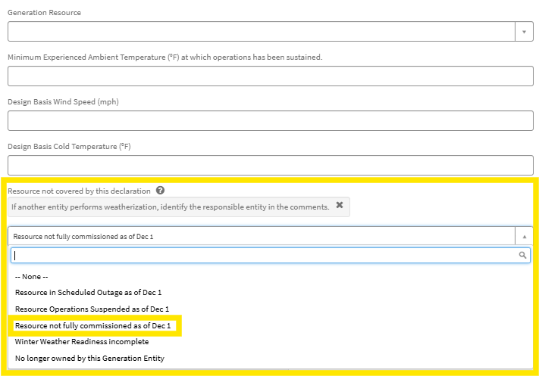
What is the correct way to declare a resource that is not fully commissioned?
Correctly declaring a resource that is not fully commissioned on the Appendix A depends on whether all weatherization requirements have been met.
All weatherization requirements are met:
leave the field, ‘Resource not covered by this declaration,’ blank.
All weatherization requirements are not met:
choose from the drop-down list, “Resource not fully commissioned as of June 1 or December 1.”

Slide 7
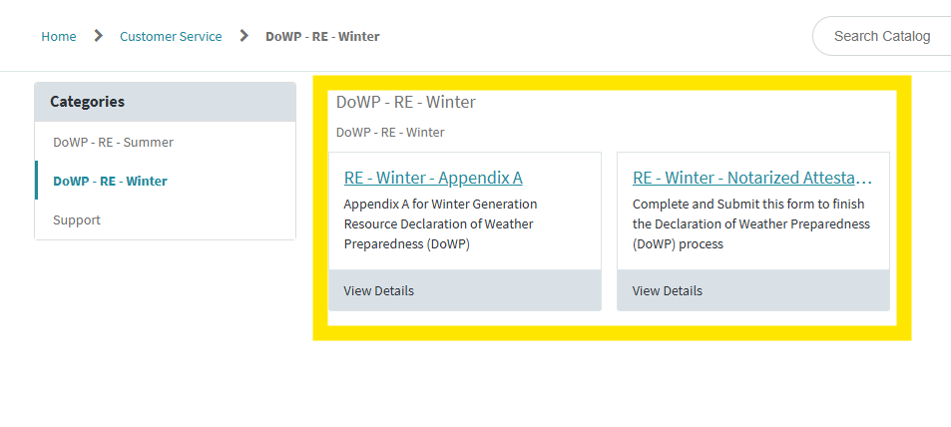
What is the process for submitting a DoWP?
Complete the Notarized Attestation document and upload the entire document to the portal.
  Must be signed by the highest-ranking representative, official, or officer with binding authority over the referenced Generation Entity and notarized.
Attach optional supplemental documents (e.g., procedures followed, checklists completed, etc.) using the paperclip icon located below the upload button.
Submit the complete declaration package by pressing the submit button.
For detailed instructions, refer to the Weatherization & Inspection Market Participant Portal User Guide.
Step 1: Appendix A
Step 2:
Notarized Attestation

Slide 8
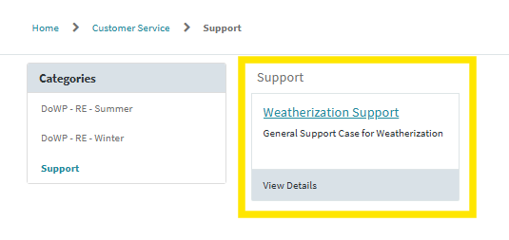
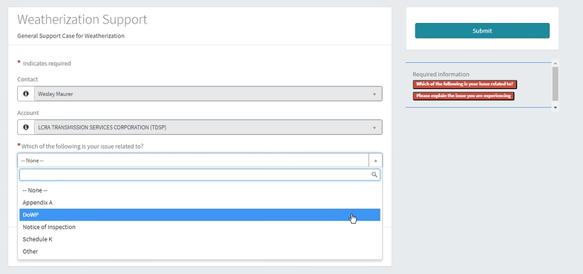
Who do I contact if I have a question or need technical assistance?
Submit a weatherization support request (wSUP) through the Weatherization & Inspection Market Participant Portal.
Your Name Will Be Here
Your Resource Entity Will Be Here

Slide 9
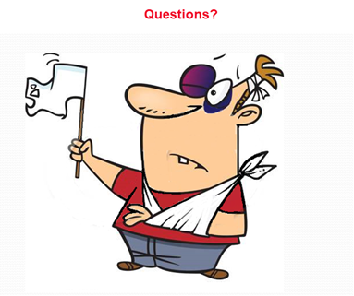
Questions?
Thank you!

