Slide 1
NDSWG Meeting
August 2025

Slide 2
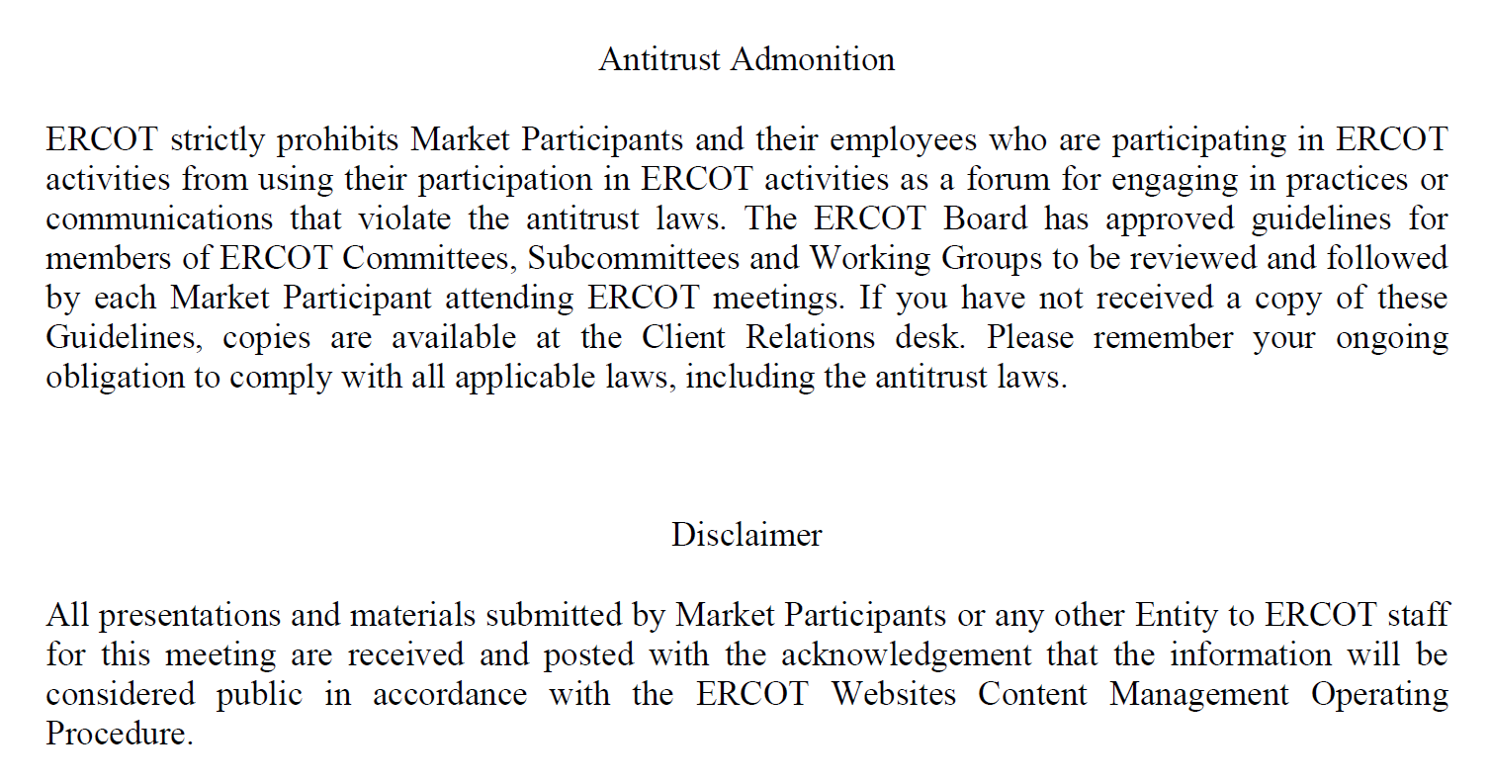
Antitrust Admonition

Slide 3
Topics
SCR 831 Joint TSP Comments
NPRR 1293: Clarifications to the Modeling Timelines
Summer Outage Restriction ending
Review of Load Classification request
RTC Model Posting
  DEC ML2 RTC model will have Battery Generating Units
CIM 16 Workshop

Slide 4
Topics
SCR 831 Joint TSP Comments
NPRR 1293: Clarifications to the Modeling Timelines
Summer Outage Restriction ending
Review of Load Classification request
RTC Model Posting
  DEC ML2 RTC model will have Battery Generating Units
CIM 16 Workshop

Slide 5
SCR 831 Joint TSP Comments
Joint Comment: Oncor, CenterPoint Energy Houston Electric (CEHE), American Electric Power (AEP) and Texas New Mexico Power (TNMP) (“Joint Transmission Service Providers (TSPs)”) provide these comments to System Change Request (SCR) 831, Short Circuit Model Integration, to acknowledge its potential benefits. Joint TSPs recognize that the successful implementation of this system change will depend on satisfactorily addressing several technical challenges and questions, including a large-scale data migration effort. While this implementation is likely to entail considerable effort on ERCOT’s part, Joint TSPs recommend that the SCR be implemented within three years of Public Utility Commission of Texas (PUCT) approval.
Joint TSPs emphasize that support for the SCR’s approval should not constitute a commitment to provide or maintain data related to this initiative until the implementation details have been proposed in writing by ERCOT for TSP review and comment, and TSPs are fully satisfied with these implementation details. Once a vendor-developed concept product is available, Joint TSPs recommend that a Nodal Operating Guide Revision Request (NOGRR) be submitted either by ERCOT or by a TSP to specifically describe the data elements that TSPs will need to provide for successful implementation of the SCR, so that that these items can be properly codified in Section 5, Network Operations Modeling Requirements, of the Nodal Operating Guide.

Slide 6
Topics
SCR 831 Joint TSP Comments
NPRR 1293: Clarifications to the Modeling Timelines
Summer Outage Restriction ending
Review of Load Classification request
RTC Model Posting
  DEC ML2 RTC model will have Battery Generating Units
CIM 16 Workshop

Slide 7
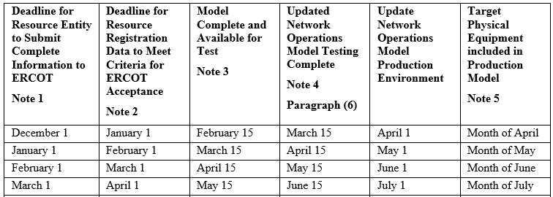
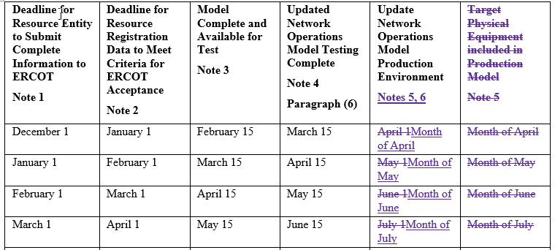
NPRR 1293: Clarifications to the Modeling Timelines.
Changes to the table in Nodal Protocol Section 3.10.1(3), (4).
After
Before
This NPRR is not intended to change the database load schedule. This change ensures the table in 3.10.1(3) matches the current process.
https://www.ercot.com/gridinfo/transmission/opsys-change-schedule

Slide 8
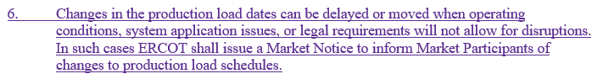
NPRR 1293: Clarifications to the Modeling Timelines.
Footnote 6 has been added to allow for changes in database load schedule due to emergency conditions, application issues, or as required by legal requests (bankruptcies).
https://www.ercot.com/gridinfo/transmission/opsys-change-schedule

Slide 9
Topics
SCR 831 Joint TSP Comments
NPRR 1293: Clarifications to the Modeling Timelines
Summer Outage Restriction ending
Review of Load Classification request
RTC Model Posting
  DEC ML2 RTC model will have Battery Generating Units
CIM 16 Workshop

Slide 10
Summer Outage Restriction ending
2025 Summer Outage Restriction ending on September 15, 2025
  Disable/enable contingencies
  Contingency definition changes
  Impedance changes
  Ratings update

Slide 11
Topics
SCR 831 Joint TSP Comments
NPRR 1293: Clarifications to the Modeling Timelines
Summer Outage Restriction ending
Review of Load Classification request
RTC Model Posting
  DEC ML2 RTC model will have Battery Generating Units
CIM 16 Workshop

Slide 12
NPRR1234
Modeling of Loads 25MW or Greater

Slide 13
Modeling of Loads 25 MW or Greater – Additional Details
TSPs will need to identify a load point or collection of load points serving a site with a historical, requested, or expected peak Demand 25 MW or greater in the ERCOT Network Operations Model.
RE will need to identify a load point or collection of load points serving a behind the meter load (excluding aux load) with a historical, requested, or expected peak Demand 25 MW or greater in the Resource Registration Data.
Load points serving sites > 25MW may include additional customers <25 MW.
For each load point identified, the TSP/RE must also provide the primary end-use activity from a list of broad categories.
The goal of these requirements is to allow ERCOT to improve its load forecasts and to provide real-time visibility to system operators.

Slide 14
Loads 25 MW or Greater - Draft End Use Classifications
Cryptocurrency Mining
Data Centers (non-Crypto)
Government and Medical
Hydrogen and Electrofuel Production
Oil and Chemical Refining
Oil and Gas Production, Processing, and Transmission
Steel and Aluminum Manufacturing
Transportation
Other Industrial

Slide 15
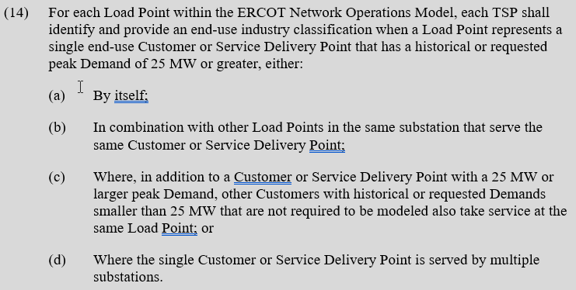
NPRR 1234 Load End Use Classification
Nodal Protocols 3.107.2(14)

Slide 16
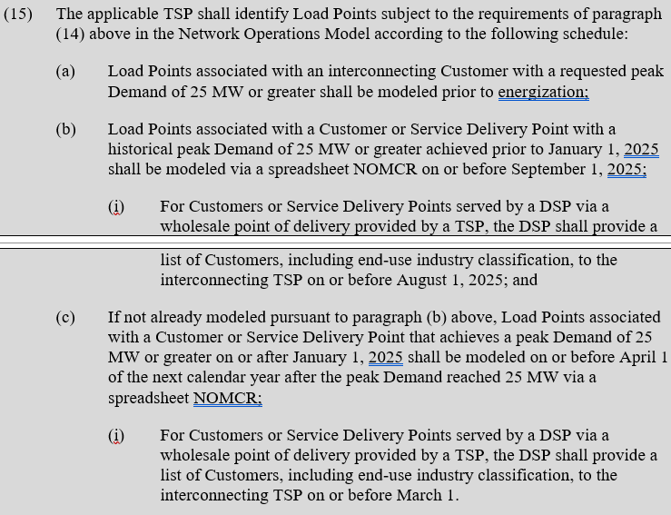
NPRR 1234 Load End Use Classification
Nodal Protocols 3.107.2(15)

Slide 17
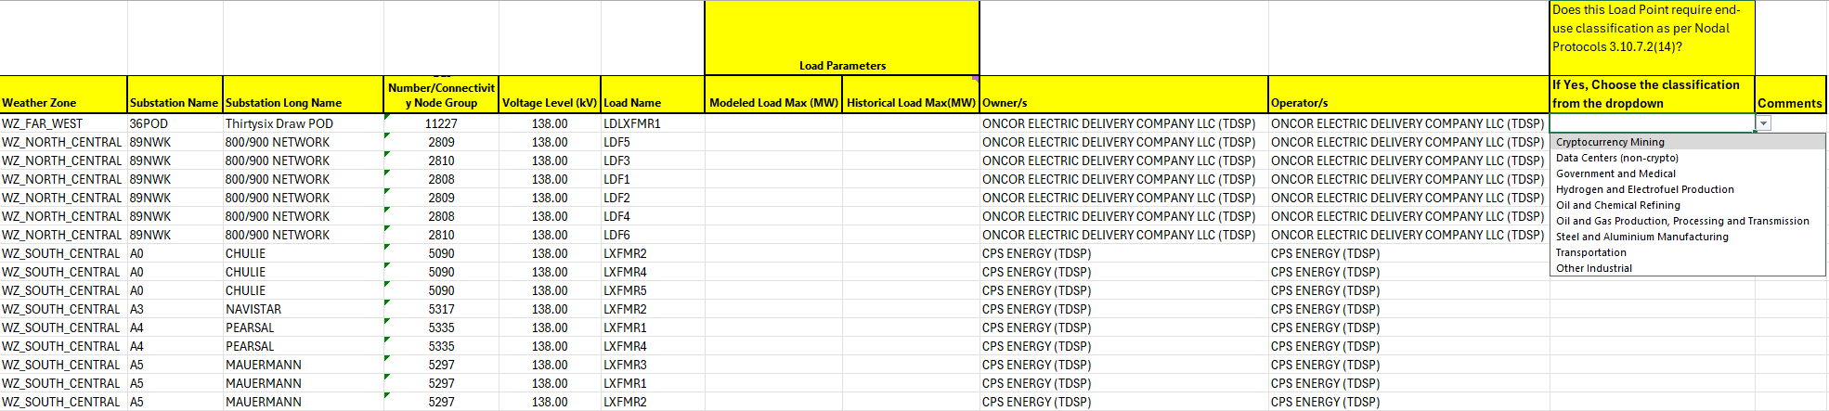
NPRR 1234 Load End Use Classification Categories
  Spreadsheet example:

Slide 18
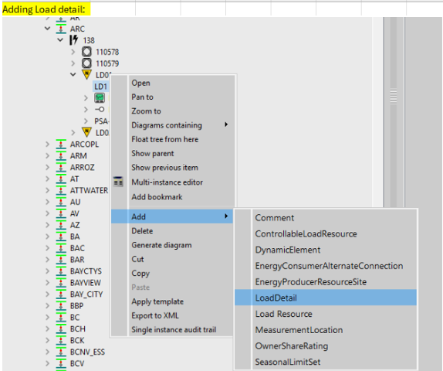
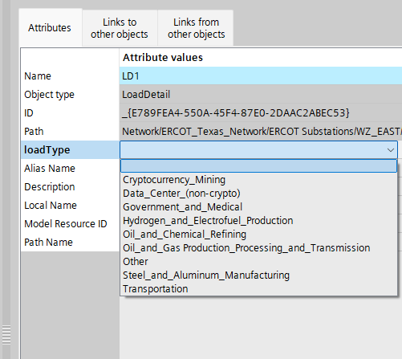
How to add Load Details
Right click on the load you want to add load details to. Pick Add-> Load details instance.
Name the load details instance
Pick from the loadType attribute on the load details dropdown to add the end use classification of the load
Save

Slide 19
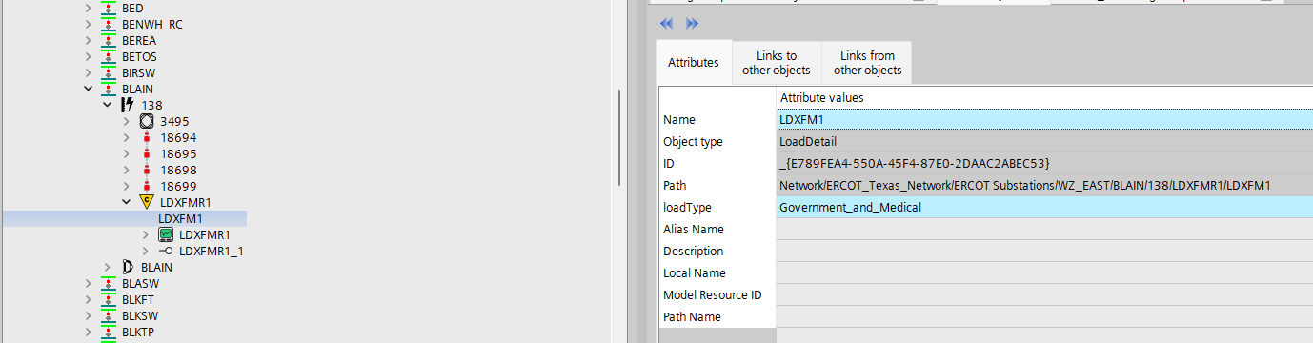
How to add Load Details Cont’d

Slide 20
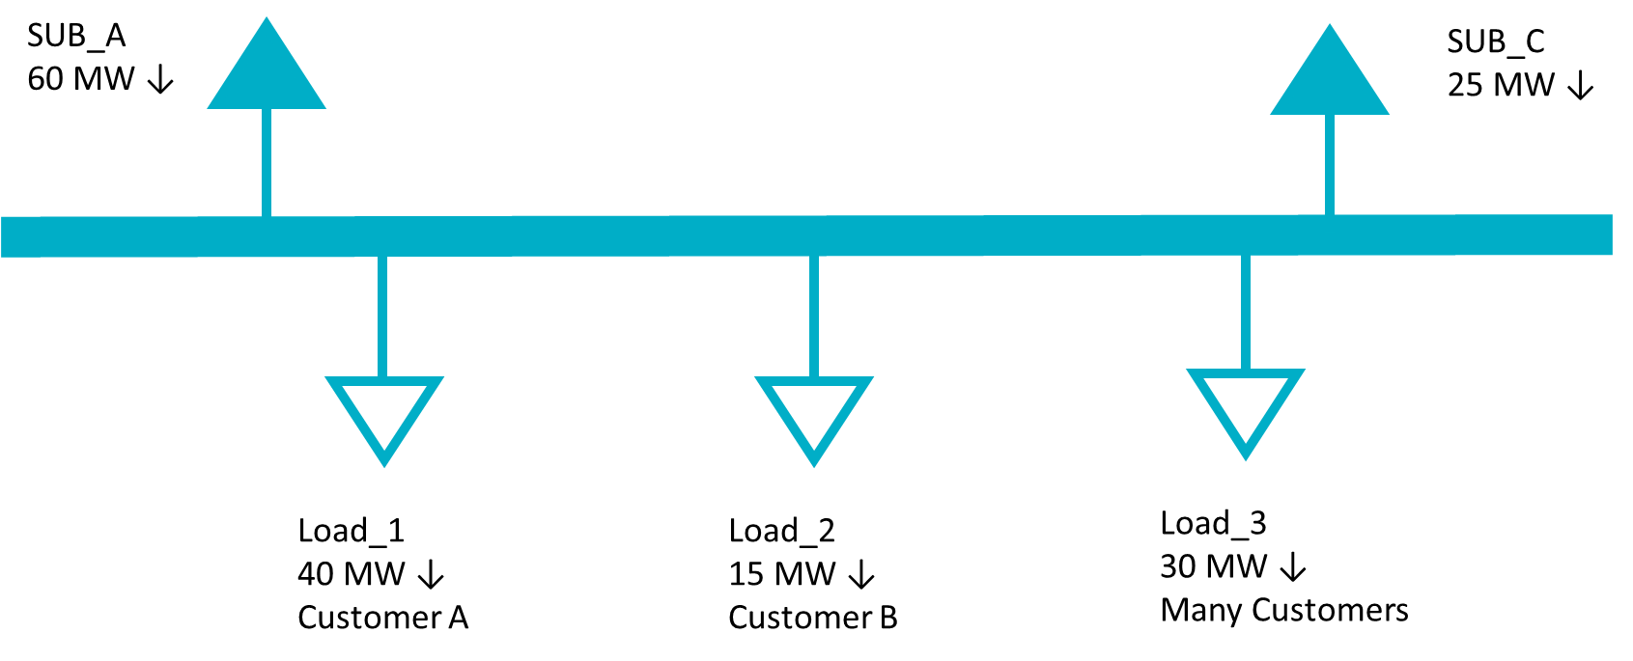
Modeling of Loads 25 MW or Greater – Conceptual Examples
Example 1
A single customer and/or site with a historical peak Demand of 25 MW or larger served from a single load point in the Network Operations Model.
In the example below, a substation serves 85 MW of customer load. Load_1 serves a single facility with a peak Demand of 40 MW and does not include any other customer load. Load_2 represents a single, smaller customer and Load_3 includes many customers across multiple sites, none of whom are 25 MW or greater individually.
TSP Actions
Identify Load_1 as a 25 MW or greater facility in the ERCOT Network Operations Model
Identify the primary end use category of Load_1 from a pre-defined list.
Load_2 does not need to be identified since it is less than 25 MW.
Load_3 does not need to be identified because it is composed of many customers and facilities.

Slide 21
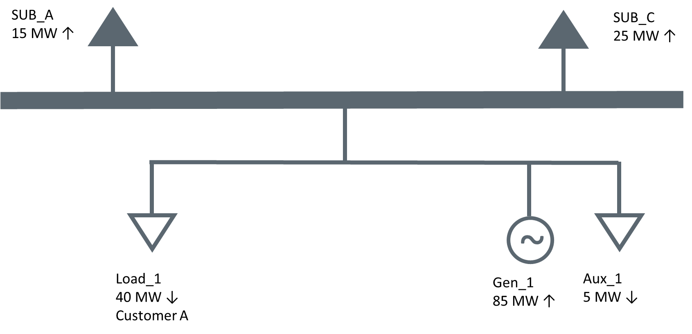
Modeling of Loads 25 MW or Greater – Conceptual Examples
Example 2
A single customer and/or site with a historical peak Demand of 25 MW or larger located with a Generation Resource served from a single load point in the Network Operations Model.
In this example, the same Load_1 from the previous example is served behind the meter of a Generation Resource. The generator also has 5 MW of Aux load.
RE Actions
Identify Load_1 as associated with a 25 MW or greater facility in its Resource Registration Data.
Identify the primary end use category of Load_1 from a pre-defined list.
The Aux load should not be identified as a 25 MW or greater facility.

Slide 22
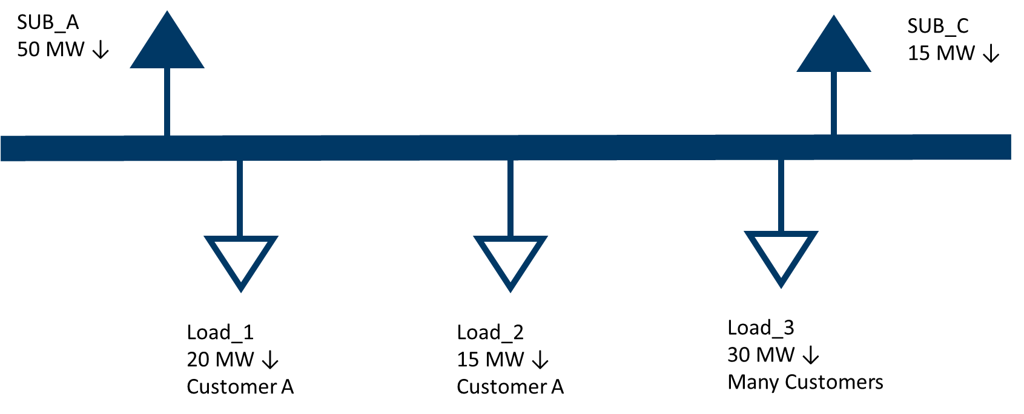
Modeling of Loads 25 MW or Greater – Conceptual Examples
Example 3
A single customer and/or site with a historical peak Demand of 25 MW or larger served from a multiple load points in the Network Operations Model.
In the example below, a substation serves 65 MW of customer load. Load_1 and Load_2 correspond to a single site with a peak Demand of 35 MW. Load_3 includes many customers across a multiple sites, none of whom are 25 MW or greater individually.
TSP Actions
Identify Load_1 AND Load_2 as associated with a 25 MW or greater site in the ERCOT Network Operations Model. Even though neither point individually exceeds 25 MW, both should be included because the correspond to a single site.
Identify the primary end use category of Load_1 and Load_2 from a pre-defined list.
Load_3 does not need to be identified because it is composed of many customers and sites.

Slide 23
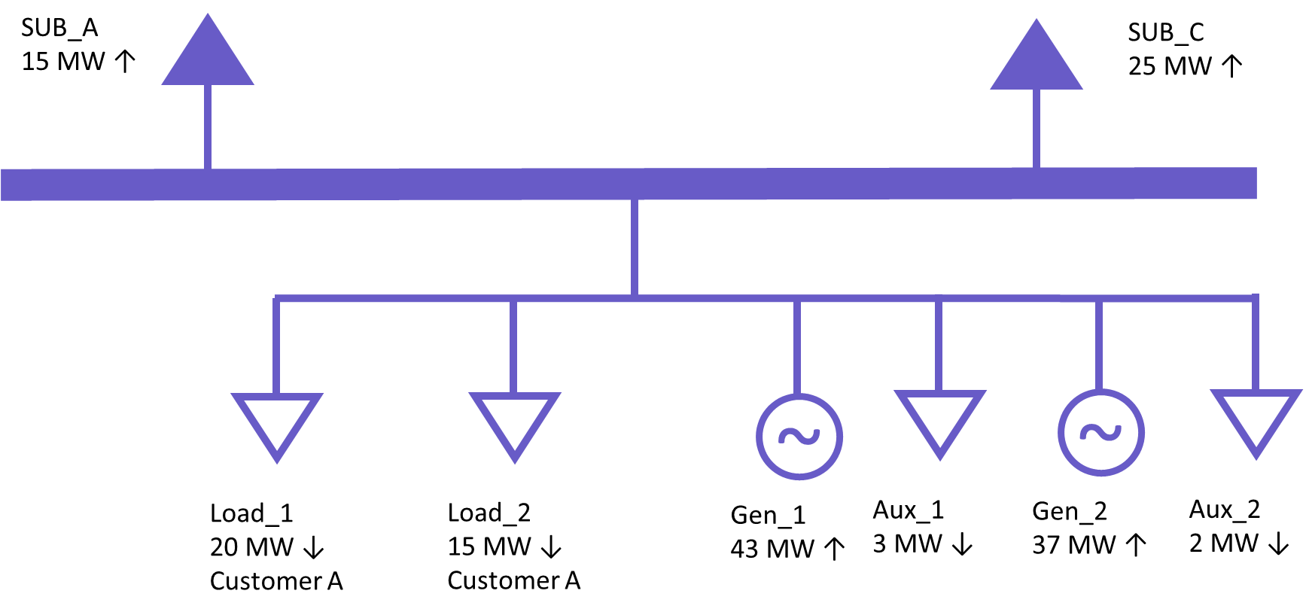
Modeling of Loads 25 MW or Greater – Conceptual Examples
Example 4
A single customer and/or site with a historical peak Demand of 25 MW or larger located with a Generation Resource served from multiple load points in the Network Operations Model.
In this example, the same Load_1 and Load_2 from the previous example are served behind the meter of a Generation Resource. The generator also has 5 MW of Aux load.
RE Actions
Identify Load_1 AND Load_2 as associated with a 25 MW or greater facility in the Resource Registration data. Even though neither point individually exceeds 25 MW, both should be included because the total load, excluding aux load, behind the POI exceeds 25 MW.
Identify the primary end use category of Load_1 and Load_2 from a pre-defined list.
The Aux loads should not be identified as part of a 25 MW or greater facility.

Slide 24
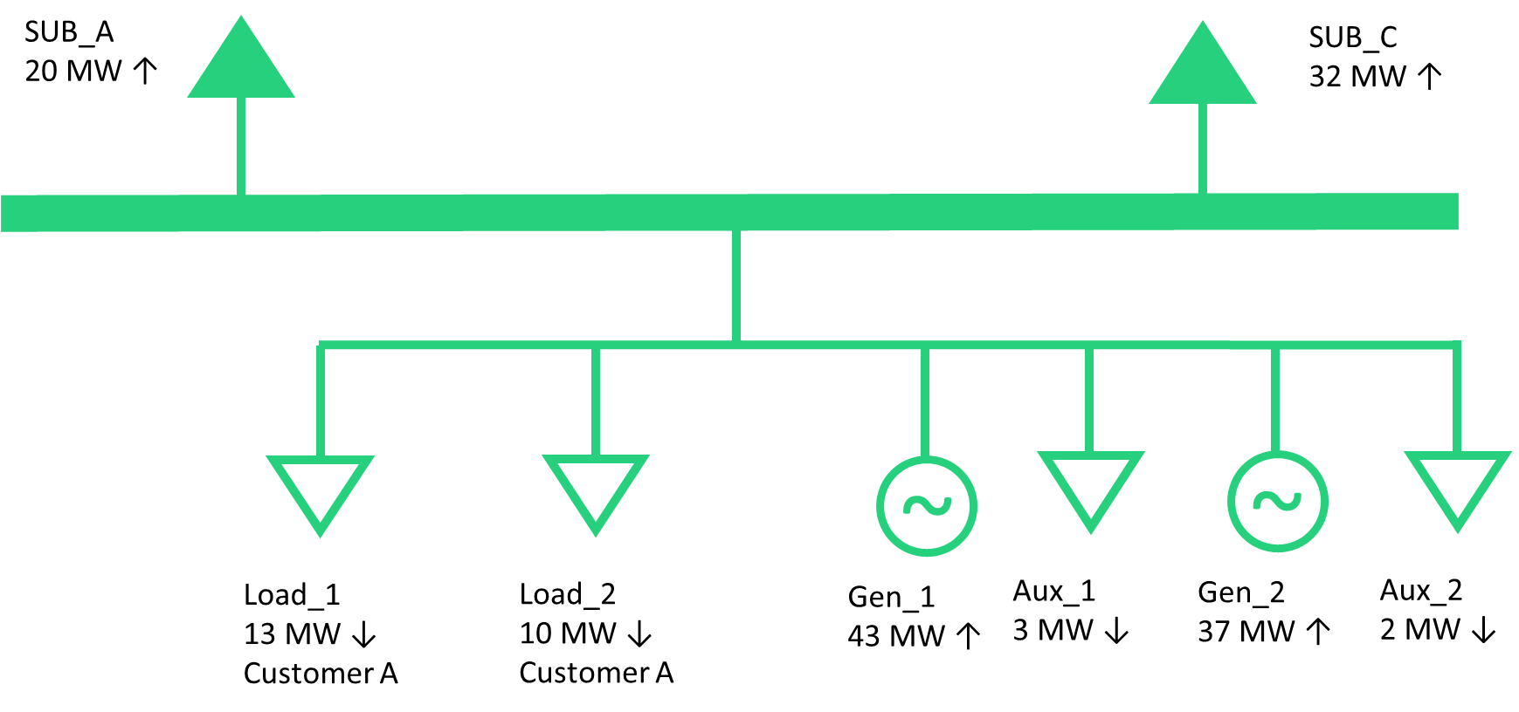
Modeling of Loads 25 MW or Greater – Conceptual Examples
Example 5
A single customer and/or site with a historical peak Demand of 22 MW located with a Generation Resource served from multiple load points in the Network Operations Model.
In this example, the same Load_1 and Load_2 from the previous example are served behind the meter of a Generation Resource. The total peak Demand of these two load points is 22 MW. The generator also has 5 MW of Aux load.
RE Actions
No loads need to be identified as associated with a 25 MW or greater facility in the Resource Registration data. Even though the total load behind the POI exceeds 25 MW, the non-aux load peak Demand is less than 25 MW.

Slide 25
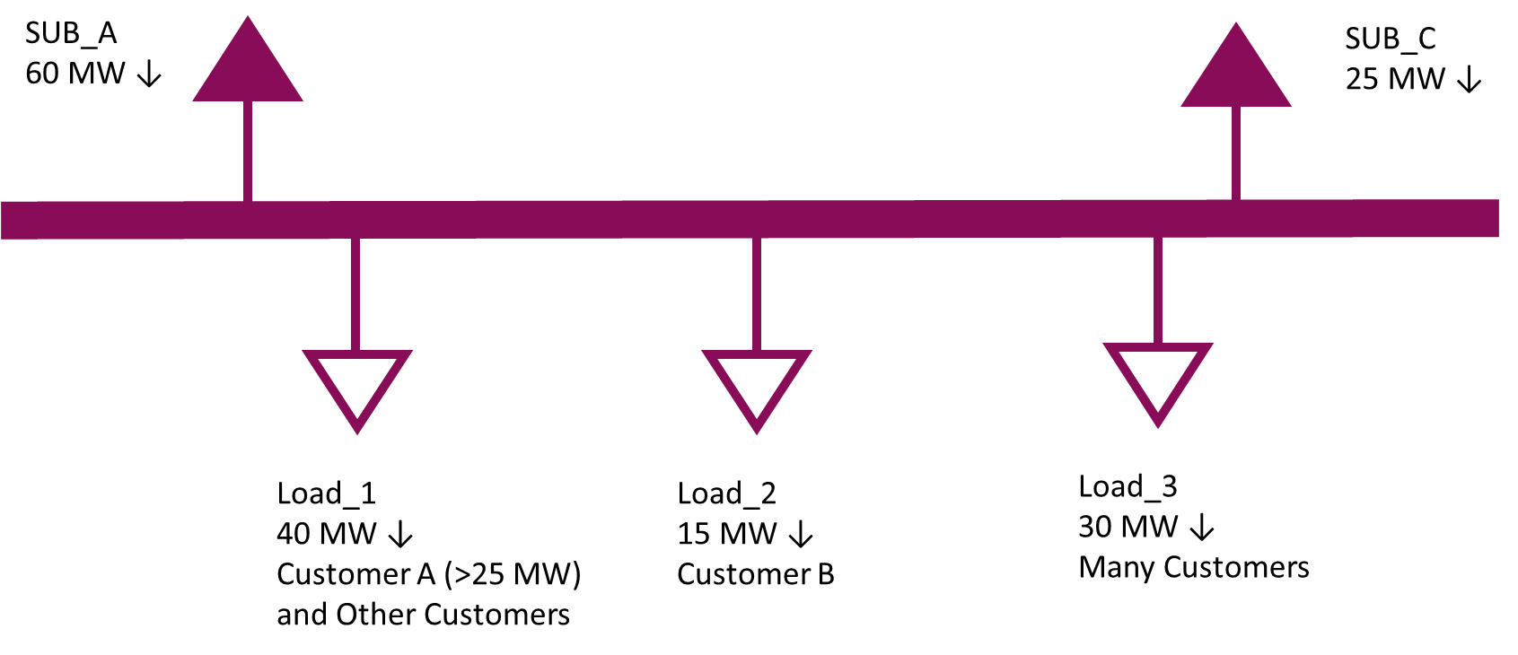
Modeling of Loads 25 MW or Greater – Conceptual Examples
Example 6
A single customer and/or site with a historical peak Demand of 25 MW or larger served from a single load point in the Network Operations Model that includes other customers.
In the example below, a substation serves 85 MW of customer load. Load_1 serves a site with a peak Demand greater than 25 MW and other, smaller customers. Load_2 represents a single, smaller customer and Load_3 includes many customers across multiple sites, none of whom are 25 MW or greater individually.
TSP Actions
Identify Load_1 as associated with a 25 MW or greater facility in the ERCOT Network Operations Model.
Identify the primary end use category of the largest customer behind Load_1 from a pre-defined list.
Load_2 does not need to be identified since it is less than 25 MW.
Load_3 does not need to be identified because it is composed of many customers and facilities.

Slide 26
Topics
SCR 831 Joint TSP Comments
NPRR 1293: Clarifications to the Modeling Timelines
Summer Outage Restriction ending
Review of Load Classification request
RTC Model Posting
  DEC ML2 RTC model will have Battery Generating Units
CIM 16 Workshop

Slide 27
Key Model Changes to Support RTC+B Effort
Energy Storage Resources will transition from a “combo” to “single” model representation
All ERCOT systems currently represent an ESR as a load/generator pair
Model
EMS/MMS
Key Change: Battery identifiers will change during this transition. (ex: UNIT1 -> ESR1)
Model
EMS/MMS
Post-RTC+B go-live, all core systems will utilize the single-model representation for ESRs

Slide 28
Full and Redacted Representations of RTC+B Model Posted
ERCOT has posted full and redacted RTC+B representations of the July ML4 model
Redacted model is posted to a new MIS location:
  Preview of Modified Redacted CIM Network Model
Full model for TSPs is posted in the NMMS Citrix Postings location:
  Located in the ECEII_NMMS_RTC_Preview folder
Key changes related to Energy Storage Resources
  BatteryGeneratingUnit (BGU) instances have replaced the HydroGeneratingUnit + ControllableLoadResource pairs
  Names of BGU instances have changed (ex: UNIT1 -> ESR1)
https://www.ercot.com/services/comm/mkt_notices/M-A073025-01

Slide 29
Topics
SCR 831 Joint TSP Comments
NPRR 1293: Clarifications to the Modeling Timelines
Summer Outage Restriction ending
Review of Load Classification request
RTC Model Posting
  DEC ML2 RTC model will have Battery Generating Units
CIM 16 Workshop

Slide 30
ERCOT Hosting Initial CIM16 Workshop on September 18th
First CIM16 Workshop to Be Held at Austin MET on September 18th
Market Notice: M-A071725-02
Agenda:
  Project overview and timeline
  Review of key schema changes
  Discussion on schema, mapping documents, and Redacted CIM16 Model
ERCOT has provided:
  Redacted CIM16 Model (posted here)
  CIM10 and CIM16 schema files
  CIM10 to CIM16 Mapping Document
https://www.ercot.com/calendar/09182025-ERCOT-CIM-16-Workshop

Slide 31
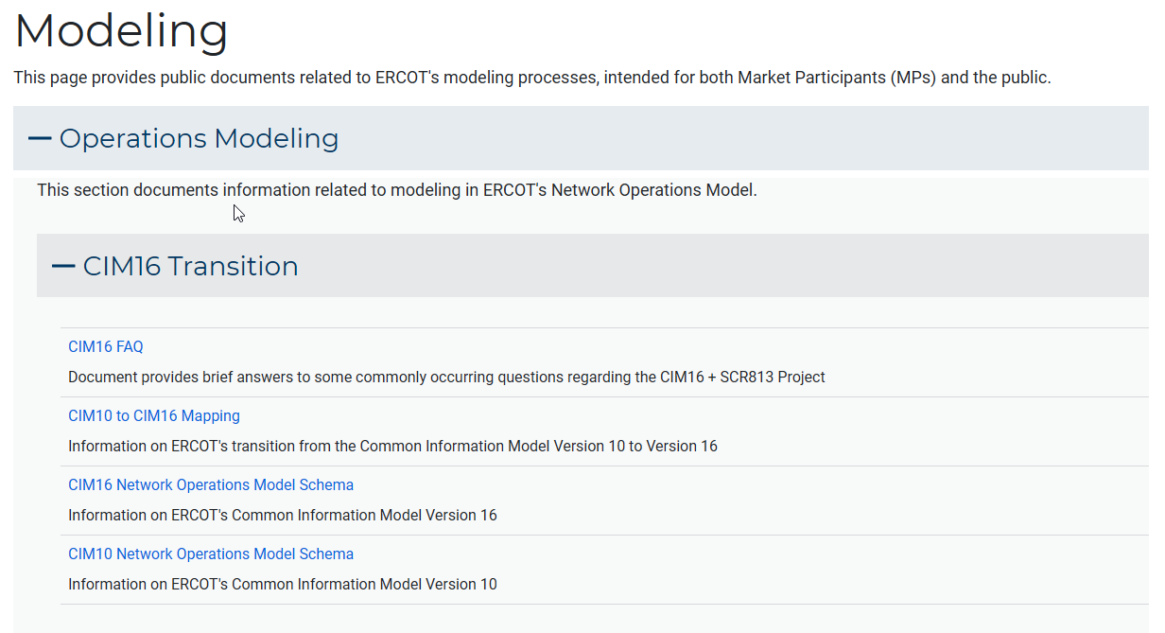
New Modeling Page on ERCOT.com
Many helpful files in the CIM16 Transition section
https://www.ercot.com/gridinfo/modeling

Slide 32
Other Topics
Open Discussion…

