Slide 1
Information Technology Report
Mick Hanna
Manager, Market Applications Services Support
ERCOT Public August 2025

Slide 2
Incident Report Highlights – July
Service Availability
  Retail Market IT systems met all SLA targets.
  Market Data Transparency IT systems met all SLA targets.
Retail Incidents & Maintenance
  7/13/2025 Site Failover
  7/26-7/27/2025 Extended Release for MarkeTrak and Registration Systems
Non-Retail Incidents & Maintenance
  7/10/2025 Site Failover
  7/24/2025 Application Release
ListServ Incidents & Maintenance
  7/13/2025 Site Failover
  SLA Documents and Incident Reporting
  https://www.ercot.com/services/sla/

Slide 3
MarkeTrak Performance
MarkeTrak
July 2025 | Availability (%) | Response Time (seconds) |  | SLO (seconds)
 |  | Monthly Average | 12 Month Average
API QueryDetail | 100.00 | .38 | 0.28 | 2
API QueryList | 100.00 | 1.09 | 0.97 | 10
API Update | 100.00 | .54 | 0.44 | 10
GUI | 99.84 | 1.12 | 1.21 | 10
Average | 99.96

Slide 4
MarkeTrak Volumes
MarkeTrak
July 2025 | Volume
 | Monthly Total | 12 Month Average
API QueryDetail | 102485 | 134647
API QueryList | 70429 | 70514
API Update | 11748 | 22312

Slide 5
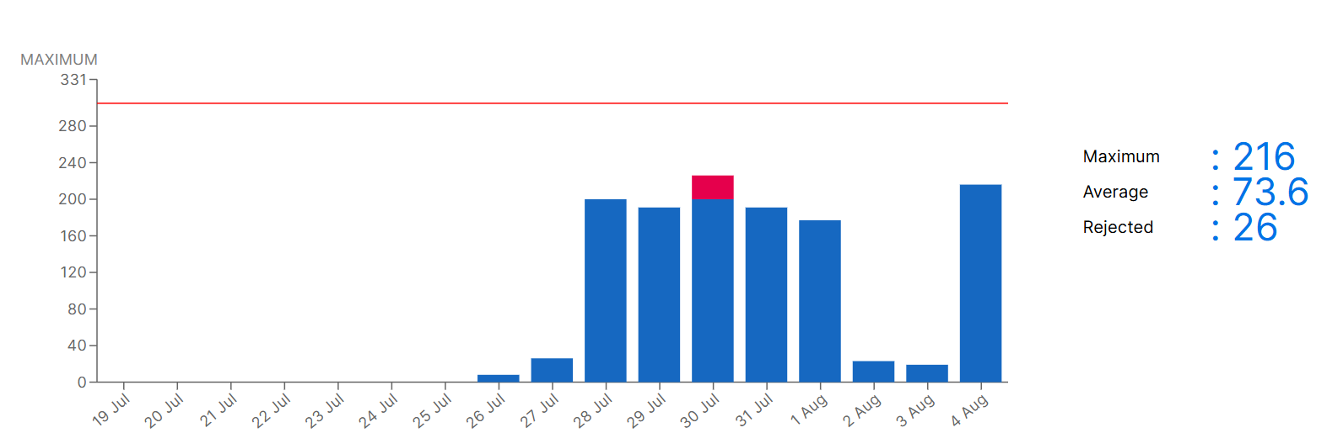
MarkeTrak Licensing Volumes

Slide 6
July ListServ Stats
3679 Posts
408650 Recipients
RMS List Highlights
  74 Posts
  8 New Subscriptions
  8 Unsubscribes
TDTMS List Highlights
  3 Posts
  1 New Subscriptions
  0 Unsubscribe

Slide 7
Weather Moratorium Removals
DATE | LIST | EMAIL | ACTION
2025-06-16 15:50:02 | weather_moratoriums | stephen.wilson2@VISTRAENERGY.COM | SIGNOFF
2025-06-16 15:50:12 | weather_moratoriums | steven.pliler@VISTRACORP.COM | SIGNOFF
2025-06-17 10:43:52 | weather_moratoriums | jriosm@NATURGY.COM | SIGNOFF
2025-06-17 10:53:50 | weather_moratoriums | ms_anna_robles@YAHOO.COM | SIGNOFF
2025-06-20 00:00:01 | weather_moratoriums | jodell@FREEPOINTSOLUTIONS.COM | AUTODEL
2025-06-20 08:14:08 | weather_moratoriums | dorianolsen@EARTHLINK.NET | SIGNOFF
2025-06-23 07:24:15 | weather_moratoriums | jay_pena@YAHOO.COM | SIGNOFF
2025-06-25 00:00:03 | weather_moratoriums | regulatory@MP2ENERGY.COM | AUTODEL
2025-07-01 15:20:22 | weather_moratoriums | dlopez@FREEPOINTSOLUTIONS.COM | SIGNOFF
2025-07-02 13:14:23 | weather_moratoriums | Tsandersparis@YAHOO.COM | SIGNOFF
2025-07-20 00:00:02 | weather_moratoriums | german.tellez@UBIQUITY.COM | AUTODEL
2025-07-23 13:57:08 | weather_moratoriums | retail-ops@GRIDMATIC.COM | SIGNOFF
2025-07-28 08:37:25 | weather_moratoriums | witiinow@HOTMAIL.COM | SIGNOFF
2025-07-28 11:59:26 | weather_moratoriums | ktrabo@AOL.COM | SIGNOFF
2025-08-01 08:56:35 | weather_moratoriums | wedum@ATT.NET | SIGNOFF
2025-08-01 10:58:05 | weather_moratoriums | kmarriott@MILLERBROS.US | SIGNOFF

Slide 8
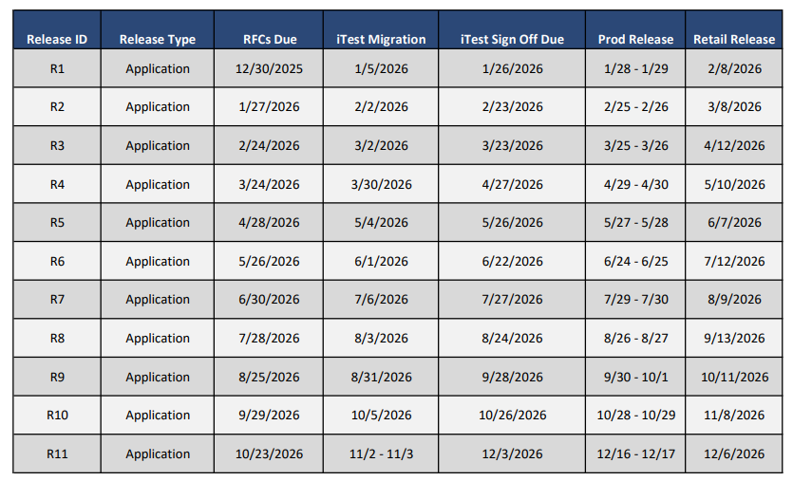
Updated 2026 Release Calendar Draft

