Slide 1
RTC+B – LFC/SCED Closed Loop Testing – Draft Cutover and Cutback Plan
Sreenivas Badri
August 19, 2025

Slide 2
Agenda
QSEs RTC+B System Configurations
QSE RTC+B Systems switch over for Closed loop testing/Go-Live
Expectations for Parallel Operations
Key Cutover and Cutback steps for Closed loop Testing

Slide 3
QSEs RTC+B Systems Configurations
ERCOT met with QSEs and their EMS and Market System vendors to gain insights into their RTC+B system design and software implementation to support Open Loop Testing, Closed Loop Testing and Go-Live.
Below are the high-level details of QSEs’ RTC+B system setup and software implementation:
  EMS AGC/SCADA
    Existing EMS AGC was modified, and a flag/switch was implemented to separate RTC+B code and database changes.
    This switch is available at Unit level and at System level to transition AGC between current production and RTC+B.
    In some cases, new RTC+B AGC instance was created, and a flag/switch is used to transition AGC between current production and RTC+B.
    QSEs who do not have AGC, use SCADA Calc or Scripts (developed on SCADA) to send the dispatch instructions to plants. These SCADA Calcs/Scripts can switch between current production and RTC+B at Unit level as well as at System level.
    Developed Market Interface between their RTC+B Market System and AGC/SCADA Calc/Scripts to get RTC+B COP etc. periodically and send production quality RTC+B telemetry to ERCOT ICCP system continuously starting from Open Loop Testing.

Slide 4
QSEs RTC+B Systems configurations
Market Submissions and Notifications
  QSEs are utilizing parallel RTC+B Market Systems to submit real-time market submissions (COP, TPO, ASO, ESR Energy Bid/Offer Curves, Output Schedules etc.) into RTC+B Market Trials System in parallel to current production.
  Some QSEs setup parallel RTC+B Market System to support both real-time and Day-Ahead market submissions into ERCOT RTC+B Market Trials system in parallel to current production.
  Some QSEs are using current production to support dual real-time market submissions into ERCOT RTC+B Market Trial Production System in parallel to Current Production starting from Open Loop Testing till Go Live.
  QSEs are utilizing parallel RTC+B Market Notifications system to support Market Trials.

Slide 5
QSEs RTC+B Systems configurations for Open Loop Testing
Open Loop Testing
  Controlled and Coordinated UDSP Testing
    QSEs will utilize Unit level switch in their EMS/AGC to operate selected generating unit in RTC+B mode.
    QSEs who do not have AGC will use SCADA Calc or Scripts (developed on SCADA) to send the dispatch instructions to plants. These SCADA Calcs/Scripts can operate the selected generating unit in RTC+B mode.
    Once testing is completed, QSEs will put back generating unit in current production mode by turning off the unit level switch.
  Market Submissions and Notifications
    QSEs are utilizing parallel RTC+B Market Systems to submit real-time market submissions for Monitoring Days (Tuesday/Thursday).
    Some QSEs are using current production to support dual real-time market submissions into ERCOT RTC+B Market Trial Production System in parallel to Current Production starting from Open Loop Testing till Go-Live.
  Dual submission of Outages is not required for Open Loop Testing.

Slide 6
QSEs RTC+B Systems configurations for Closed Loop Testing
Closed Loop Testing
  EMS/AGC/SCADA Calc/Scripts
    QSEs will utilize System level switch of their EMS/AGC/SCADA Calc/Scripts to switchover their entire system to RTC+B mode. Switchover time must be within 30-60 seconds.
    At the end of the closed loop testing, QSEs must switchback to current production mode by turning off the system level switch. Switchback time must be within 30-60 seconds.
  Market Submissions and Notifications
    QSEs are utilizing parallel RTC+B Market Systems Production system to submit real-time market submissions into ERCOT RTC+B Market Trial Production System in parallel to current production. No systems switchover is required.
    Some QSEs are using current production to support dual real-time market submissions into ERCOT RTC+B Market Trial Production System in parallel to Current Production starting from Open Loop Testing till Go Live. No systems switchover is required.
  For the Closed Loop Testing, QSEs are expected to perform dual real-time market submissions from 5:00PM of the day prior to the closed loop testing until the completion of the test.
  Dual submission of Outages is not required for Closed Loop Testing.

Slide 7
RTC+B – Parallel Operations
Currently we are in “Parallel Operations”, will continue to be in this state until Go-Live.
Parallel Operations expectations:
  QSEs should continue to send Production Quality and Consistent Telemetry to ERCOT RTC+B ICCP system in parallel to current production.
  QSEs control room operators should perform the dual entry of telemetry manual overrides etc. based on grid conditions.
  QSEs should continue to make Production quality real-time Market submissions to ERCOT RTC+B market systems in parallel to current production.
  QSE Telemetry issues (identified by ERCOT and communicated to QSEs) should be fixed no later than 08/22/2025.
  ERCOT will continue to validate RTC+B telemetry and Market Submissions and communicate issues to QSEs.
  ERCOT will continue to validate RTC+B EMS and SCED applications results based on RTC+B telemetry and market submissions and send UDSP, AS Awards etc. through ICCP and post SCED prices.
If these expectations are not met by QSEs, ERCOT EMS/SCED solution quality can not be validated consistently. This creates a risk for Closed Loop Testing on September 11th and overall program delivery on December 5th.

Slide 8
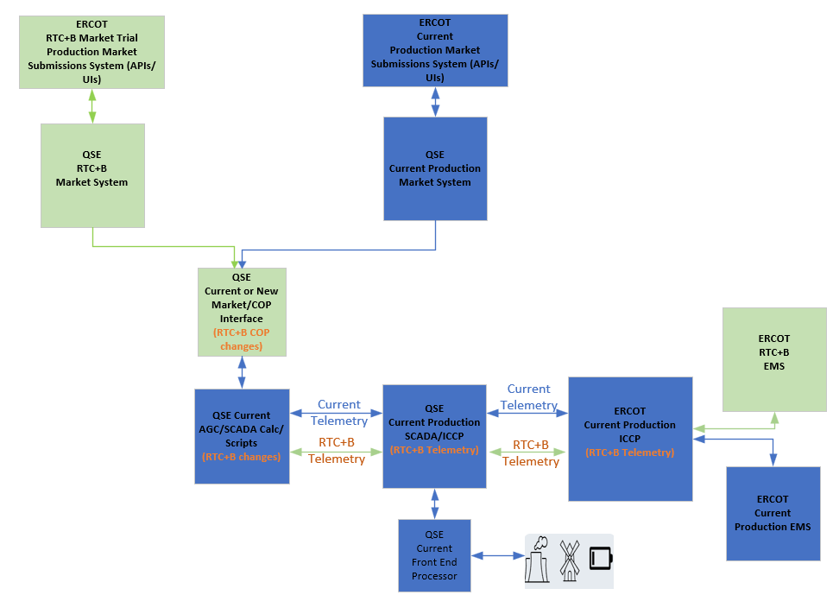
RTC+B – Parallel Operations – Current ERCOT and QSE Systems Setup

Slide 9
RTC+B – Parallel Operations – Telemetry Issues
ERCOT identified telemetry issues and met with QSEs that had lower telemetry pass% to discuss the issues.
Based on the discussions with QSEs, telemetry issues can be broadly categorized into two buckets.
  Resource Status and AS Capabilities Telemetry issues – Due to setup/mapping issue within QSEs RTC+B COP Interface that gets the COP data from RTC+B market system and feed into EMS AGC/SCADA.
  ESR specific telemetry issues directly from plants.
ERCOT requests all QSEs to proactively look at the telemetry mismatches between RTC+B and current production and implement fixes in RTC+B on or before 08/22/2025.
  ERCOT can share the list of telemetry issues upon QSE request through RTCB@ercot.com.

Slide 10
Closed Loop LFC/SCED Testing
One of the key goal of the Closed Loop Testing is to ensure that QSEs RTC+B ICCP/SCADA/EMS/Interfaces system changes are designed and setup correctly to respond to RTC+B UDSP signals.
Although it is called “Test”, QSEs must cutover all their resources operating in current production to RTC+B and control the Grid for 2 hours following RTC+B UDSP signal. This means ERCOT and QSEs RTC+B systems will be Live for 2 hours on 09/11/2025.
QSEs are expected to develop their own internal Closed Loop Testing cutover/cutback plan and checklist to ensure smooth transition of QSEs EMS systems/applications to RTC+B and back to current production. This cutover plan and checklist should be updated with any lessons learned from closed loop testing and is expected to be used for Go-Live.

Slide 11
Closed Loop LFC/SCED Testing – Key Pre Cutover Steps for QSEs
QSEs to verify that their RTC+B EMS AGC/SCADA Calcs/Scripts and Market/COP Interfaces are setup and ready for Closed Loop Testing.
QSEs to verify that RTC+B ICCP/EMS and Market systems are updated with latest model.
QSEs to verify all their resources RTC+B Resource Status (RSTR) telemetry point in their ICCP/SCADA is setup correctly and sending good quality RSTR telemetry to ERCOT ICCP.
QSEs to verify all their resources UDSP telemetry point in their ICCP/SCADA is setup correctly and receiving good quality UDSP signal from ERCOT ICCP.
QSEs to continue to submit production quality real-time market submissions (COP, TPO, AS Offers, ESR Bids/Offers, Output Schedules etc.) utilizing their parallel RTC+B Market Systems.

Slide 12
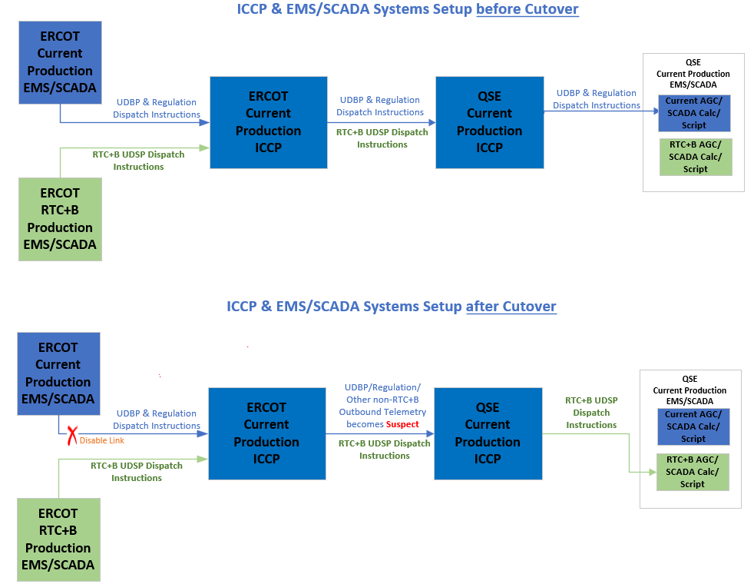
Closed Loop LFC/SCED Testing – Draft EMS/ICCP Cutover Plan

Slide 13
Closed Loop LFC/SCED Testing – Key Cutover Steps
ERCOT Control room makes final Go/No-Go decision few minutes before start of the Closed Loop Testing based on Grid Conditions.
  Start/End Times of Closed Loop Testing is subjected to change based on Grid conditions.
ERCOT will host a Webex call with Market participants for cutover and cutback coordination and status updates. Webex call details will be emailed directly to QSEs.
Control Room makes hotline call to Market approximately 15 - 20 minutes before ERCOT ICCP/EMS systems cutover to RTC+B.
At approximately 10:34:30 AM, ERCOT will perform QSE ICCP systems fail over (similar to weekly model loads) to cutover to RTC+B EMS. It takes around 30-60 seconds to complete the failover. ERCOT ICCP systems failover is required to switch below common telemetry points from Current Production EMS to RTC+B EMS.
  Cutover start time 30 seconds before 10:35 AM ensures that 10:35 AM UDBP from current production is not sent out to QSEs.
The following outbound telemetry points common to both current and RTC+B systems will be updated from the RTC+B EMS during this test. Similarly, all existing system level points will be telemetered from RTC+B EMS for the duration of the test.
  BP/LMP/SBBH/SCCT/NDPL/RDPL/MMEC/KVM/KVT

Slide 14
Closed Loop LFC/SCED Testing – Key Cutover Steps
During ICCP systems failover, current Production UDBP, Regulation and other non-RTC outbound telemetry to QSEs will be disabled. These points will become suspect for the duration of this test. This means these telemetry points value will be stale with suspect quality for duration of test with a UDBP value approximately from 10:34:30 AM.
After ERCOT ICCP systems fail over to RTC+B EMS, ERCOT will give go ahead to QSEs to cutover to RTC+B through Webex Call.
  QSEs should not automate the Cutover to RTC+B based on UDBP quality or any other ICCP telemetry points from ERCOT.
QSEs must cutover to their RTC+B EMS AGC/SCADA Calc/Script within 30-60 seconds.
QSEs must provide update on cutover status to ERCOT through Webex call.
After all QSEs are cutover to RTC+B, Control Room makes hotline call to Market announcing ERCOT is operating on RTC+B and posts a message on the MIS as well.
QSEs control room operators should perform the dual entry of telemetry manual overrides etc. based on grid conditions and communicate to ERCOT control room as they do normally during normal operations.

Slide 15
Closed Loop LFC/SCED Testing – Key Cutback Steps
In preparation for cutback, good quality current production UDBP, Regulation and other non-RTC outbound telemetry to QSEs will be enabled 10-15 minutes before completion of the closed loop test. It ensures smooth cutback to current production.
Control Room makes hotline call to Market approximately 15 minutes before ERCOT ICCP/EMS systems cutback to current production.
Around 12:34:30 PM, ERCOT will perform QSE ICCP systems fail over (similar to weekly model loads) to cutback to current production. It takes around 30-60 seconds to complete the failover. ERCOT ICCP systems failover is required to switch below common telemetry points from RTC+B EMS to Current Production EMS.
The following outbound telemetry points common to both current and RTC+B systems will start getting updated again from the current production EMS. Similarly, all existing system level points will be telemetered again from current production EMS.
  BP/LMP/SBBH/SCCT/NDPL/RDPL/MMEC/KVM/KVT

Slide 16
Closed Loop LFC/SCED Testing – Key Cutback Steps
After ERCOT ICCP system fail over to current production EMS, ERCOT will give go ahead to QSEs to cutback to current production EMS through Webex Call.
QSEs must cutback to their current production EMS AGC/SCADA Calc/Script within 30-60 seconds.
QSEs must provide update on cutback status to ERCOT through Webex call.
After all QSEs are cutback to current production, Control Room makes hotline call to Market announcing control system is back to normal operations and posts a message on the MIS as well.

Slide 17
Closed Loop LFC/SCED Testing – Current Production EMS/SCED State
  During Closed Loop Testing, ERCOT Current Production EMS and SCED will continue to run normally without any down time (except UDBP, Regulation Signals and other Non-RTC Outbound telemetry will NOT be sent out to QSEs). It ensures
    smooth transition back to current production at the end of closed loop testing and
    current production SCED can continue to create prices during closed loop testing.
  It is critical for Market participants to
    continue to send production quality telemetry to current production ICCP/EMS (e.g. Current production resource status codes, Regulation participation factors, combo model telemetry for batteries etc.,) and
    continue to submit real-time market submissions into current production Market System before and during closed loop testing without any down time.

