Slide 1
RTC+B Task Force
General Readiness
Issues and Risk Mitigation
Matt Mereness
RTCBTF
August 19, 2025

Slide 2
Deeper Dive on some risks and mitigation
Outreach- are companies getting the message?
  Initiating more direct communications
Telemetry Outreach
  Full-on IT press with QSEs to identify and resolve potential telemetry issues
Attestation for Live Production Closed-Loop LFC Test
  Confirm QSE are aware and getting prepared for Sept 11
Adapt to improve market Trials- two key changes/improvements needed
  Load Resources- NCLRs need to submit differently until DAM trials begin
  Continuous QSE Telemetry supported 5days/week during Business Hours (similar for COP)

Slide 3
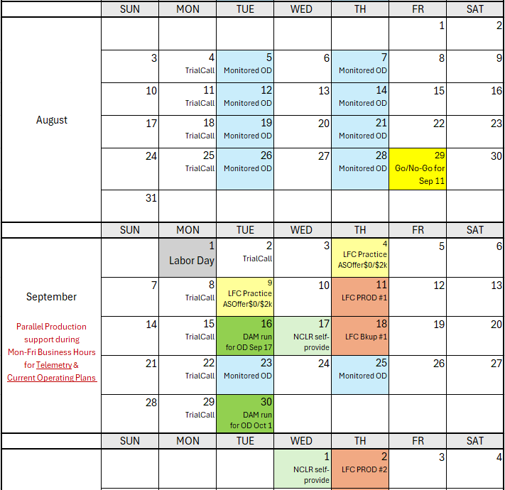
Market Trials Calendar and Communication
We are here….
Go/No-Go Decision for 10-day Mkt Notice
And then quickly here in live RTC Production for 2 hours

Slide 4

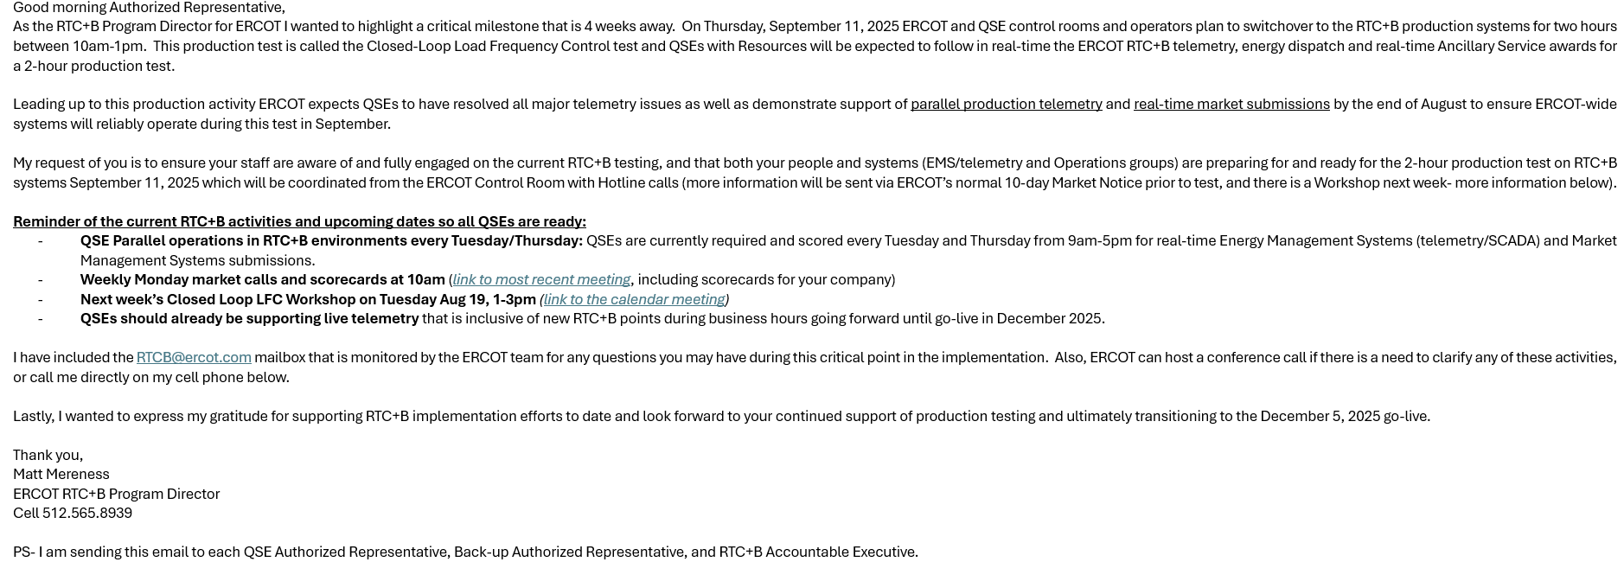
Outreach- are companies getting the message?
Email sent Friday Aug 15 from Matt Mereness

Slide 5
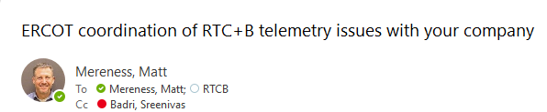
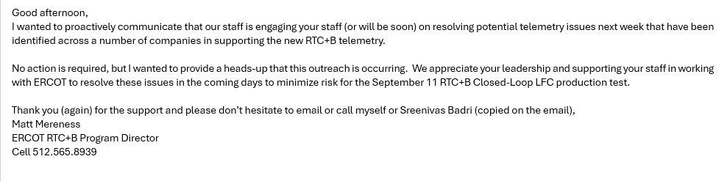
Telemetry Outreach
As of Friday Aug 15, ERCOT EMS teams have contacted a number of QSEs to work through potential telemetry issues.
Goal for resolution by end of this week (Aug 22).
Email sent Friday Aug 15 from Matt Mereness to those companies providing heads-up:

Slide 6
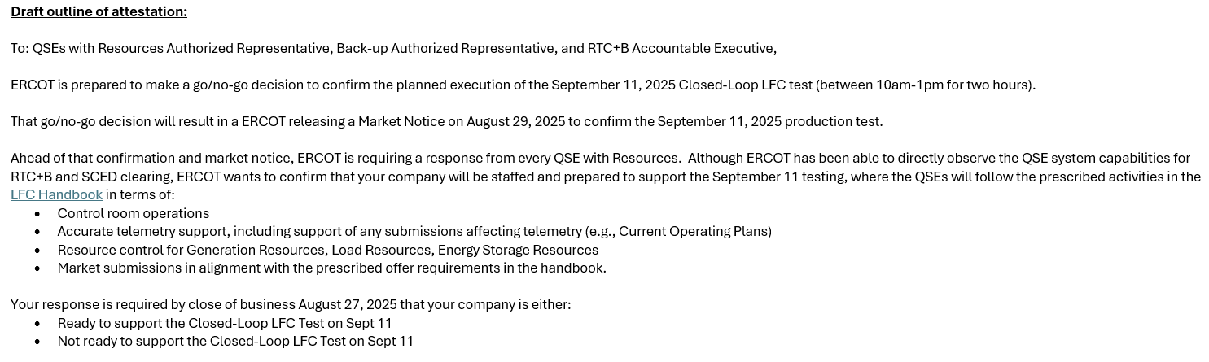
Attestation for Live Production Closed-Loop LFC Test
Quick turn-around this week for QSE Attestation of Readiness for Go-Live
Draft below to release tomorrow Aug 20, for response by next Thursday Aug 27
Send to QSE AR, BAR, RTC+B AE and Public Market Notice

Slide 7

Adapt to improve market Trials-
Two key changes/improvements needed
Need parallel production quality telemetry to be maintained from now and through Go-Live, with support for Mon-Fri Business Hours 9am-5pm
  Helpful if COP is also kept up to date.
Load Resources (NCLRs): since self-provision for Real-Time requires DAM Awards, ERCOT requests submitting AS Offers as if for LFC Test (next page)

Slide 8
Load Resources
NCLR Problem Statement and proposed solution for next few weeks:
  Current Market Trials DO NOT currently include DAM/Trades/Self-Arrangement, which affects how NCLR can participate, specifically self-provision
After RTC+B Go-Live most NCLR providers will likely use the market design allowed by protocols to “self-provide”:
  Ancillary Service Position: Self-provision is limited to the Sum (DAM AS Awards + SelfArrangements + net Trades)
  Self-provision is also validated using telemetry: Armed UFR and AS Capability of Load Resource(s). NOTE: QSE Telemetered self-provision cannot exceed QSE AS position.
  ASOffer= reflects real-time capacity being offered, where self-provided amount is auto-awarded and extra capacity begins at AS Offer price.
  The normal result is “Self-Provision award amount” plus any extra capacity awarded that is in the money (this is the market design).
However, in the absence of DAM, Trades, Self-Arrangement what “needs to occur” for market trials both today and for LFC Test
  For LFC Test, a workaround is prescribed since self-provision cannot be supported:
    QSEs must set Resource-level self-provision values to zero during these Closed Loop tests
    If AS Responsibility exists in current hour, QSE must offer each applicable AS at $0/MW for the MW amount of AS Responsibility on those Resources
    This logic needs to also be followed in current August and Early September Trials to help reflects parallel RTC AS awards
  This is in addition to the NCLR having correct telemetry for things like: Armed UFR status, AS Capability, Resource Status, MPC/LPC/NPC
  NCLRs will be able to test the self-provision functionality beginning with the first Day-Ahead Market run (anticipated September 16) and subsequent DAM days to follow.

Slide 9
Wrap-Up
Again… thanks for the support and open to any feedback and suggestions on what we covered below.
Outreach- are companies getting the message?
  Initiating more direct communications
Telemetry Outreach
  Full-on IT press with QSEs to identify and resolve potential telemetry issues
Attestation for Live Production Closed-Loop LFC Test
  Confirm QSE are aware and getting prepared for Sept 11
Adapt to improve market Trials- two key changes/improvements needed
  Continuous QSE Telemetry supported 5days/week during Business Hours (similar for COP)
  Load Resources- NCLRs need to submit differently until DAM trials begin

