Slide 1
Monthly Review of Reliability Unit Commitment Market Impacts – July 2025
Wholesale Market Working Group
ERCOT Market Analysis

Slide 2
RUC Resource-Hours
July 2025 | Total | Capacity |  | Congestion
 |  | Opt-Out | Non-Opt-Out | Opt-Out | Non-Opt-Out
Instructed Resource-Hours
Total Count | 237.0 | 0.0 | 0.0 | 0.0 | 237.0
Effective Resource-Hours*
Total Count | 226.9 | 0.0 | 0.0 | 0.0 | 226.9
Average Megawatts (MW) for Effective Resource-Hours
Average LSL | 33.1 | - | - | - | 33.1
Average LDL | 48.3 | - | - | - | 48.3
Average BP | 52.3 | - | - | - | 52.3
Average HSL | 173.4 | - | - | - | 173.4
* The difference between “Instructed” and “Effective” values is a result of Resources starting up, shutting down, receiving partial hour instructions, or otherwise not being dispatchable by SCED.

Slide 3
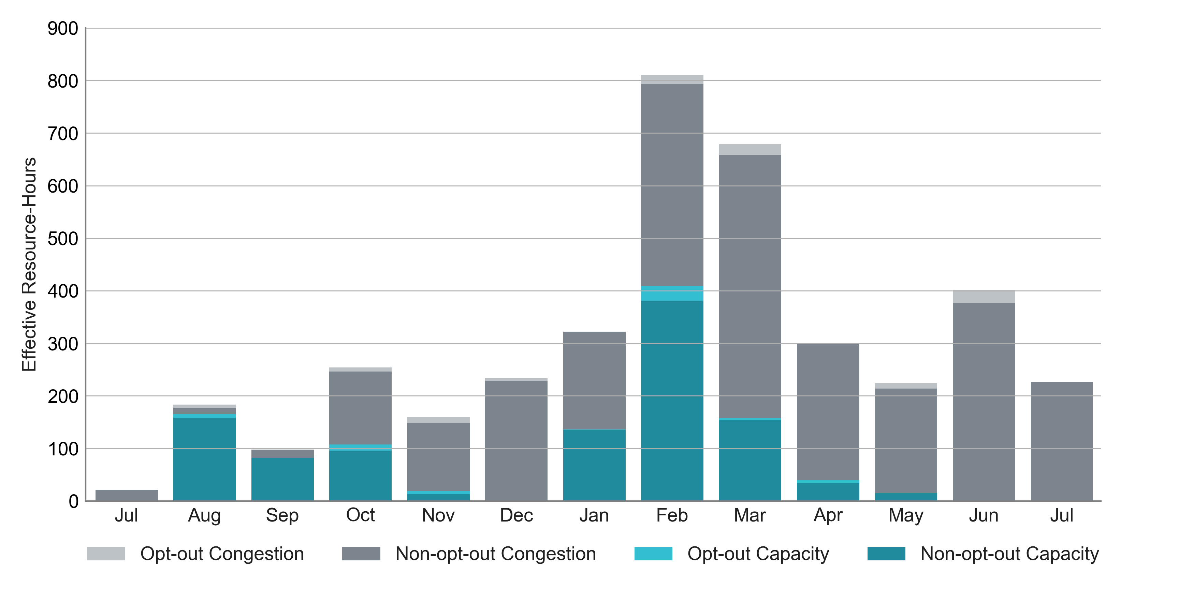
RUC Instruction Reasons: Last 13 Months
All RUC effective hours in July 2025 were nominally attributed to congestion.

Slide 4
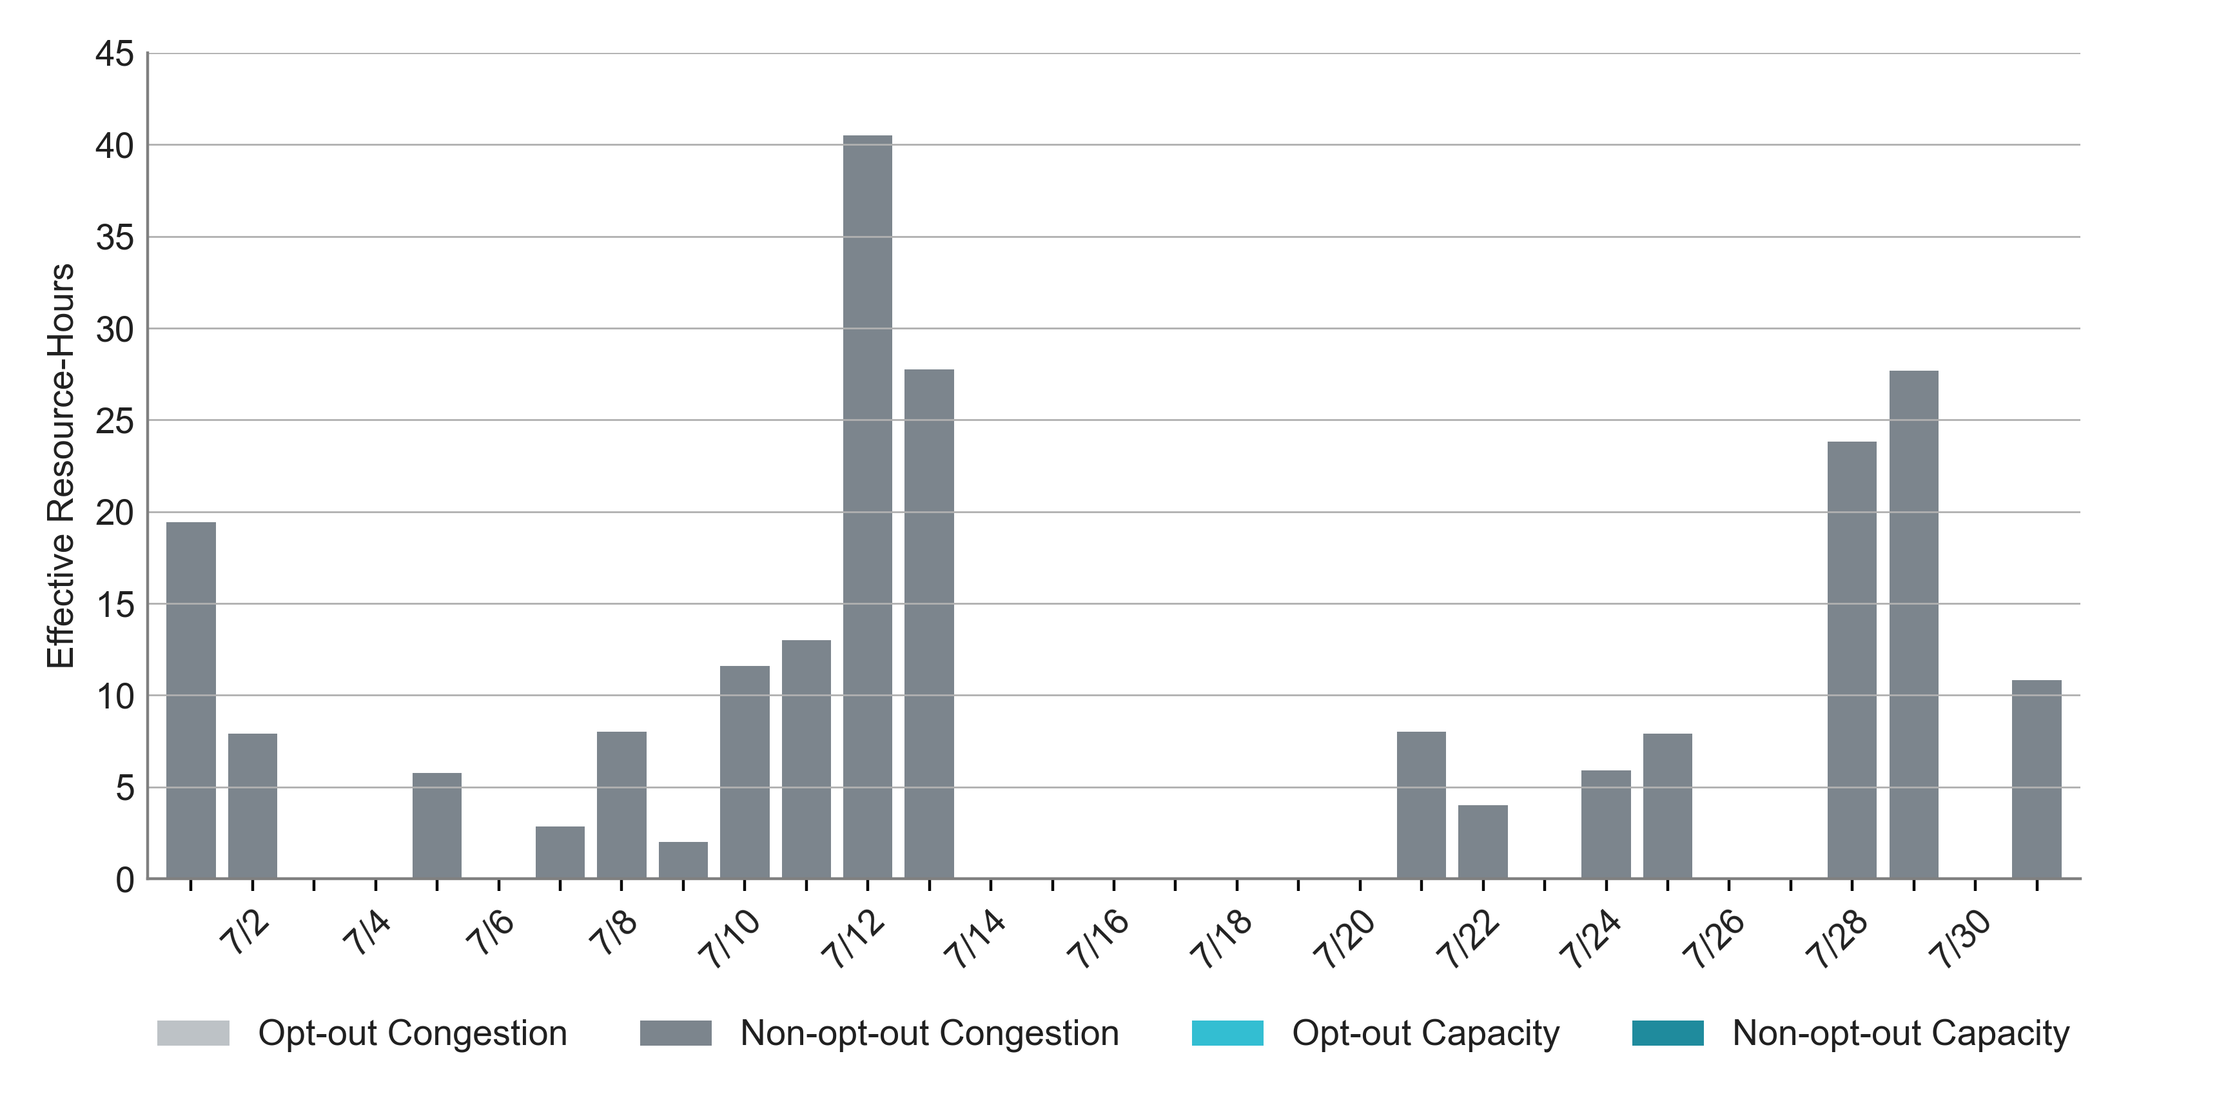
RUC Instruction Reasons in July 2025
226.9 RUC effective Resource-hours:
  226.9 hours (100%) for congestion

Slide 5
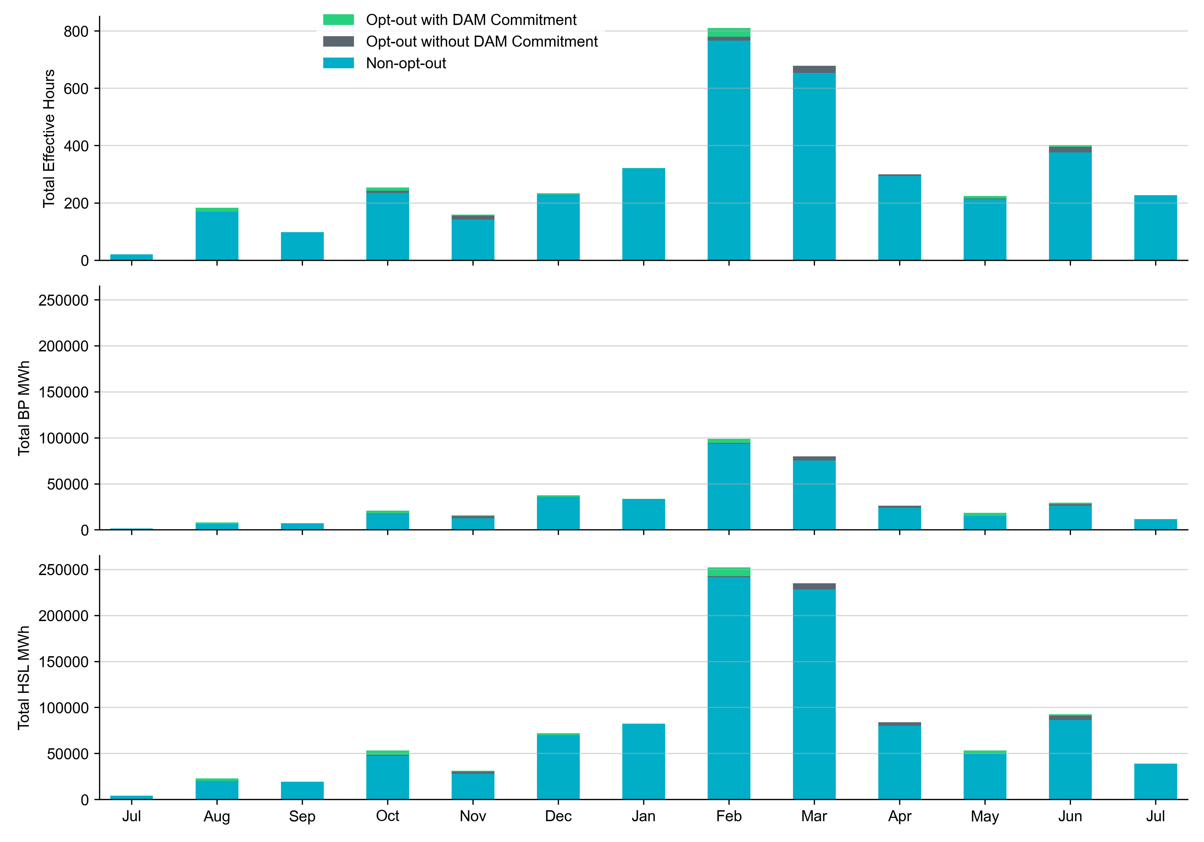
Non-opt-out and Opt-out Totals: Last 13 Months
July 2025 had a total of 226.9 non-opt-out effective Resource-hours (100%) and 0 opt-out effective Resource-hours (0%).

Slide 6
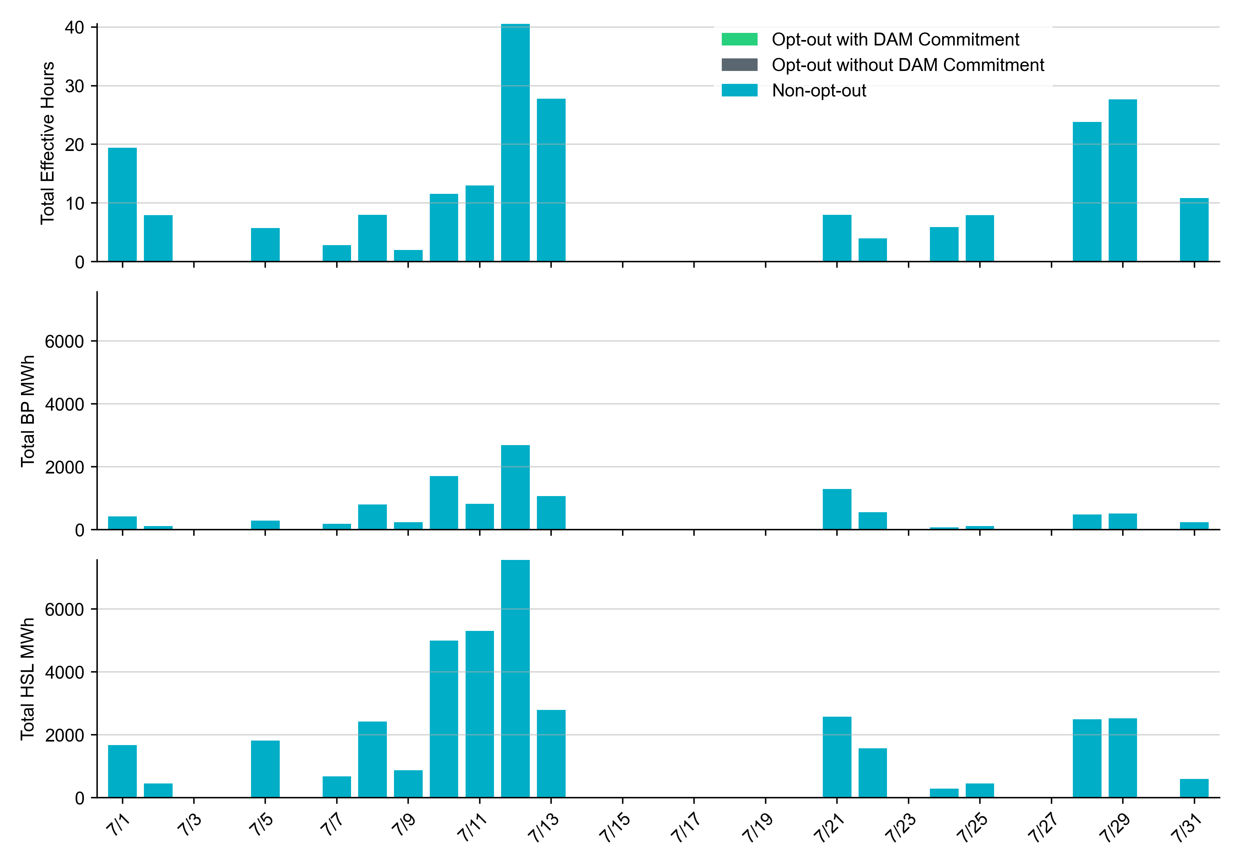
Non-opt-out and Opt-out Totals: July 2025

Slide 7
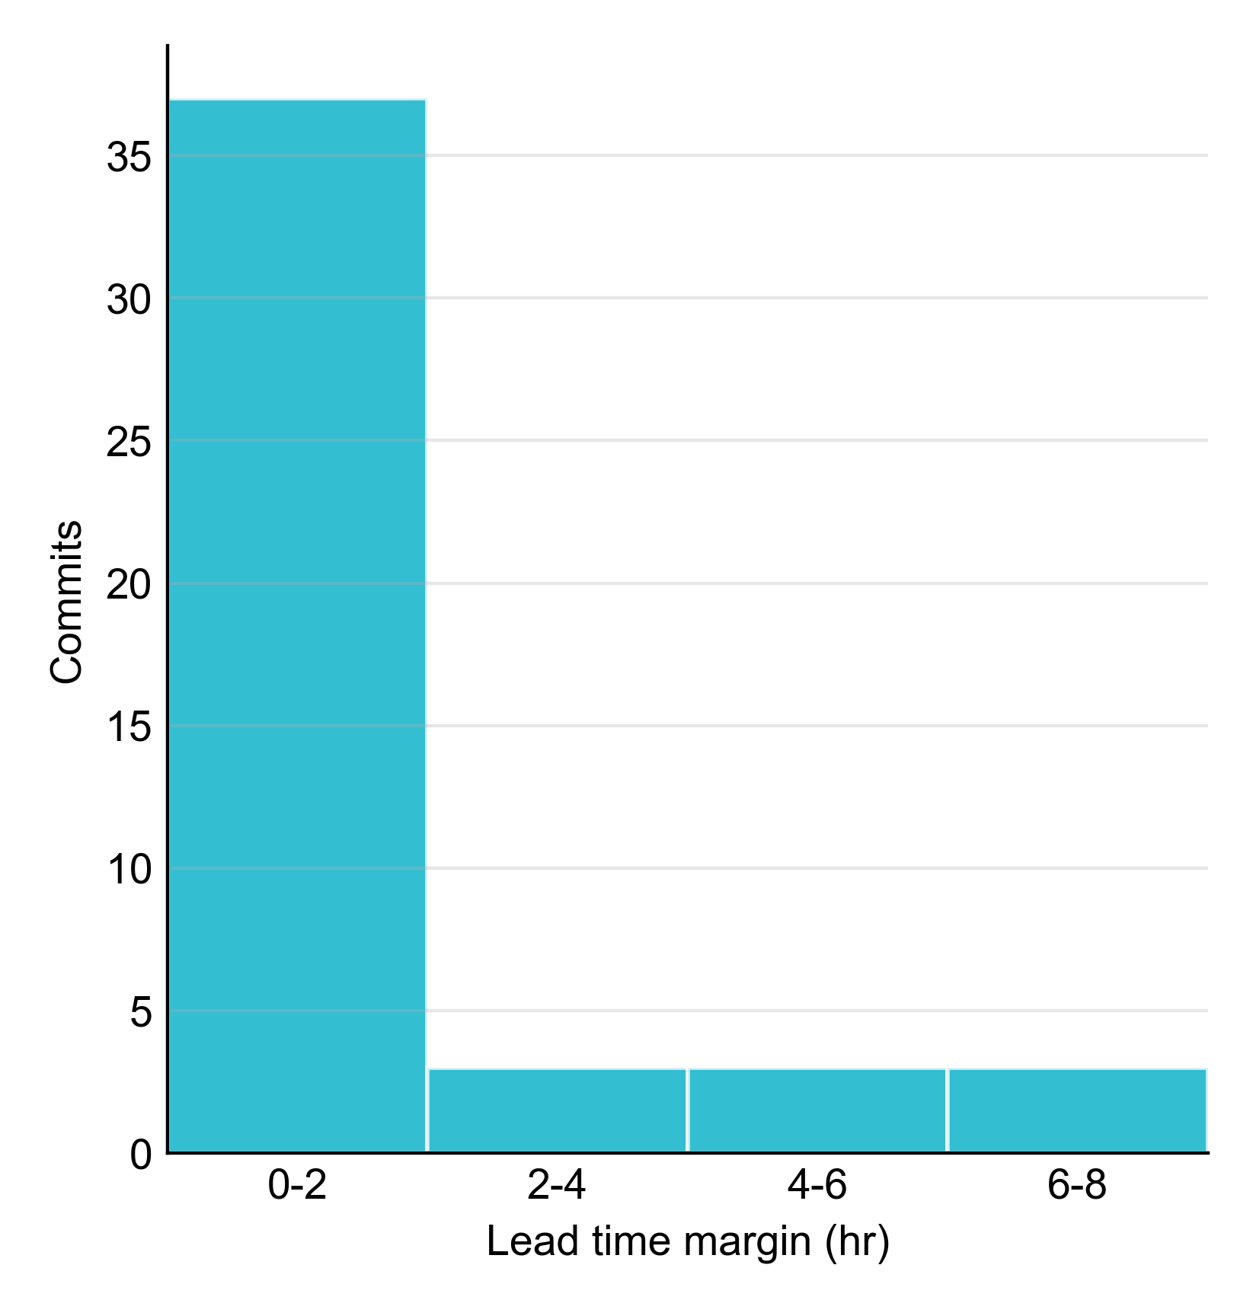
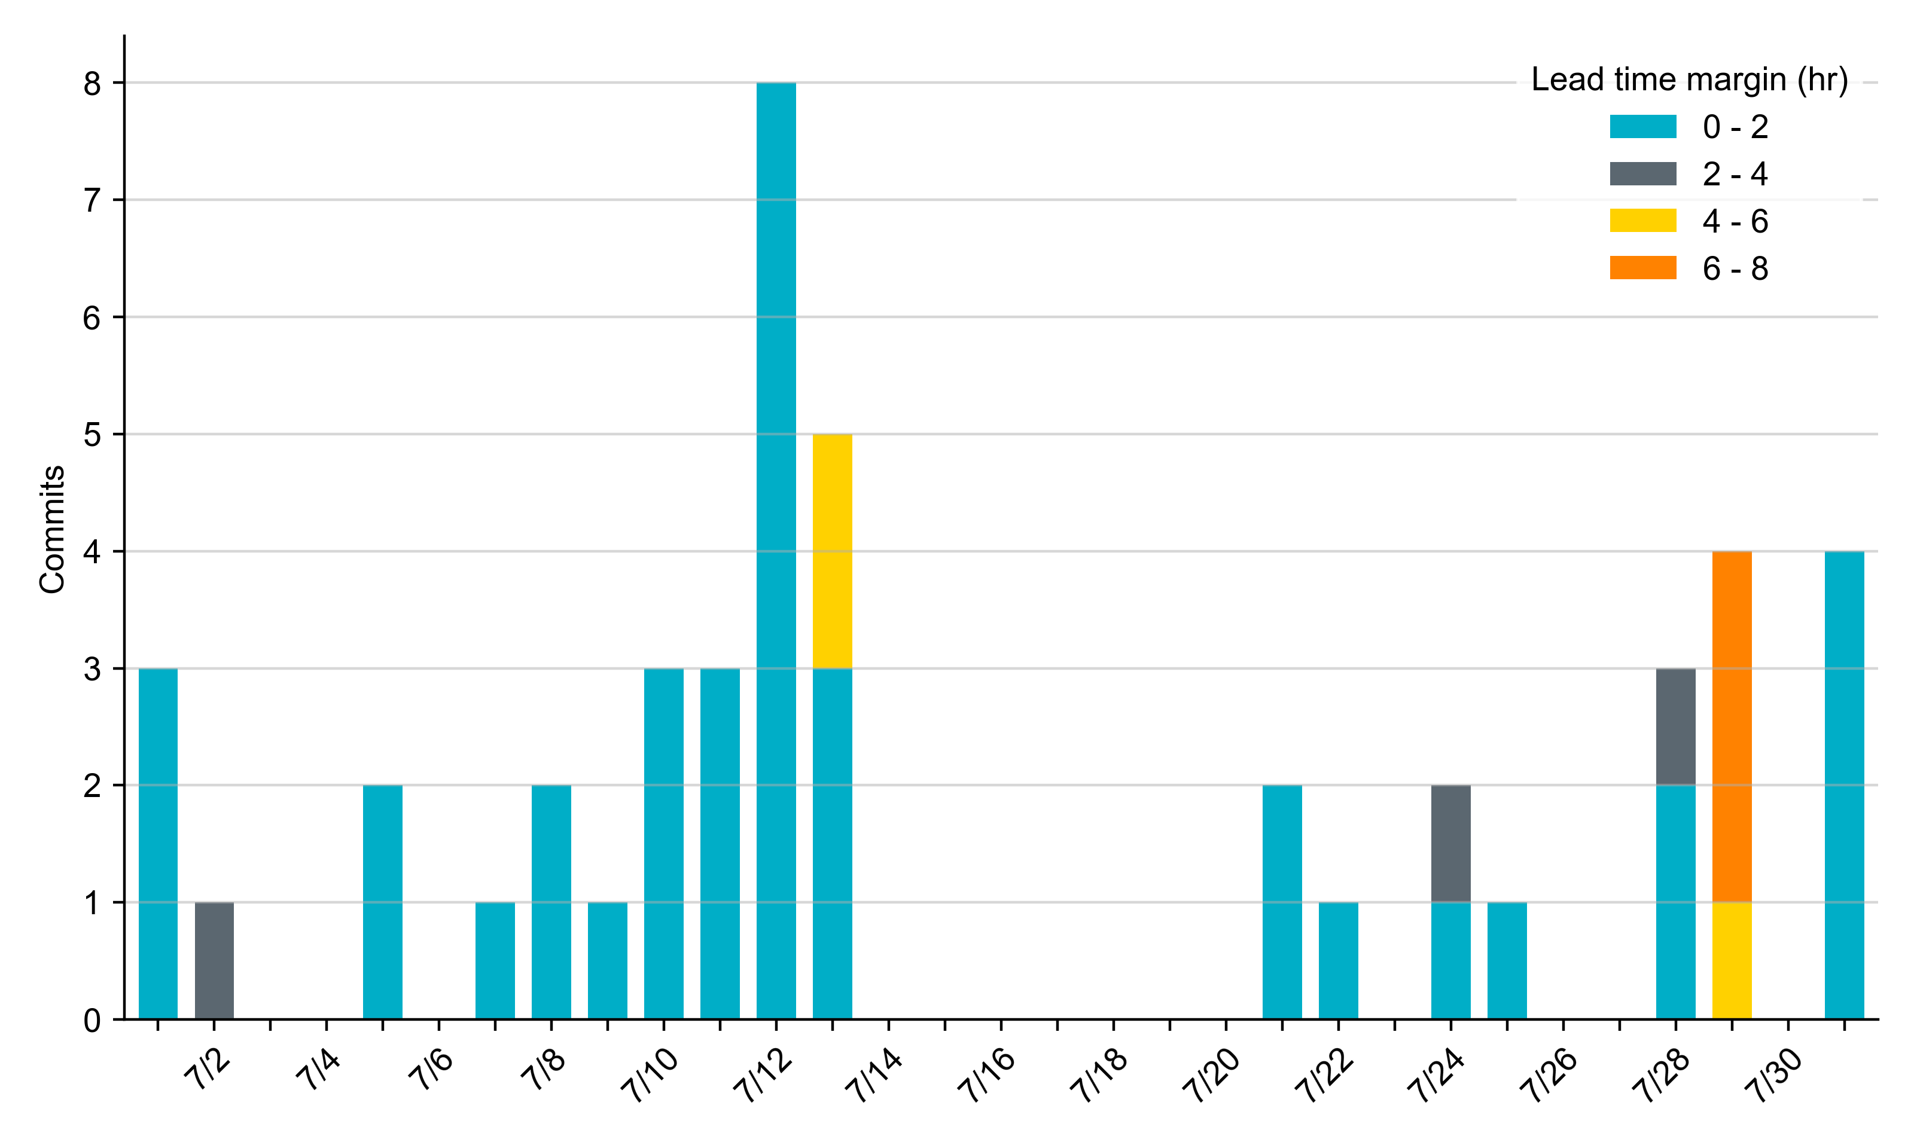
RUC Lead Time Margin: July 2025
Most RUC commitment windows (80%) had a lead time margin of 2 hours or less.
Lead time refers to the length of time between a RUC instruction and the start of the commitment window.
Lead time margin is the difference between lead time and the Resource’s startup time.
  In cases where a Resource is committed for multiple back-to-back time blocks, lead time margin is calculated from the first instruction.

Slide 8
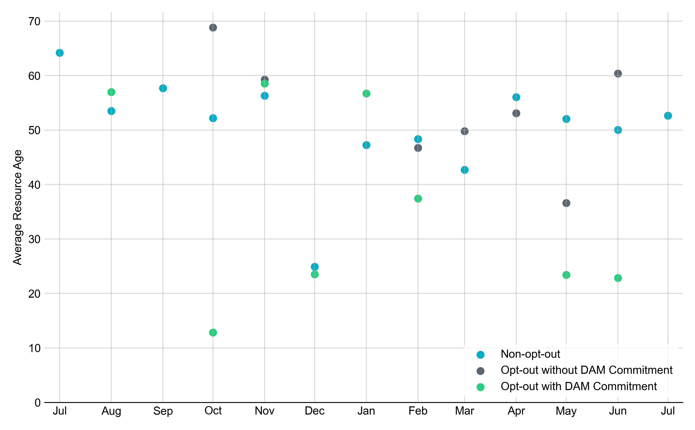
Average Resource Age: Last 13 Months
In July 2025, the average age of RUC-committed Resources was 52.6 years for Non-opt-out Resource-hours.
Note: For Resource configurations with multiple physical generators, the age of the oldest generator is used.

Slide 9
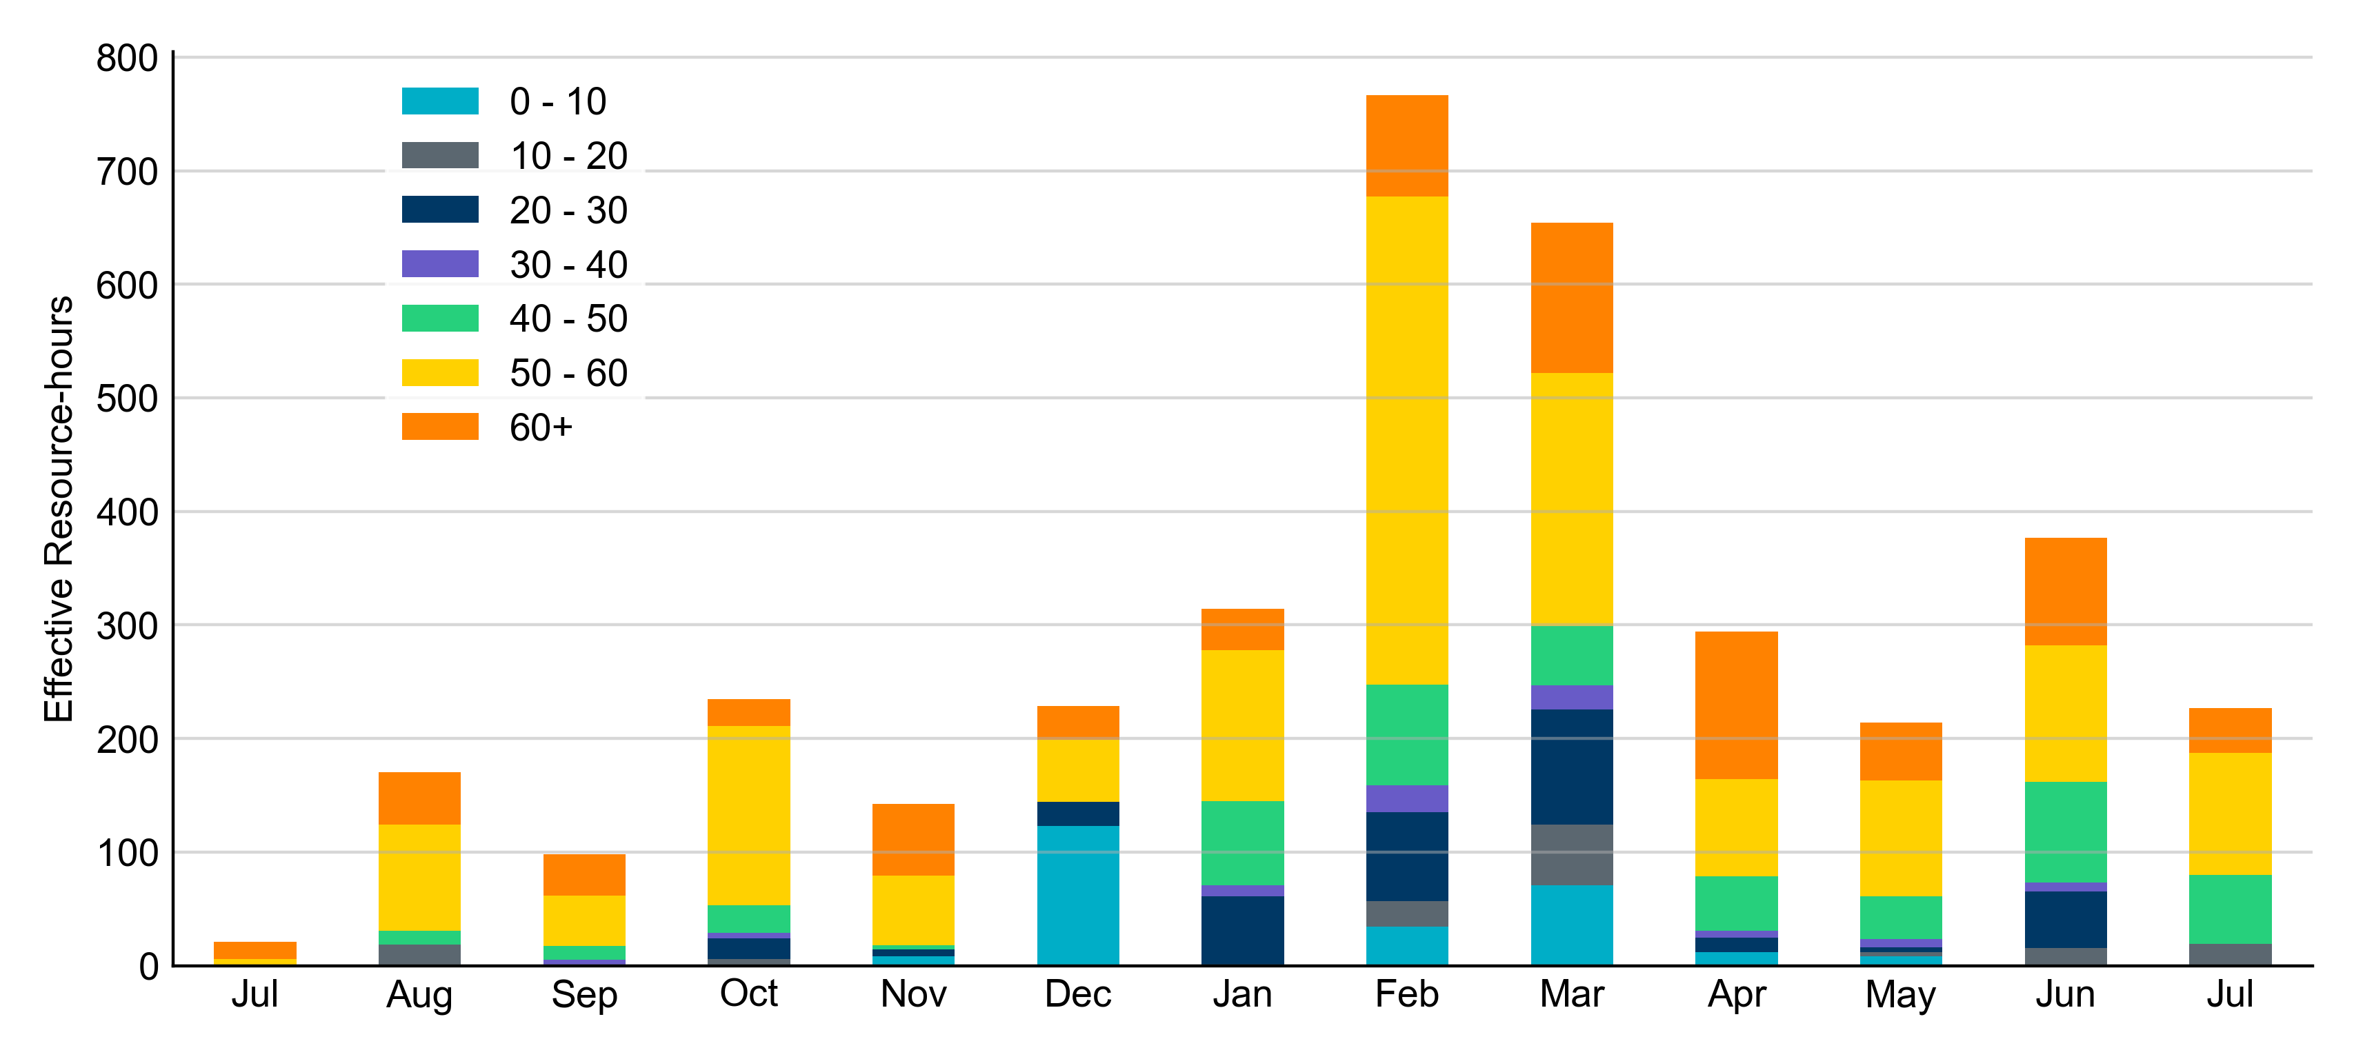
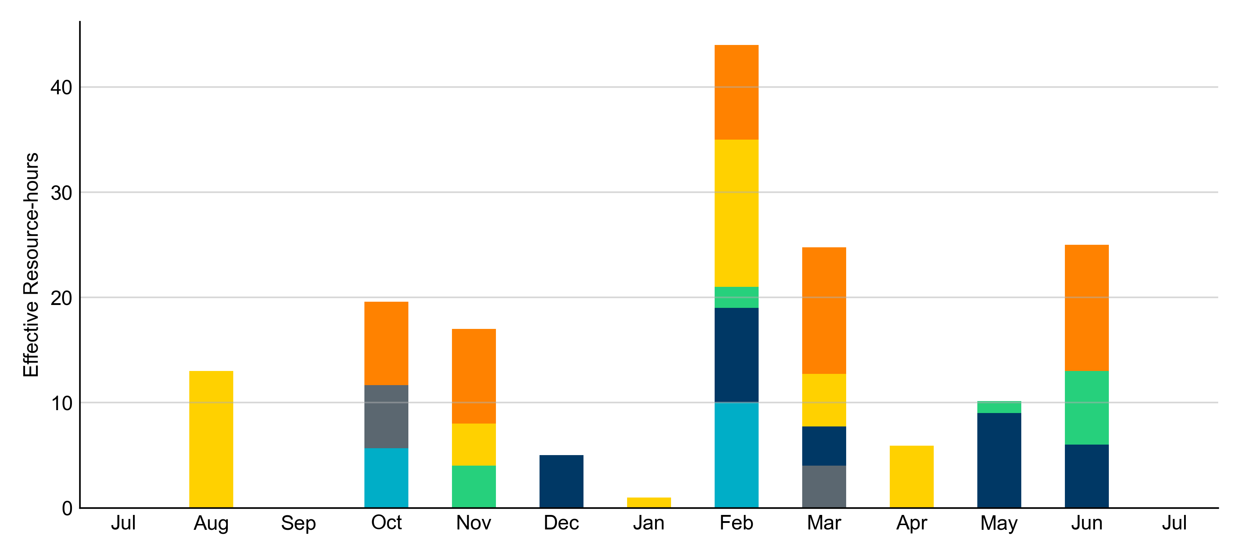
Age Category: Last 13 Months
In July 2025, most RUC Effective Resource-Hours (65%) were provided by resources that were at least 50 years old.
Non-opt-out
Opt-out

Slide 10
RUC-Instructed Resource Dispatch above LDL
July 2025
There were 23.1 effective Resource-hours in which Resources that did not successfully opt out were dispatched above their LDL.
  For 4.1 of these Resource-hours, the LMP for the RUC-instructed Resource was above the RUC offer floor.
  For 19.1 of these Resource-hours, the LMP for the RUC-instructed Resource was below the RUC offer floor.
    For all of these 19.1 Resource-hours, the RUC-instructed Resource was mitigated.
There were no Exceptional Fuel Cost submissions for any RUC-committed Resources.

Slide 11
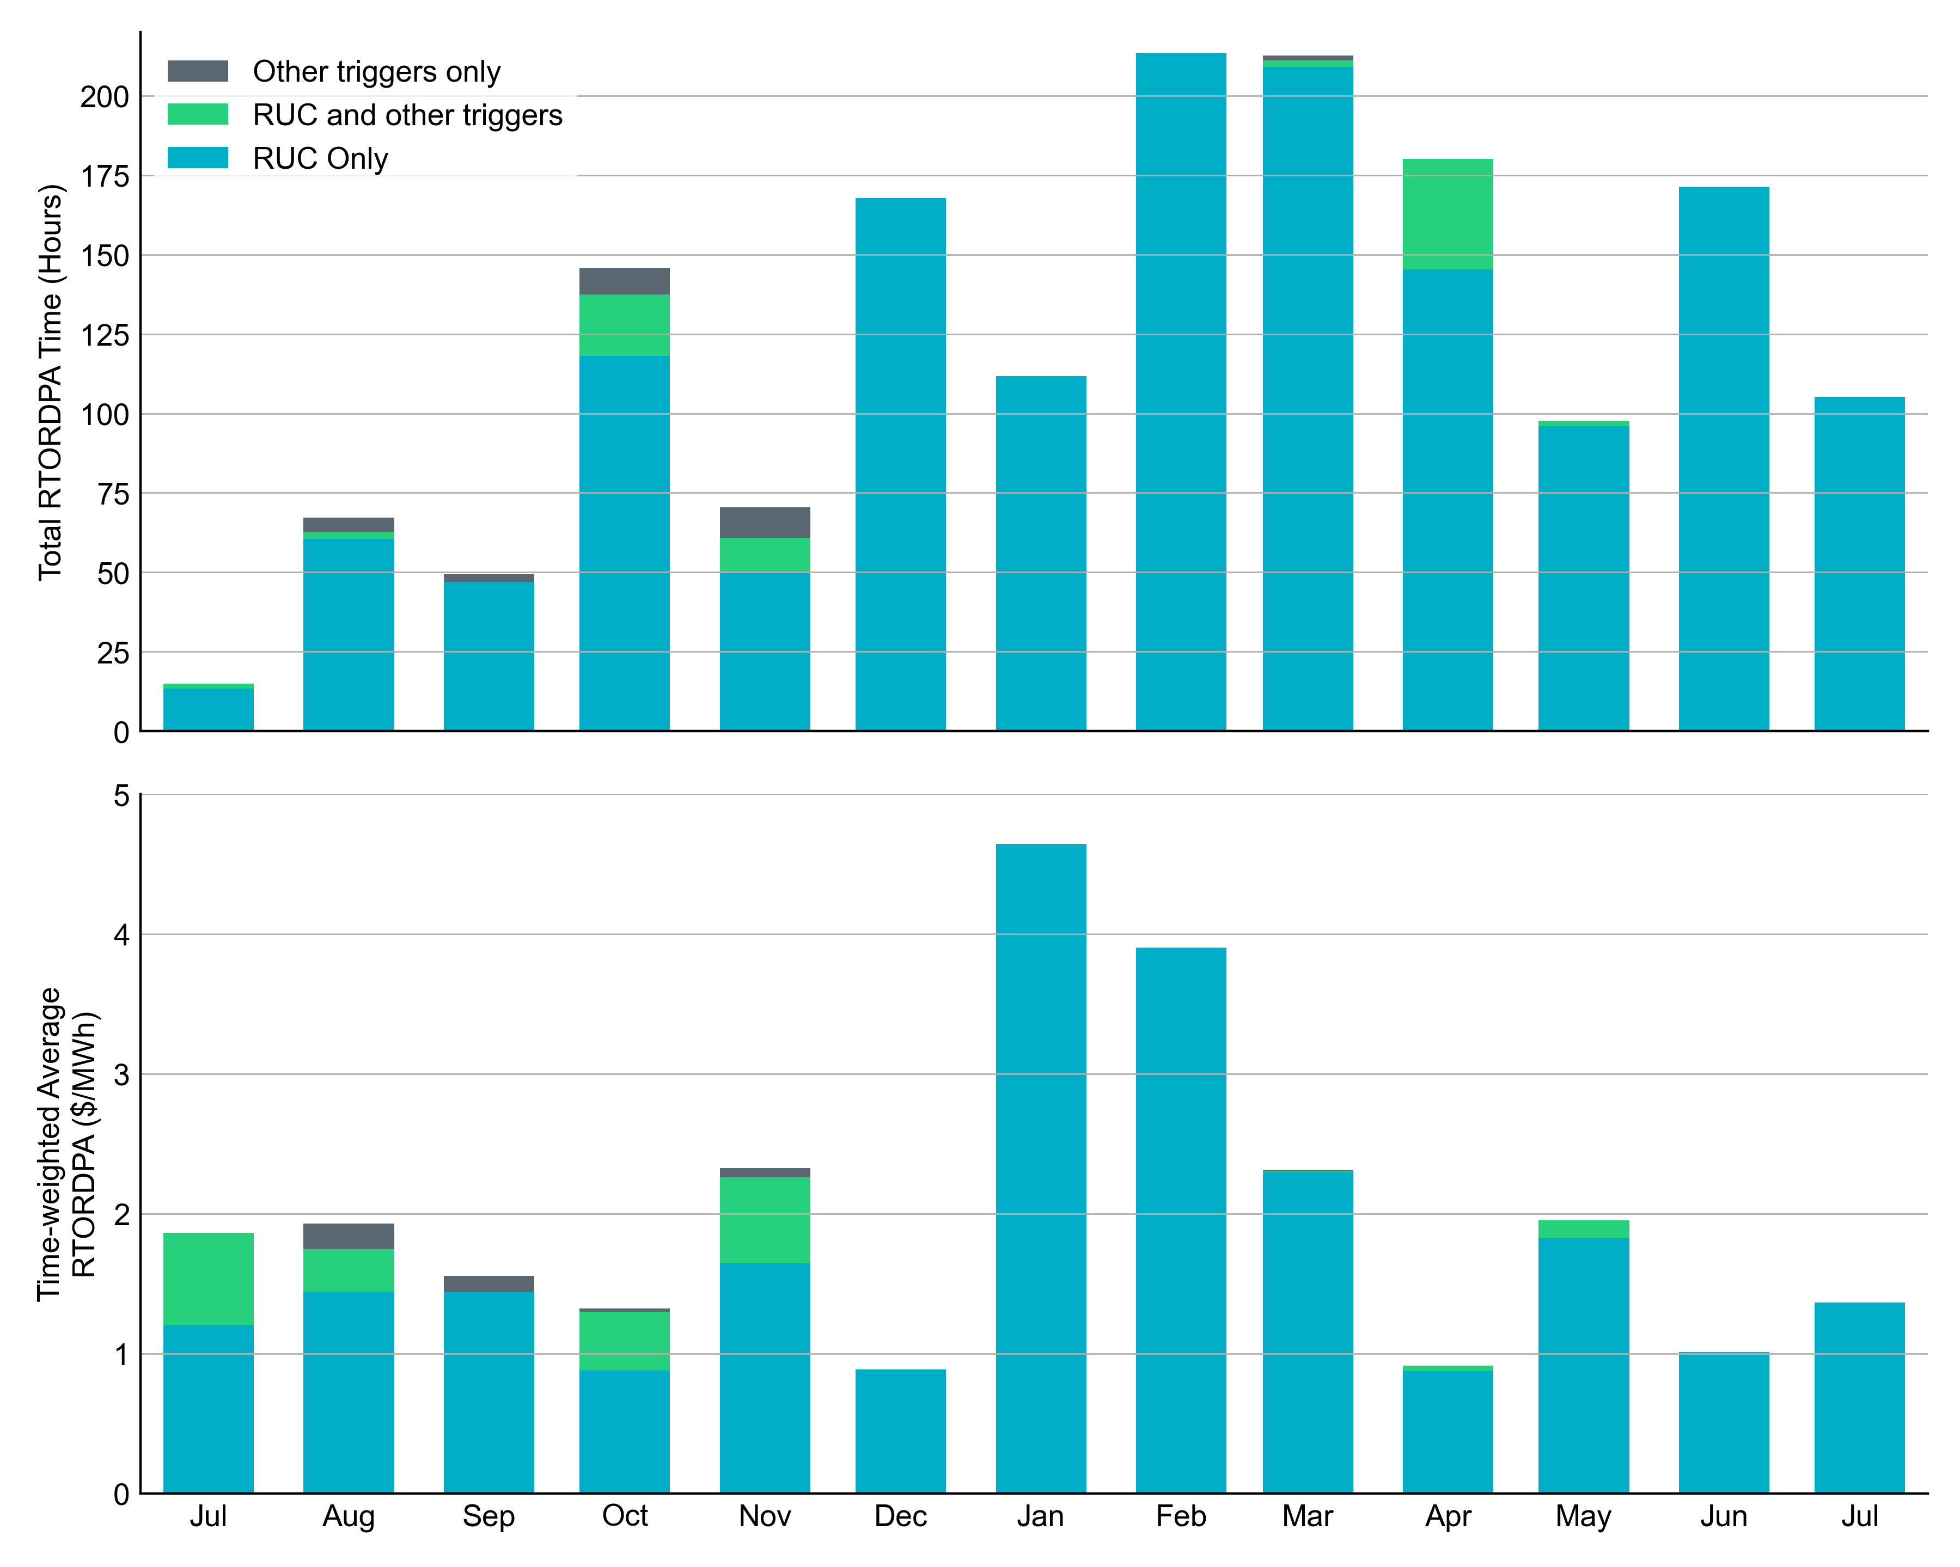
Reliability Deployment Price Adder: Last 13 Months
July 2025 had a total of 105.3 RTORDPA hours with a time-weighted average value of $1.37/MWh.
These graphs show RTORDPA instances by reliability action: 'RUC Only' for instances triggered solely by Reliability Unit Commitment, 'RUC and other triggers' for instances with RUC and additional triggers, and 'Other triggers only' for instances with non-RUC triggers. The daily average RTORDPA is calculated using the total duration across all categories. See ERCOT protocol section 6.5.7.3.1 for details.

Slide 12
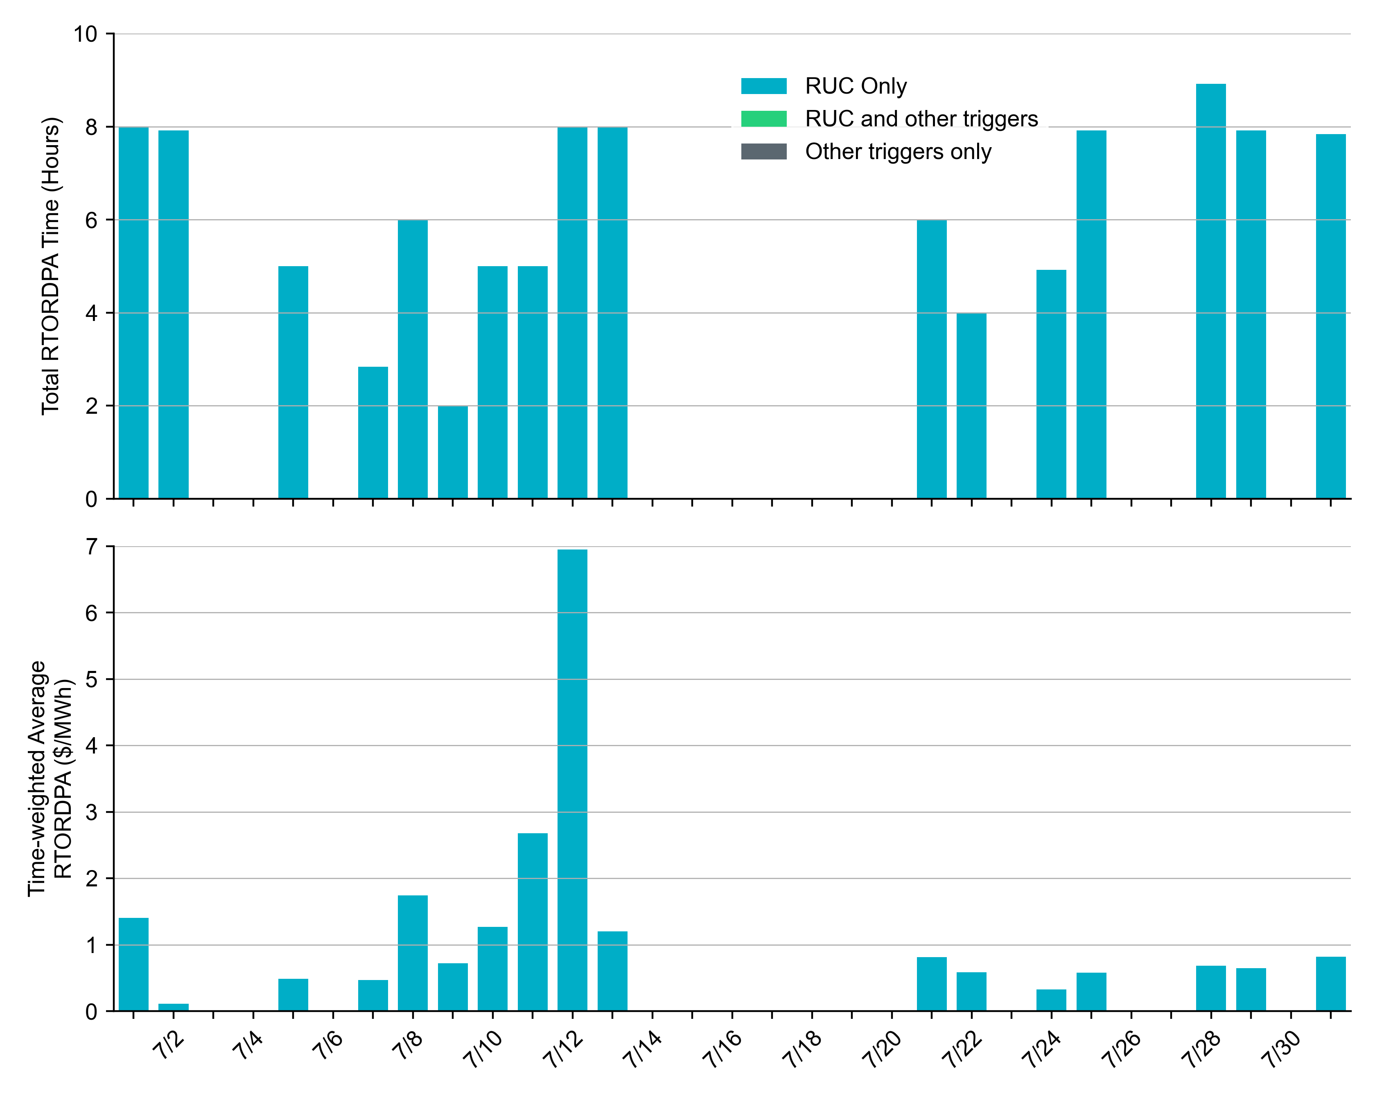
Reliability Deployment Price Adder: July 2025
OD 07/12 had the highest daily time-weighted average RTORDPA of $6.95/MWh.
These graphs show RTORDPA instances by reliability action: 'RUC Only' for instances triggered solely by Reliability Unit Commitment, 'RUC and other triggers' for instances with RUC and additional triggers, and 'Other triggers only' for instances with non-RUC triggers. The daily average RTORDPA is calculated using the total duration across all categories. See ERCOT protocol section 6.5.7.3.1 for more details.

Slide 13
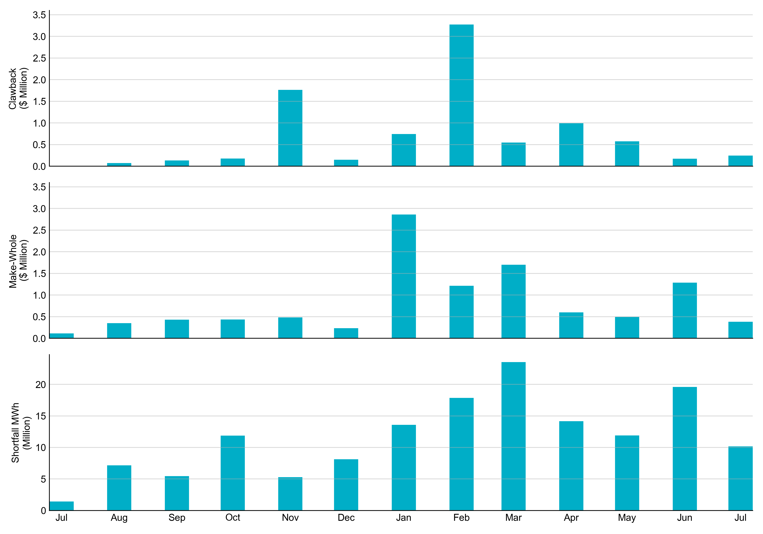
RUC Clawback, Make-Whole, and Shortfall
For July 2025, the total Clawback Charge was $246,345. The total Make-Whole Payment was $382,594.
Of the $382,594 in Make-Whole Payments made in July 2025, $6.54 was uplifted to load due to rounding.
The remaining amount was collected through Capacity-Short Charges.
Data as of August 7th, 2025

Slide 14
RUC Clawback by Settlement Type
Month | Initial Settlement ($) | Final Settlement Change ($) | True-up Settlement Change ($) | Net as of August 07, 2025 ($)
Jul ‘24 | 47,627 | 0 | -47,627 | 0
Aug ‘24 | 73,690 | 0 | 498 | 74,188
Sep ‘24 | 140,239 | 0 | -7,864 | 132,375
Oct ‘24 | 179,331 | 0 | 0 | 179,331
Nov ‘24 | 2,022,874 | 0 | -259,986 | 1,762,888
Dec ‘24 | 147,389 | -3 | 0 | 147,386
Jan ‘25 | 1,037,717 | 0 | -294,094 | 743,623
Feb ‘25 | 3,272,312 | 0 | 0 | 3,272,312
Mar ‘25 | 545,642 | 0 | - | -
Apr ‘25 | 993,341 | 119 | - | -
May ‘25 | 574,643 | 0 | - | -
Jun ‘25 | 173,176 | 0 | - | -
Jul ‘25 | 246,345 | - | - | -
Negative dollars represent a payment from ERCOT to a market participant
“-” indicates settlement has yet to be completed.
Net figures may differ slightly due to rounding.

Slide 15
RUC Make-Whole by Settlement Type
Month | Initial Settlement ($) | Final Settlement Change ($) | True-up Settlement Change ($) | Net as of August 07, 2025 ($)
Jul ‘24 | -4,297 | 0 | -109,781 | -114,078
Aug ‘24 | -305,171 | 0 | -47,508 | -352,679
Sep ‘24 | -239,681 | 0 | -192,123 | -431,804
Oct ‘24 | -364,395 | 0 | -72,381 | -436,776
Nov ‘24 | -164,191 | 0 | -317,703 | -481,894
Dec ‘24 | -179,587 | 0 | -53,342 | -232,929
Jan ‘25 | -834,867 | -80529.9 | -1,947,157 | -2,862,554
Feb ‘25 | -1,198,579 | -17,762 | 0 | -1,216,341
Mar ‘25 | -1,701,707 | 0 | - | -
Apr ‘25 | -594,864 | -3,693 | - | -
May ‘25 | -493,728 | 0 | - | -
Jun ‘25 | -1,285,661 | 0 | - | -
Jul ‘25 | -382,594 | - | - | -
Negative dollars represent a payment from ERCOT to a market participant
“-” indicates settlement has yet to be completed.
Net figures may differ slightly due to rounding.

