Slide 1
CRR Updates
Samantha Findley
CMWG
August 18, 2025

Slide 2
Agenda
LTAS transactions and solution times
CRR auction limits table (no changes)

Slide 3
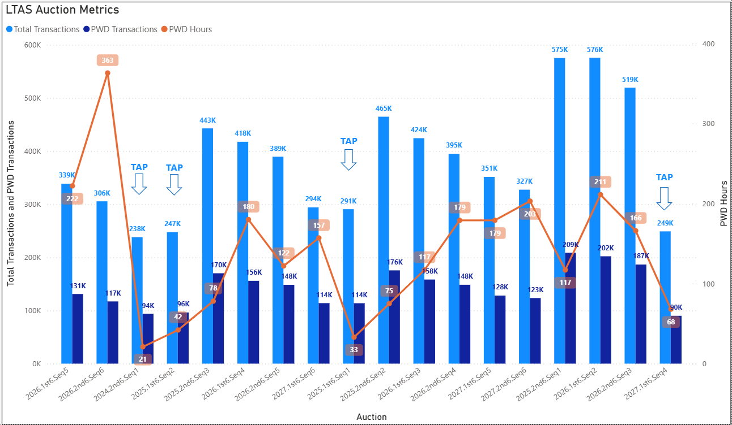
Historical LTAS transactions and solution times

Slide 4
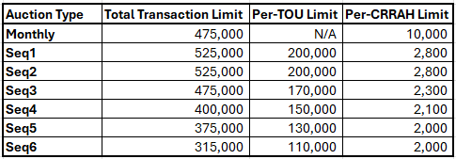
CRR auction transaction limits (no changes)

Slide 5
What’s next
Planning to bundle NPRRs 1288 Remove Multiple Month Transactions in CRR Auctions and 936 CRR Account Holder Limits for a project to start early 2026. With implementation, the bid limit will change to the Counter-Party level rather than the CRRAH level.
NPRR 1289 Option Price Report and Establish 1 MW Bid Minimum to be delivered in a subsequent release.
Proposal to remove the budget constraint from the optimization. This will align with the way DAM handles credit consumption and will help reduce the number of submitted transactions because they will be limited by credit. Draft NPRR language will be brought to a future CMWG for discussion.

