Slide 1
Day-Ahead Market PTP and PTPLO Submission Activity, Update
August 18, 2025
Curry Holden
Supervisor, Day-Ahead Market

Slide 2
Background Overview
High volumes of PTP and PTPLO interval records submissions are linked to increased optimization engine execution times.
PTP submission volumes continue to be a concern.
Some form of submission fee for PTP submissions (excluding PTPLOs) has been proposed by ERCOT.
In the meantime, it is possible that the existing, static counter party PTP Obligation submission interval record count limit could be lowered to help promote timely DAM execution.
ERCOT is anticipating post-RTC implementation of bid fees and is aiming to propose NPRR language soon.

Slide 3
Updated Raw Data
See excel file posted to the CMWG web page that includes the DAM execution times and the PTP+CRR interval record counts.
The last file was posted on October 2023 WMWG, and the file posted to this month’s CMWG web page has the data since 8/31/23.

Slide 4
Reduction In Bid ID Limit
In addition to the option to lower the per CP interval record count limit, ERCOT also has the option to lower the number of CP daily record (Bid ID) count limit.
Based on the recent aggregate Bid ID trend, it is likely that ERCOT will lower the Bid ID limit soon.
If market-wide Bid ID counts exceed the system limitations, manual intervention is required to cancel PTP Bid IDs.
Increasing system limits requires a release and cannot be increased indefinitely.
The change to the Bid ID limit requires a market notice.

Slide 5
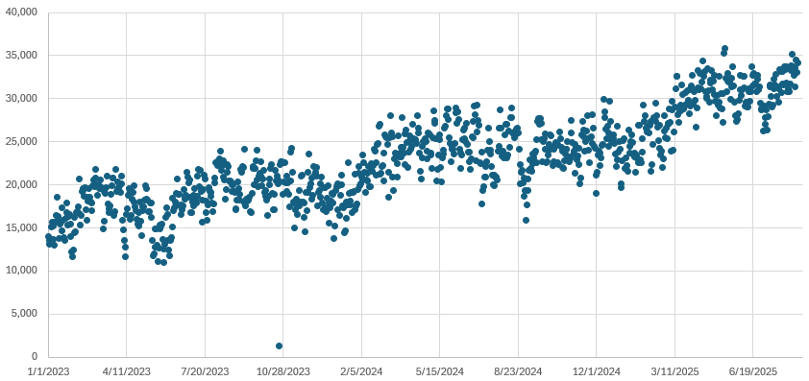
PTP Bid ID Count
PTP Bid ID count has continued to grow over the last few years
Daily PTP Bid ID Submissions: 2023-present (OD 8/14/25)

Slide 6
Next Steps
ERCOT will likely soon decrease PTP Bid ID Limit.
ERCOT is continuing to study and closely monitor the PTP/CRR interval record submissions and is aiming to propose NPRR language soon regarding PTP bid fees.
PTPLO Attestation Reminder Market Notice will be sent by 9/1.
Any questions or concerns?

